Slide 1
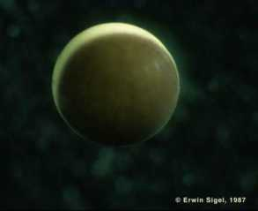
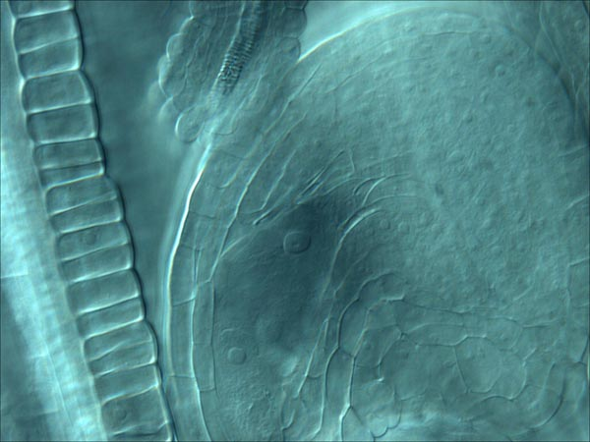
Genes and Development
GN434 SPRING 2018
Textbook
Developmental Biology
by Scott Gilbert
Sinauer, 11th edition
Instructor: Dr. Bob Franks
2548 Thomas Hall
Email: rgfranks@ncsu.edu; Phone: 513-7705
Office hours: by appointment
CLASS WEB SITE: https://wordpress-projects.wolfware.ncsu.edu/gn434v5-y3ct9jq/

Slide 2
Course Outline
Grading
Participation and explanations at the board 5%
Exam I 20%
Exam II 20%
Exam III 20%
Exam IV 20%
Paper presentation project 15%

Slide 3
Homework for Friday
Read Chapter 1
GN434 – First assignment – Pass/fail
Answer question 1 or 2 as assigned in class: You can work together. You can use Wikipedia or other resources. Your answers don’t have to be correct, just thoughtful and based on what ever you know from past biology/biochem/genetics classes or what you can find on the web. Due on Jan 10th. Write it down, make two copies, and hand one in at beginning of class so I know that you did it. Be prepared to discuss you ideas in class.
Molecular signals and can cells remember?
1a) What signals in the embryo regulate the development of the different cell types? (i.e. what biological molecules function as signals?)
1b) How are these signals generated?
1c) How are they received and acted upon by cells? (i.e. What are the possible responses of the cells once they have received a signal?)
1d) What is the experimental evidence or data that supports what you claim?
1e) If the signal is present for a period during early development and then later removed, can the cell “remember” that it received the early signal? How can a cell remember (i.e. what is the molecular mechanism?
Morphogenesis, polarity and evolution.
2) Consider how is organ polarity controlled during development of the human arm. How does the developmental program ensure that fingers will always be at the apex (tip of the arm) while elbow will be in the middle and shoulder at the opposite end? Think about it. You are going from a single cell through cell divisions and then on to a multi-celled organ with different cell types and each cell type positioned in an appropriate position.
2a) What types of biological molecules would be involved for both generating signals and responding to these signals?
2b) Do you think that some of the same signals would be used to pattern the human leg? Why or why not? What types of evidence might help us to determine this?
2c) Do you think that many of the same molecular signals would be used to make a chicken wing? Why or why not? What type of experiment of evidence might help you determine this?
2d) If you were to design a computer program that was to model or recreate the formation of the human arm in silico (i.e. in a computer) what rules would you have to define for the cells behavior? What does each cell have to know to form the overall structure?

Slide 4
Syllabus in wolfware
CLASS WEB SITE: https://wordpress-projects.wolfware.ncsu.edu/gn434v5-y3ct9jq/

Slide 5
Things I liked or hated about Biology/Science

Slide 6
What is Developmental Biology?

Slide 7
Key Interests in Developmental Biology
Generating cellular diversity - Differentiation
Generating shapes in three dimensions - Morphogenesis
Control of cellular division and growth
Reproduction - generation of the sperm and egg (i.e. the germ cells)
Changes in form and function over generations or between species - “EvoDevo”

Slide 8
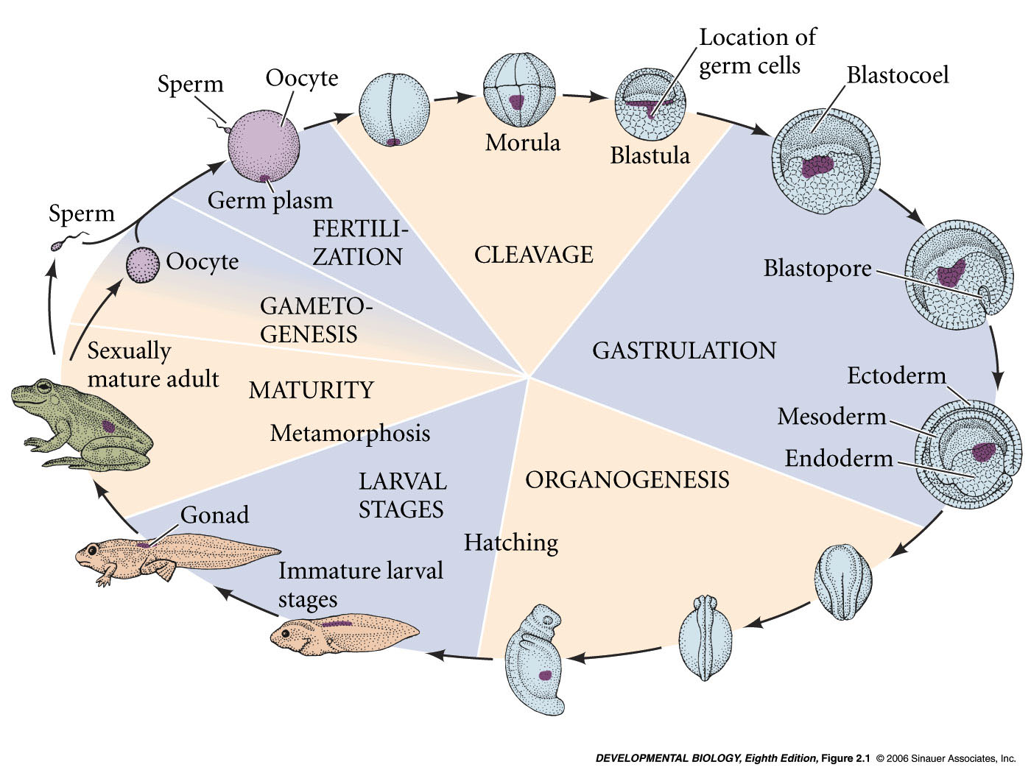
Developmental history of the leopard frog, Rana pipiens
zygote -
fertilized egg
blastula
gastrula
neurula
3 germ layers
Notes:
devbio8e-fig-02-01-0.jpg

Slide 9
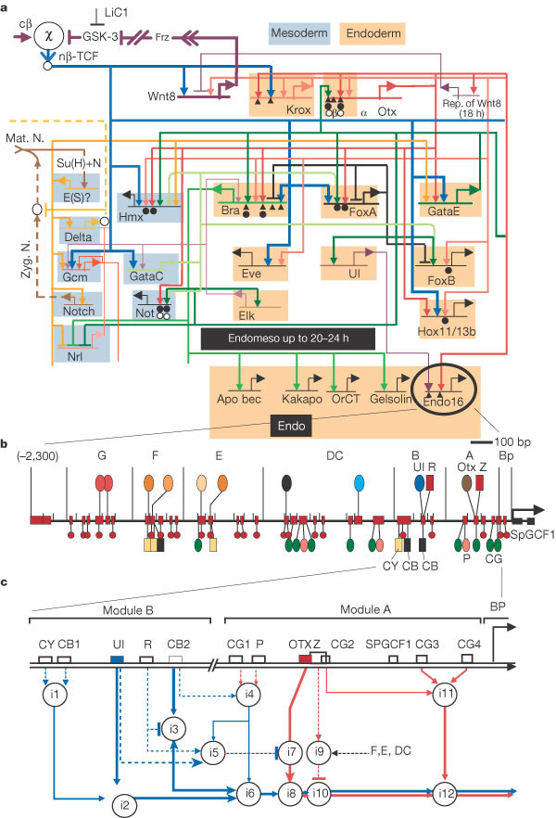
FIGURE 2. A gene regulatory network involved in sea urchin development.
From the The Digtal Code of DNA
Leroy Hood and David Galas
Nature 421, 444-448 (23 January 2003)
doi:10.1038/nature01410

Slide 10
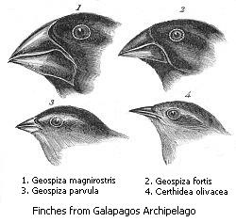
Heterometry
change in amount of expression
Darwin’s Finches
adaptive radiation -
rapid speciation of a single species to fill different ecological niches

