Slide 1
Homework for Weds.
Read Chapter 1
GN434 – First assignment – Pass/fail
Answer question 1 or 2 as assigned in class: You can work together. You can use Wikipedia or other resources. Your answers don’t have to be correct, just thoughtful and based on what ever you know from past biology/biochem/genetics classes or what you can find on the web. Due on Weds Jan 10th. Write it down, make two copies, and hand one in at beginning of class so I know that you did it. Be prepared to discuss you ideas in class on Friday.
Molecular signals and can cells remember?
1a) What signals in the embryo regulate the development of the different cell types? (i.e. what biological molecules function as signals?)
1b) How are these signals generated?
1c) How are they received and acted upon by cells? (i.e. What are the possible responses of the cells once they have received a signal?)
1d) What is the experimental evidence or data that supports what you claim?
1e) If the signal is present for a period during early development and then later removed, can the cell “remember” that it received the early signal? How can a cell remember (i.e. what is the molecular mechanism?
Morphogenesis, polarity and evolution.
2) Consider how is organ polarity controlled during development of the human arm. How does the developmental program ensure that fingers will always be at the apex (tip of the arm) while elbow will be in the middle and shoulder at the opposite end? Think about it. You are going from a single cell through cell divisions and then on to a multi-celled organ with different cell types and each cell type positioned in an appropriate position.
2a) What types of biological molecules would be involved for both generating signals and responding to these signals?
2b) Do you think that some of the same signals would be used to pattern the human leg? Why or why not? What types of evidence might help us to determine this?
2c) Do you think that many of the same molecular signals would be used to make a chicken wing? Why or why not? What type of experiment of evidence might help you determine this?
2d) If you were to design a computer program that was to model or recreate the formation of the human arm in silico (i.e. in a computer) what rules would you have to define for the cells behavior? What does each cell have to know to form the overall structure?

Slide 2
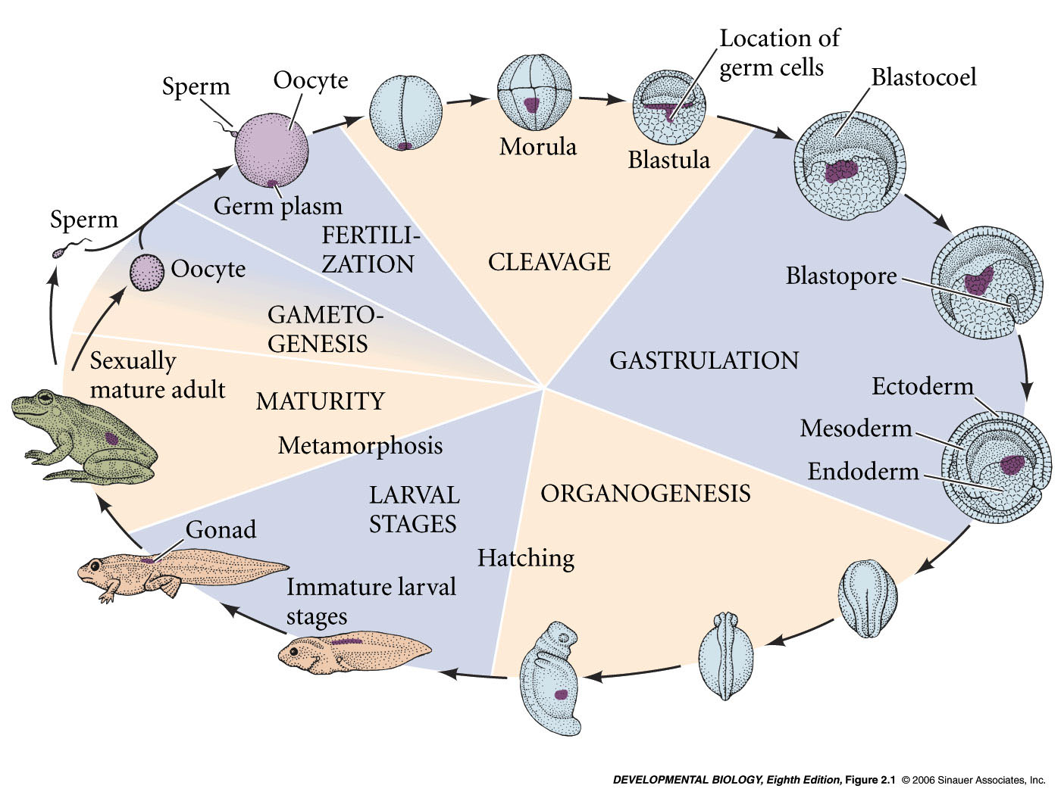
Developmental history of the leopard frog, Rana pipiens
zygote -
fertilized egg
blastula
gastrula
neurula
Gametes– sperm and egg (oocyte)
Germ cell – gamete or any direct precursor cell (germ line cell)
Somatic cells – any non germ line cell
Genome – collection of genes in an organism
Cleavage – rapid mitotic divisions that follow fertilization
Blastomeres – cells of the blastula stage embryo
Blastocoel – fluid filled space in blastula stage embryo caused by cell movements
3 germ layers
Notes:
devbio8e-fig-02-01-0.jpg

