Slide 1
Chapter 3 – Differential gene expression
Figures assignments to do on Monday the 22nd?
3.25 – Matthew A.
3.26 – Rachel B.
3.27 – Kelly B.
3.29 – Beth B.
3.32 – Daphne C.
3.10 – Maggie C.
3.09 - Alease D.
Prepare for chapter three – watch this tutorial before class weds the 17th
https://sophia.smith.edu/blog/barresilab/devidetorials/#differential-gene-expression
Prep three questions or comments to hand in on Jan 17th. Use Moodle to turn in assignment.

Slide 2
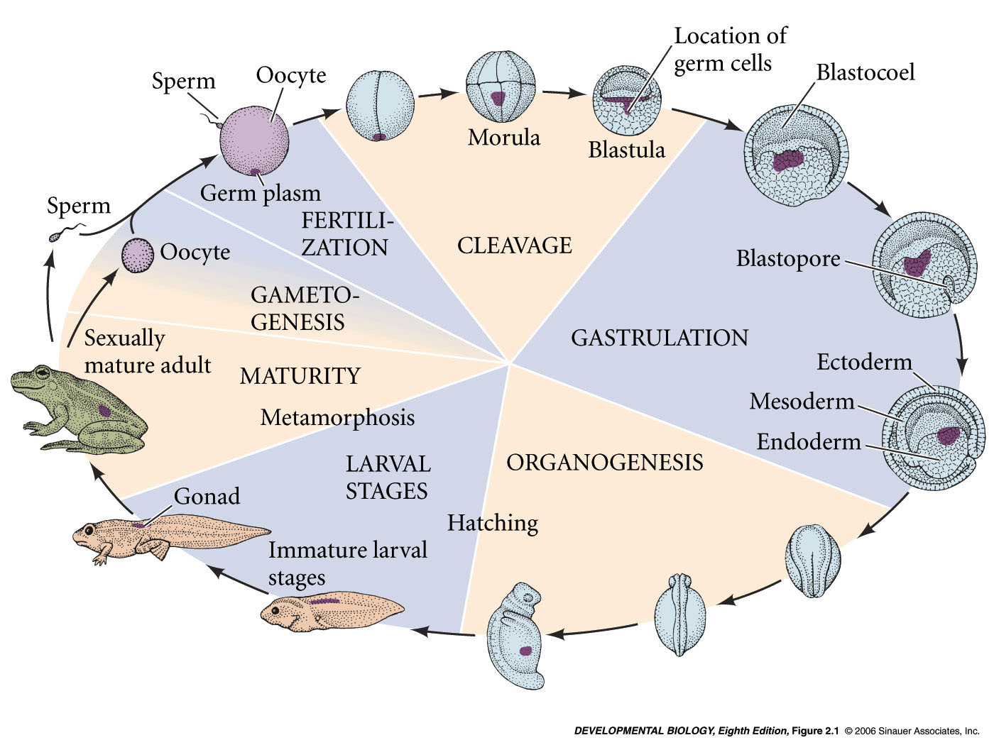
Developmental history of the leopard frog, Rana pipiens
zygote -
fertilized egg
blastula
gastrula
neurula
Gametes– sperm and egg (oocyte)
Germ cell – gamete or any direct precursor cell (germ line cell)
Somatic cells – any non germ line cell
Genome – collection of genes in an organism
Cleavage – rapid mitotic divisions that follow fertilization
Blastomeres – cells of the blastula stage embryo
Blastocoel – fluid filled space in blastula stage embryo
3 germ layers
Figure 1.1
Notes:
devbio8e-fig-02-01-0.jpg

Slide 3
Three germ layers
Zygote = fertilized egg (i.e. a single cell)
Blastula = after initial cleavages but before cell migrations (many cells)
Gastrula = cell movements generate the three cell layers
Blue = ectoderm; Yellow - endoderm; Red - mesoderm
Notes:
devbio8e-fig-01-01-0.jpg

Slide 4
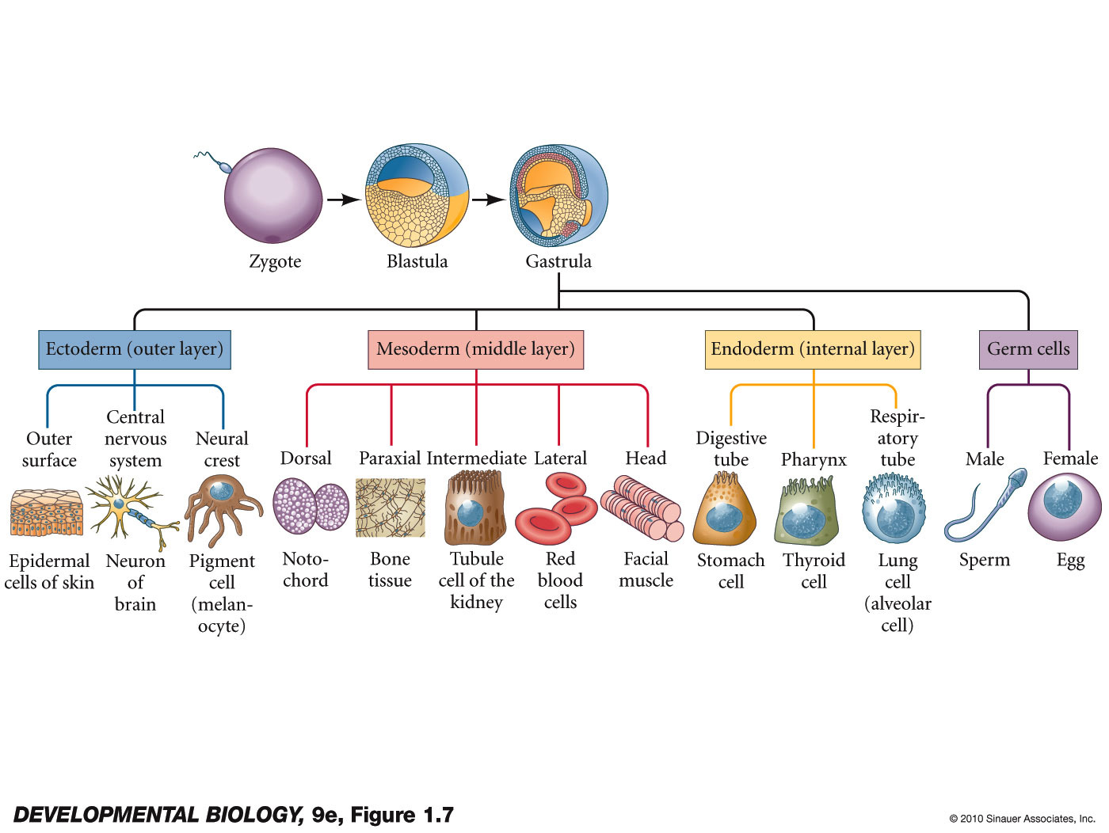
Figure 1.7 Dividing cells of the fertilized egg form three embryonic germ layers
somatic vs. germ cells
Notes:
DevBio9e-Fig-01-07-0.jpg

Slide 5
Three Germ Layers
Ectoderm (“outside skin”) - outer layer
produces skin and nerves
Endoderm (“within skin”) - innermost layer
produces digestive tube and associated organs (including lungs)
Mesoderm (“middle skin”) - becomes sandwiched between ectoderm and endoderm
generates blood, heart, kidney, gonads, bones and connective tissue
Induction or signaling between the germ layers induces new fates in responding tissue
Notochord (mesodermal) induces overlying ectoderm to form the CNS

Slide 6
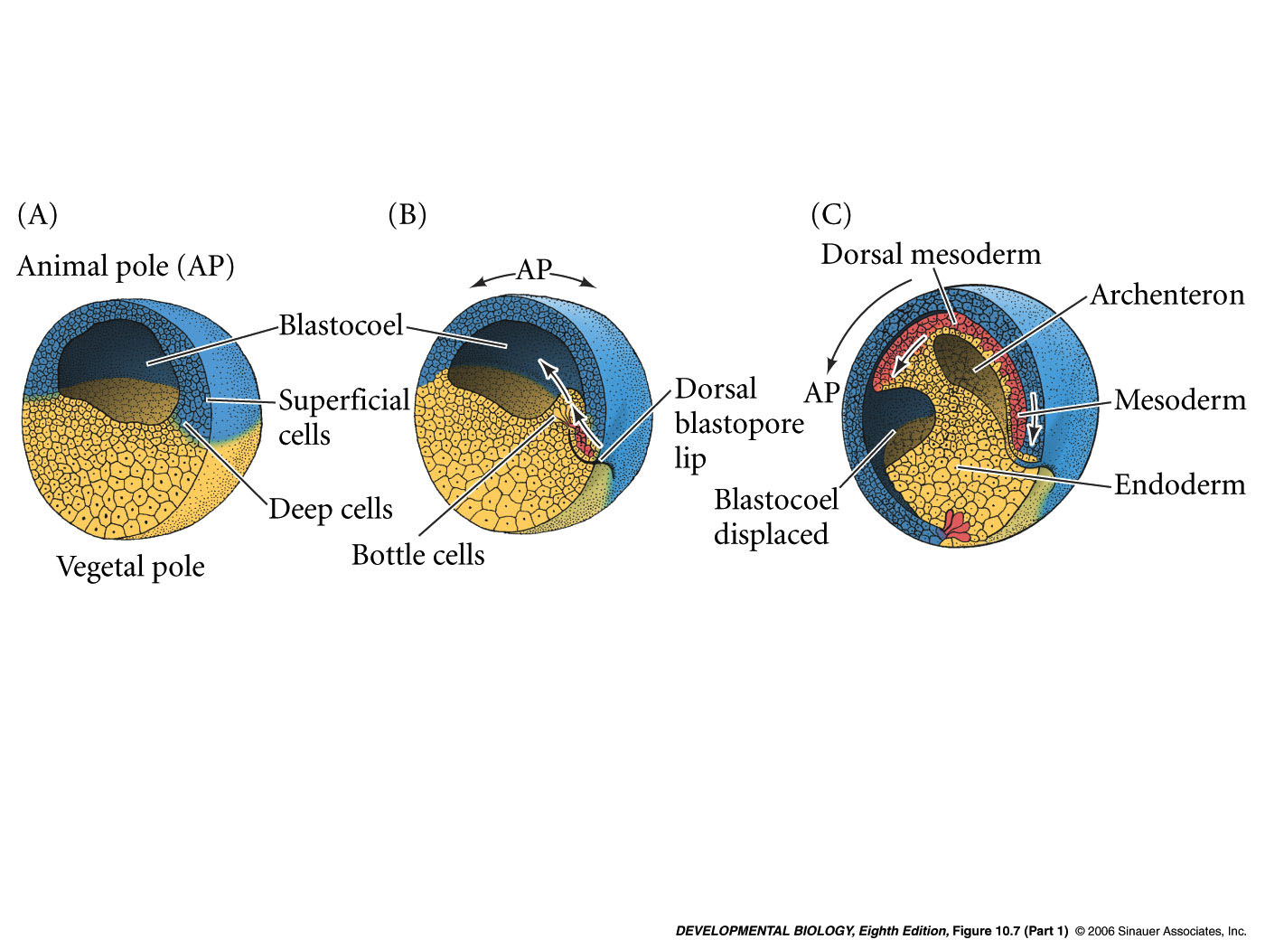
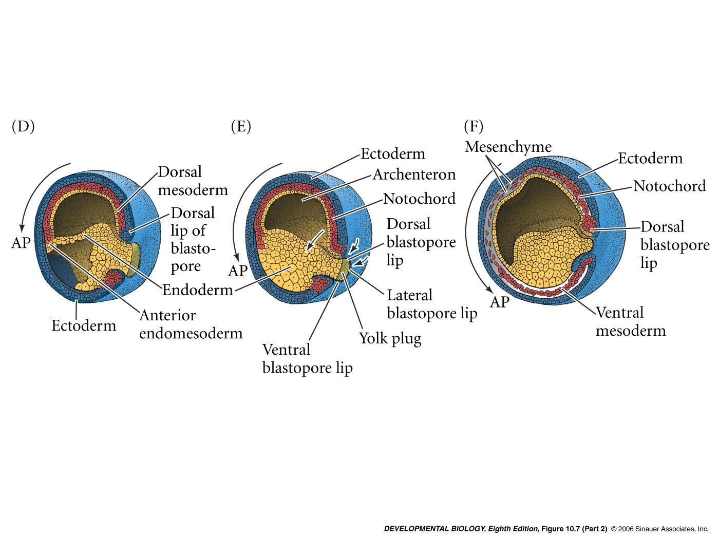
How to get three layers - Gastrulation
Blastula
stage
Figure 7.6

Slide 8
Cell movements during Gastrulation
Vade Macum - CD-ROM
Amphibian/early development
Xenopus I and Xenopus II
early and late gastrulation -
Link to the tenth edition web site -
http://10e.devbio.com/
Labs.devbio.com

Slide 9
Developmental history of the leopard frog, Rana pipiens
zygote -
fertilized egg
blastula
gastrula
neurula
Gametes– sperm and egg (oocyte)
Germ cell – gamete or any direct precursor cell (germ line cell)
Somatic cells – any non germ line cell
Genome – collection of genes in an organism
Cleavage – rapid mitotic divisions that follow fertilization
Blastomeres – cells of the blastula stage embryo
Blastoceol – fluid filled space in blastula stage embryo caused by cell movements
3 germ layers
Notes:
devbio8e-fig-02-01-0.jpg

Slide 10
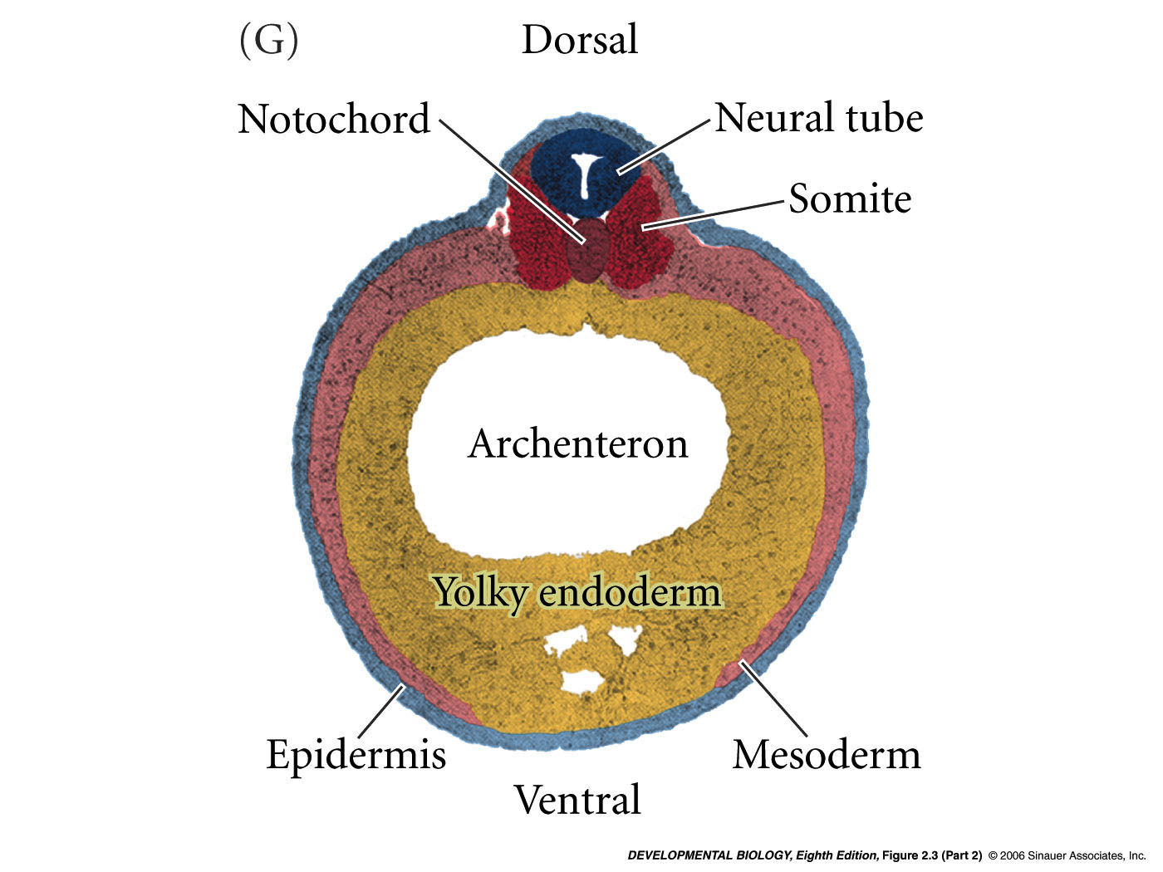
Xenopus laevis - neurula stage embryo
Recriprical induction event –
notochord and neural groove/tube (future CNS) induce the somites (mesoderm)
Notes:
devbio8e-fig-02-03-2.jpg

Slide 11
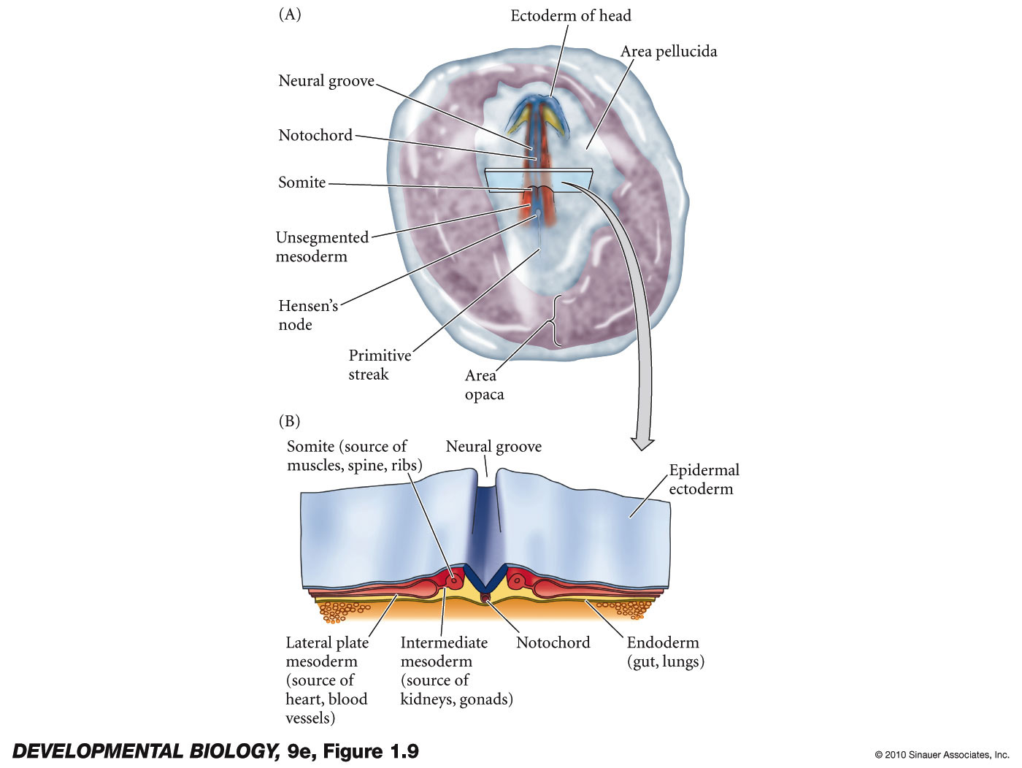
Figure 1.9 Notochord in chick development
Recriprical induction event –
notochord and neural groove/tube (future CNS) induce the somites (mesoderm)
Notes:
DevBio9e-Fig-01-09-0.jpg

Slide 12
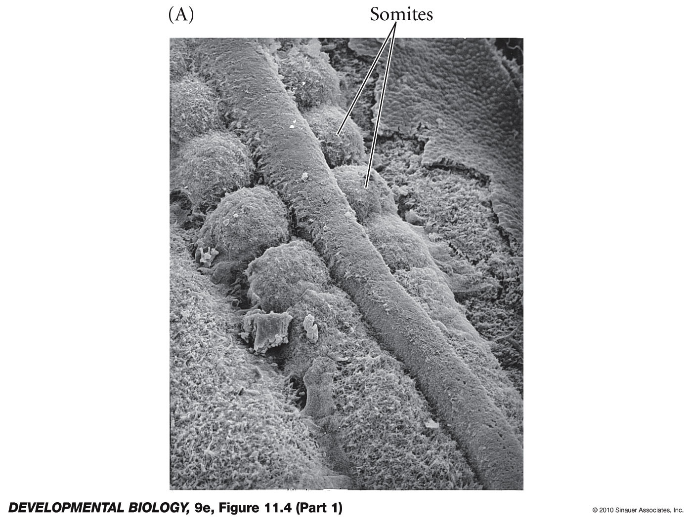
Somites form from paraxial mesoderm

Slide 13
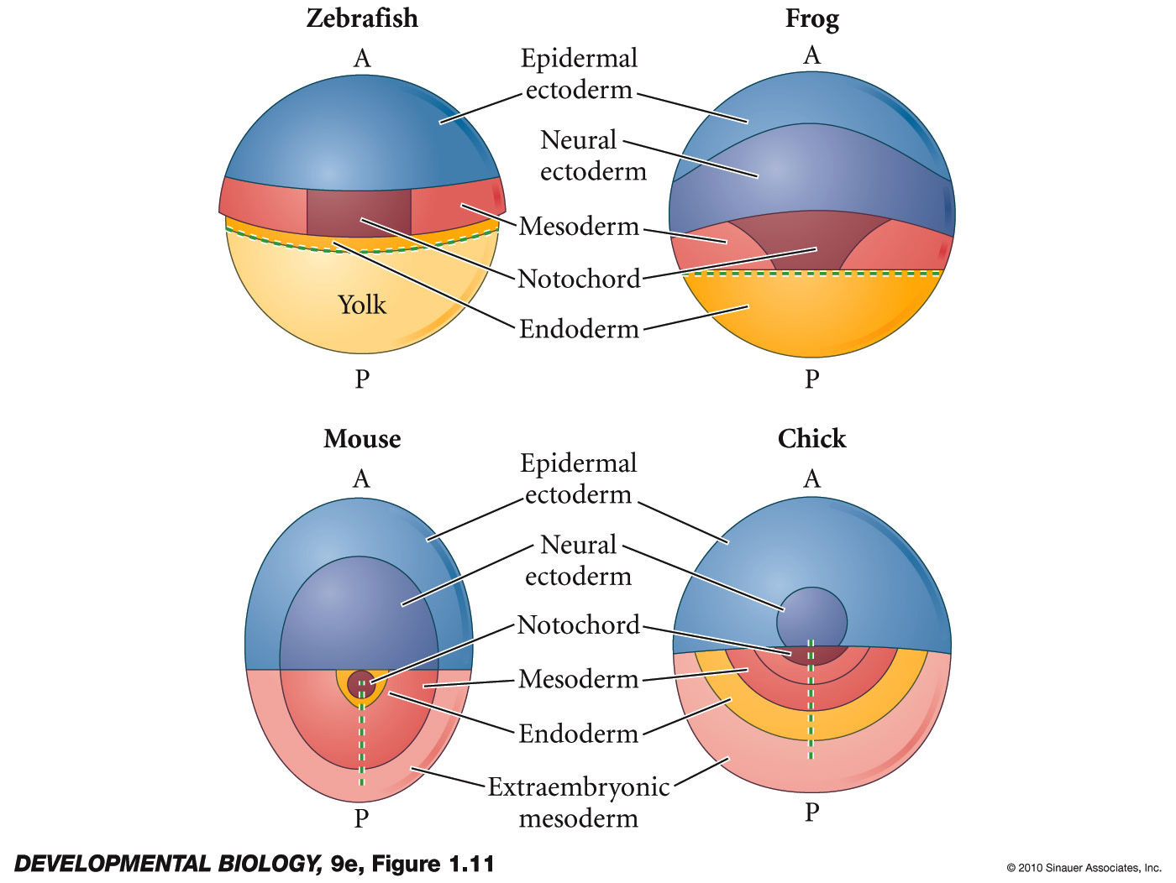
Figure 1.11 Fate maps of vertebrates at the late blastula/early gastrula stage
Notes:
DevBio9e-Fig-01-11-0.jpg

Slide 14
Fate mapping the embryo
tracing cell lineages:follow individual cells to see what they become
Fate map: maps larval or adult structure onto the region of the embryo from which it arose

Slide 15
Fate maps can be generated by:
1. Observing living embryos.
2. Vital dye marking
3. Radioactive labeling and fluorescent dyes
4. Genetic marking

Slide 16
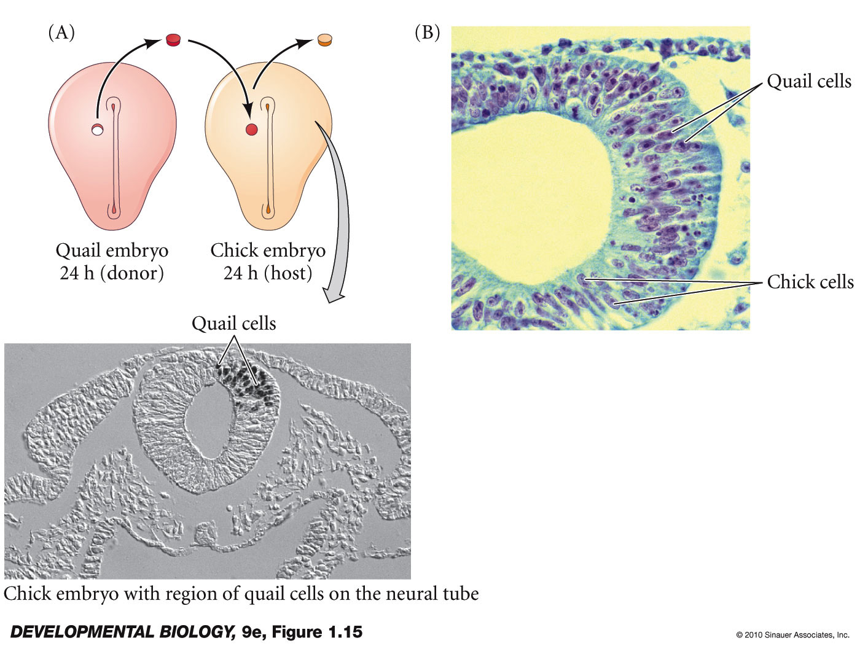
Figure 1.15 Genetic markers as cell lineage tracers
Cell migrations and cell lineages
Notes:
DevBio9e-Fig-01-15-0.jpg

Slide 17
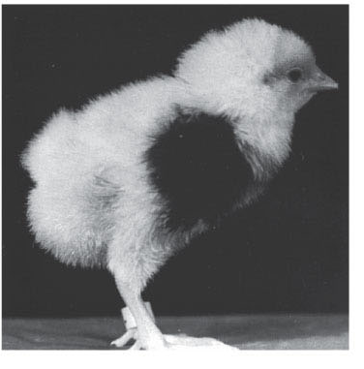
Neural crest cell migration
Mary Rawles (1940)
Extensive cell migrations during development
Pigment cells (melanocytes) of chick originate in the neural crest
Transplanted migrating pigment cells entered epidermis and later feathers

Slide 18
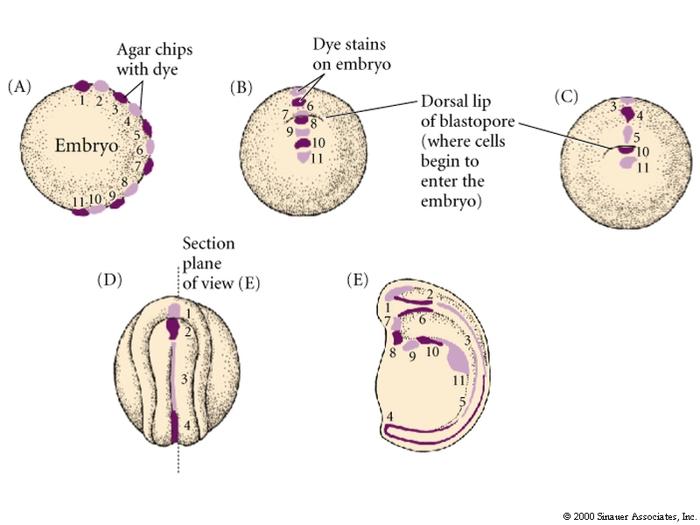
Vital dye staining of amphibian embryos
Vogt (1929)
blastopore = where cells enter embryonic interior during gastrulation
Vital dye does not damage cells

Slide 19
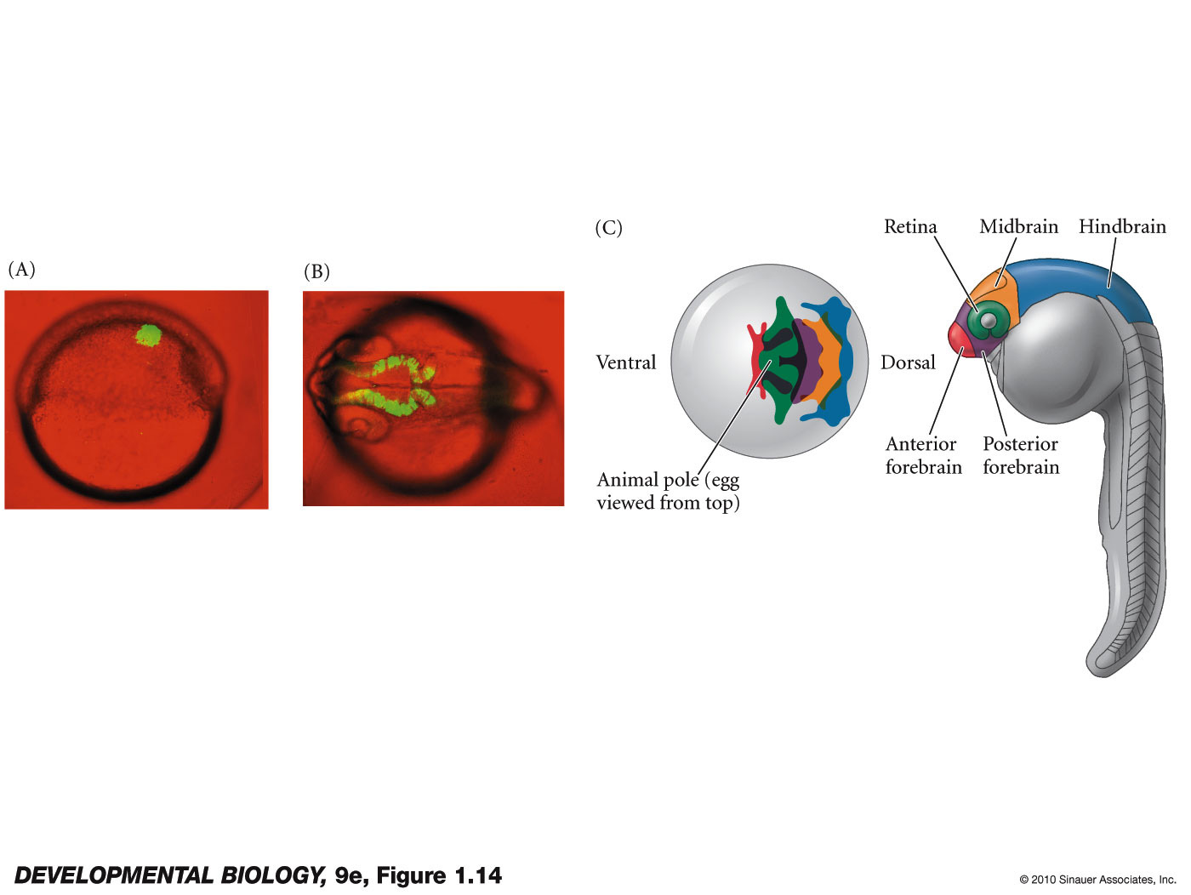
Figure 1.14 Fate mapping using a fluorescent dye
Notes:
DevBio9e-Fig-01-14-0.jpg

Slide 20
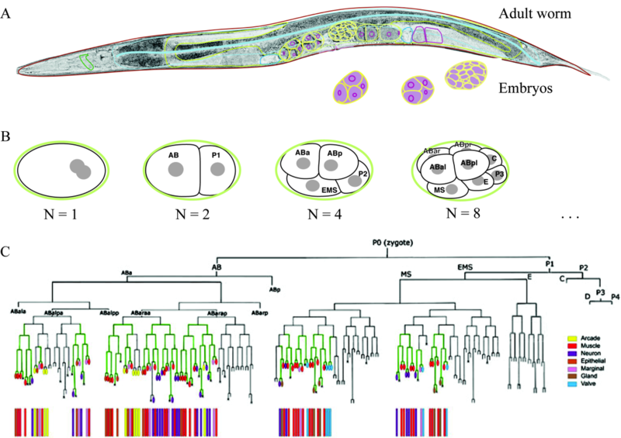
C. elegans lineage map
https://morpho13.wikispaces.com/file/view/Rothman1.png/442160568/800x565/Rothman1.png
Cell to cell communication? Asymmetric cell divisions? Autonomous versus conditional

Slide 21
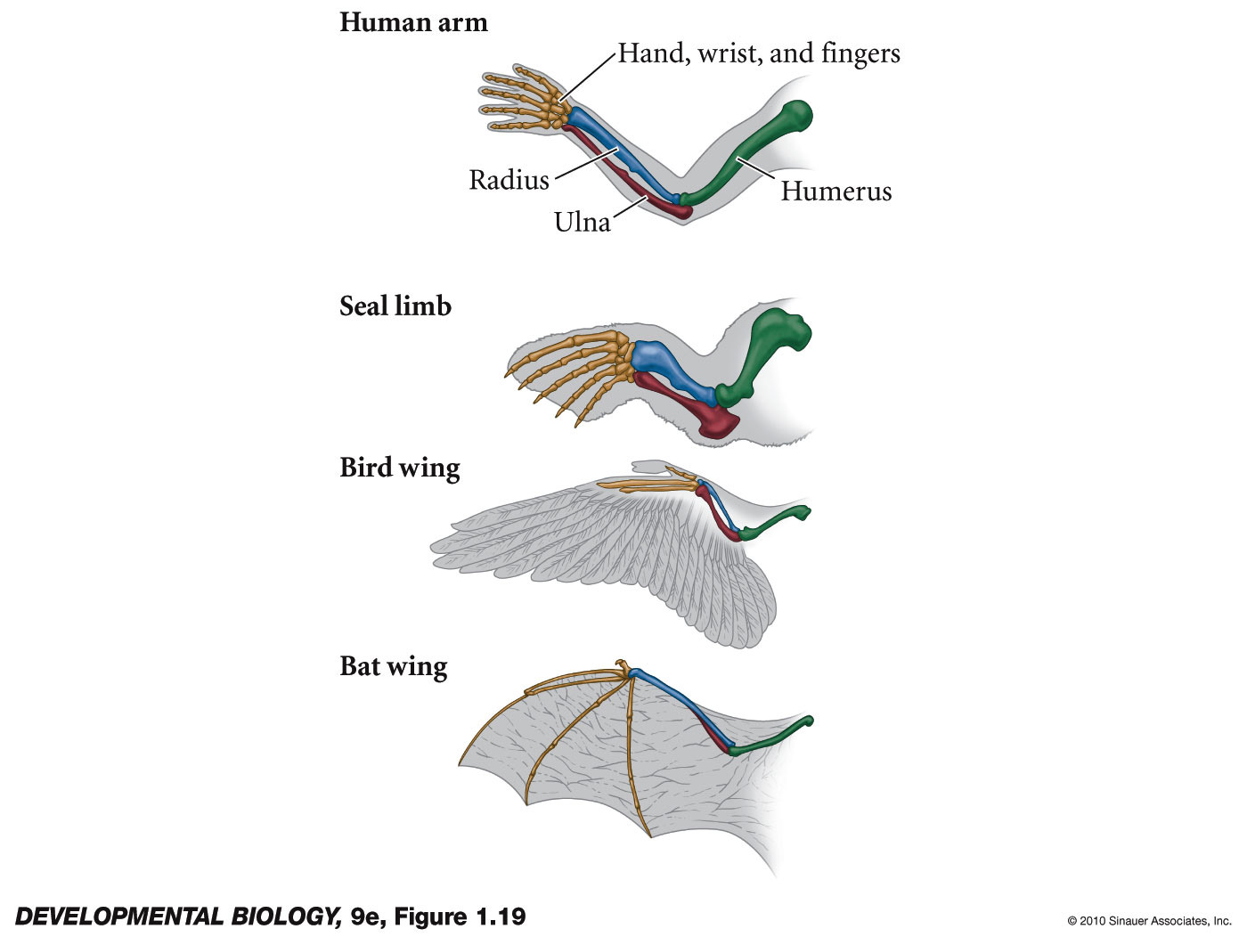
Figure 1.19 Homologies of structure among human arm, seal forelimb, bird wing, and bat wing
Notes:
DevBio9e-Fig-01-19-0.jpg

Slide 22
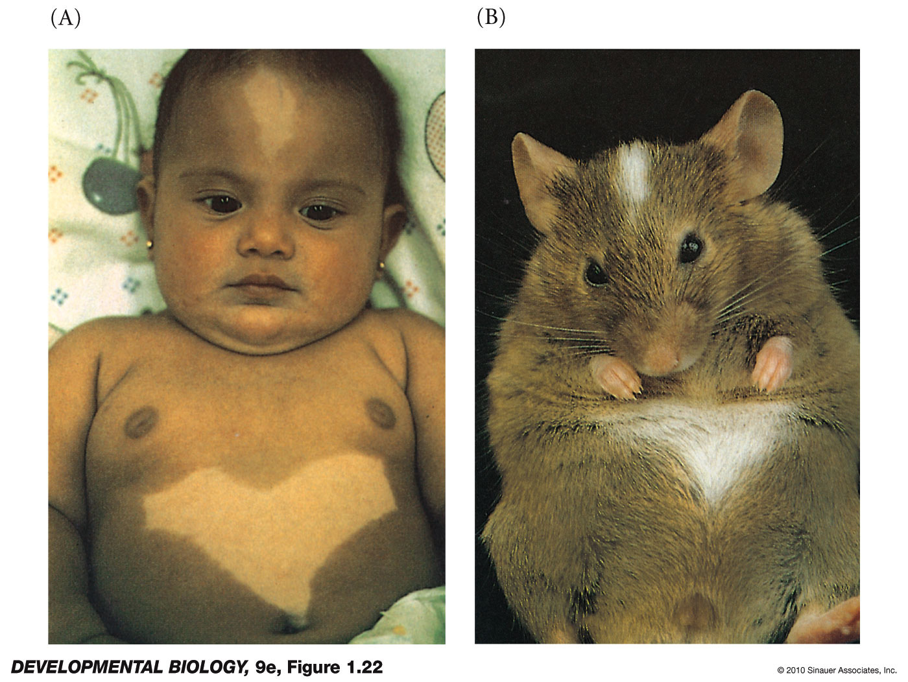
Figure 1.22 Developmental anomalies caused by genetic mutation
Notes:
DevBio9e-Fig-01-22-0.jpg

