Slide 1
GN434 - Genes and Development
Discussion of Differential Gene expression video
Biochemistry and molecular biology review

Slide 2
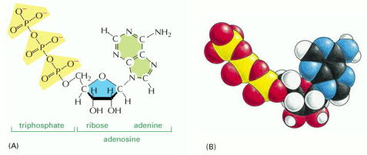
ATP - adenosine triphosphate The cells energy carrier
Figure 2-26. Chemical structure of adenosine triphosphate (ATP). (A) Structural formula. (B) Space-filling model. In (B) the colors of the atoms are C, black; N, blue; H, white; O, red; and P, yellow. From Molecular Biology of the Cell by Alberts
© 2002 by Bruce Alberts, Alexander Johnson, Julian Lewis, Martin Raff, Keith Roberts, and Peter Walter.

Slide 3
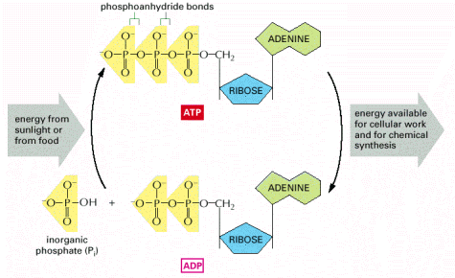
ATP - adenosine triphosphate The cells energy carrier
Figure 2-27. The ATP molecule serves as an energy carrier in cells. (A) Structural formula. (B) Space-filling model. In (B) the colors of the atoms are C, black; N, blue; H, white; O, red; and P, yellow. From Molecular Biology of the Cell by Alberts
© 2002 by Bruce Alberts, Alexander Johnson, Julian Lewis, Martin Raff, Keith Roberts, and Peter Walter.

Slide 4
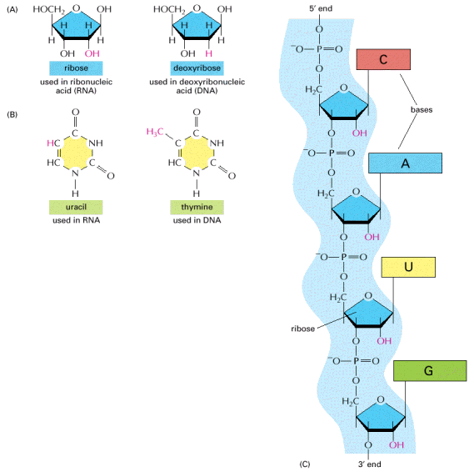
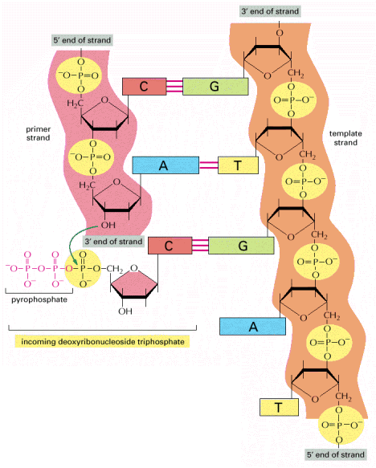
RNA
DNA
= adenine
Figure 6-4. The chemical structure of RNA . From Molecular Biology of the Cell by Alberts
© 2002 by Bruce Alberts, Alexander Johnson, Julian Lewis, Martin Raff, Keith Roberts, and Peter Walter.

Slide 5
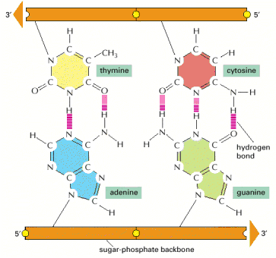
Complementary strands bind due to hydrogen binding
hybridization of nucleic acids
make specific probes
Figure 4-4. Complementary base pairs in the DNA double helix. From Molecular Biology of the Cell by Alberts
© 2002 by Bruce Alberts, Alexander Johnson, Julian Lewis, Martin Raff, Keith Roberts, and Peter Walter.

Slide 6
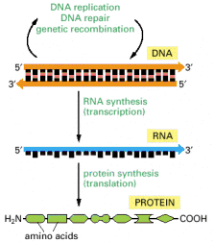
Central Dogma
Replication - DNA to DNA
Transcription - DNA to RNA
Translation - RNA to protein
Figure 6-2. The pathway from DNA to protein. From Molecular Biology of the Cell by Alberts
© 2002 by Bruce Alberts, Alexander Johnson, Julian Lewis, Martin Raff, Keith Roberts, and Peter Walter.

Slide 7
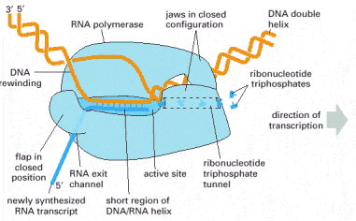
Transcription
hnRNA or nRNA is single stranded complementary copy of one strand of the DNA
mRNA - is the spliced and polyadenylated hnRNA
Figure 6-8. DNA is transcribed by the enzyme RNA polymerase. From Molecular Biology of the Cell by Alberts
© 2002 by Bruce Alberts, Alexander Johnson, Julian Lewis, Martin Raff, Keith Roberts, and Peter Walter.

Slide 8
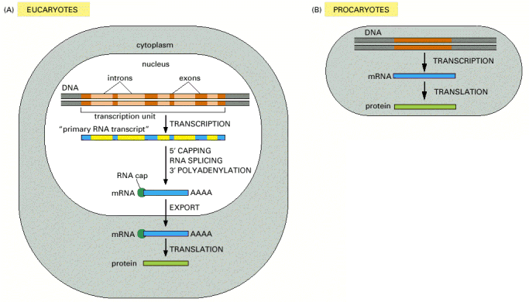
How to make a protein
hnRNA
mRNA
Figure 6-21. Summary of the steps leading from gene to protein in eucaryotes. From Molecular Biology of the Cell by Alberts
© 2002 by Bruce Alberts, Alexander Johnson, Julian Lewis, Martin Raff, Keith Roberts, and Peter Walter.

Slide 9
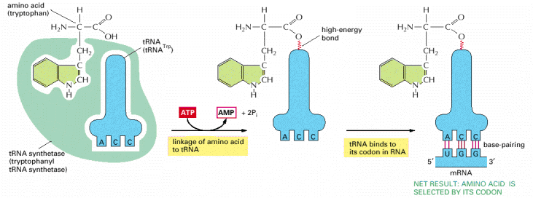
How to make a protein
codon and anticodon
t-RNA - brings the amino acid
Figure 6-58. The genetic code is translated by means of two adaptors that act one after another. From Molecular Biology of the Cell by Alberts © 2002 by Bruce Alberts, Alexander Johnson, Julian Lewis, Martin Raff, Keith Roberts, and Peter Walter.

Slide 10
How to make a protein
Need three things:
1) a charged tRNA
2) an mRNA
3) a ribosome - complex of rRNA and proteins
Figure 6-65. Translating an mRNA molecule. . From Molecular Biology of the Cell by Alberts © 2002 by Bruce Alberts, Alexander Johnson, Julian Lewis, Martin Raff, Keith Roberts, and Peter Walter.

Slide 11
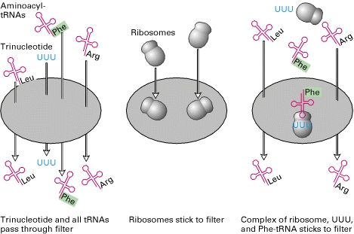
Want to see it?
http://commons.wikimedia.org/w/index.php?title=File%3ATransfer_RNA_morph_AT_to_PE_conformation.ogv
How do we know?
http://www.ncbi.nlm.nih.gov/books/NBK21603/figure/A875/?report=objectonly
Marshall Nirenberg and his collaborators prepared 20 ribosome-free bacterial extracts containing all possible aminoacyl-tRNAs (tRNAs with an amino acid attached). In each sample, a different amino acid was radioactively labeled (green); the other 19 amino acids were bound to tRNAs but were unlabeled. Aminoacyl-tRNAs and trinucleotides passed through a nitrocellulose filter (left), but ribosomes were retained by the filter (center) and would bind trinucleotides and their cognate tRNAs (right). Each possible trinucleotide was tested separately for its ability to attract a specific tRNA by adding it with ribosomes to samples from each of the 20 aminoacyl-tRNA mixtures. The sample was then filtered. If the added trinucleotide caused the radiolabeled aminoacyl-tRNA to bind to the ribosome, then radioactivity would be detected on the filter (a positive test); otherwise, the label would pass through the filter (a negative test). By synthesizing and testing all possible trinucleotides, the researchers were able to match all 20 amino acids with one or more codons (e.g., phenylalanine with UUU as shown here). [See M. W. Nirenberg and P. Leder, 1964, Science 145:1399.]

Slide 12
Differential Gene Expression Molecular Mechanisms

Slide 13
Genomic Equivalence
Genomic Equivalence - All cells contain the same genome (DNA)

Slide 14
Genomic Equivalence
Somatic nuclear transfer - “cloning”
1997 Ian Wilmut

Slide 15
Differential Gene Expression Molecular Mechanisms

Slide 16
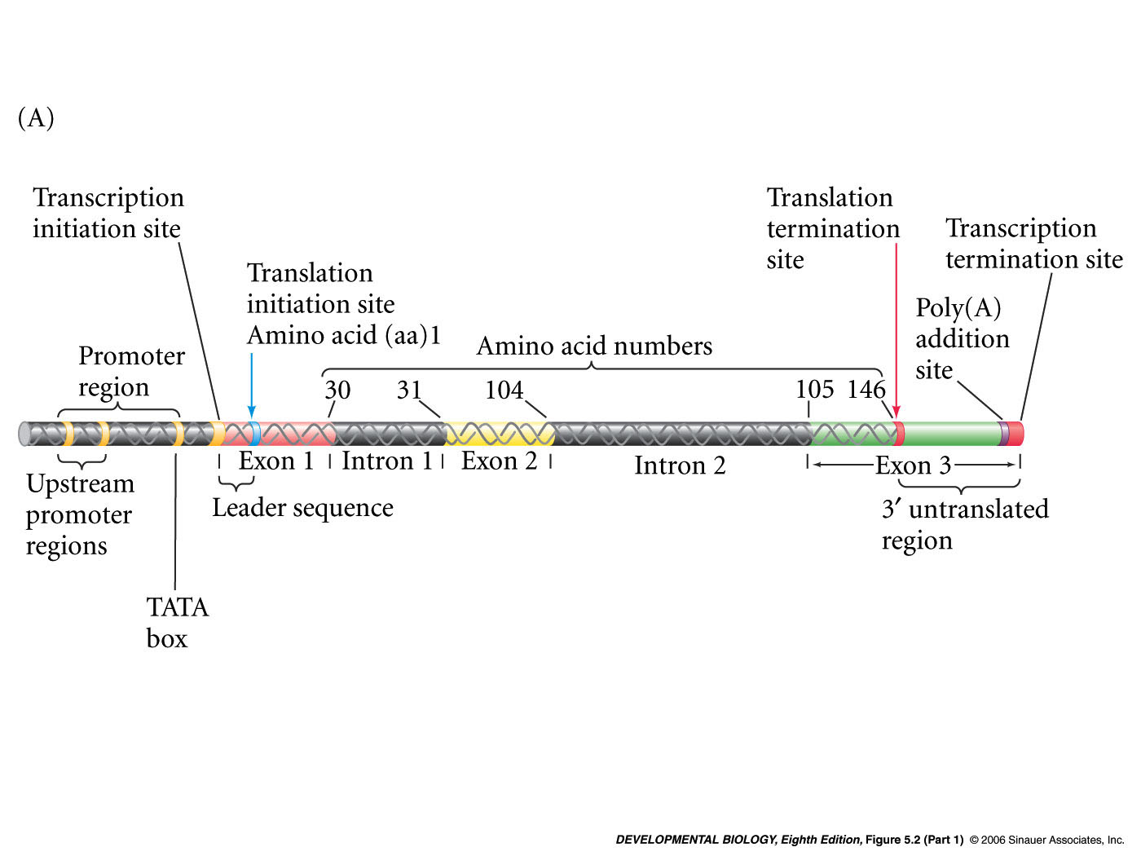
Parts of a Gene (β-globin)
Enhancer regions

Slide 17
Transcriptional Regulation
Enhancer regions
nRNA

Slide 18
Parts of a Gene (β-globin)
Enhancer regions
nRNA that will be processed into mRNA
AUG
UAG
5’metG
CAP
AAAA
Capped, spliced and polyA tail added (i.e. mRNA)

Slide 19
Parts of a Gene (β-globin)
Enhancer regions

Slide 20
Transcriptional Regulation
cis-elements
(DNA elements)
Promoters, enhancers and silencers
trans-factors (diffusible proteins or RNA)
RNA polymerase, Basal transcription factors, Cell-specific transcription factors, regulatory RNAs

Slide 21
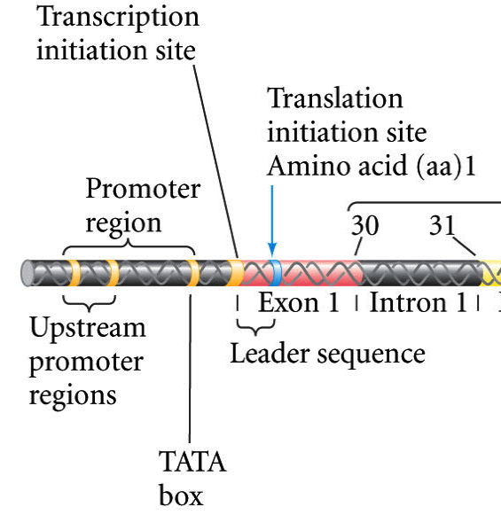
Promoter and transcription initiation site
Promoter (cis-element)
(i.e. a DNA sequence)
Main job: allows RNA polymerase II
to bind and initiate transcription

Slide 22
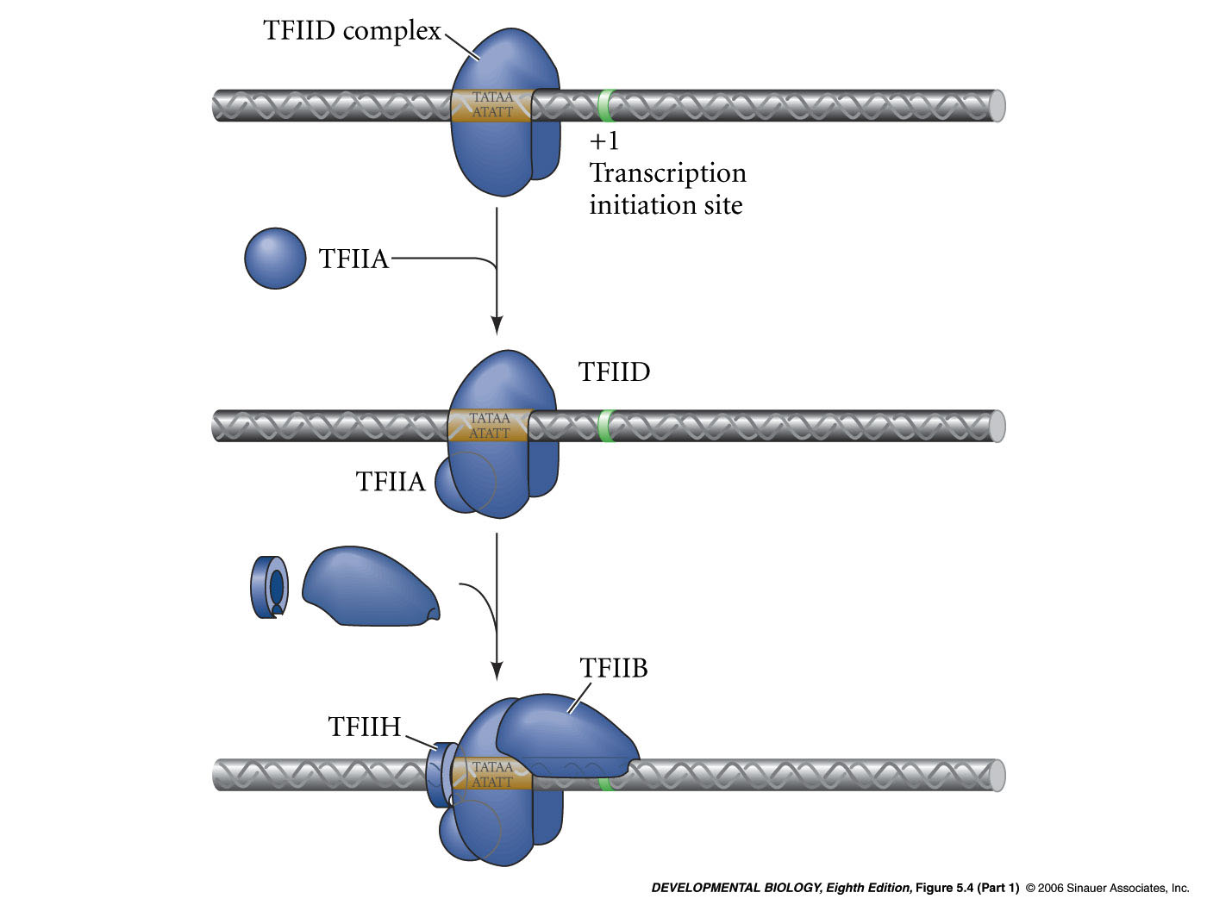
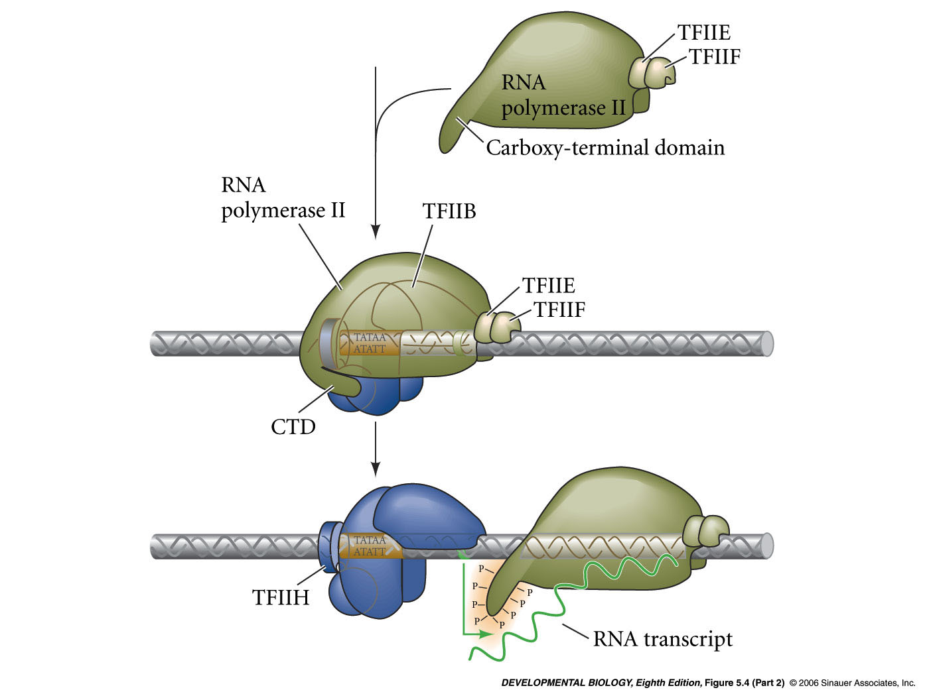
Basal transcription factors help RNA pol II bind to the promoter
diffusible trans-acting factors
1)
TFIID complex = TATA-binding protein (TBP) plus other proteins
TFIIA complex and TFIIB complex bind
2)
3)
RNA polymerase II binds
4)
TFIIE, TFIIF, TFIIH bind.
TFIIH phosphorylates RNA polymerase II CTD. Initiation of transcription.
5)

Slide 23
TAFs (TBP associated factors) and the mediator complex assist basal transcription factors and RNA polymerase II

Slide 24
Methods to study transcription factors and transcriptional regulation
In vitro transcription assays
Grind up tissue and extract basal transcription factors
Pass the extract over a column - fractionate
Add back fractions to a test tube with promoter:reporter gene
Determine with fractions are required for transcription of reporter

Slide 25
Enhancer elements
Enhancer regions
Enhancers can be upstream or downstream of transcription start
they act at a distance
they are bound by cell-specific transcription factors
Alter rate of transcription initiation

