Slide 1
Chapter 3 – Differential gene expression
Figures assignments to do Friday
3.25 – Matthew A.
3.26 – Rachel B.
3.27 – Kelly B.
3.29 – Beth B.
3.32 – Daphne C.
3.10 – Maggie C.
3.09 - Alease D.

Slide 2
Transcriptional Regulation
cis-elements
(DNA elements)
Promoters, enhancers and silencers
trans-factors (diffusible proteins or RNA)
RNA polymerase, Basal transcription factors, Cell-specific transcription factors, regulatory RNAs

Slide 3
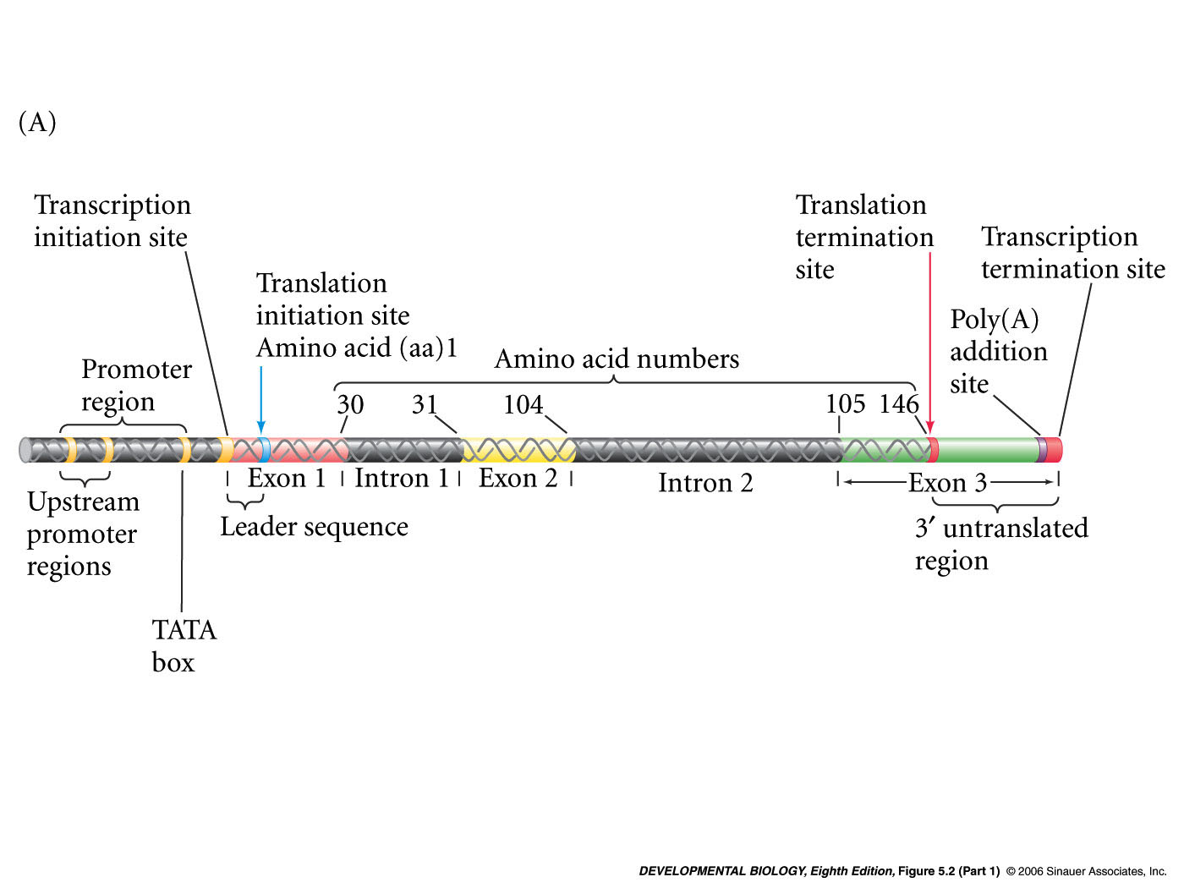
Parts of a Gene (β-globin)
Enhancer regions

Slide 4
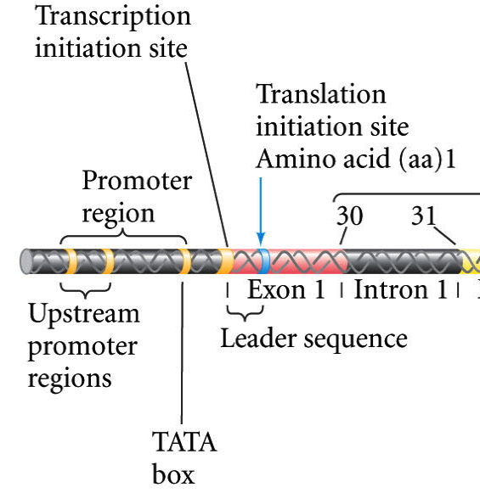
Promoter and transcription initiation site
Promoter (cis-element)
(i.e. a DNA sequence)
Main job: allows RNA polymerase II
to bind and initiate transcription

Slide 5
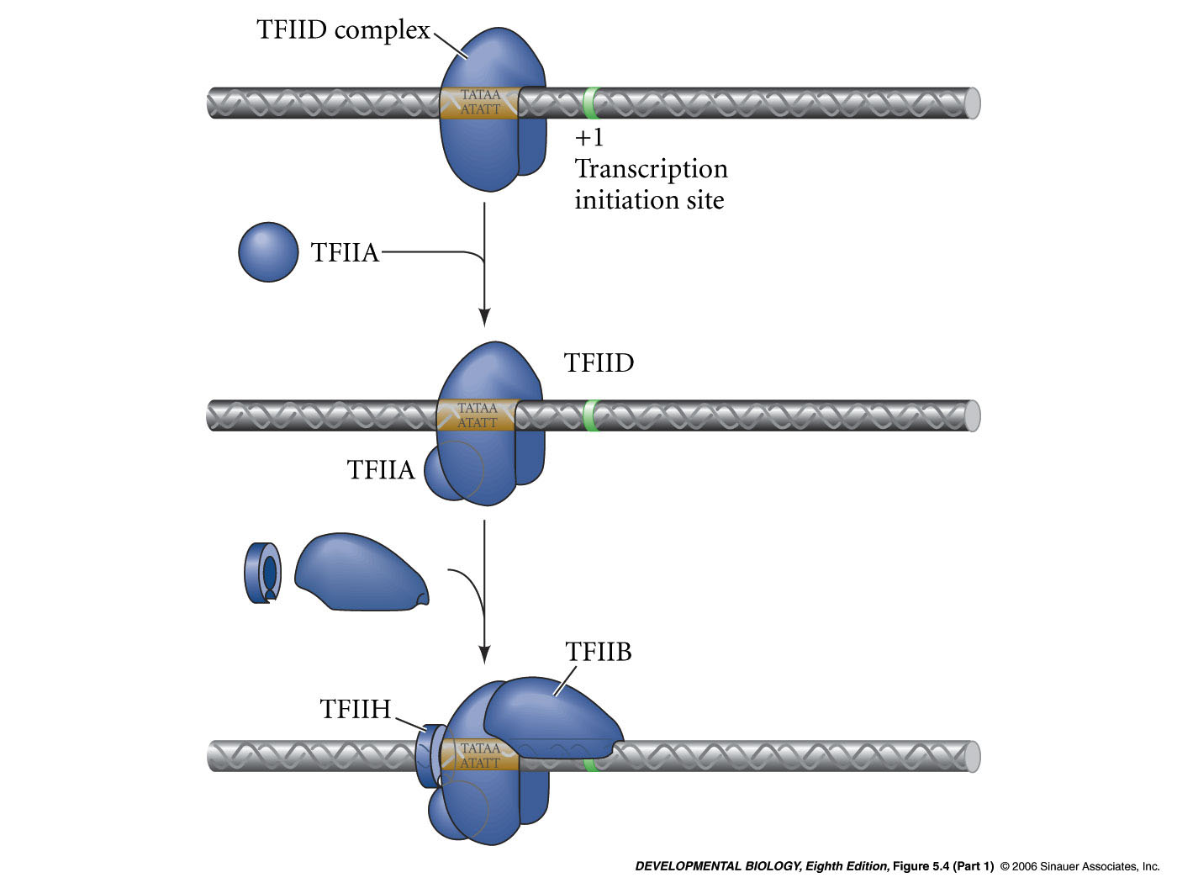
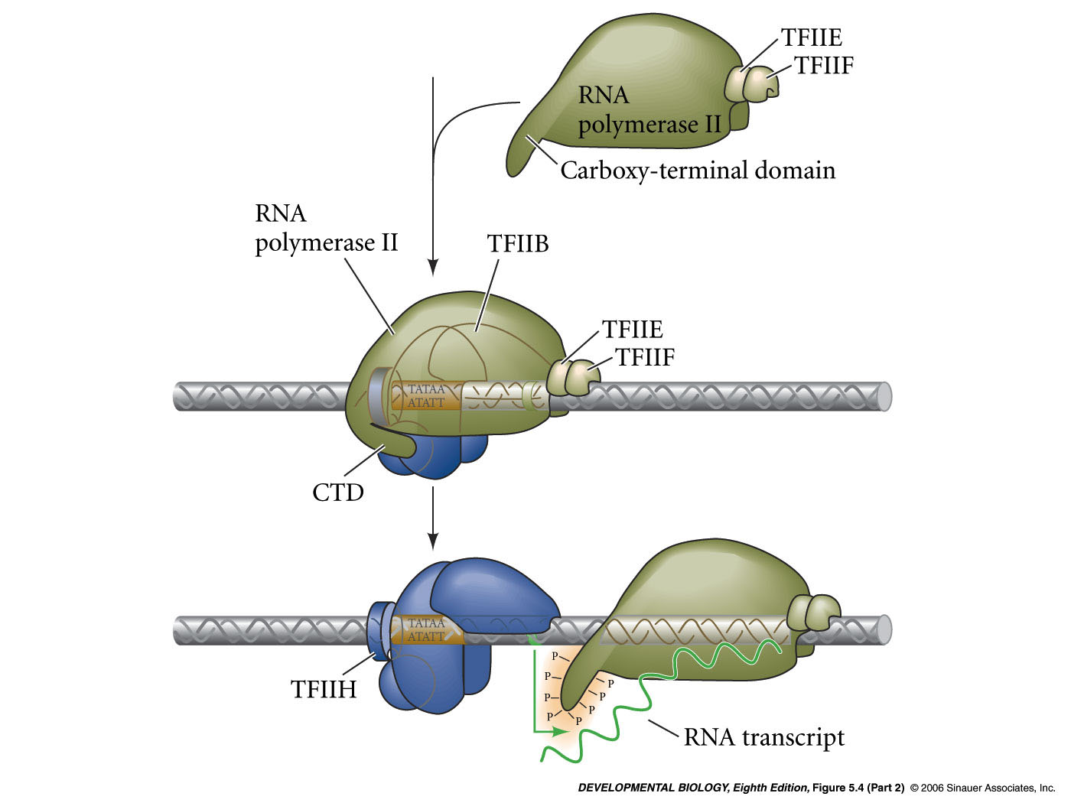
Basal transcription factors help RNA pol II bind to the promoter
diffusible trans-acting factors
1)
TFIID complex = TATA-binding protein (TBP) plus other proteins (TAFS)
2)
TFIIA complex and TFIIB complex bind
3)
RNA polymerase II binds
4)
TFIIE, TFIIF, TFIIH bind.
TFIIH phosphorylates RNA polymerase II CTD. Initiation of transcription.
5)

Slide 6
TAFs (TBP associated factors) and the mediator complex assist basal transcription factors and RNA polymerase II

Slide 7
Methods to study transcription factors and transcriptional regulation
In vitro transcription assays
Grind up tissue and extract basal transcription factors
Pass the extract over a column - fractionate
Add back fractions to a test tube with promoter:reporter gene
Determine with fractions are required for transcription of reporter

Slide 8
Enhancer elements
Enhancer regions
Enhancers can be upstream or downstream of transcription start
they act at a distance
they are bound by cell-specific transcription factors
Alter rate of transcription initiation

Slide 9
Enhancers
Modular - One gene can have several enhancer sites
for different sets of cells (Pax6 enhancer elements)
Combinatorial - Many transcription factors can bind
each enhancer (somatostatin enhancer elements)
Enhancers can inhibit transcription
Negative enhancers = silencers

Slide 10
Enhancers can stimulate transcription by:
Recruiting proteins/enzymes that modify chromatin/histones
Stabilizing the transcriptional initiation complex/RNA pol.

Slide 11
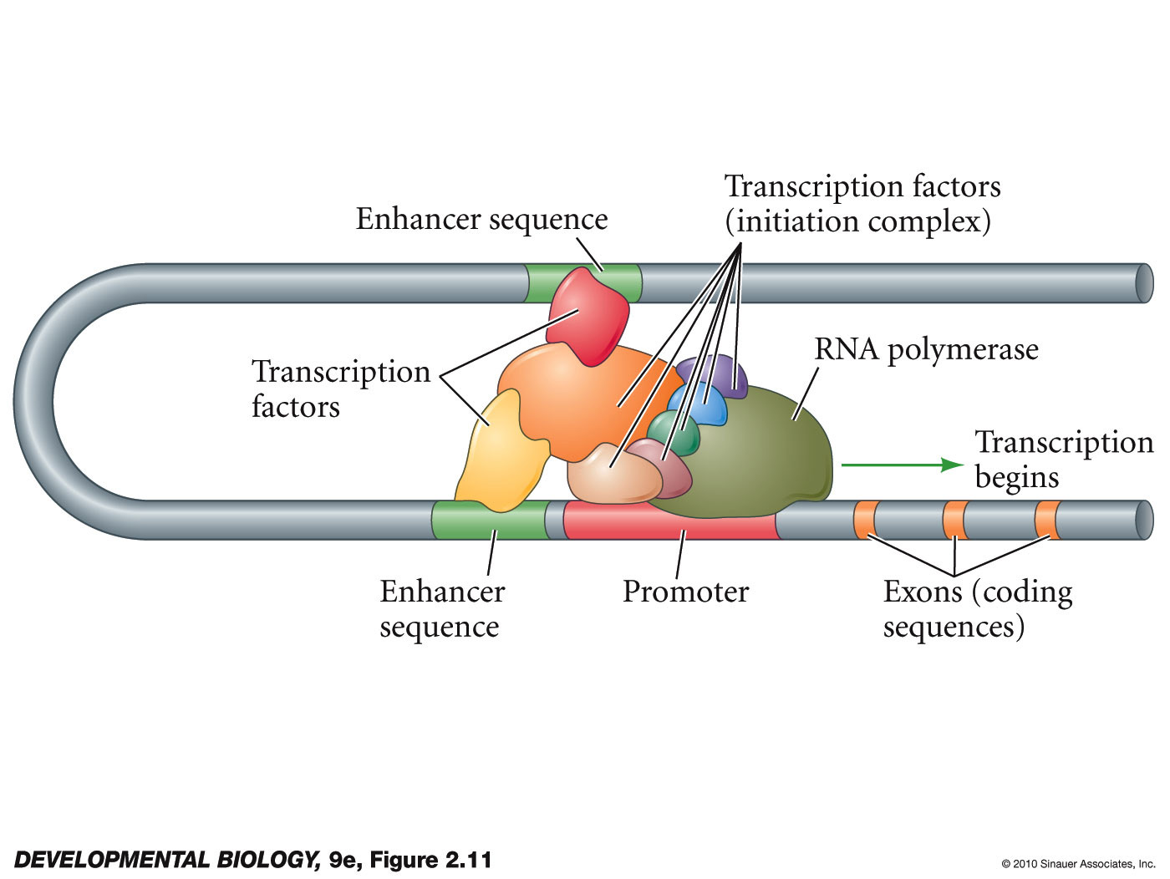
RNA polymerase is stabilized on the promoter site of the DNA by transcription factors recruited by the enhancers
Notes:
DevBio9e-Fig-02-11-0.jpg

Slide 12
Eukaryotic Genes packages in chromatin
Transcription factors can also influence the state of chromatin and thus gene expression

Slide 13
Chromatin
made up of nucleosomes
A nucleosome is made up of
an octamer of histone proteins
2 loops:
~140 bp of DNA

Slide 14
Nucleosomes and gene expression
Usually nucleosomes
are wrapped in solenoids
Histone H1 is found in the 60 bp
linker DNA
inhibits the transcription by
packing DNA

Slide 15
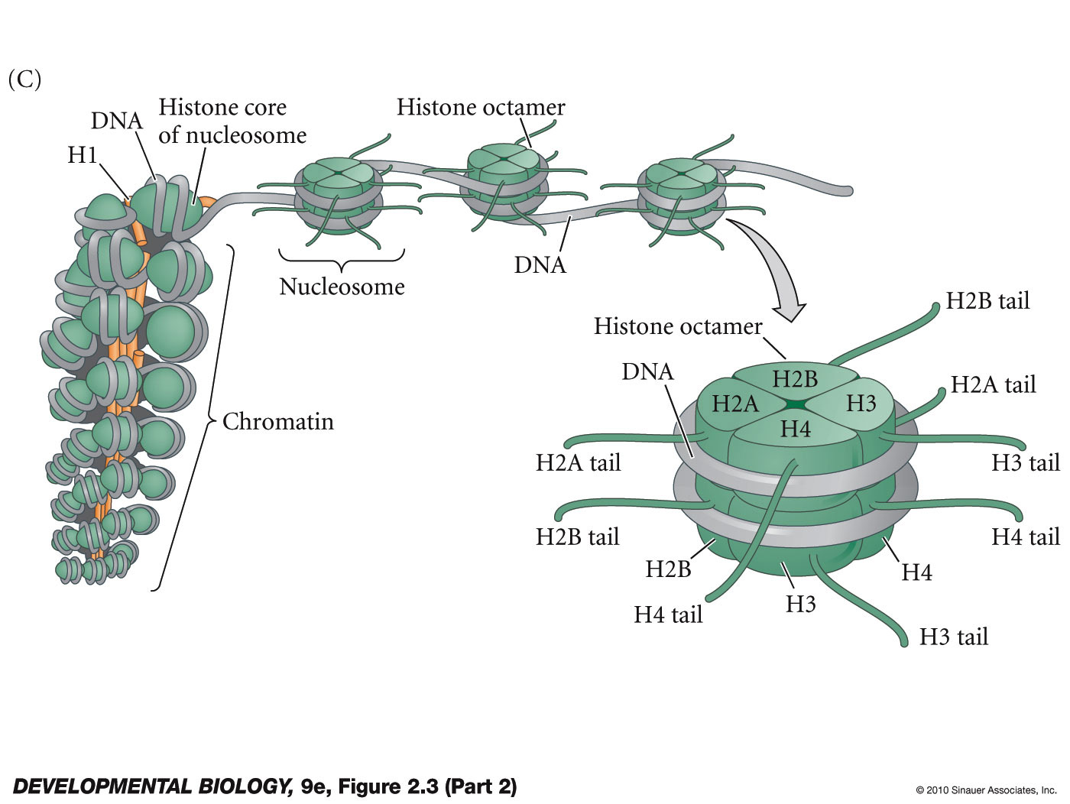
Nucleosome and chromatin structure
Notes:
DevBio9e-Fig-02-03-2R.jpg

Slide 16
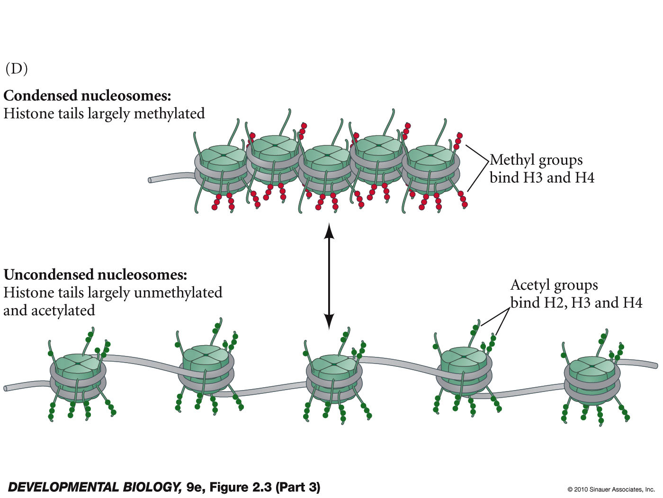
Nucleosome and chromatin structure
histone deacetylases
and histone methyl transferases
histone acetyltransferases
Notes:
DevBio9e-Fig-02-03-3R.jpg

Slide 17
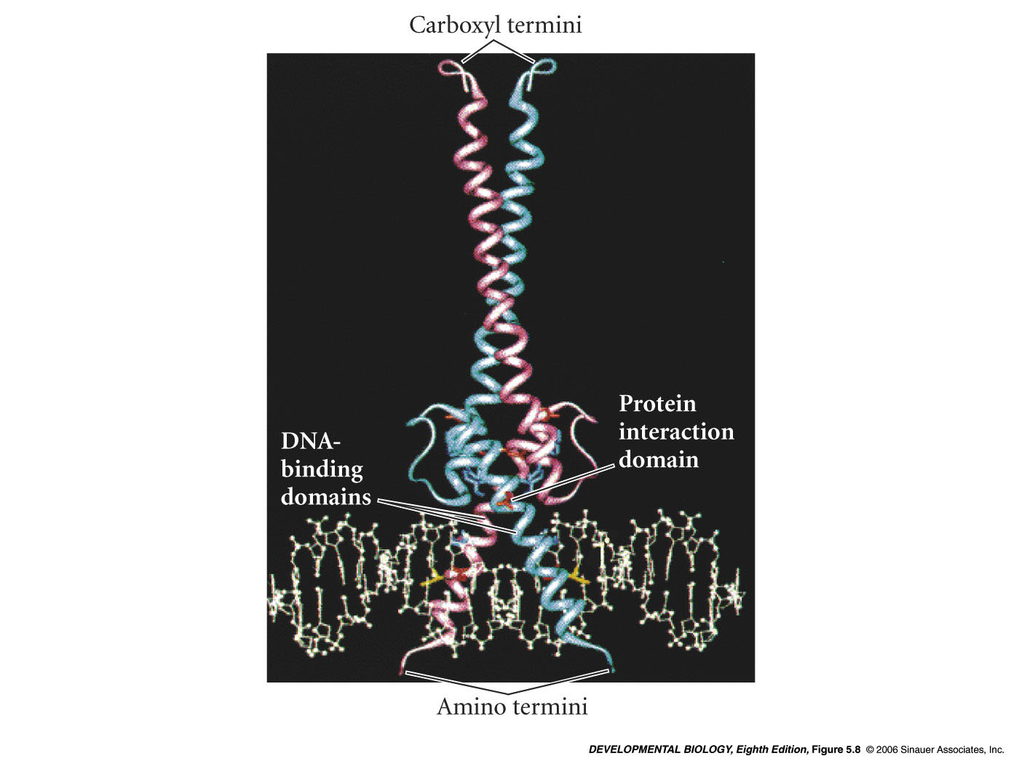
Transcription factors
3 domains:
DNA-binding domain
Trans-activating domain
Protein-protein interaction domain

Slide 18
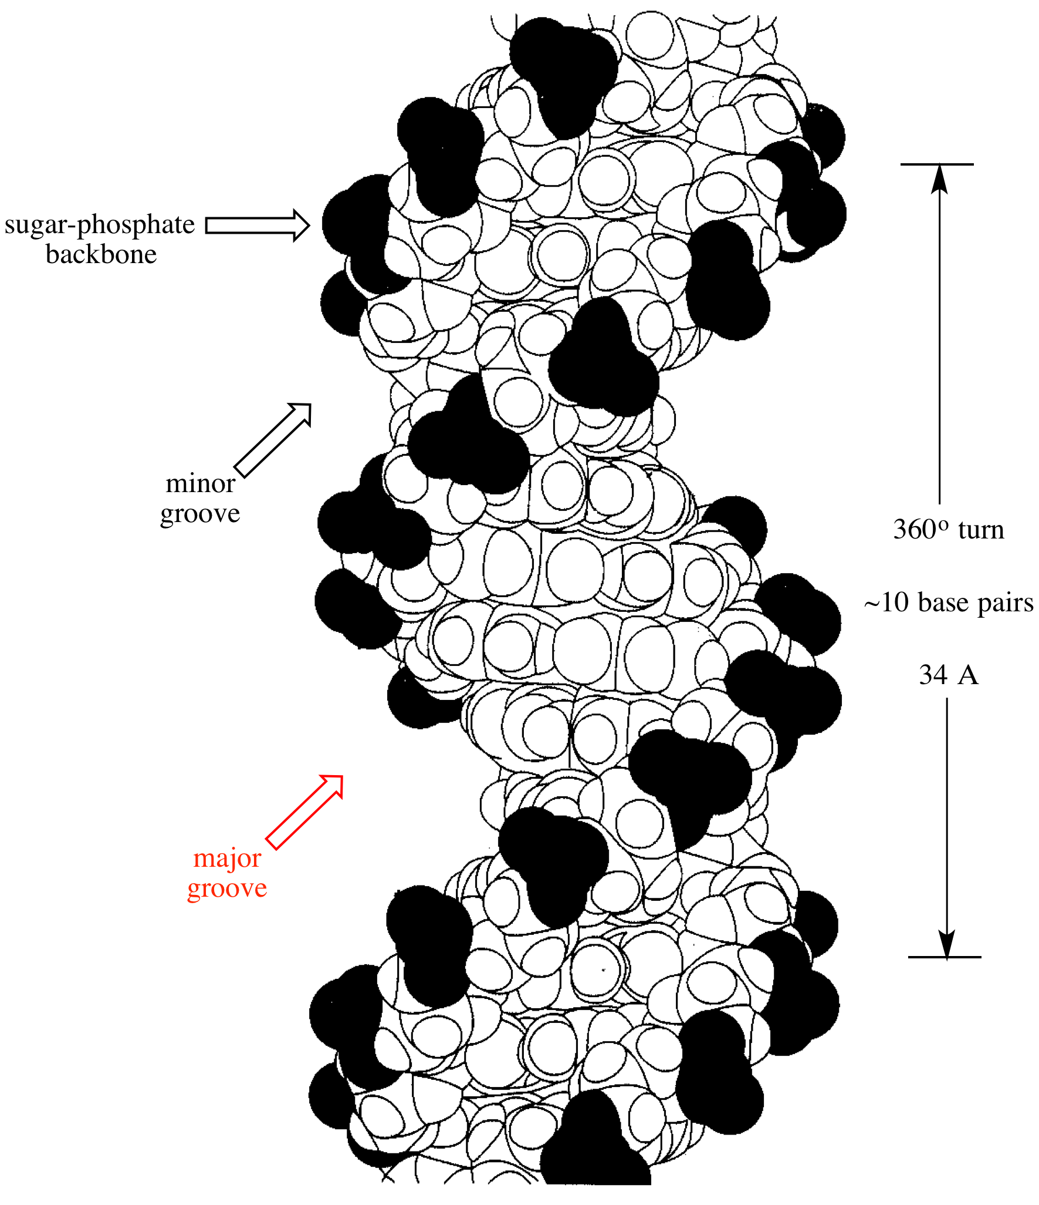
http://www.chem.ucla.edu/~harding/IGOC/M/major_groove.html

Slide 19
Microphthalmia protein (MITF)
basic helix-loop-helix (bHLH) family
3 functionally important domains:
1. Protein-protein interaction domain
Homodimerizes with another MITF protein then binds DNA
2. DNA-binding domain contains basic amino acids that contact DNA
3. Trans-activating domain - activates transcription

Slide 20
MITF
Trans-activating domain binds a protein called p300/CBP
p300/CBP is a histone acetyltransferase (HAT)
transfers acetyl groups to histone H3 in the nucleosome
destabilizes the nucleosomes
Genes become expressed

Slide 21
Required for production of pigments in eye and skin
MITF protein binds in the enhancer regions of
3 tyrosinase proteins - enzymes that make pigments in melanoblasts derived from the neural crest
Also active in ear and gut
MITF
A melanoblast is a precursor cell of a melanocyte. Melanoblasts migrate from the neural crest to skin and pigment the skin.

Slide 22
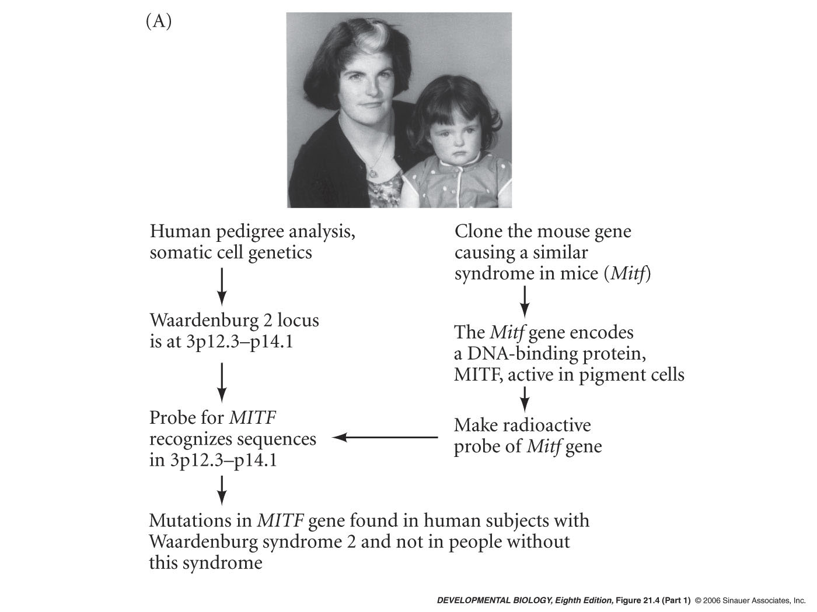
MITF
Waardenburg Syndrome
Deafness
Multicolored iris
White forelock
reduced peristalsis
Mutations found in the Human MITF gene

Slide 23
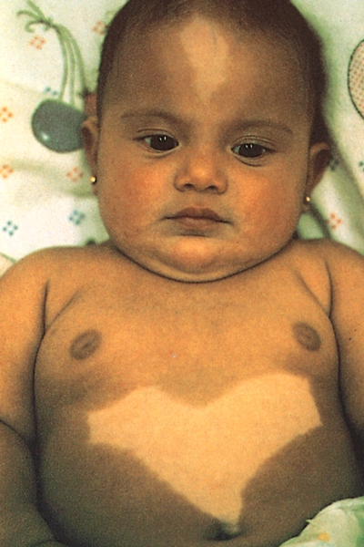
Piebaldism due to dominant mutation in a gene (KIT)
on the long arm of chromosome 4
Syndrome includes
anemia
sterility
unpigmented regions of the
skin and hair
deafness
Reduced peristalsis in the gut
Common feature -
KIT gene encodes a protein (receptor kinase) expressed in
neural crest cells and in the precursors of blood cells
and germ cells

Slide 24
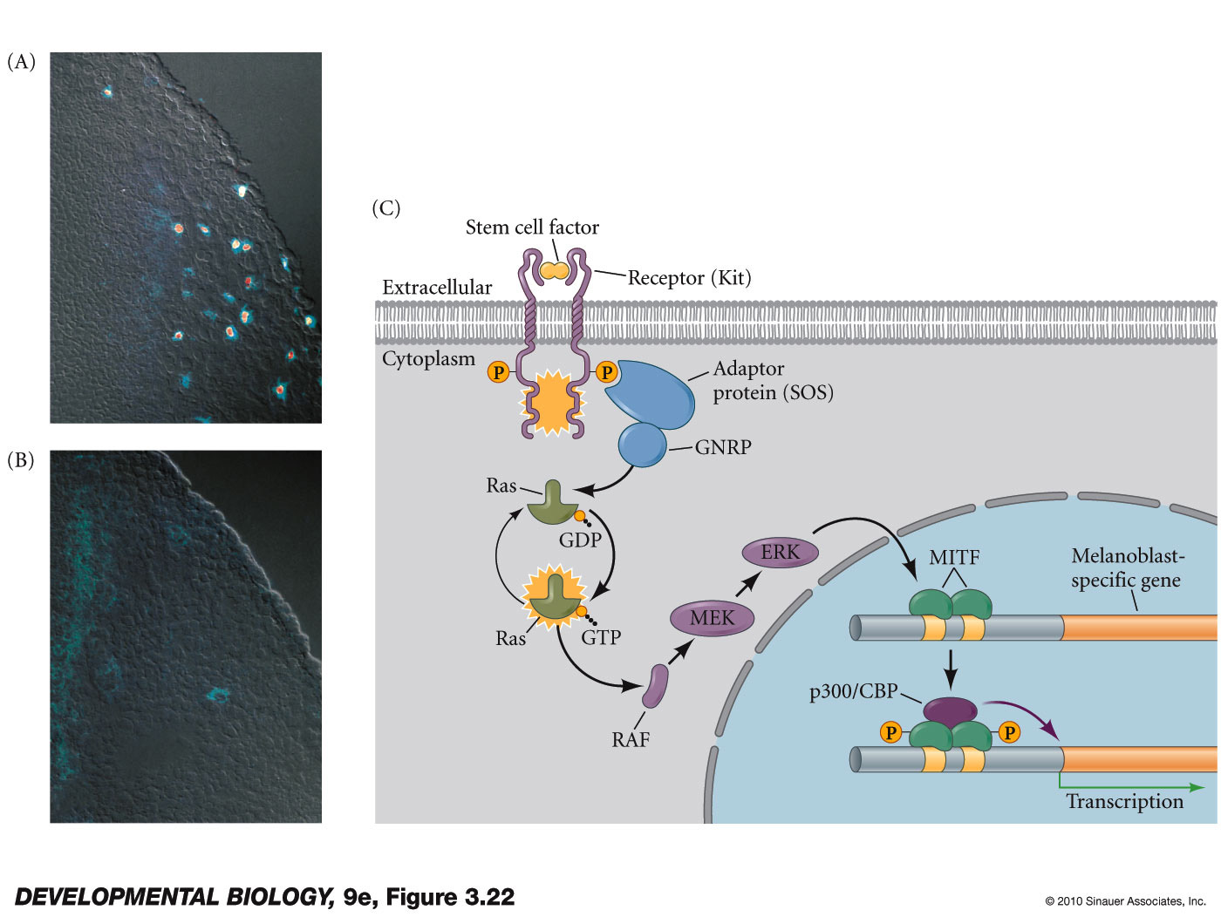
Activation of MITF transcription factor through the binding of stem cell factor by the Kit RTK protein
Notes:
DevBio9e-Fig-03-22-0.jpg

Slide 25
Additional Biochemical mechanisms to regulate gene expression

Slide 26
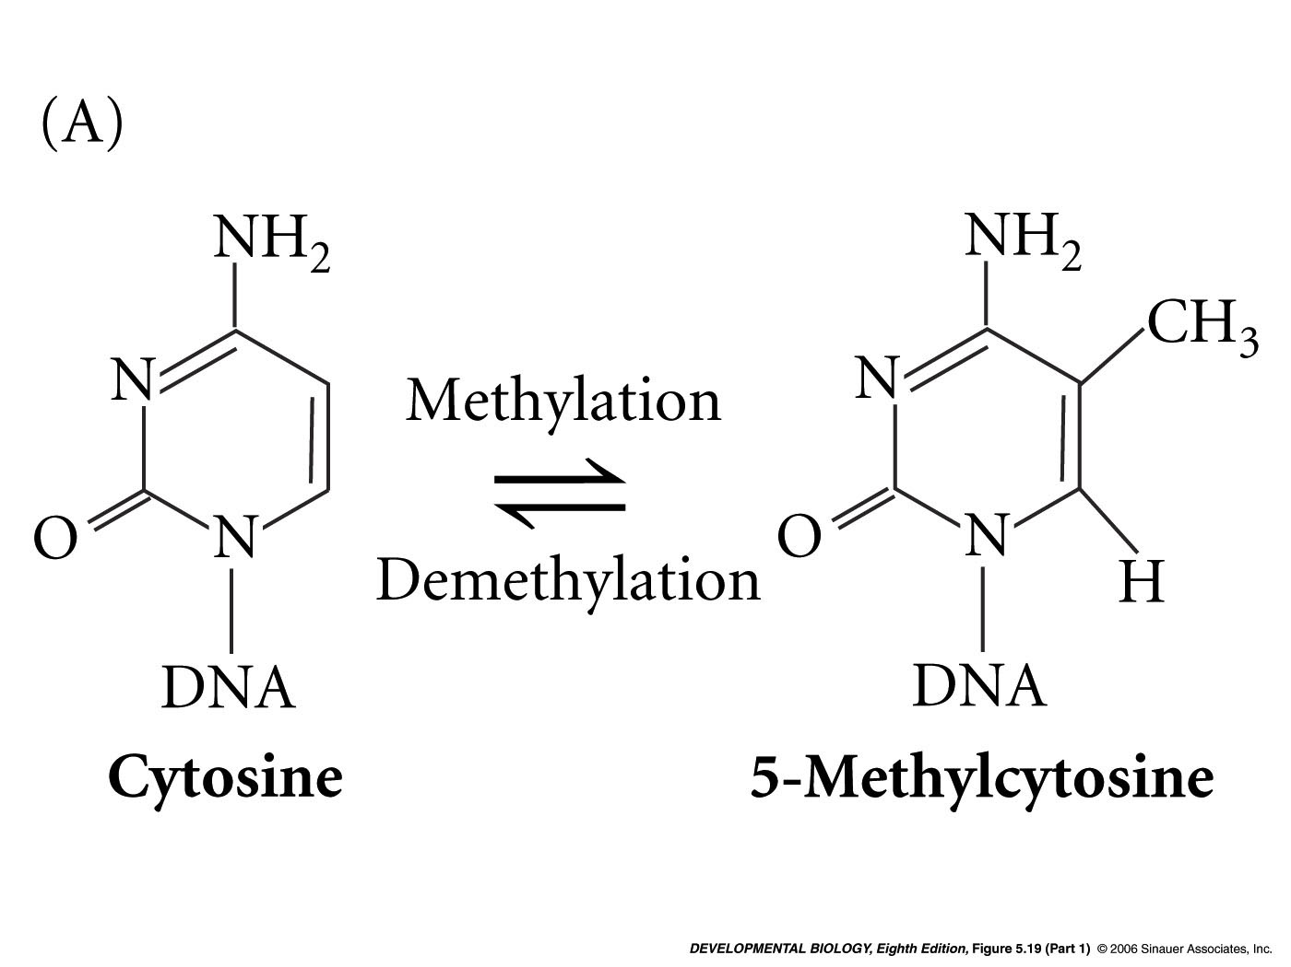
Methylation of DNA and transcription regulation
DNA methyltransferases

Slide 27
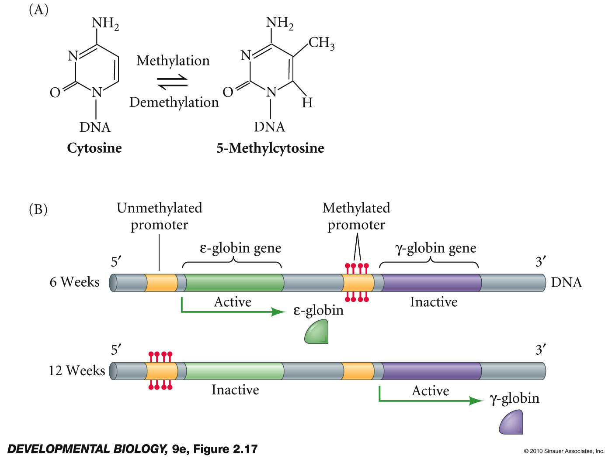
Methylation of globin genes in human embryonic blood cells
Notes:
DevBio9e-Fig-02-17-0.jpg

Slide 28
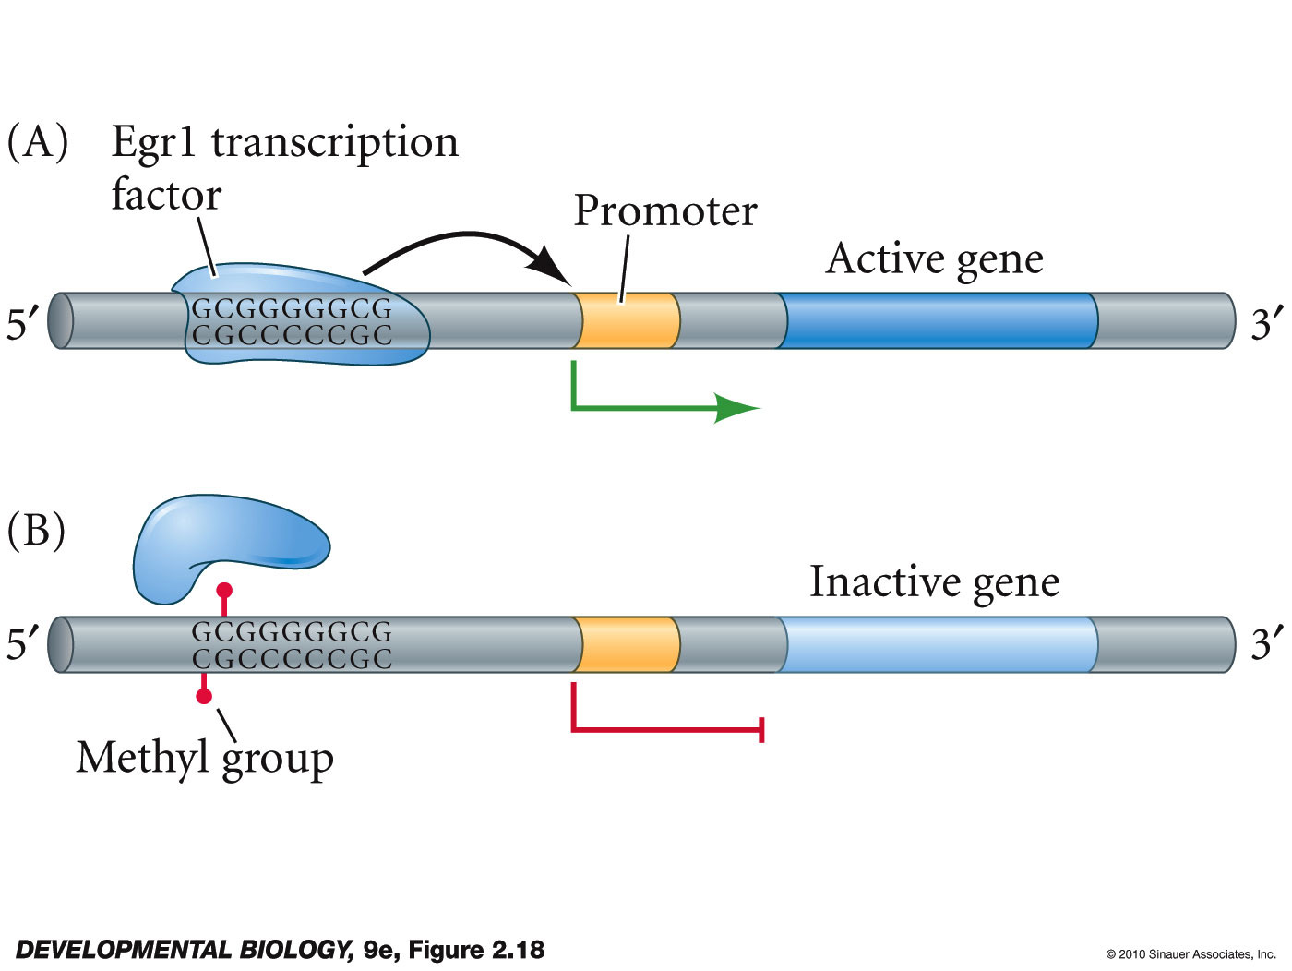
DNA methylation can block transcription by preventing transcription factors binding to enhancer region
Notes:
DevBio9e-Fig-02-18-0.jpg

Slide 29
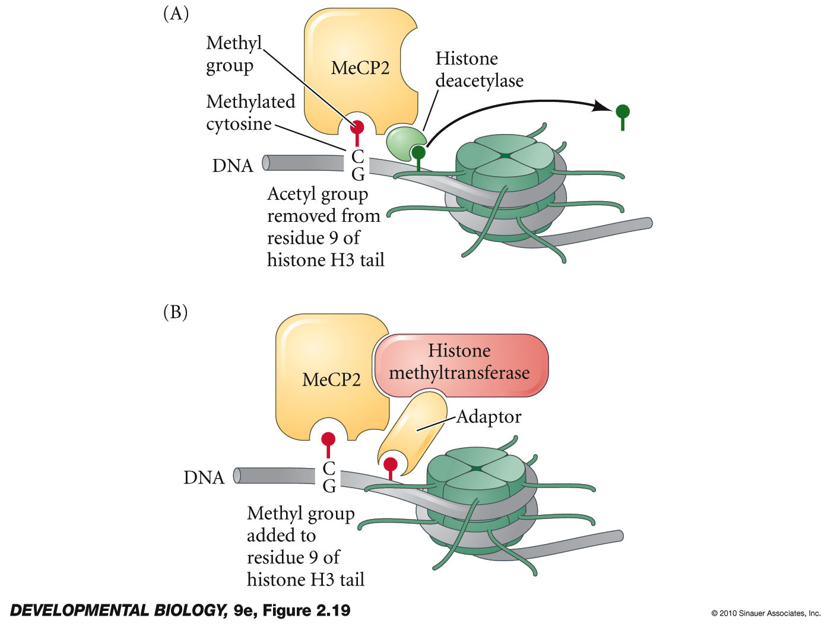
Methylated DNA can alter histone modifications -
Notes:
DevBio9e-Fig-02-19-0.jpg

Slide 30
It goes both ways: alterations of histones affects DNA methylation
K9H3 = Lysine residue in position 9 on Histone H3
If methylated by
histone methyl transferase
nucleosome stabilized
DNA methyl transferase attracted or stabilized
DNA is methlyated at CpG sites
transcriptional repression
If acetylated by p300/CBP (HAT)
nucleosome destabilized
transcriptional activation

Slide 31
Chapter 4 Figures–
Fig. 4.6 – Emily D.
4.15 – Aidan G.
4.24 – Brandon G.
4.25 – John H.
4.26 – Chinmaya J.
4.13 – Kerri K.
4.22 – Monty K.
4.23 – Nathan K.

Slide 32
Differential regulation via alternative splicing
generates increased diversity of gene products

Slide 33
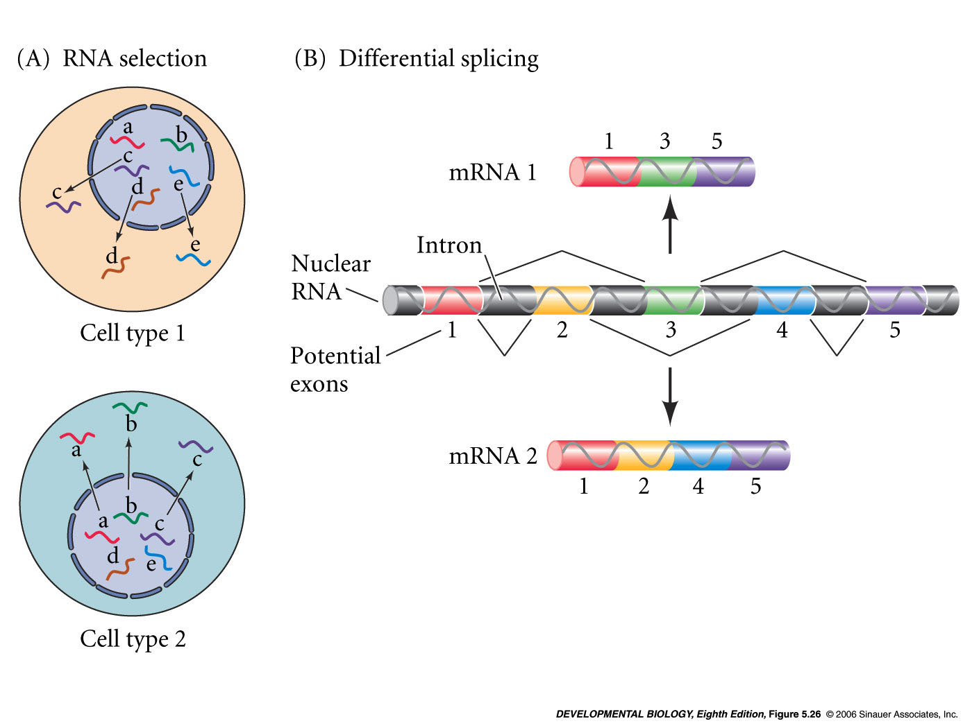
Differential Splicing
one gene makes two different mRNA molecules
nRNA is alternatively spliced
different protein coding sequences

Slide 34
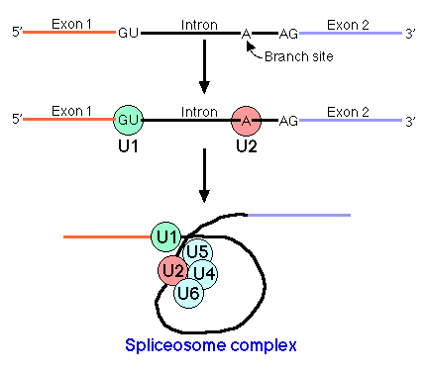
Spliceosomes
a complex of small RNAs and proteins
small nuclear RNA (snRNAs)
splicing factors (proteins)
recognize splice sites - conserved RNA sequences at the ends of the intron

Slide 35
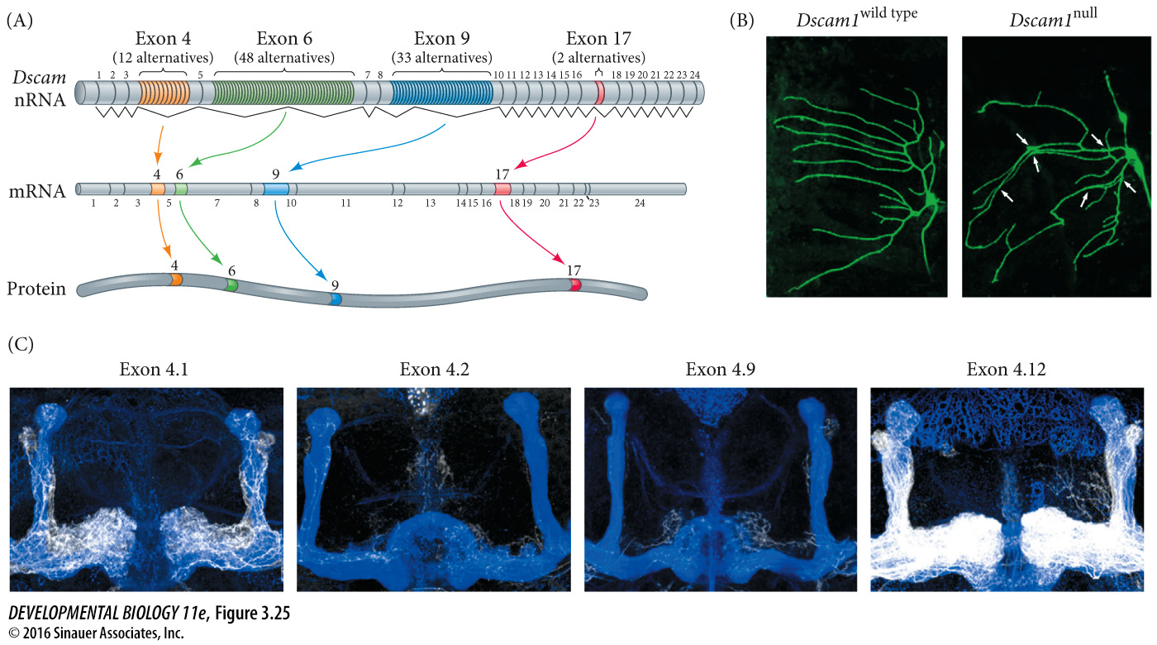
Fig. 3.25** The Dscam gene of Drosophila can produce 38,016 different types of proteins by alternative nRNA splicing
Notes:
DevBio9e-Fig-02-28-0.jpg

Slide 36
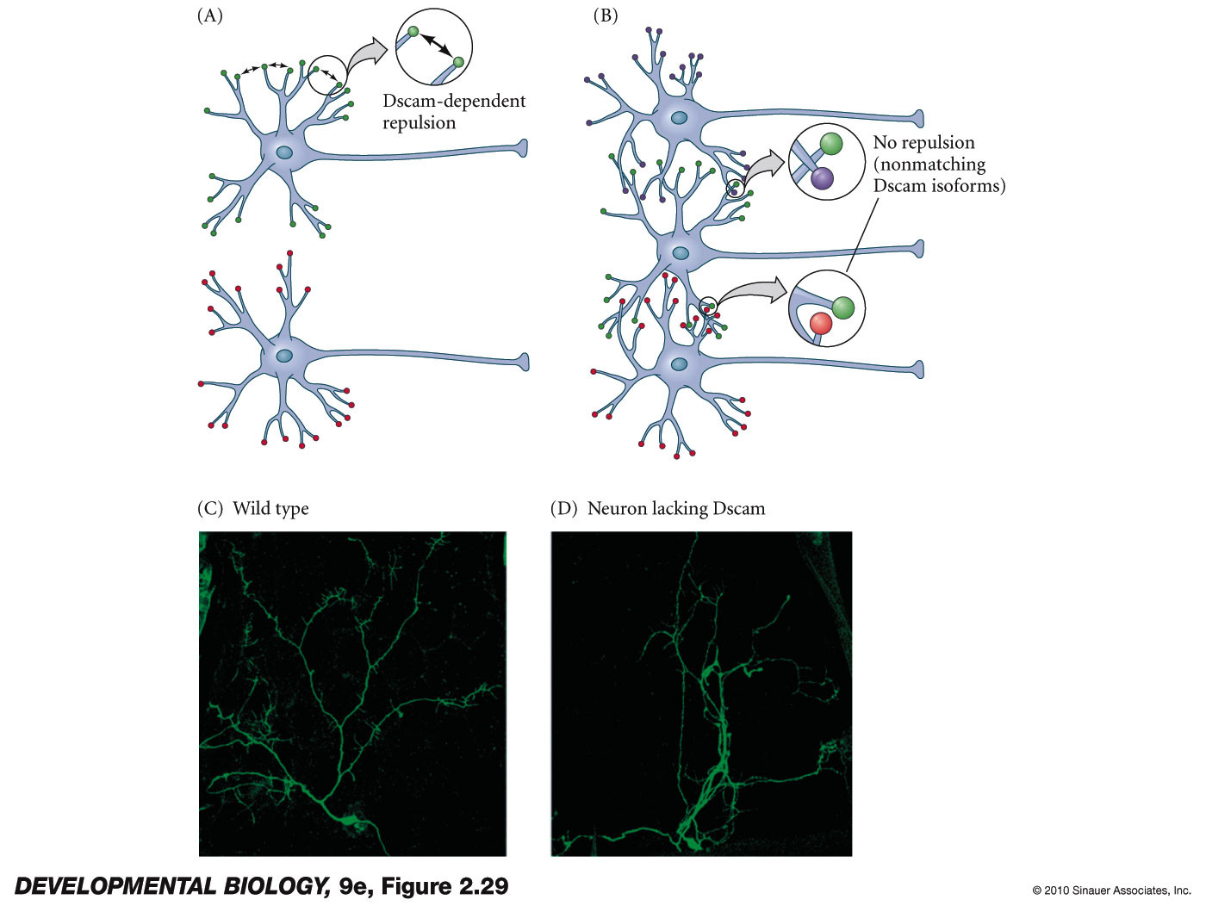
Dscam protein is specifically required to keep dendrites from the same neuron from adhering to each other
Notes:
DevBio9e-Fig-02-29-0.jpg

Slide 37
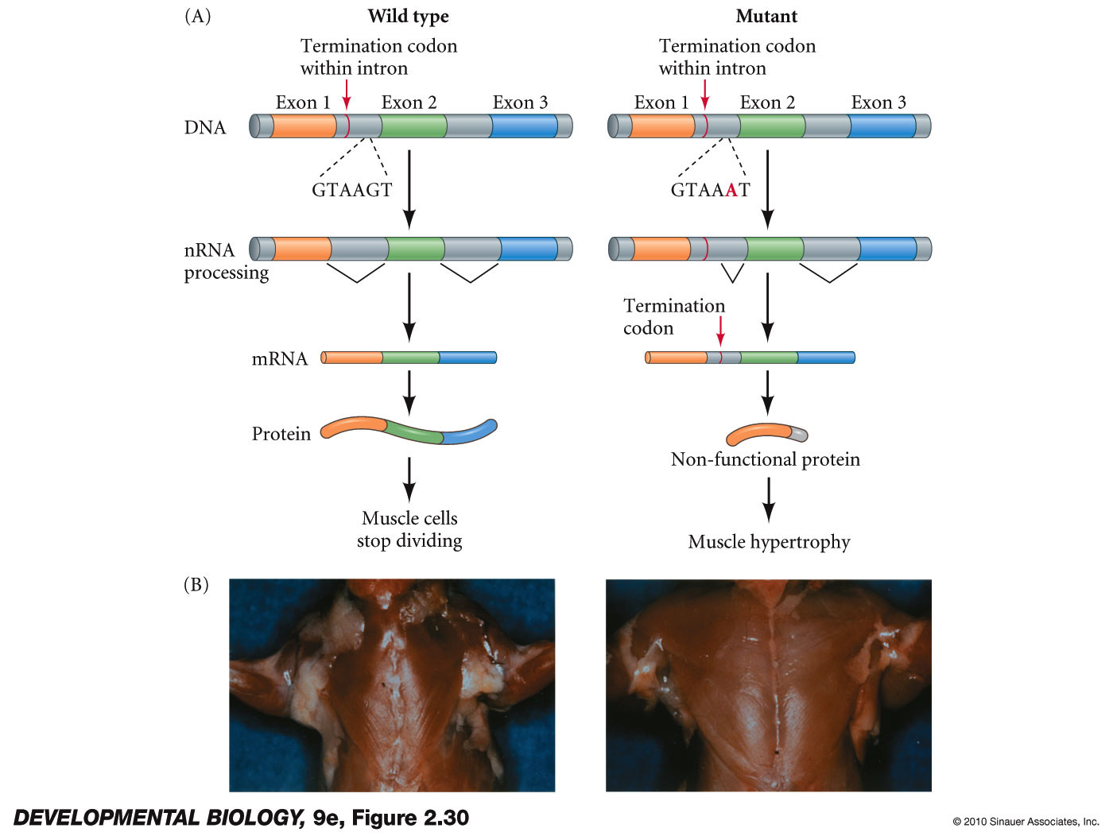
Splice site mutations
Fig 3.26**

Slide 38
Regulation of mRNA stability

Slide 39
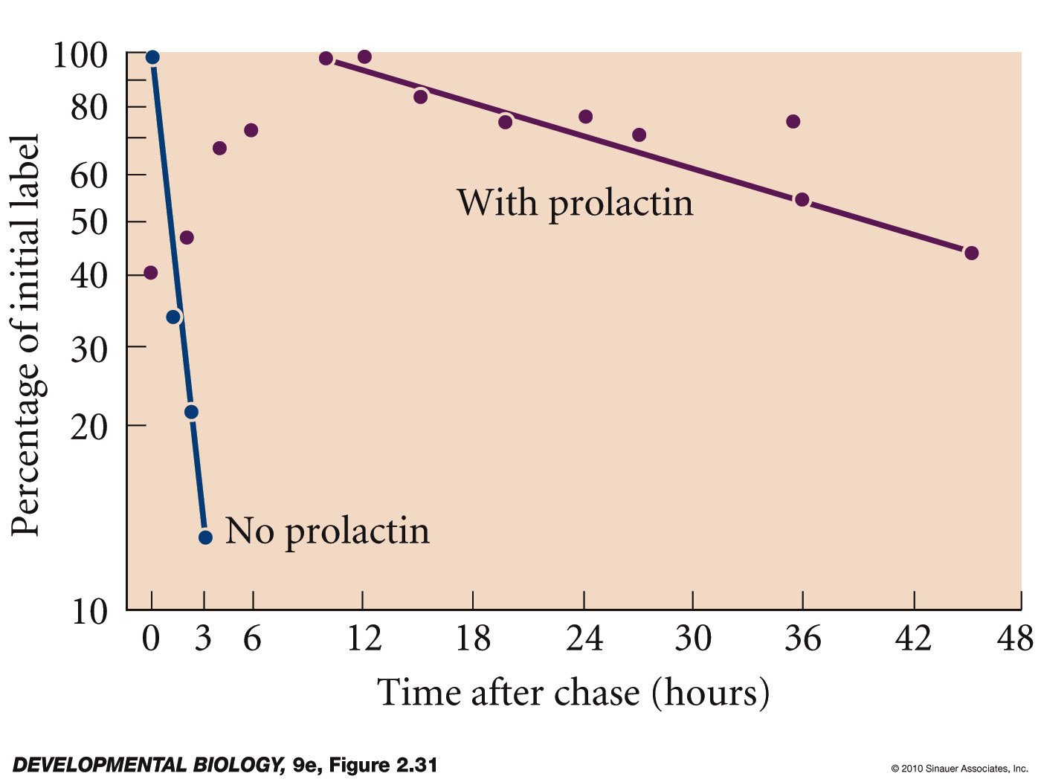
Regulation of mRNA stability – fig 3.27 **
casein mRNA (encodes milk protein)
cultured rat mammary cells - pulse/chase experiment
http://www.sumanasinc.com/webcontent/animations/content/pulsechase/pulsechase.html

Slide 40
Regulation of mRNA stability
stability of message often depends on polyA tail length
and on sequences in the 3’UTR

Slide 41
Regulation of Translation

Slide 42
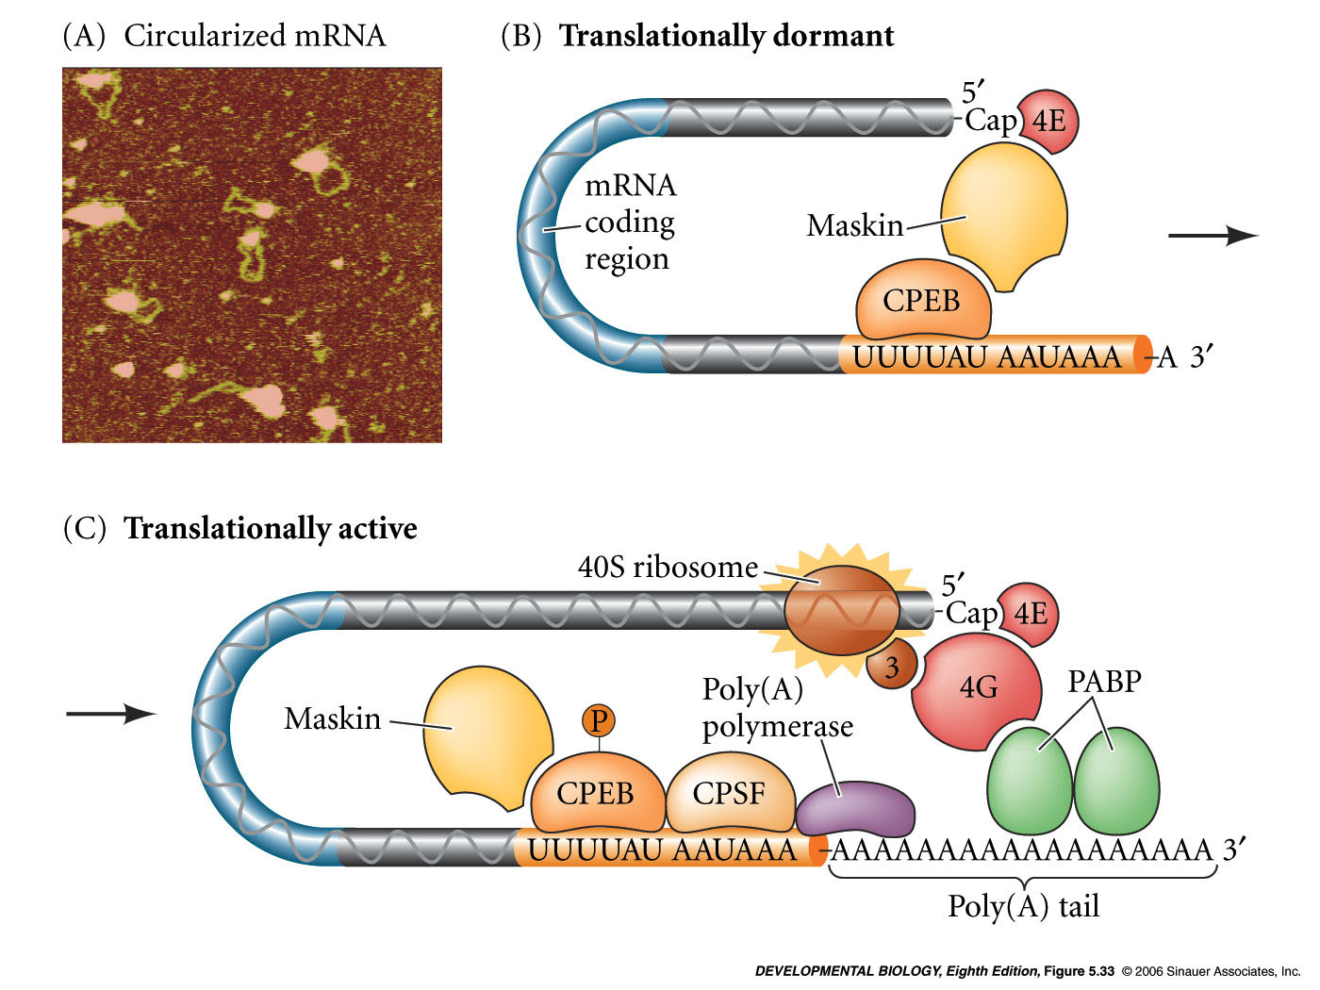
Regulation of Translation
mRNA molecules are often circular
eIF4E - eukaryotic initiation factor-4E binds the 5 prime 7-methylguanosine cap
eIF4G - scaffold or linker protein
PolyA binding protein - (PABP)
eIF4E
eIF4G
PABP
5’CAP
3’polyA
UAA
AUG

Slide 43
Translation
Small ribosomal subunit 40S RNA - scans for AUG
Initiation tRNA charged with Methionine
60S ribosomal unit
eIF4E
eIF4G
PABP
5’CAP
3’polyA
40S
UAA
AUG
60S
UAC

Slide 44
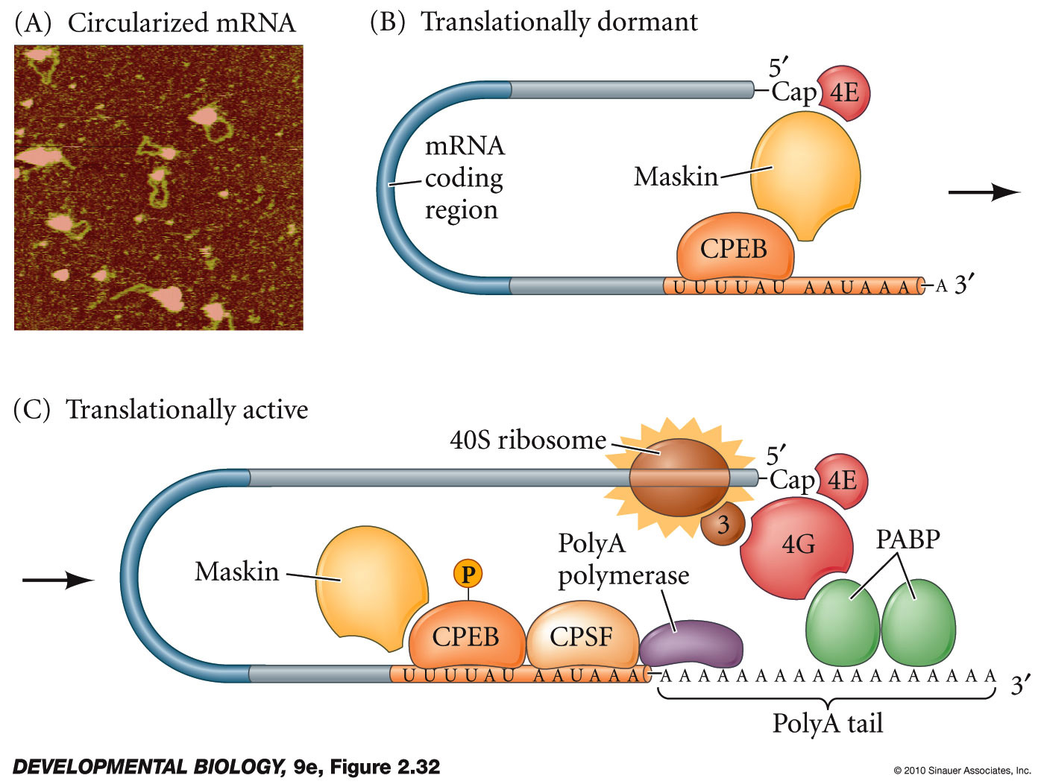
Figure 3.29** Translational regulation in oocytes
Notes:
DevBio9e-Fig-02-32-0.jpg

Slide 45
microRNAs
microRNAs (miRNAs) regulate gene expression at level of translation or message (mRNA) stability

Slide 46
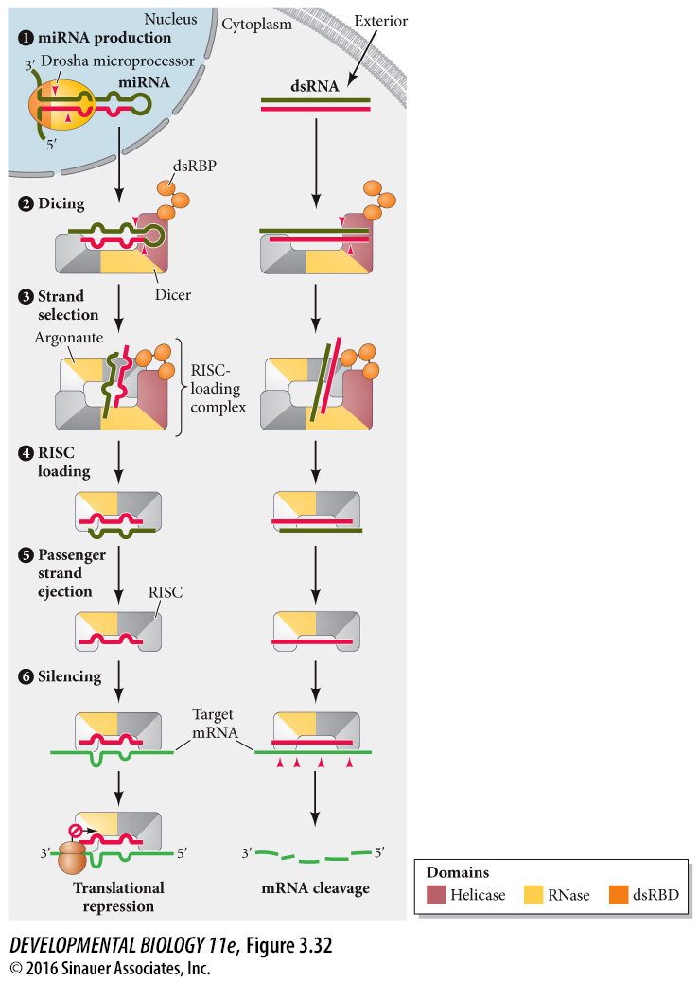
Figure 3.32** Current model for the formation and use of microRNAs and siRNAs
Notes:
DevBio9e-Fig-02-35-0.jpg

Slide 47
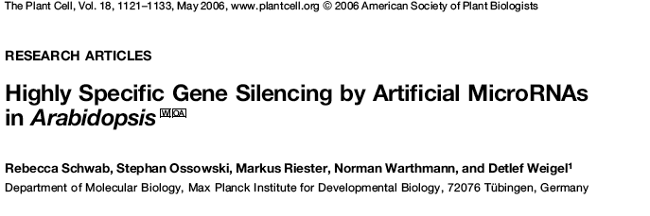
Artificial miRNA

Slide 48
Method to study enhancer elements
Reporter genes

Slide 49
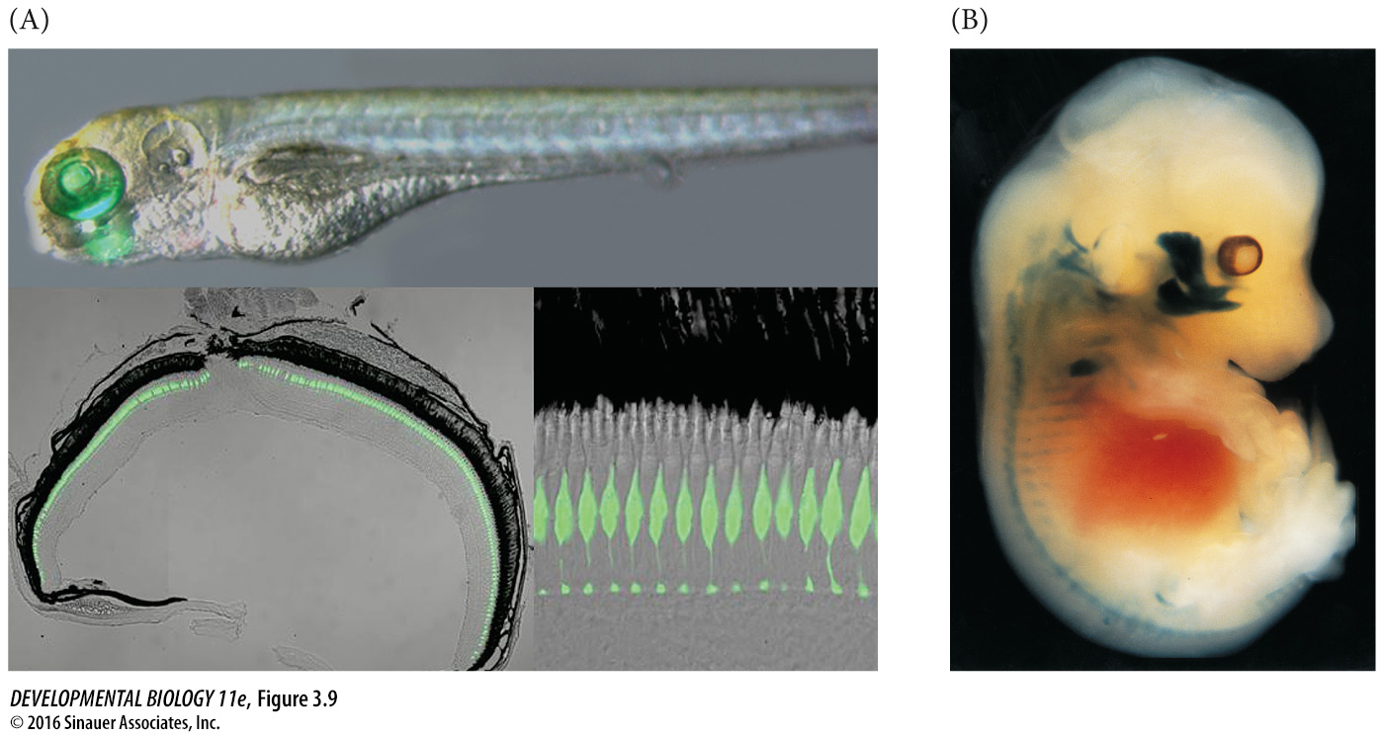
Fig 3.09**

Slide 50
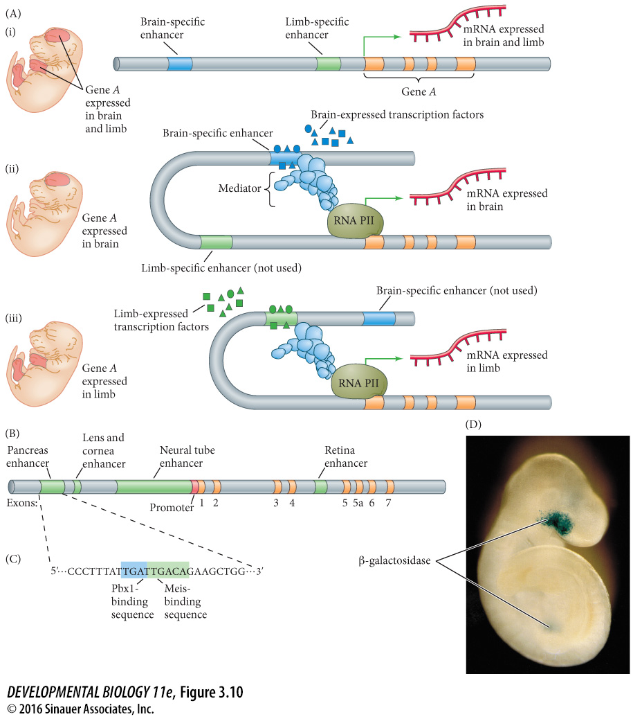
Fig 3.10**

Slide 51
Enhancers
Modular - One gene can have several enhancer sites
for different sets of cells (Pax6 enhancer elements)
Combinatorial - Many transcription factors can bind
each enhancer (somatostatin enhancer elements)
Enhancers can inhibit transcription
Negative enhancers = silencers

Slide 52
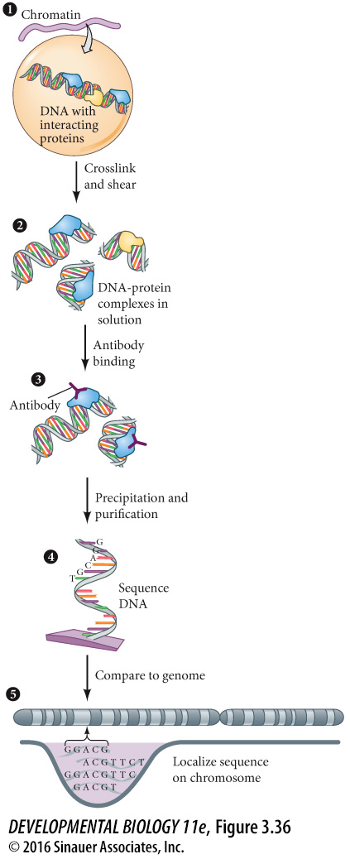
Methods to study transcription factors and transcriptional regulation
DNA Binding assay
Chromatin Immunoprecipitation “ChIP” Assay

Slide 53
Pax6
Needed for eye, nervous system and pancreas development
Binding sites for Pax6 found in enhancers of crystallin genes - proteins in the eye lens
Known as “eyeless” in Drosophila due to mutant phenotype - loss of eyes during development

Slide 54
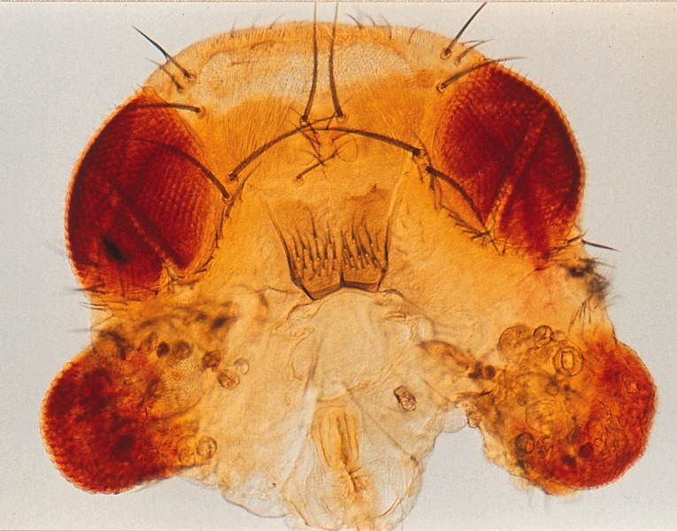
Ectopic expression assay
Experimentally cause ectopic expression of Pax6 in the imaginal discs that normally generates mouth parts
Normal eyes
extra “eyes”
Replace mouth parts

Slide 55
Genetic Mapping
Types of maps???
Methods to make maps???
SNPs – single nucleotide polymorphisms
Haplotype – a set of SNPs that are close to each other on the chromosome and thus most often inherited together.

Slide 56
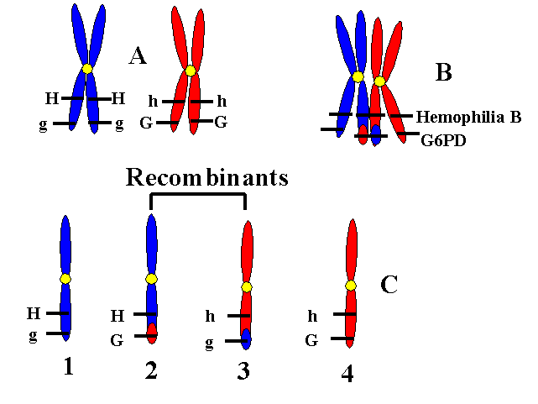
Large majority of progeny have these
Small percentage of progeny have these chromosomes
https://www.uic.edu/classes/bms/bms655/lesson12.html

Slide 57
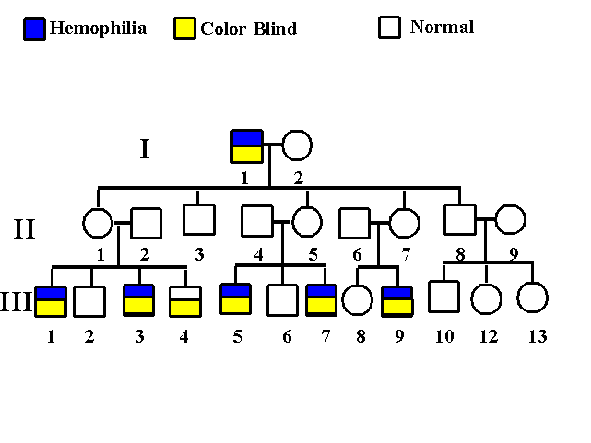
https://www.uic.edu/classes/bms/bms655/lesson12.html

Slide 58
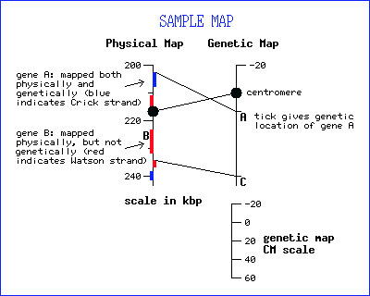
Physical map (distances are in bases or megabases 10⁶ bases)
A map of the locations of identifiable landmarks on DNA (e.g., restriction-enzyme cutting sites, genes, or specific sequences, Giemsa staining bands), regardless of inheritance. Distance is measured in base pairs. For the human genome, the lowest-resolution physical map is the banding patterns on the 24 different chromosomes; the highest-resolution map is the complete nucleotide sequence of the chromosomes.
Definition adapted from: Human Genome Project Information at the U.S. Department of Energy
http://web.ornl.gov/sci/techresources/Human_Genome/glossary.shtml
http://wiki.yeastgenome.org/index.php/Combined_Physical_and_Genetic_Maps_of_S._cerevisiae

Slide 59
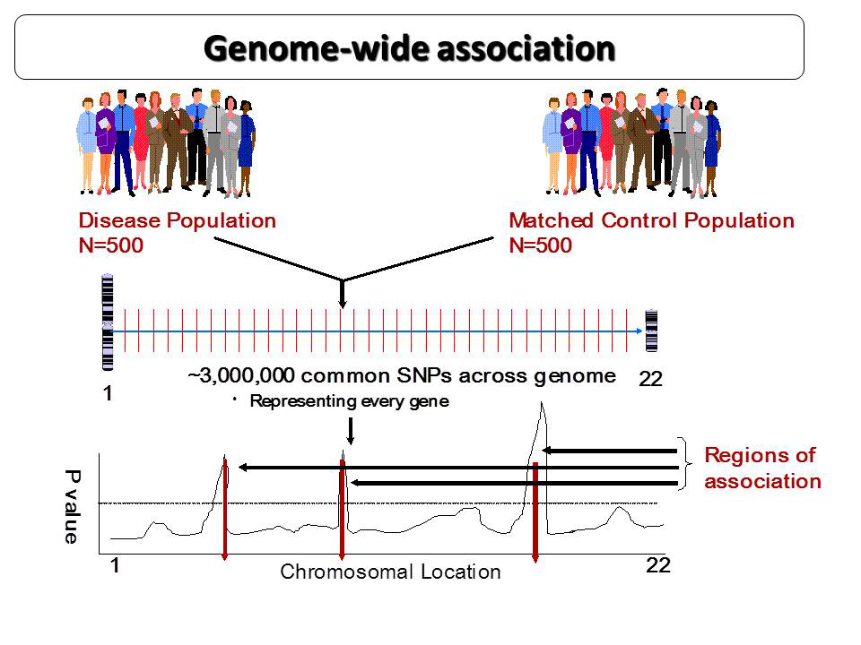
Line of statistically significance
http://www.cincinnatichildrens.org/assets/0/9823/9824/9839/9932/9933/10567/12239/12722/c9ab3a3b-a9c0-4cad-a34a-4c72d30218f1.jpg

Slide 60
Very basic info on genetic linkage mapping from NIH –
https://www.genome.gov/10000715
Association mapping and Haplotype/HAPMAP
http://www.genome.gov/10001665
Wikipedia page describing the HapMAp effort
https://en.wikipedia.org/wiki/International_HapMap_Project

Slide 63
Stem Cell Biology and DNA Methylation
methylation during differentiation
pluripotent cells of the inner cell mass - very limited methylation of DNA
later multipotent, progenitor and mature somatic cells - more methylation of DNA
methylation marks need to be ignored or removed (reprogramming) for cloning from adult cells to work

Slide 64
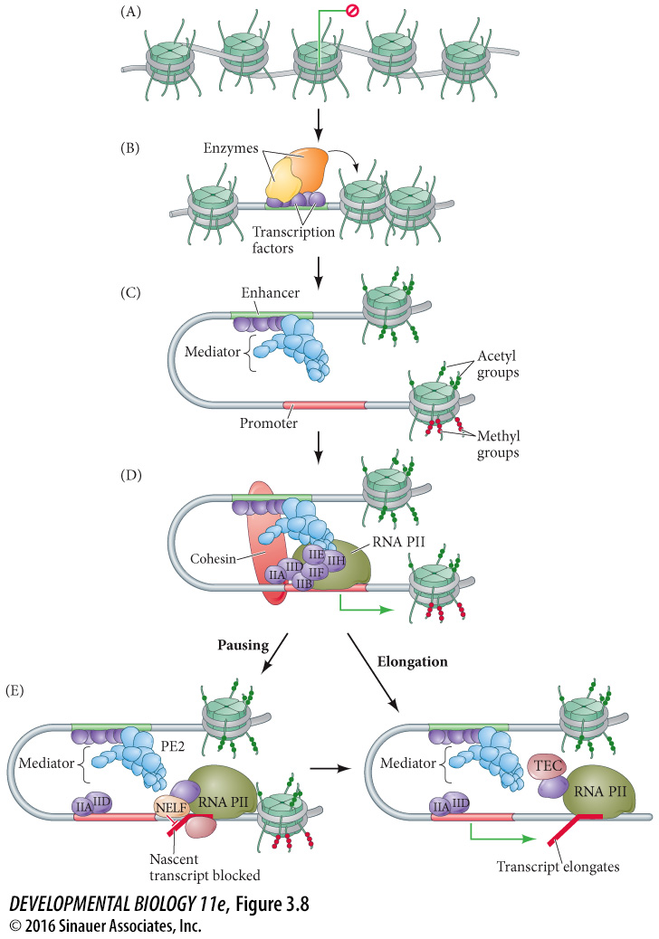
Pre-initiation complex
Transcription elongation complex (TEC)

