Slide 1
Chapter 4 Figures–
Fig. 4.6 – Emily D.
4.15 – Aidan G.
4.24 – Brandon G.
4.25 – John H.
4.26 – Chinmaya J.
4.13 – Kerri K.
4.22 – Monty K.
4.23 – Nathan K.

Slide 2
Chapter 4
Cell Adhesion
Cell Signaling (Induction)
Cell Migration

Slide 3
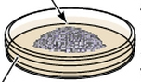
Reaggregation experiments
Townes and Hoftreter 1955
  Dissociated amphibian tissues with alkaline solution
  Combined 2 or more cell suspensions
  then normalized the pH
  Cells adhered to each other and formed aggregates on
  agar-coated petri dishes

Slide 4
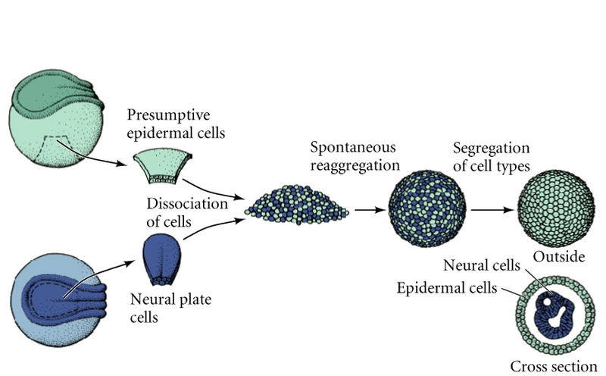
Reaggregation of cells from amphibian neurulae
after formation of neural tube cell suspensions mixed
separation of epidermal and neural cells

Slide 5
Reaggregation results
1. Reaggregated cells become spatially segregated
(true also for the three different germ layers)
  2. Final positions of the reaggregated cells reflect
their embryonic positions
  3. Selective affinities must change over developmental time

Slide 6
Differential adhesion hypothesis
Cells interact to form an aggregate with the smallest
interfacial free energy
the most thermodynamically stable
lower surface tension moves to the outside layers

Slide 7
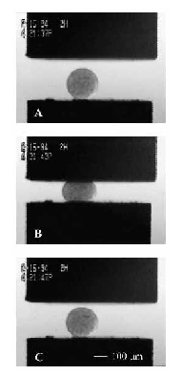
Testing differential adhesion hypothesis
Spherical heart aggregate before compression
Foty et al., 1996
Measuring surface tensions of different reaggregated tissues
Initiation of compression
Released after compression
behaves as an elastic solid springing back to its original shape

Slide 8
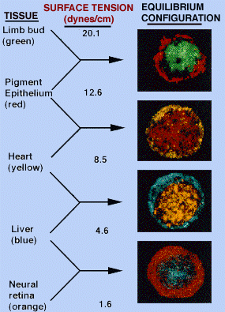
Hierarchy of cell sorting in order of decreasing surface tensions
After Foty et al., 1996
Colors assigned by computer

Slide 9
The thermodynamic model of cell interactions
Boundaries between tissues can by created both by
(1) Different cell types having different types of cell
adhesion molecules
and
  (2) Different cell types having different amount of cell
  adhesion molecules
    cadherins = major cell adhesion molecules
      Calcium-dependent adhesion molecules

Slide 10
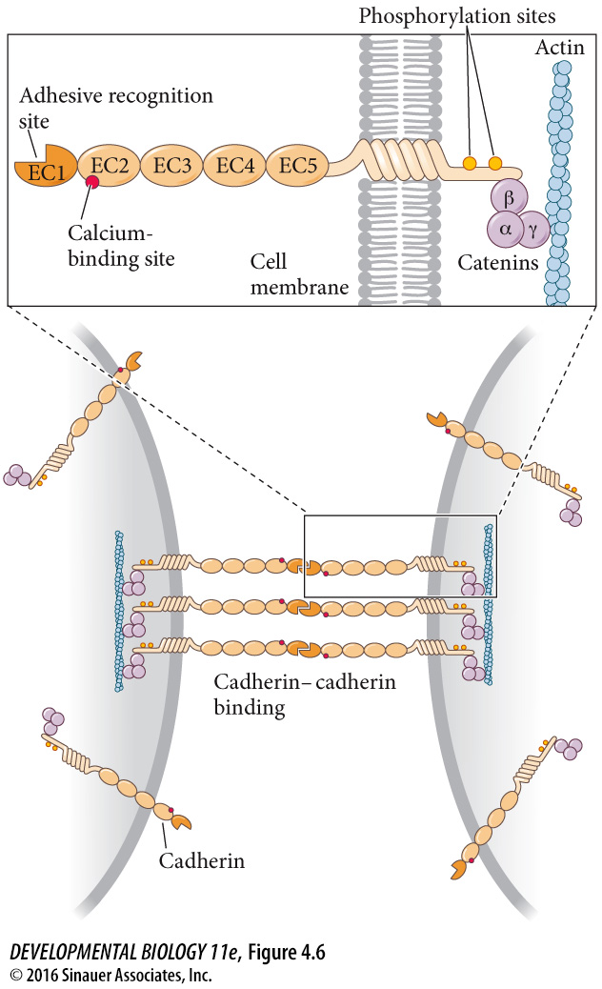
Cadherins – figure 4.6** -

Slide 11
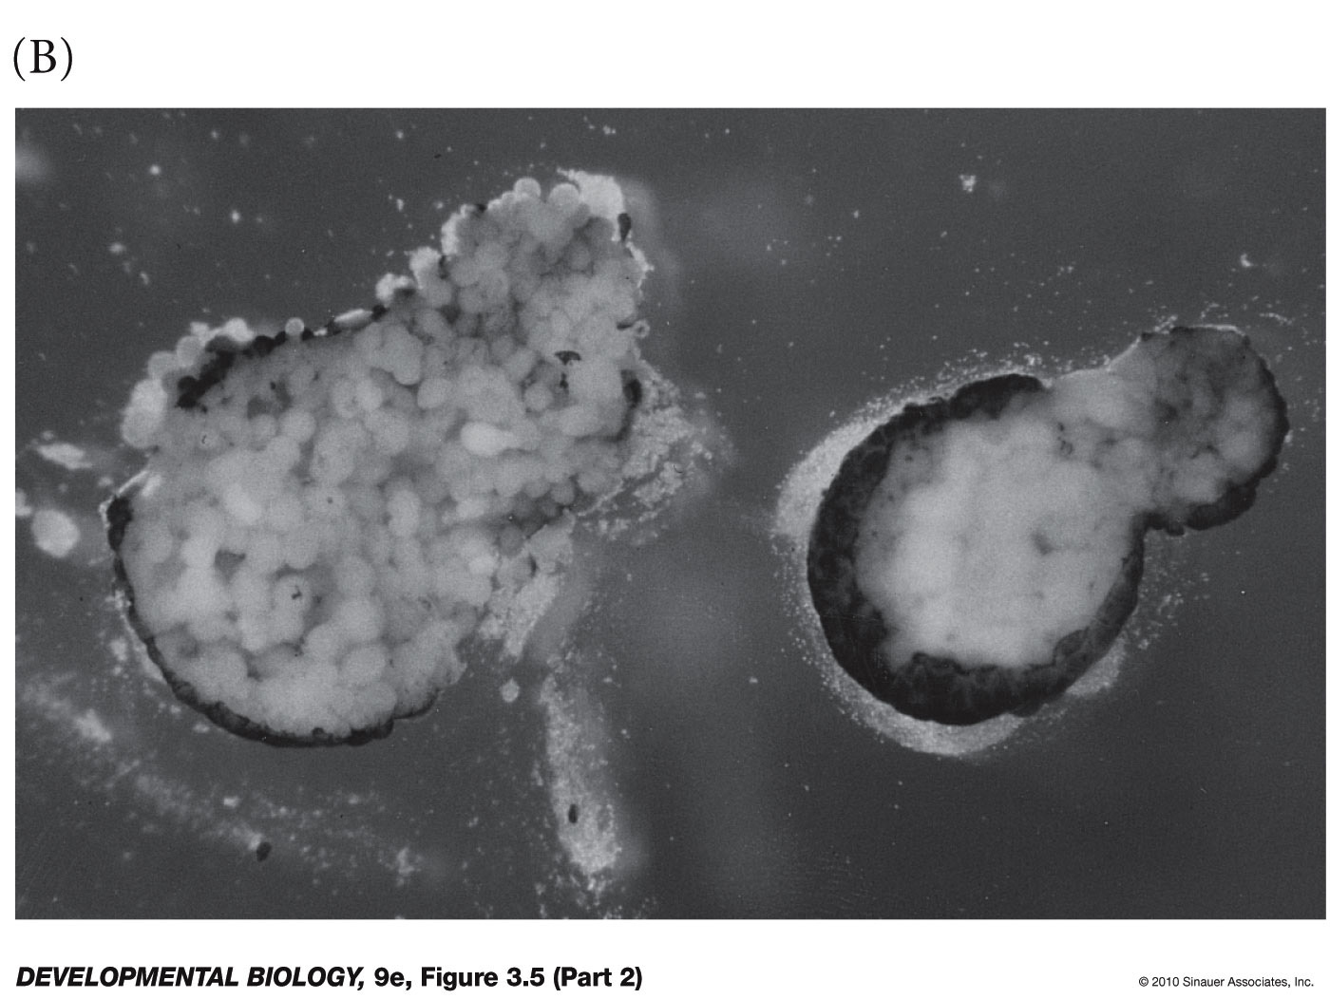
Cadherin mediated cell adhesion in amphibian embryo
Morpholinos –
antisense oligonucleotide complementary to a mRNA molecule

Slide 12
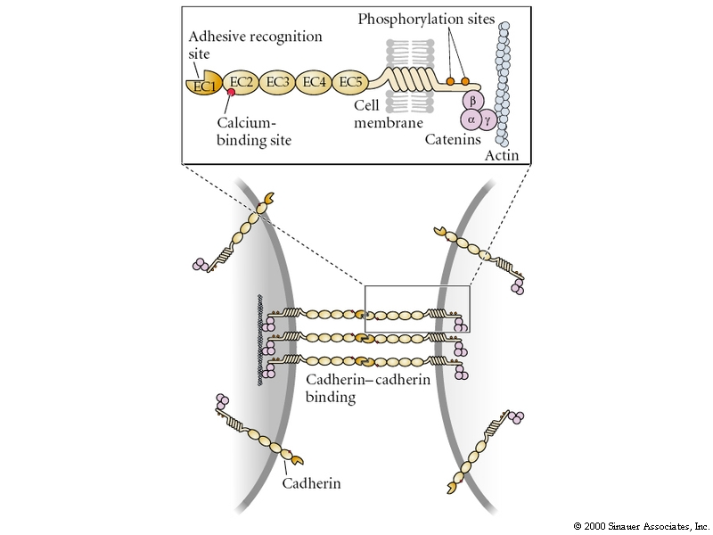
Cadherins
    establish and maintain intercellular connections
    spatially segregate cell types and
      organize animal form
      Anchored by catenins
      Form adherens junctions
      Catenins bind to actin cytoskeleton
      integrate epithelial cells together into
      a mechanical unit

Slide 13
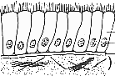
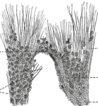
Induction between Epithelial and Mesenchymal cells
Epithelial cells are
tightly connected
to one another in
sheets or tubes
Mesenchymal cells are
unconnected to one another and
operate as semi-independent units

Slide 14
Cadherins
E-cadherin – epithelial
expressed on all early mammalian embryonic cells
even at 1-cell stage
Later, restricted to epithelial cells
P-cadherin- placental
expressed primarily on trophoblasts
(placental cells that contact the uterine wall)
and on the uterine wall epithelia
facilitates connection of embryo to uterus

Slide 15
Cadherins
N-cadherin – neural
1st seen on mesodermal cells in gastrulating embryo
as they lose their E-cadherin expression
Highly expressed on central nervous system cells

Slide 16
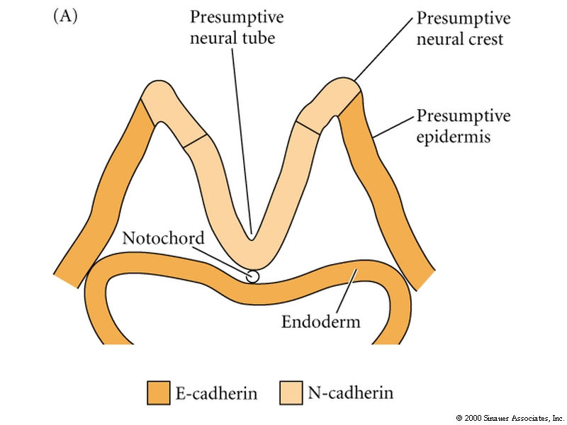
2 cadherins during formation of the mouse
neural tube
Xenopus gastrula
N-cadherin
E-cadherin
epidermis
neural tube

Slide 17
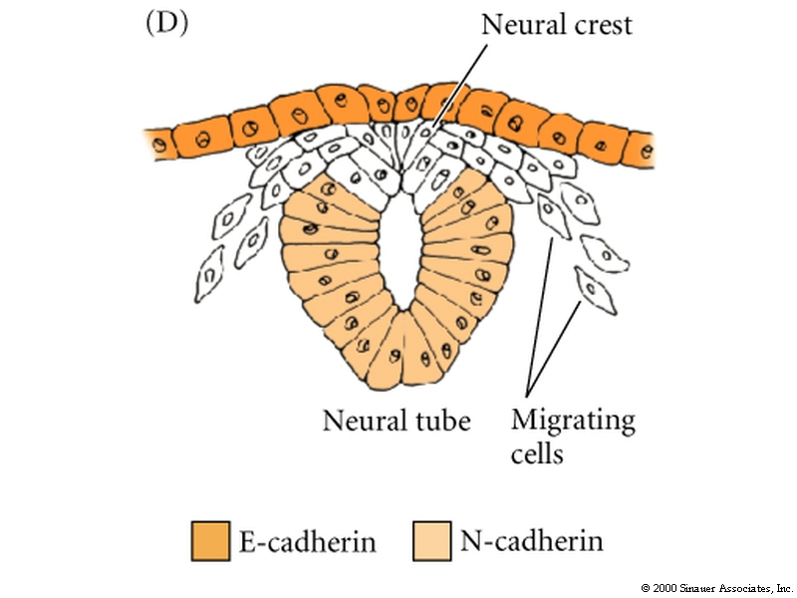
2 cadherins during formation of the mouse
neural tube
neural tube inside
and epidermis
covers the body
E-cadherin
N-cadherin

Slide 18
2 cadherins during formation of the mouse
neural tube
Remove E-cadherin from the epidermis
epidermal epithelium falls apart
E-cadherin
Express N-cadherin in epidermis
or eliminate it in neural cells
Then neural tube will not separate
from the epidermis
N-cadherin

Slide 19
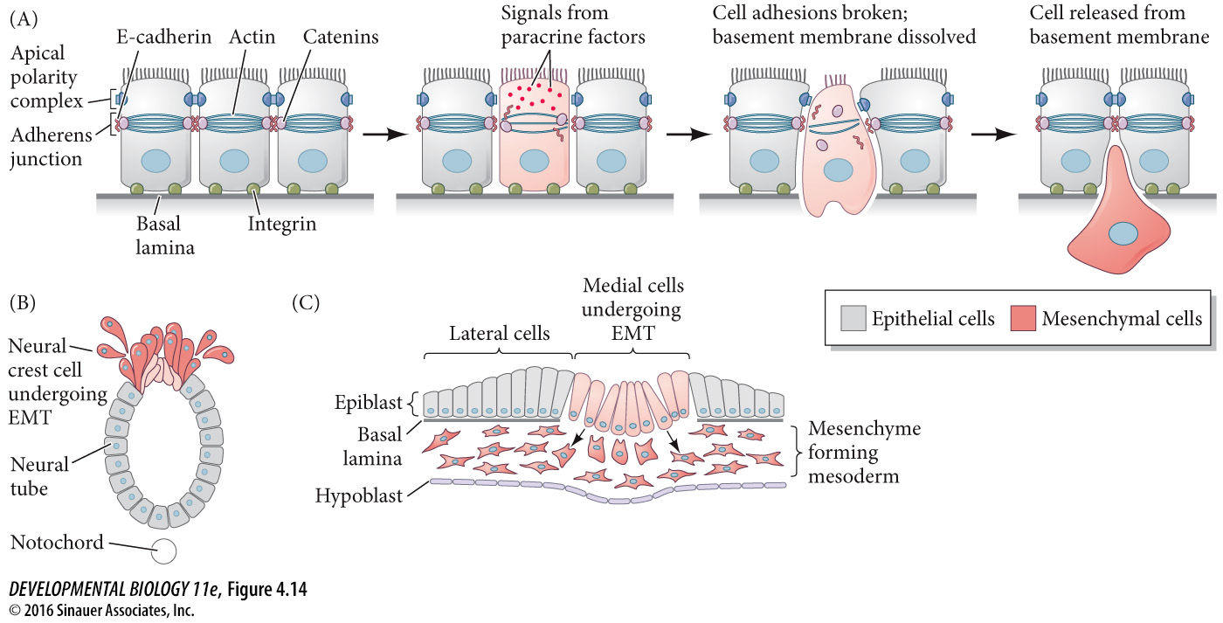
Epithelial to Mesenchymal transitions

Slide 20
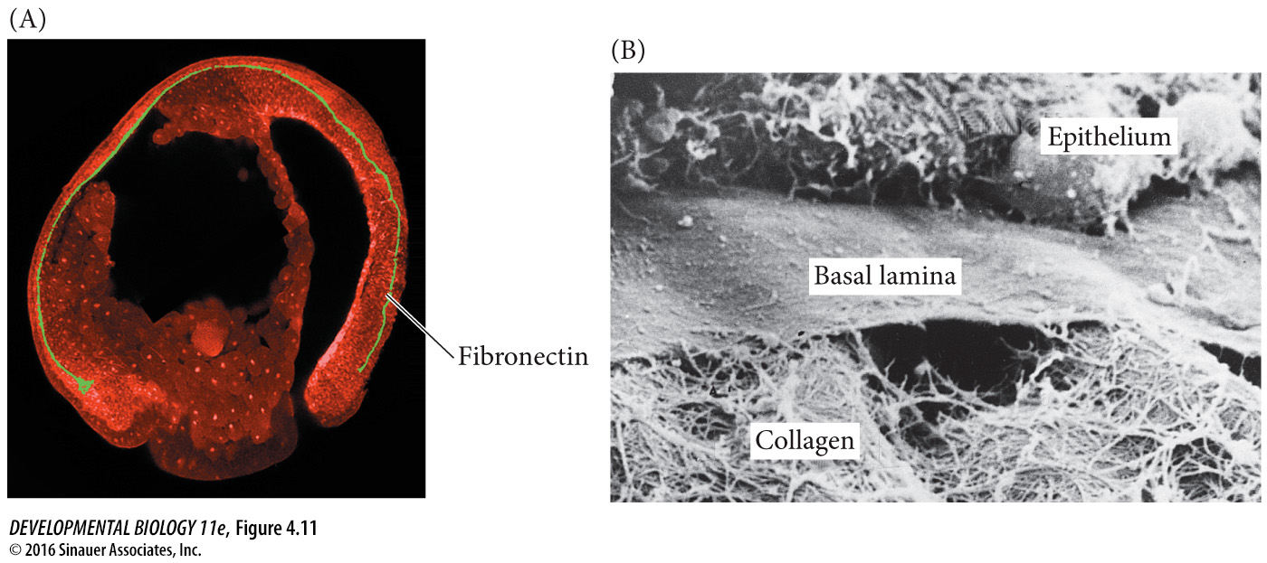
Extracellular Matrix
1) Collagen
2) Protoglycans – Heparan Sulfate – binds and concentrates paracrine factors
3) Glycoproteins – Fibronectin and Laminin
Fibronectin – orient the movement of migrating cells
Laminin and Type IV collagen – make up the basal lamina – underlies epithelial sheets

Slide 21
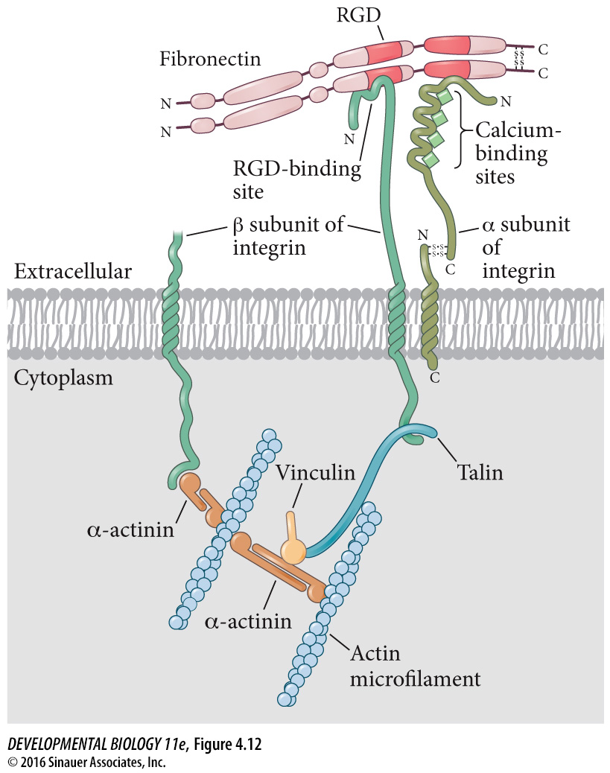
Integrins
Receptors for ECM molecules
Integrins bind to “RDG” motif common in ECM proteins
Interact with actin cytoskeleton
Important for
Cell migrations
Cell shape changes
Cell Fate

Slide 22
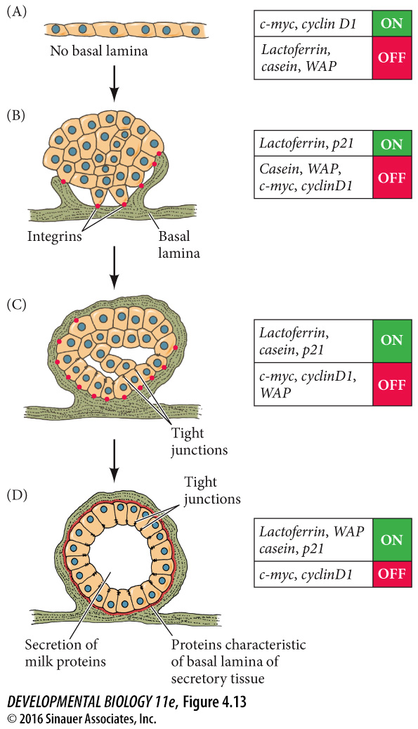
** - 4.13
Interaction of Basal Lamina with Integrins is important for differentiation and organogenesis

Slide 24
Induction
Induction – one group of cells changing the behavior of an
adjacent set of cells
causing them to change their
    shape
    mitotic rate
    or fate
Requires an inducer and a responder

Slide 25
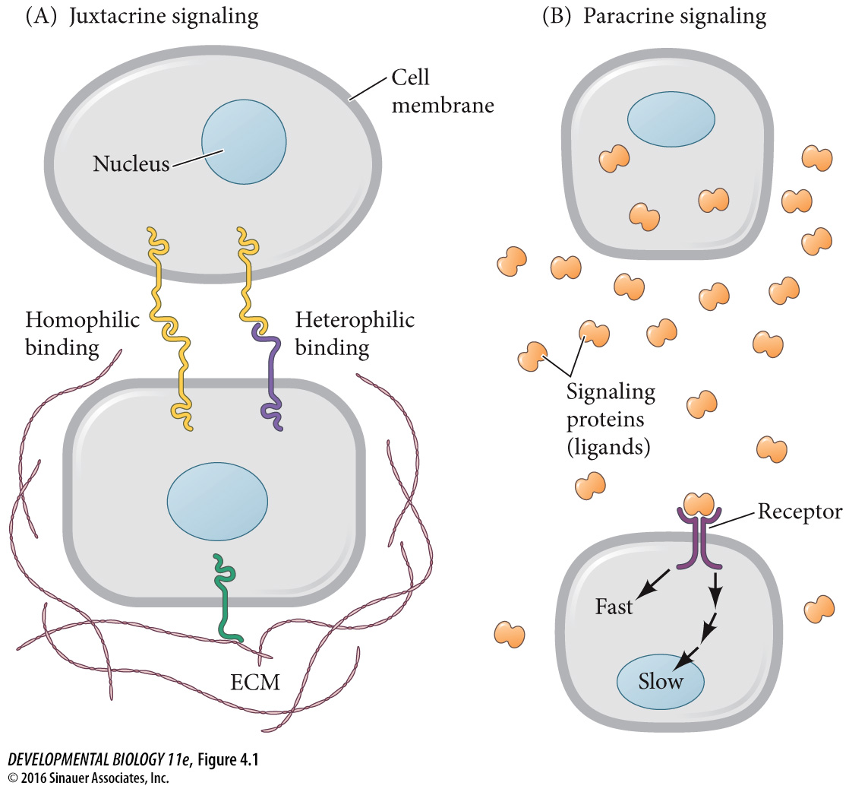

Slide 26
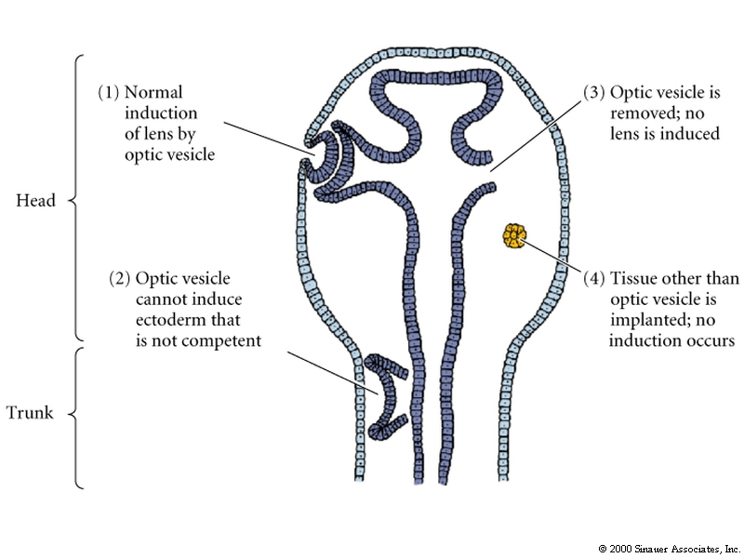
Induction Figure 4.15**

Slide 27
Induction
Inducer: the optic vesicle (presumptive retina) of Xenopus
Responder: the head ectoderm must be competent to respond

Slide 28
Induction
Competence = ability to respond to inducer
Not all tissues can respond to the signal made by the inducer.
Actively acquired
chick and mammalian eye
Pax6 protein makes ectoderm competent to respond to the optic vesicle
Expressed only in head ectoderm not other regions of ectoderm

Slide 29
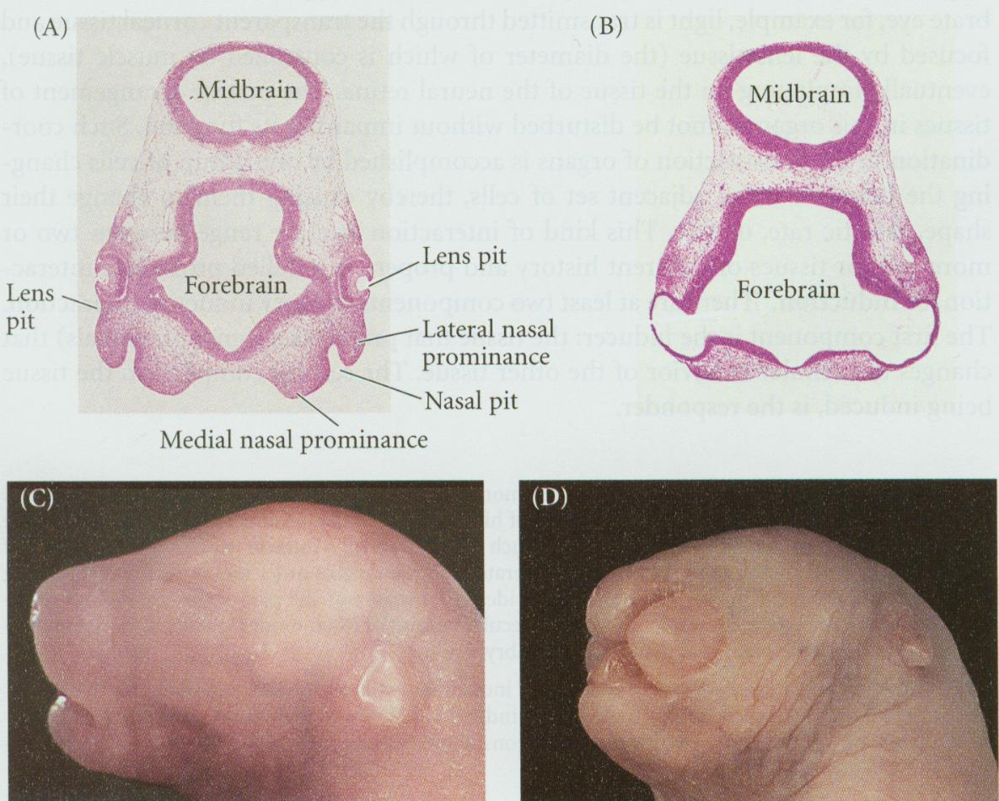
Homozygous Pax6 mutant rats,similar to homozygous Pax6 mutant mice, lack eyes and nose
wild type
mutant
Role of Pax6 as a competence factor
demonstrated by recombination experiments
using embryonic rat eye tissue

Slide 30
Where is Pax6 required?
In the inducing tissue
(optic vesicle)
Or the responding tissue (head ectoderm)?

Slide 31
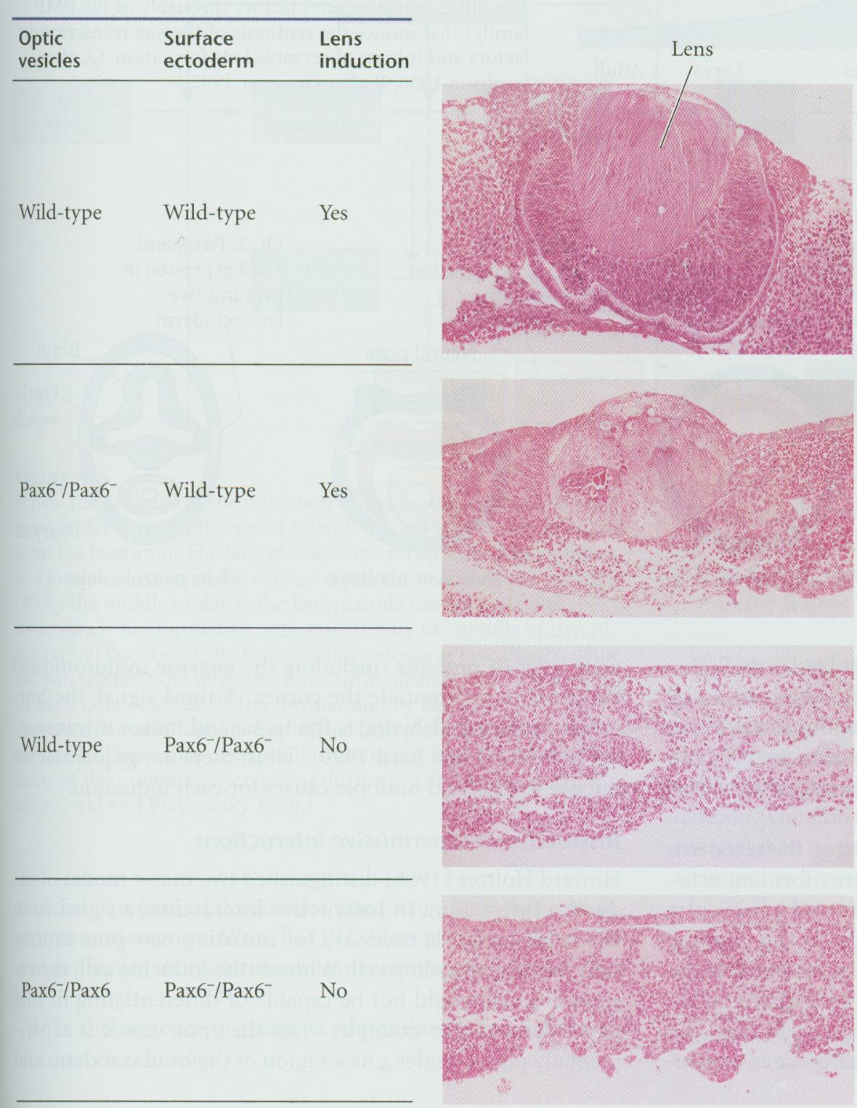
Where is Pax6 required?
In the inducing tissue
(optic vesicle)?
Or the responding tissue (head ectoderm)?
Recombination Experiment
Answer:
responding tissue:
surface ectoderm

Slide 32
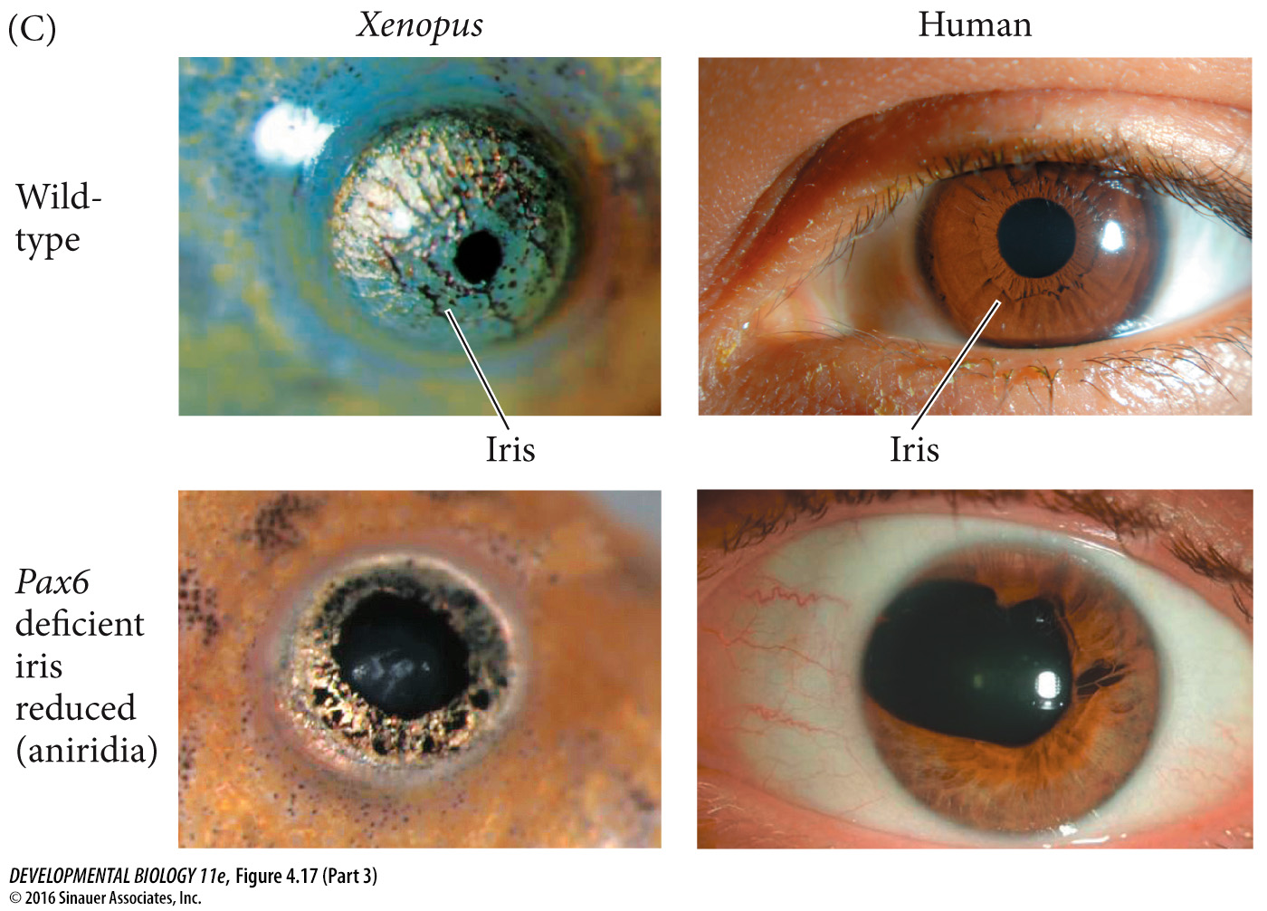

Slide 33
Induction between Epithelial and Mesenchymal cells
Epithelial cells are
tightly connected
to one another in
sheets or tubes
Mesenchymal cells are
unconnected to one another and
operate as semi-independent units

Slide 34
Induction between Epithelial and Mesenchymal cells
Example: Induction of cutaneous structures
(hairs, feathers, etc)
Skin consist of an epithelium
and an associated mesenchyme
Skin has 2 main tissues:
epidermis – an epithelial tissue derived from
ectoderm
dermis - a mesenchymal tissue derived from
mesoderm

Slide 35
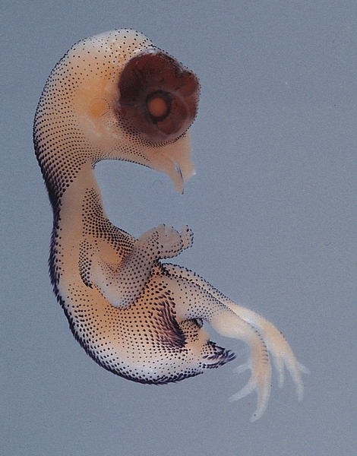
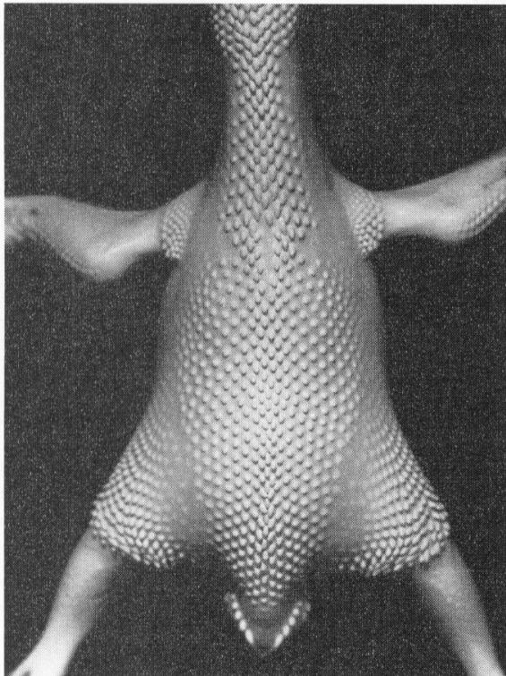
Region specificity of induction
Chick epidermis signals the underlying dermal cells to
form condensations (by secreting Sonic hedgehog
and TGF-β proteins)
In situ hybridization of a day 10 chick
Sonic hedgehog expression in ectoderm of developing feathers and scales
Feather tracts on a day 9 chick embryo

Slide 36
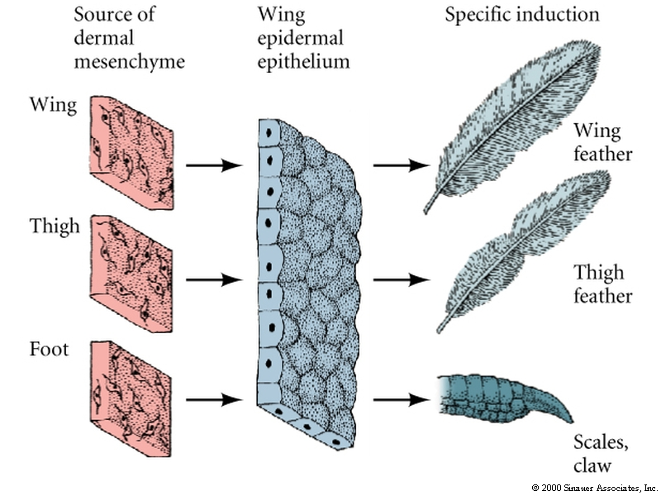
Regional specificity of induction
chick
epidermis dermal mesenchyme
secrete TGF-β and Sonic form condensations
hedgehog and secretes factors
forms regionally specific cutaneous structures
Can be broad feathers of the wing
narrow feathers of the thigh
or scales and claws of feet

Slide 37
Regional specificity of induction
Recombine cells from the dermis (mesenchyme) with the epidermis (epithelium) in the chick
Type of cutaneous structure made by the epidermal epithelium is determined by source of mesenchyme

