Slide 1
Chapter 4 Figures–
Fig. 4.6 – Emily D.
4.15 – Aidan G.
4.24 – Brandon G.
4.25 – John H.
4.26 – Chinmaya J.
4.13 – Kerri K.
4.22 – Monty K.
4.23 – Nathan K.

Slide 2
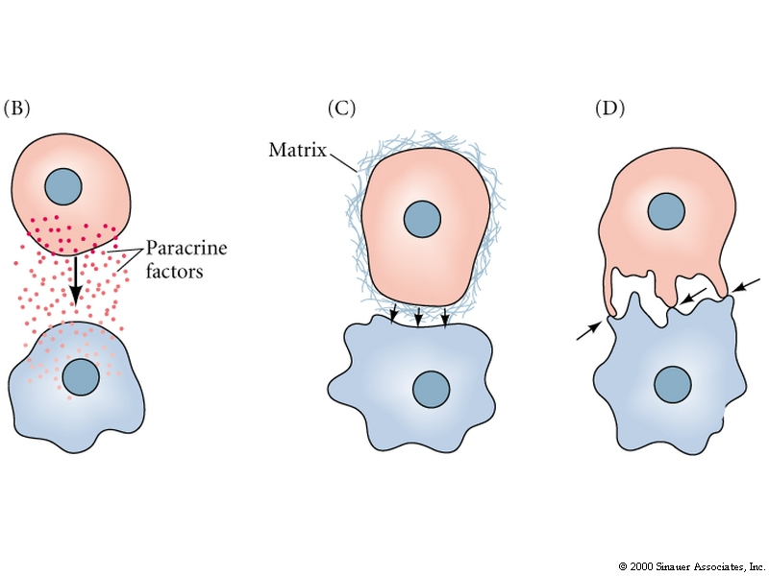
How are signals sent from one cell to another during induction?
paracrine factors = Proteins synthesized by one cell that diffuse over small distances
to induce changes in neighboring cells

Slide 3
Paracrine factors
Paracrine factors are secreted into the
immediate spaces around the cell producing them
Paracrine factors associated with matrix of one cell induces change in another cell

Slide 4
Paracrine factors
Induction of many organs by relatively few paracrine factors
Compact “tool kit”
Same proteins utilized throughout the animal kingdom
Factors that create the Drosophila eye or heart = those used in generating mammalian organs

Slide 5
Paracrine factors are ligands
4 major families based on structure:
Fibroblast growth factor (FGF) family
Hedgehog family (hh)
Wingless (Wnt) family
Transforming growth factor (TGF-β) superfamily
Ligand is a molecule that binds to a receptor

Slide 6
Fgf family of paracrine ligands
over 20 genes in this family
hundreds of protein isoforms

Slide 7
Fgf family members regulate many developmental events
Fgf8 - induction of the lens tissue by the optic cup

Slide 8
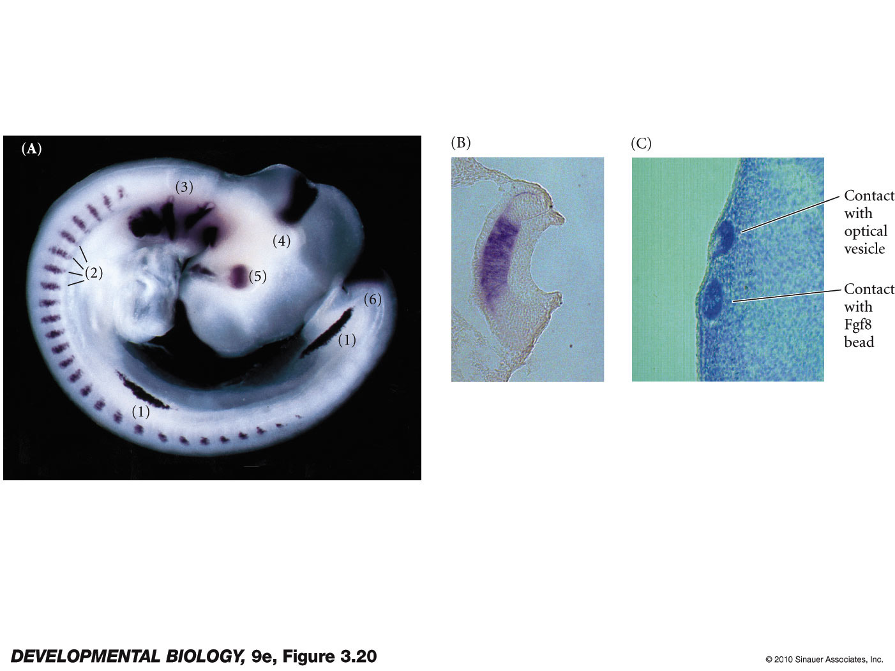
Figure 3.20 Fgf8 in the developing chick
Figure 4.25**.
L-Maf
FGF-8
FGF-8
Notes:
DevBio9e-Fig-03-20-0.jpg

Slide 9
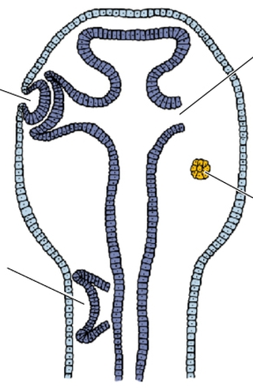
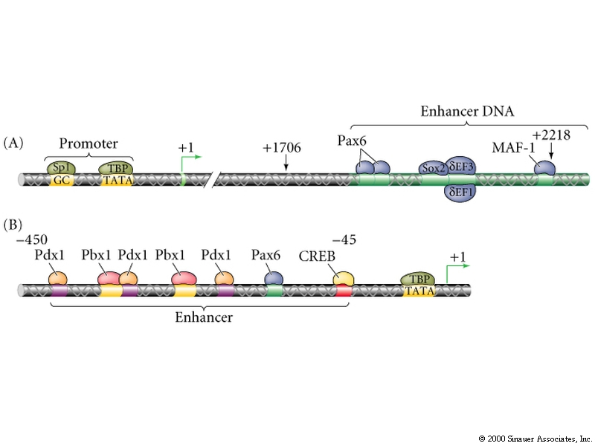
Fgf -8 lens induction
Pax6
L-Maf
Fgf8
Fgf-8 - induces L-Maf
Combination of Pax6, Sox2, and L-Maf ensures production of the lens
lens crystallin gene

Slide 10
How are paracrine factor signals transduced?
Fgf signal transduction by G-protein coupled receptors.

Slide 11
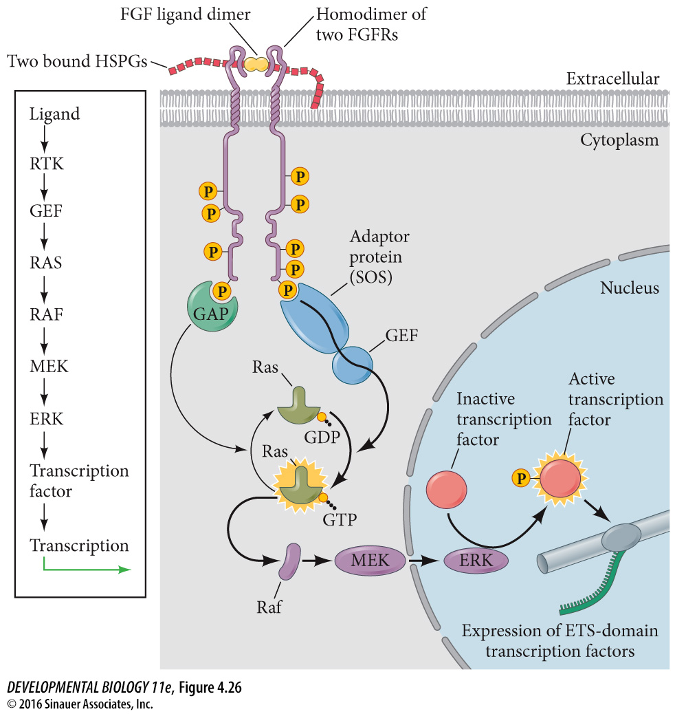
Fgf and others use a G-protein coupled receptor
Figure 4.26**
Notes:
DevBio9e-Fig-03-21-0.jpg

Slide 12
Fgf and others use a G-protein coupled receptor
Receptor spans
membrane
Ligand binds
2. Conformational change in receptor
3. Cytoplasmic domain changes shape

Slide 13
Fgf and others use a G-protein coupled receptor
Activates the enzymatic kinase activity of the cytoplasmic domain
5. phosphorylated receptor activates the Ras G-protein
6. Active Ras form activates a series of kinases molecules that phosphorylate other targets.

Slide 14
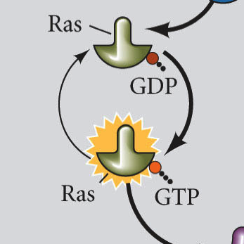
G-proteins
G-proteins exist in two states - active and inactive
inactive
GAP
GTPase activating protein
GNRP
Guanine nucleotide releasing protein
active
Mutations in Ras that prevent the binding of GAP cause an overactivation of Ras and can result in cancer

Slide 15
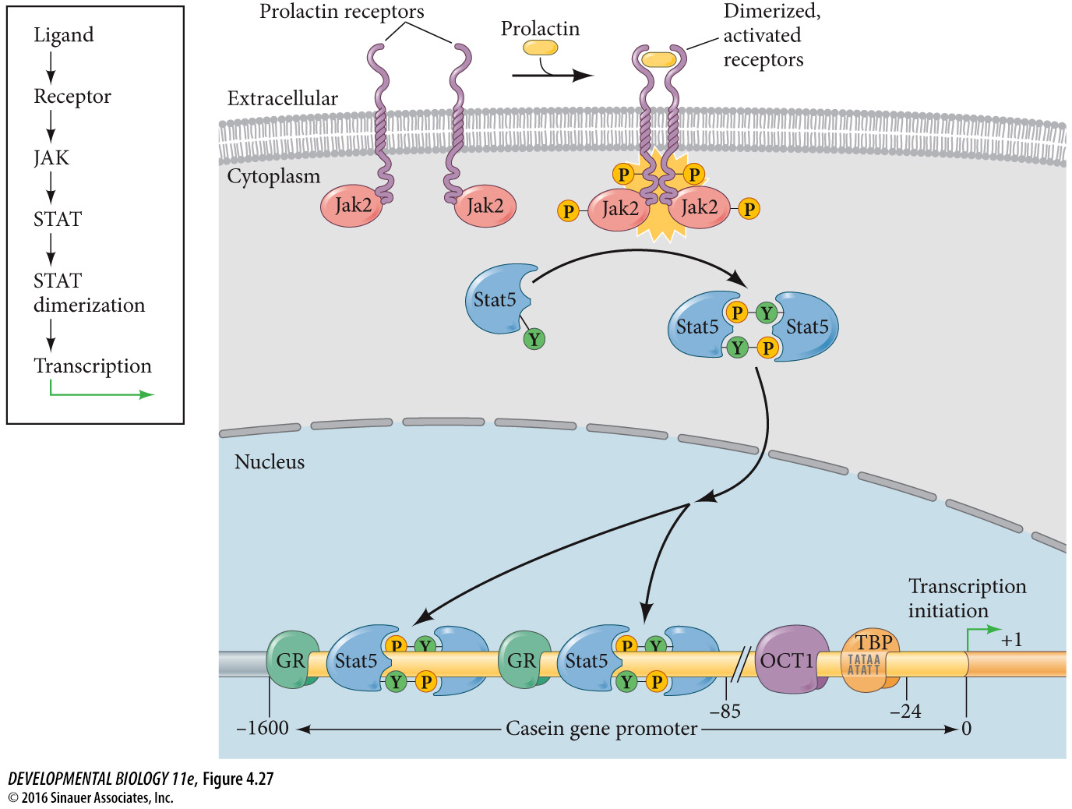
FGFs also can activate the JAK/STAT signal transduction pathway
(this example shows prolactin for some reason and not FGFs but details are similar)
Fig 4.27 –

Slide 16
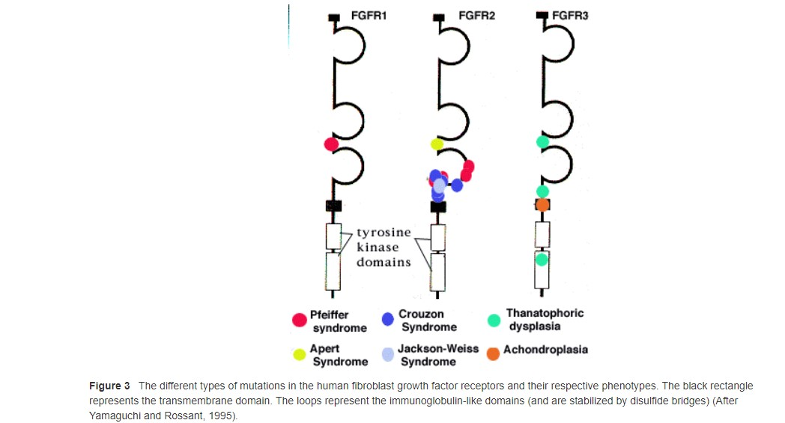
Gain-of-function mutations in human fibroblast growth factor receptors
http://11e.devbio.com/wt0402.html
Notes:
Fibroblast growth factors play important roles in human limb and craniofacial development. This can be seen in dominant human conditions that are characterized by the premature differentiation of cartilage and bone. Mutations in FGFR1 can cause the Pfeiffer syndrome, a malformation syndrome characterized by limb defects and by the premature fusion of the cranial sutures (craniosynostosis) that results in abnormal skull and facial shape.
Mutations in FGFR2 can give a variety of syndromes (Figure 3). In one region of the protein, several mutations give rise to the Pfeiffer syndrome, just like the mutations of FGFR1. Overlapping this region is an area where mutations can give a different syndrome, the Crouzon Syndrome. Patients with Crouzon syndrome also have craniosynostosis, but have normal limbs. Also in this region are mutations that can give rise to the Jackson-Weiss syndrome, a syndrome of craniofacial malformation and foot abnormalities (enlarged great toes and the coalescence of the tarsals and metatarsals) and Apert Syndrome, a condition involving craniosynostosis and severe syndactyly (fusion of digits). The fact that identical FGFR2 mutations have been found in patients diagnosed with these three different syndromes suggests that these syndromes may actually constitute one spectrum of craniosynostosis and limb malformation anomalies, whose severity is modified by other genes (Park et al., 1995; Wilkie et al., 1995).
Mutations of FGFR3 give achondroplasia. Roughly 95% of the achondroplastic dwarfs have the same mutation of FGFR3, a base pair substitution that converts glycine to arginine at position 380 in the transmembrane region of the protein. In addition, mutations in the extracellular portion of the FGFR3 protein or in the tyrosine kinase intracellular domain have resulted in thanatophoric dysplasia, a lethal form of dwarfism that resembles homozygous achondroplasia (Bellus et al., 1995; Tavormina et al., 1995).
The mutations of fibroblast growth factor receptors that give rise to dwarfism and craniosynostosis are not loss-of-function mutations. Rather, they are gain-of-function mutations that enable the FGF receptor to become active without binding its FGF ligand (Webster and Donaghue, 1996; Deng et al., 1996). It appears that the normal role of the FGFs on cartilage cells is to limit cartilage cell growth. A constitutively active mutation would severely retard bone development in those areas (the skull and limb) where it normally functions. Conversely, the knockout of the FGFR3 gene from mice causes an expansion of endochondral bone growth. Most of these human FGFR mutations in single dosage do not appear to completely inhibit growth, as the homozygotes are more severely effected. The mutations of thanatophoric dwarfism appear to be most severe and resemble that of the achondroplasia homozygotes. The mutation in FGFR3 that characterizes thanatophoric dysplasia type II gives the FGFR3 constitutive tyrosine kinase activity. This particular activity has been seen to phosphorylate the Stat1 protein and to induce its translocation into the nucleus. Moreover, this kinase activity also promoted the expression of proteins that block the cell cycle (Su et al., 1997). Such constitutive Stat1 activation and cell cycle withdrawal were seen in cartilage cells from fetuses with thanatophoric dwarfism but not with cartilage cells from normal fetuses.

Slide 17

Achrondroplasia – a form of dwarfism caused by pre-mature premature differentiation of cartilage and bone.
95% of the achondroplastic dwarfs have the same mutation of FGFR3, a base pair substitution that converts glycine to arginine at position 380 in the transmembrane region of the protein
Tyrion Lannister (Peter Dinklage)

Slide 18
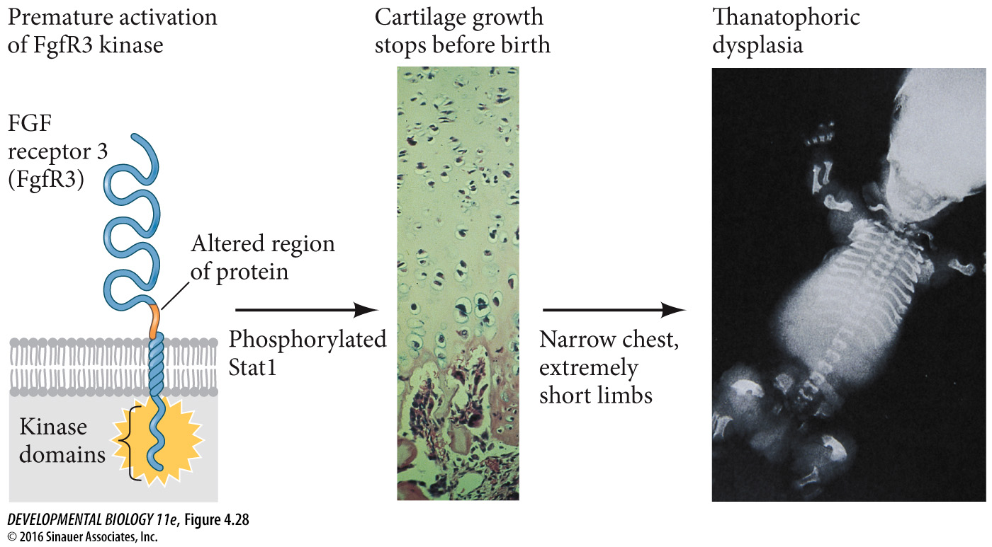
4.28

Slide 19
Morphogen – “Form Giver”
Diffusible biochemical molecule that can determine the fate of a cell by its concentration

Slide 20
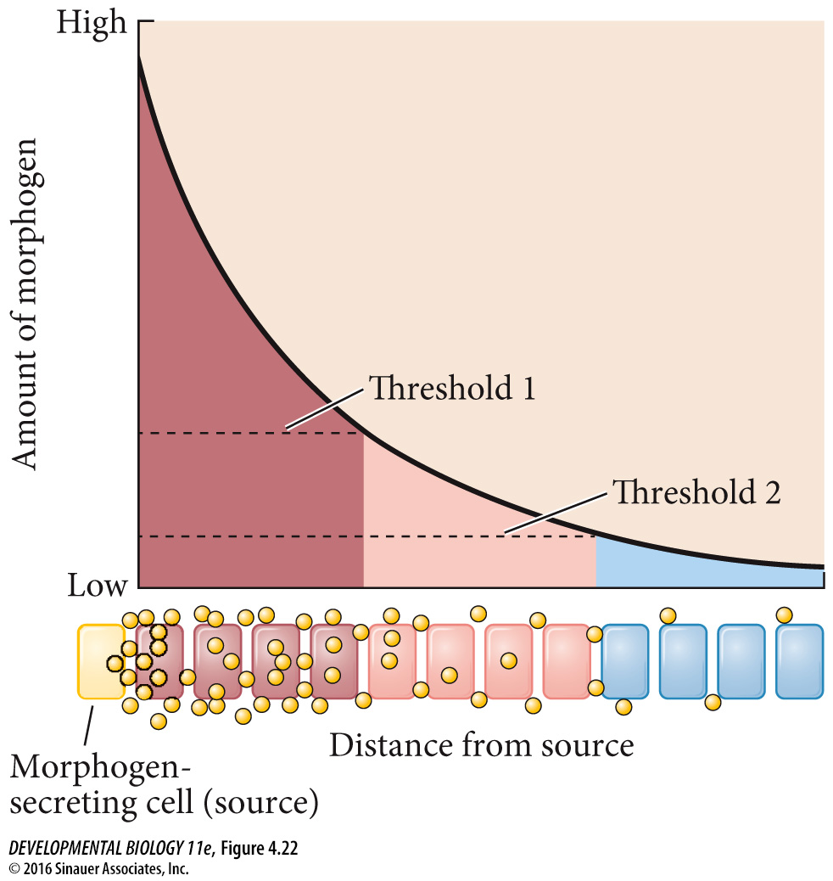
Fig 4.22 **

Slide 21
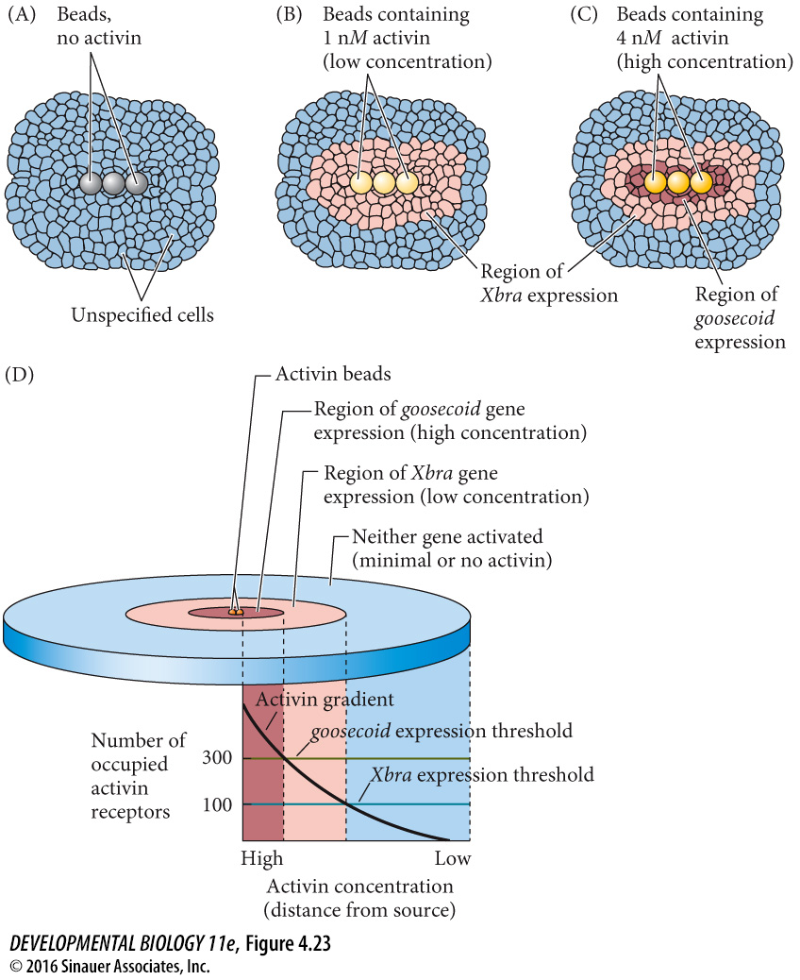
Fig 4.23 **

Slide 22
Maintenance of gene expression
Auto-activation
Chromatin remodeling
Autocrine signaling
Paracrine loop

Slide 23
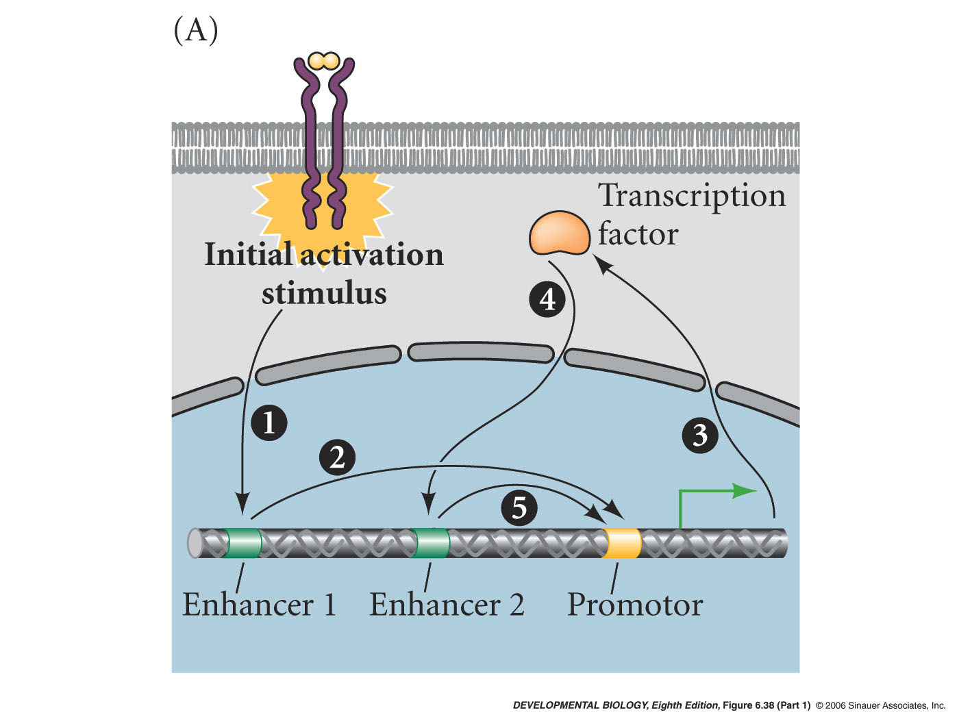
Maintenance of gene expression
1) Auto-activation

Slide 24
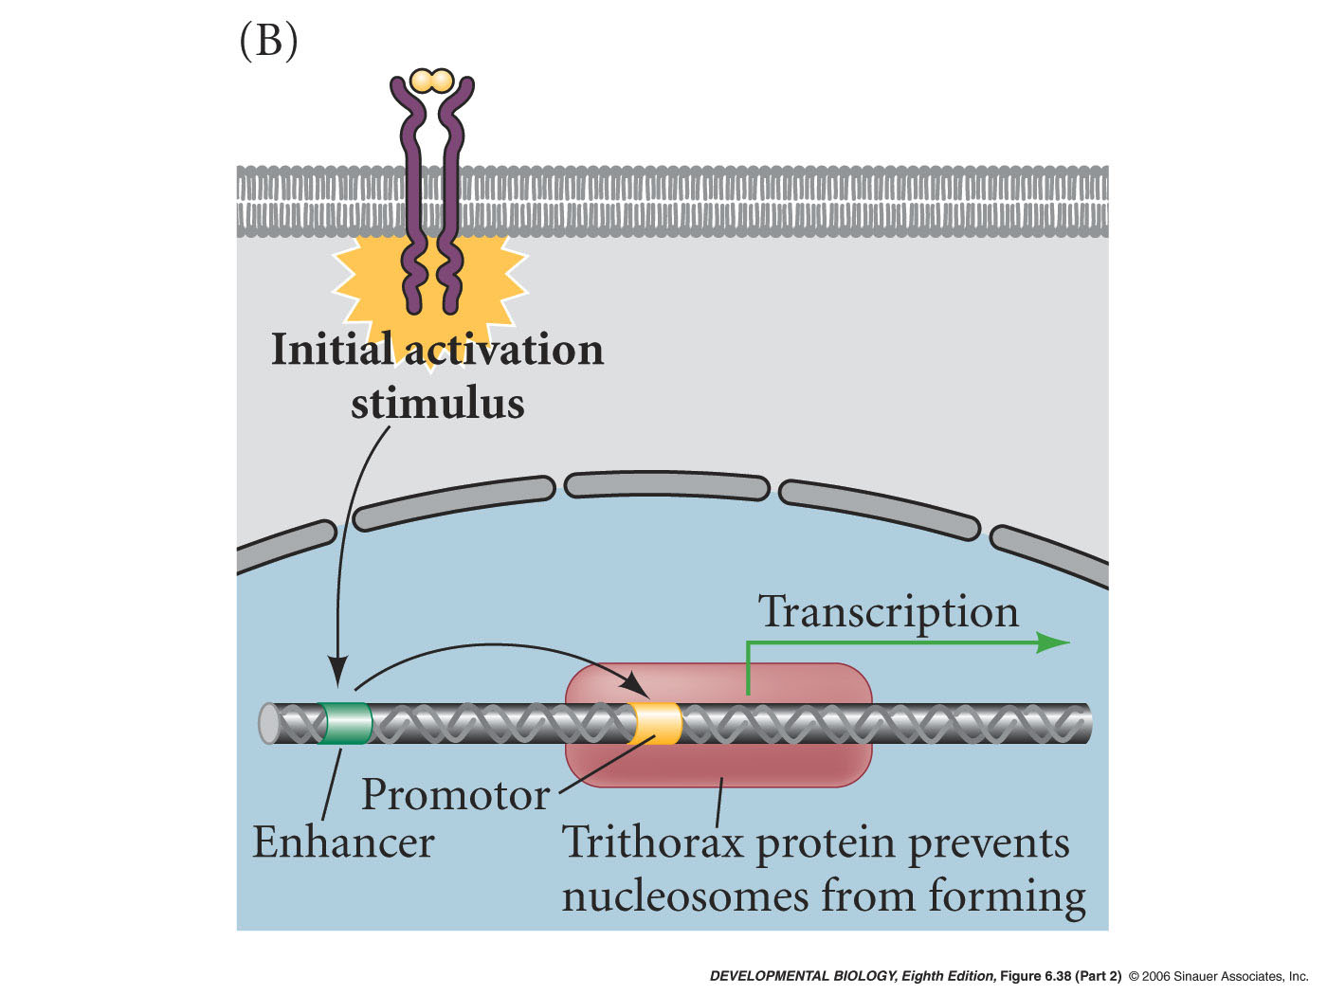
Maintenance of gene expression
2) Chromatin remodeling

Slide 25
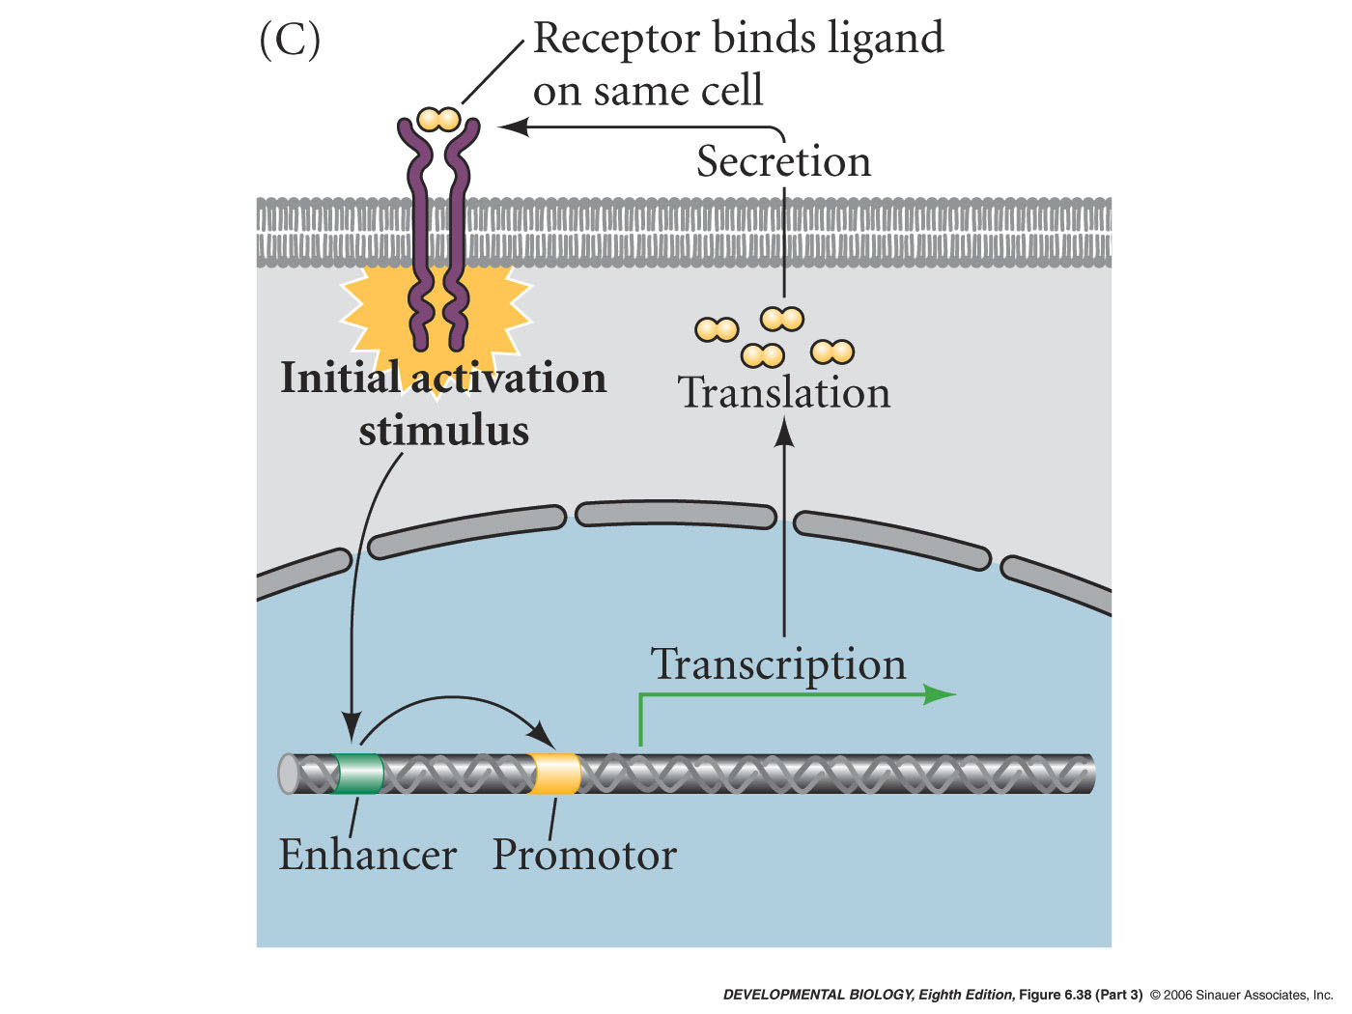
Maintenance of gene expression
3) Autocrine stimulation

Slide 26
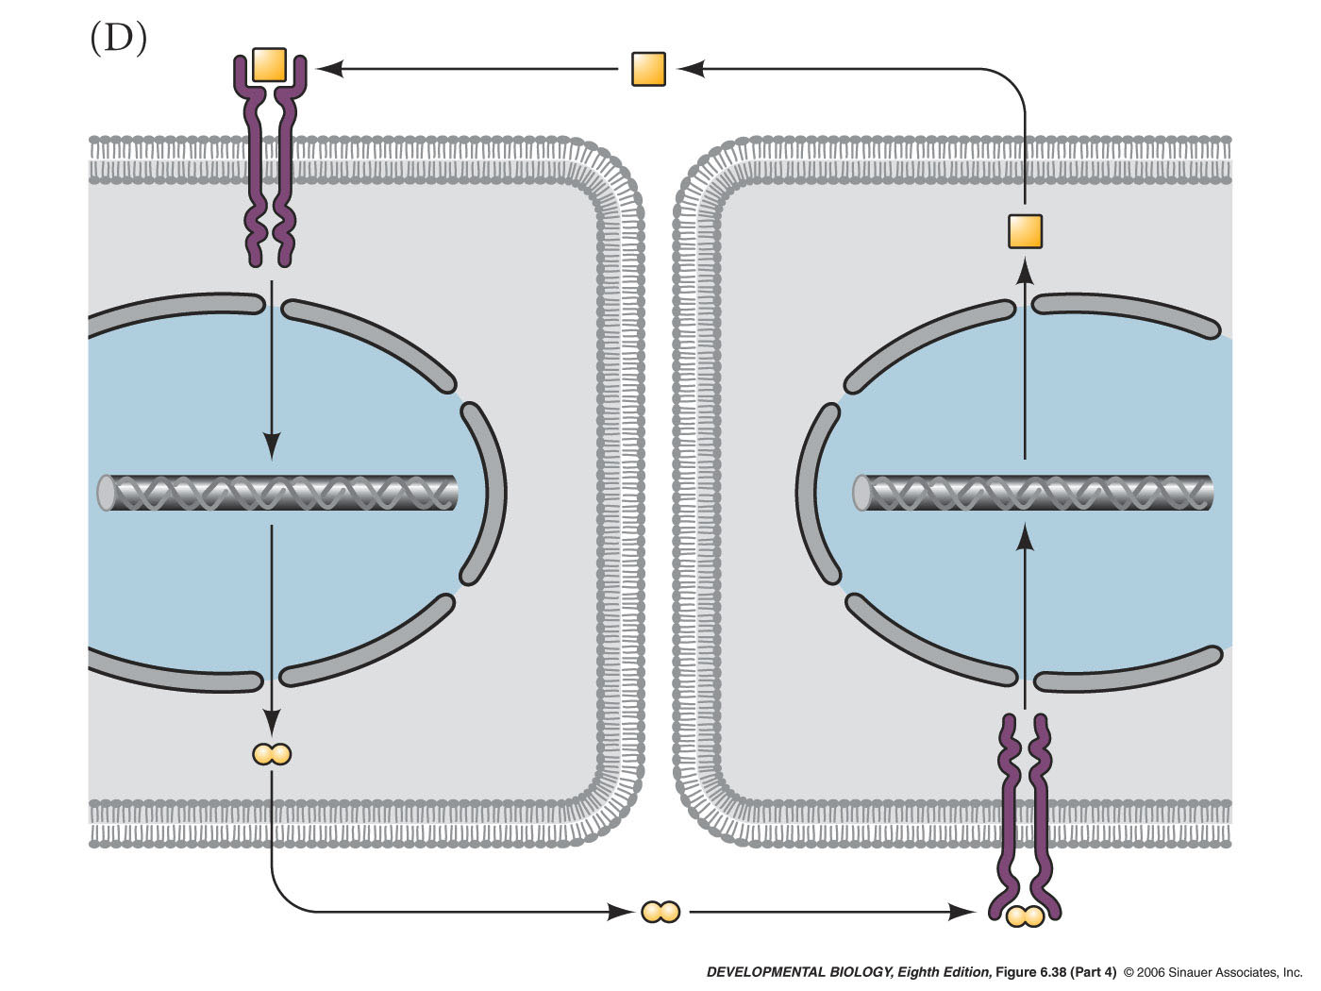
Maintenance of gene expression
4) Paracrine loop

Slide 27
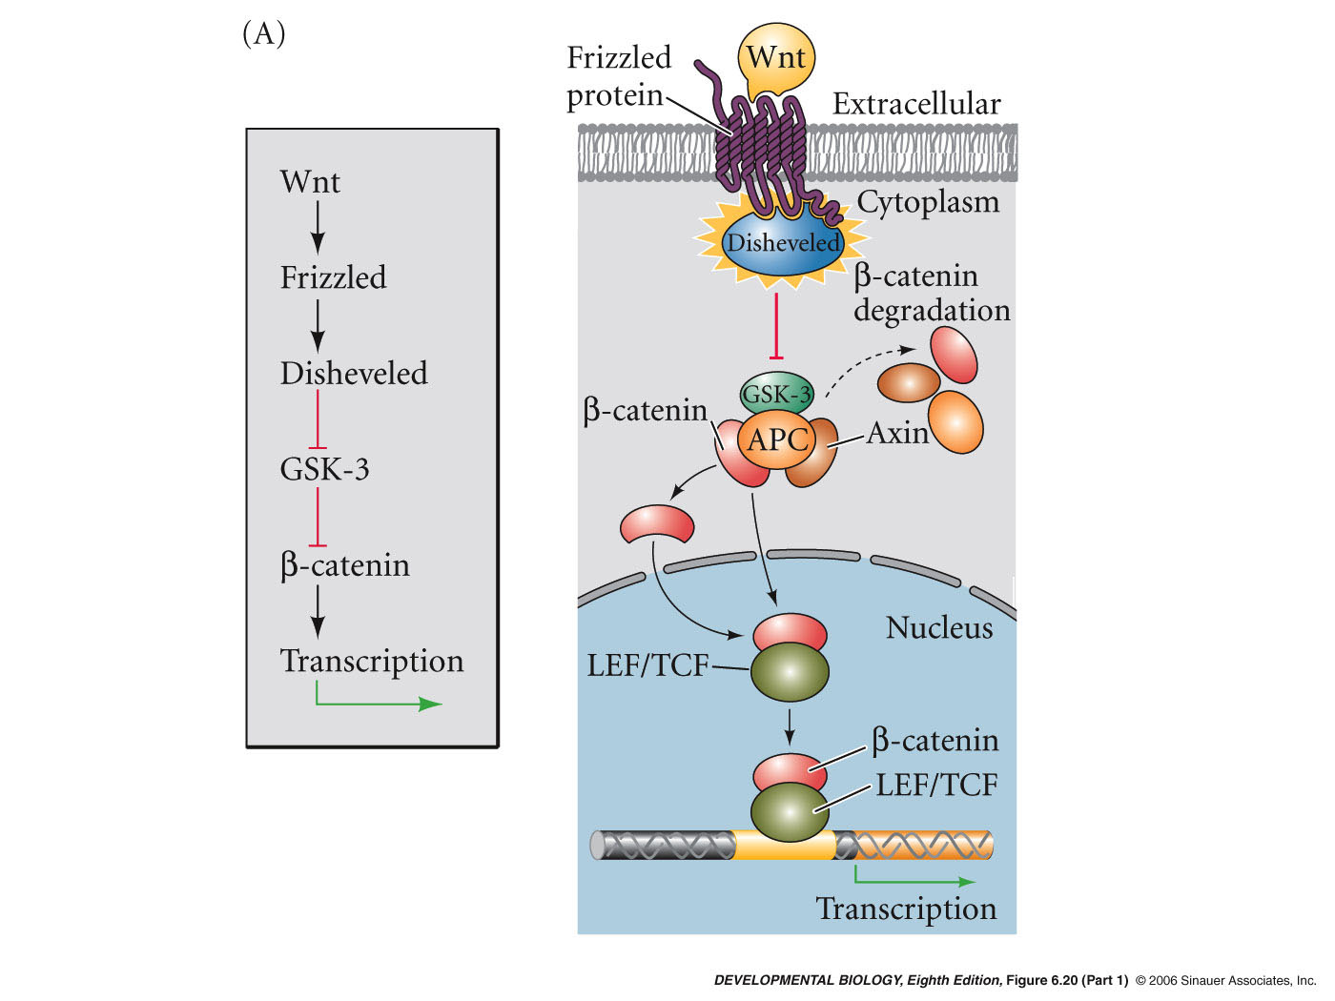
Drosophila wingless
wnt (wingless/integrated) family - 15 vertebrate members
Developmental roles:
somite differentiation
limb polarity
stem cell development

Slide 28
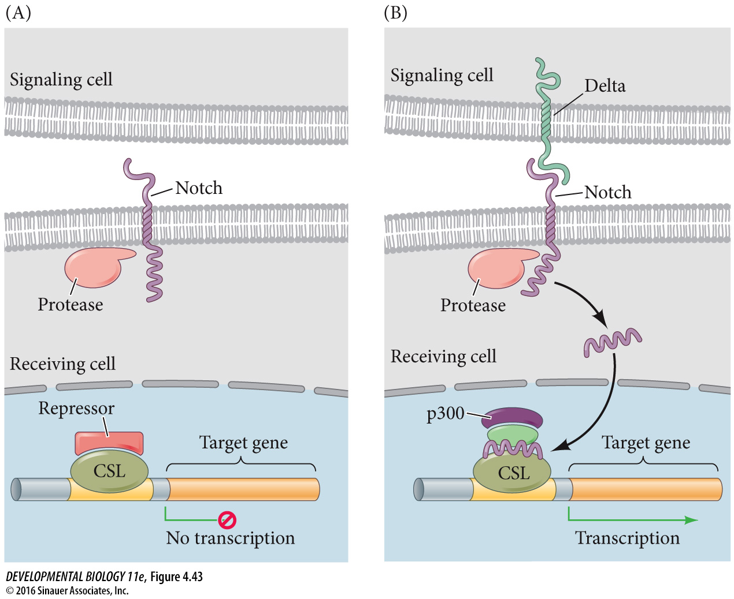

Slide 29
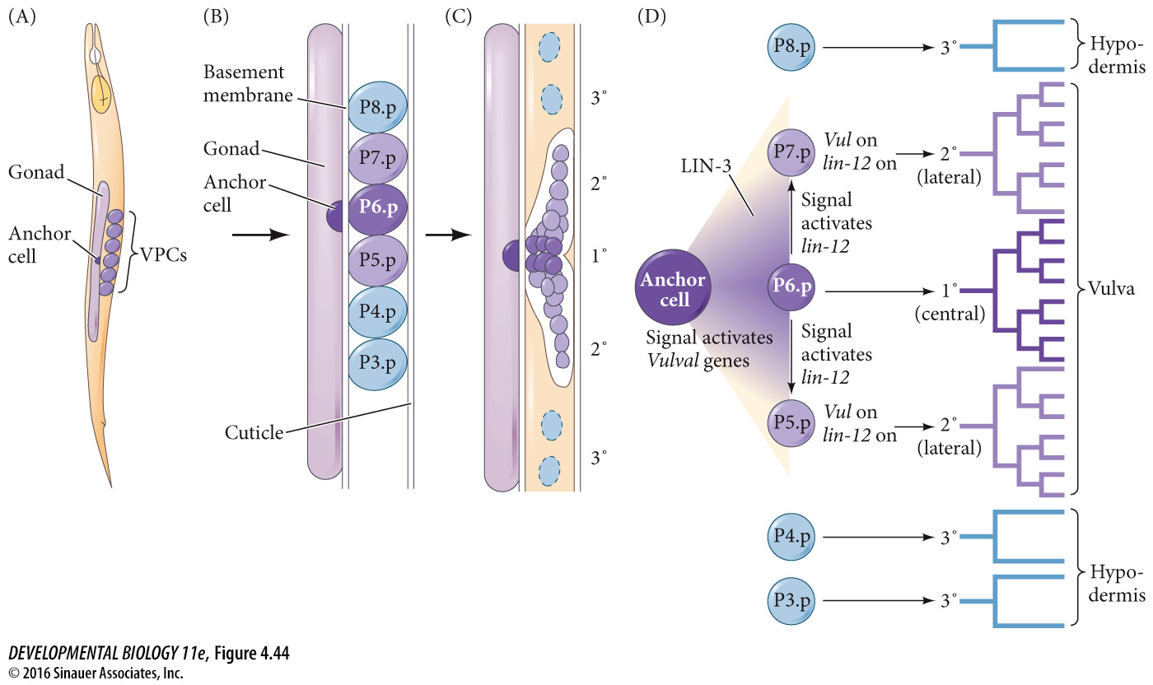

Slide 30
