Slide 1
A Quick Introduction to Plant Development
GN434

Slide 2
Differences between animal and plant development
plant cells do not migrate
plant meristems generate organs throughout the life of the plant not just during embryogenesis
plant cells are more plastic than animal cells
cell death is more rarely used to generate form in plants
developmental mechanisms evolved independently - minimal homology

Slide 3
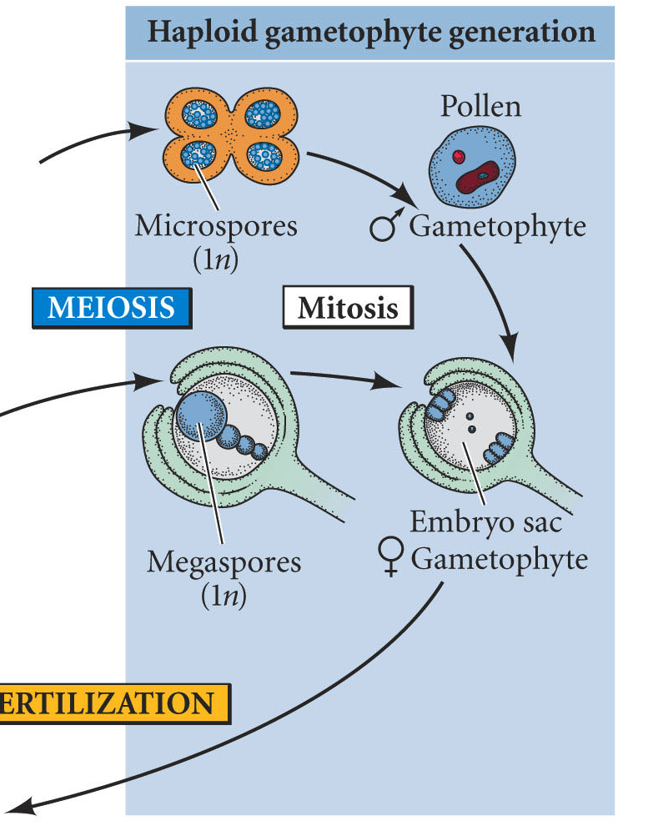
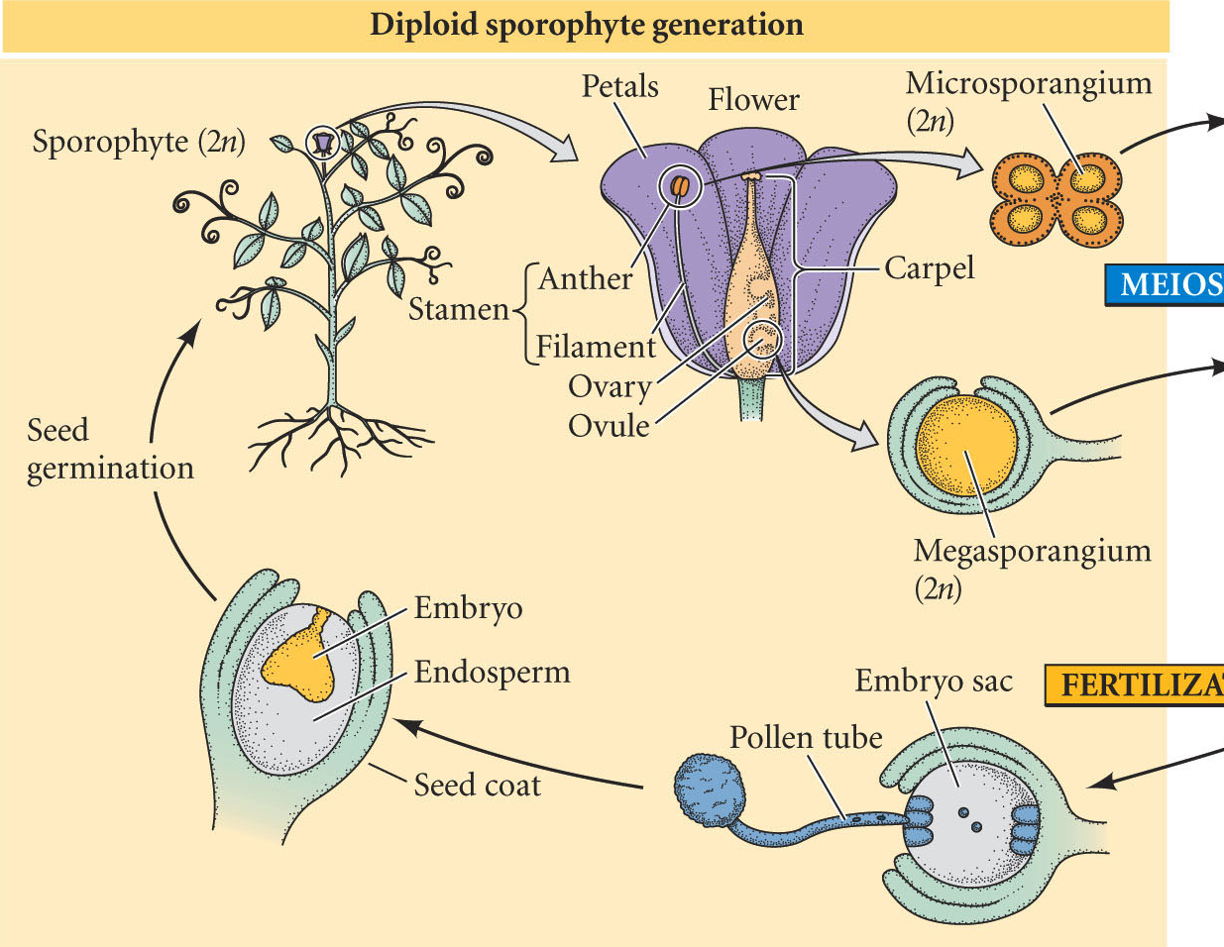
Plant Life Cycle
sporophyte = 2n; gametophyte = 1n

Slide 4
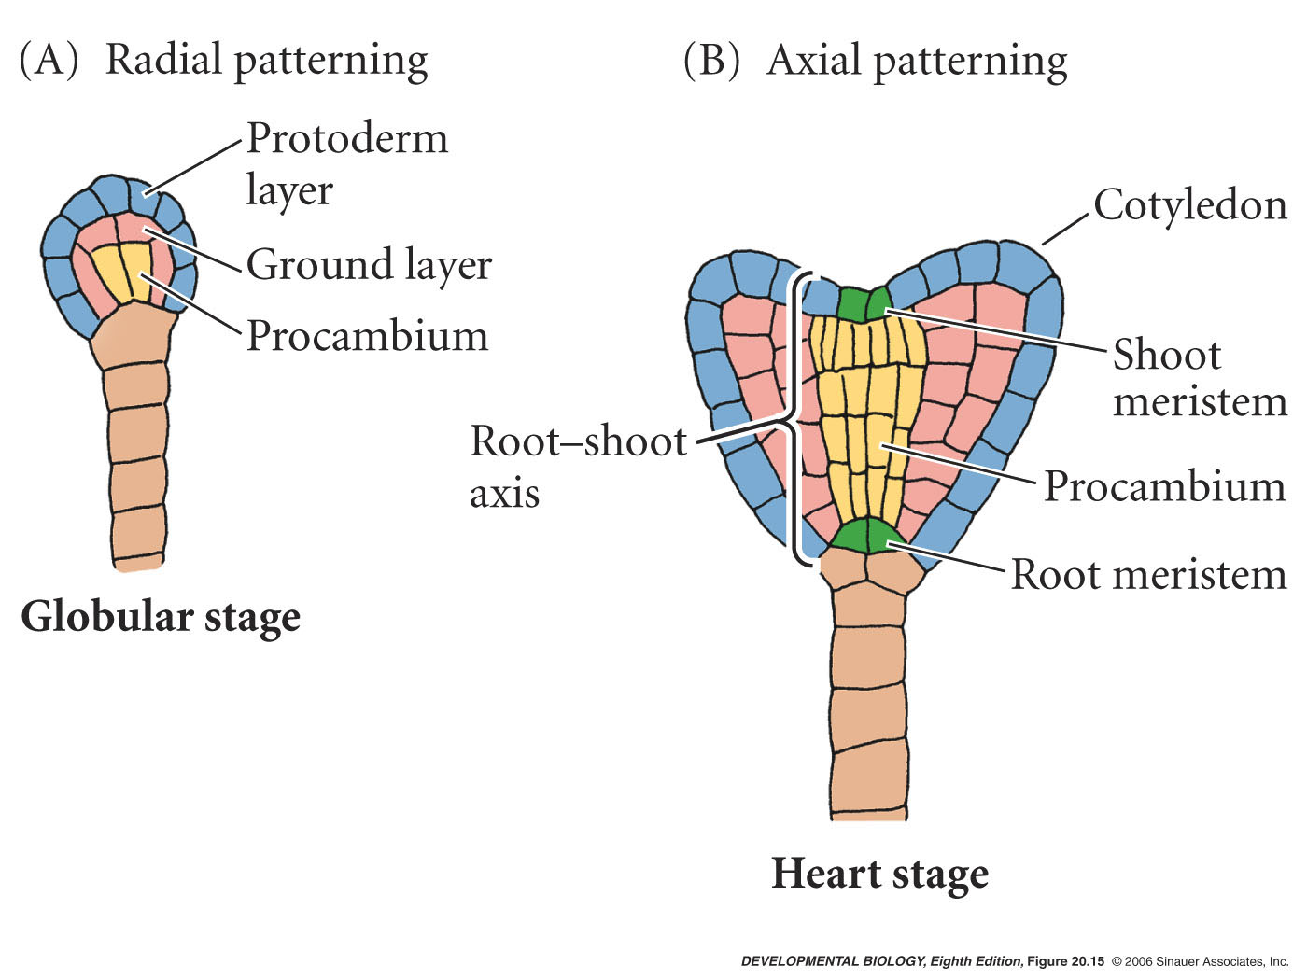
Shoot and Root Meristems

Slide 5
Plant Shoot Meristems
What is a meristem and what does it do?
Group of organized cells that has two major functions
1. Generates organs
2. Maintains itself
Root
Meristem
Shoot
Apical
Meristem

Slide 6
What organs do they generate?
Shoot Apical Meristem Leaves, stems, branches, thorns, flowers, and additional meristems
Root Apical Meristem roots

Slide 7
Where are plant meristems located?
Shoot Apical
Meristem
Axillary Shoot
Meristem
Root Apical
Meristem

Slide 8

Some Meristems are Indeterminate
Continuous ability to produce organs

Slide 9
Stem Cells

Slide 10
Zones of the meristem have different rates of cell division
Rate of Cell Division
Central Zone - Low
Peripheral and Rib - Higher

Slide 11
Molecular mechanisms of meristem maintenance and functioning

Slide 12
Mutants that fail to make meristems
wuschel (wus) (loss-of-function allele)
phenotype is the loss of the shoot apical meristem
Leaves from SAM
No SAM
Wild Type
wus mutant

Slide 13
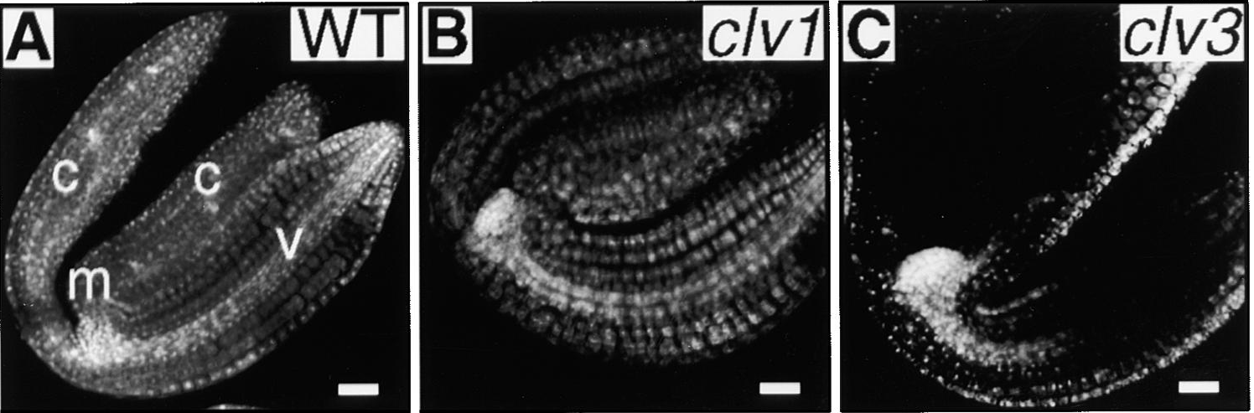
Mutants that make larger meristems
clavata1 (clv1), clavata2 (clv2) and clavata3 (clv3)
(loss-of-function allele)

Slide 14
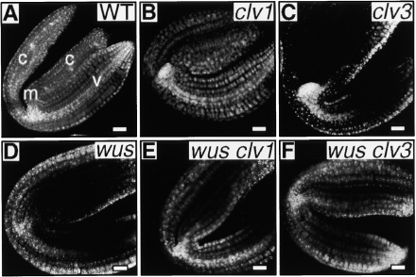
wus clv3 double mutant analysis
extent of shoot apical meristem circled in red
wus clv double mutants look like wus single mutants

Slide 15
Double mutant suggests a linear pathway
WUS
CLV
or
CLV
WUS
Prediction?
Opposite effects of wus and clv mutants suggest negative regulation
Remember:
Active WUSCHEL gene product increases meristem size
Active CLV gene products decrease meristem size

Slide 16
WUS is ectopically expressed in clv mutants
WUS in situ probe
Wild Type
clv1
clv2
clv3
WUS normally expressed only in organizing center
WUS now ectopic in upper layers and higher amount
In situ hybridization shows pattern of WUSCHEL mRNA expression.
This is consistent with CLV inhibiting WUS

Slide 17
Ectopic expression of WUS induces ectopic expression of CLV3
CLV3 in situ probe
Wild Type
35S viral promoter:WUS
The result suggests WUS activates CLV3

Slide 18
Ectopic expression of WUS (35S:WUS ) prevents organogenesis
Conclusion:
WUS must be switched “off” for organ primordia formation

Slide 19
What do the CLV genes encode?
CLV1 - Receptor Kinase (LRR - Leucine Rich Repeat)
CLV2 - Receptor co-factor (LRR but no kinase domain)
CLV1 and CLV2 heterodimerize and generate a receptor complex
CLV3 - A 96 amino acid peptide ligand for the CLV1/CLV2 receptor complex

Slide 20
What does the WUSCHEL gene encode?
WUSCHEL - DNA-binding transcription factor (Homeodomain type)

Slide 21
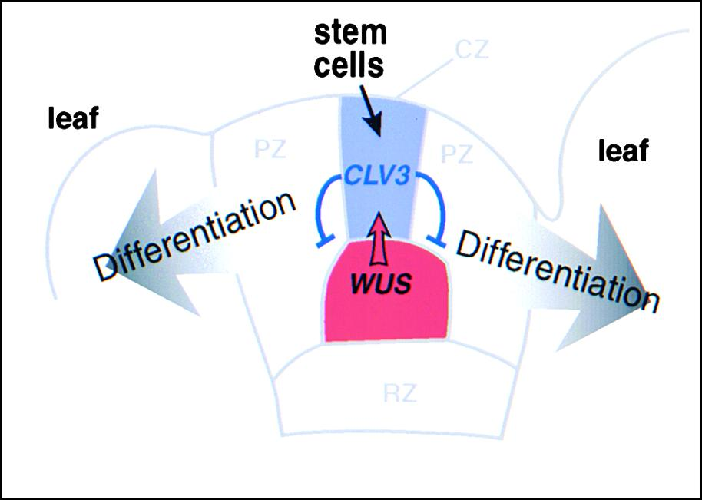
Model for CLV and WUS Function in SAM
CLV1
CLV2
WUS = organizing center (stimulates CLV3 expression)
CLV3 = expressed in stem cells
CLV1, 2, 3 inhibit WUS expression

Slide 22
SUMMARY
Stem cells in the SAM generate all post-embryonic above-ground plant organs
Organizing center maintains stem cell population size
A variety of molecules are required to maintain stem cell homeostasis during organogenesis: transcription factors; peptide signaling molecules; LRR receptor kinases.
Organs initiate from peripherial zone as they leave the CZ niche

