Slide 1
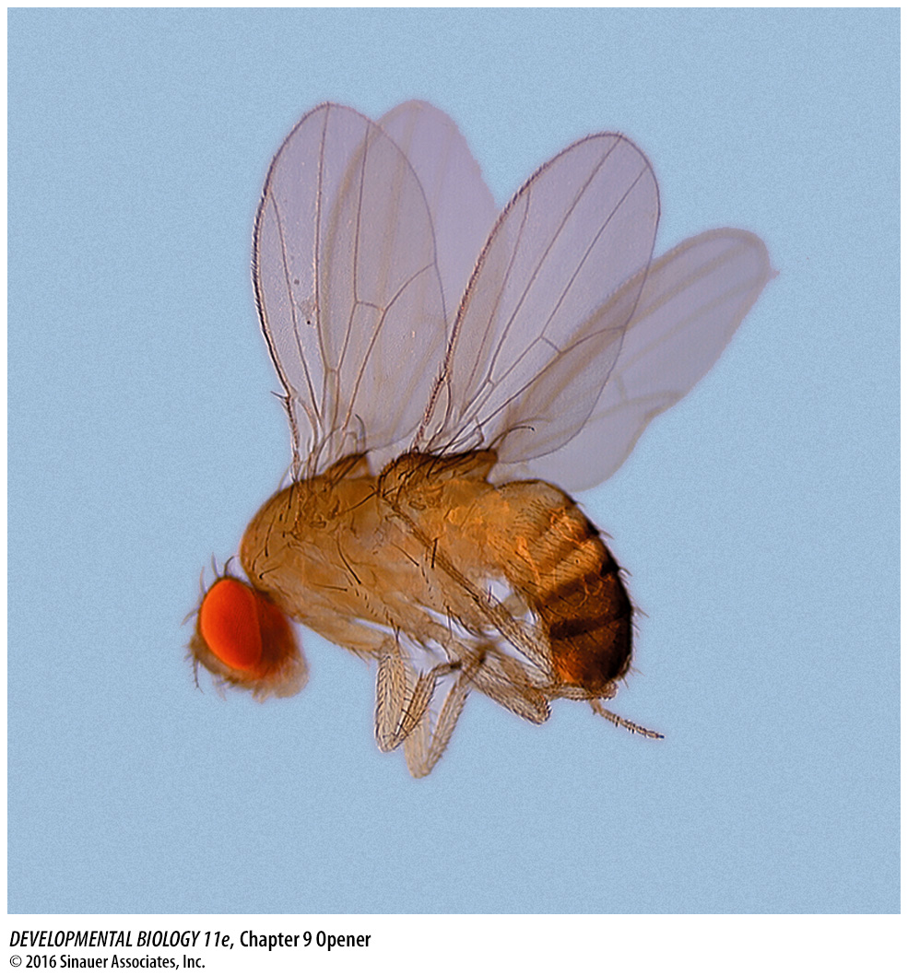
Drosophila I

Slide 2
Pick a topic for team presentations (April 13th)
pick topic by Feb 16th by email
Teams will be made up of three people and an effort to connect these teams by interest in the topic.
Presentation of an original research paper
One person – Introduction and background – What was known going into the study
One person main experiments and results
One person on conclusions of the data – potential limitations of the data – implications of the data – future work
18-20 minute presentation plus 5 min for questions from the rest of class.

Slide 3
doi:10.1016/S0092-8674(02)01087-5 Copyright © 2002 Cell Press.
Whole-Genome Analysis of Dorsal-Ventral Patterning in the Drosophila Embryo
Angelike Stathopoulos , Madeleine Van Drenth , Albert Erives , Michele Markstein and Michael Levine
Read and Prepare . Feb 19th discussion of this paper
CHAPTER 9 –
Fig 9.13 (A and B parts only) – Greg L.
Fig 9.19 Nicole L.
Fig 9.23 – Jared M..
Whole-Genome Analysis of Dorsal-Ventral Patterning in the Drosophila Embryo
Figures
Overview/introduction: - Nicholas M..
1A, - Allison R
1B, -.Abigail S.
Fig. 2, - Michael S.
Fig 3 A-E = Hannah S.
Fig 3 F-J = Gavin S.
Fig 3 K-O = Jessee T.
Fig 4 – A -.Vivian T.
Fig4B,C,D – Matthew A.
Fig 4E,F,G-.Rachel B
Fig 4 – H, I – Kelly B.

Slide 4
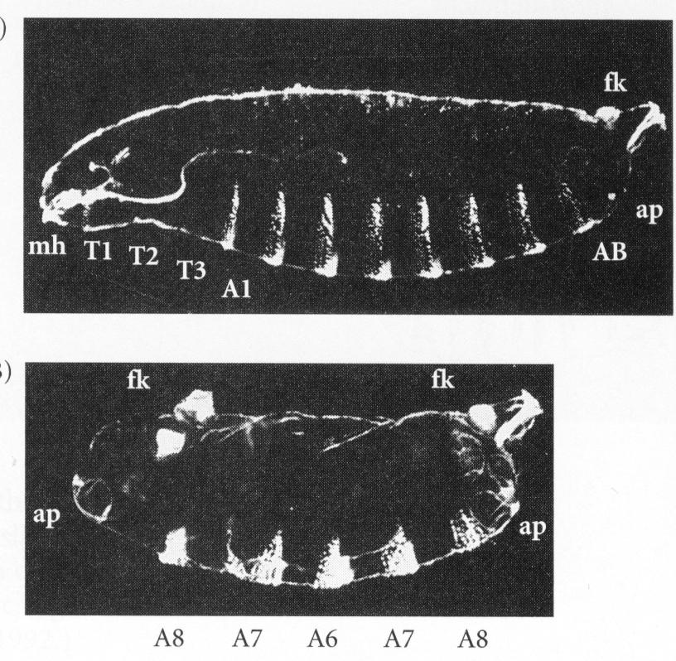
Drosophila I
Maternal Effect genes
Anterior/posterior patterning

Slide 5
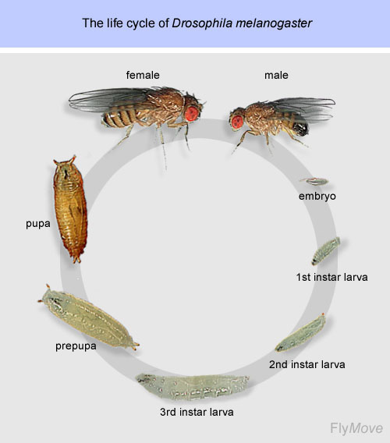
Drosophila melanogaster embryonic development

Slide 6
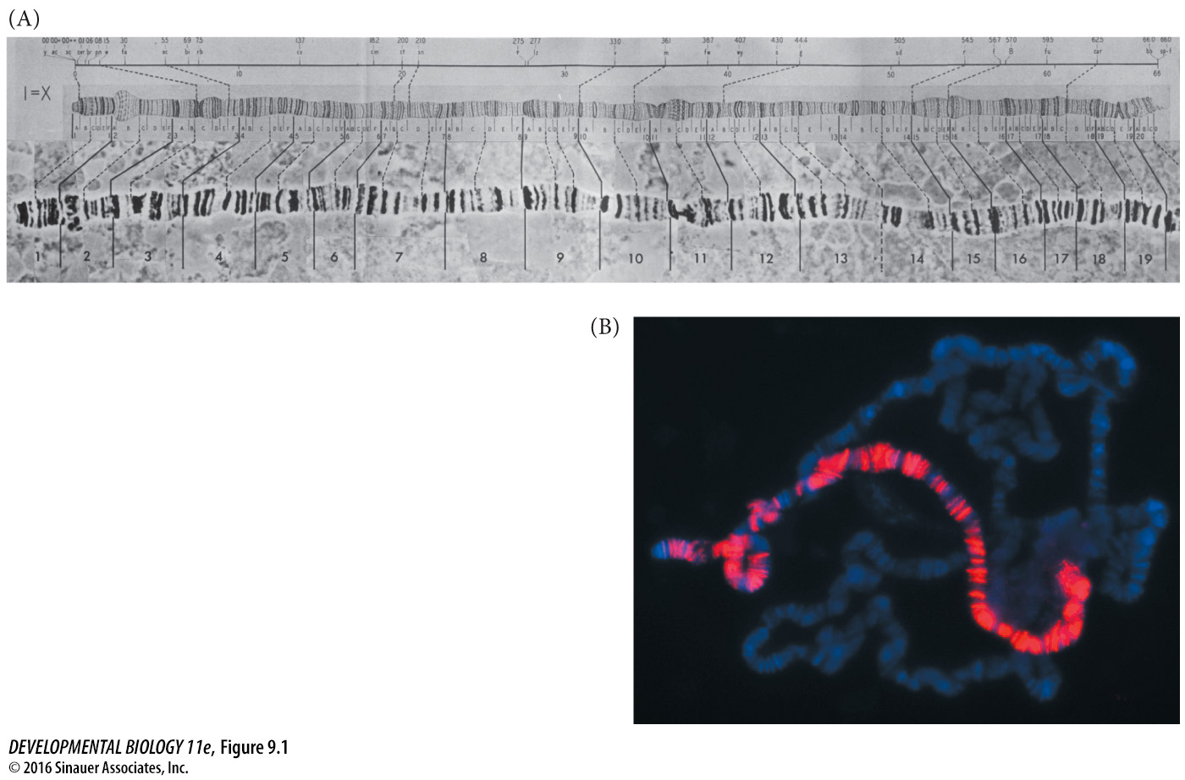
Figure 9.1 Polytene chromosomes of Drosophila
Notes:
Figure 9.1 Polytene chromosomes of Drosophila. DNA in the larval salivary glands and other larval tissue replicates without separating. (A) Photograph of the D. melanogaster X chromosome. The chart above it was made by Morgan’s student Calvin Bridges in 1935. (B) Chromosomes from salivary gland cells of a third instar D. melanogaster male. Each polytene chromosome has 1024 strands of DNA (blue stain). Here, an antibody (red) directed against the MSL transcription factor binds only to genes on the X chromosome. MSL accelerates gene expression in the single male X chromosome so it can match the amount of gene expression by females with their two X chromosomes. (A from Brody 1996; B photograph by A. A. Alekseyenko and M. I. Kuroda.)

Slide 7
Drosophila melanogaster embryonic development
5 classes of mutations/genes
Maternal effect
Gap
Pair Rule
Segment Polarity
Homeotic Selector

Slide 8
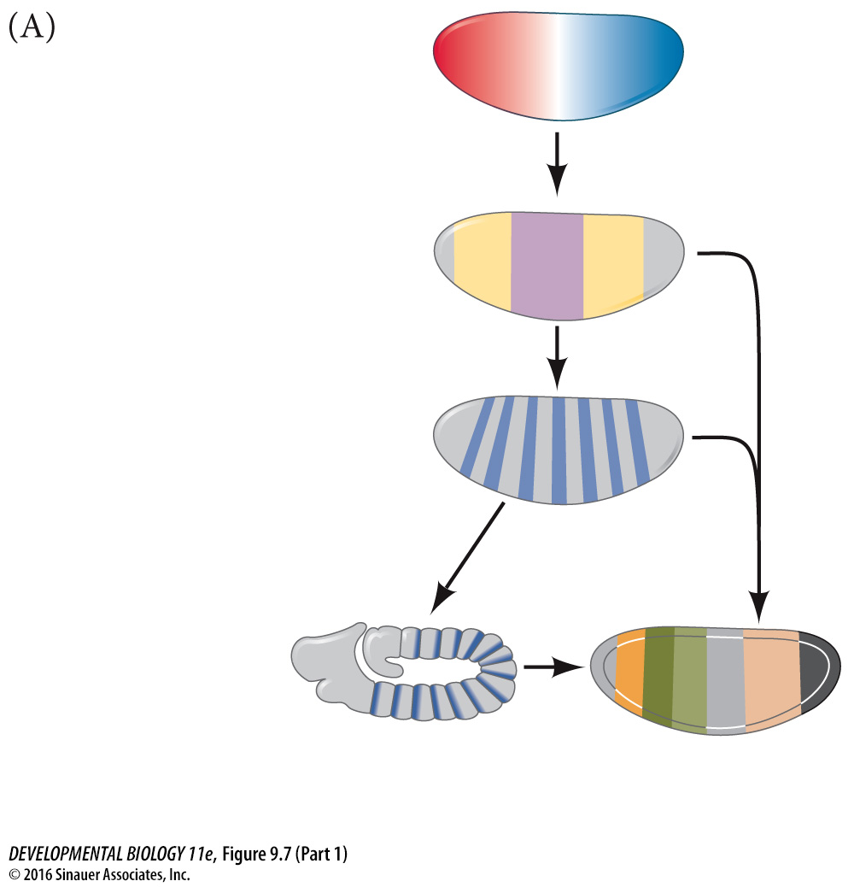
Maternal effect genes
Gap genes
Pair-rule genes 7 stripes
Segment polarity genes 14 stripes
Homeotic selector genes – determines developmental fate of each segment

Slide 9
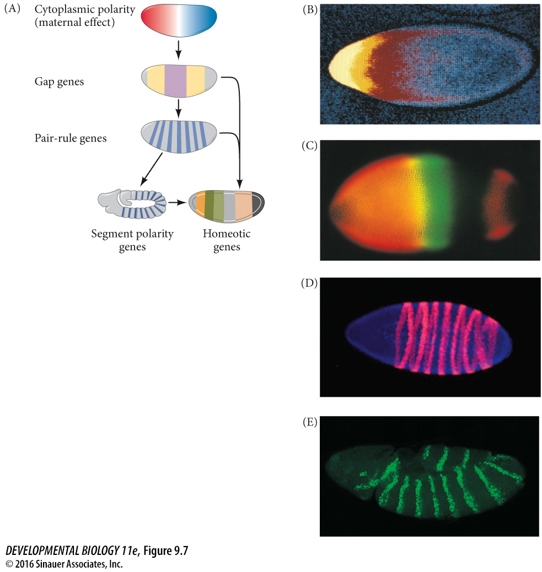
7 stripes
14 stripes
Notes:
Figure 9.7 Generalized model of Drosophila anterior-posterior pattern formation. Anterior is to the left; the dorsal surface faces upward. (A) The pattern is established by maternal effect genes that form gradients and regions of morphogenetic proteins. These proteins are transcription factors that activate the gap genes, which define broad territories of the embryo. The gap genes enable the expression of the pair-rule genes, each of which divides the embryo into regions about two segments wide. The segment polarity genes then divide the embryo into segment-sized units along the anterior-posterior axis. Together, the actions of these genes define the spatial domains of the homeotic genes that define the identities of each of the segments. In this way, periodicity is generated from nonperiodicity, and each segment is given a unique identity. (B) Maternal effect genes. The anterior axis is specified by the gradient of Bicoid protein (yellow through red; yellow being the highest concentration). (C) Gap gene protein expression and overlap. The domain of Hunchback protein (orange) and the domain of Krüppel protein (green) overlap to form a region containing both transcription factors (yellow). (D) Products of the fushi tarazu pair-rule gene form seven bands across the blastoderm of the embryo. (E) Products of the segment polarity gene engrailed, seen here at the extended germ band stage. (B courtesy of C. Nüsslein-Volhard; C courtesy of C. Rushlow and M. Levine; D courtesy of D. W. Knowles; E courtesy of S. Carroll and S. Paddock.)

Slide 10
Maternal Effect Genes
Genotype of mother determines the phenotype
Mother’s cells provide the gene product
Gene product required for development of early egg
example bicoid

Slide 11
Bicoid phenotype
Dorsal
Anterior
Posterior
Wild type
Bicoid mutant
telson-abdomen-abdomen-telson

Slide 12
Maternal Effect Genes
Genotype of mother determines the phenotype
Note: this is true with a bicoid recessive mutation
Mom is bicoid⁻/bicoid⁻
Dad is bicoid⁺/bicoid⁺
offspring is bicoid⁻/bicoid⁺
offspring is mutant phenotype due to mother’s genotype

Slide 13
How do cytoplasmic determinants get localized within the egg?

Slide 14
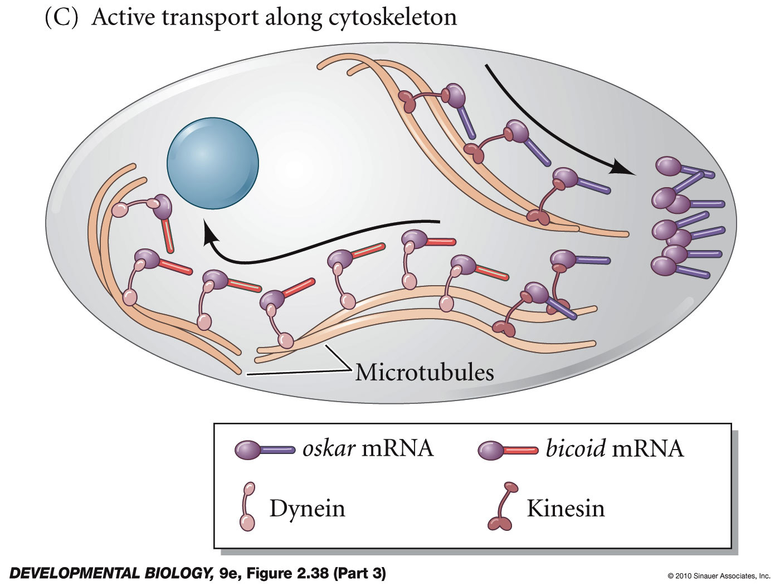
subcellular localization of mRNA
3’UTR of bicoid mRNA binds two other proteins that allow interaction with microtubules
bicoid is localized to anterior end of the egg
molecular “motors” - dynein motor moves along microtubules toward “-” end

Slide 15
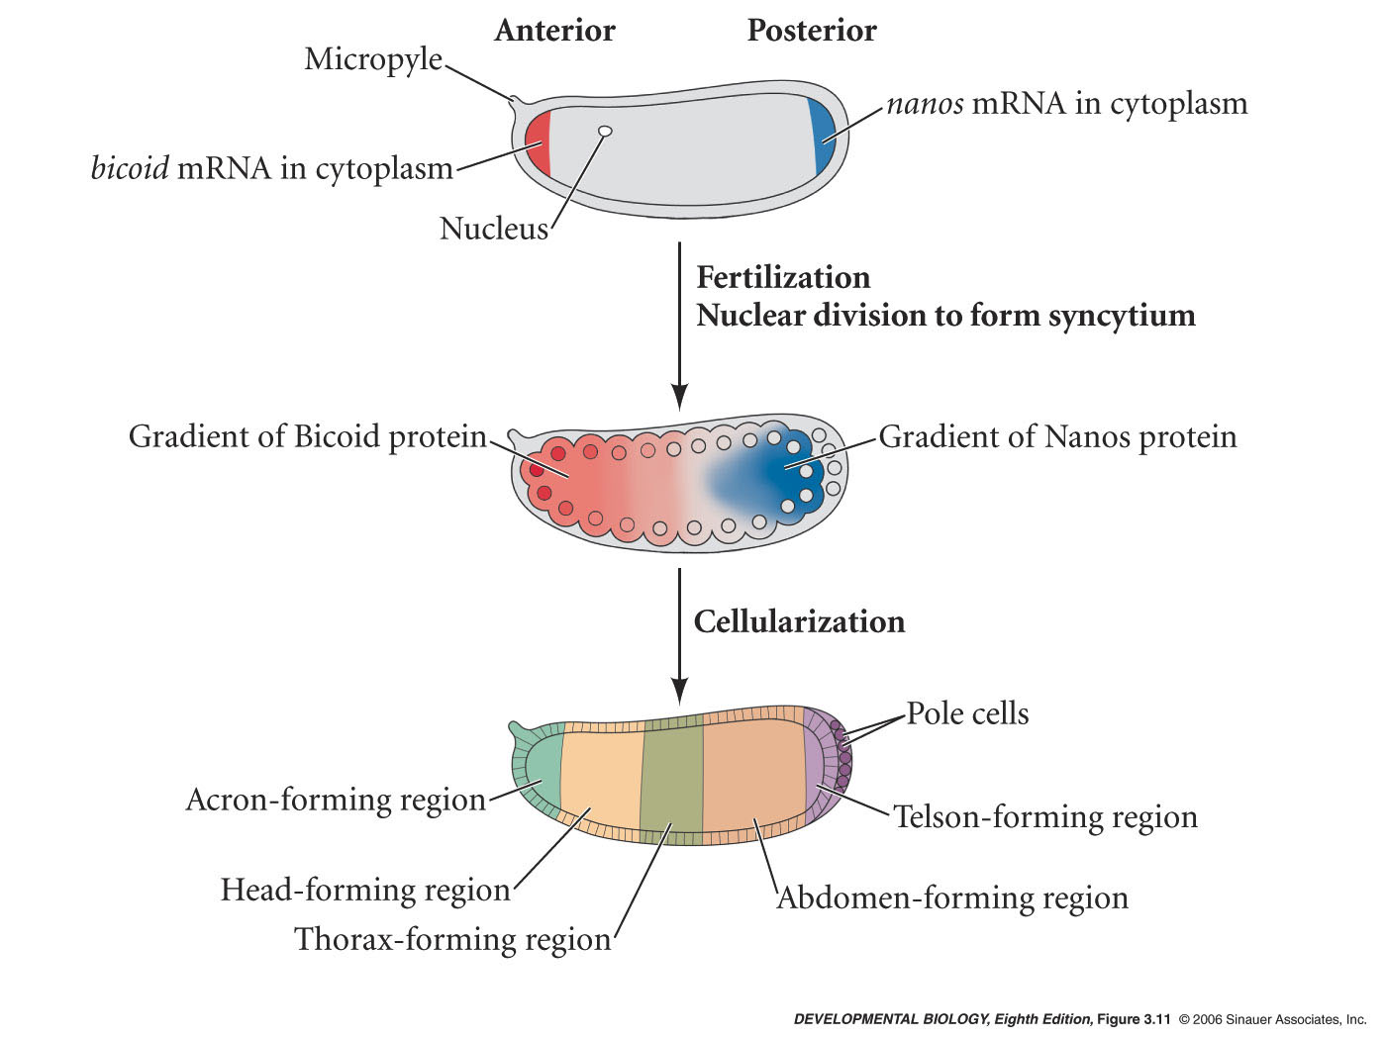
Bicoid maternal effect gene - subcellular localization of mRNA
3’UTR of bicoid mRNA binds two other proteins that allow interaction with microtubules
bicoid is localized to anterior end of the egg
molecular “motors” - dynein motor moves along microtubules toward “-” end

Slide 16
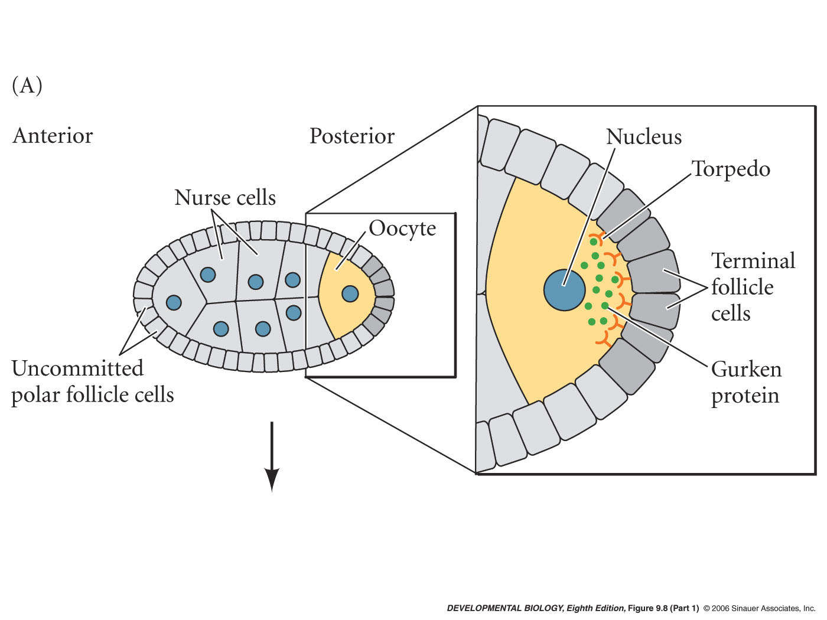
Interaction between oocyte/egg and maternal follicle cells (ovarian cells) patterns the egg during oogenesis
oocyte = egg
oogenesis = female gametogenesis (development of the egg)

Slide 17
Interaction between oocyte/egg and maternal follicle cells (ovarian cells) patterns the egg during oogenesis
follicle cells = cells of the ovary that surround the egg chamber - somatic cell
one role of follicle cells is to signal the egg

Slide 18
Interaction between oocyte/egg and maternal follicle cells (ovarian cells) patterns the egg during oogenesis
during oogenesis a single germ cell gives rise to 16 clonally related cells (four division cycles). cytoplasmic bridges connect the cells
one egg cell/oocyte and 15 nurse cells
function of the nurse cells is to provide mRNA, ribosomes, proteins. etc to the egg cell

Slide 19
Interaction between oocyte/egg and maternal follicle cells (ovarian cells) patterns the egg during oogenesis
oocyte nucleus produces Gurken ligand
terminal follicle cells receive Gurken signal with Torpedo receptor
posterior follicles differentiate and signals back

Slide 20
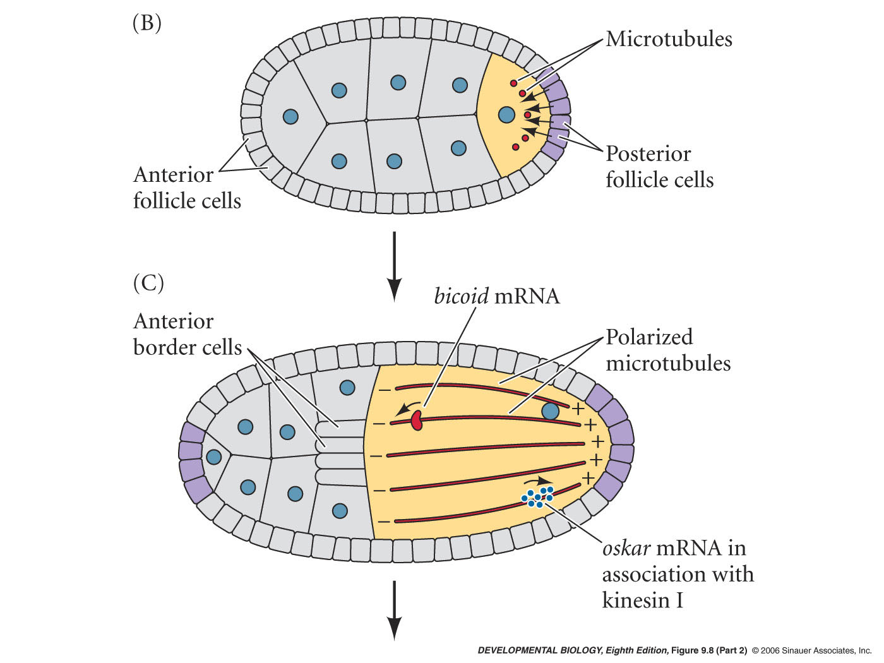
Setting up for Anterior/Posterior patterning during Oogenesis
signal from posterior follicle cells reorganizes microtubules in oocyte/egg
bicoid, nanos, oskar come in from the nurse cells

Slide 21
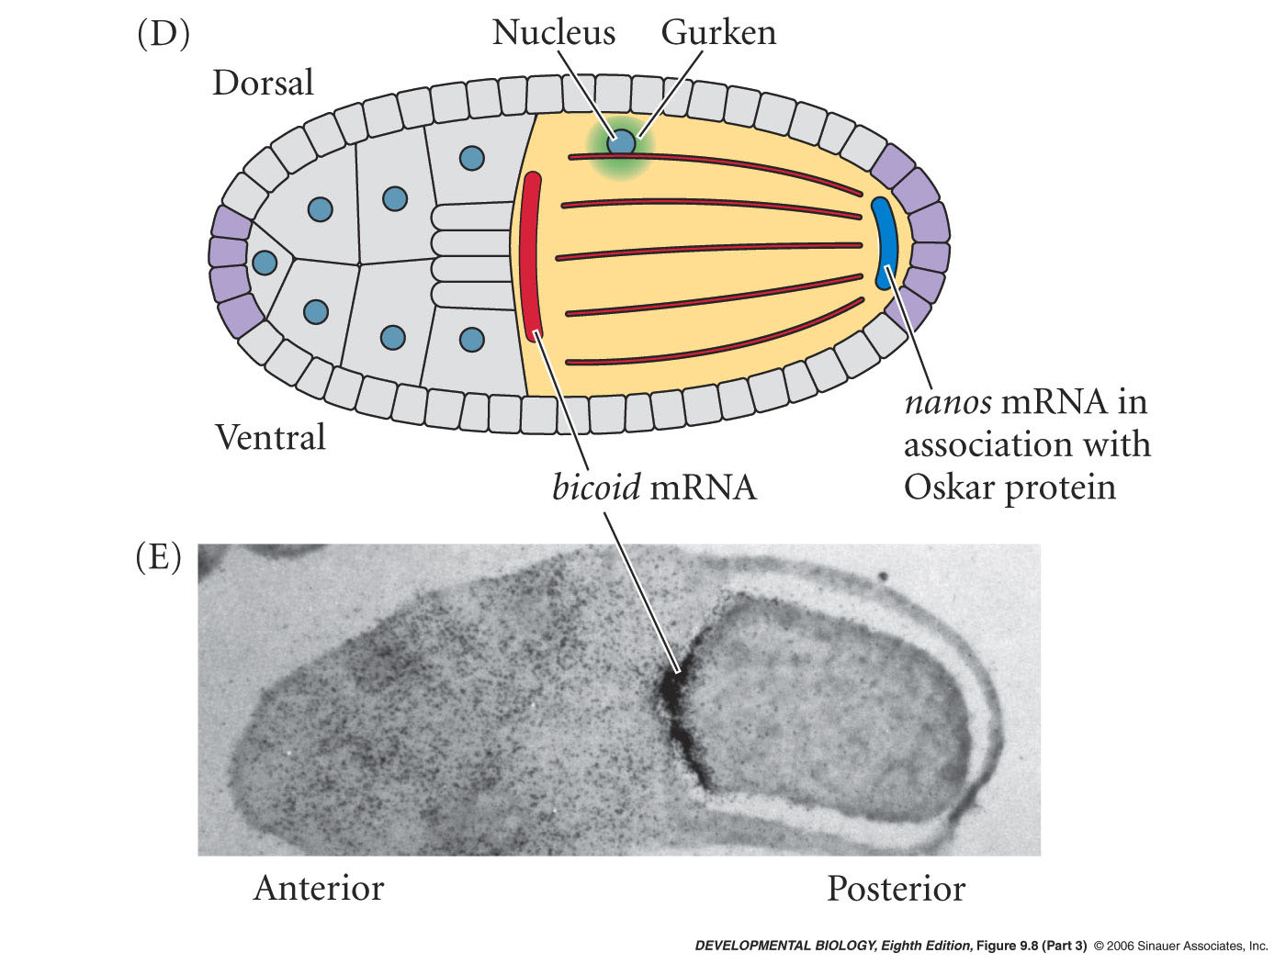
Setting up for Anterior/Posterior patterning during Oogenesis
oskar mRNA associates with kinesin I motor protein - moves to microtubule plus end
Oskar protein will bind 3’UTR of nanos mRNA
thus nanos is localized to the posterior portion of the egg cytoplasm

Slide 22
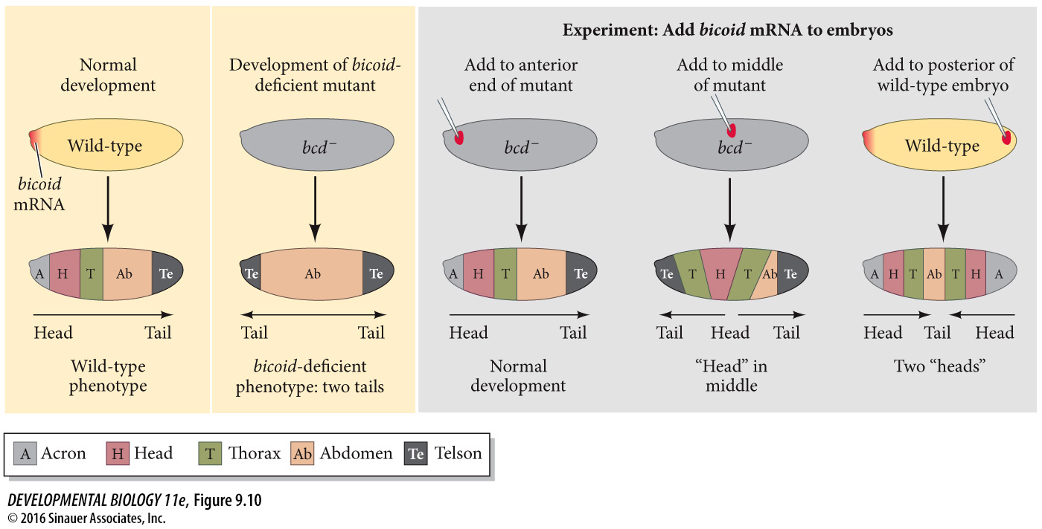
Figure 9.10 Schematic representation of experiments demonstrating that the bicoid gene encodes the morphogen responsible for head structures in Drosophila
Notes:
Figure 9.10 Schematic representation of experiments demonstrating that the bicoid gene encodes the morphogen responsible for head structures in Drosophila. The phenotypes of bicoid-deficient and wild-type embryos are shown at left. When bicoid-deficient embryos are injected with bicoid mRNA, the point of injection forms the head structures. When the posterior pole of an early-cleavage wild-type embryo is injected with bicoid mRNA, head structures form at both poles. (After Driever et al. 1990.)

Slide 23
Syncytial specification
Specification of cell types along:
anterior-posterior (AP) and
dorsal-ventral (DV) axes
determined by gradients of cytoplasmic determinants within syncytium
Syncytium - Multiple nuclei within a single cell

Slide 24
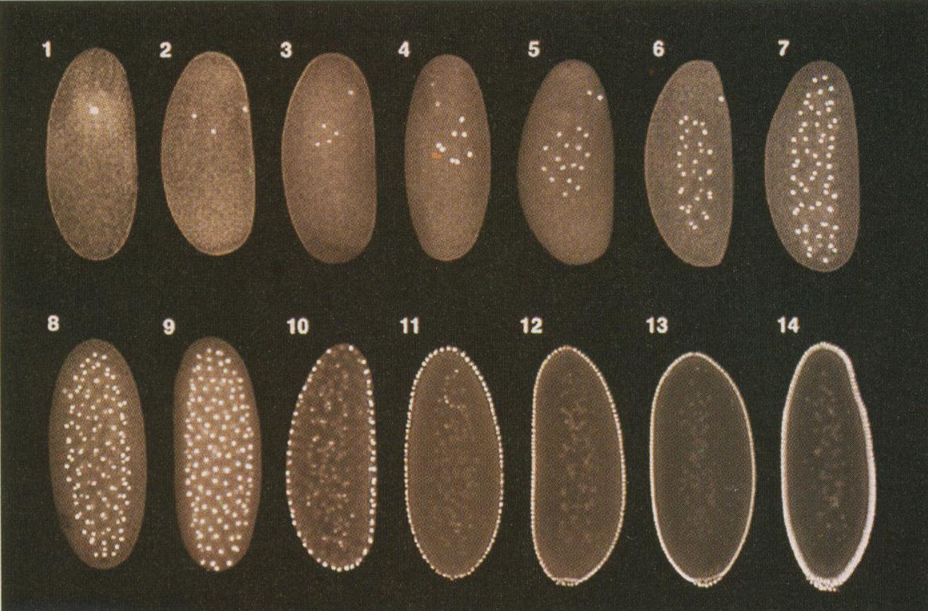
Early Drosophila Embryonic Development
Syncytial Specification
Many nuclei within a single cell
cytoplasmic determinants exist in gradients and can affect nuclei
Cell membranes form during the 13th nuclear division

Slide 25
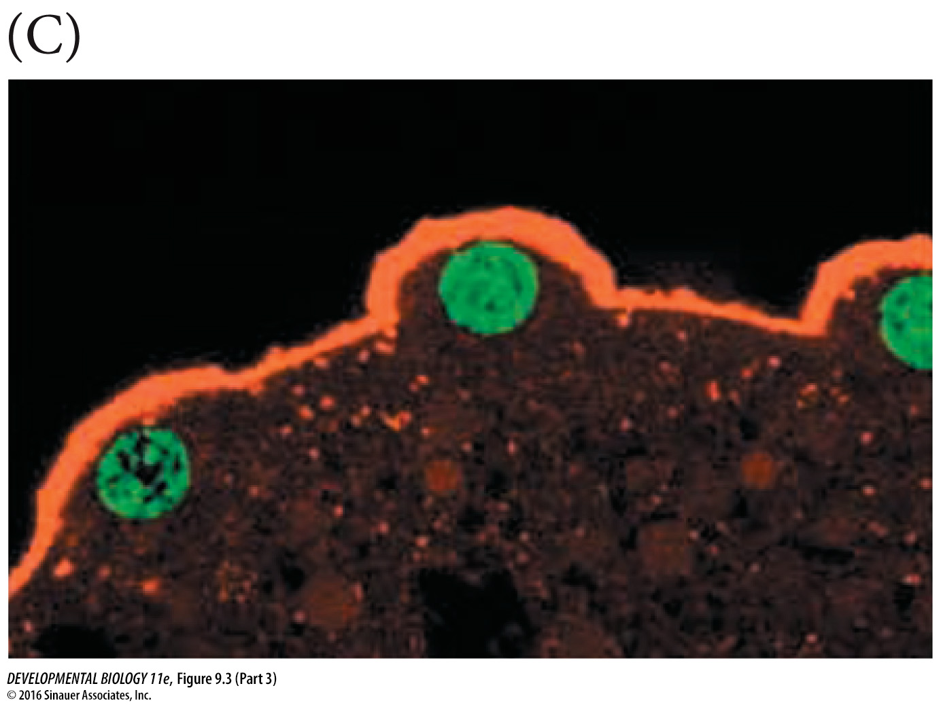
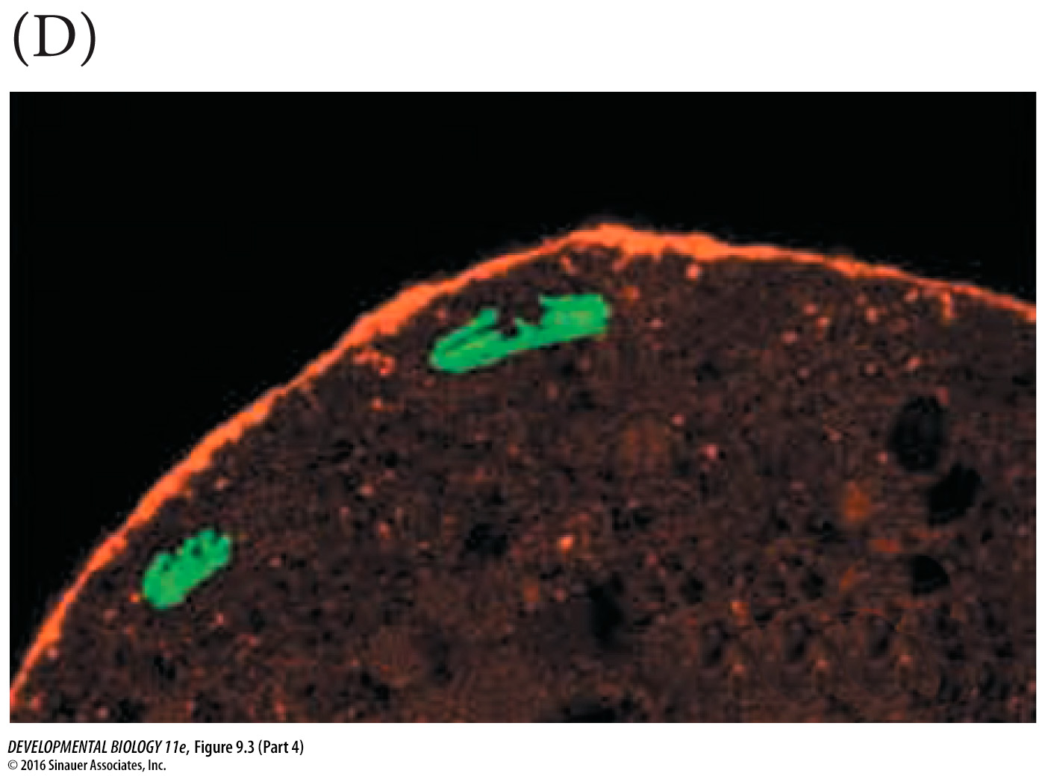
Figure 9.3 Syncytial blastoderm nuclei at the periphery of embryo/cell
Notes:
Figure 9.3 Nuclear and cell division in Drosophila embryos. (A) Nuclear division (but not cell division) can be seen in a syncytial Drosophila embryo using a dye that stains DNA. The first region to cellularize, the pole region, can be seen forming the cells in the posterior region of the embryo that will eventually become the germ cells (sperm or eggs) of the fly. (B) Chromosomes dividing at the cortex of a syncytial blastoderm. Although there are no cell boundaries, actin (green) can be seen forming regions within which each nucleus divides. The microtubules of the mitotic apparatus are stained red with antibodies to tubulin. (C,D) Cross section of a part of a cycle 10 Drosophila embryo showing nuclei (green) at the cortex of the syncytial cell, adjacent to a layer of actin microfilaments (red). (C) Interphase nuclei. (D) Nuclei in anaphase, dividing parallel to the cortex and enabling the nuclei to stay in the cell periphery. (A from Bonnefoy et al. 2007; B from Sullivan et al. 1993, courtesy of W. Theurkauf and W. Sullivan; C,D from Foe 2000, courtesy of V. Foe.)

Slide 26
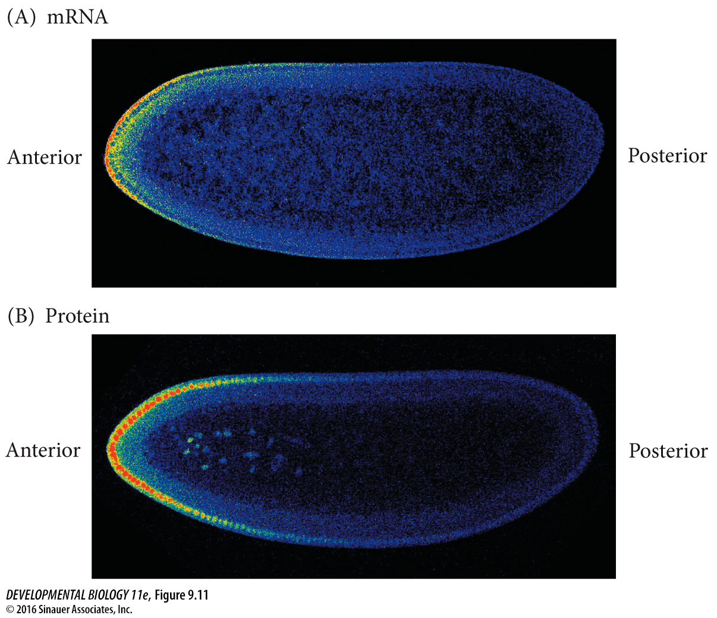
Figure 9.11 The bicoid mRNA and protein gradients
Notes:
Figure 9.11 The bicoid mRNA and protein gradients shown by in situ hybridization and confocal microscopy. (A) bicoid mRNA shows a steep gradient (here seen as red to blue) across the anterior portion of the oocyte. (B) When the mRNA is translated, the Bicoid protein gradient can be seen in the anterior nuclei. Anterior is to the left; the dorsal surface is upward. (After Spirov et al. 2009, courtesy of S. Baumgartner.)

Slide 27
Anterior/posterior pattern specification
Fig 9.13 -

Slide 28
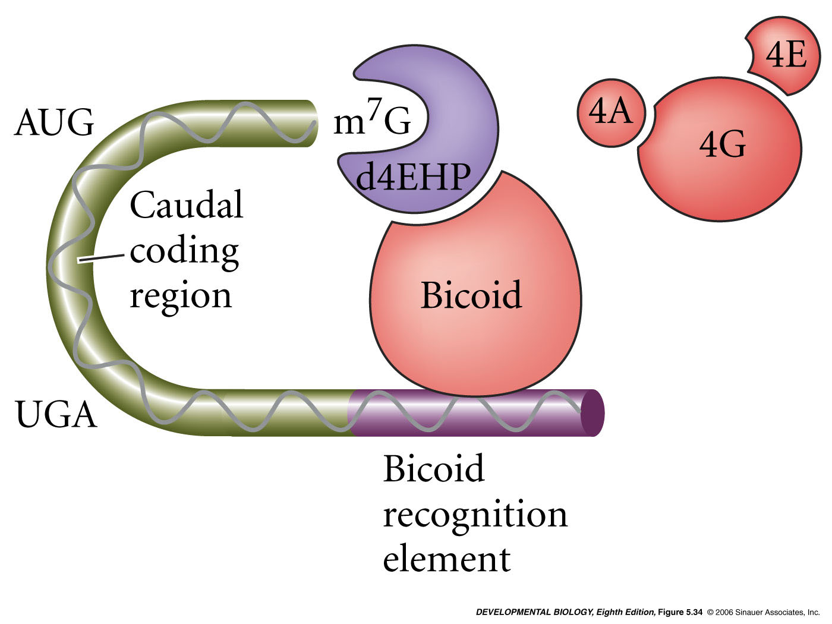
Translational control during drosophila A/P patterning
Bicoid binds 3’UTR of caudal mRNA
Bicoid blocks eIF4E and eIf4G
Translation inhibited

Slide 29
Mid-blastula transition
around nuclear division cycle 11
nuclear divisions slow down
zygotic genes are expressed from the nuclei
i.e. this is the first time that mRNA’s are being made from the zygotic nuclei
Later, cellularization at nuclear cycle 14 =
cellular blastoderm stage

Slide 30
Early Drosophila Embryonic Development
Syncytial Specification
Many nuclei within a single cell
cytoplasmic determinants exist in gradients and can affect nuclei
Cell membranes form during the 13th nuclear division

Slide 31
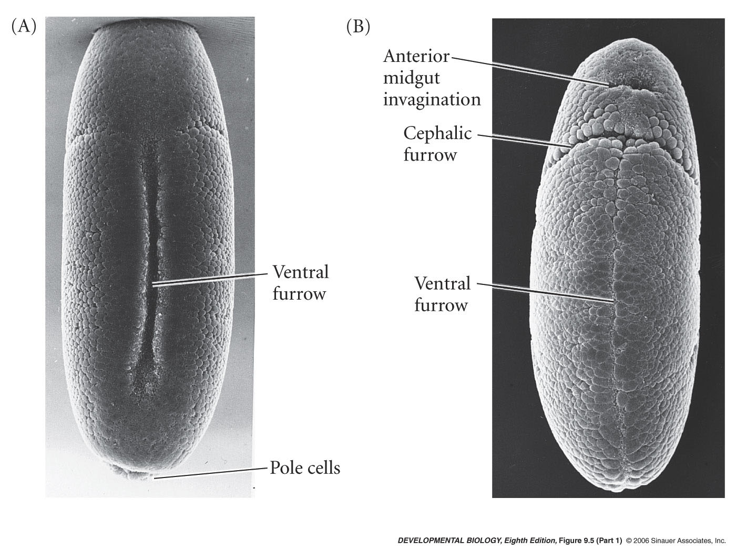
Gastrulation
Segregate the presumptive
mesoderm
endoderm
ectoderm
I . Mesoderm invaginates
~1000 cells from ventral midline folds inward to produce ventral furrow
Furrow pinches off, forms a tube and then a layer of cells under the ventral ectoderm

Slide 33
Setting up for Dorsal Ventral patterning during Oogenesis
bicoid mRNA associates with dynein motor in egg and moves to the microtubule minus end
notice that the egg cell nucleus has moved to the future dorsal portion of the egg

Slide 34
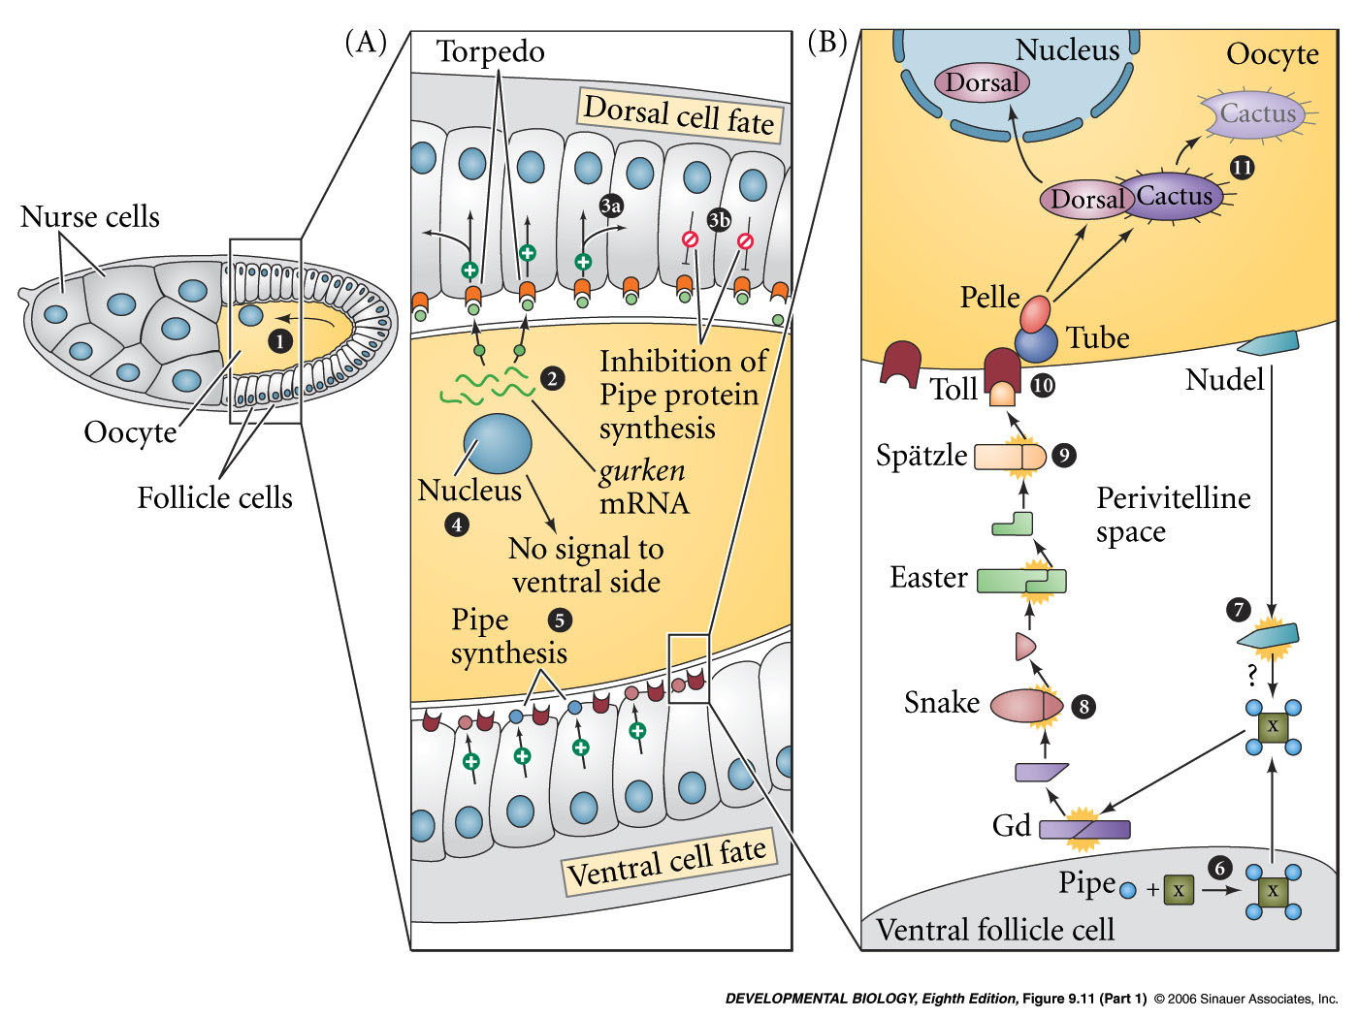
Setting up for Dorsal ventral patterning during Oogenesis
egg cell nucleus makes Gurken protein
Gurken binds Torpedo receptor
dorsal follicle cells differentiate
Stop expressing Pipe protein
Pipe in the ventral follicle cells starts a signal cascade allows Dorsal protein into the nucleus

Slide 35
Setting up for Dorsal ventral patterning during Oogenesis
egg cell nucleus makes Gurken protein
Gurken binds Torpedo receptor
dorsal follicle cells differentiate
Stop expressing Pipe protein
Pipe in the ventral follicle cells starts a signal cascade allows Dorsal protein into the nucleus

Slide 36
Regulated subcellular localization
Pelle kinase
Phosphorylates Cactus
Cactus is degraded
Dorsal can move into nucleus
same pathway used in mammalian lymphocytes

Slide 37
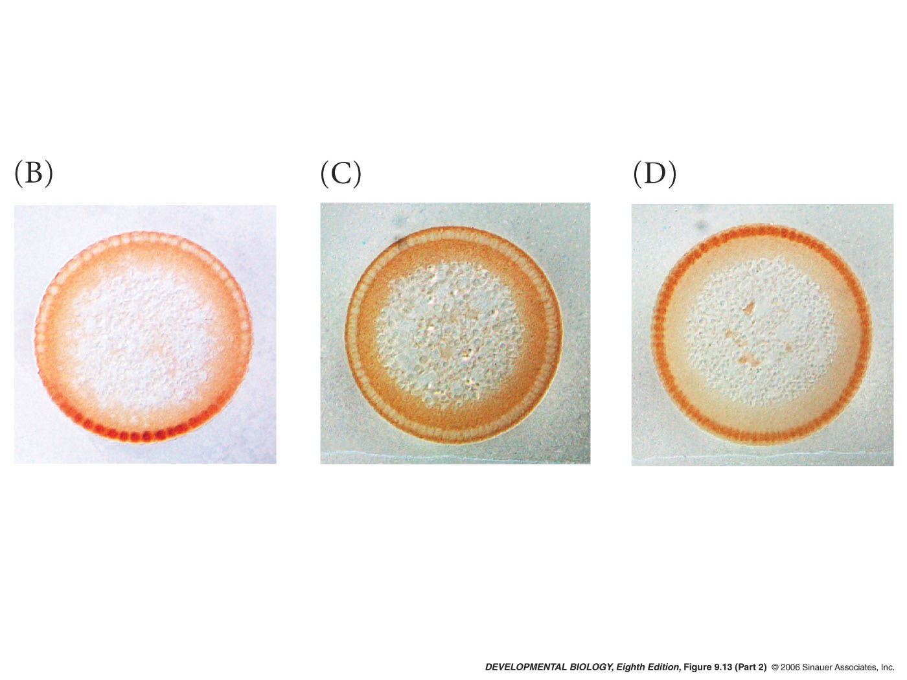
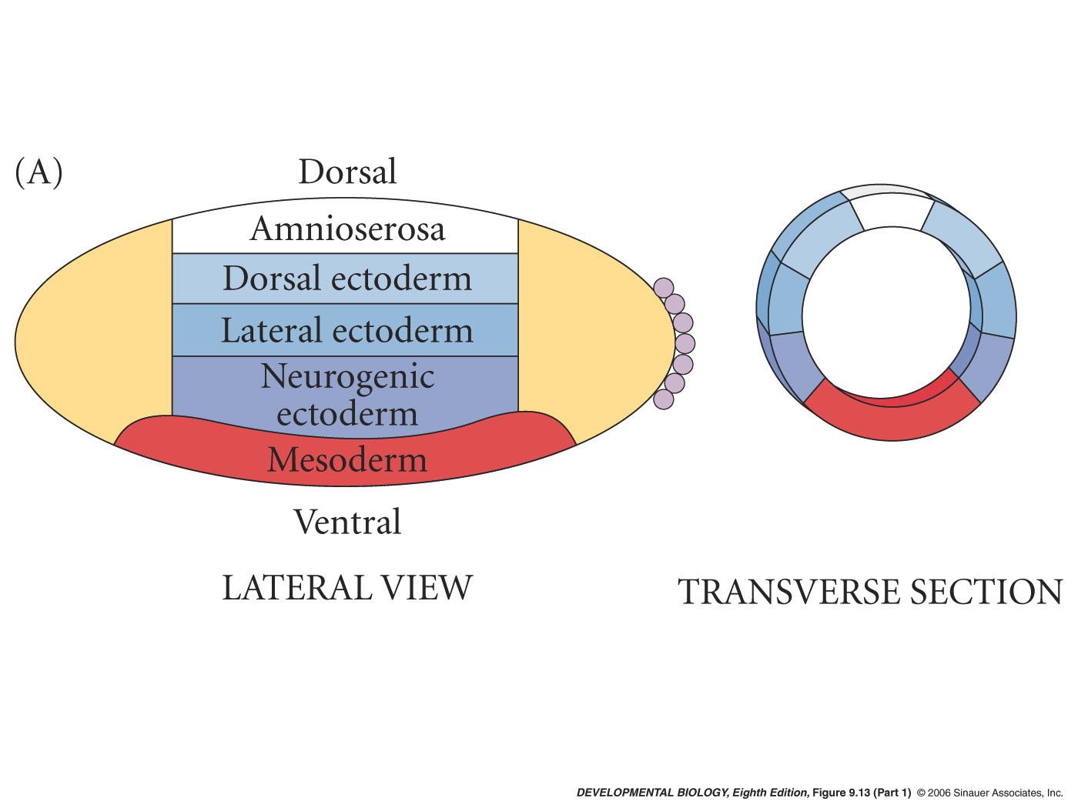
Later, the different levels of Dorsal in the nucleus pattern the cellular blastoderm
fate map triggered by dorsal transcription factor
dorsal nuclear protein gradient

Slide 38
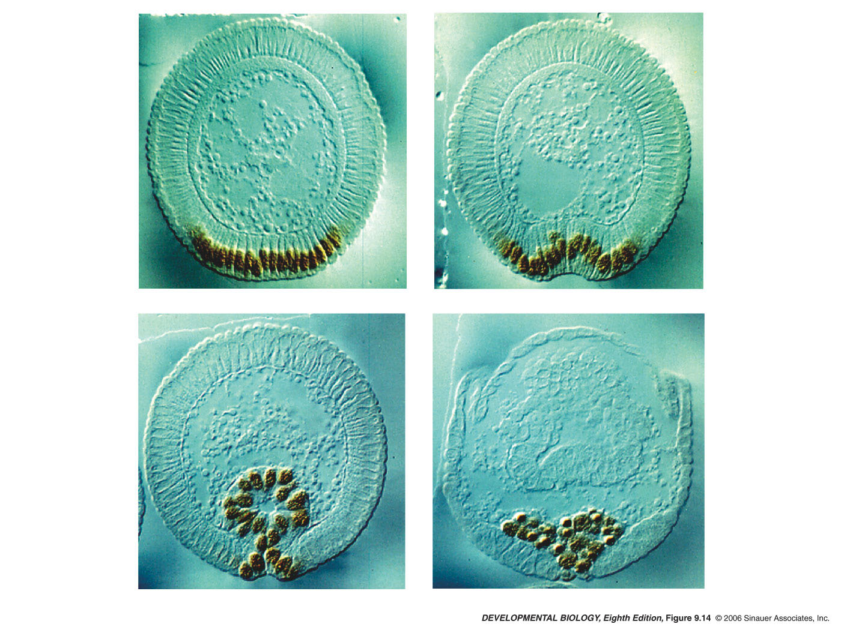
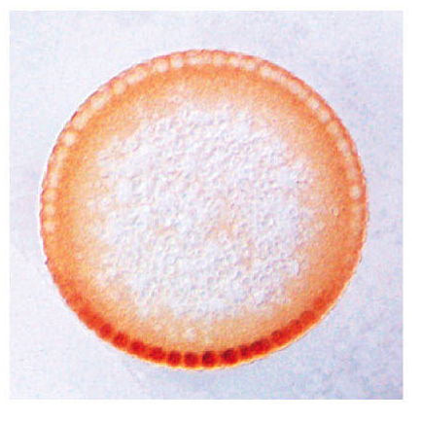
High levels of Dorsal activate Twist gene expression
twist helps determine mesodermal fate
future mesoderm
dorsal nuclear protein gradient

Slide 39
Different genes - Different enhancers
zen has binding sites for dorsal but also has sites for Groucho co-repressor that switches Dorsal from an activator to a repressor
short gastrulation (sog) has high- affinity binding sites for Dorsal
twist promoter has low-affinity Dorsal binding sites
expression patterns
zen
sog
twist

Slide 40
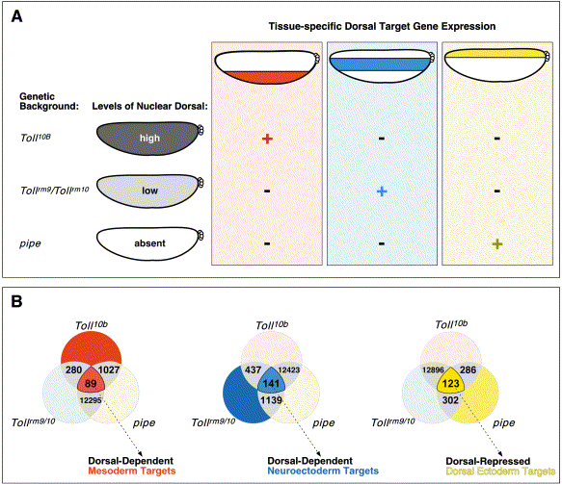
doi:10.1016/S0092-8674(02)01087-5 Copyright © 2002 Cell Press.
Whole-Genome Analysis of Dorsal-Ventral Patterning in the Drosophila Embryo
Angelike Stathopoulos , Madeleine Van Drenth , Albert Erives , Michele Markstein and Michael Levine
Genes/RNAs that respond to high levels of Dorsal
Discuss in class Feb. 19th
Twist
sog
zen

