Slide 1
doi:10.1016/S0092-8674(02)01087-5 Copyright © 2002 Cell Press.
Whole-Genome Analysis of Dorsal-Ventral Patterning in the Drosophila Embryo
Angelike Stathopoulos , Madeleine Van Drenth , Albert Erives , Michele Markstein and Michael Levine
Read and Prepare . Feb 19th discussion of this paper
CHAPTER 9 –
Fig 9.13 (A and B parts only) – Greg L.
Fig 9.19 Nicole L.
Fig 9.23 – Jared M..
Whole-Genome Analysis of Dorsal-Ventral Patterning in the Drosophila Embryo
Figures
Overview/introduction: - Nicholas M..
1A, - Allison R
1B, -.Abigail S.
Fig. 2, - Michael S.
Fig 3 A-E = Hannah S.
Fig 3 F-J = Gavin S.
Fig 3 K-O = Jessee T.
Fig 4 – A -.Vivian T.
Fig4B,C,D – Matthew A.
Fig 4E,F,G-.Rachel B
Fig 4 – H, I – Kelly B.

Slide 2
Pick a topic for team presentations (April 13th)
pick topic by Feb 16th by email
Teams will be made up of three people and an effort to connect these teams by interest in the topic.
Presentation of an original research paper
One person – Introduction and background – What was known going into the study
One person main experiments and results
One person on conclusions of the data – potential limitations of the data – implications of the data – future work
18-20 minute presentation plus 5 min for questions from the rest of class.

Slide 3
Drosophila II
Genetic screen for zygotic anterior/posterior patterning mutants
gap mutants
pair-rule mutants
segement polarity mutants
Molecular control of pair-rule gene expression
Segment polarity specification

Slide 4
A-P axis formation
Maternal effect genes
Gap genes
Pair-rule genes 7 stripes
Segment polarity genes 14 stripes
Homeotic selector genes – determines
developmental fate of each
segment
Anterior
Posterior

Slide 5
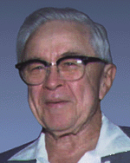
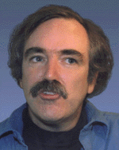
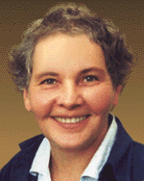
The Nobel Prize in Physiology or Medicine 1995
"for their discoveries concerning the genetic control of early embryonic development"

Slide 6
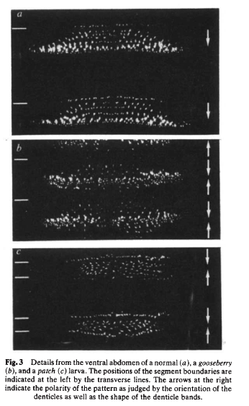
Genetic Screen for Patterning Mutants
Mutagenize thousands of flies
Establish mutant fly lines stocks
Examine larval cuticle (denticle bands) under a microscope
Sort mutants into different categories
Denticle Bands - hairs on the ventral surface of the larvae

Slide 7
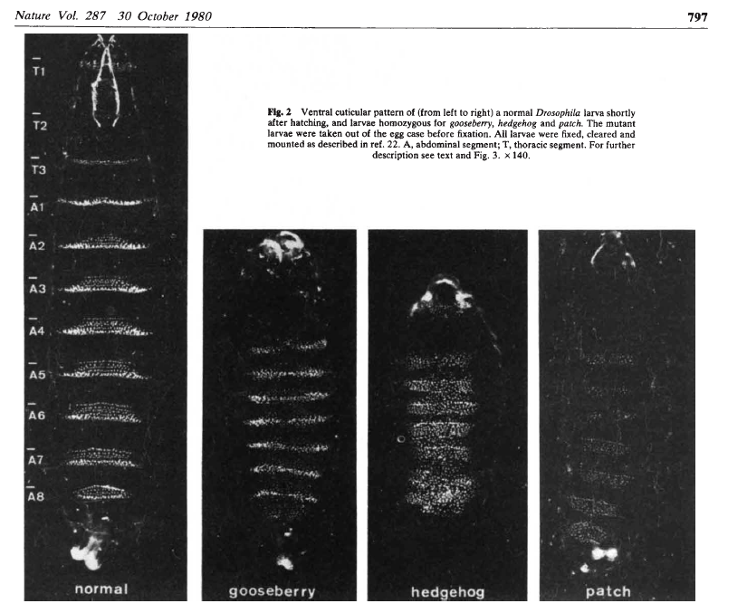
Larval Cuticles

Slide 8
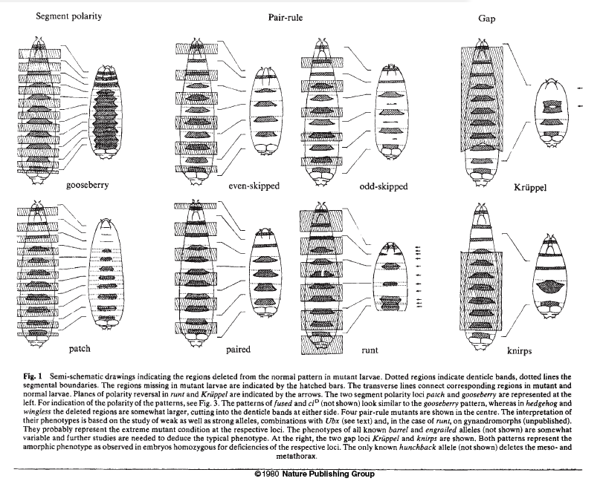
Mutant phenotypes
Segment Polarity - polarity affected in every segment
Pair rule - missing every other segment
GAP - missing a gap of several contiguous segments

Slide 9
Segment Polarity Mutants
Pattern is altered in each segment
often the missing half is replaced by a duplicate of the other half

Slide 10
A-P axis formation
Maternal effect genes
Gap genes
Pair-rule genes 7 stripes
Segment polarity genes 14 stripes
Homeotic selector genes – determines
developmental fate of each
segment

Slide 11
Genes
Maternal effect genes activate or repress gap genes
Gap gene expression :
1st time embryos divided into distinct units
Divide embryo into broad domains containing several parasegments

Slide 12
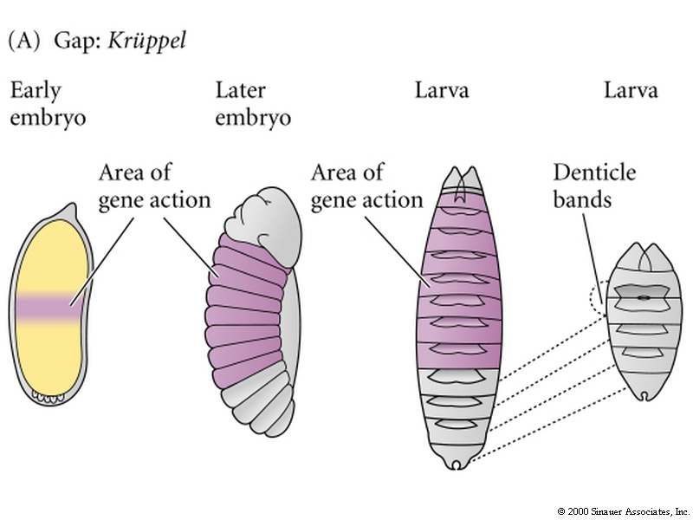
Gap gene, Kruppel
normal
mutant

Slide 13
Gap genes
4 gap genes:
hunchback
Kruppel
giant
Knirps
encode DNA-binding proteins that can activate or repress transcription

Slide 14
Genes
Hunchback forms a steep gradient
Giant anterior stripe –
Medium levels of hunchback and high levels of bicoid activate giant while high hunchback levels represses giant.
Note that Hunchback can act as a repressor or an activator
Giant posterior stripe
controlled by caudal protein gradient
Note: Patterns are refined over time
The two giant stripes controlled by different enhancer modules

Slide 15
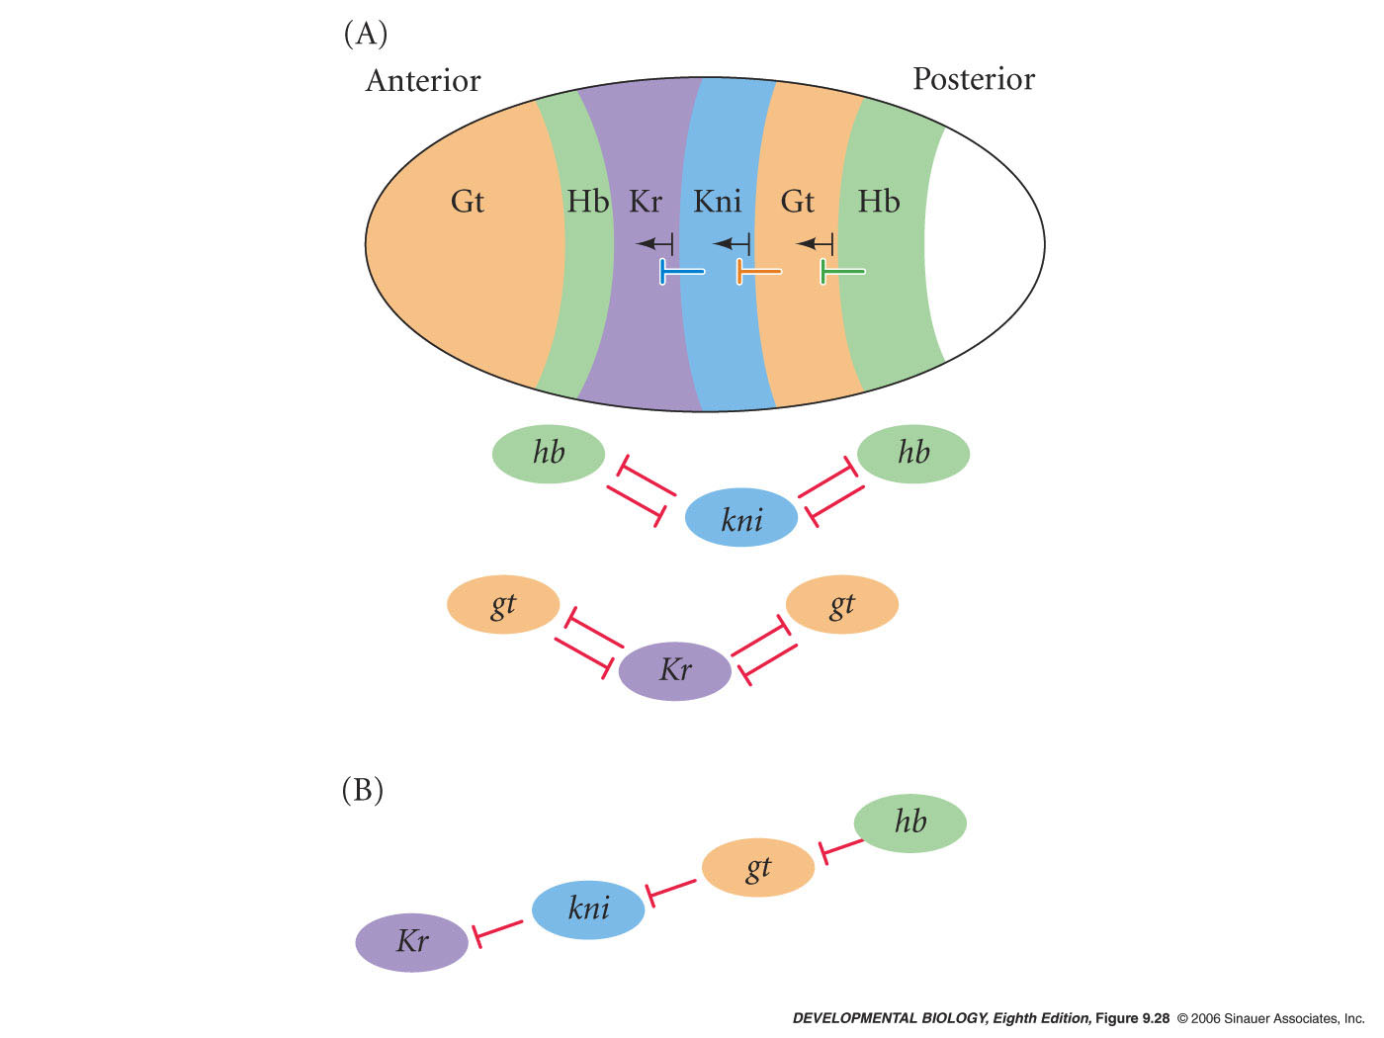
Expression and regulatory interactions among
gap gene products
mutual repression between non-adjacent domains
still a syncytium at this time
There is some overlap in expression between adjacent domains
Notes:
devbio8e-fig-09-28-0.jpg

Slide 16
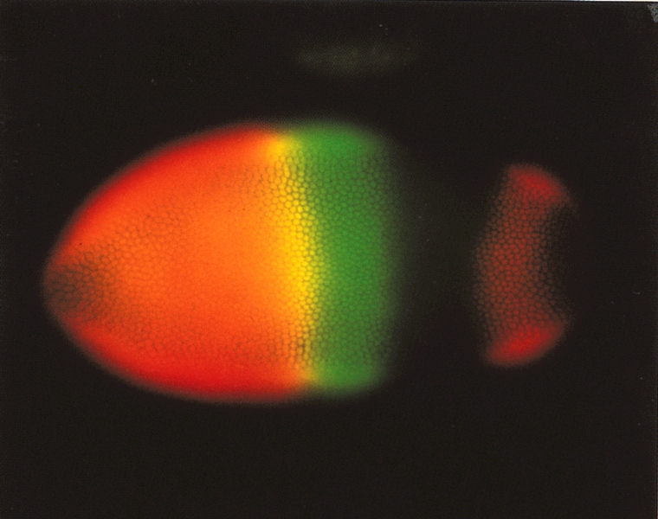
Adjacent GAP proteins overlap
Hunchback protein (orange)
Kruppel protein (green)
Overlap (yellow)

Slide 17
Gap genes turn on the primary Pair-rule genes
Pair-rule genes - expressed in 7 stripes
nuclear cycle 13
Divide embryo into parasegments
Alternating stripes of expression and no expression
Divides embryo into 14 parasegments, plus the acron and telson regions

Slide 18
Pair-rule genes
8 pair-rule genes
Primary
hairy (h)
even-skipped (eve)
runt (run)
Secondary
fushi taratzu (ftz)
odd-paired (opa)
odd-skipped (odd)
sloppy-paired (slp)
paired (prd)

Slide 19
Pair-rule Gene Enhancer Elements
recognized by gap genes
respond to different concentrations of gap gene proteins
are modular

Slide 20
Regulation of pair-rule stripes
Importance of enhancers demonstrated experimentally
Mutation in enhancer causes deletion of that stripe
Fuse lacZ to the enhancer – lacZ is expressed in that stripe
Delete gap genes that regulate a stripe – change location of the stripe

Slide 21
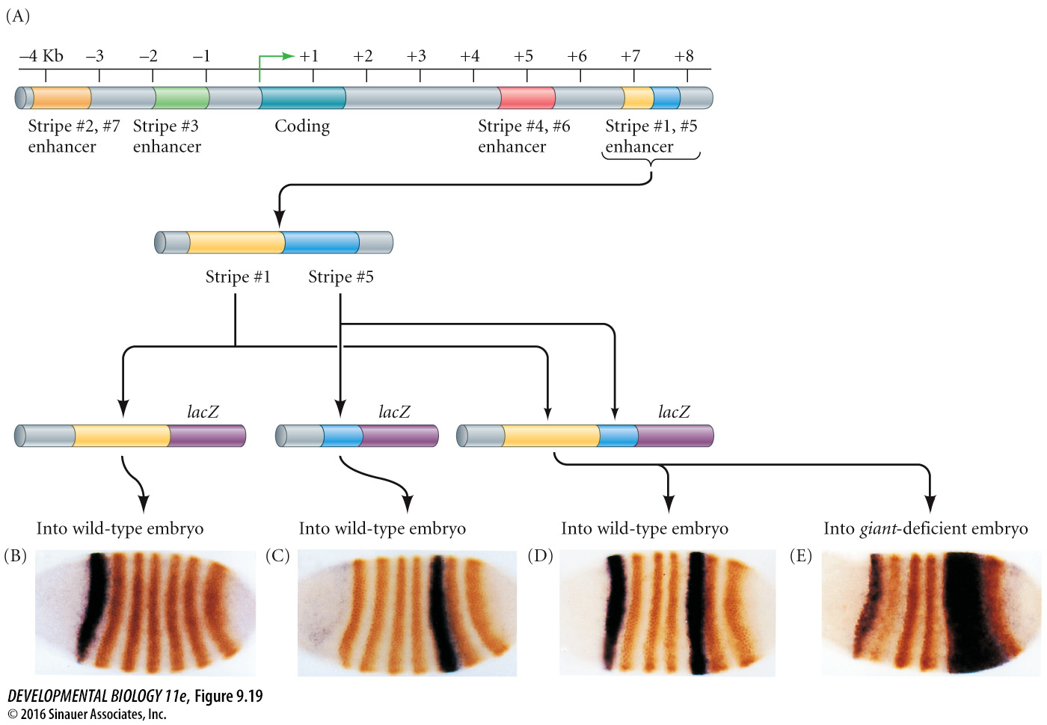
Figure 9.19 Specific promoter regions of the even-skipped (eve) gene
Enhancers of eve
Fig 9.19
Notes:
Figure 9.19 Specific promoter regions of the even-skipped (eve) gene control specific transcription bands in the embryo. (A) Partial map of the eve promoter, showing the regions responsible for the various stripes. (B–E) A reporter β-galactosidase gene (lacZ) was fused to different regions of the eve promoter and injected into fly embryos. The resulting embryos were stained (orange bands) for the presence of Even-skipped protein. (B–D) Wild-type embryos that were injected with lacZ transgenes containing the enhancer region specific for stripe 1 (B), stripe 5 (C), or both regions (D). (E) The enhancer region for stripes 1 and 5 was injected into an embryo deficient in giant. Here the posterior border of stripe 5 is missing. (After Fujioka et al. 1999 and Sackerson et al. 1999; photographs courtesy of M. Fujioka and J. B. Jaynes.)

Slide 22
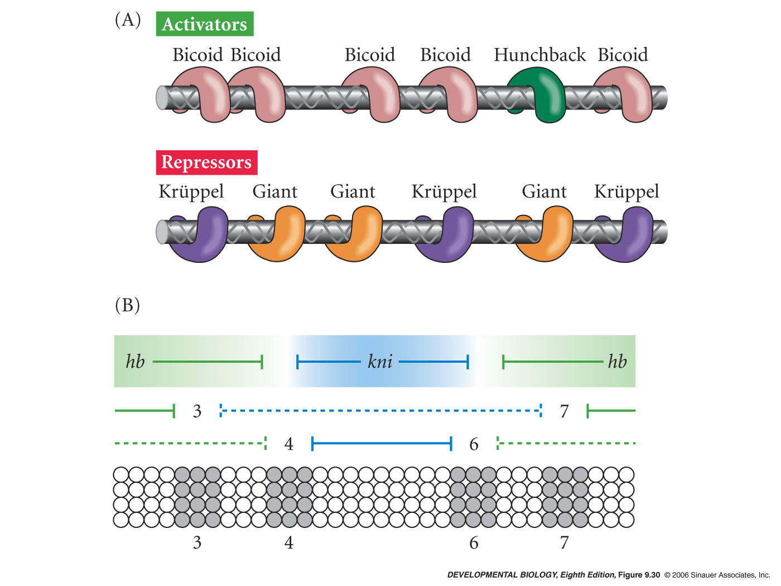
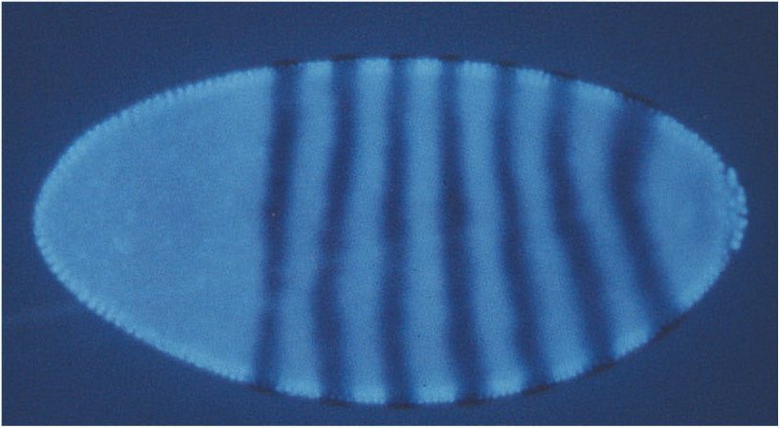
Enhancers of eve stripe 2
binding sites for Kruppel
binding site for Hunchback
binding sites for Giant
binding sites for Bicoid
stripe 2

Slide 23
Regulation of primary pair-rule stripes
Pair-rule gene expression a result of:
1. Modular cis-regulatory enhancer elements of pair-rule genes
2. Trans-regulatory proteins (gap genes) that bind enhancers

Slide 24
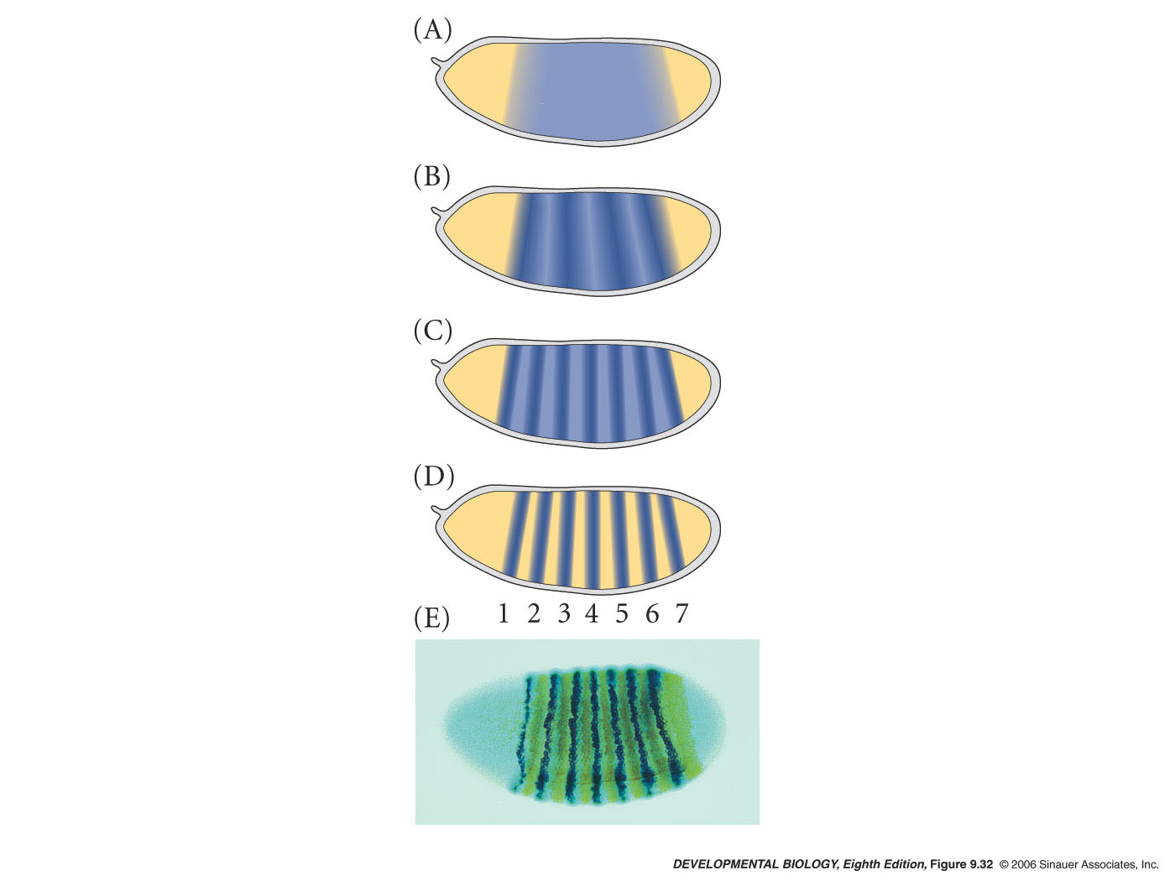
Transcription of the fushi tarazu gene in the Drosophila embryo
starts out diffuse and widespread
secondary pair-rule gene
regulated by gap and primary pair rule genes
refinement of pattern by:
repression in inter-stripe regions
positive autoregulation
Notes:
devbio8e-fig-09-32-0.jpg

Slide 25
Pair-rule genes
Fushi taratzu (brown) transcripts
Even-skipped (blue) transcripts
Pair rule expression stripes are not coincident
Each row of nuclei expresses
a unique constellation
of pair-rule genes

Slide 26
Segment Polarity Genes
Gap genes
Pair-rule genes
Segment polarity genes 14 stripes
Formation of cells

Slide 27
Segment Polarity Genes
Segment polarity genes:
Reinforce parasegmental periodicity established by earlier factors
Establish cell fates through cell-cell signaling
generate new A/P signaling center in each segment
Mutations cause defects in segmentation and gene expression in each segment/parasegment

Slide 28
Segment Polarity Mutants
Pattern is altered in each segment
often the missing half is replaced by a duplicate of the other half

Slide 29
Three Important Segment Polarity Genes
(nine total)
hedgehog (hh)
wingless (wg)
engrailed (en)
paracrine factors
transcription factor

Slide 30
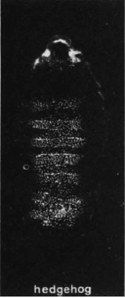
Drosophila hedgehog
from initial screen for cuticle defects
(Nusslein-Volhardt and Weischaus, 1980)

Slide 31
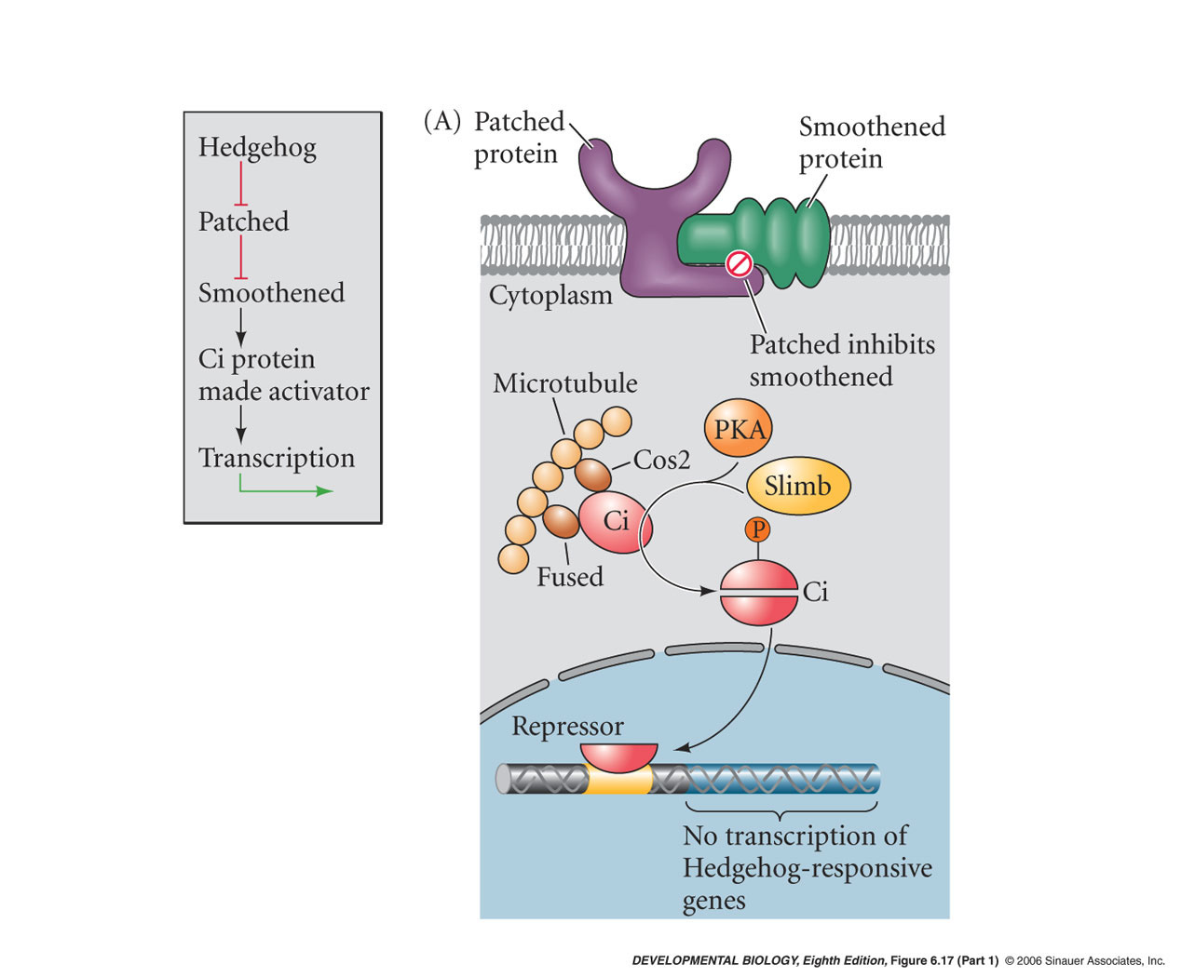
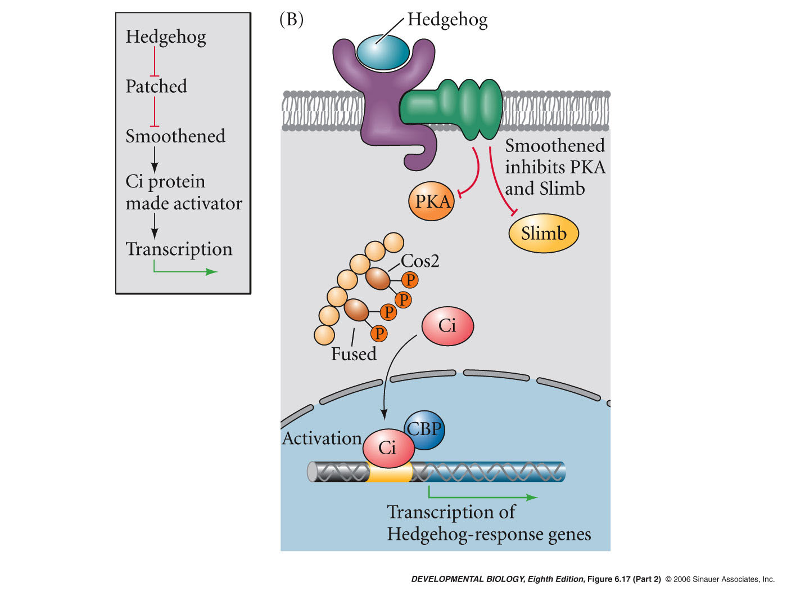
Hedgehog signaling
similar molecules used to transduce the signal in Drosophila and vertebrates
inhibit the inhibitor

Slide 32
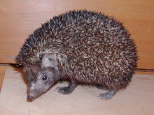
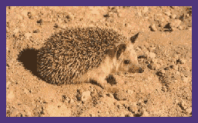
Vertebrate hedgehog genes
vertebrates have three hedgehog-like molecules
Indian
desert
sonic
Developmental roles:
vertebrate limb,
neural differentiation
mutations cause malformations and cancer

Slide 33
Inactivation of hedgehog pathway
in mouse results in:
cyclopia
limb abnormalities
Human diseases:
Pallister Hall Syndrome
extra digits, poor development of hypothalamus and pituitary

Slide 34
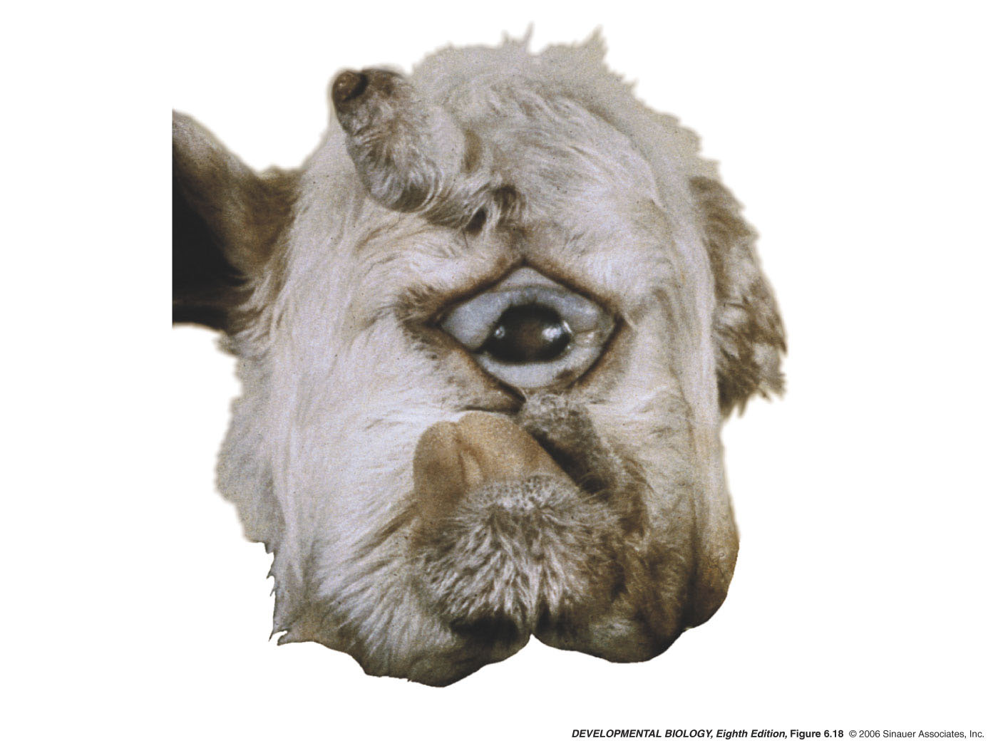
Inactivation of hedgehog pathway
in mouse results in:
cyclopia
limb abnormalities
hedgehog pathway requires cholesterol to allow diffusing of the hedgehog ligand.
Head of a cyclopic lamb born of a ewe who had eaten Veratrum californicum early in pregnancy

Slide 35
overactivation of hedgehog pathway
basal cell carcinomas,
tumors of the basal cell layer of the epidermis

Slide 36
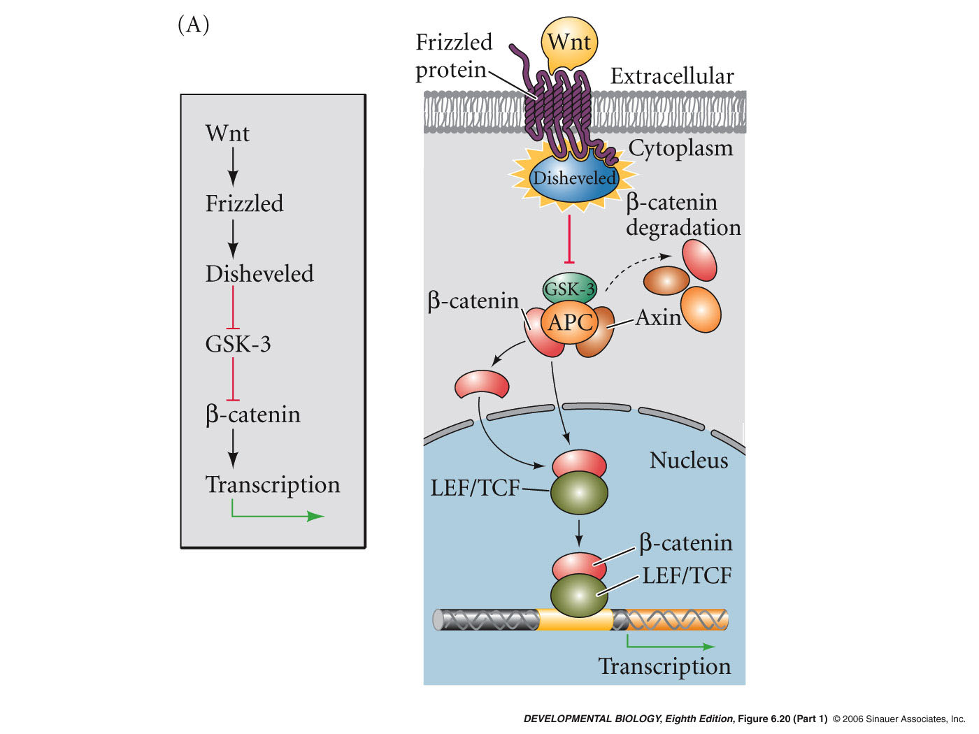
Drosophila wingless
wnt (wingless/integrated) family - 15 vertebrate members
Developmental roles:
somite differentiation
limb polarity
stem cell development

Slide 37
Drosophila engrailed
Engrailed (en) is expressed in 14 stripes - every segment
Engrailed transcription marks the posterior compartment of each segment

Slide 38
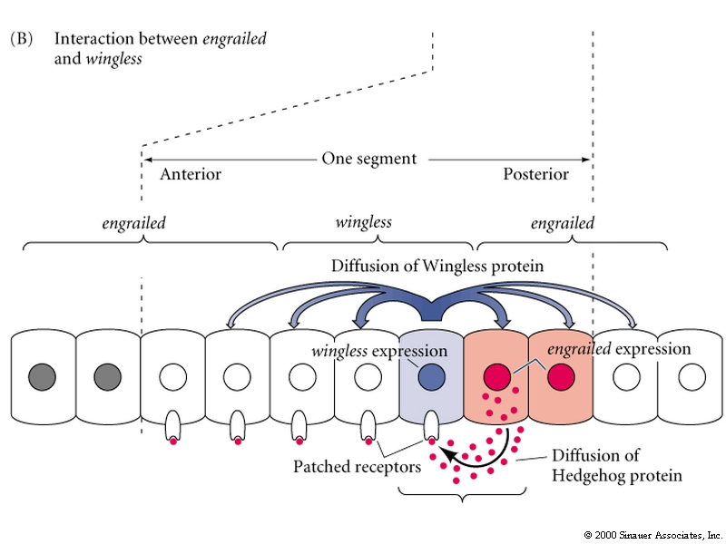
Three Important segment polarity genes
1 row expresses hedgehog (hh)
1 row expresses wingless (wg)
2 rows express engrailed (en)
paracrine factors
transcription factor

Slide 39
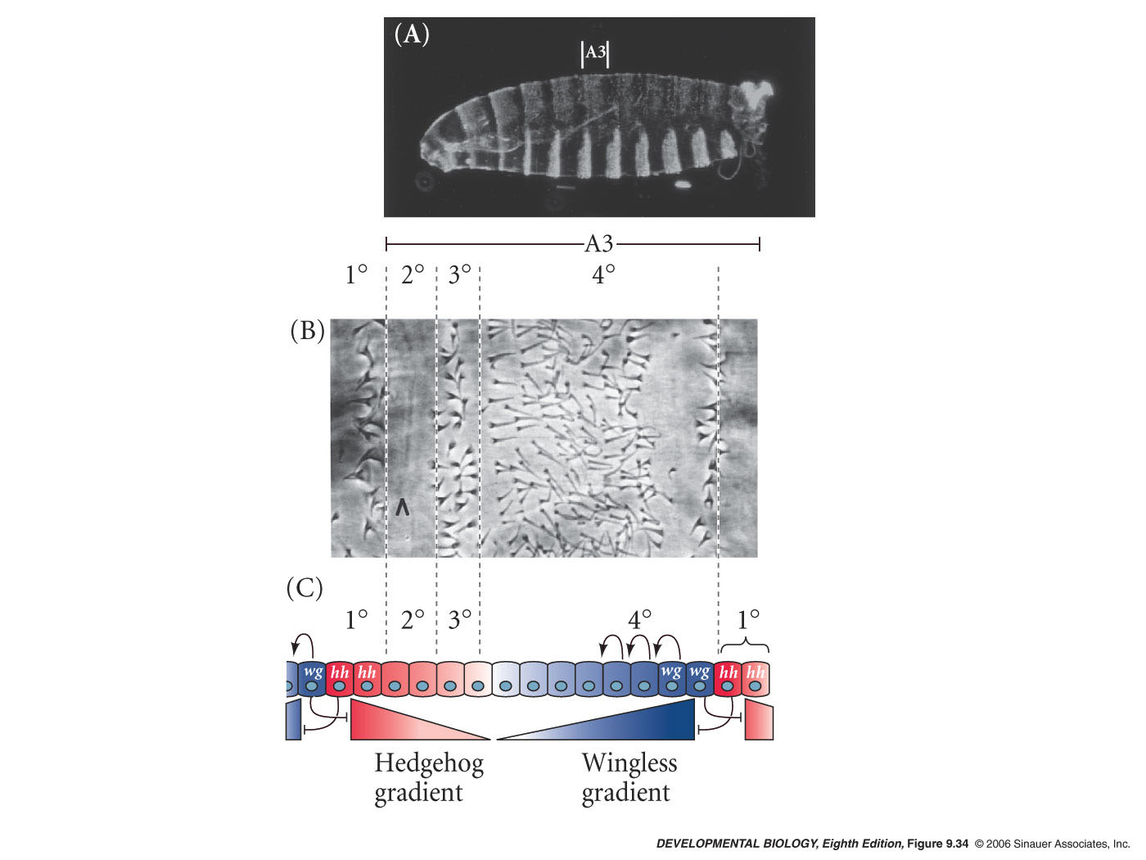
Cell specification by the Wingless/Hedgehog signaling center
Fig 9.24
Notes:
devbio8e-fig-09-34-0.jpg

Slide 40
Maintainence of Expression
En activates hedgehog
Hedgehog is secreted and binds patched
Hedgehog/Patched signaling maintains Wg expression in neighboring cells

Slide 41
Maintainence of Expression
Wg secreted
binds to frizzled on engrailed expressing cells
continues expression of engrailed and hedgehog
Generates a stable boundary

Slide 42
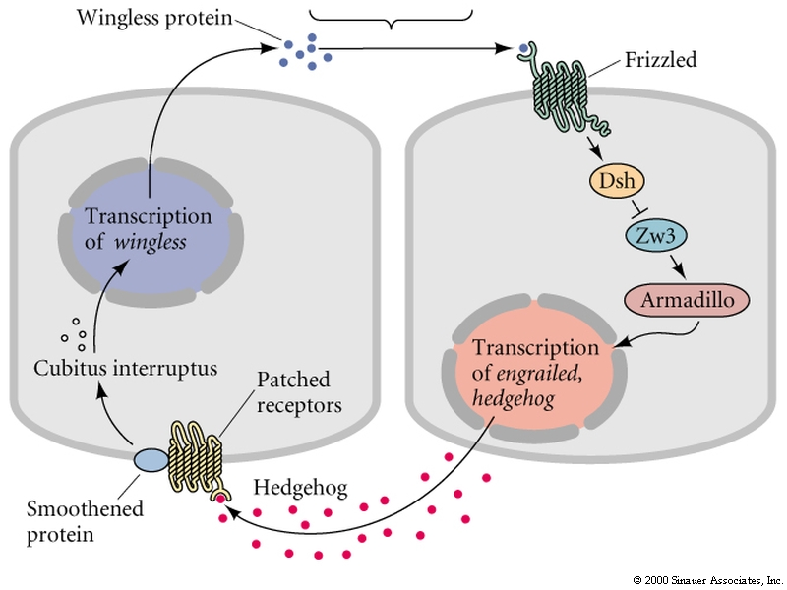
Paracrine loop
disheveled
β catanin

Slide 43
Paracrine loop
all segment polarity genes

Slide 44
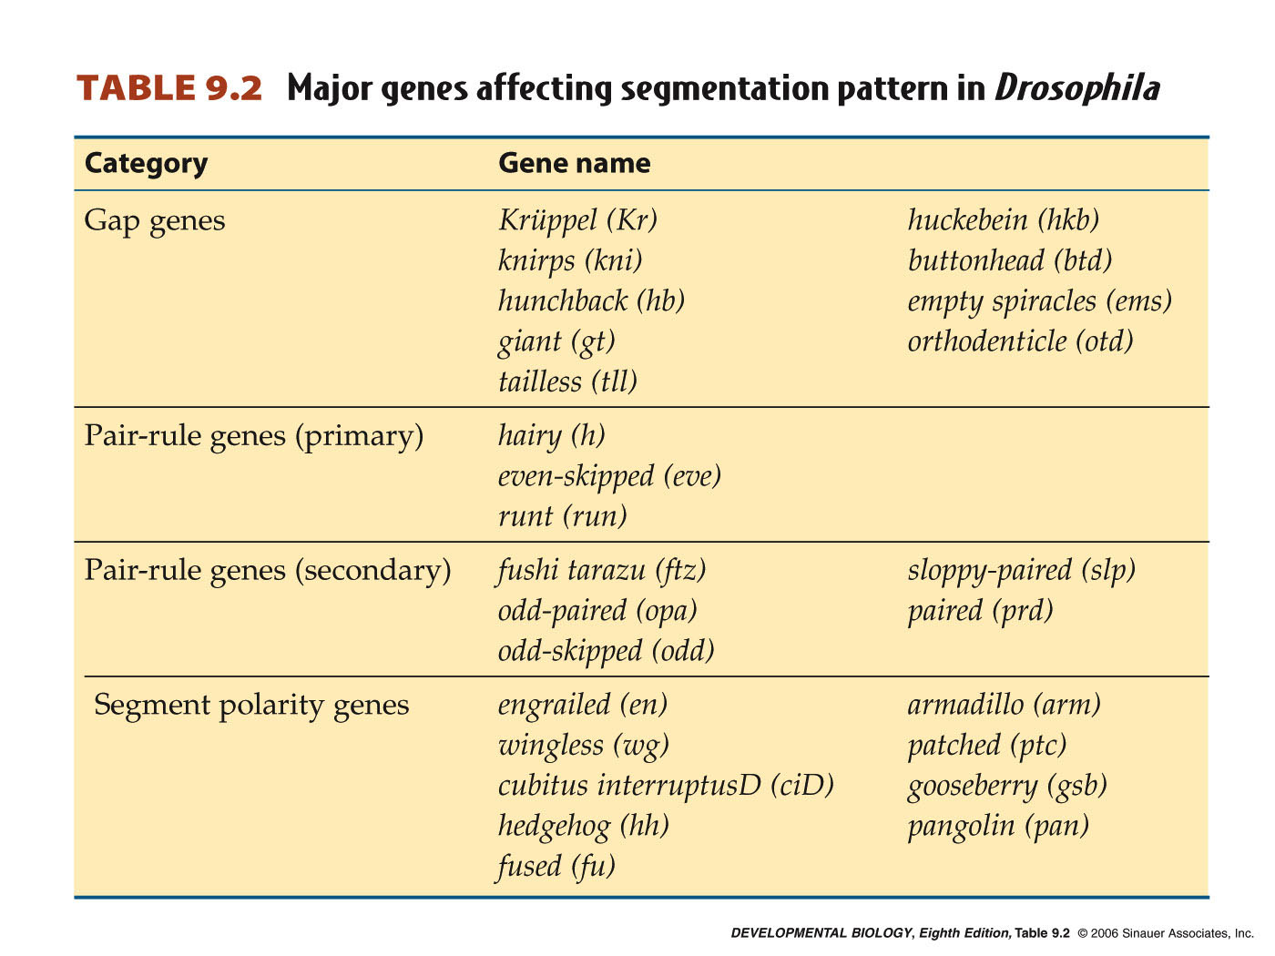
Notes:
devbio8e-table-09-02-0.jpg

Slide 45
A-P axis formation
Maternal effect genes
Gap genes
Pair-rule genes 7 stripes
Segment polarity genes 14 stripes
Homeotic selector genes – determines
developmental fate of each
segment

