Slide 1
Whole Genome Analysis of Dorsal Ventral Patterning in the Drosophila Embryo
Stathopoulous et al; 2002

Slide 2
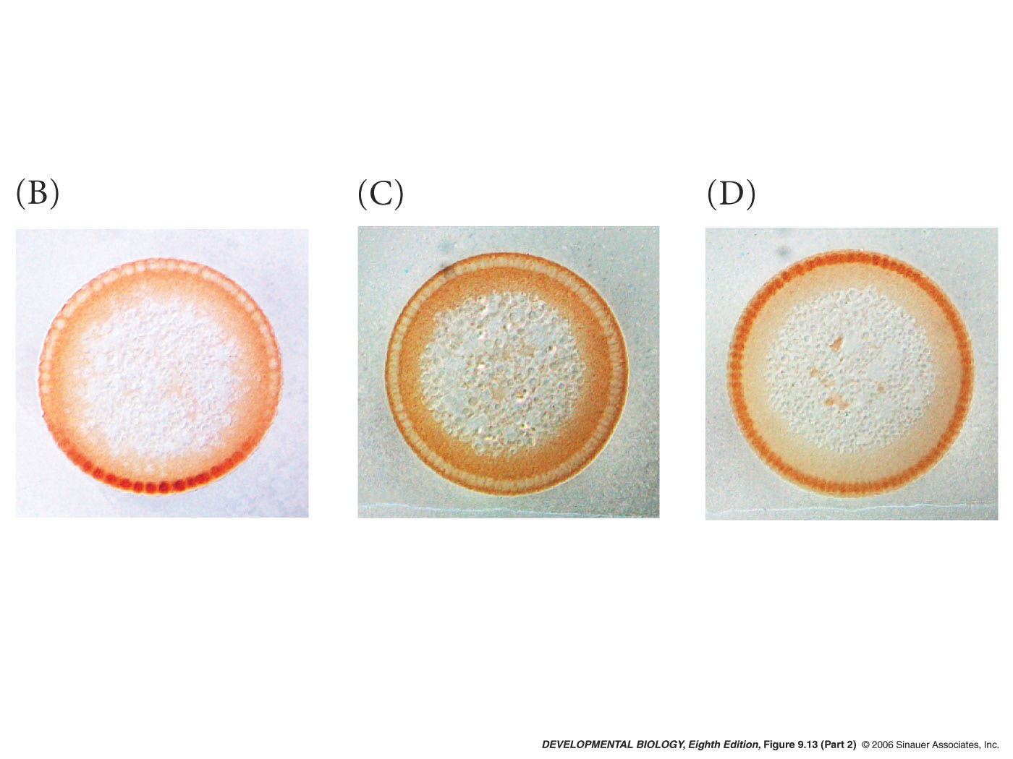
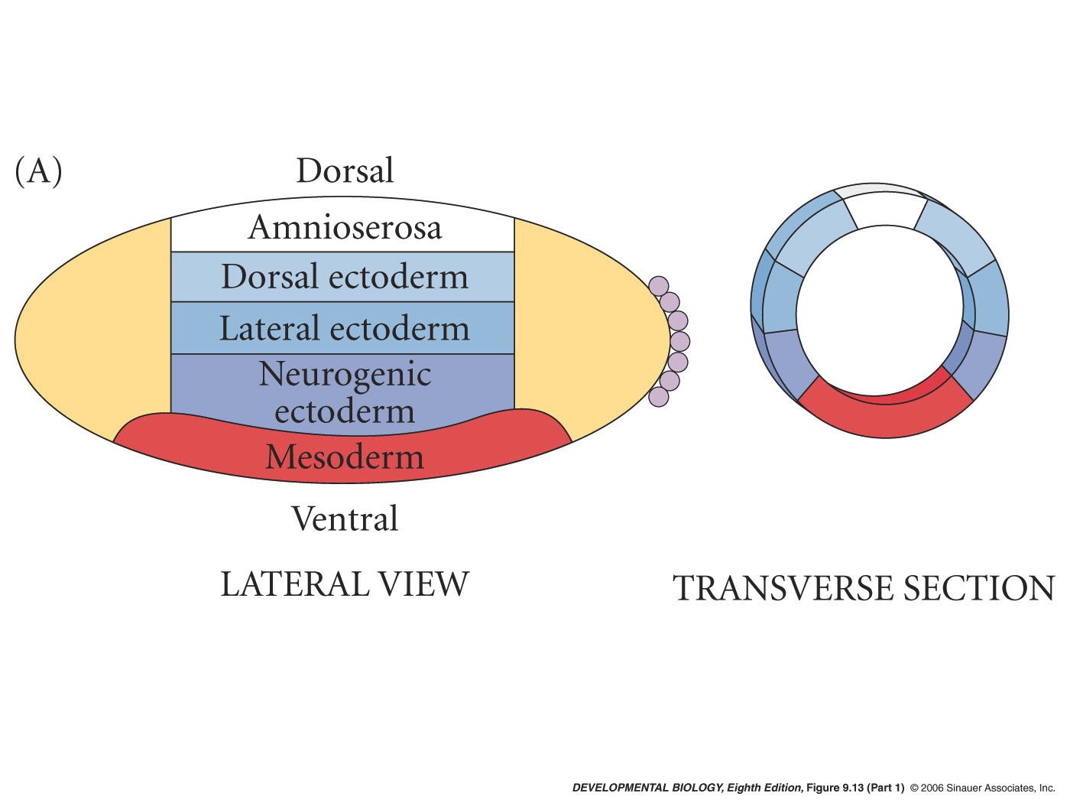
How do different levels of Dorsal in the nucleus pattern the cellular blastoderm?
fate map triggered by dorsal transcription factor
dorsal nuclear protein gradient

Slide 3
Different genes - Different enhancers
zen has binding sites for dorsal but also has sites for Groucho co-repressor that switches Dorsal from an activator to a repressor
short gastrulation (sog) has high- affinity binding sites for Dorsal
twist promoter has low-affinity Dorsal binding sites
expression patterns
zen
sog
twist

Slide 4
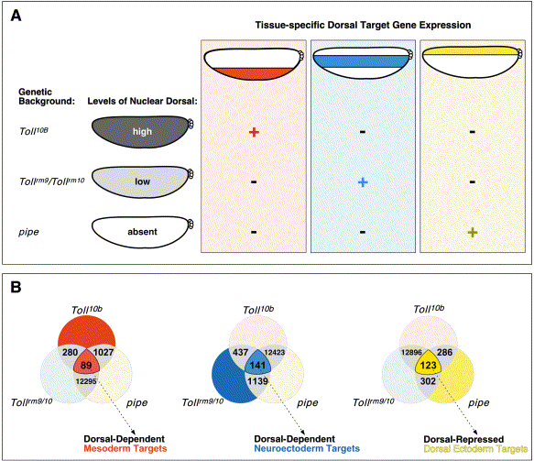
doi:10.1016/S0092-8674(02)01087-5 Copyright © 2002 Cell Press.
Whole-Genome Analysis of Dorsal-Ventral Patterning in the Drosophila Embryo
Angelike Stathopoulos , Madeleine Van Drenth , Albert Erives , Michele Markstein and Michael Levine
Fig 1A

Slide 5
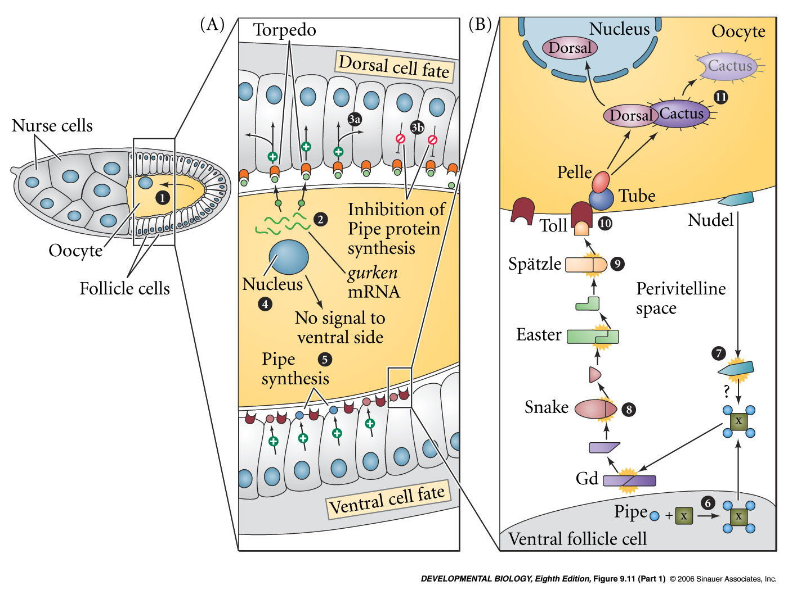
Toll receptor
oocyte cell
extracellular space
extracellular protease cascade

Slide 6
doi:10.1016/S0092-8674(02)01087-5 Copyright © 2002 Cell Press.
Whole-Genome Analysis of Dorsal-Ventral Patterning in the Drosophila Embryo
Angelike Stathopoulos , Madeleine Van Drenth , Albert Erives , Michele Markstein and Michael Levine
Fig 1B
Twist
sog
zen

Slide 7
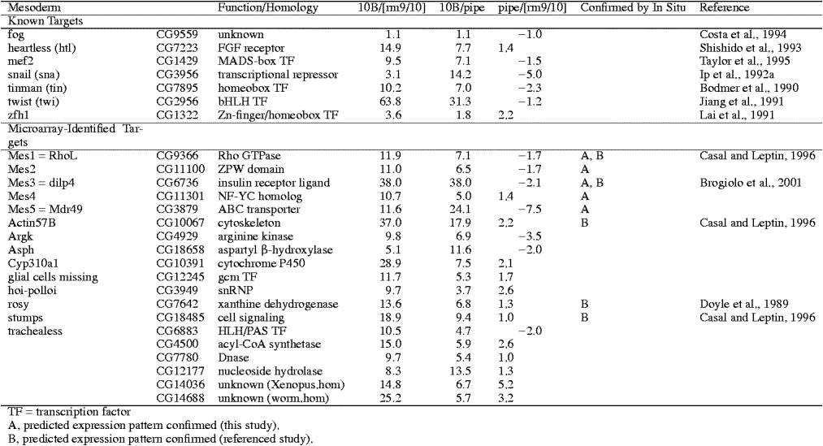

Slide 8
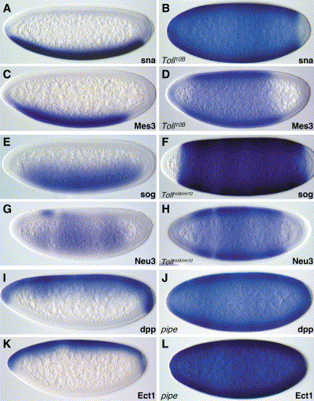
Fig 2 -

Slide 9
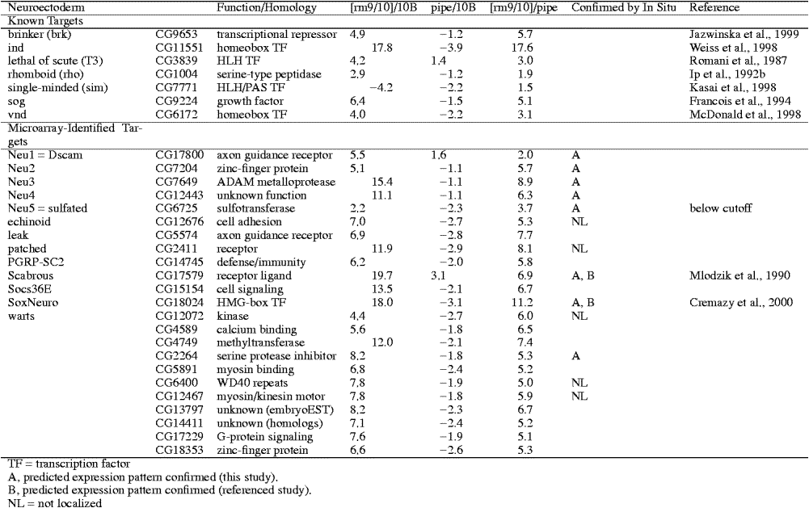

Slide 10
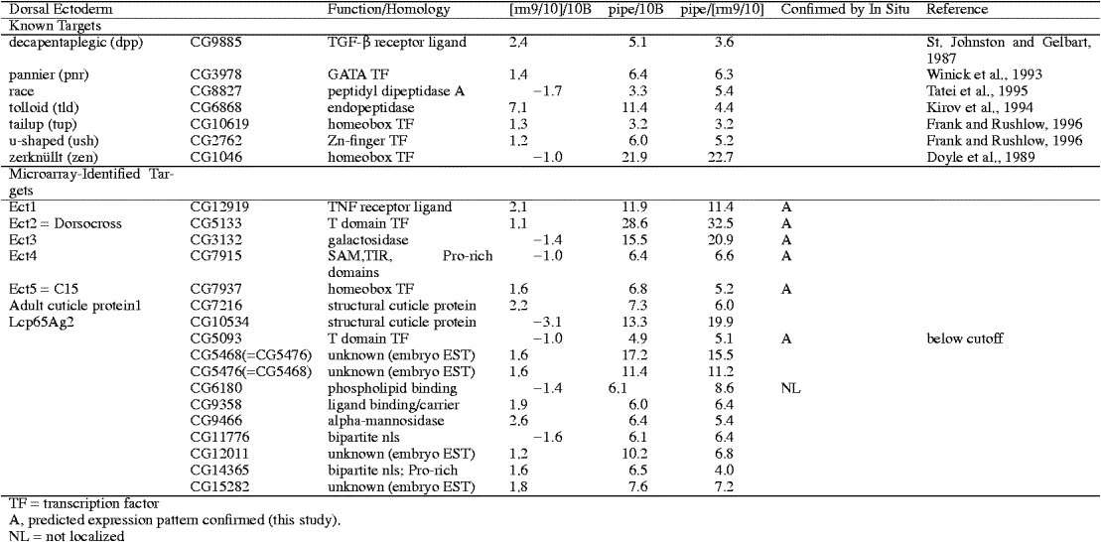

Slide 11
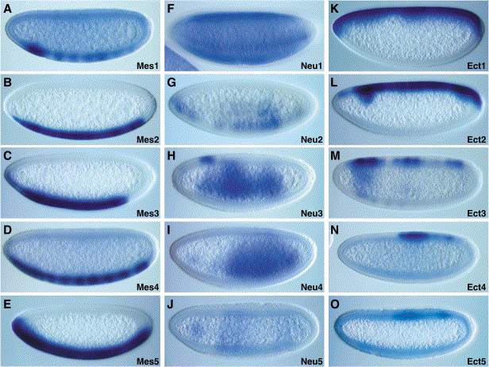
Fig 3
A-E =
F-J =
K-O =

Slide 12
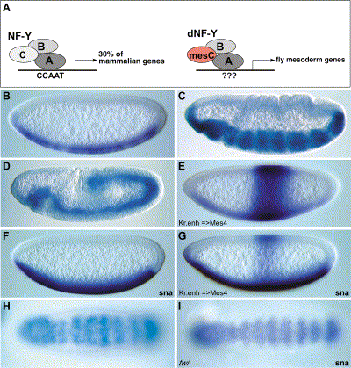
Fig 4 – A –
Fig 4 –B, C and D -
Fig 4- E, F,and G –.
Fig 4 – H and I -

Slide 13
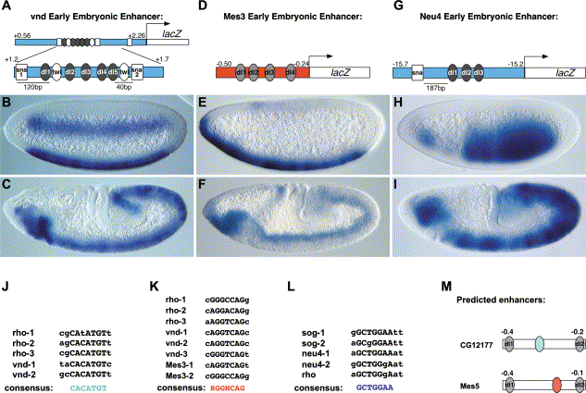
Fig 5 A,B ,C –.
Fig 5 D,E,F, -
Fig 5 G,H,I
Fig 5 – J,K,L,M –
permits lower levels of dorsal gradient to activate dorsal portions of neurogenic ectoderm
twist binding site

