Slide 1
Chapter 11 amphibian – figure assignments
Fig 11.12 – Rachel N.
Fig 11.17 – Beth B.
Fig 11.18 – Daphne C
Fig 11.22 – Maggie C.
11.25 – Alease D.
11.28 – Emily D.
11.26 – Aidan G.

Slide 2
Genetic Mapping
Associating phenotypes with genotypes
Types of maps???
Methods to make maps???
SNPs – single nucleotide polymorphisms
Haplotype – a set of SNPs that are close to each other on the chromosome and thus most often inherited together.

Slide 3
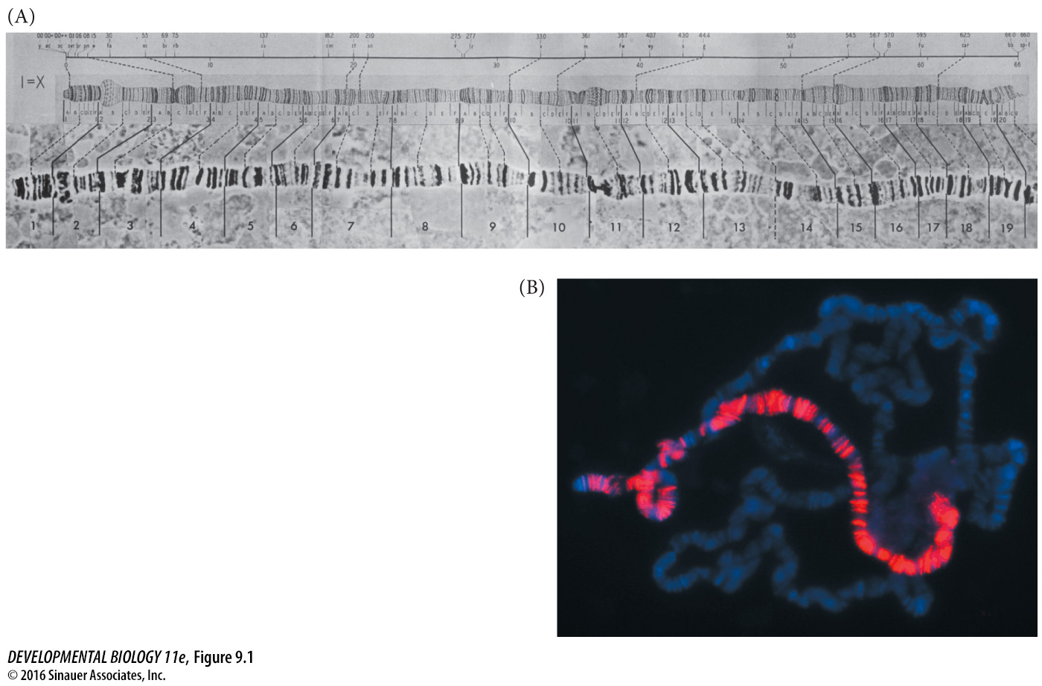
Figure 9.1 Polytene chromosomes of Drosophila
Notes:
Figure 9.1 Polytene chromosomes of Drosophila. DNA in the larval salivary glands and other larval tissue replicates without separating. (A) Photograph of the D. melanogaster X chromosome. The chart above it was made by Morgan’s student Calvin Bridges in 1935. (B) Chromosomes from salivary gland cells of a third instar D. melanogaster male. Each polytene chromosome has 1024 strands of DNA (blue stain). Here, an antibody (red) directed against the MSL transcription factor binds only to genes on the X chromosome. MSL accelerates gene expression in the single male X chromosome so it can match the amount of gene expression by females with their two X chromosomes. (A from Brody 1996; B photograph by A. A. Alekseyenko and M. I. Kuroda.)

Slide 4
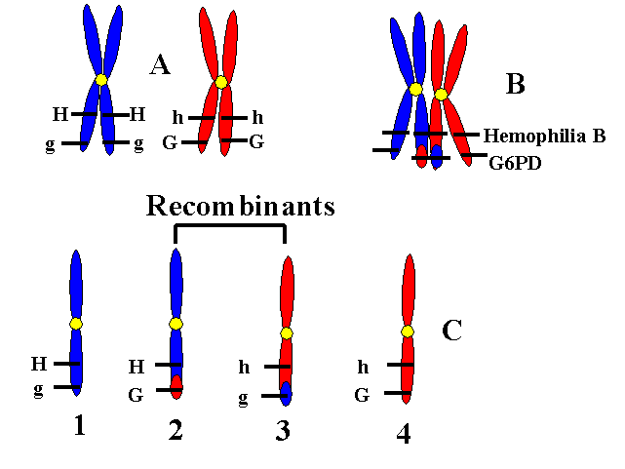
Large majority of progeny have these
Small percentage of progeny have these chromosomes
https://www.uic.edu/classes/bms/bms655/lesson12.html

Slide 5
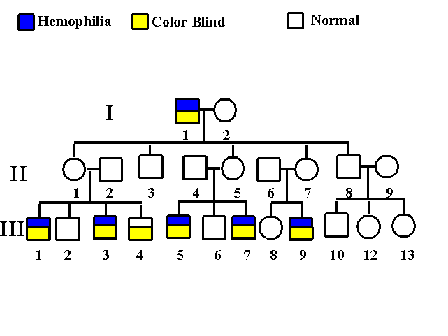
https://www.uic.edu/classes/bms/bms655/lesson12.html

Slide 6
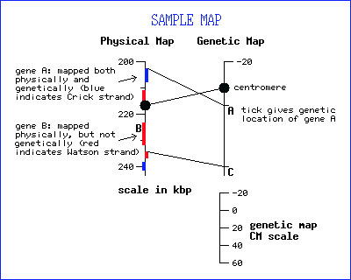
Physical map (distances are in bases or megabases 10⁶ bases)
A map of the locations of identifiable landmarks on DNA (e.g., restriction-enzyme cutting sites, genes, or specific sequences, Giemsa staining bands), regardless of inheritance. Distance is measured in base pairs. For the human genome, the lowest-resolution physical map is the banding patterns on the 24 different chromosomes; the highest-resolution map is the complete nucleotide sequence of the chromosomes.
Definition adapted from: Human Genome Project Information at the U.S. Department of Energy
http://web.ornl.gov/sci/techresources/Human_Genome/glossary.shtml
http://wiki.yeastgenome.org/index.php/Combined_Physical_and_Genetic_Maps_of_S._cerevisiae

Slide 7
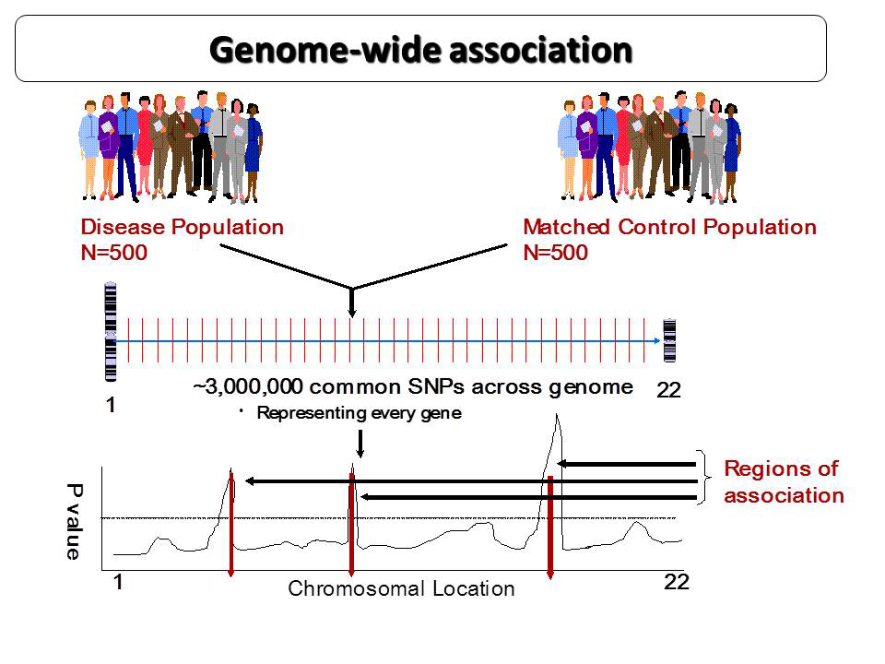
Line of statistically significance
http://www.cincinnatichildrens.org/assets/0/9823/9824/9839/9932/9933/10567/12239/12722/c9ab3a3b-a9c0-4cad-a34a-4c72d30218f1.jpg

Slide 8
Very basic info on genetic linkage mapping from NIH –
https://www.genome.gov/10000715
Association mapping and Haplotype/HAPMAP
http://www.genome.gov/10001665
Wikipedia page describing the HapMAp effort
https://en.wikipedia.org/wiki/International_HapMap_Project

Slide 9
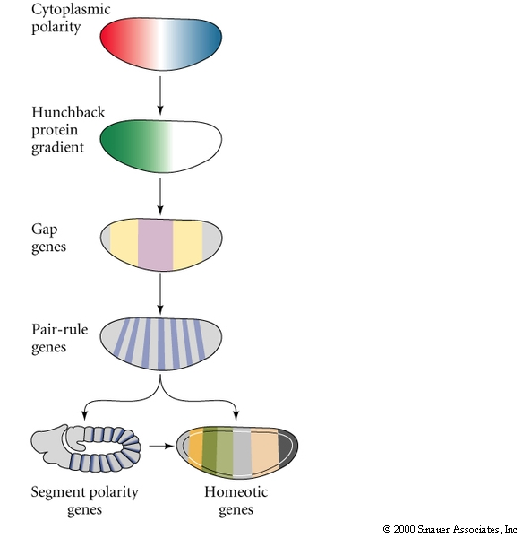
A-P axis formation
Maternal effect genes
Gap genes
Pair-rule genes 7 stripes
Segment polarity genes 14 stripes
Homeotic selector genes – determines
developmental fate of each
segment

Slide 10
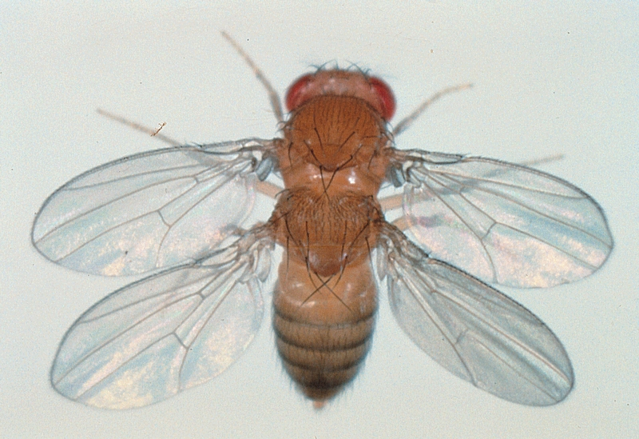
Homeotic Selector Genes
Ed Lewis
The Nobel Prize in Physiology or Medicine 1995
"for their discoveries concerning the genetic control of early embryonic development"

Slide 11
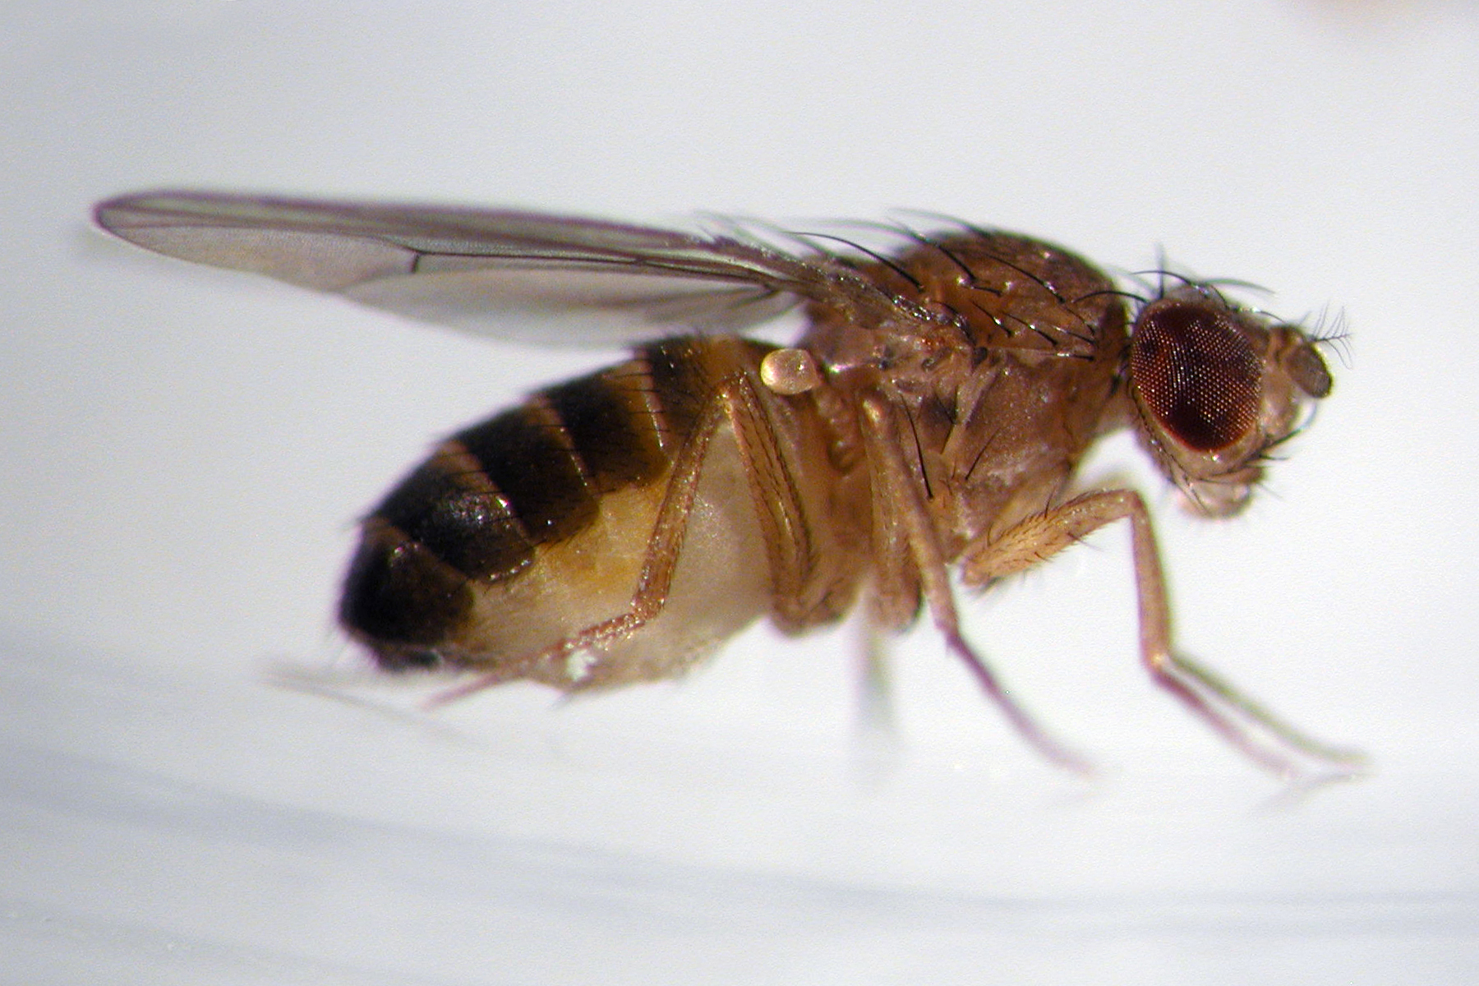
Terms
Homeo = similar
Homeotic mutations – one structure replaced by another
Homeotic genes specify the identity of a particular segment
wing
haltere (balancer)
http://neurophilosophy.wordpress.com

Slide 12
Terms
Homeobox = conserved DNA sequence ~180 bp shared by many homeotic genes
Encodes the homeodomain – 60 amino acid protein sequence - (the DNA binding Domain)
Not all genes with homeoboxes are homeotic genes
Not all homeotic mutations are caused by mutated homeobox containing genes

Slide 13
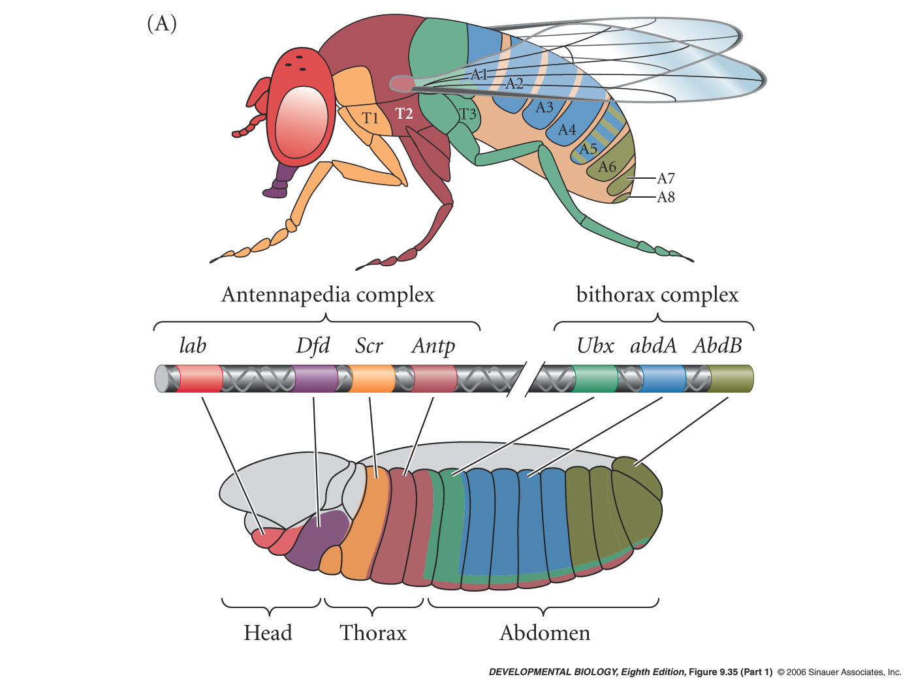
Homeotic gene expression in Drosophila
linear chromosomal order
anterior
posterior
Notes:
devbio8e-fig-09-35-1.jpg

Slide 14
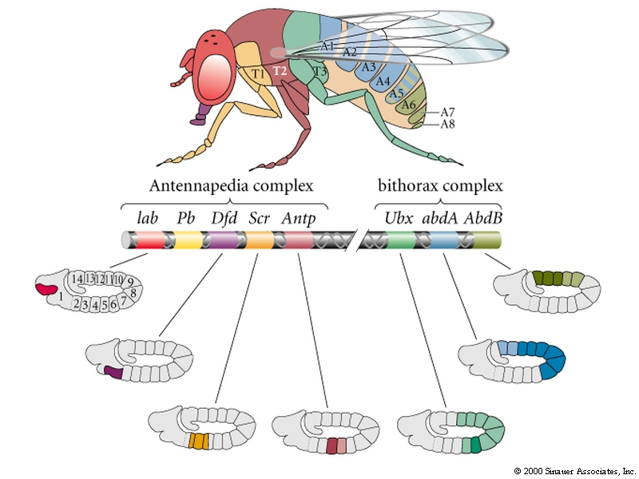
Homeotic selector genes
Initial expression domains of homeotic genes are established by the gap and pair-rule genes
Ultrabithorax gene activated by Hunchback in the middle of the embryo

Slide 15
Homeotic selector genes
Boundaries of homeotic gene expression confined to parasegments defined by Ftz and Eve pair-rule genes

Slide 16
Homeotic selector genes regulate other homeotic selector genes
All homeotic genes are repressed by the homeotic gene
expressed posterior to it
“posterior dominance”
Antp is repressed by all
members of the
bithorax complex

Slide 17
Ubx represses Antp
If Ultrabithorax deleted, Antp activity extends through
region normally expressing Ubx
and stops where Abd region begins
This allows 3rd thoracic segment
to form wings like 2nd
thoracic segment

Slide 18
Ubx deleted
wild type
wing
haltere (balancer)

Slide 19
Realisator gene –
Wingless (wg)
Targets of homeotic gene proteins that form the specified tissue or organ primordia
Ubx specifies 3rd thoracic segment by repressing expression of “wing genes”
Ubx represses wg expression
structures develop as halteres (balancers)
Pleiotropy - when a single gene influences multiple phenotypic traits

Slide 20
Realisator gene - Homothorax
Antp expressed in 2nd thoracic segment
Binds enhancer in the homothorax gene and prevents homothorax expression
Homothorax = a transcription factor required for antennal formation
Antp represses genes needed for antennal development

Slide 21
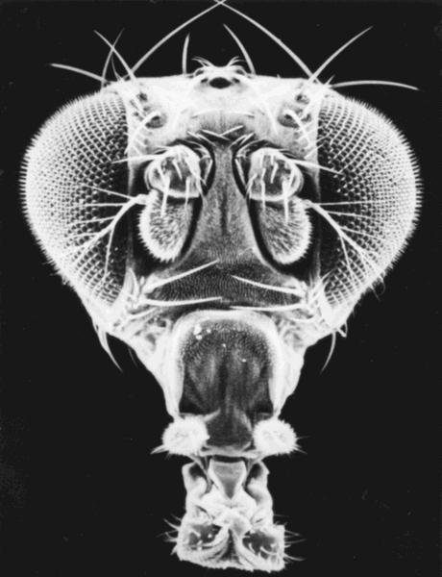
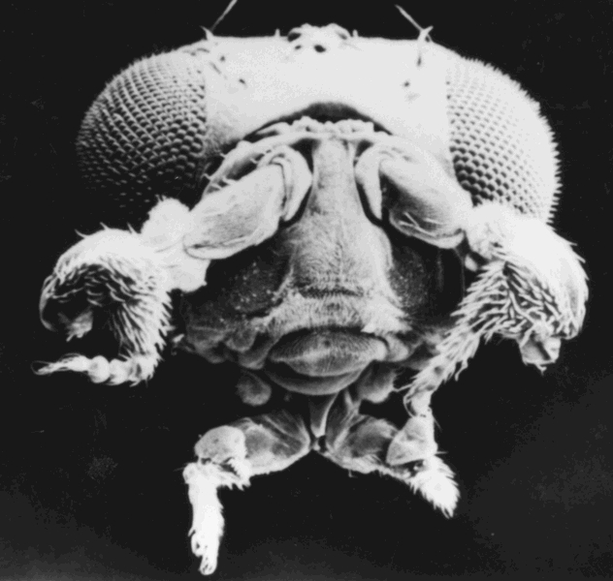
Homeotic selector genes
Antennapedia expressed in
2nd thoracic segment
Gain of function mutation: Ectopic
Antennapedia expressed in head

Slide 22
Maintenance of Homeotic Gene Expression
Gap and pair-rule genes are transient
Identities of segments must be stabilized
Homeotic genes stabilized by alteration of chromatin structure
Repression maintained by the Polycomb proteins
Active chromatin conformation maintained by Trithorax genes
Mitotic inheritance – but reset during gametogenesis

Slide 23
H3K9 and H3K27
H3K9 = Lysine residue in position 9 on Histone H3
Trithorax – H3K9 acetylated
Polycomb – H3K27me3
If acetylated by p300/CBP (HAT)
nucleosome destabilized
transcriptional activation
If methylated by histone methyl transferase
nucleosome stabilized
DNMT attracted or stabilized
DNA is methlyated at CpG sites
transcriptional repression

Slide 24
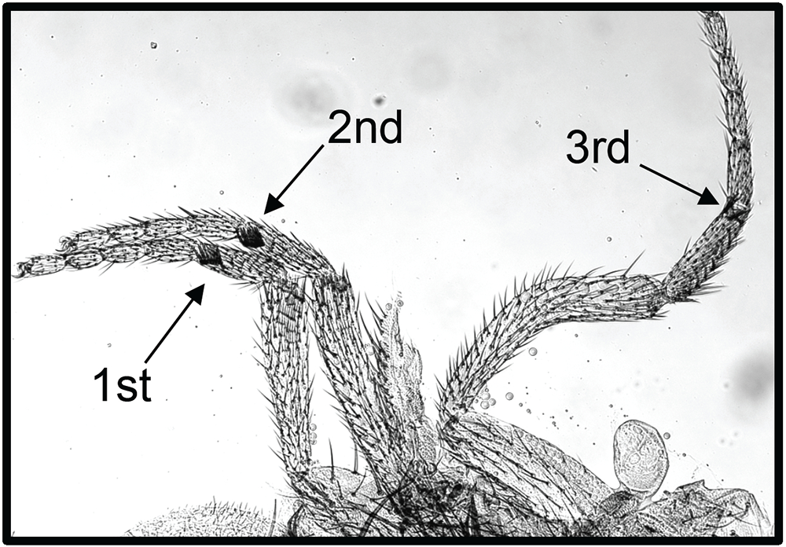
Polycomb phenotype
Conversion of 2nd and 3rd legs to first leg fate –
1st leg leg specific sexcombs in male triplicated
In 2nd and third legs of wt the polycomb proteins maintain repression of homeotic genes that normally specify 1st leg fate
http://annualreport.nichd.nih.gov/kassis.html

Slide 25
Polycomb mutations in mouse and man
Polycomb mouse knockout –
embryonic lethal – misexpression (ectopic expression) of homeotic genes
(ES) cells mutant for PRC2 genes lose the ability to maintain themselves in an undifferentiated state
Polycomb genes required to prevent differentiation of stem cells
Human overexpression phenotypes associated with cancers

