Slide 1
Chapter 11 amphibian – figure assignments
Fig 11.12 – Rachel N.
Fig 11.17 – Beth B.
Fig 11.18 – Daphne C
Fig 11.22 – Maggie C.
11.25 – Alease D.
11.28 – Emily D.
11.26 – Aidan G.

Slide 2
HOX genes flies and mice

Slide 3
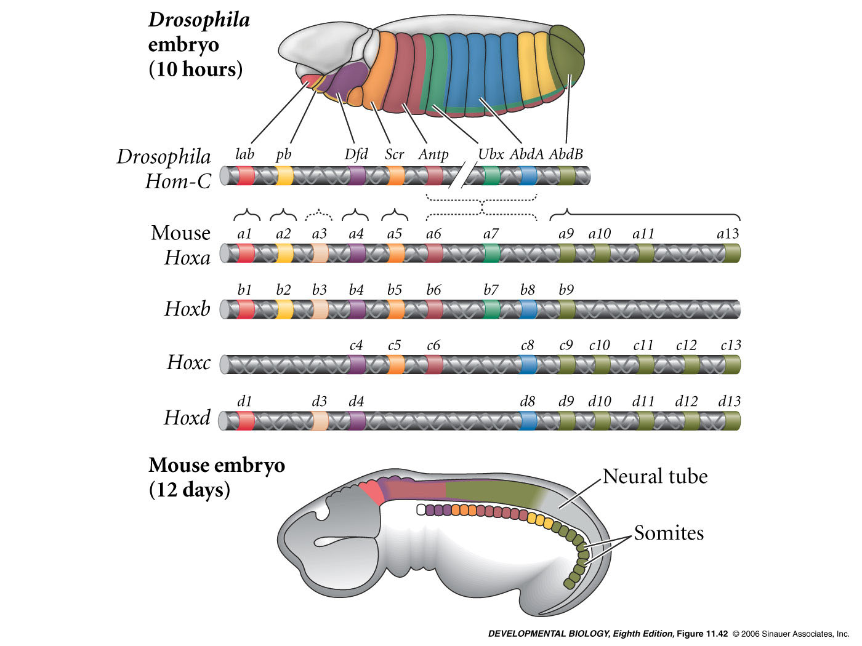
Evolutionary conservation of homeotic gene organization and expression
Gene duplication
divergence
paralogous group -
group of genes (paralogues) that have similar sequence due to a past gene duplication event
Example Hoxa4, Hoxb4, Hoxc4, Hoxd4
Notes:
devbio8e-fig-11-42-0.jpg

Slide 4
What do Hox genes do in vertebrates and how do we know?

Slide 5
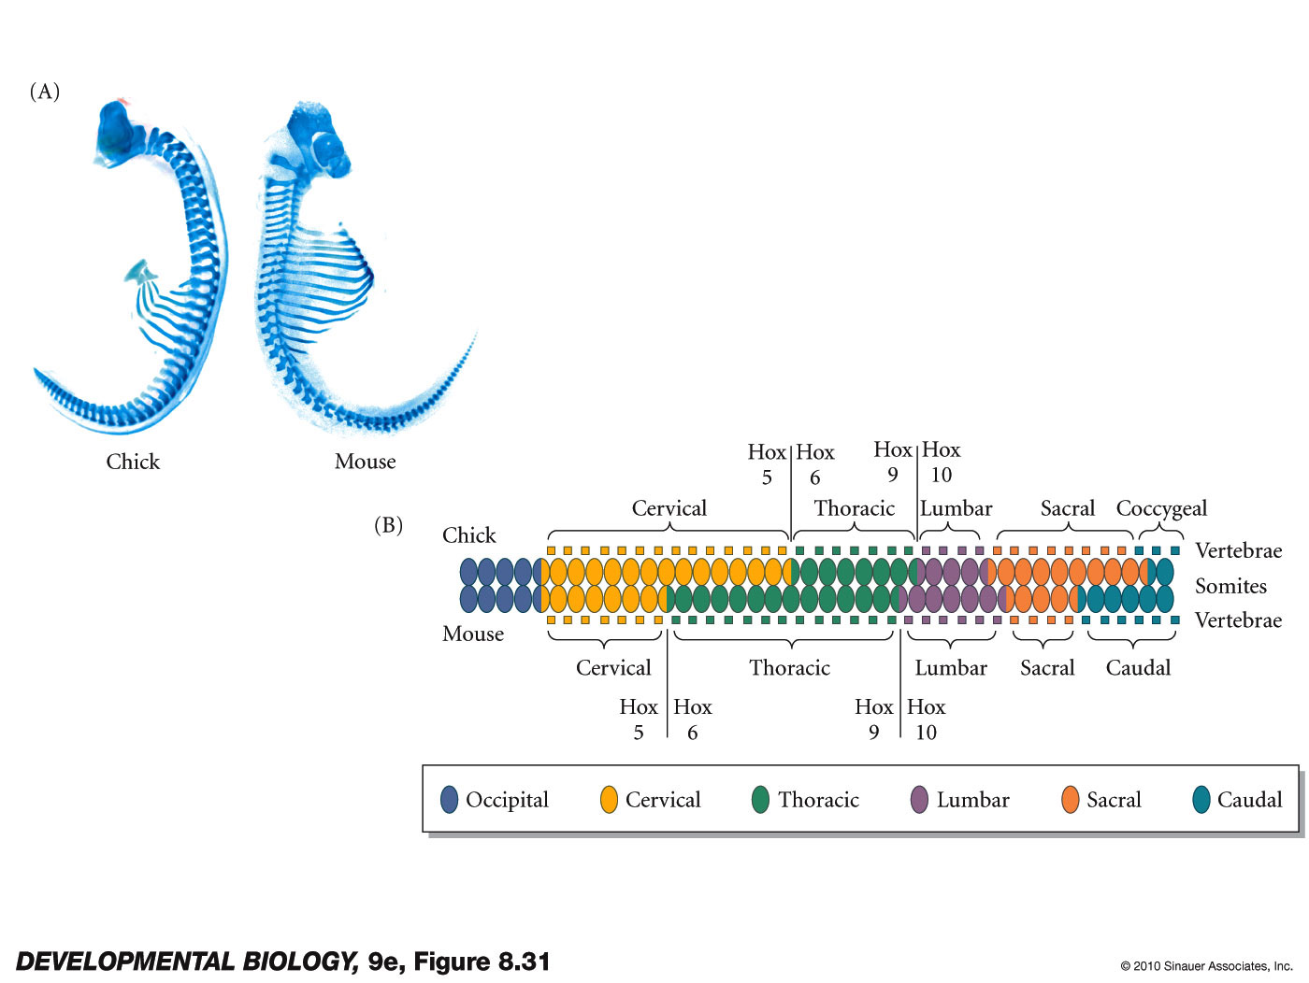
Comparative studies

Slide 6
Redundancy
Knockout 2 or more genes of a paralogous group
Mice homozygous for:
Hoxd-3 deletion have mild abnormalities of the 1st cervical vertebra
Hoxa-3 deletion have no abnormalities
Combine both mutations –
Much more severe skeletal defects
Paralogues can sometimes replace
one another - they share function

Slide 7
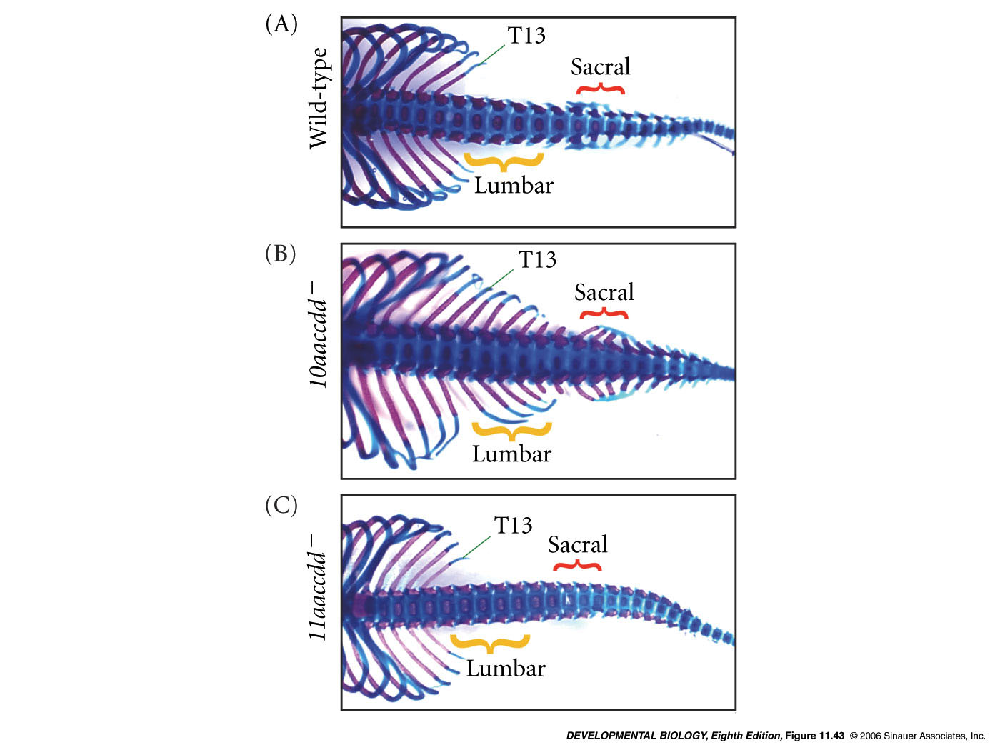
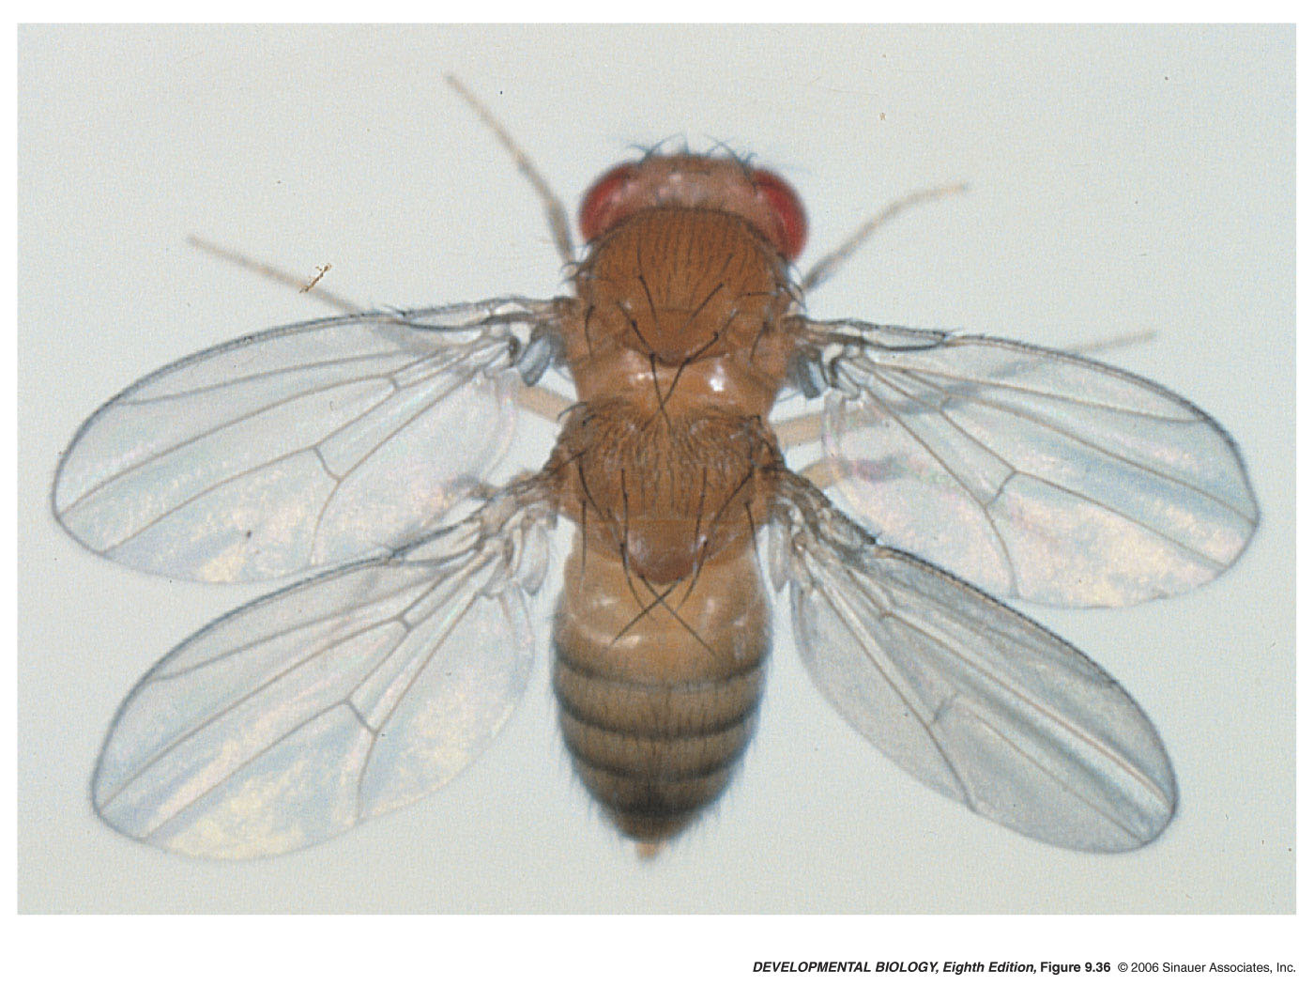
Axial skeletons of mice in gene knockout experiments
Hox10 triple mutant
Hox11 triple mutant
Notes:
devbio8e-fig-11-43-0.jpg

Slide 8
How to make knockout mice

Slide 9
CRISPR/Cas9 to make “knock out” mutations in mice
Reverse genetic approach -
What does gene X do during development?
What is its function?

Slide 10
CRISPR/Cas9 system for gene editing
https://www.youtube.com/watch?v=2pp17E4E-O8

Slide 11
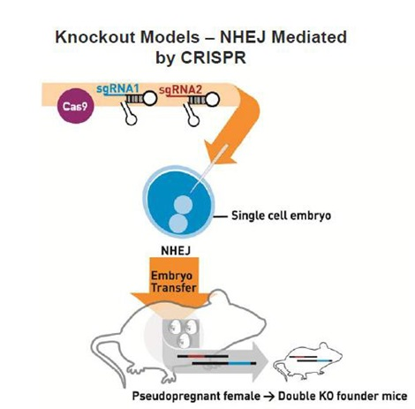
1) injecting Cas9 mRNA and guide RNA (sgRNA) directly into mouse embryos to generate precise genomic edits into specific loci
https://www.jax.org/news-and-insights/jax-blog/2016/february/three-crispr-approaches-for-mouse-genome-editing

Slide 12
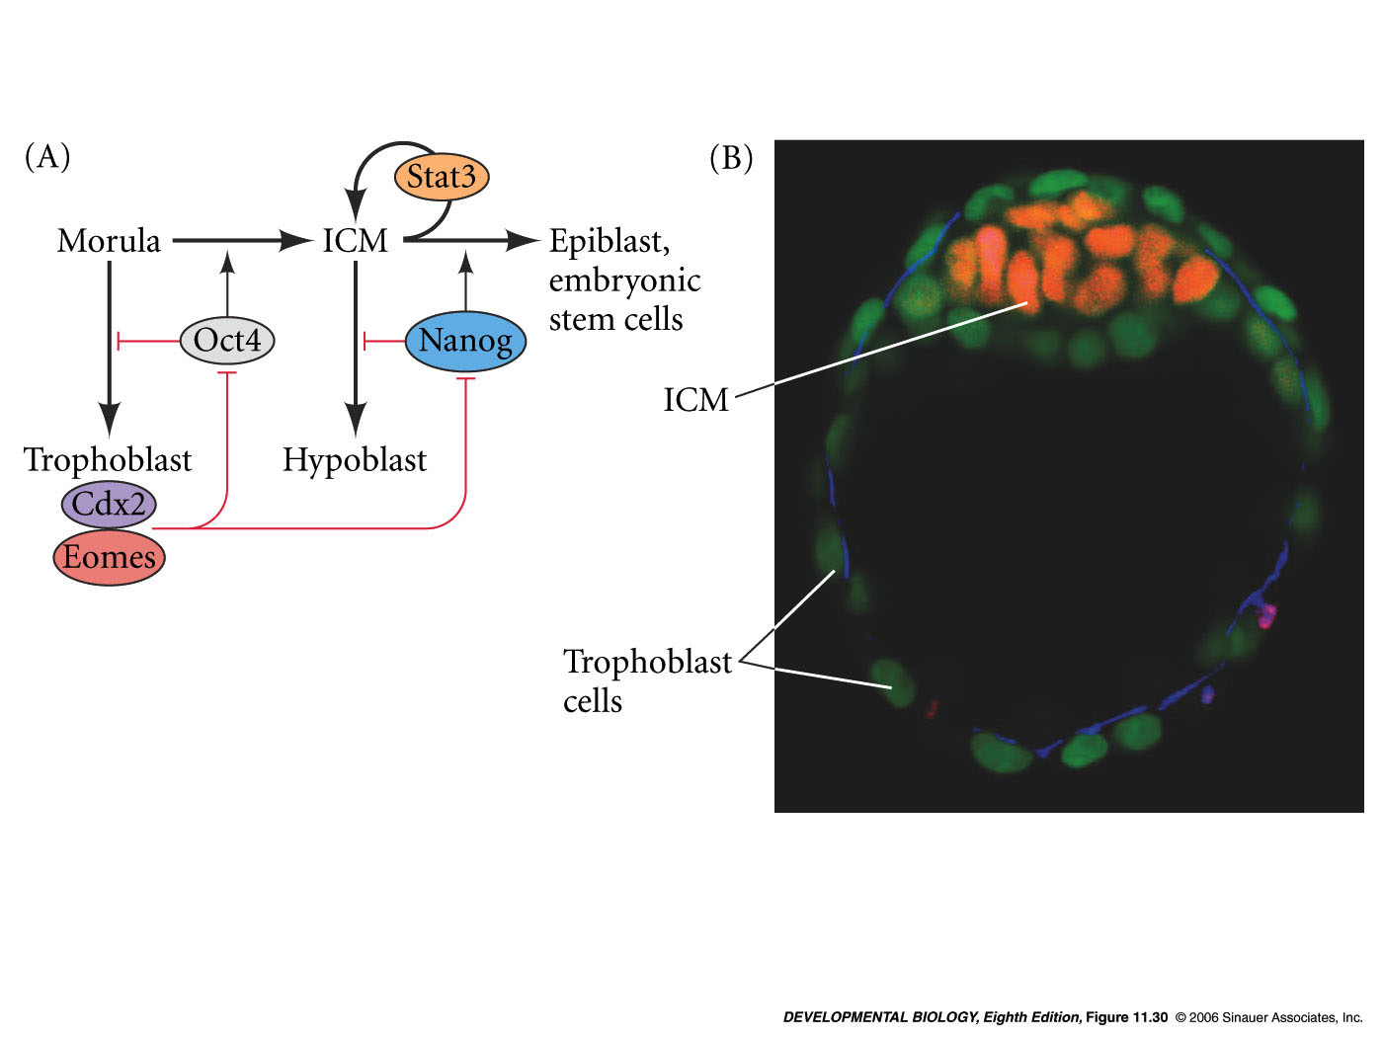
How to make transgenic mice
(like a GFP reporter line)
Inner Cell Mass (ICM) generates embryo proper
Pluripotent
Source of embryonic stem cells (ES cells)
mammalian blastula

Slide 13
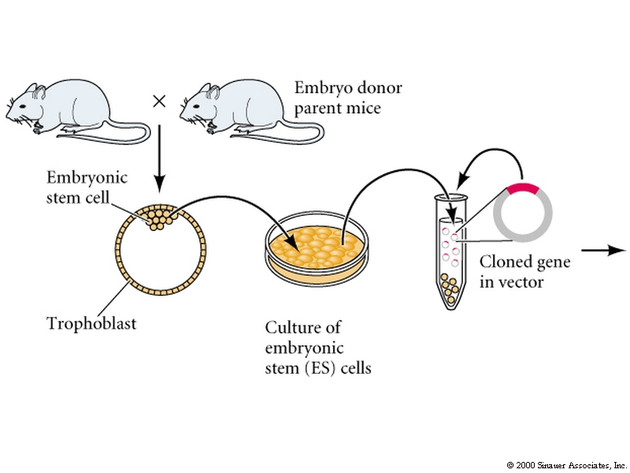
Transgenic Mice –
“knock in” adding an exogenous gene (e.g. a reporter transgene)
Retrovirus vector - random insertion
Embryonic stem (ES) cells are inner cell mass blastomeres
ES cells retain totipotency and can contribute to all organs if injected into a host embryo

Slide 14
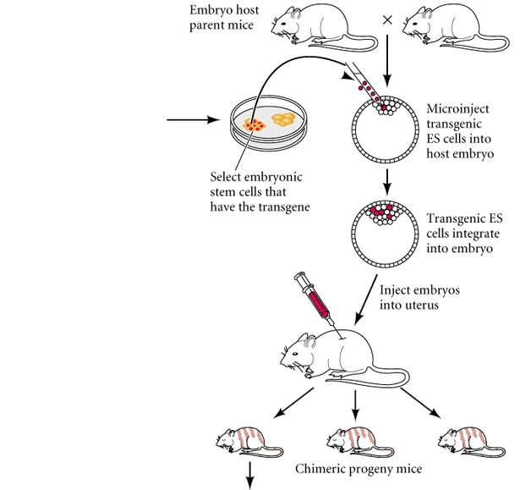
Transgenic Mice
Treated ES cell
reintroduced into
another early stage embryo
and integrated
Cells from both
host ES cells
treated ES cells

Slide 15
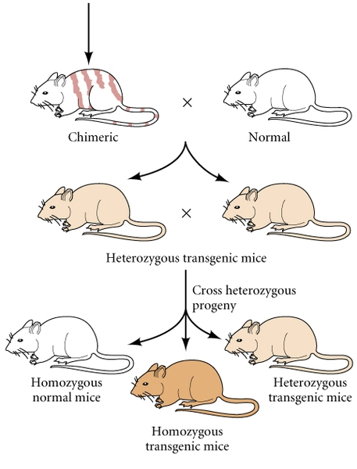
Transgenic Mice
Germline:
some gametes derived from donor
Mate with wild-type
some progeny will carry 1 copy of the inserted gene
When heterozygous progeny are mated
25% offspring will have 2 copies of inserted gene

Slide 16
Human ES cells
possible uses
degenerative nervous system disorders
spinal injuries
immune deficiencies

Slide 17
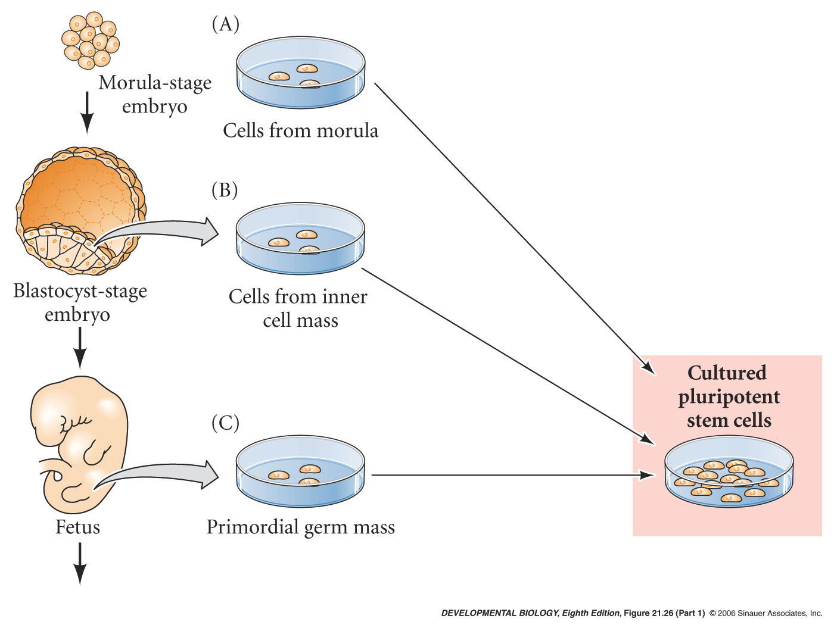
Human ES cells
Sources
early embryos - ICM or morula (discarded after in vitro fertilization efforts)
germ cell precursors from spontaneously aborted fetus
not immunologically matched to the patient

Slide 18
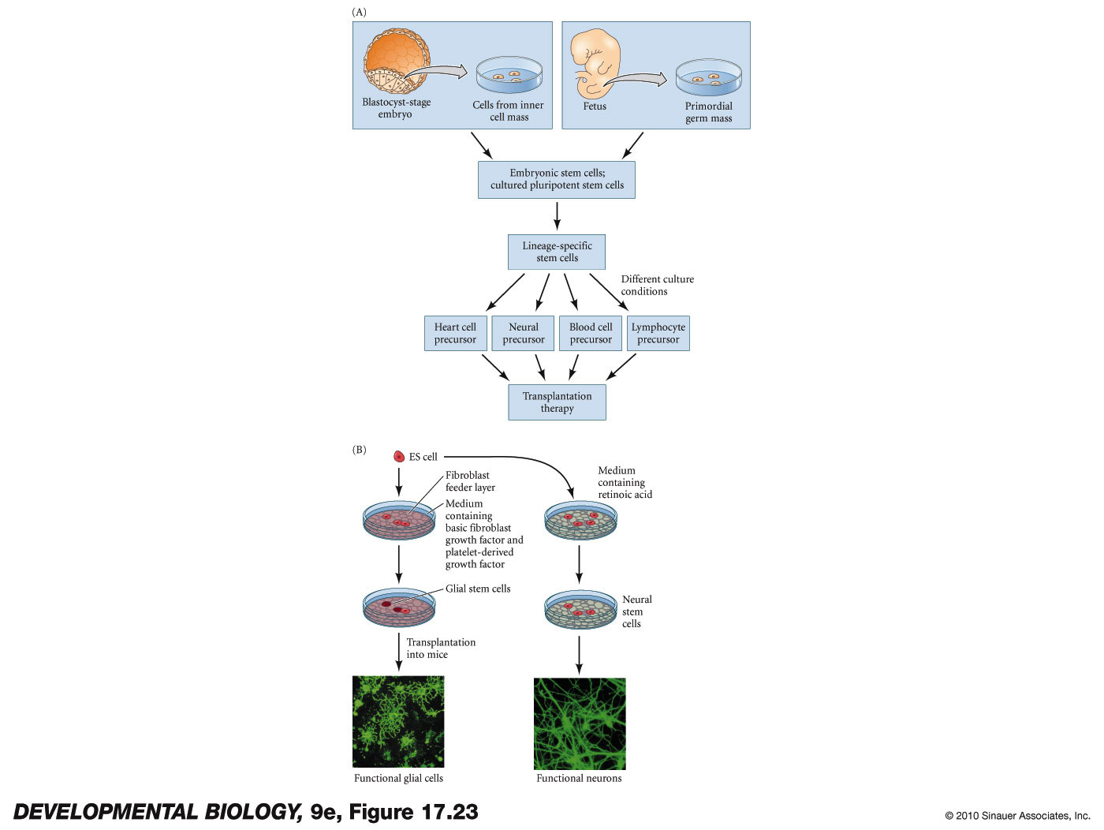
add paracrine factors
signaling molecules
culture with other cell types or ECM

Slide 19
Inner cell mass niche genes
Inner Cell Mass (ICM) generates embryo proper
ICM cells express:
Oct4, sox2 and Nanog
Critical for maintenance of pluripotency
Can we reprogram an adult cell to become like and ES cell again???
mammalian blastula

Slide 20
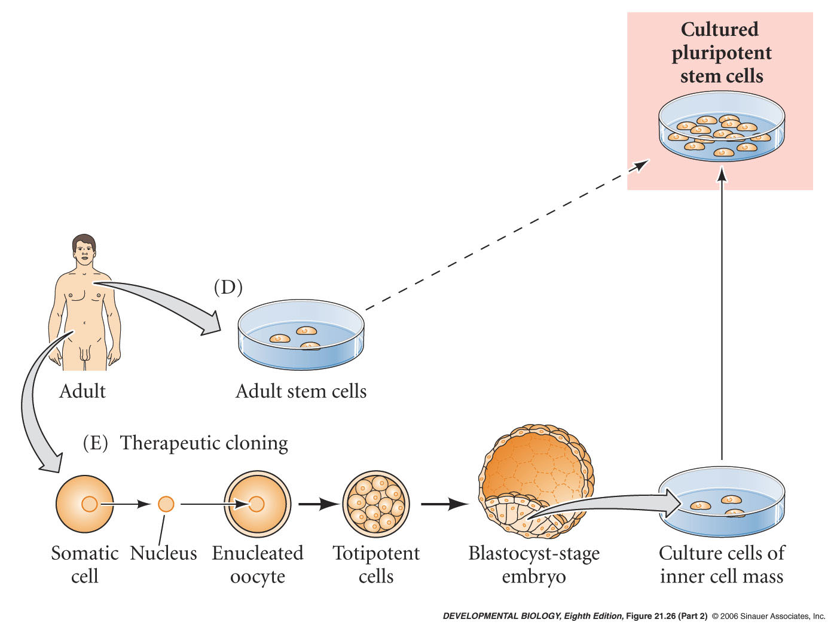
Reprogram adult skin cell without using oocyte or blastula iPS - induced pluripotent cells
add in plasmids expressing nanog, sox2, oct4
take adult skin cell nucleus
add back genes that will give it pluripotent properties
nanog, Oct4, etc.
called iPS - induced pluripotent stem cells
first generated by Shinya Yamanaka at Kyoto University, Japan in 2006

Slide 21
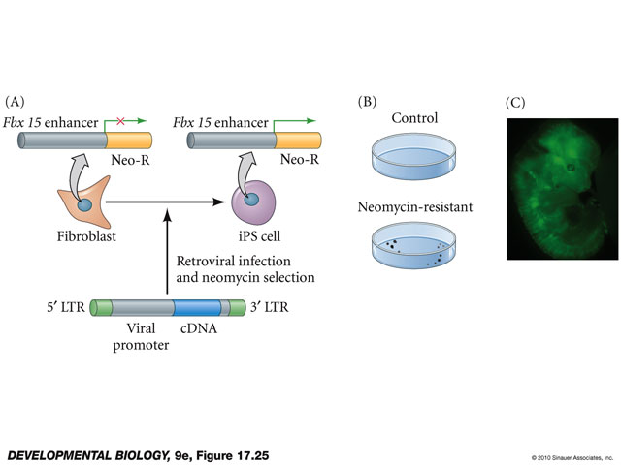
How to identify nanog, sox2 and oct4 in the first place?
Fbx15 enhancer only activated in ES cells
Shinya Yamanaka at Kyoto University

Slide 22
Induction of Pluripotent Stem Cells from Mouse Embryonic and Adult Fibroblast Cultures by Defined Factors
Kazutoshi Takahashi1 and Shinya Yamanaka1,2,*
Department of Stem Cell Biology, Institute for Frontier Medical Sciences, Kyoto University, Kyoto 606-8507, Japan
CREST, Japan Science and Technology Agency, Kawaguchi 332-0012, Japan
*Contact: yamanaka@frontier.kyoto-u.ac.jp
Cell 126, 663–676, August 25, 2006 ª2006 Elsevier Inc
We will discuss this paper on ???

Slide 23
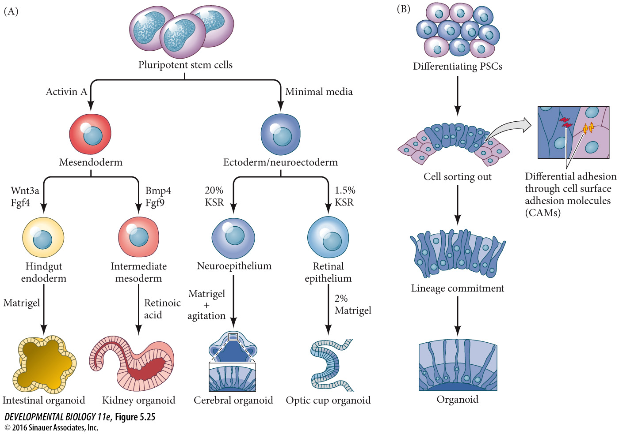
ES cells and iPS cells can be grown into organoids
Test drugs
Make them from diseased individuals and see what goes wrong
Genetically manipulate and see effect on organogenesis
Eventually make tissue/organ for transplant into an individual
Recently creation of ovary and induction of egg cell fate from mouse iPS cells

Slide 24
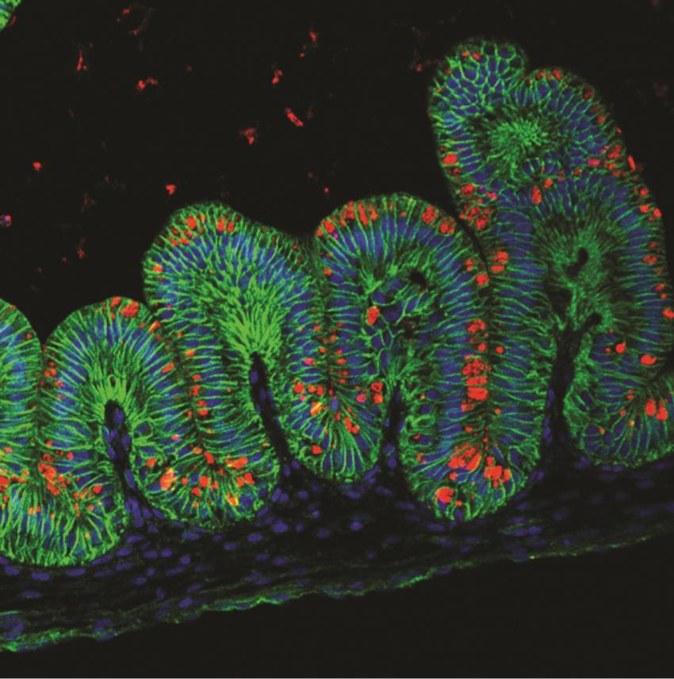
Organoids and gastric tumors
In patient’s primary tumor – (non-metastatic) one allele of TGFBR2 (TGFbeta Receptor) gene mutated
Metastatic cells - both alleles of the TGFBR2 gene mutated
Create a knock down of TGFBR2 in mouse ES cells – shRNA (short hairpin RNA molecules) (RNAi strategy)
Grow the gastric organoid from mouse ES cells
See evidence of higher rates of metastasis when TGFBR2 activity is knocked down.
Immunofluorecent image of human gastric organoid derived stained with E-cadherin (green), MUC5AC (red) and DAPI (blue). Credit: Kyle McCracken
Read more at: https://medicalxpress.com/news/2014-10-scientists-human-stomach-tissue-lab.html#jCp
Nadauld, L. D.; Garcia, S.; Natsoulis, G.; Bell, J. M.; Miotke, L.; Hopmans, E. S.; Ji, H. P. (2014). "Metastatic tumor evolution and organoid modeling implicate TGFBR2as a cancer driver in diffuse gastric cancer". Genome Biology. 15: 8. doi:10.1186/s13059-014-0428-9

Slide 25
Human kidney organoids
Human induced pluripotent stem cells (iPS)
USE CRISPR system to introduce targeted mutations in genes relevant to kidney diseases
human kidney organoids - exhibited disease-specific phenotypes
create models of human disease in laboratory
Freedman, BS; Brooks, CR; Lam, AQ; Fu, H; Morizane, R; Agrawal, V; Saad, AF; Li, MK; Hughes, MR; Werff, RV; Peters, DT; Lu, J; Baccei, A; Siedlecki, AM; Valerius, MT; Musunuru, K; McNagny, KM; Steinman, TI; Zhou, J; Lerou, PH; Bonventre, JV (23 October 2015). "Modelling kidney disease with CRISPR-mutant kidney organoids derived from human pluripotent epiblast spheroids". Nature Communications. 6: 8715. doi:10.1038/ncomms9715. PMC 4620584Freely accessible. PMID 26493500.

Slide 26
Stem Cells and Stem Cell Niches

Slide 27
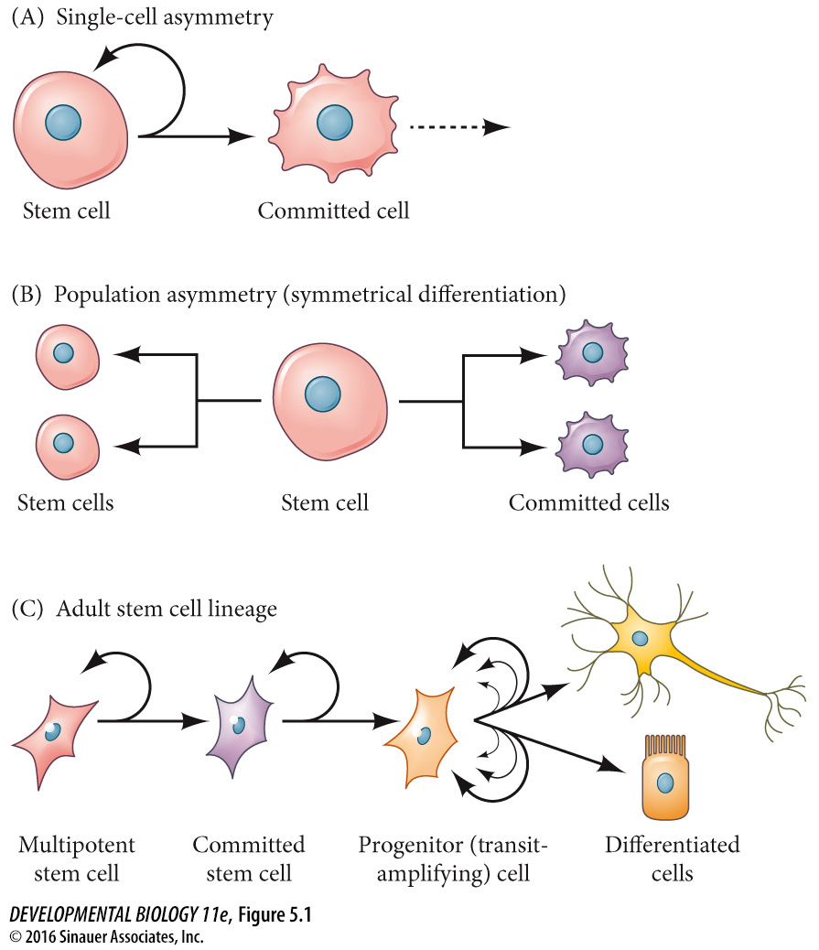
Stem cells
asymmetric division
Niche

Slide 28
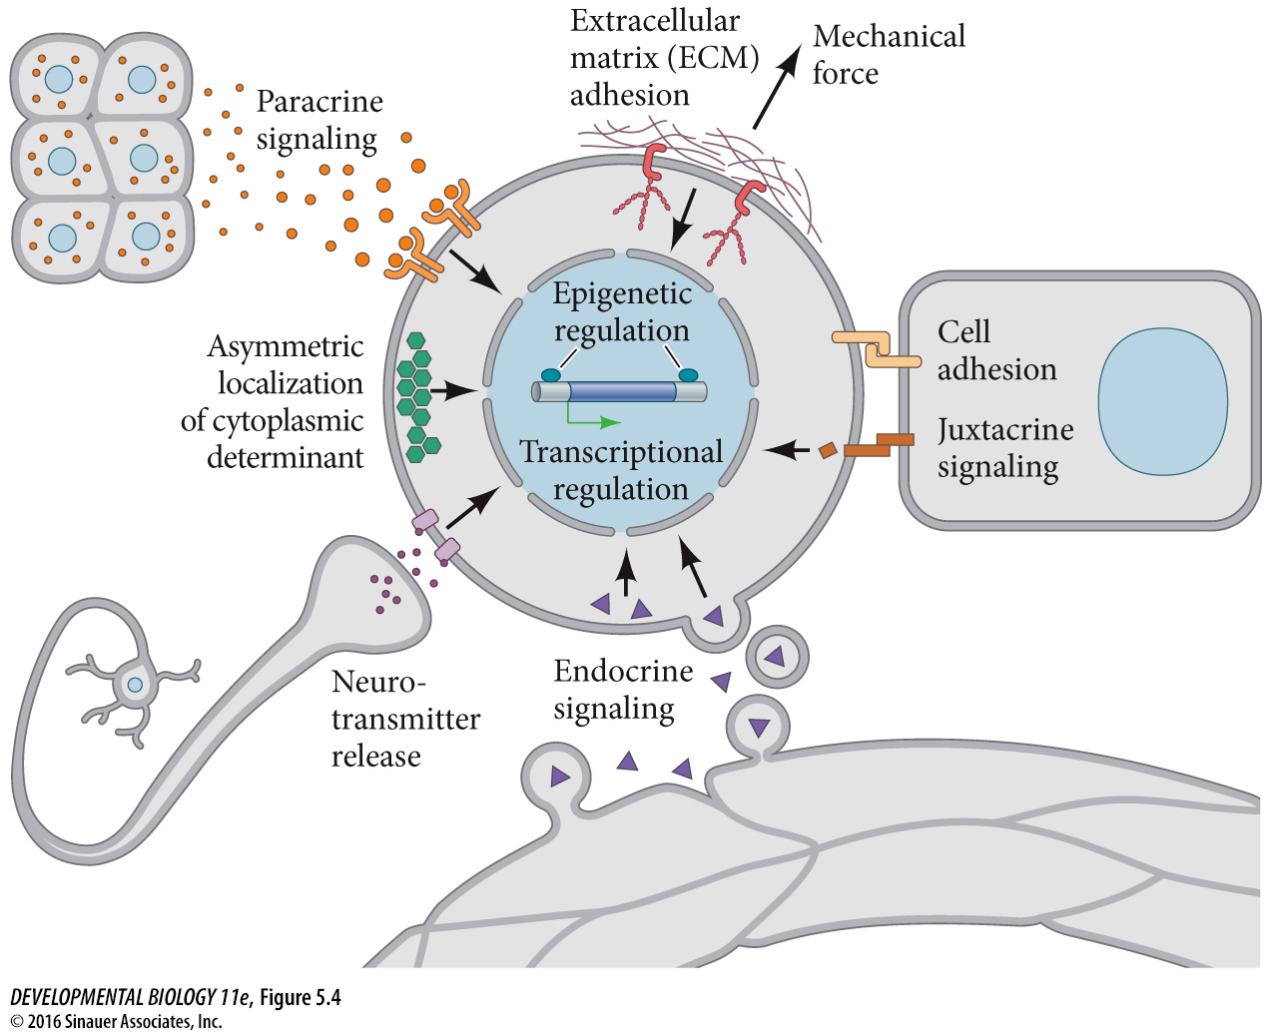
Stem cell regulatory mechanisms

Slide 29
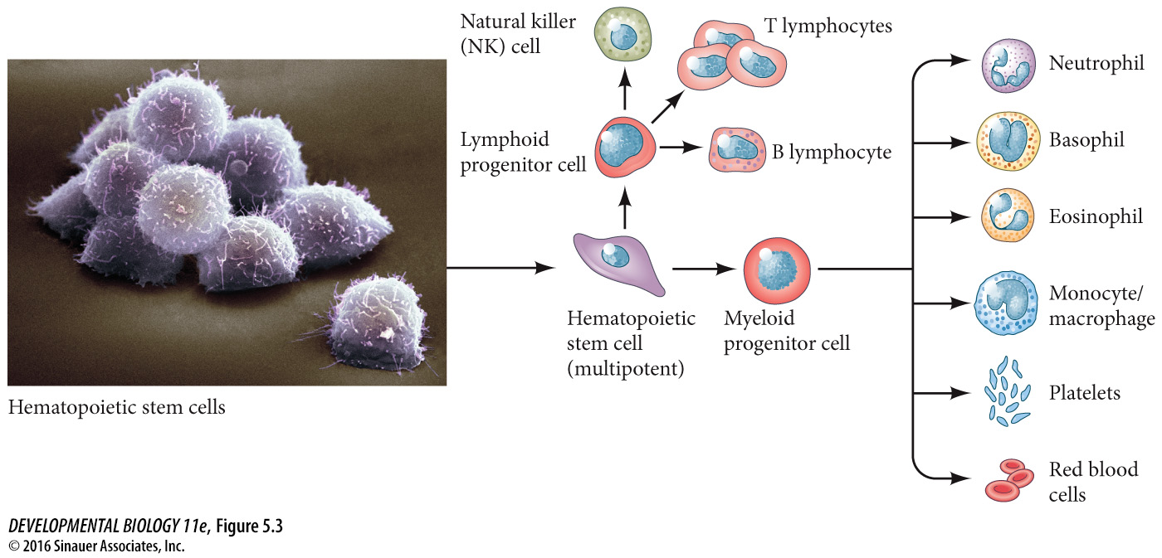
hematopoietic stem cells
Every day 100 billion cells replaced in blood

Slide 30
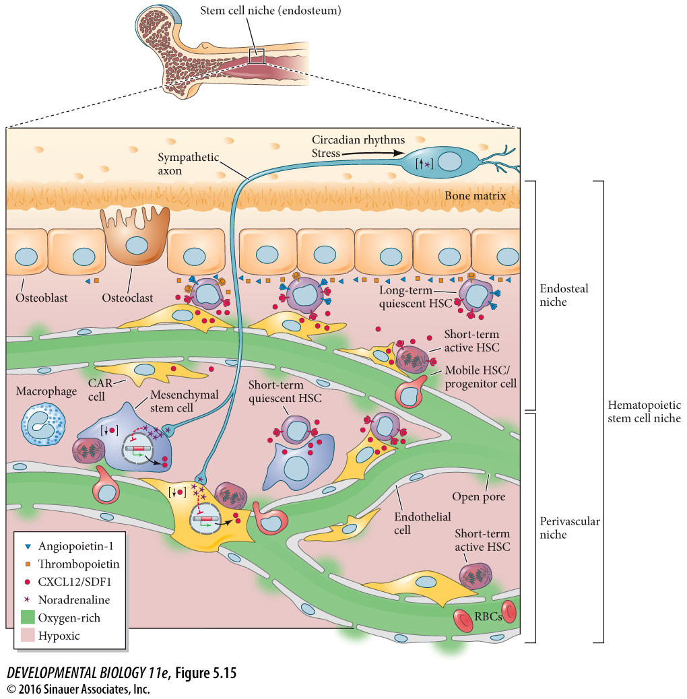
hematopoietic stem cells
In the bone marrow
Two sub-niches
Endosteal niche and perivascular niche
Endosteal niche:
Quiescent long term HSC stem cells adhere to osteoblasts
Perivascular niche:
Shorter term active associated with blood vessels – give rise to mobile HSCs in blood stream

Slide 31
hematopoietic stem cells
In the bone marrow
Activity of HSCs is regulated by cell adhesion, paracrine, ECM, hormonal, blood pressure and nervous system input.

Slide 32
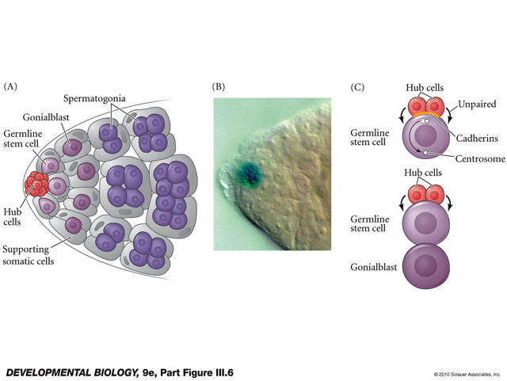
Drosophila germ line stem cells
asymmetric cell division
paracrine factor maintains niche

Slide 33
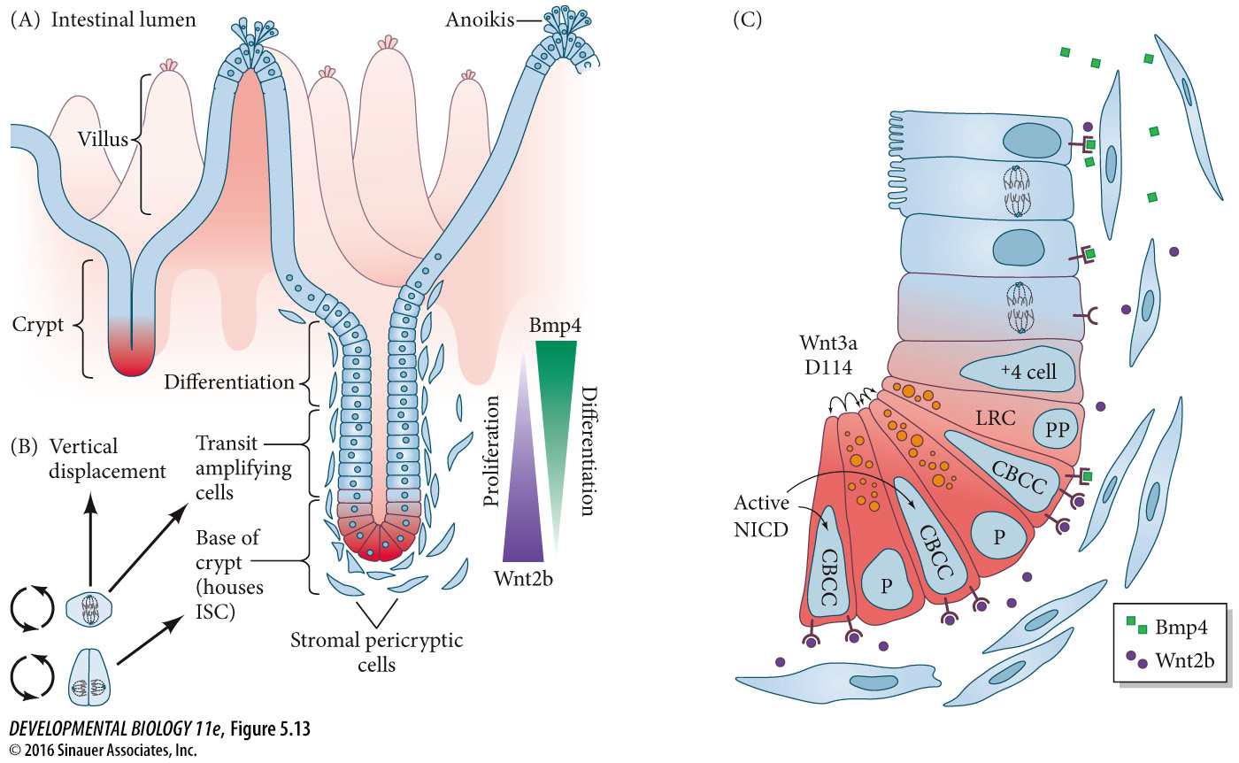
Adult intestinal stem cell niche
Base of villi – crypt – niche environment maintains stem cell properties (ISC- intestinal stem cell)
Cell generation (division) is toward the base of the crypt
Differentiation in differentiation zone
Cells lost at tips – programmed cell death and loss
Niche environment maintained by high WNT signaling and low BMP signaling

