Slide 1
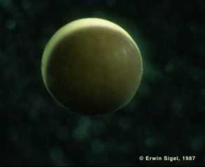
Amphibian Development
photo credit - Erwin Sigel http://www.cx.unibe.ch/~sigel/xenopicts.html

Slide 2
*** Figures for iPS paper
March 16th
John H.– 1A and 1B
Alison J- 1C and 1D
Chinmaya J. - 1E and 1F
Kerri K- 2A
Monty K.– 2B, 2C. 2D
Nathan K.– 3A
Greg L.– 3B
Nicki L.– 3C and 3D
Jared M.– 4 A and B
Nicolas M.– 5 A and B
Rachel N. - 5C and D
Allison R.– 6A and B
Abby S.– 6C and D
Michael S.– 6E
Figures for Chapter 13 - Neural tube formation (March 17th)
13.4 -
13.6 –
13.7 –
13.8 -
Chapter 11 amphibian – figure assignments
Fig 11.12 – Rachel N.
Fig 11.17 – Beth B.
Fig 11.18 – Daphne C
Fig 11.22 – Maggie C.
11.25 – Alease D.
11.28 – Emily D.
11.26 – Aidan G.

Slide 3
Axis Formation
Spemann Organizer
The Nieuwkoop Center

Slide 4
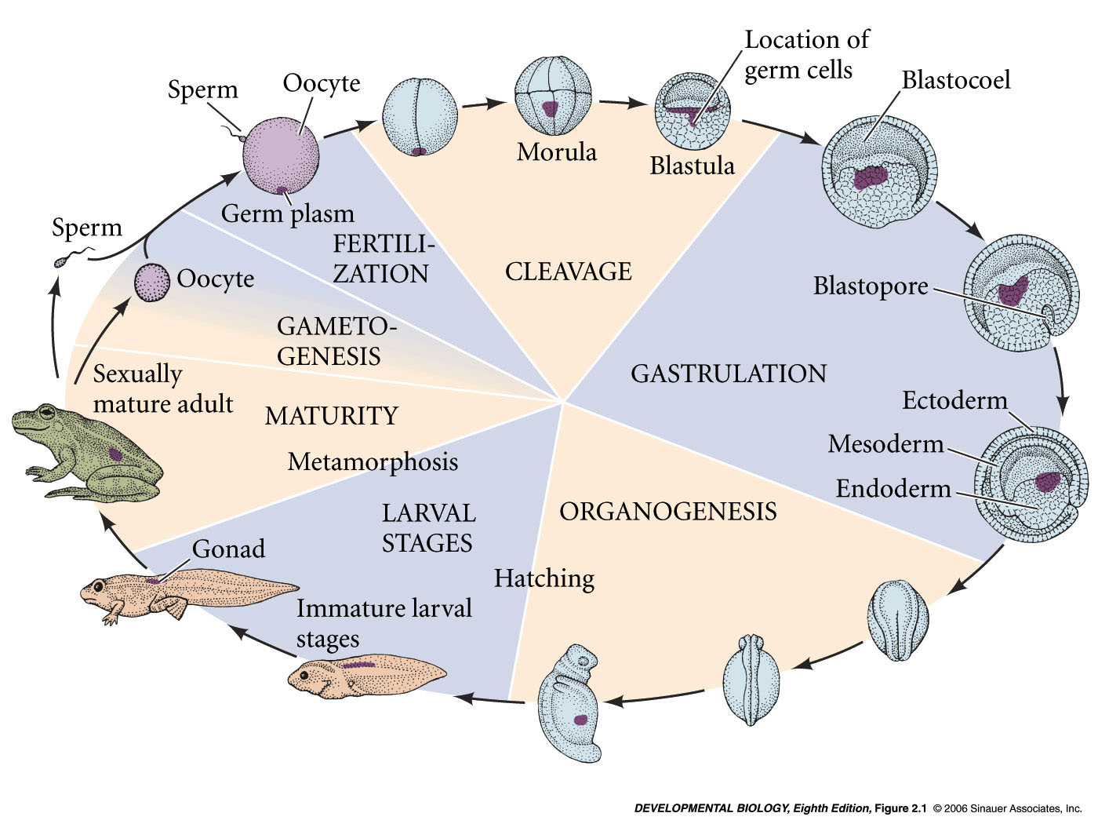
Developmental history of the leopard frog, Rana pipiens
zygote -
fertilized egg
blastula
gastrula
neurula
3 germ layers
Notes:
devbio8e-fig-02-01-0.jpg

Slide 5
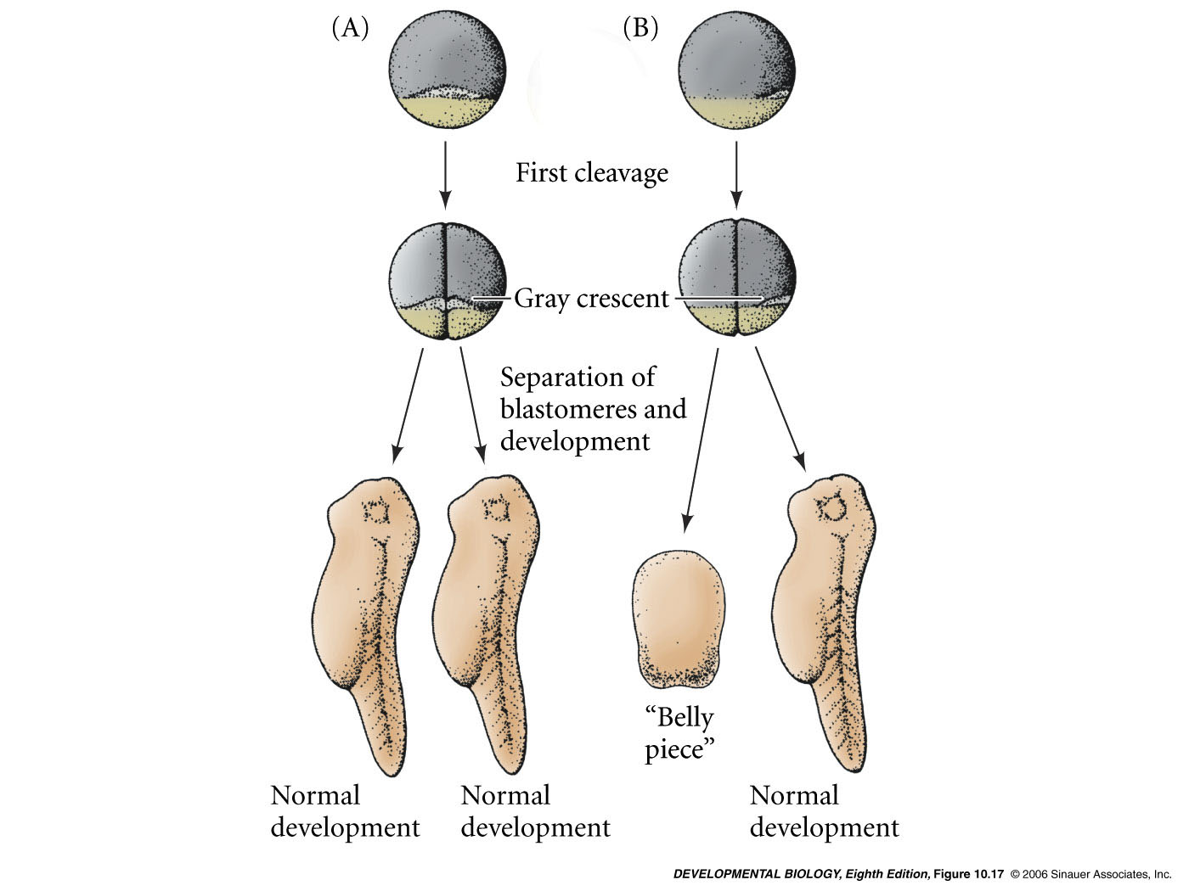
Hans Spemann and Hilde Mangold 1920’s-30’s – Discovery of the organizer
Split the egg into two with a fine hair
Two different results
11.12
“Bauchstuck”

Slide 6
Hans Spemann and Hilde Mangold 1920’s-30’s – Discovery of the organizer
Something in the gray crescent area required for dorsal structures
Fate mapping indicated that gray crescent became the dorsal lip of blastopore
11.12
“Bauchstuck”

Slide 7
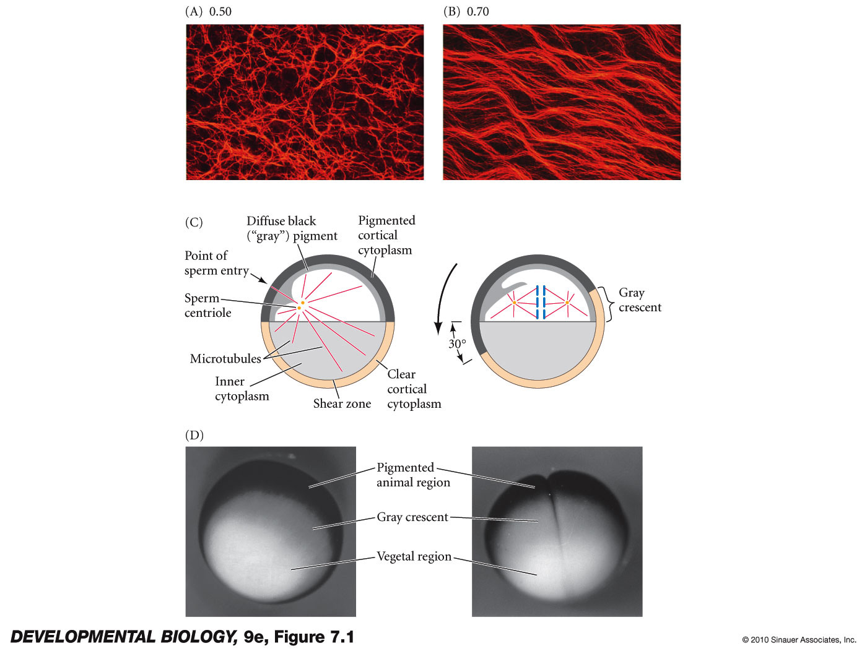
What is the grey crescent?
single cell egg – pigmented animal half
fertilization – any where in animal half
rotation of cortical cytoplasm
results in the formation of a grey crescent on side opposite sperm entry site
Results in the deposition of a cytoplasmic determinant on future dorsal side

Slide 8
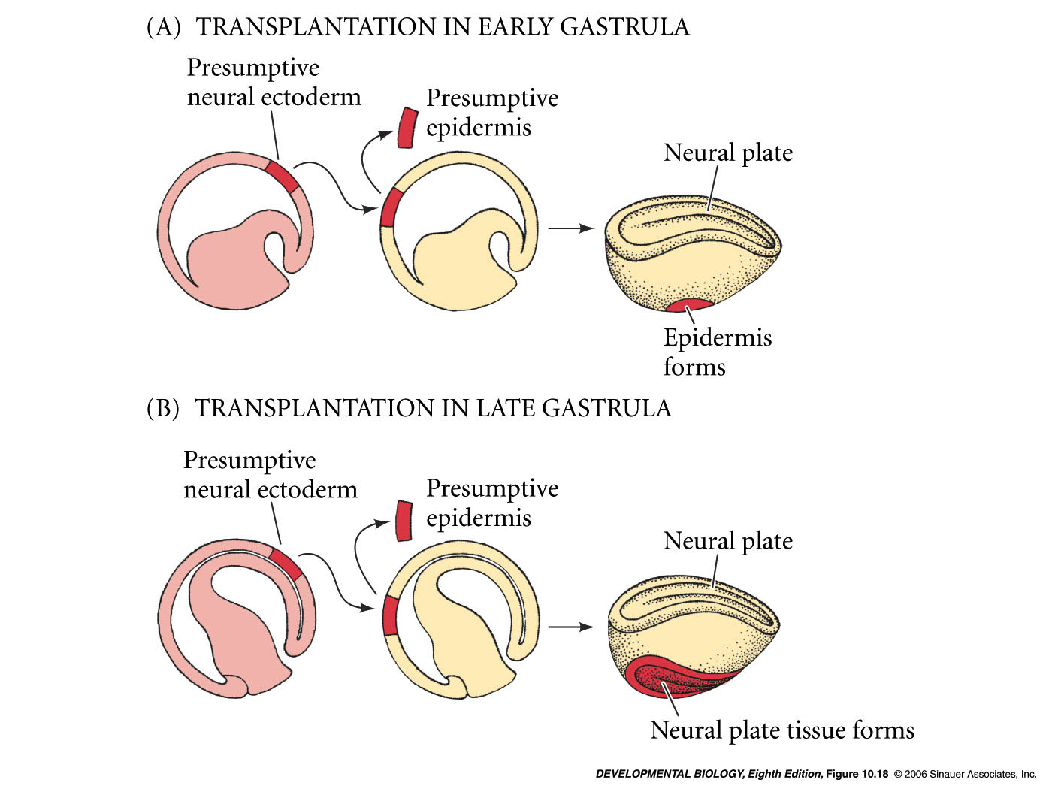
Determination of cell fates during gastrulation
Early gastrula is not yet determined.
(regulative or conditional development early)
Late gastrula determined - potencies restricted.
(determined fates later)

Slide 9
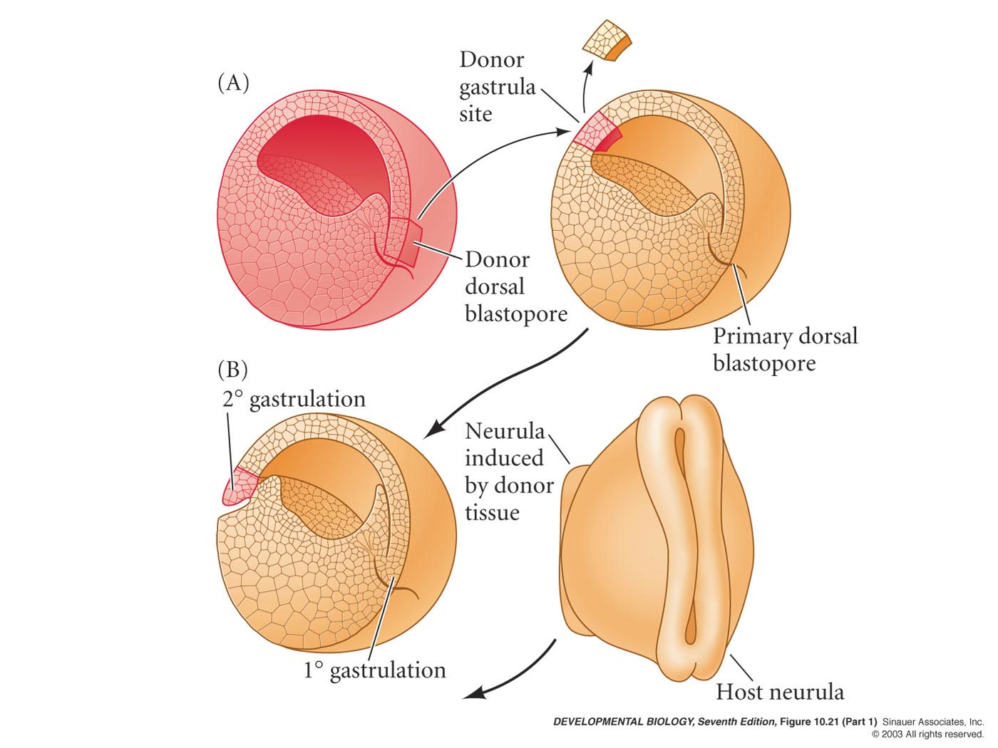
Hans Spemann and Hilde Mangold Nobel Prize - 1935
Exception is cells of the dorsal lip of the blastopore.
Its fate is determined earlier.
Derived from the gray crescent area.

Slide 10
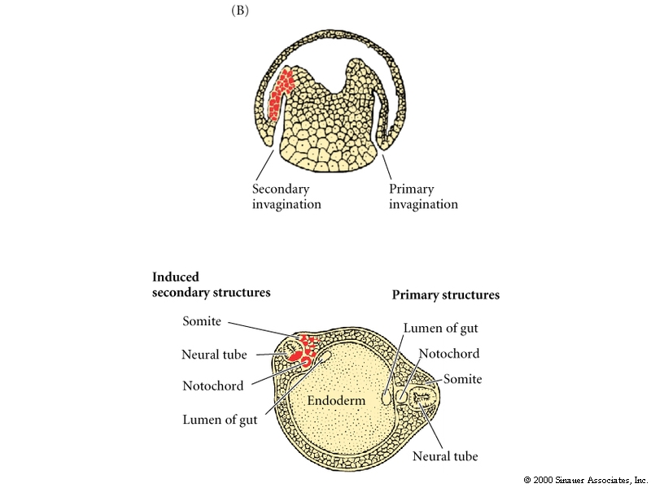
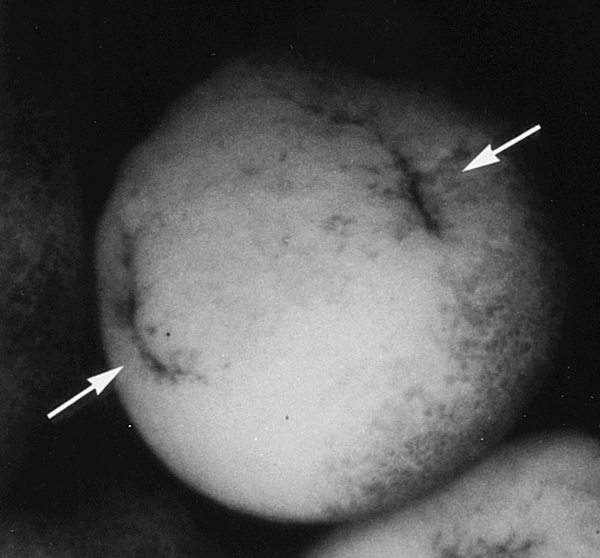
Transplantation of the dorsal lip to the ventral side causes a double axis.
Initiated gastrulation and a second embryo.

Slide 11
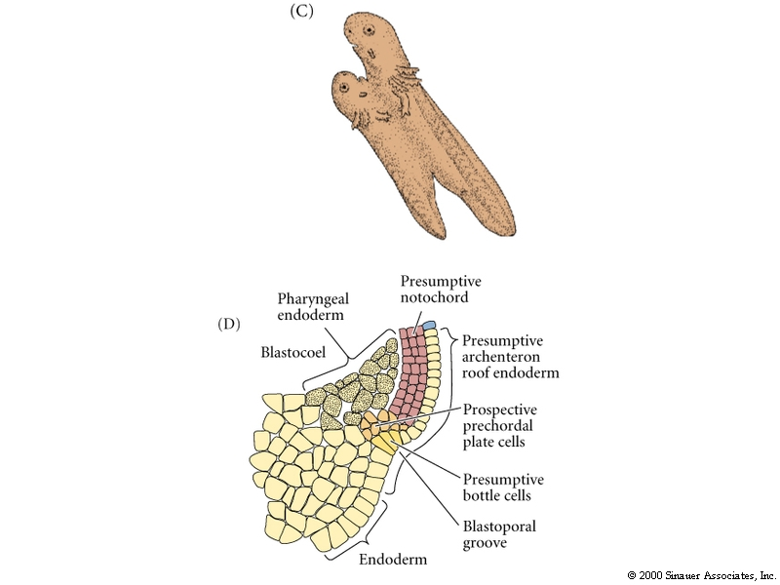
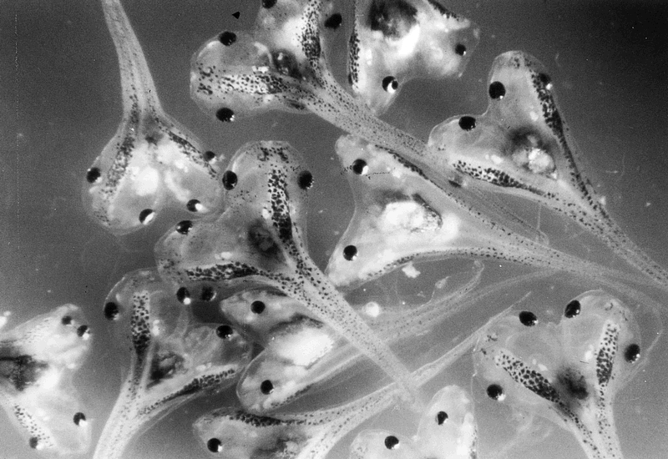
Organizer induces second dorsal/ventral axis
Organizer refers to the cells of the dorsal lip of the blastopore and their derivatives -
notochord
derived from dorsal lip of blastopore
Induce and pattern the brain and spinal cord

Slide 12
Video of Spemann Mangold experiment
http://11e.devbio.com/wd1105.html

Slide 13
How is the organizer specified?
What molecules are active in the organizer?
How do they cause induction of dorsal fate?
How is dorsal fate tied to Anterior/Posterior fate?

Slide 14
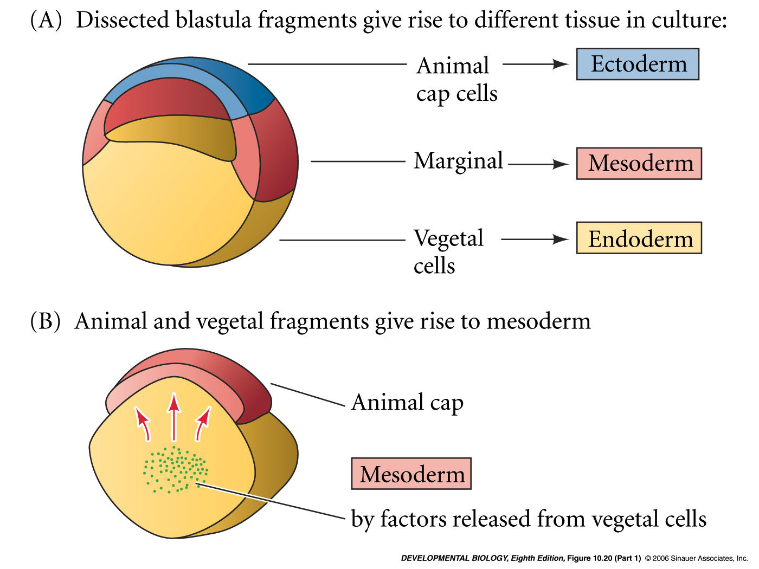
Nieuwkoop/Nakamura (1970s)
Vg1 - ligand

Slide 15
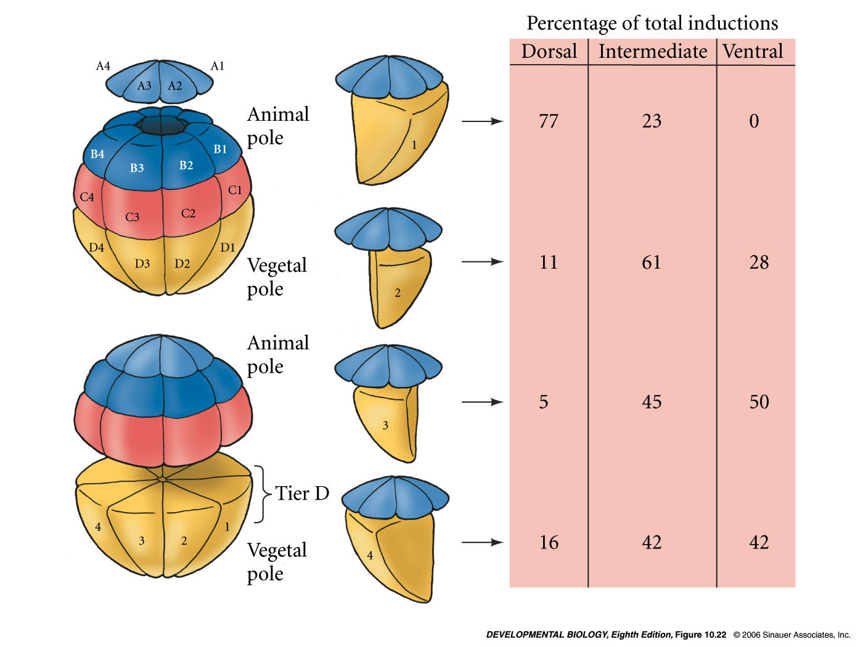
Different vegetal portions induce different mesoderm
ventral vegetal blastocyst
(i.e. D4) induces ventral mesoderm
dorsal vegetal blastocysts
(i.e. D1 = Nieuwkoop center) induces dorsal mesoderm
(i.e. the spemann organizer)
Dale and Slack; 1987

Slide 16
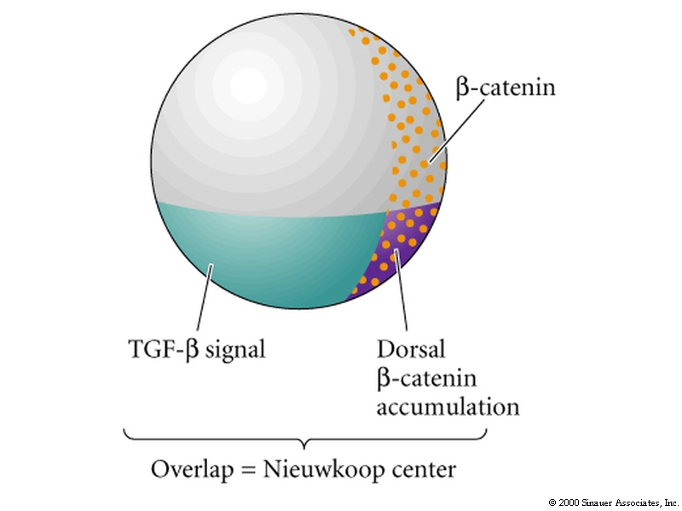
Nieuwkoop Center
2 signals
β catenin-
in future dorsal side due to cortical rotation
sperm entry
TGF−β ligand- Vg1
transcription factor - VegT
in vegetal portion of egg by mother
induces mesodermal fate in marginal region
VegT mutant/antisense morpholinos – no endoderm and no mesoderm
Vg1 mutant/antisense morpholinos – no mesoderm
Nieuwkoop center induces Spemann organizer

Slide 17
The Nieuwkoop Center and Spemann organizer
animal pole
Spemann
organizer
future ventral side
(goosecoid expression)
Nieuwkoop
center
vegetal pole
(VegT, Vg1)

Slide 18
Vegetal induces mesoderm
Vg1 - TGFβ family ligand
VegT - transcription factor
turn on Nodal and nodal-related proteins (Xnr)
(all TGFβ family members)
this induces Xbra (Brachyury) in equatorial region;
cells become mesoderm
Xbra

Slide 19
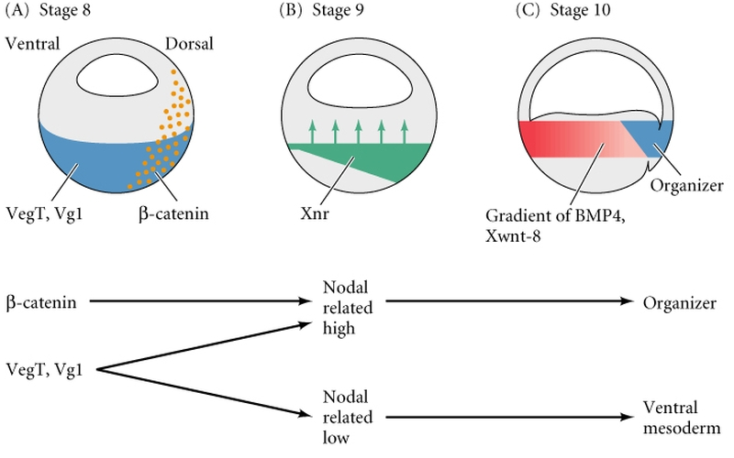
Model for differential mesoderm induction
gradient of multiple Nodal-related signals (Xnrs) released by endoderm
conditions in the vegetal hemisphere
level of nodal-related signal sent
result in equatorial zone

Slide 20
11.17

Slide 21
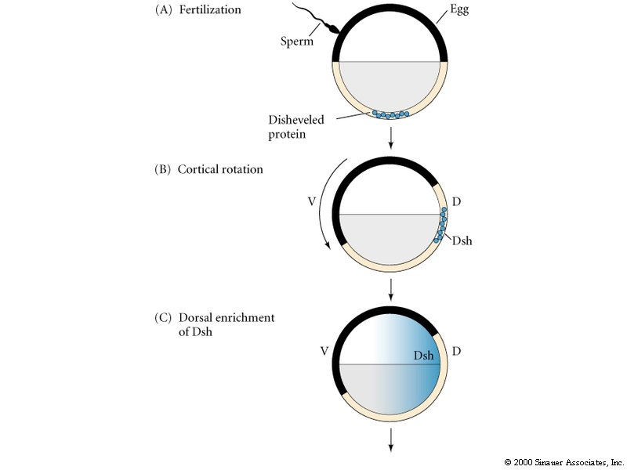
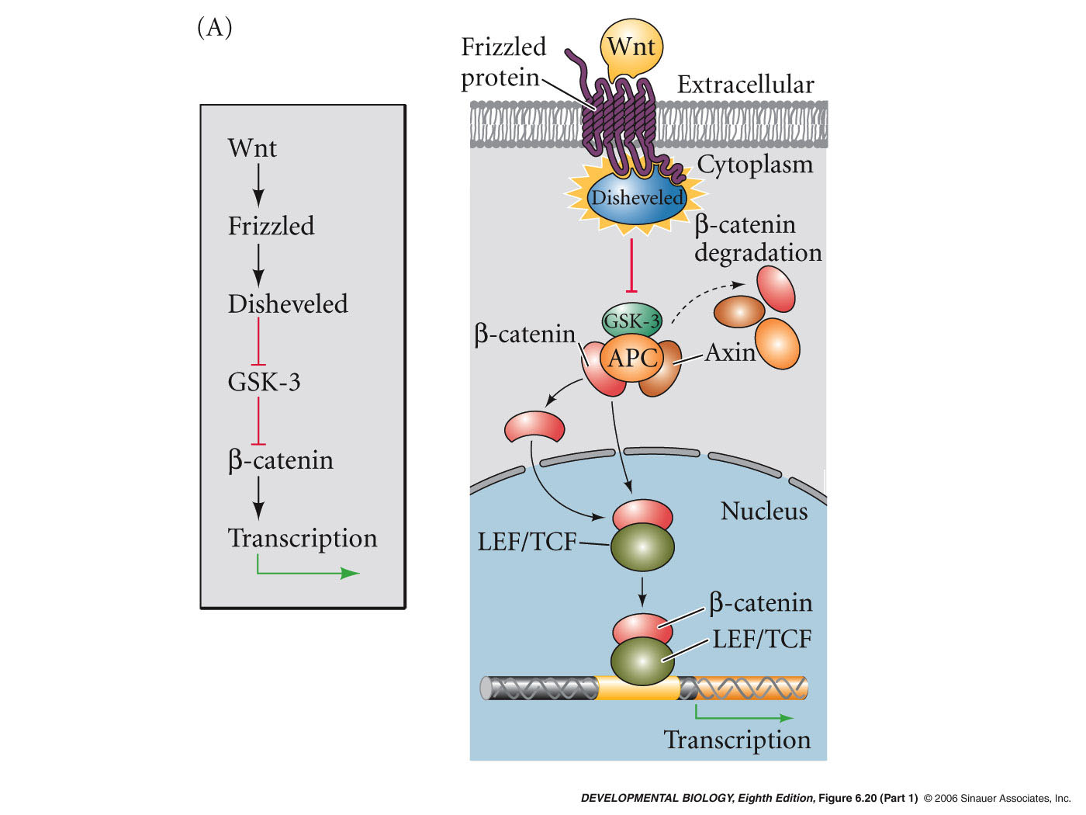
Cortical rotation stabilizes β-catenin
dorsal enrichment of dishelveled

Slide 22
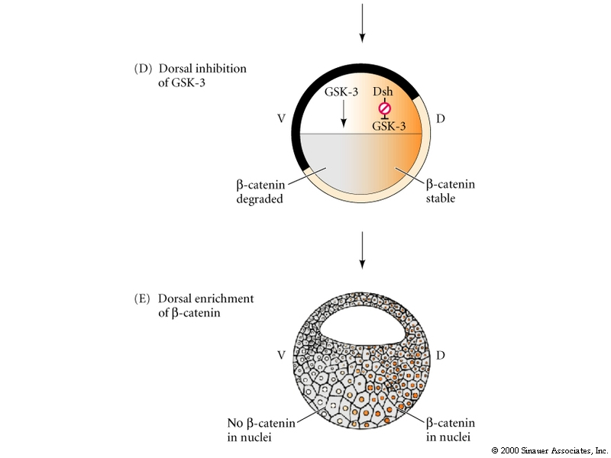
GSK3 degrades β-cat ventrally; Dsh degrades GSK3 dorsally preventing degradation of β-cat
Cortical rotation stabilizes β-catenin

Slide 23
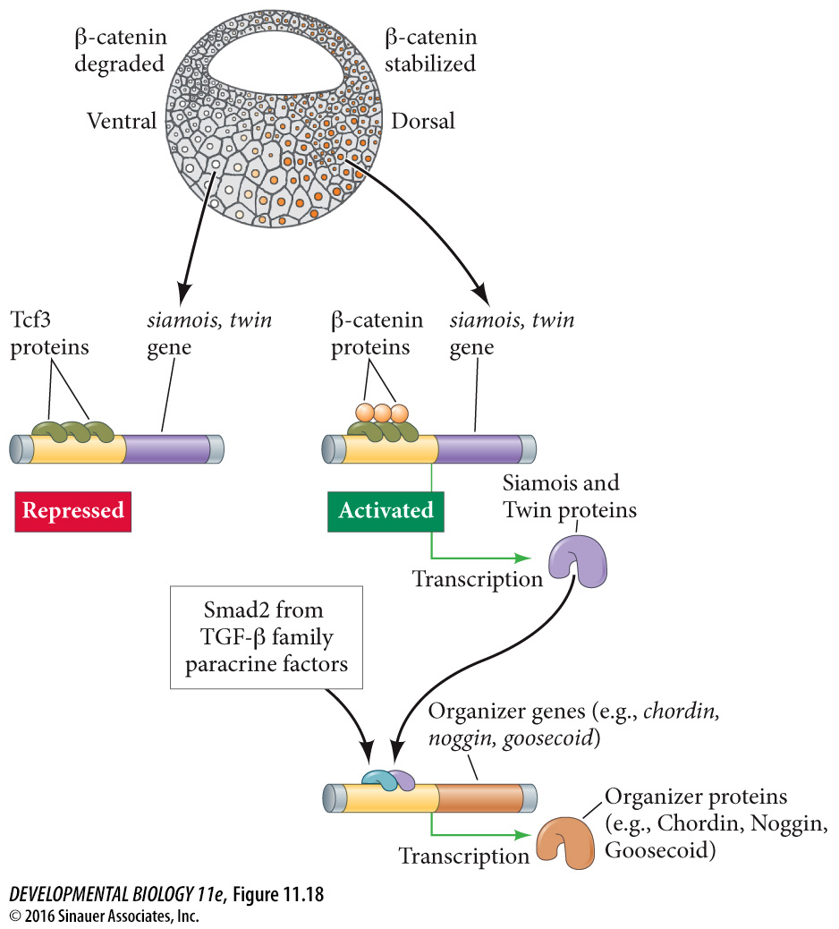
TGFβ and β-catenin signaling converge on goosecoid expression
Goosecoid expression in Spemann organizer
11.18

Slide 24
Goosecoid
Expressed in the dorsal lip in response to Nieuwkoop center
Encodes transcription factor
Injected mRNA can induce a new axis
Notes:
Figures\Chapter10\DevBio7e10280.jpg

Slide 25
Three functions of the Spemann Mangold organizer
1) initiate gastrulation
2) differentiate into different types of dorsal mesoderm – (includes pharengeal endoderm, head mesoderm, and notochord)
3) dorsalize the ectoderm and induce neural tube

Slide 26
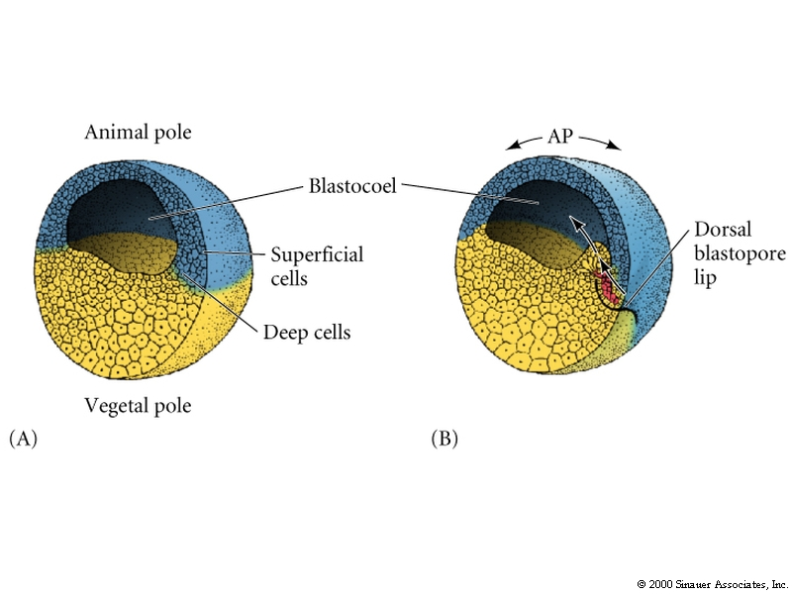
Cell movements during frog gastrulation
sperm entry
Spemann organizing center
Cells opposite sperm entry point will form the blastopore and become the dorsal part of the body

Slide 27
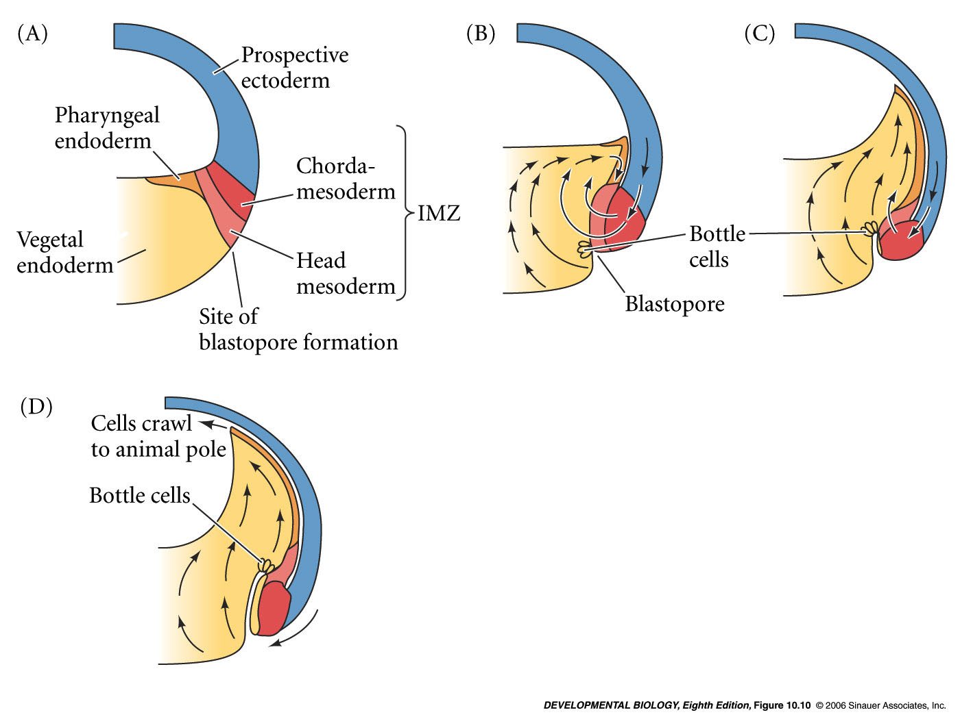
Cell movements during frog gastrulation
extracellular matrix - fibronectin lines blastocoel

Slide 28
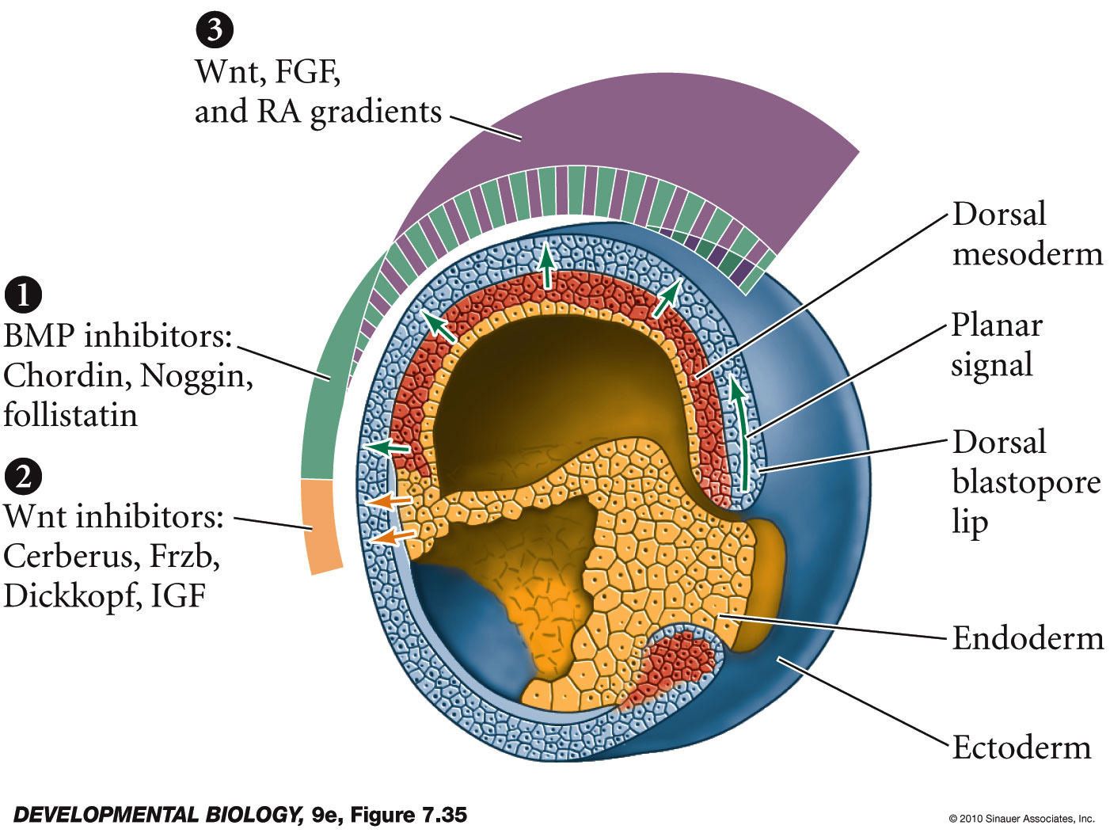
Model of the organizer function and axis specification in the Xenopus gastrula

