Slide 1
Induction of Pluripotent Stem Cells from Mouse Embryonic and Adult Fibroblast Cultures by Defined Factors
Kazutoshi Takahashi1 and Shinya Yamanaka1,2,*
Department of Stem Cell Biology, Institute for Frontier Medical Sciences, Kyoto University, Kyoto 606-8507, Japan
CREST, Japan Science and Technology Agency, Kawaguchi 332-0012, Japan
*Contact: yamanaka@frontier.kyoto-u.ac.jp
Cell 126, 663–676, August 25, 2006 ª2006 Elsevier Inc

Slide 2
*** Figures for iPS paper
March 16th
John H.– 1A and 1B
Alison J- 1C and 1D
Chinmaya J. - 1E and 1F
Kerri K- 2A
Monty K.– 2B, 2C. 2D
Nathan K.– 3A
Greg L.– 3B
Nicki L.– 3C and 3D
Jared M.– 4 A and B
Nicolas M.– 5 A and B
Rachel N. - 5C and D
Allison R.– 6A and B
Abby S.– 6C and D
Michael S.– 6E

Slide 3
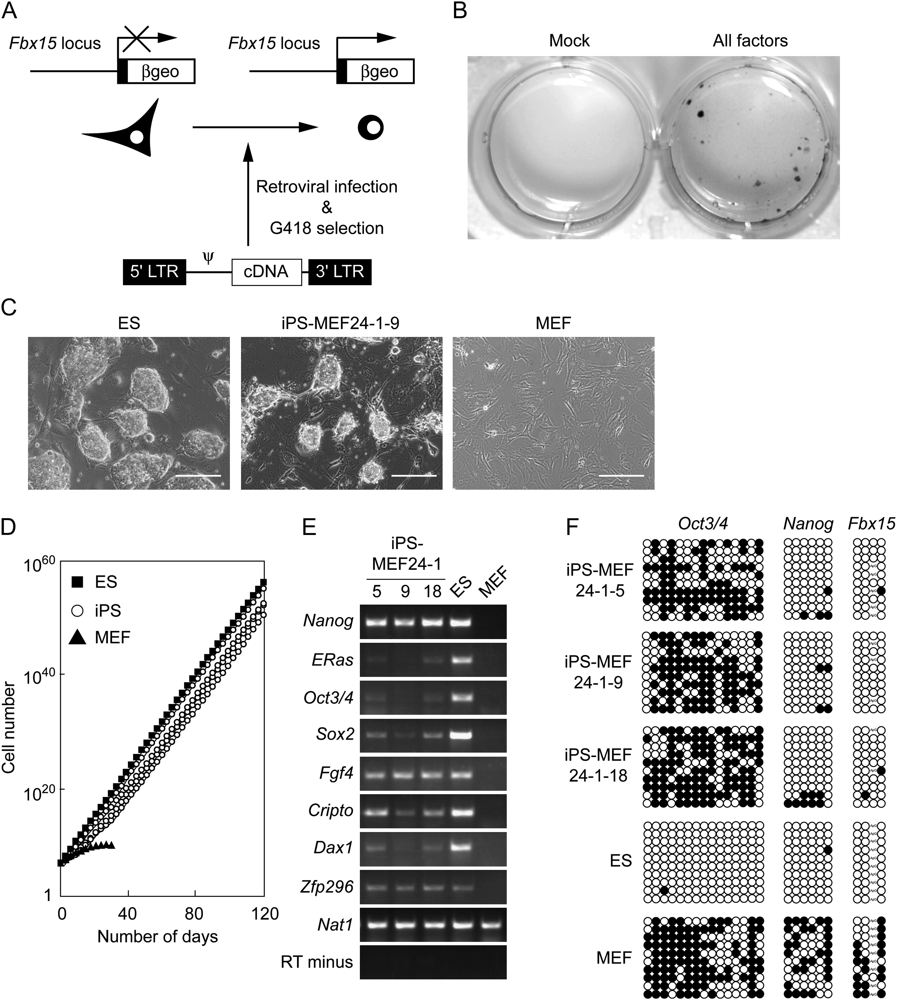
http://fc01.deviantart.net/fs17/f/2007/173/f/4/Retro_Never_Dies___Wallpeper_by_Jazzgin.jpg

Slide 4
Retro virus – RNA virus uses reverse transcriptase to make a DNA copy of itself then integrates in genome.
http://fc01.deviantart.net/fs17/f/2007/173/f/4/Retro_Never_Dies___Wallpeper_by_Jazzgin.jpg

Slide 5
Bisulfate sequencing – determines if a particular cytosine in the DNA is methylated
http://fc01.deviantart.net/fs17/f/2007/173/f/4/Retro_Never_Dies___Wallpeper_by_Jazzgin.jpg

Slide 6
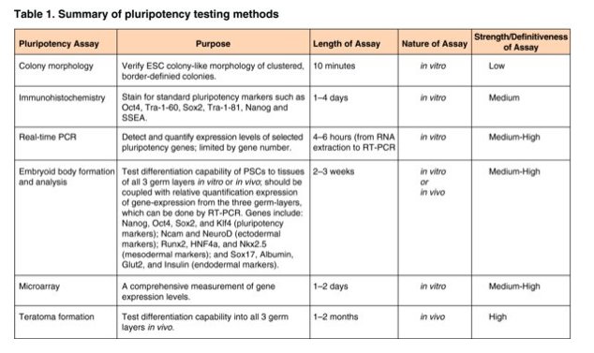
http://genesdev.cshlp.org/content/19/10/1129.long

Slide 7
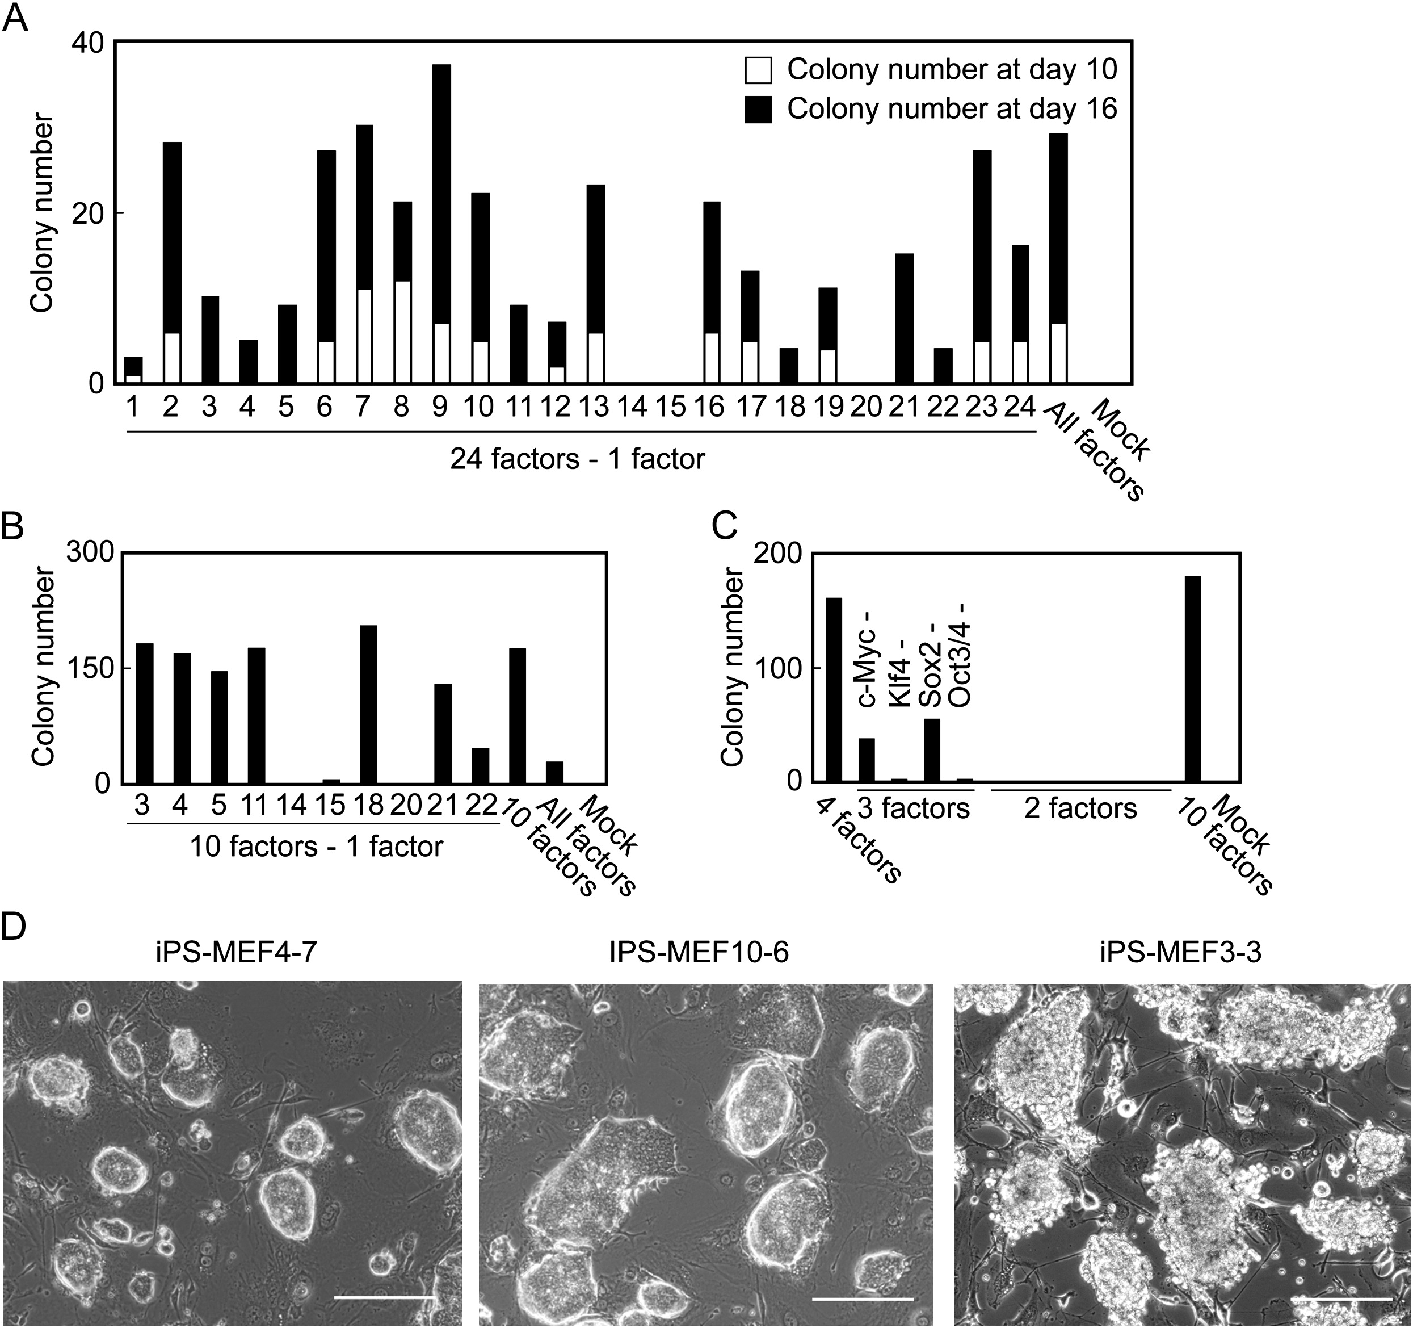

Slide 8
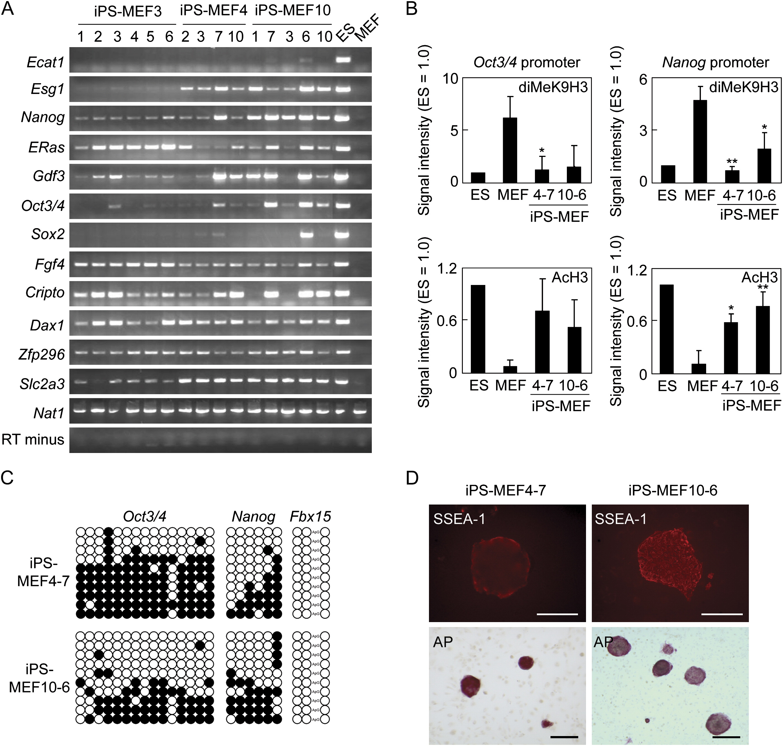
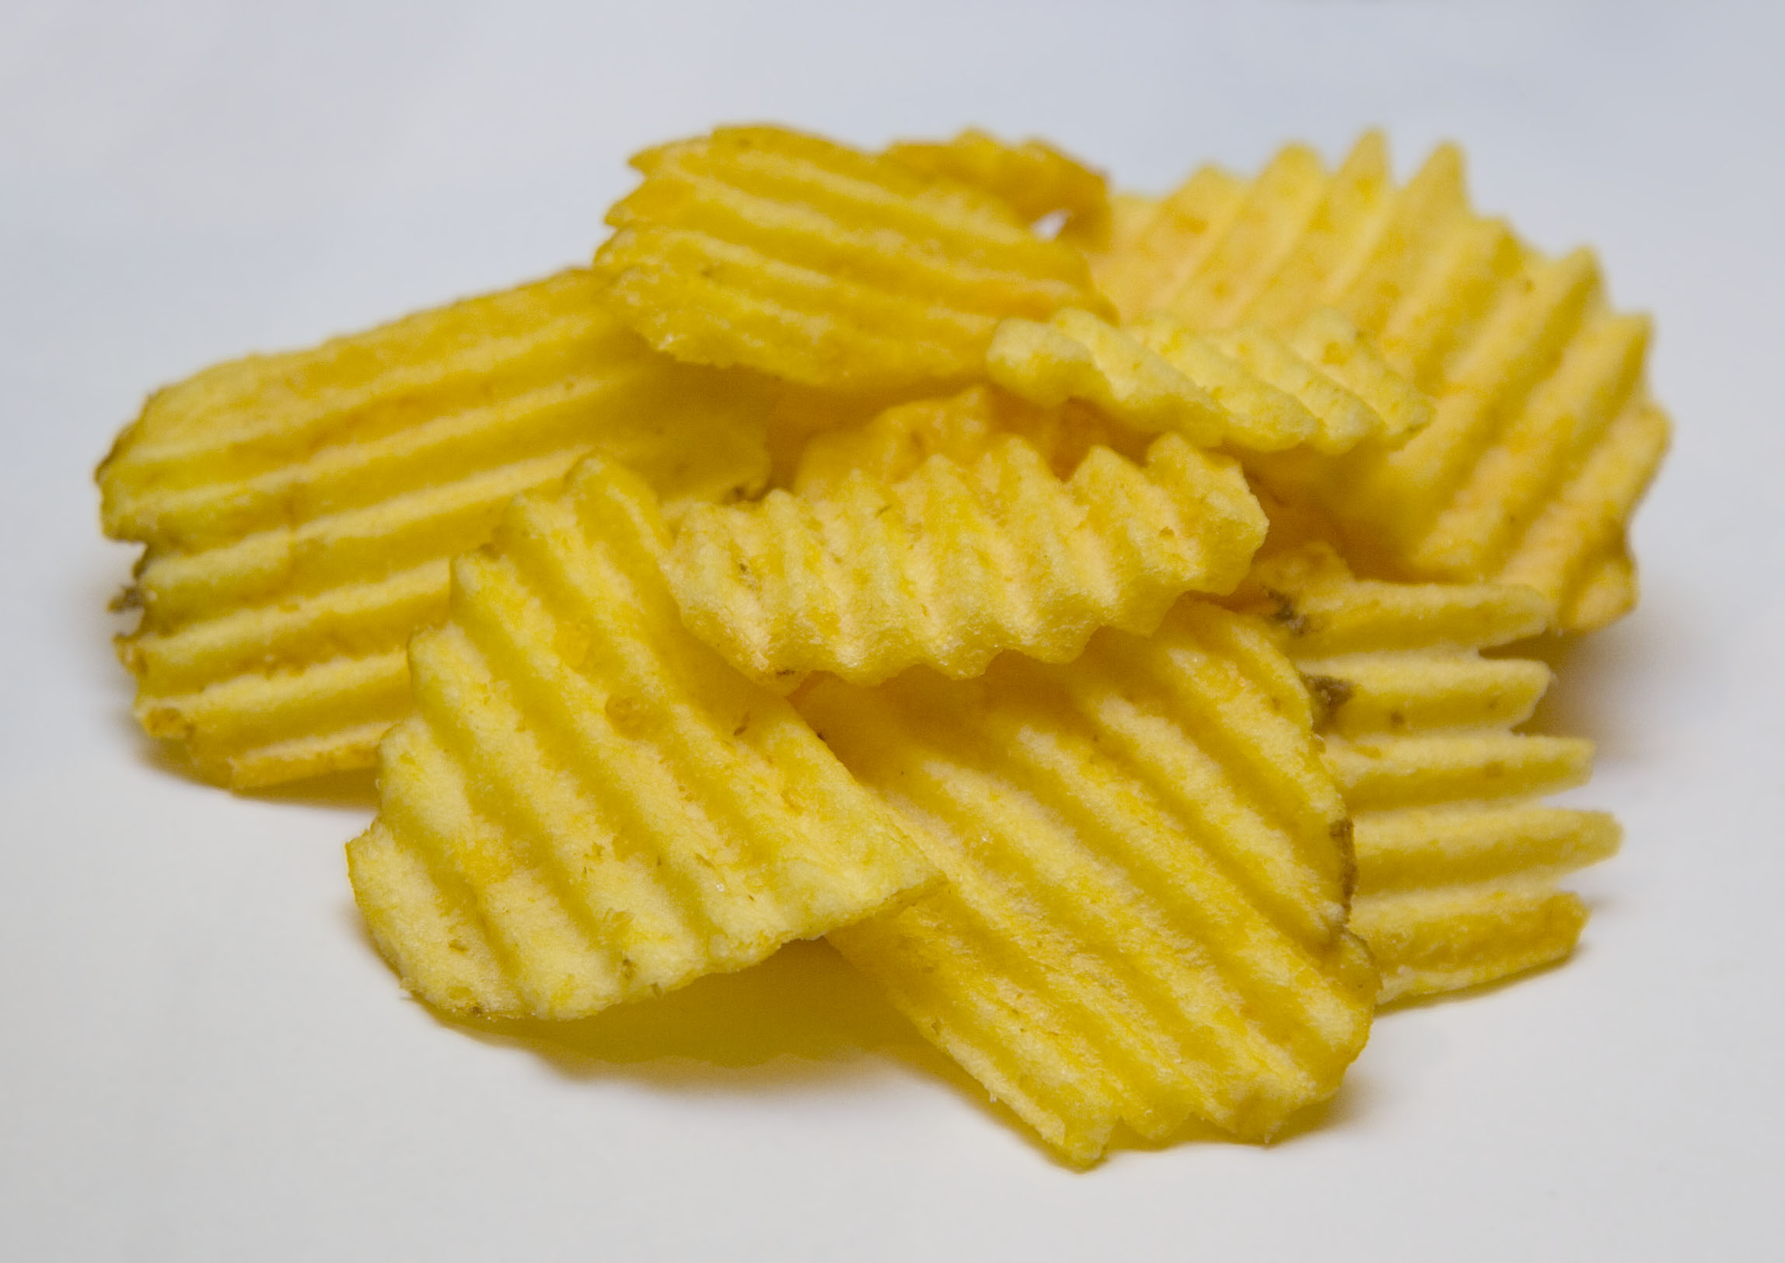
http://upload.wikimedia.org/wikipedia/commons/3/34/McCoy%27s_Crisps.jpg

Slide 9
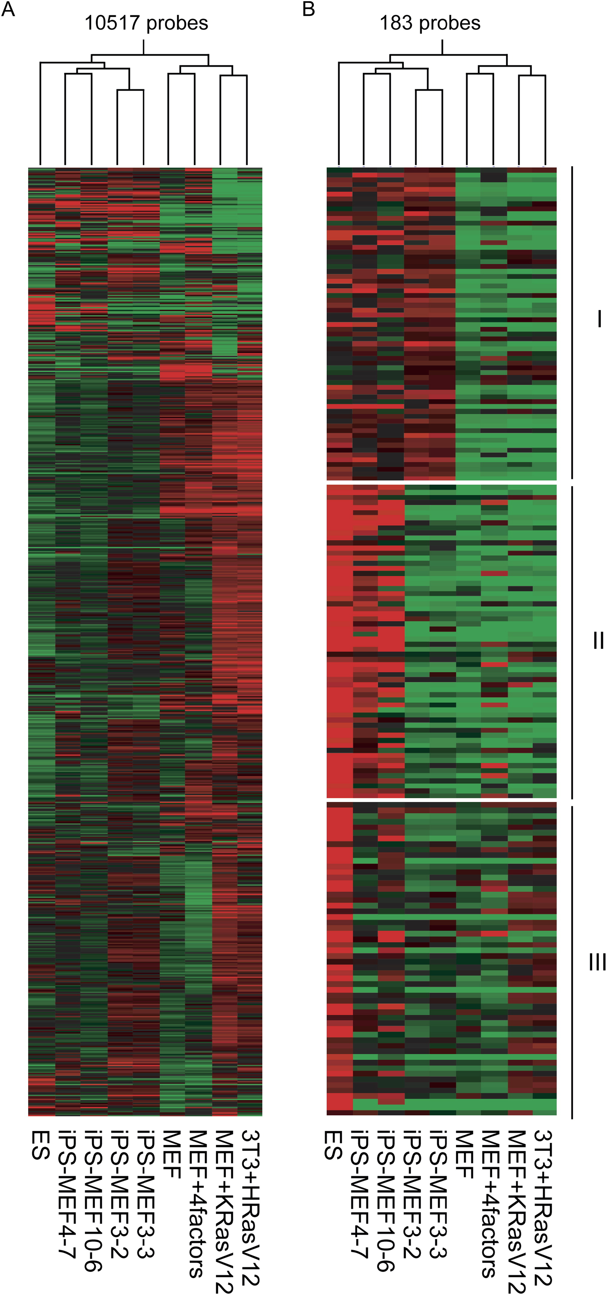

Slide 10
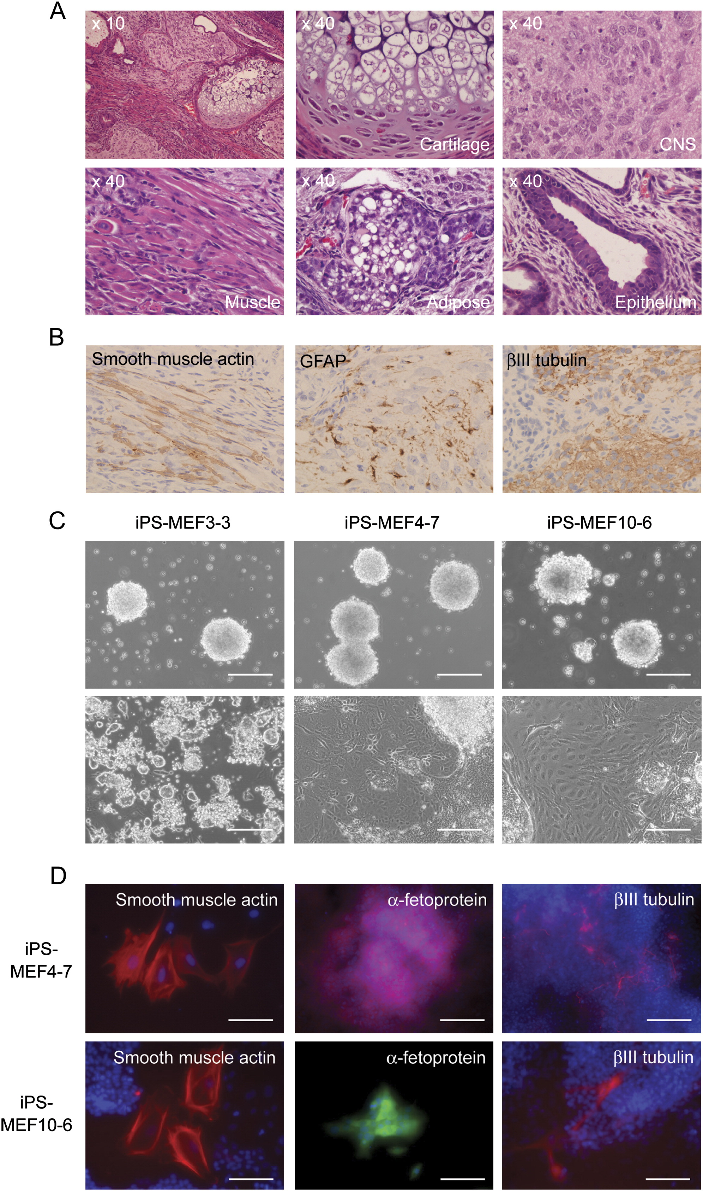

Slide 11
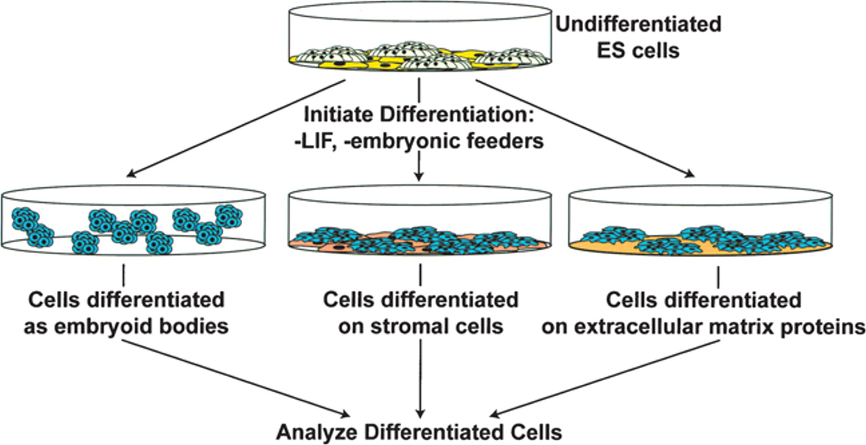
Three different protocols used for ES cell differentiation.
Keller G Genes Dev. 2005;19:1129-1155
Cold Spring Harbor Laboratory Press
Notes:
Three different protocols used for ES cell differentiation.

Slide 12
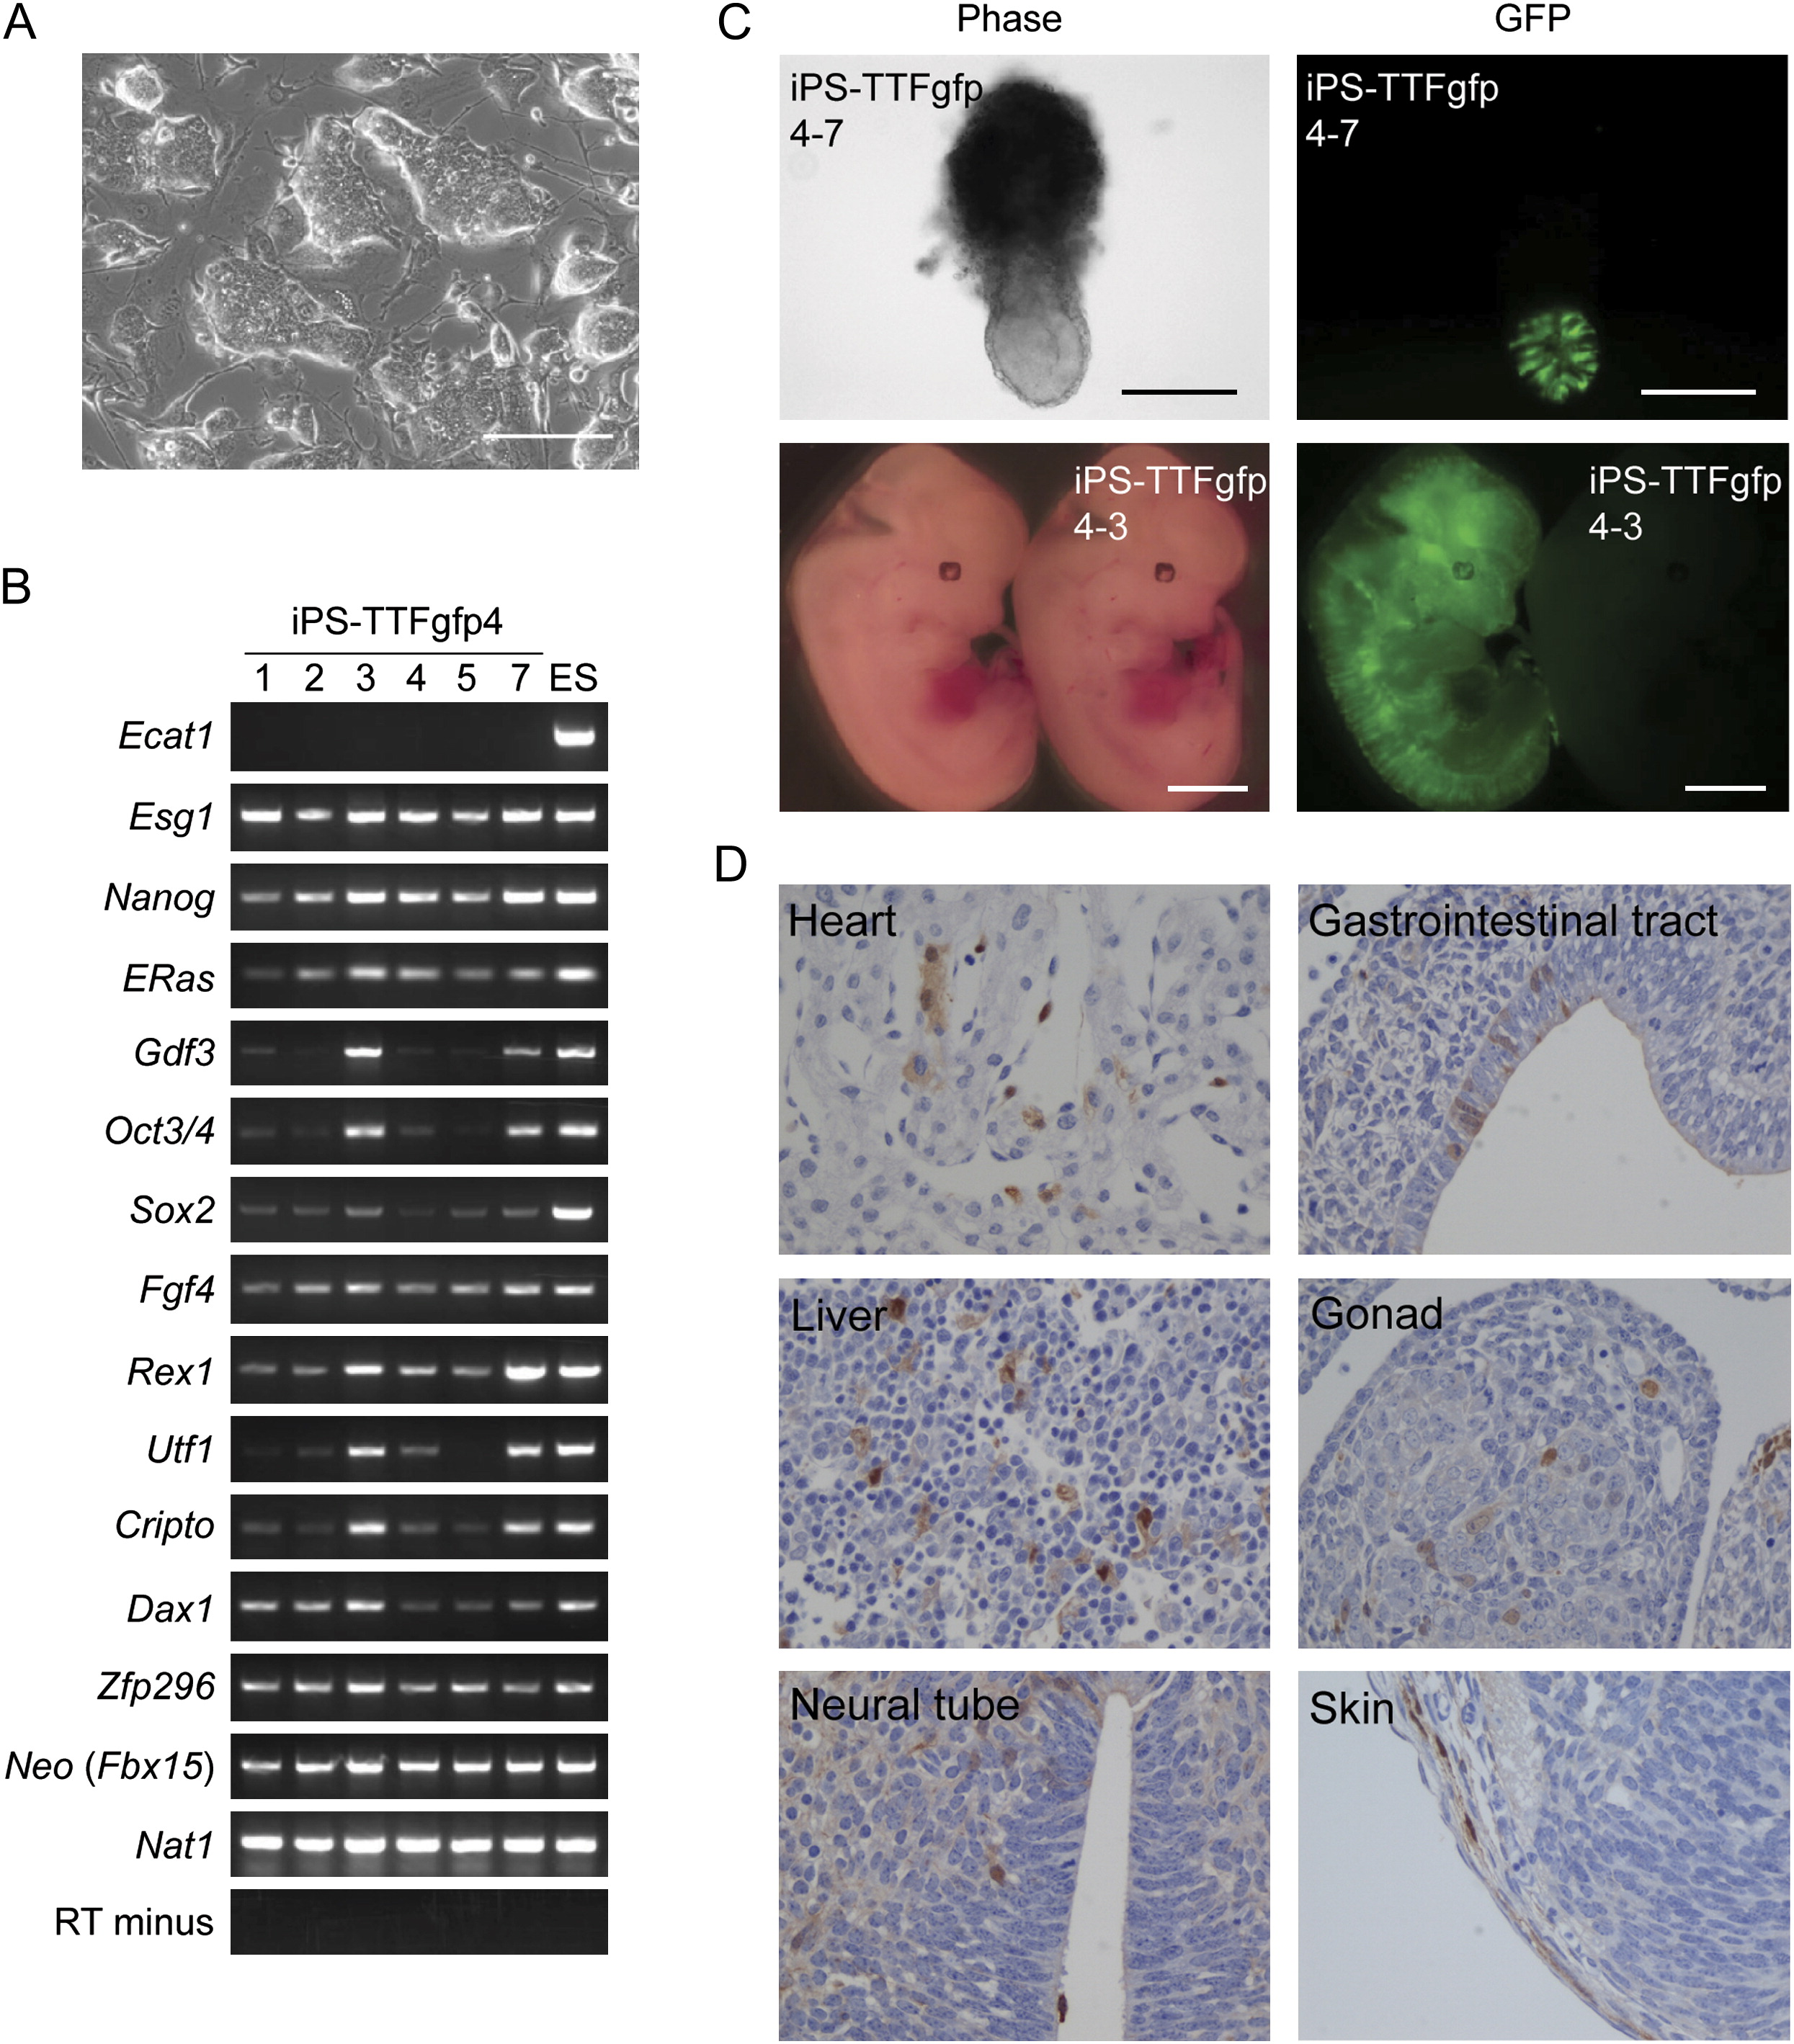

Slide 13
