Slide 1
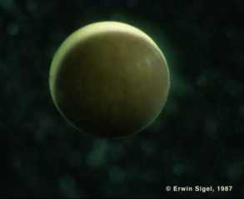
Amphibian Development II
photo credit - Erwin Sigel http://www.cx.unibe.ch/~sigel/xenopicts.html

Slide 2
Upcoming lectures and assignments
March 19 | Amphibian Axis II - 03_19_18amphibianspartsIIandIII | Chapter 11 up to p365
March 21 | Amphibians finish up
March 23 | Guest Lecture - C. Elegans - Jim Mahaffey | INTRO to C. elegans video - please watch before today's class
March 26 | Neural Crest development | Chapter 15 pp. 463-488
March 28 | Zebrafish neural crest and cancer - read and discuss the research paper | 1) click here for main article 2) click here for shorter perspective summary 3) homework questions link here
March 30 | Spring Break II - No Class
April 2 | EXAM III | exam covers from Feb 26th lecture on mammalian homeotic genes and stem cells - thru march 28th lecture on zebrafish neural crest and cancer.

Slide 3
Paper to read and discuss March 28°
A zebrafish melanoma model reveals emergence of neural crest identity during melanoma initiation
Fig 1 ABC – Michael S.
Fig1 DEFG – Hanna S
Fig 1H – Jesse T.
Fig 2 ABCD– Vivian T.
Fig 2 EF – Matthew A
Fig2 G – Rachel B.
Fig 3 A– Kelly B.
Fig 3 BCD- Beth B.
Fig 3E – Maggie C
Fig. 3F – Alease D
Fig 3G – Emily D
Chapter 11 amphibian – figure assignments
Fig 11.12 – Rachel N.
Fig 11.17 – Beth B.
Fig 11.18 – Daphne C
Fig 11.22 – Maggie C.
11.25 – Alease D.
11.28 – Emily D.
11.26 – Aidan G.

Slide 4
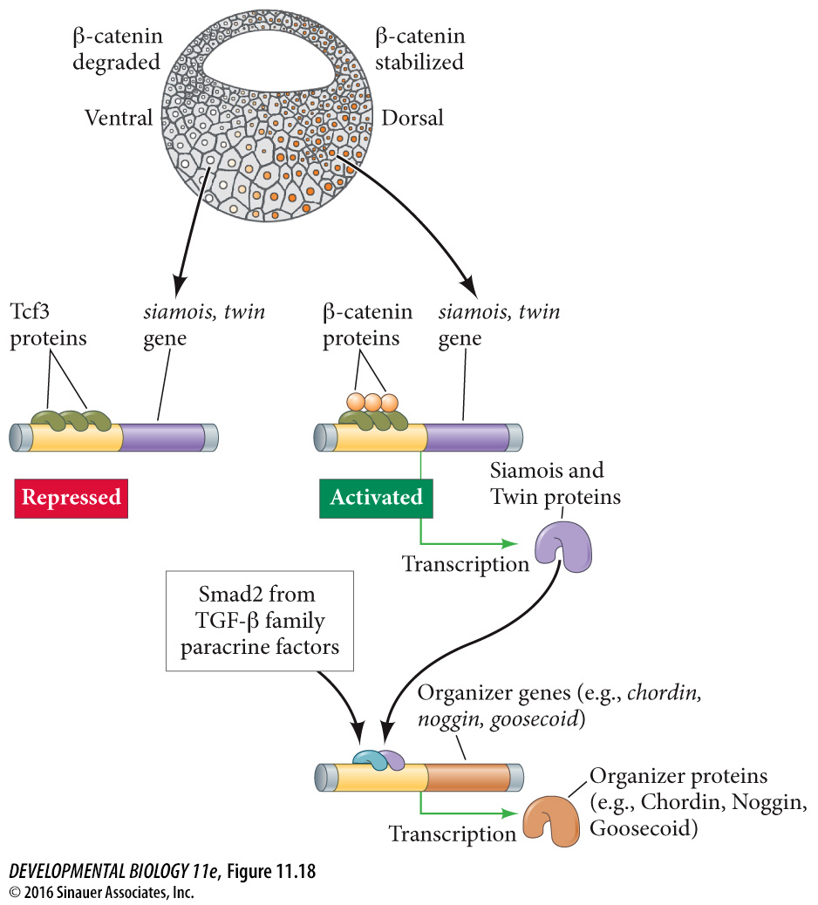
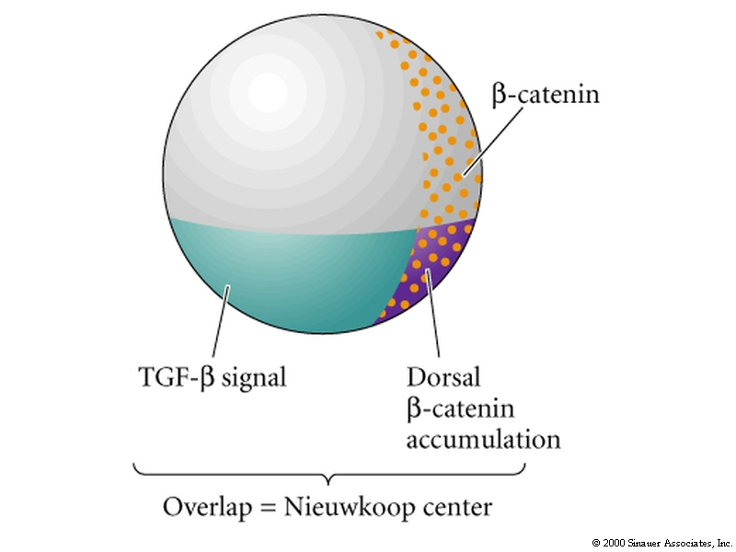
TGFβ and β-catenin signaling converge on goosecoid expression
Goosecoid expression in Spemann organizer
11.18

Slide 5
Five organizer secreted proteins (downstream of Goosecoid)
Noggin, Chordin, Follistatin– block BMP signals
Frz-B – blocks wnt signals
Cerberus – blocks both wnt and BMP signals

Slide 6
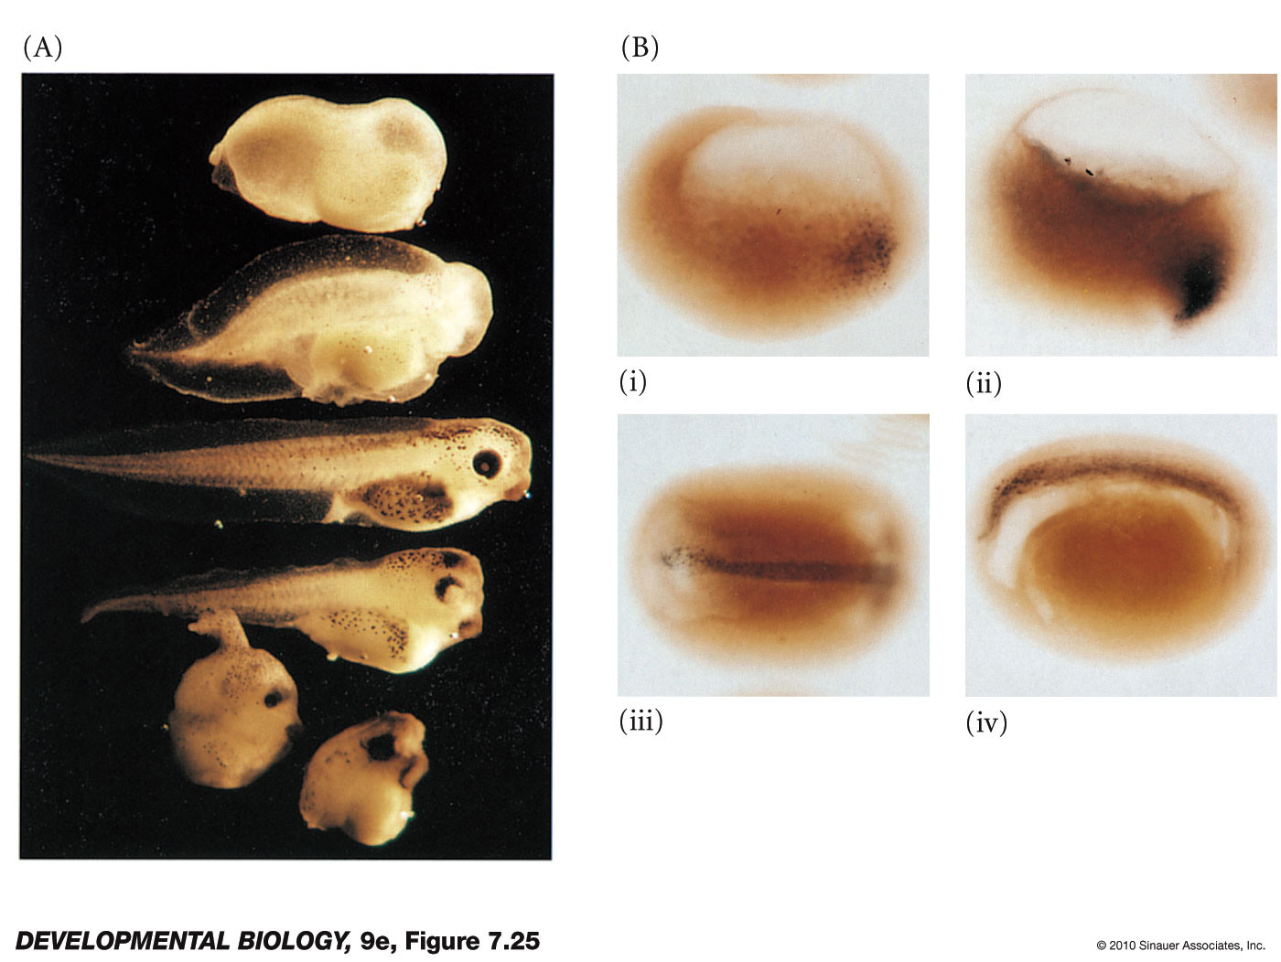
The soluble protein Noggin dorsalizes the amphibian embryo
Fig 11.22

Slide 7
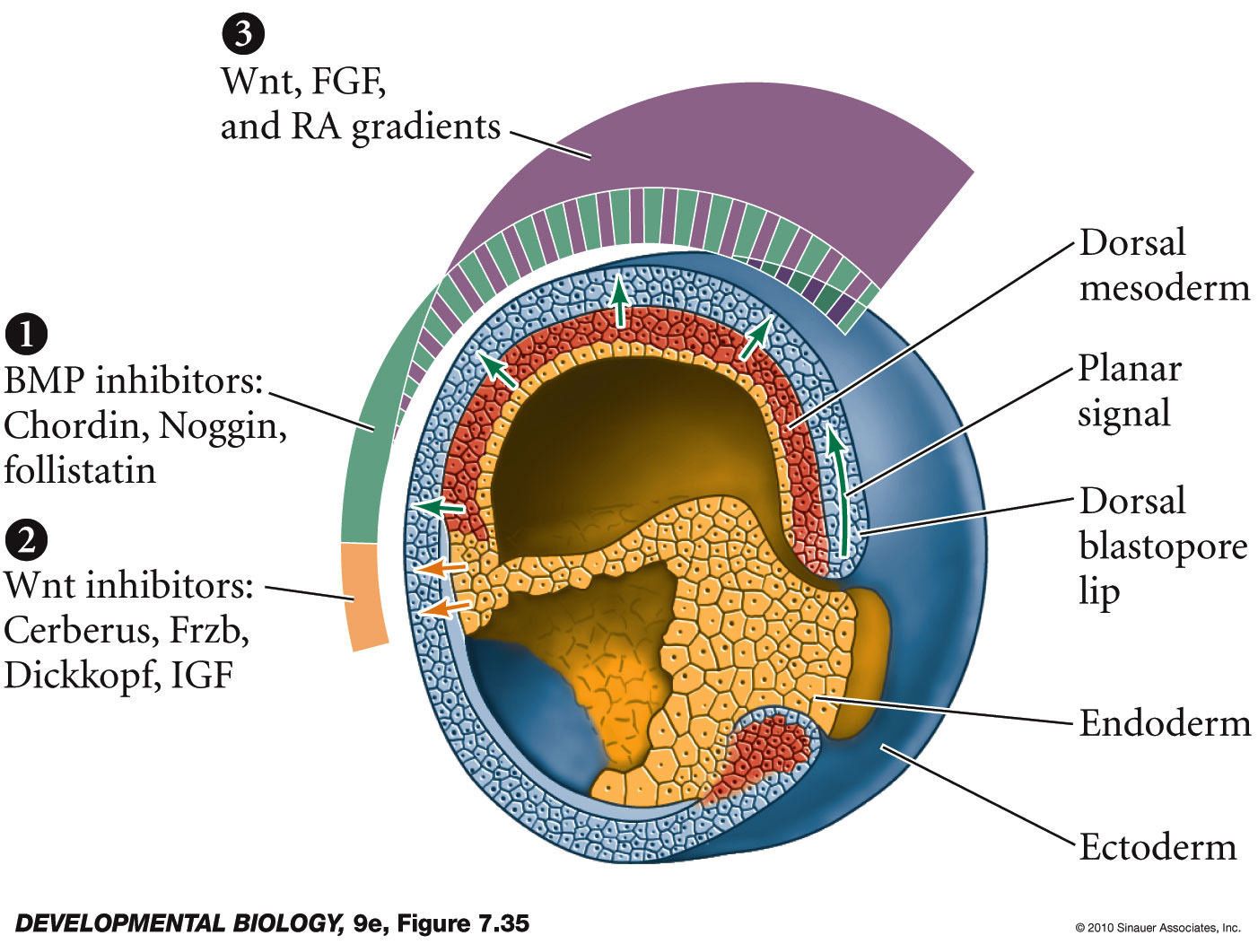
Model of the organizer function and axis specification in the Xenopus gastrula

Slide 8
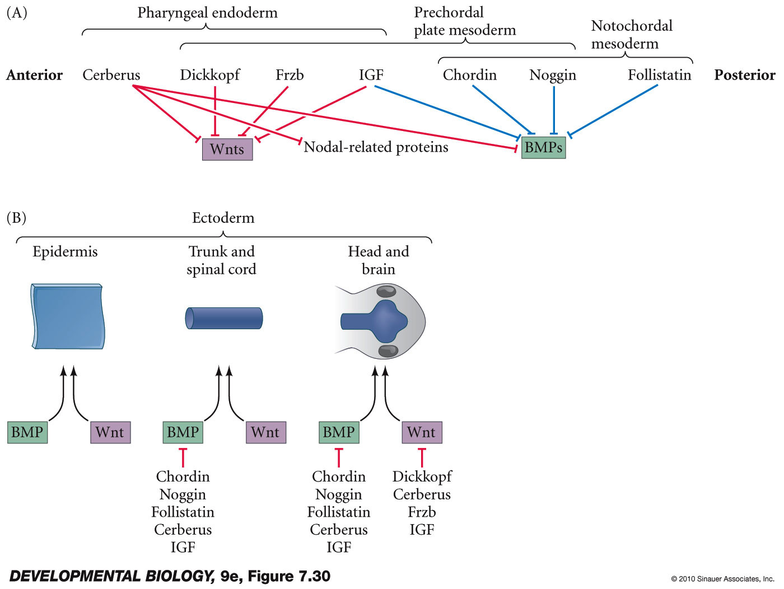
Paracrine factor antagonists from the organizer are able to block specific paracrine factors to distinguish head from tail

Slide 9
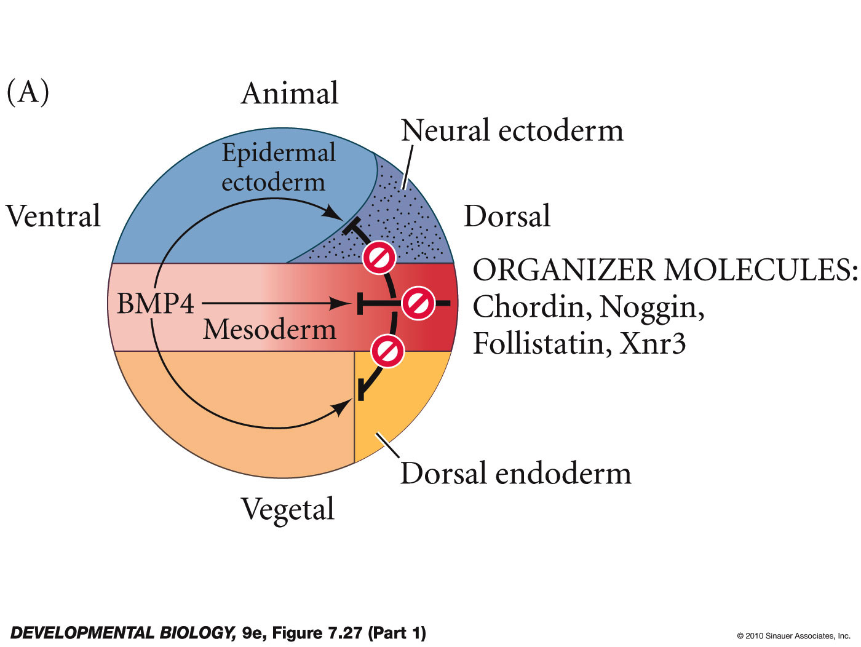
Model for the action of the organizer

Slide 10
BMP and wnt signals must be inhibited in the future neural ectoderm
default state of ectoderm is neural
BMP and wnt push ectoderm to a epidermal fate
soluble factors from the organizer/notochord block BMP and wnt signals - allow default state = neural

Slide 11
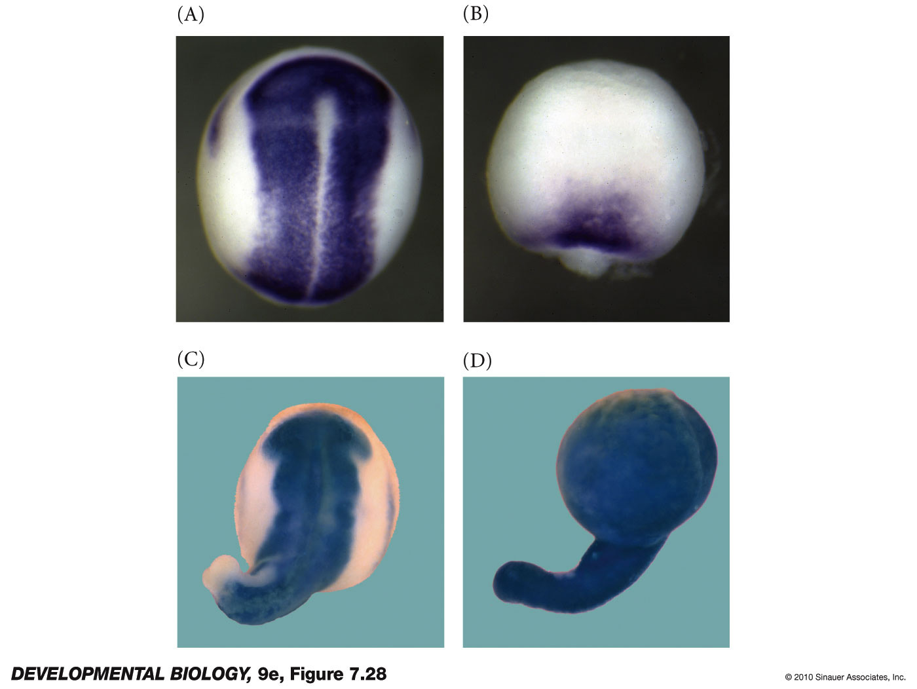
Control of Neural specification by the levels of BMPs
11.25

Slide 12
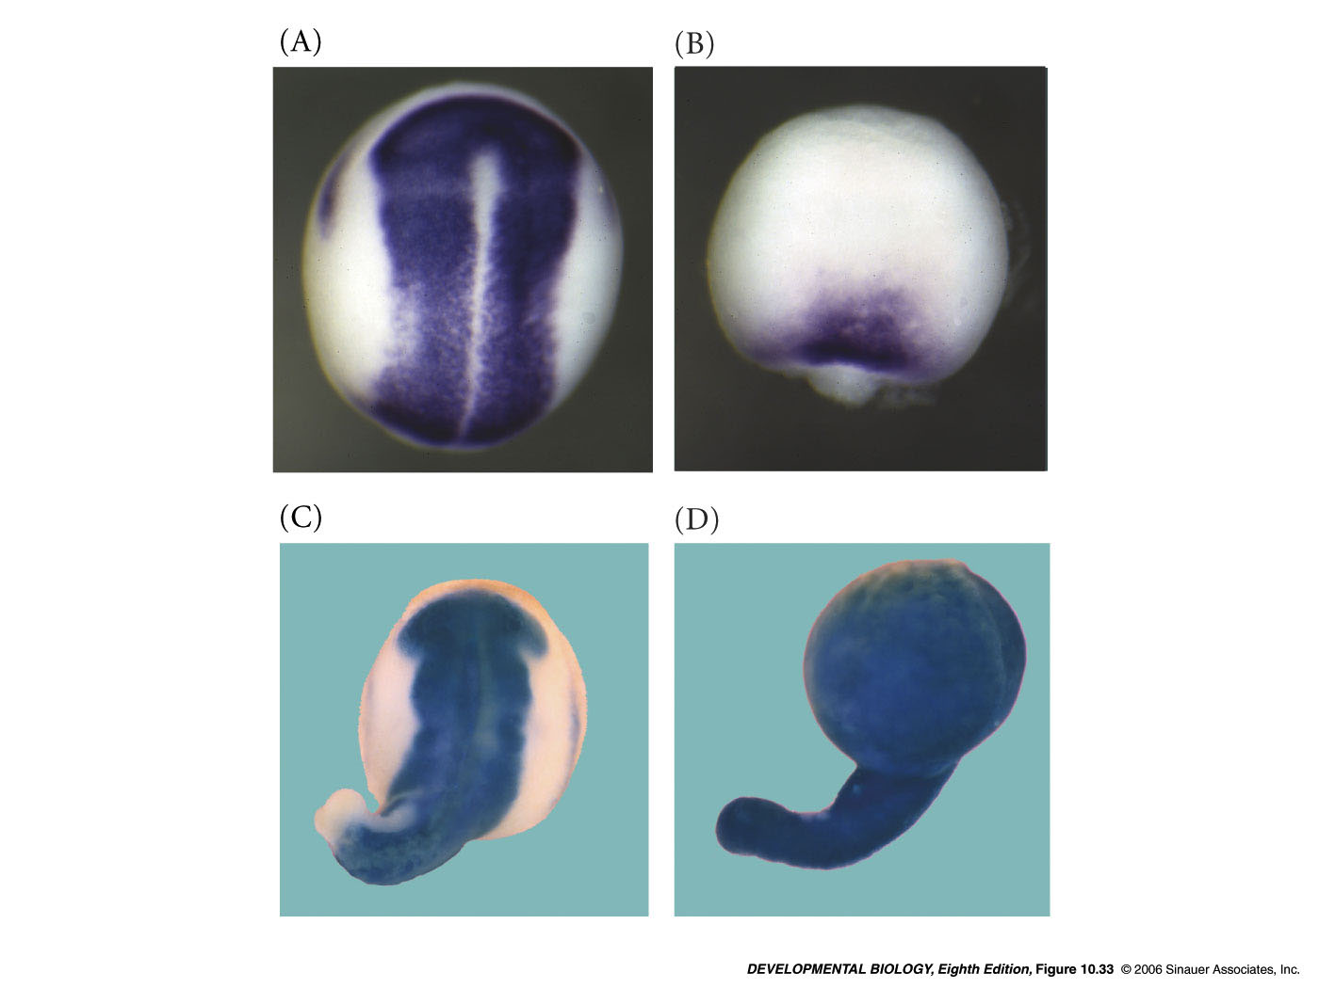
Control of neural specification by the levels of BMPs
Looking at sox2 gene expression as a marker of neural development
morpholinos inhibiting chordin, follistatin and noggin
wild type -
morpholinos inhibiting BMP2, BMP4 and BMP7 as well as ADMP
morpholinos inhibiting BMP2, BMP4 and BMP7
Notes:
devbio8e-fig-10-33-0.jpg

Slide 13
BMP ligands (BMP2,4,7 and ADMP) support development of epidermis
BMP antagonists (chordin , Noggin, Follistatin) support development of neural ectoderm

Slide 14
Five organizer secreted proteins (downstream of Goosecoid)
Noggin, Chordin, Follistatin– block BMP signals
Frz-B – blocks wnt signals
Cerberus – blocks both wnt and BMP signals

Slide 15
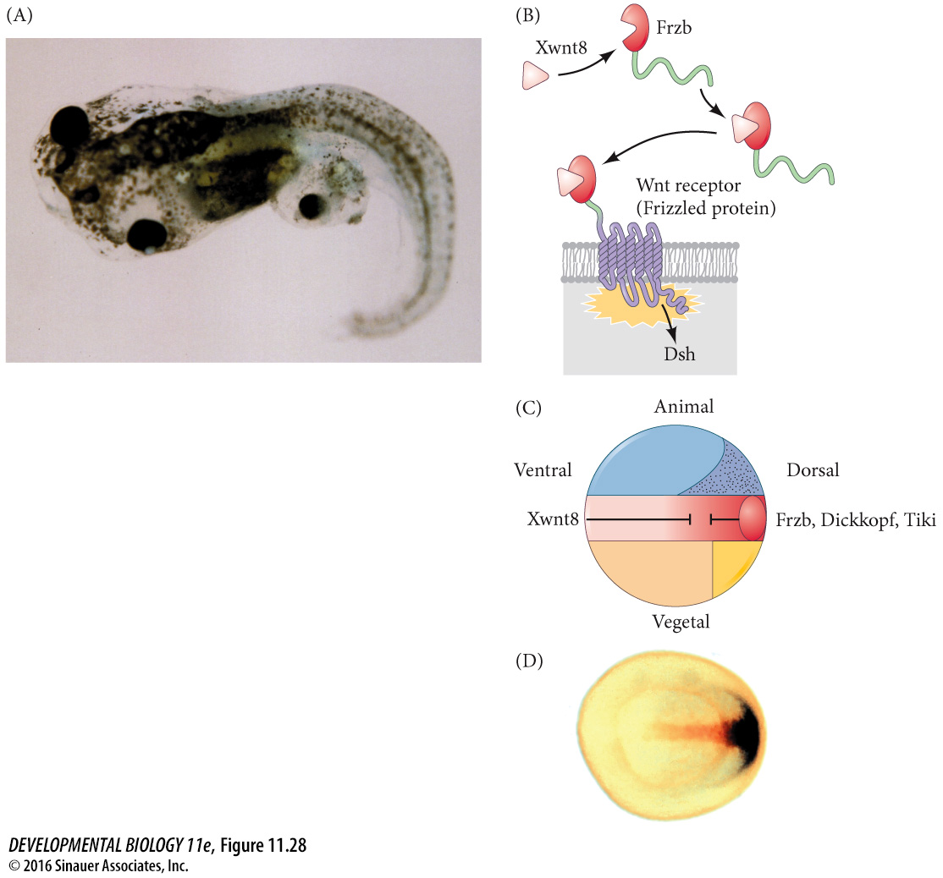
Frzb is secreted by the organizer and inhibits Wnt signaling
11.28

Slide 16
Frzb
frizzled b – soluble frizzled receptor
blocks wnt signaling

Slide 17
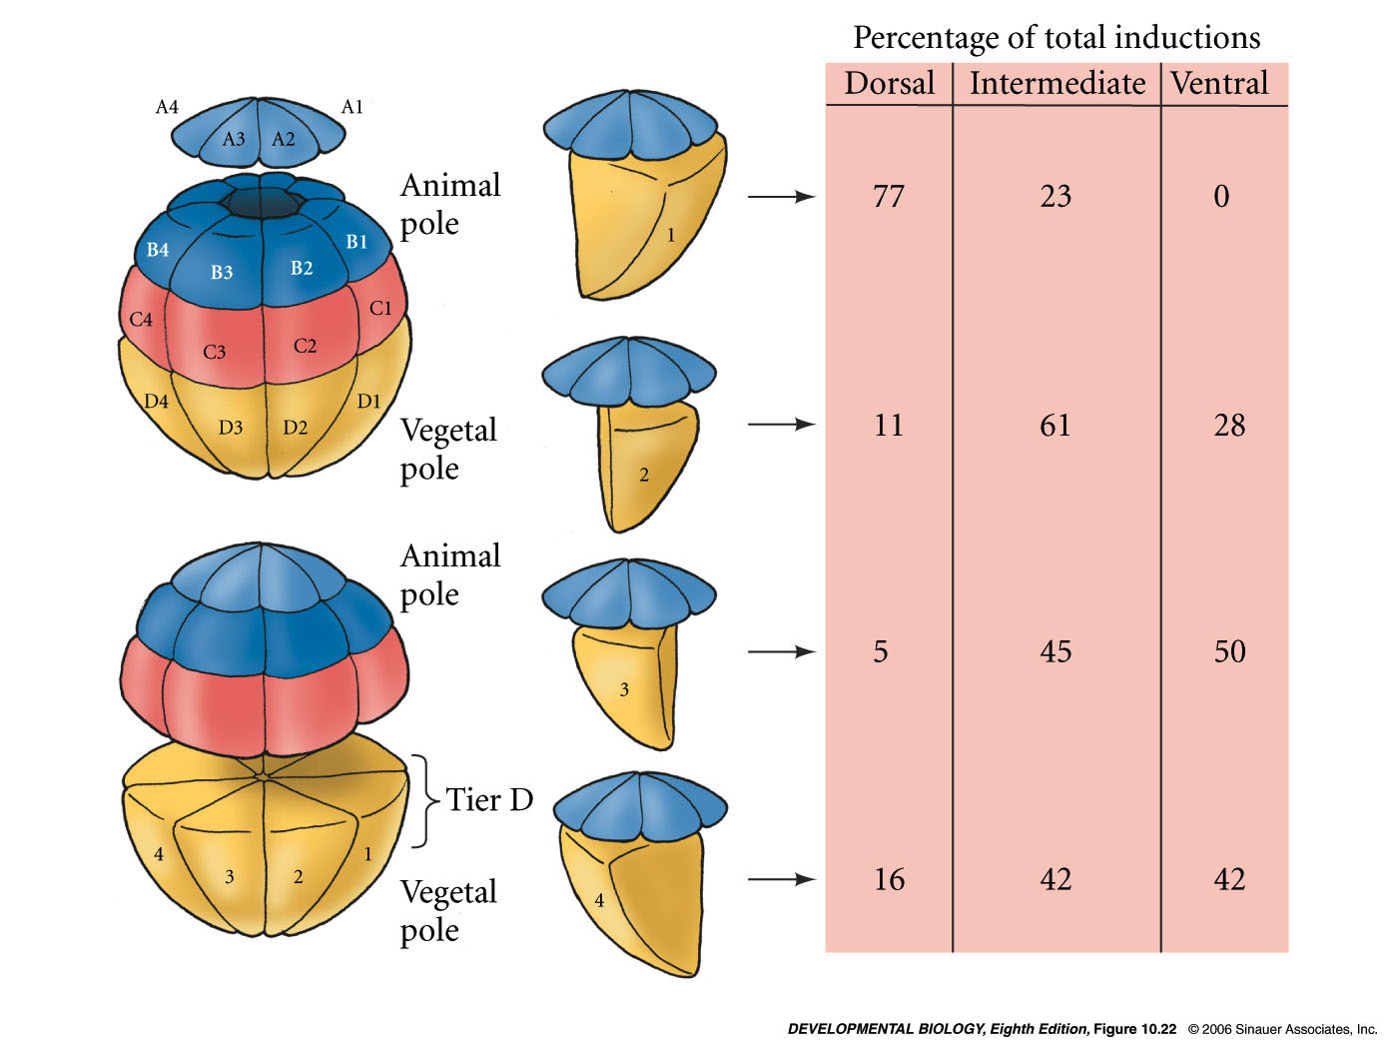
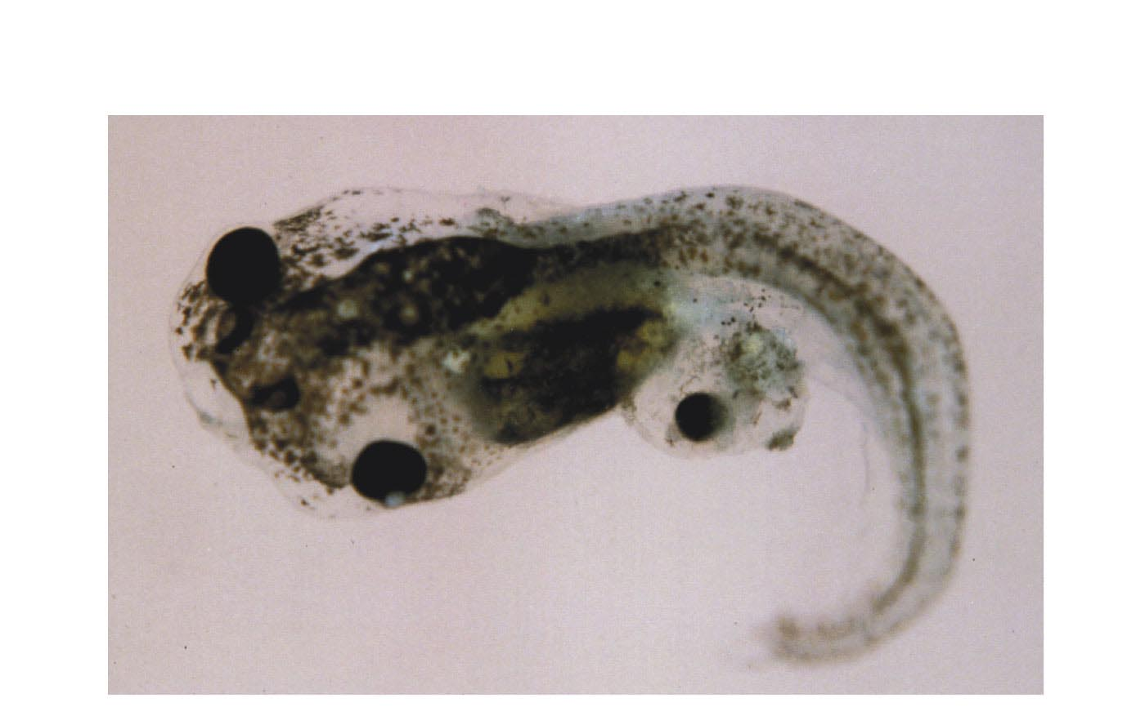
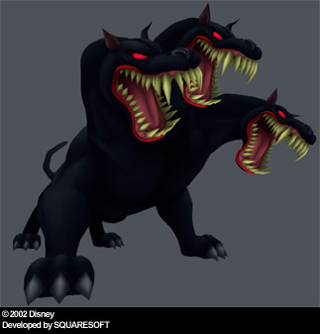
Cerberus mRNA
Cerberus is a head-inducing secreted factor
Antagonist of Nodal, BMP and Wnt signals
α-BMP
α-Wnt
α-Xnr
Injected into a Single D4 Blastomere of a 32-Cell Xenopus Embryo
Notes:
Figures\Chapter10\DevBio7e10340.jpg

Slide 18
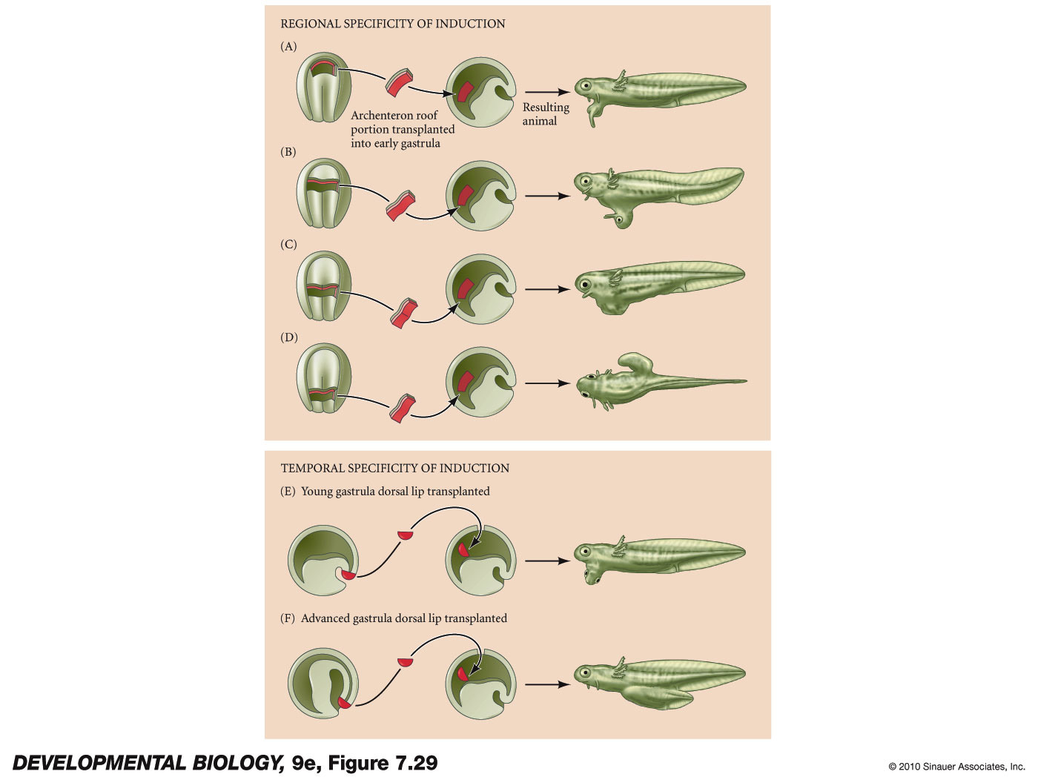
11.26

Slide 19
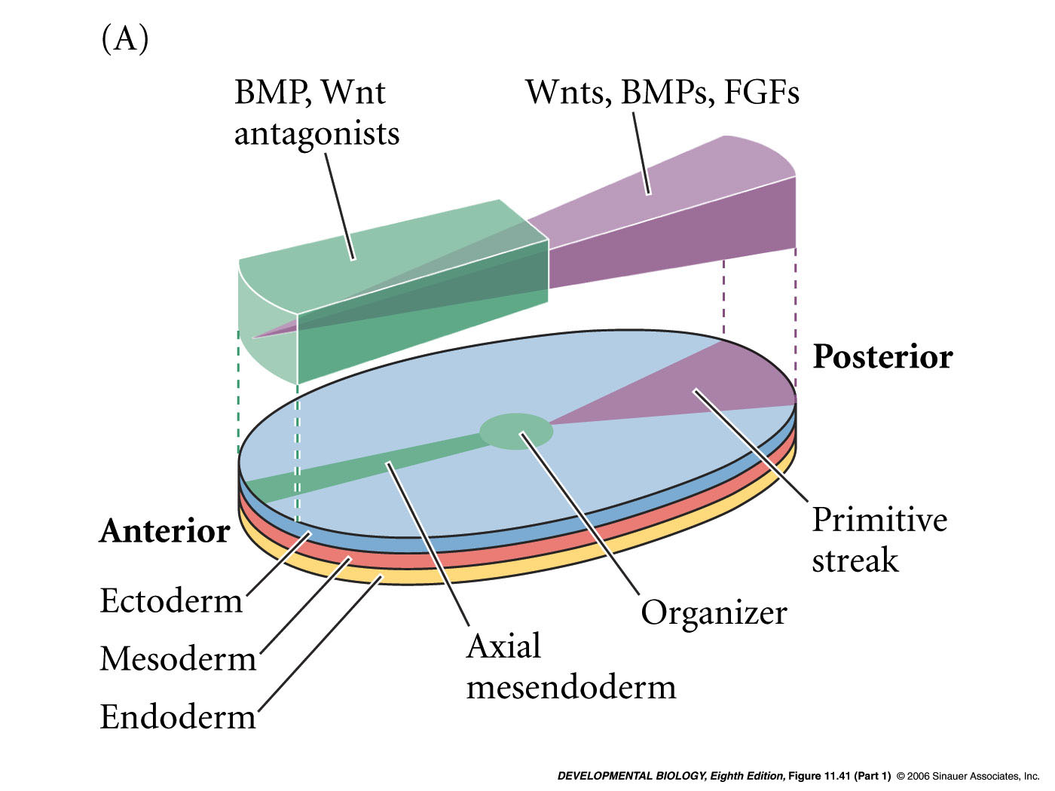
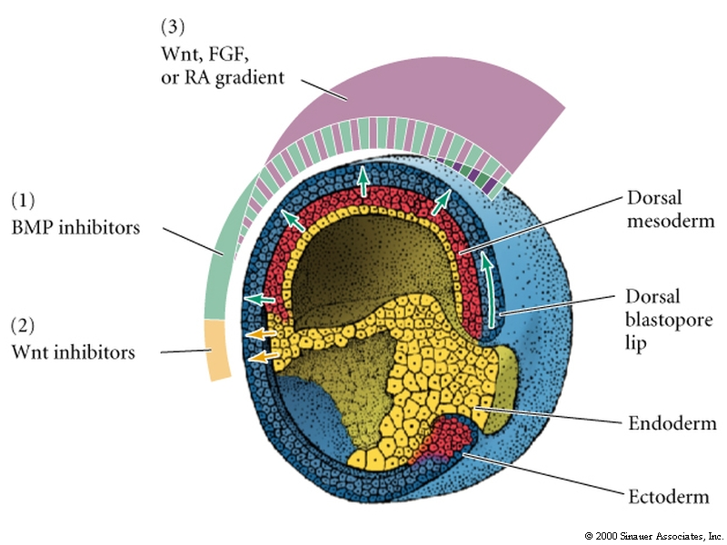
Anterior-posterior patterning in the mouse embryo

Slide 20
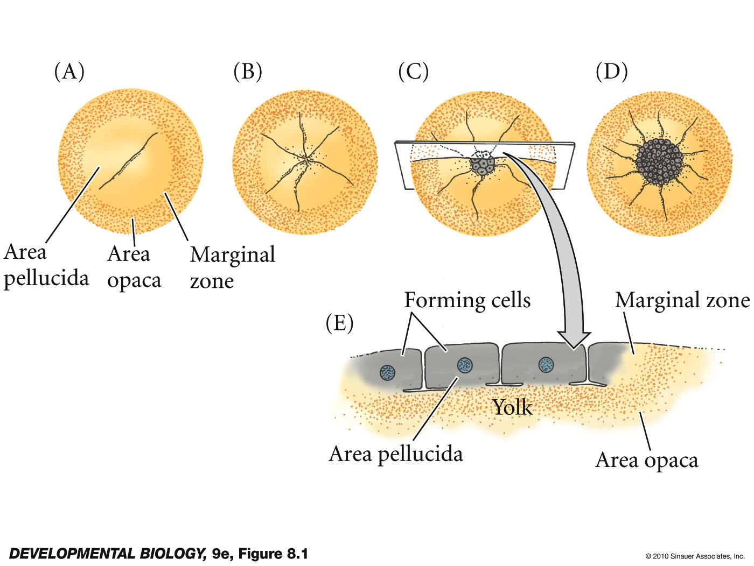
Avian development
small disc of cytoplasm sits on top of large yolk - blastodisc
single layered blastoderm
discoidal meroblastic cleavage

Slide 21
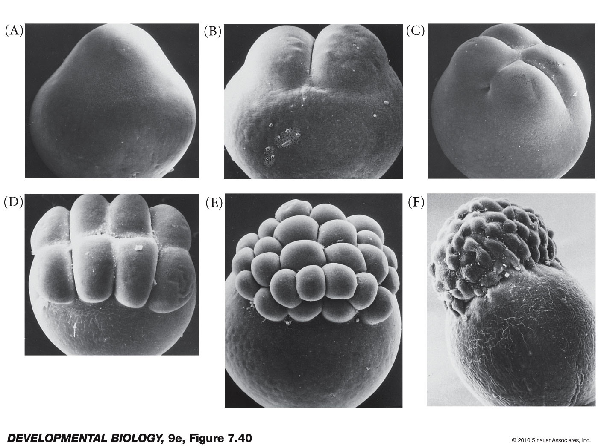
discoidal meroblastic cleavage

Slide 22
videos
Avian gastrulation –
https://www.youtube.com/watch?v=sUuX-4fEF3A
First 1.5 min.

Slide 23
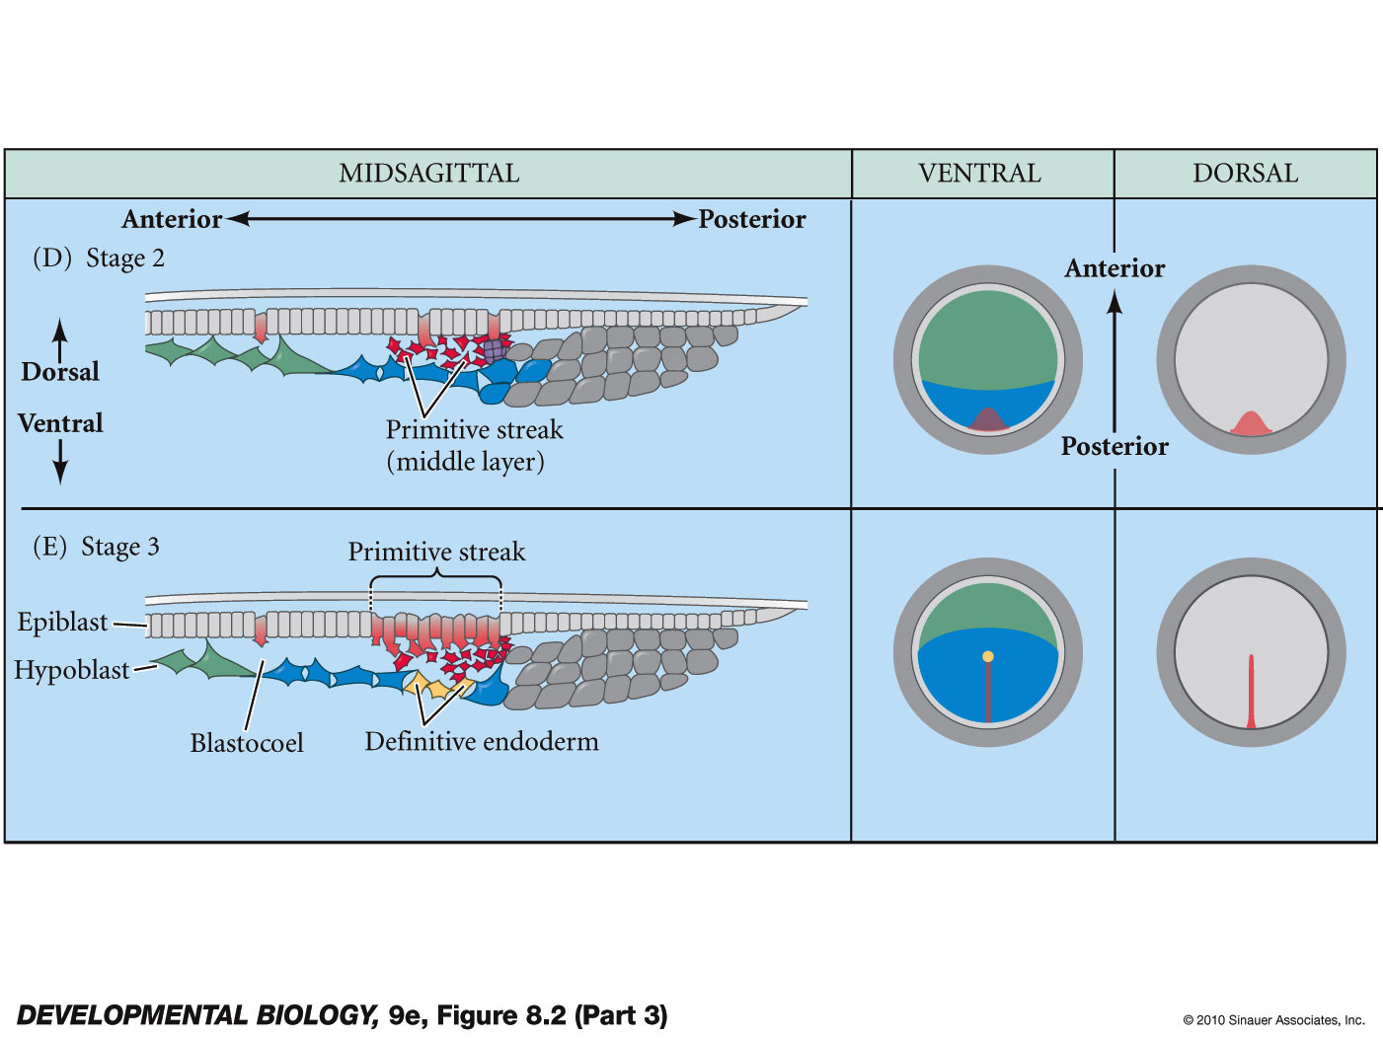
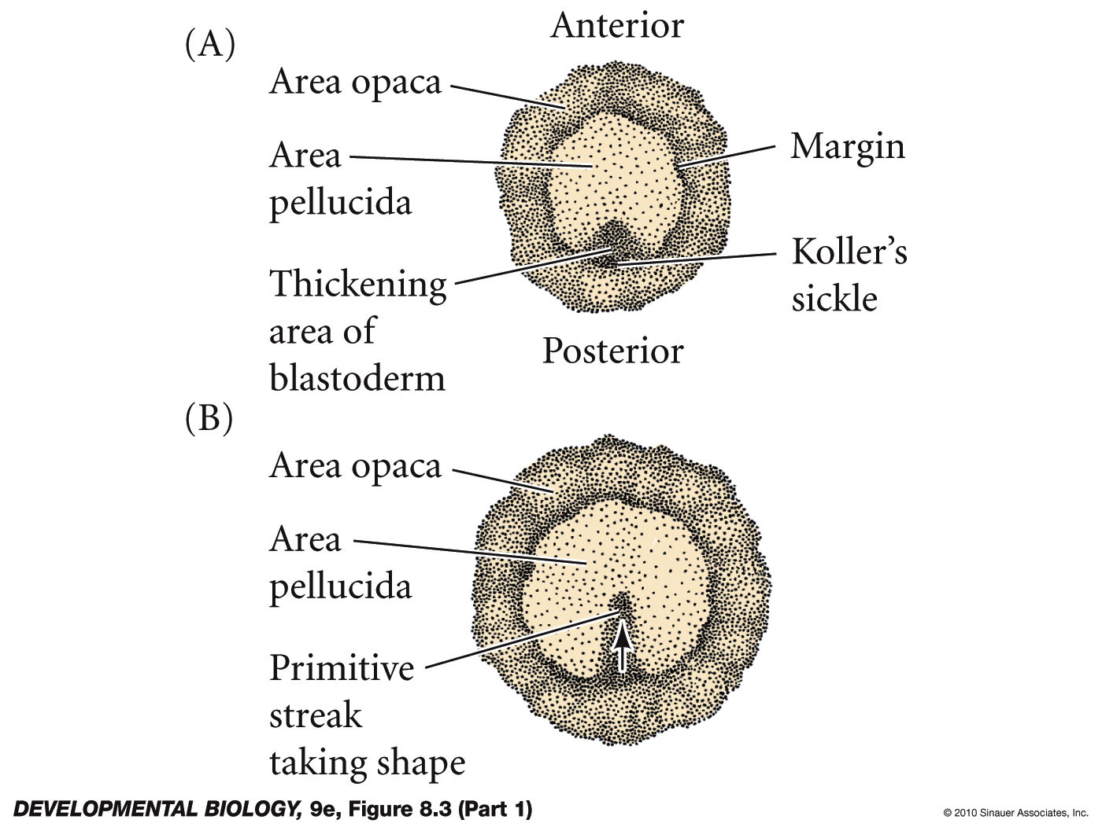
Primitive Streak
major structural characteristic of avian, reptilian and mammalian gastrulation

Slide 24
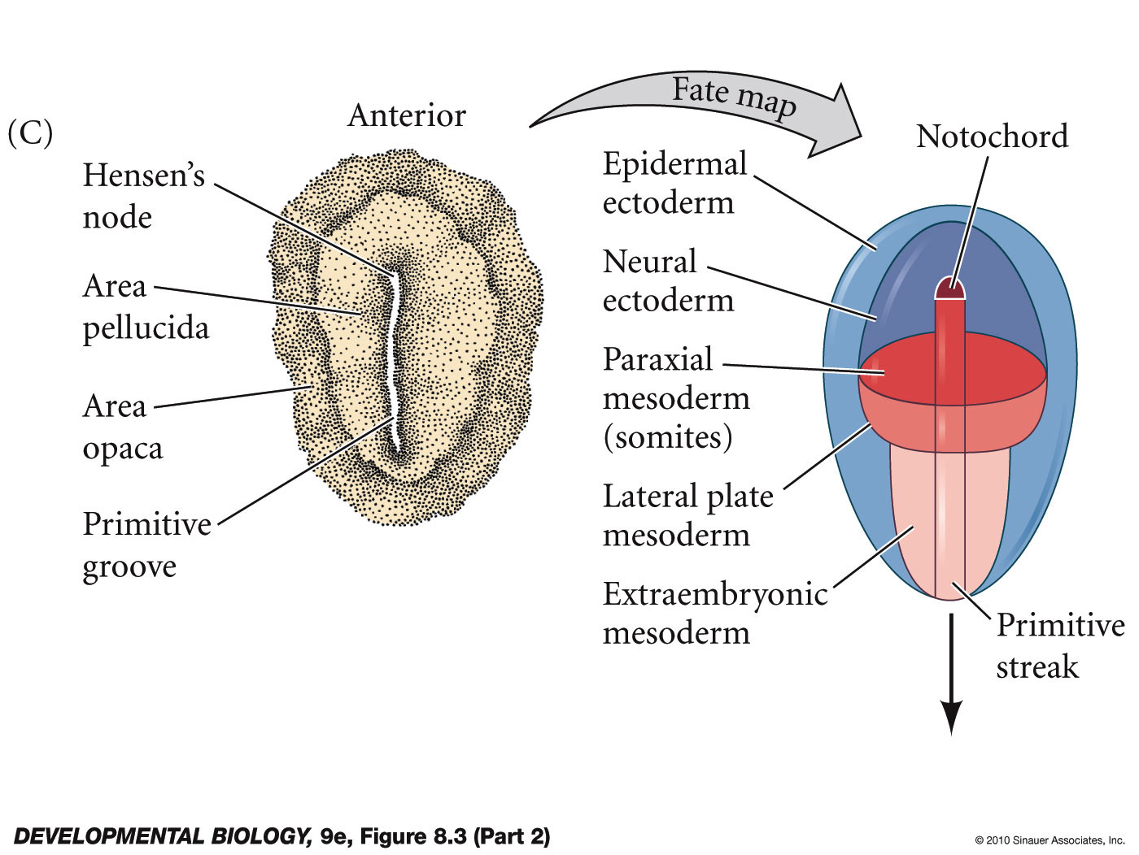
Primitive streak forms into the primitive groove
primitive streak and primitive groove are analagous to the blastopore
hensen’s node is analagous to the spemann organizer

Slide 25
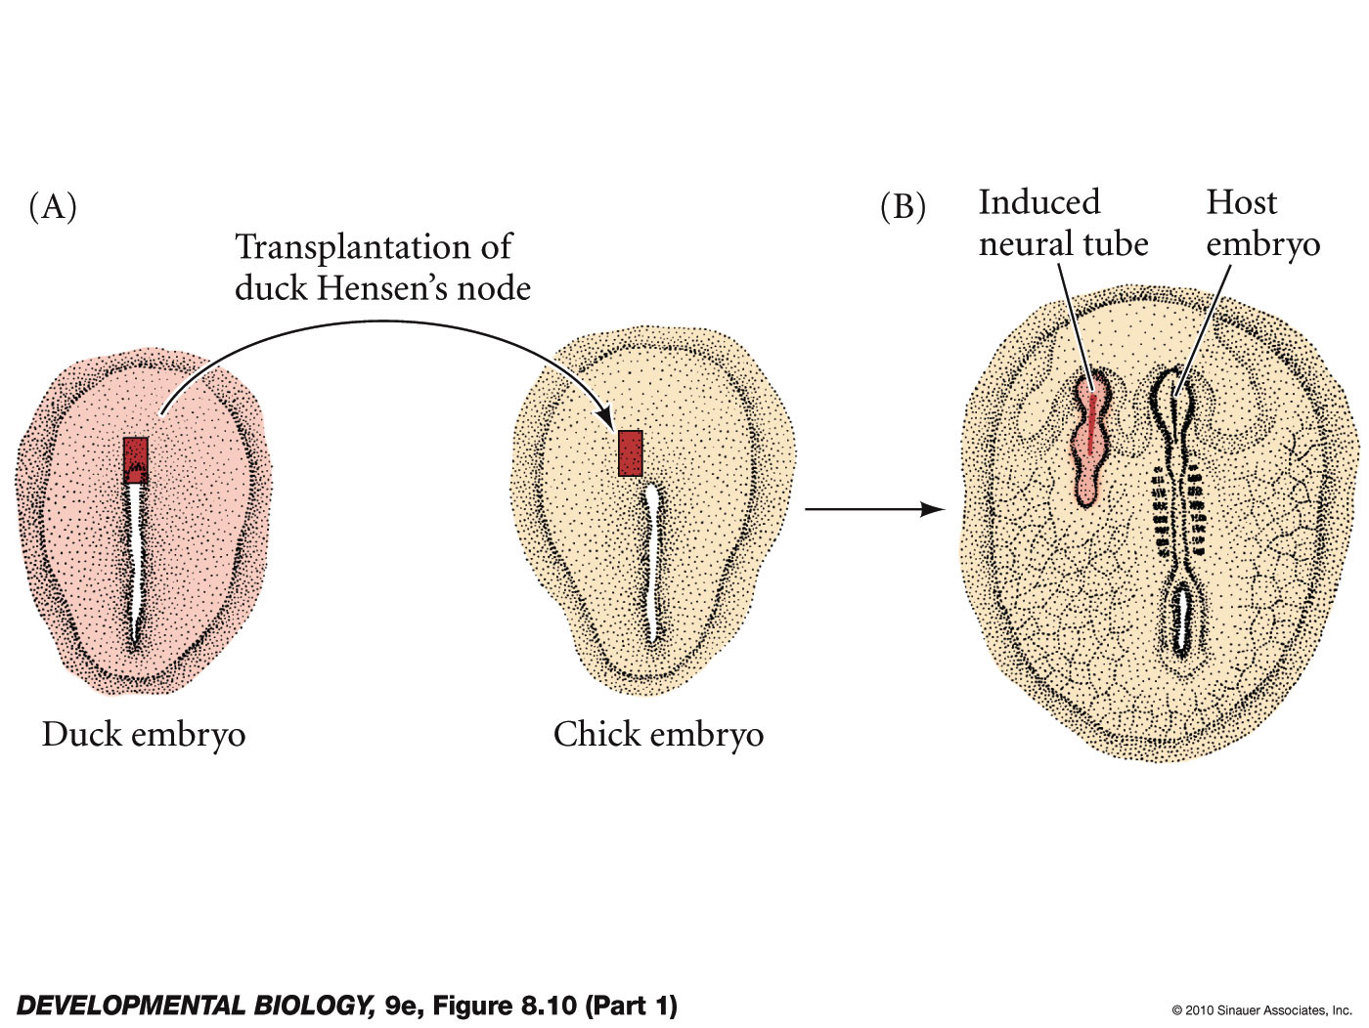
Hensen’s node = spemann organizer
cells become head and notochord mesoderm
can induce secondary embryonic axis
expresses goosecoid and other organizer genes
can induce neural tissue in fish amphibian or mammalian embryos

Slide 26
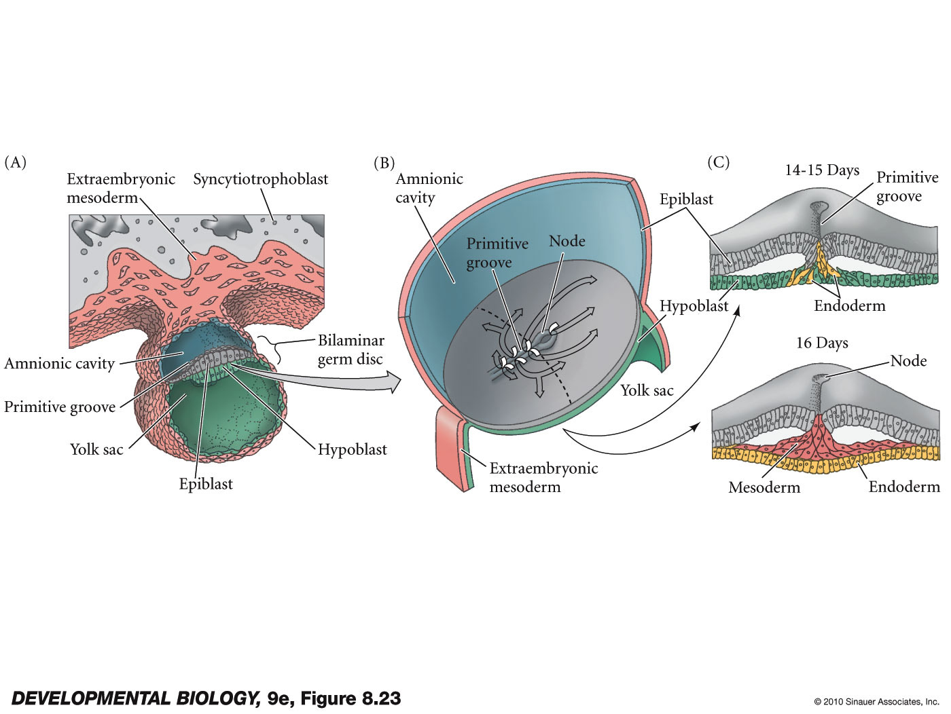
Mammalian development
epiblast – embryo
hypoblast – extraembryonic structures
Spemann organizer – two parts in mammals
the node - secretes chordin, noggin
AVE (anterior visceral endoderm) – secretes cerberus

Slide 27
videos
human gastrulation and neurulation –
https://www.youtube.com/watch?v=ifGva03F5Ns

