Slide 1
Upcoming lectures and assignments
March 19 | Amphibian Axis II - 03_19_18amphibianspartsIIandIII | Chapter 11 up to p365
March 21 | Amphibians finish up
March 23 | Guest Lecture - C. Elegans - Jim Mahaffey | INTRO to C. elegans video - please watch before today's class
March 26 | Neural Crest development | Chapter 15 pp. 463-488
March 28 | Zebrafish neural crest and cancer - read and discuss the research paper | 1) click here for main article 2) click here for shorter perspective summary 3) homework questions link here
March 30 | Spring Break II - No Class
April 2 | EXAM III | exam covers from Feb 26th lecture on mammalian homeotic genes and stem cells - thru march 28th lecture on zebrafish neural crest and cancer.

Slide 2
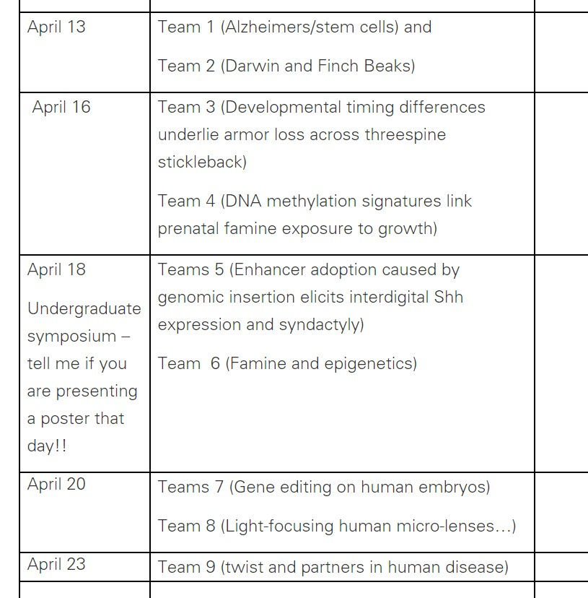

Slide 3

Neural Crest: the history of your face

Slide 4
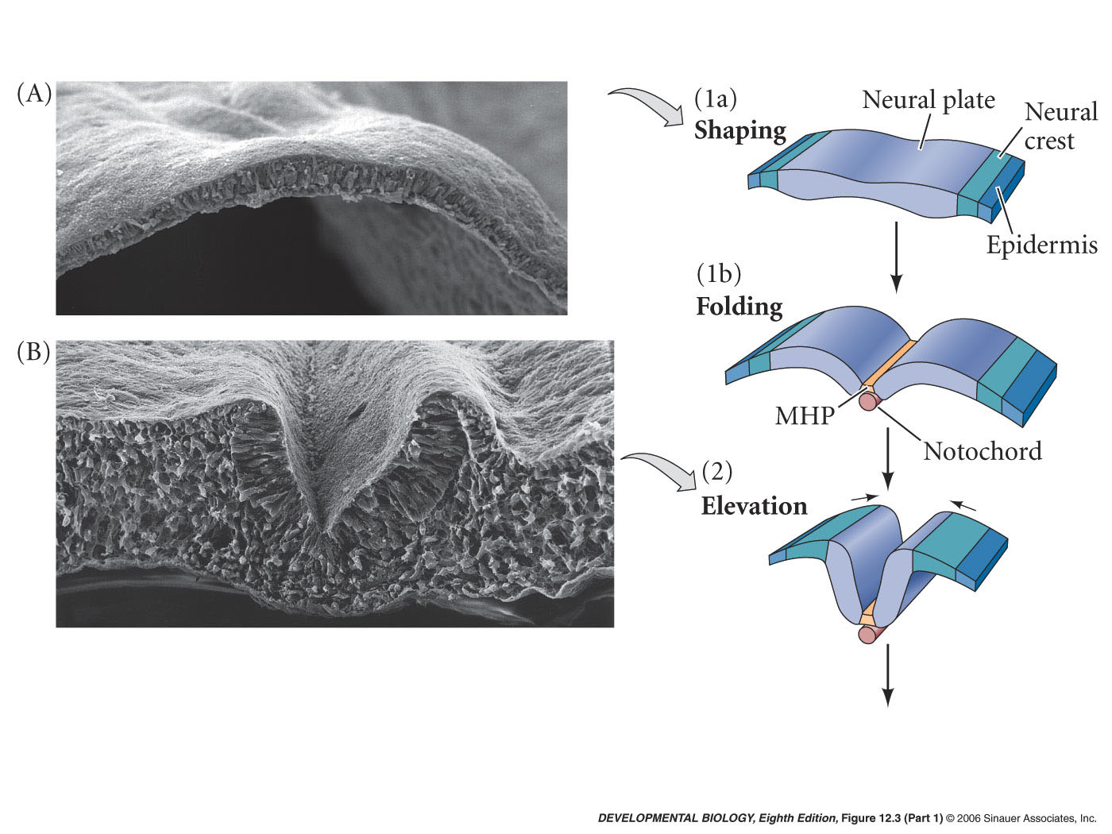
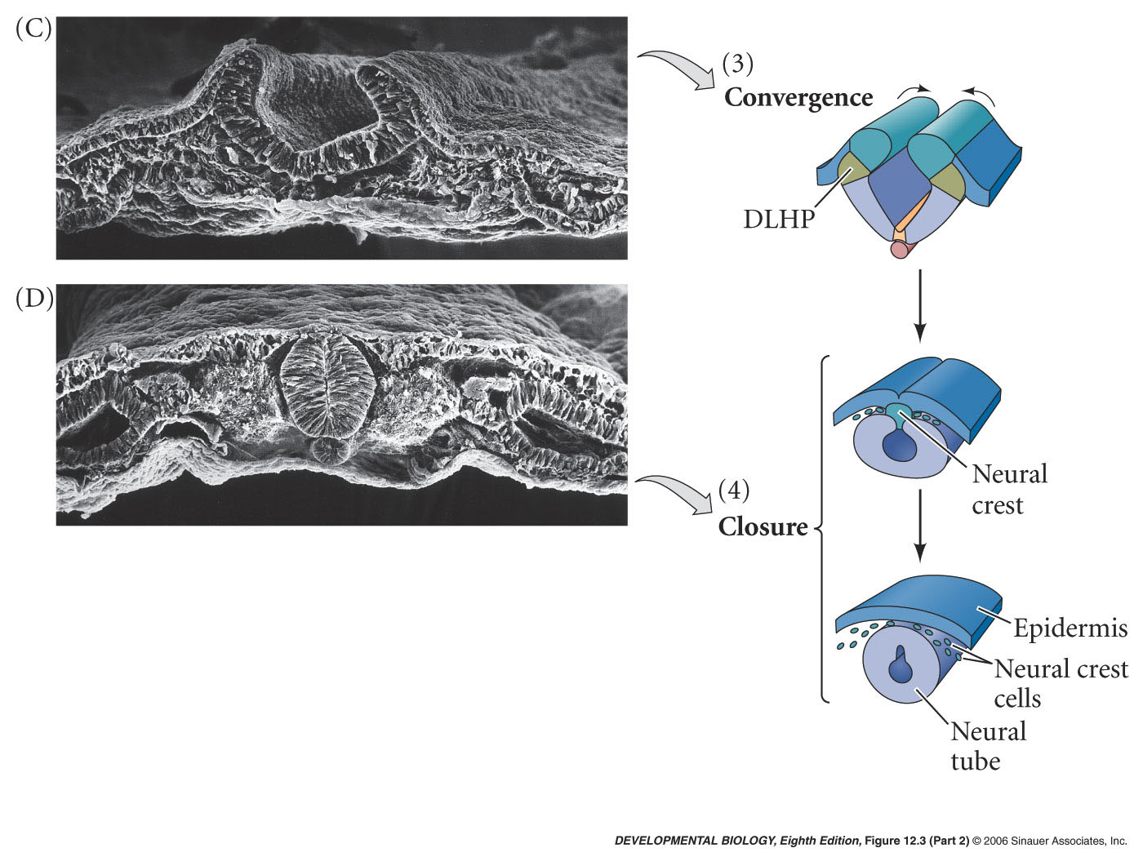
Neural Crest
Neural Crest Forms where neural tube and epidermis meet

Slide 5
Special properties of the neural crest cells
1. Neural crest cells undergo a epithelial to mesenchymal transition: cells transition from an epithelium to mesenchyme, losing cell-cell junctions.
2. Cells undergo complex migration patterns throughout the body: Neural crest cells migrate from points along the A-P axis via multiple migration pathways.
3. Fates are not purely ectodermal derivatives: Neural crest cells can differentiate into tissue types normally formed by mesoderm.
4. Cells are multi-potent: Neural crest cells contribute to diverse tissue types, and single migrating cells are capable of multiple end fates.
5. Some Neural crest cells retain stem-cell like properties: Some neural crest derivatives remain self-renewing and multi-potent in the adult.

Slide 6
Some neural crest cell derivatives
Neural crest cells give rise to neurons and glia of PNS
Parts of adrenal gland
Melanocytes – pigmented epithelial cells
Skeletal and connective tissues of the face and head

Slide 7
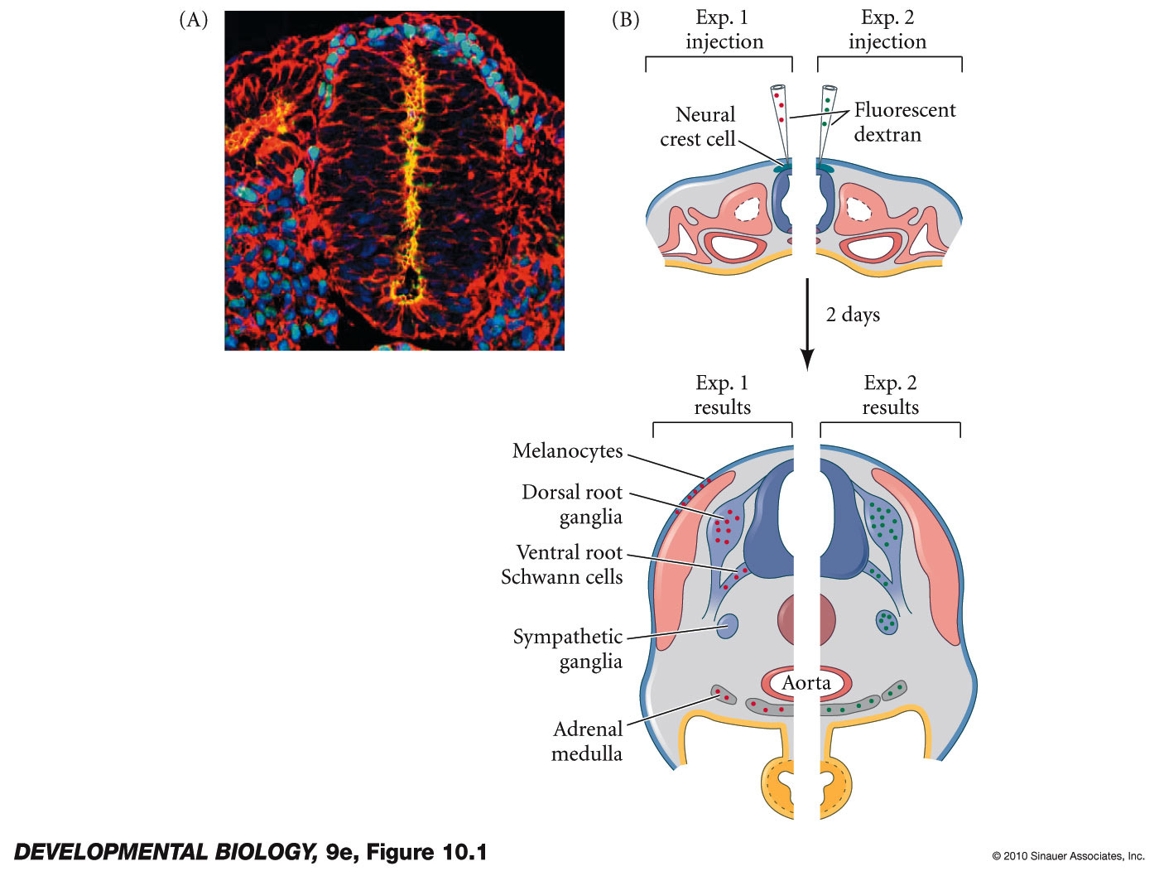
Neural Crest cells migrate and give rise to many different cell types
Neural Crest progenitor cells function as a multipotent stem cell
Fluorescent dye injection

Slide 8
Neural Crest cells migrate and give rise to many different cell types
Neural Crest progenitor cells are multipotent when they leave the crest
Signals at the target sites required to acquire fate

Slide 9
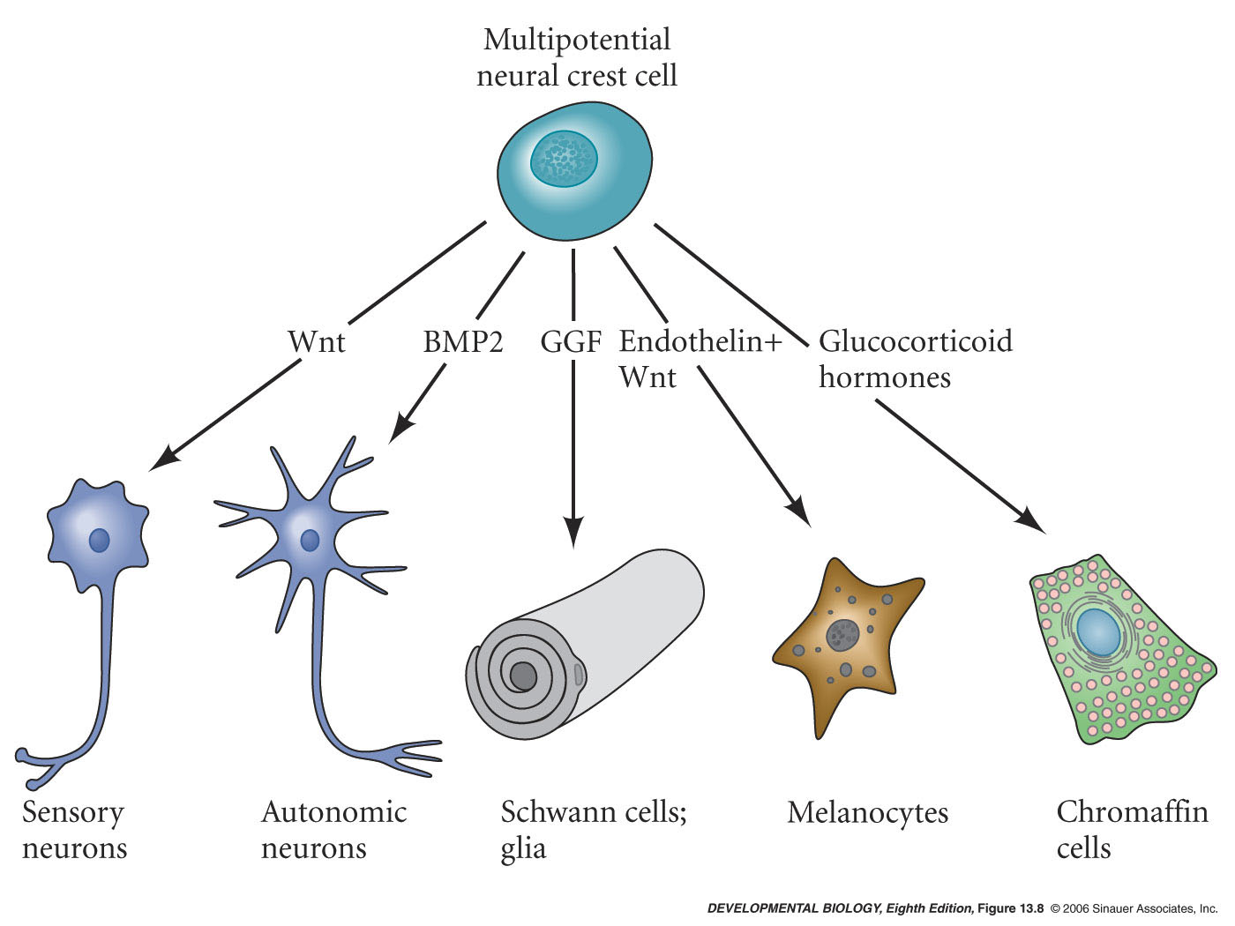
Paracrine factors help specify neural crest derived cells

Slide 10
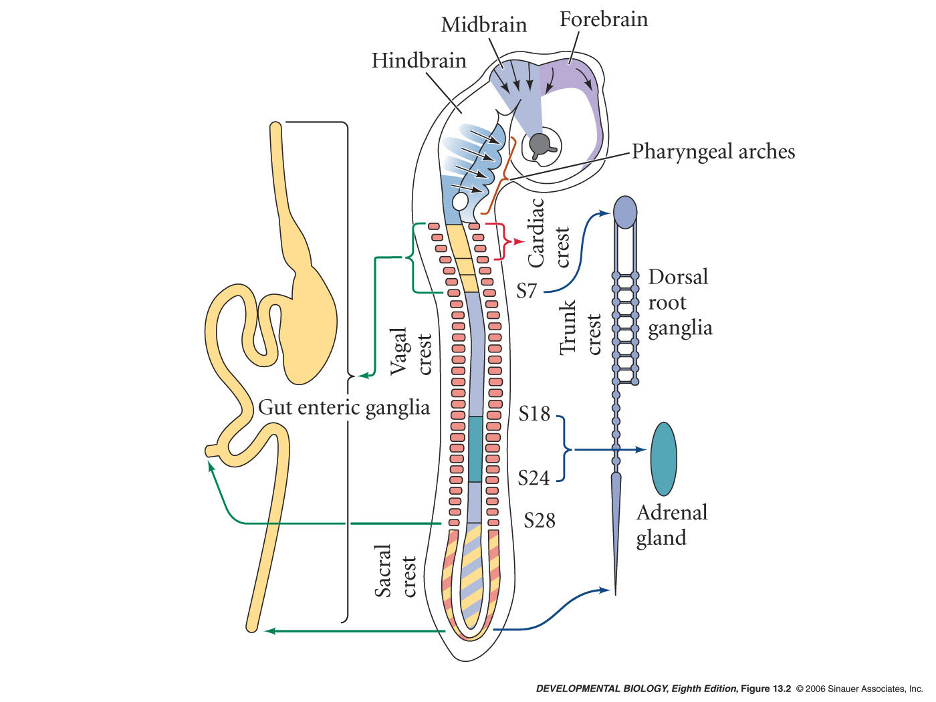
Four Regions of the Neural Crest
Cranial Neural Crest -
cartilage, bone neurons, glia, connective tissue of the face
Trunk Neural Crest -
Dorsal root ganglion, adrenal gland and melanocytes
Vagal and Sacral Neural Crest -
PNS of gut
Cardiac Neural Crest -
heart connective tissue

Slide 11
Four Regions of the Neural Crest
Cranial Neural Crest -
cartilage, bone neurons, glia, connective tissue of the face
Trunk Neural Crest -
Dorsal root ganglion, adrenal gland and melanocytes
Vagal and Sacral Neural Crest -
PNS of gut
Cardiac Neural Crest -
heart connective tissue

Slide 12
Regions of the neural crest
Cranial neural crest
migrates into branchial/pharyngeal arches and face
form bones and cartilage of face, jaw and neck
Pigment cells and cranial nerves
Thymus, thyroid, & parathyroid glands
Teeth

Slide 13
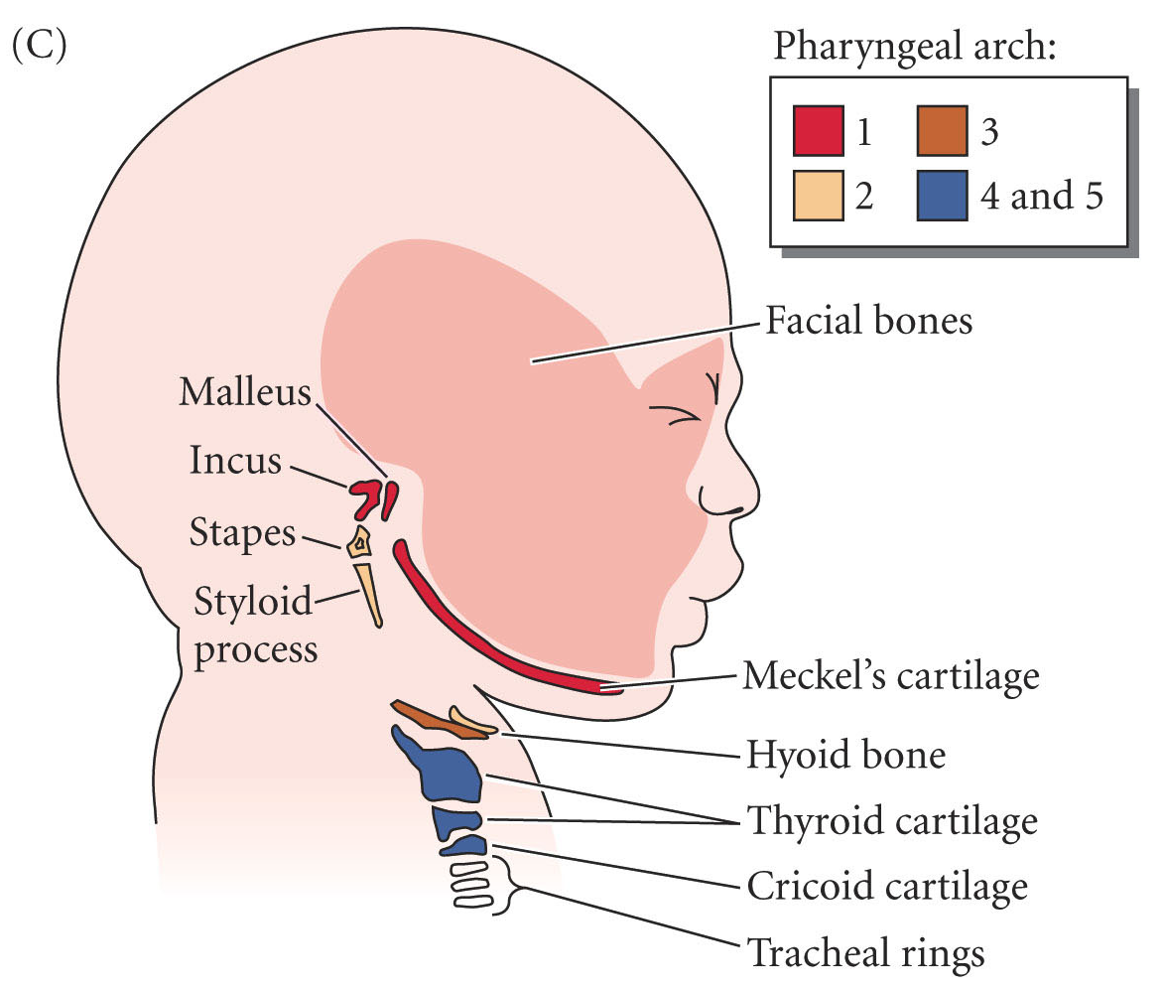
Cranial neural crest
Neural crest progenitor cells migrate through the pharyngeal arches (temporary embryonic structures)
Jaws, teeth, facial cartilage are evolutionary novelties of vertebrates and are products of neural crest

Slide 14
Human syndromes associated with neural crest defects
Human condition called DiGeorge Syndrome (also called CATCH 22) acronym for:
    Cardiac defects
    Abnormal face
    Thymic hypoplasia
    Cleft palate
    Hypocalcemia (parathyroid disfunction)
    And deletions of chromosome 22

Slide 15
CATCH-22
CELLULAR LEVEL DEFECT
Cranial and cardiac level neural crest cells are able to specify and migrate but do not proliferate properly
MOLECULAR LEVEL DEFECT
Haploinsufficiency of the transcription factor TBX1
Point mutations in this gene have also been observed in individuals with 22q11.2 deletion syndrome.
TBX1 is part of the T-box family of genes may have a role in the regulation of differentiation of post migration neural crest cells.

Slide 16
Four Regions of the Neural Crest
Cranial Neural Crest -
cartilage, bone neurons, glia of face
Trunk Neural Crest -
Dorsal root ganglion, adrenal gland and melanocytes
Vagal and Sacral Neural Crest -
PNS of gut
Cardiac Neural Crest -
heart muscle and neurons

Slide 17
Hirschsprung's Disease (Intestinal Aganglionosis)
lack of enteric nervous system (neural ganglia) in the intestinal tract responsible for gastric motility (peristalsis).
severity is dependent upon the amount of the GI tract that lacks ganglia,
due to developmental lack of neural crest migration into those segments.
first indication in newborns is an absence of the first bowel movement, other symptoms include throwing up and intestinal infections.
currently only be treated by surgery.

Slide 18
Hirschsprung's Disease (Intestinal Aganglionosis)
CELLULAR LEVEL DEFECT
Vagal neural crest cells do not migrate properly
MOLECULAR LEVEL DEFECT
endothelin-3 ligand or receptor required for proper migration

Slide 19
Four Regions of the Neural Crest
Cranial Neural Crest -
cartilage, bone neurons, glia of face
Trunk Neural Crest -
Dorsal root ganglion, adrenal gland and melanocytes
Vagal and Sacral Neural Crest -
PNS of gut
Cardiac Neural Crest -
heart muscle and neurons

Slide 20
TRUNK NEURAL CREST
Two main migratory pathways
Ventro lateral - thru anterior half of sclerotome (dorsal root ganglion neurons and adrenal gland)
Dorsal lateral migration – (melanocytes)
Sclerotome – part of the somite that differentiates into the bone (vertebrae)

Slide 21
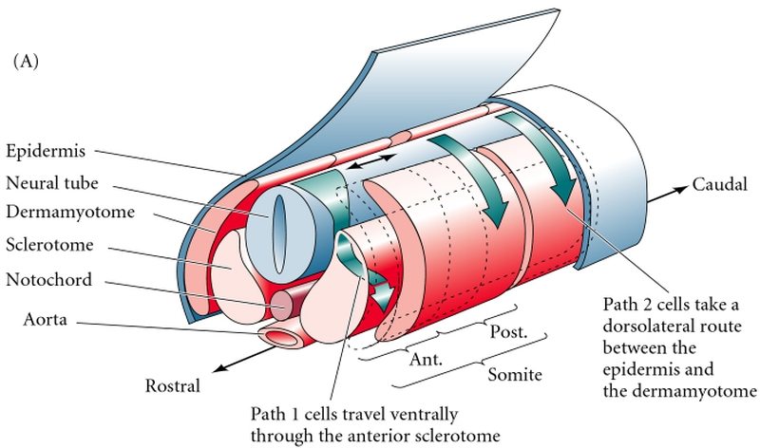
Neural crest cell migration in trunk of chick embryo
Early migration - Ventral pathway -
cells become sensory (dorsal root ganglion) cells and adrenomedullary cells (adrenal gland)
Later Migration - Dorsolateral pathway –
cells become melanocytes

Slide 22
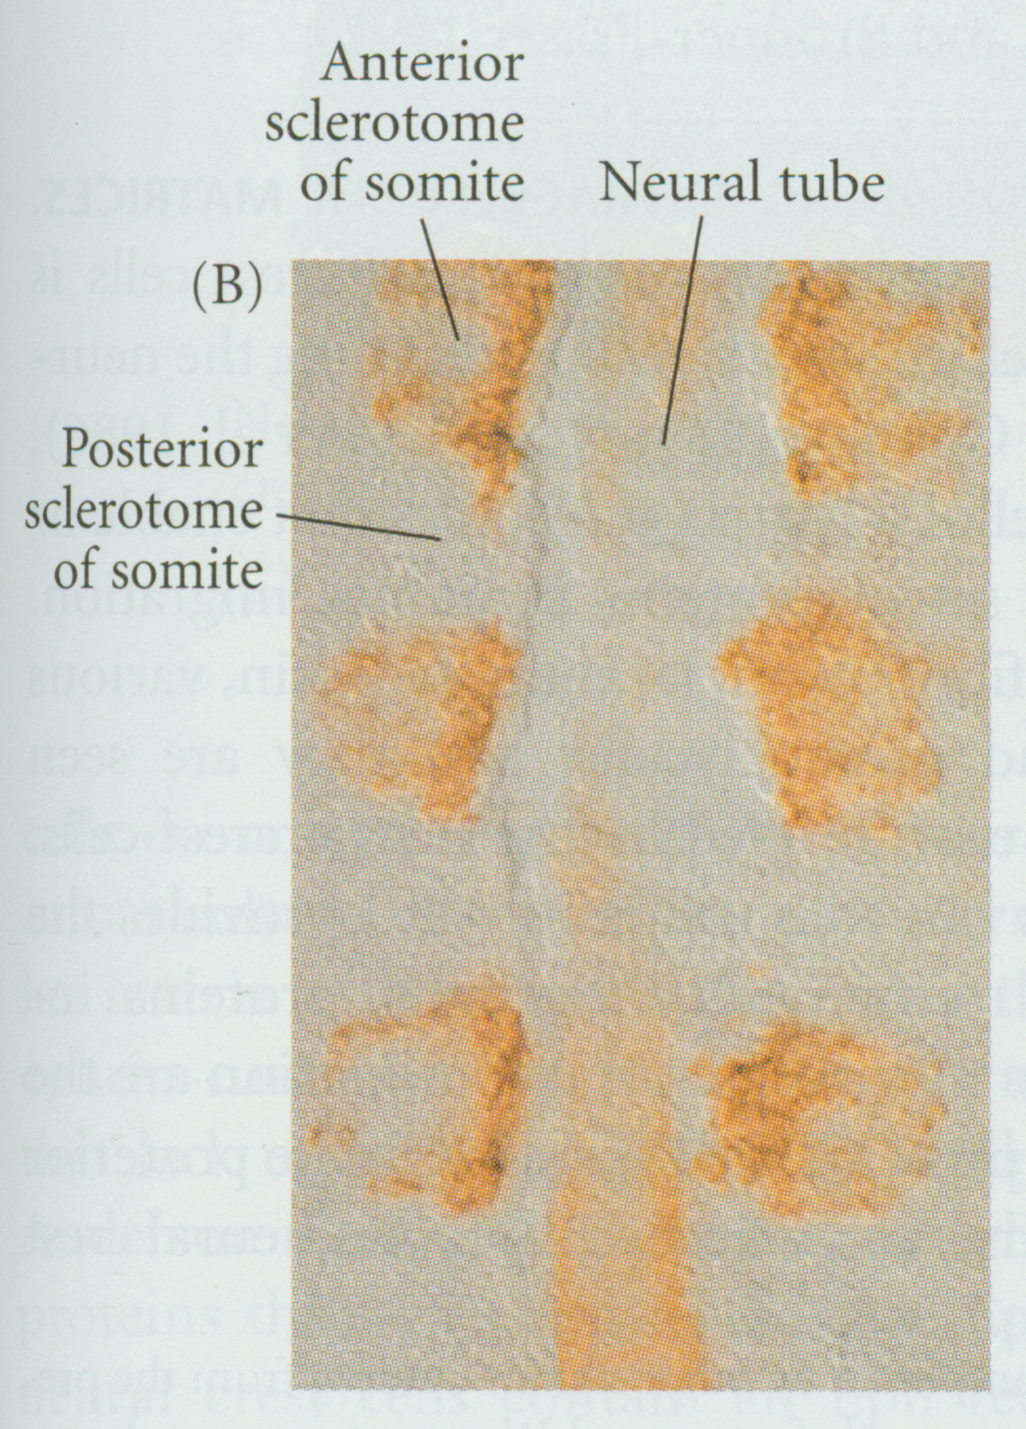
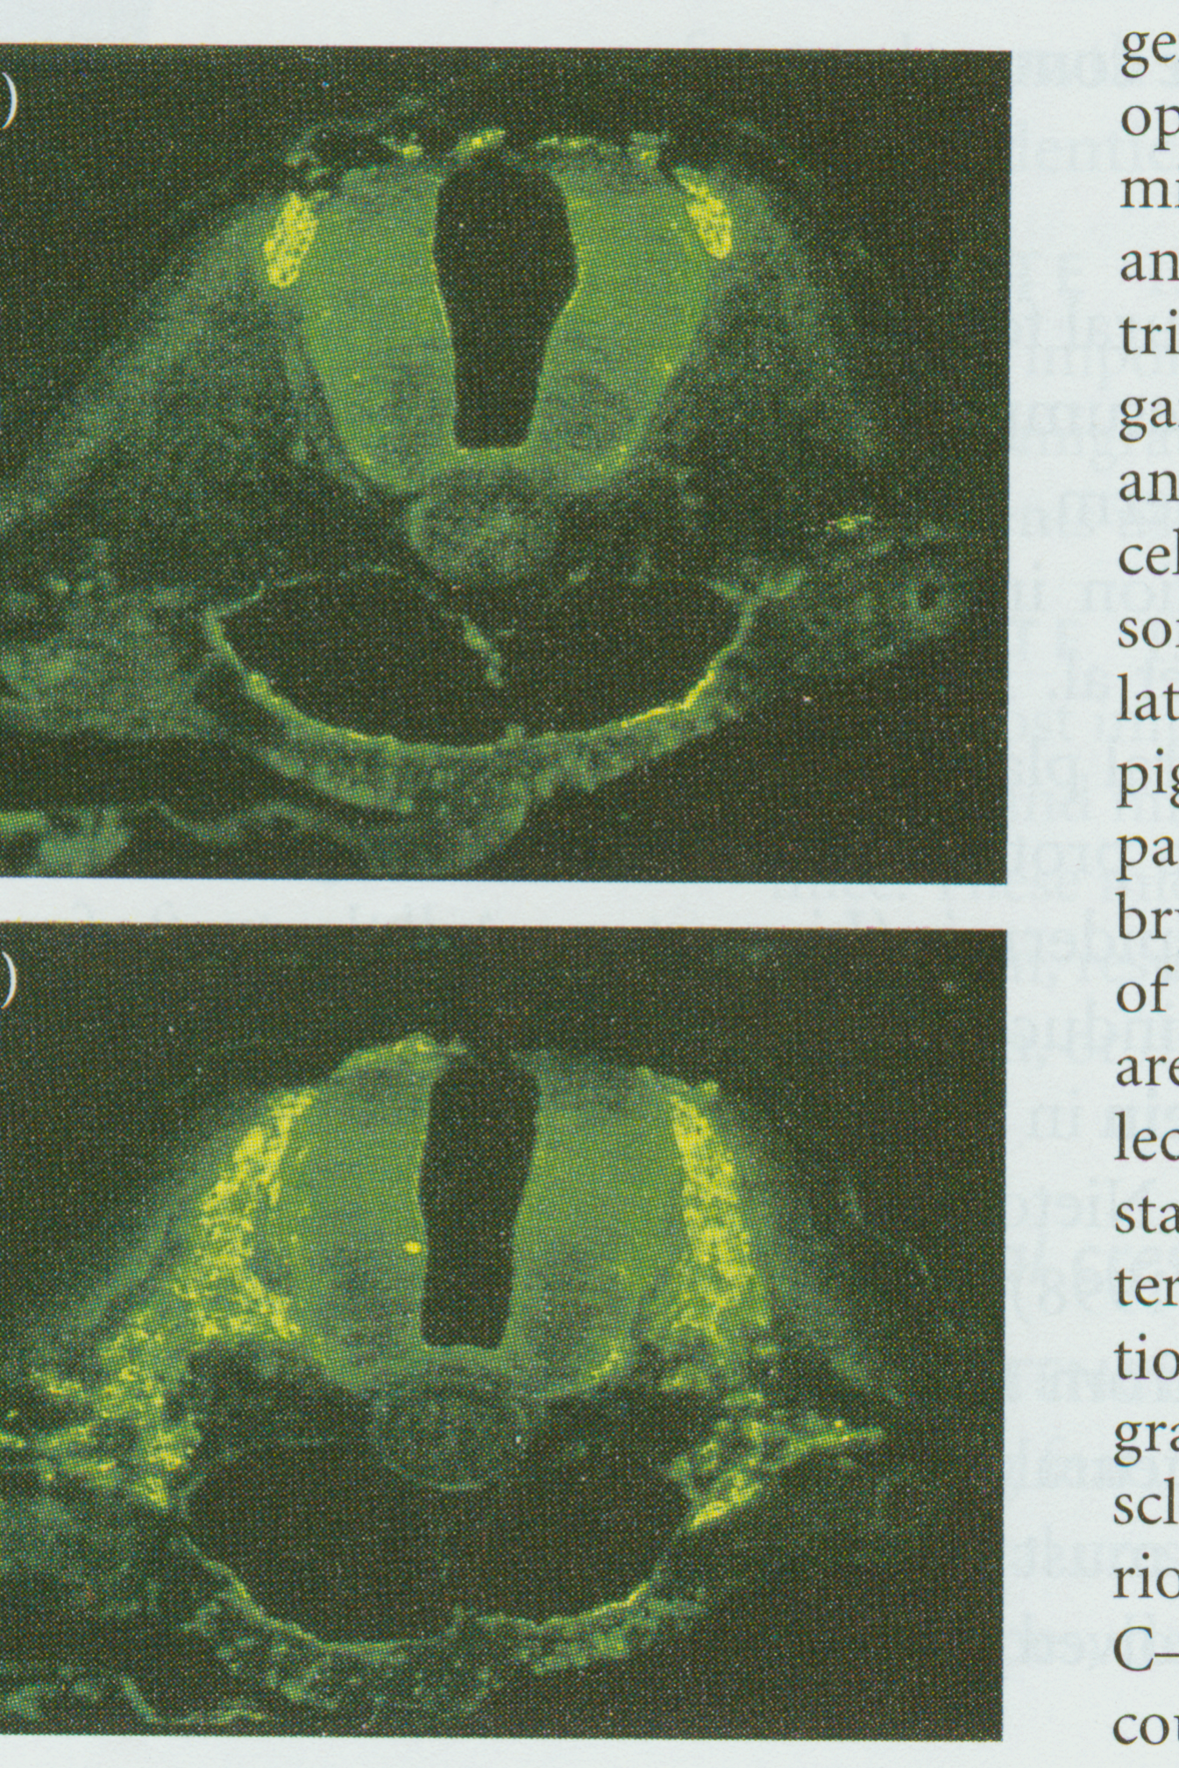
Early (Ventral) Migration
Longitudinal sections
Cross sections
Migration through anterior portion of sclerotome
No migration through posterior portion

Slide 23

Early (Ventral) Migration
Extracellular matrix and cell surface
and
Diffusible (chemotactic) factors

Slide 24
Extracellular matrix and cell surface
fibronectin, laminin
expressed in both anterior and posterior sclerotome
thrombospondin - specifically expressed in anterior sclerotome - supports neural crest migration
ephrin - cell surface molecule -
expressed in posterior sclerotome -
represses early neural crest cell migrations

Slide 25
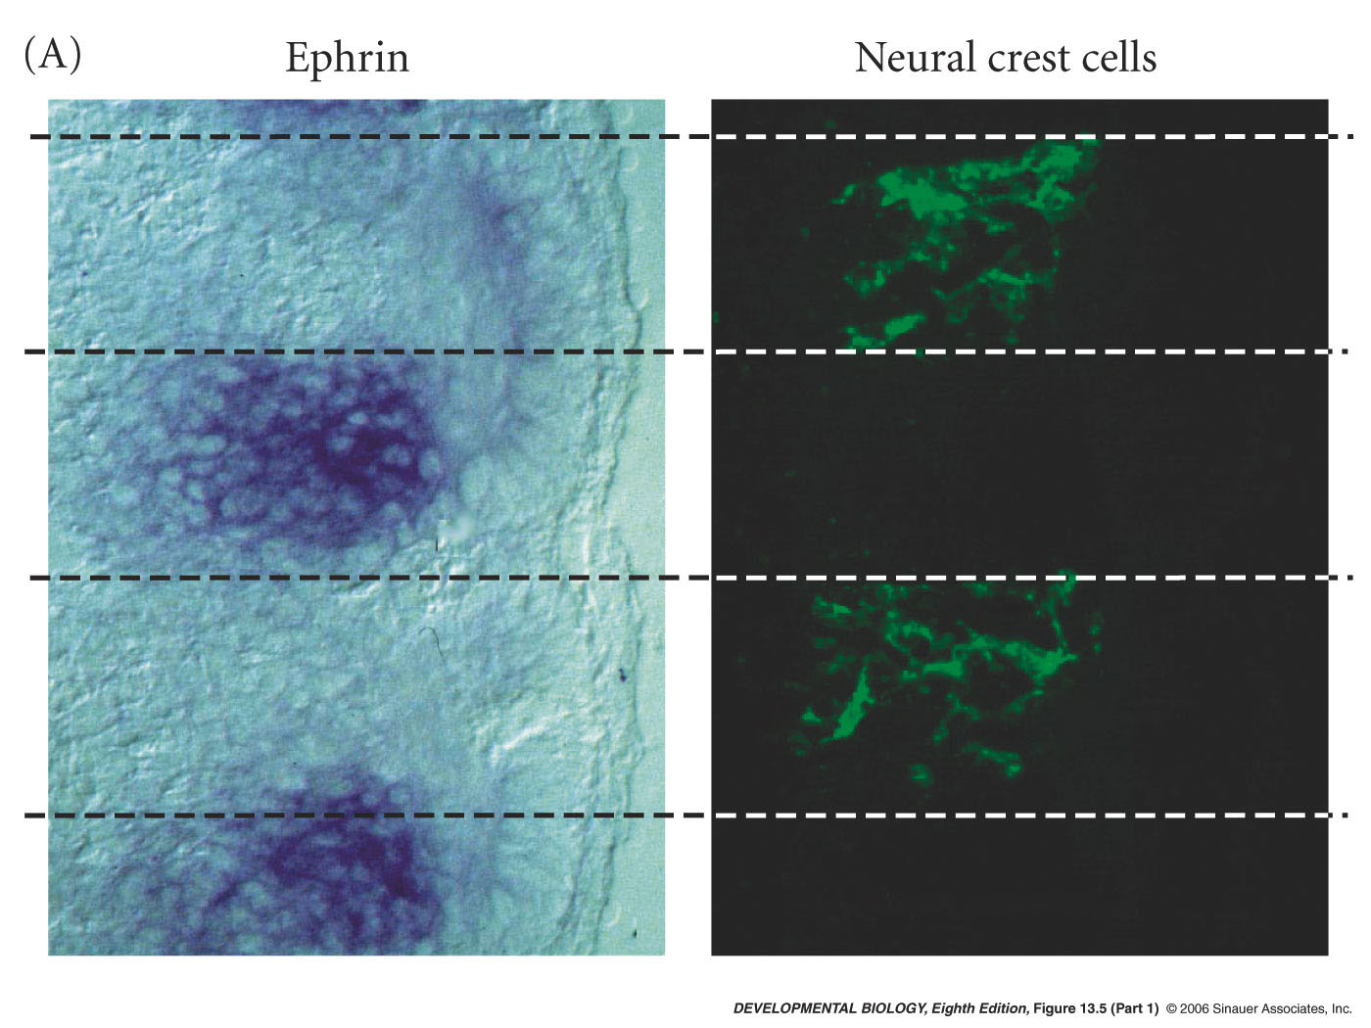
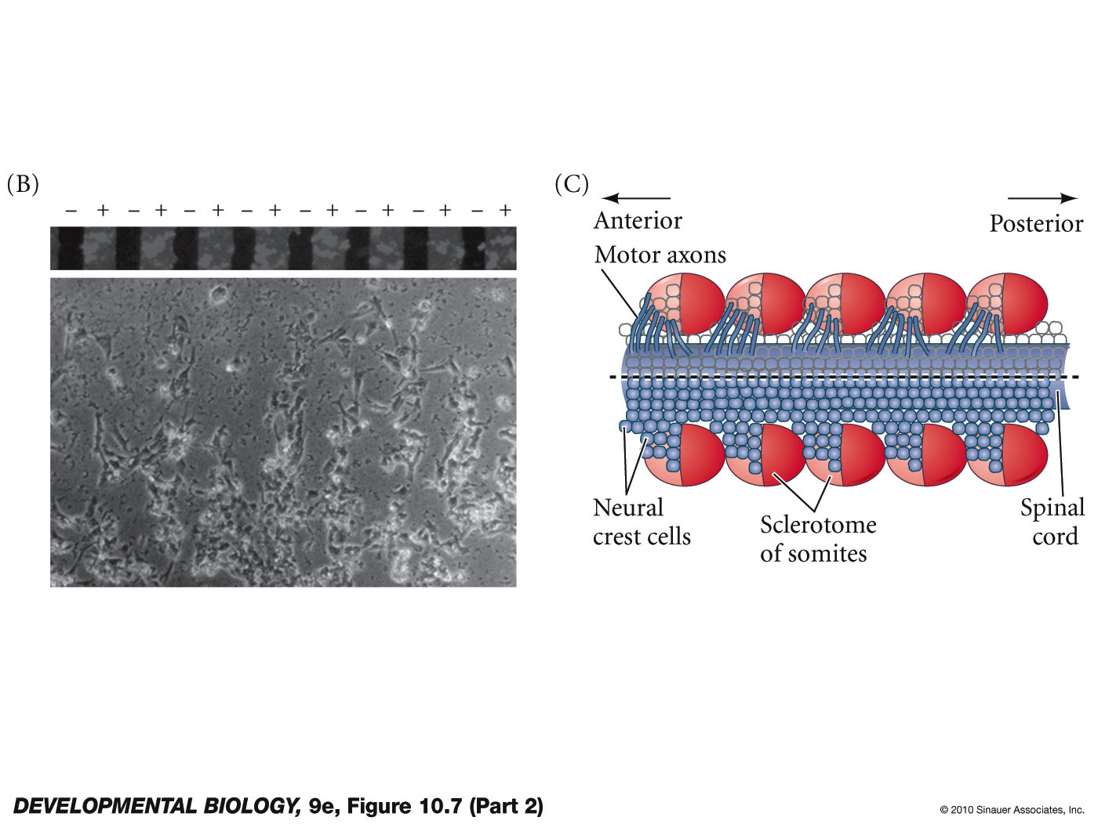
Ephrin prevents migration of neural crest from ventral migrating cells
.
A
P

Slide 26
Later (Dorsolateral) Migration
ephrin plays a positive role in supporting migration of the later dorsal migrating neural crest cells

Slide 27
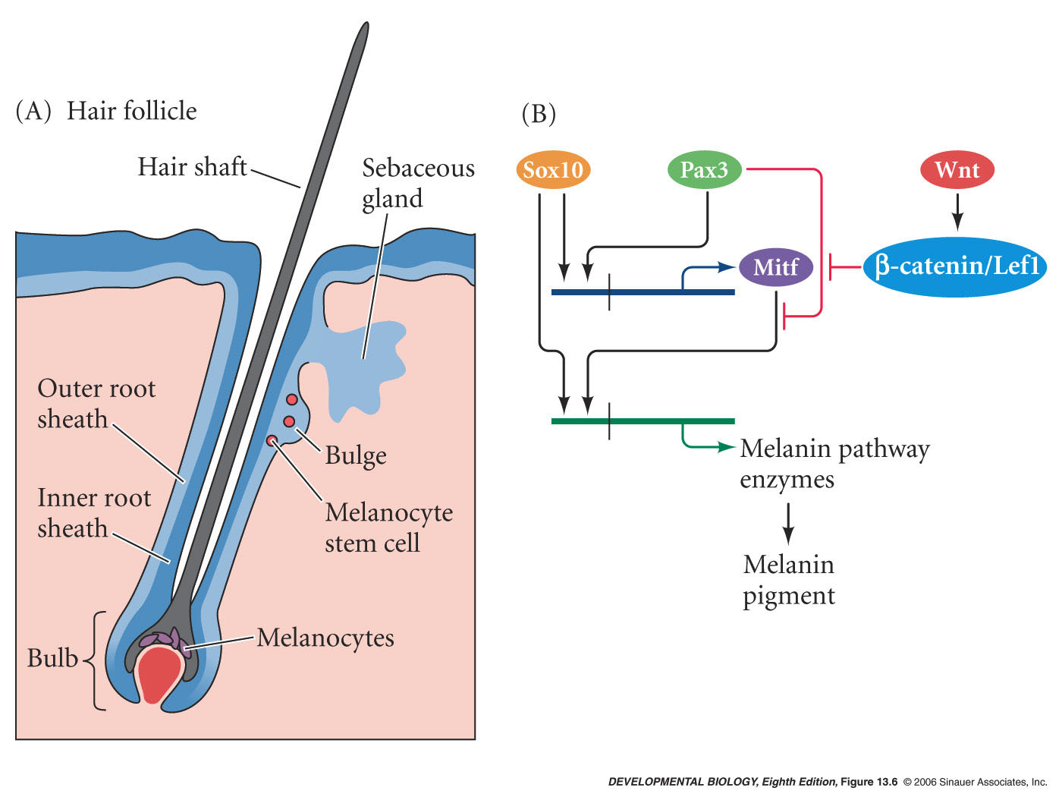
Later (Dorsolateral) Migration
will form melanocyte stem cells -
migrate into hair folicle
occupy the bulge - stem cell niche
some migrate out of the niche to bulb at each hair growth cycle
pigment the hair

Slide 28
Development of the Mammalian Central Nervous System

Slide 29
Development of the Mammalian Central Nervous System
For the real amazement, if you wish to be amazed, is this process. You start out as a single cell derived from the coupling of a sperm and an egg; this divides in two, then four, then eight, and so on, and at a certain stage there emerges a single cell which has as all its progeny the human brain. The mere existence of such a cell should be one of the great astonishments of the earth. People ought to be walking around all day, all through their waking hours calling to each other in endless wonderment, talking of nothing else except that cell.
LEWIS THOMAS (1979)

Slide 30
Axonal pathfinding

Slide 31
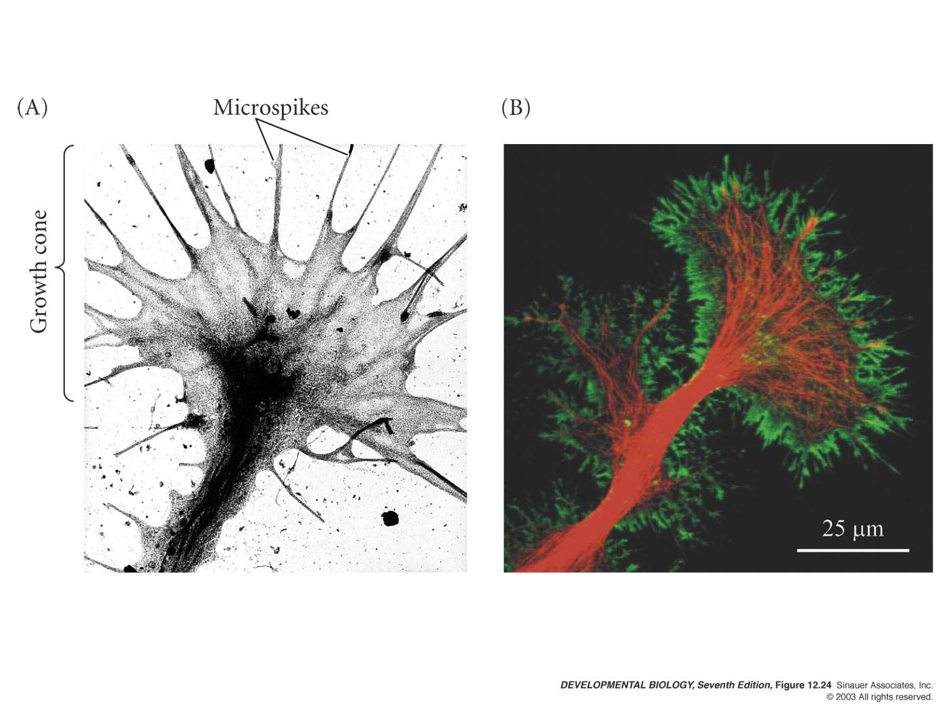
Axon Growth Cones
Green= actin
Red= tubulin
Pulling and sensing
Fig 15.24
Notes:
Figures\Chapter12\DevBio7e12240.jpg

Slide 32
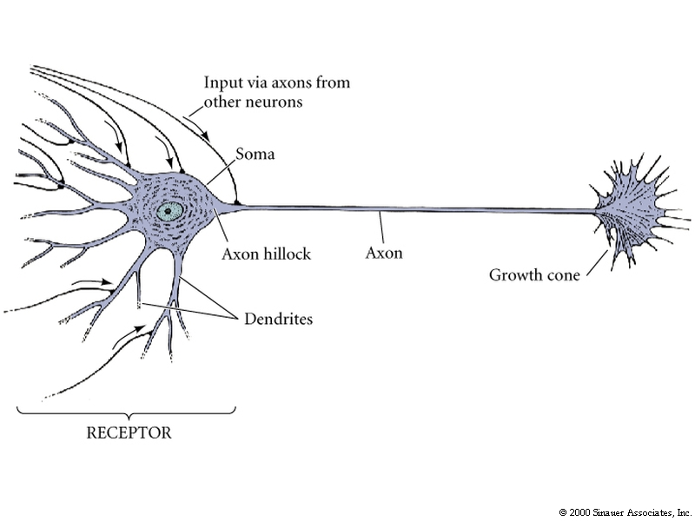
Axonal outgrowth involves a specialized structure called the growth cone

Slide 33
Axonal Guidance
3 steps:
Pathway selection – axons travel along route to particular region
Target selection – axons reach correct area and recognize and bind to cells and form stable connections
Address selection – initial patterns refined and each axon binds to small subset of targets

Slide 34
Cell adhesion and contact guidance
Migrational cues come from
extracellular matrix or
adjacent cell surfaces
signals can be attractive or repulsive depending on cell type and developmental stage

Slide 35
Target selection and Address Selection (Refinement)
Neurotrophins (secreted factors that guide and support growth or suppress apoptosis)
Activity dependant mechanisms

Slide 36
Neurotrophins
Neurons respond to proteins produced by target cells
nerve growth factor (NGF)
brain-derived neurotrophic factor (BDNF)
neurotrophin 3 (NT-3)
NT-4/5

Slide 37
Differential survival after innervation: Neurotrophic factors
Neuronal cell death
Many parts of vertebrate CNS and PNS over half of the neurons die

Slide 38
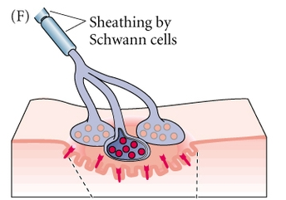
Differential survival after innervation: Neurotrophic factors
Target tissue has
limiting supply of a
neurotrophin
Neurotrophins regulate survival of different subsets of neurons
Removal of neurons’ target tissues
cause death of neurons
that would have innervated them
Good correlation between
amount of NGF secreted and
survival of neurons that innervate tissue

Slide 39
Neurotrophic factors and adult onset disease
Glial cell line-derived neurotrophic factor (GDNF)-
Enhances survival of midbrain dopaminergic neurons. Destruction of these may cause Parkinson disease
Brain-derived Neurotropic Factor (BDNF) - patients with Huntington’s disease have lower levels

Slide 40
Activity dependant development
radioactive labeled proline labels columns of cortex that responds to one eye
normal
one eye deprived of stimulus
experience/stimuli can modify neural connections

