Slide 1
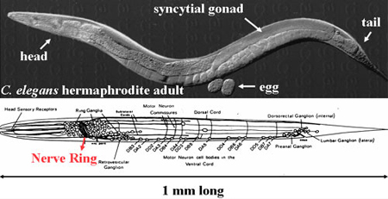
Cell Death
Chuang Lab

Slide 2
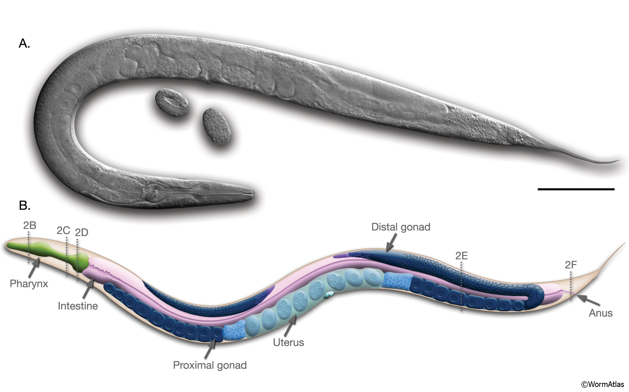
Caenorhabditis elegans is a small, free-living roundworm.
They exist as hermaphrodites and males.
Altun, Z.F. and Hall, D.H. 2009. Introduction. In WormAtlas. doi:10.3908/wormatlas.1.1

Slide 3
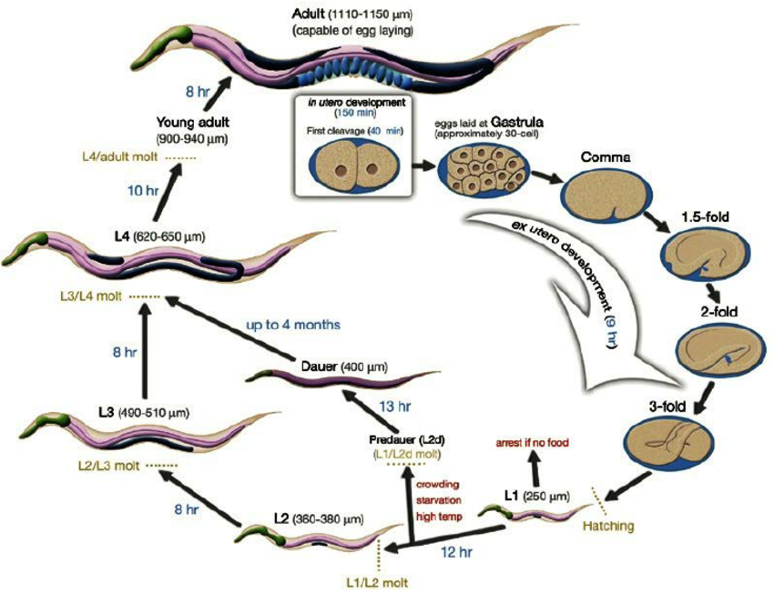
Altun, Z.F. and Hall, D.H. 2009. Introduction. In WormAtlas. doi:10.3908/wormatlas.1.1

Slide 4
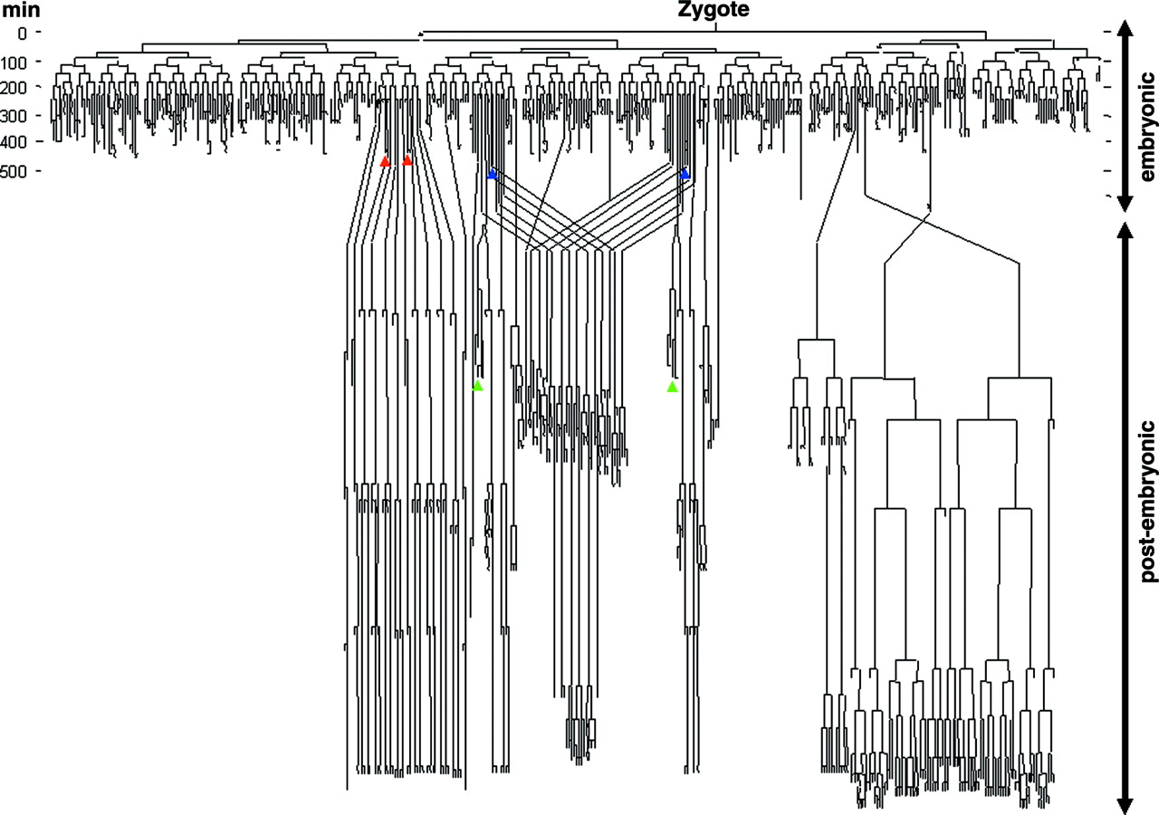

The C. elegans cell lineage.
Complete cell lineage is known, and is essentially invariant.
Syntichaki P , Tavernarakis N Physiol Rev 2004;84:1097-1153
©2004 by American Physiological Society
Notes:
The C. elegans cell lineage. A remarkable feature of the C. elegans model system is the availability of the complete cell lineage description from the fertilized oocyte to the 959-celled adult animal (396, 397). The positions of the six touch receptors are shown. Four are born embryonicaly (ALML/R, red; PLML/R, blue), and two are born after hatching (AVM, PVM; green) More specific information on individual cells and sublineages of C. elegans is available at the following web address: http://www.wormbase.org/db/searches/pedigree. [Drawing adapted with permission from Nick Rhind (http://elegans.swmed.edu/parts/lineage.gif).]

Slide 5
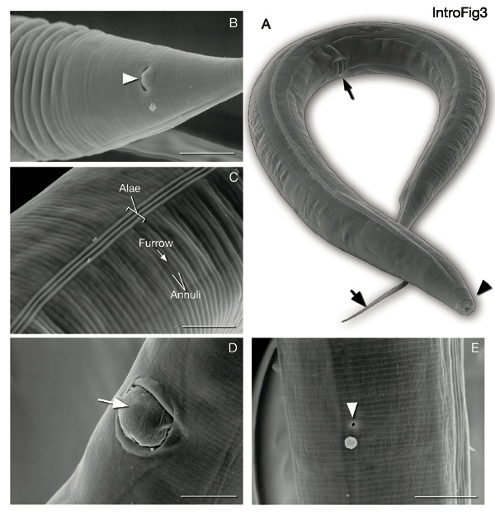
Altun, Z.F. and Hall, D.H. 2009. Introduction. In WormAtlas. doi:10.3908/wormatlas.1.1

Slide 6
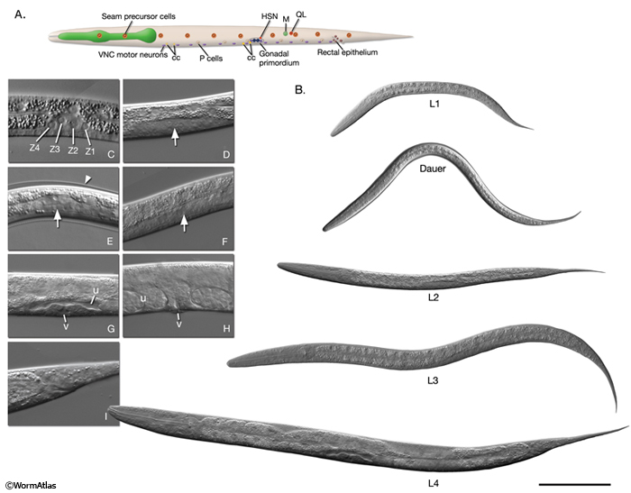
Altun, Z.F. and Hall, D.H. 2009. Introduction. In WormAtlas. doi:10.3908/wormatlas.1.1

Slide 7
Caenorhabditis elegans is a small, free-living roundworm.
They exist as hermaphrodites and males.
Altun, Z.F. and Hall, D.H. 2009. Introduction. In WormAtlas. doi:10.3908/wormatlas.1.1

Slide 8
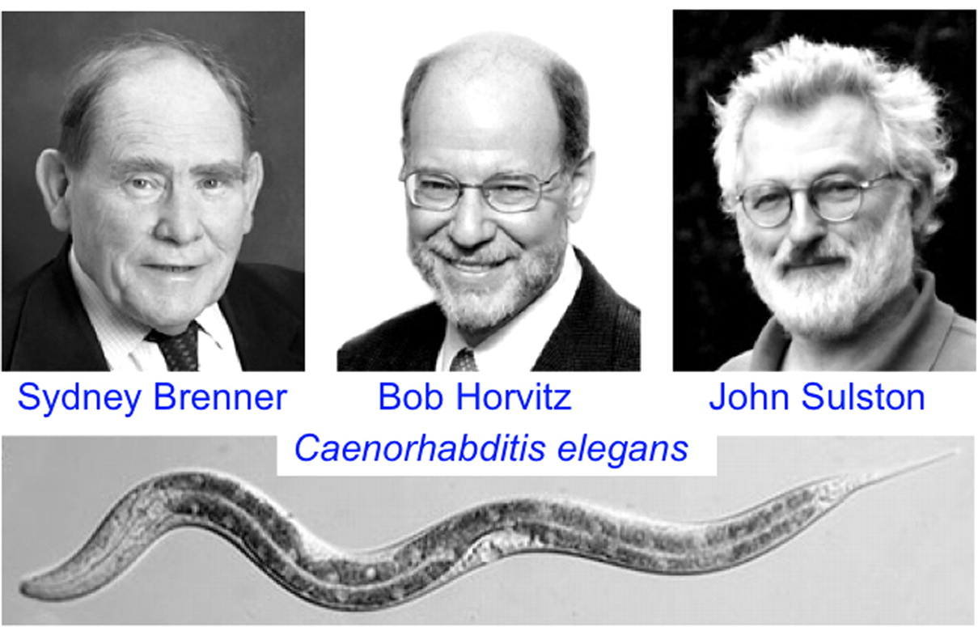

Nobel Prize 2002
©2009 by National Academy of Sciences
Notes:
Influences on my career. (Top) The success I had working for José Zadunaisky (Left) convinced me that maybe I could be a scientist. Bob Perlman (Right) was an outstanding Ph.D. advisor who always had time to listen to my (often crazy) ideas. (Middle) Working with Sydney Brenner (Left), John Sulston (Right), and Bob Horvitz (Center) during my postdoctoral years started me on my continued research with C. elegans (Bottom). I am convinced that working with this transparent animal was a major reason I was excited about the possibilities of GFP as a biological marker. [Photo credits: photo of José Zadunaisky (Journal of Experimental Zoology, Vol. 305, No. 1, 2006) reprinted permission of John Wiley & Sons, Inc.); photo of Bob Perlman (M. Chalfie); photos of Sydney Brenner, John Sulston, and Bob Horvitz (the Nobel Foundation); and photo of C. elegans (Adam Antebi).]

Slide 9
Adult has 959 cells, but 1030 arise during development. 131 cells undergo apoptosis.
Of the 959 cells, 302 are neurons.

Slide 10
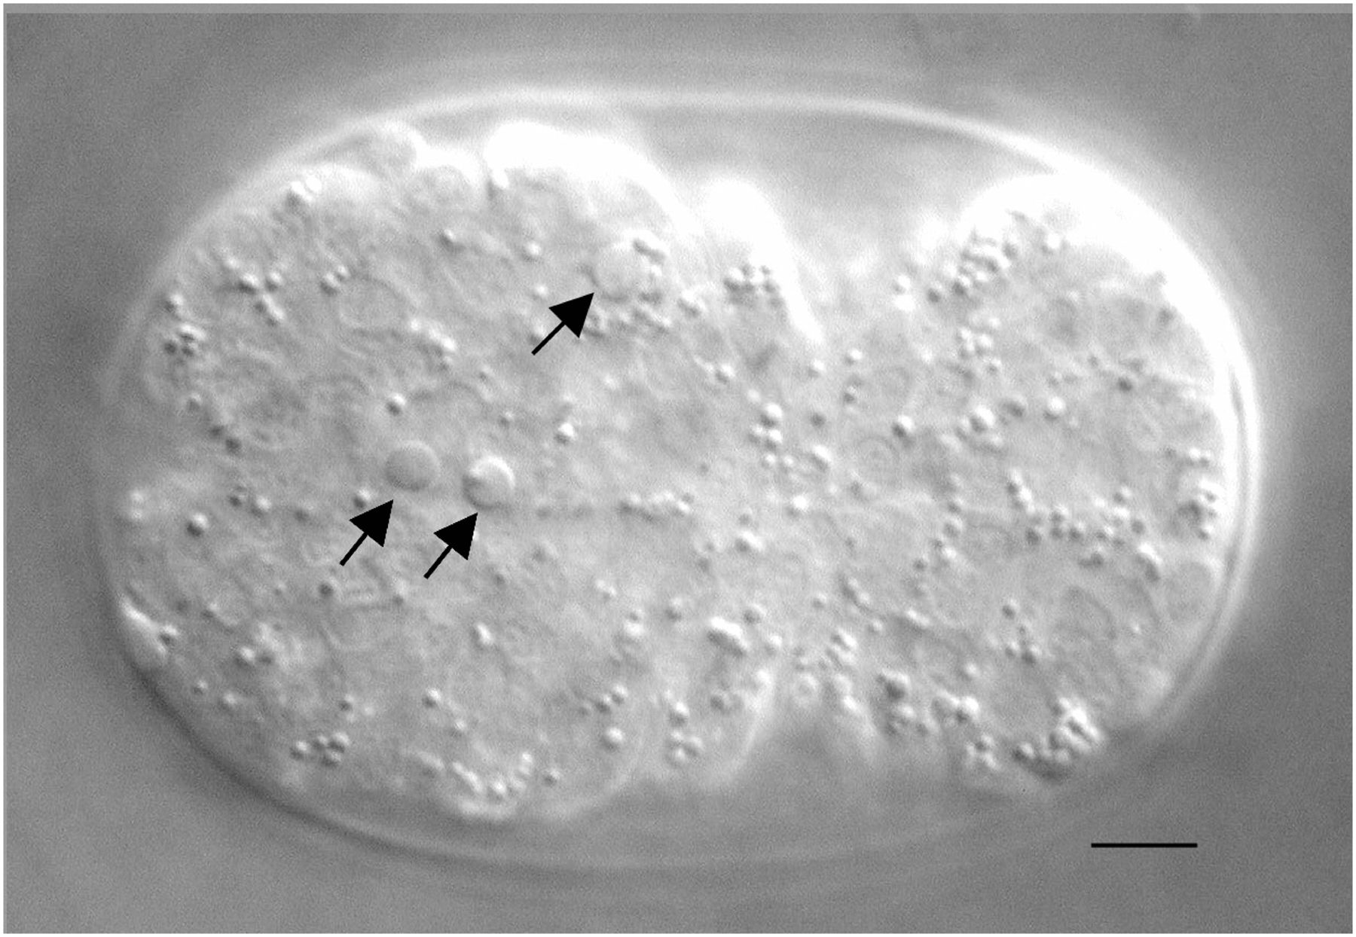
Conradt, B. and Xue D. Programmed cell death (October 06, 2005), WormBook, ed. The C. elegans Research Community, WormBook, doi/10.1895/wormbook.1.32.1, http://www.wormbook.org.

Slide 11
Altun, Z.F. and Hall, D.H. 2009. Introduction. In WormAtlas. doi:10.3908/wormatlas.1.1

Slide 12
Screens for mutations that disrupt normal development.
How?
What would you expect from screen?

Slide 13
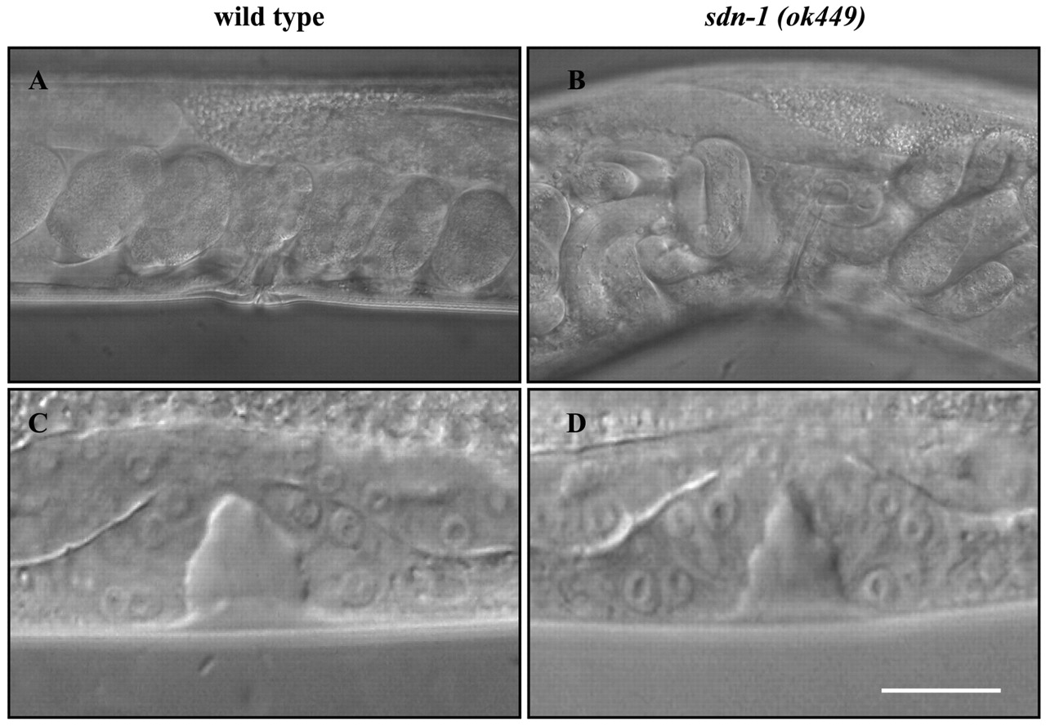

C. elegans sdn-1 mutants show accumulation of embryos in the uterus and weak morphological defects of the invaginating vulva.
Minniti A N et al. J Cell Sci 2004;117:5179-5190
©2004 by The Company of Biologists Ltd
Notes:
C. elegans sdn-1 mutants show accumulation of embryos in the uterus and weak morphological defects of the invaginating vulva. (A,B) DIC images of in uterus embryos in wild-type worms and sdn-1 (ok449) mutants respectively. (C,D) DIC micrographs of the vulvae of mid-L4 larvae from both strains. In sdn-1 (ok449), the space between the vulva cells and the cuticle is slightly smaller than in wild-type samples. Bar, 10 μm.

Slide 14
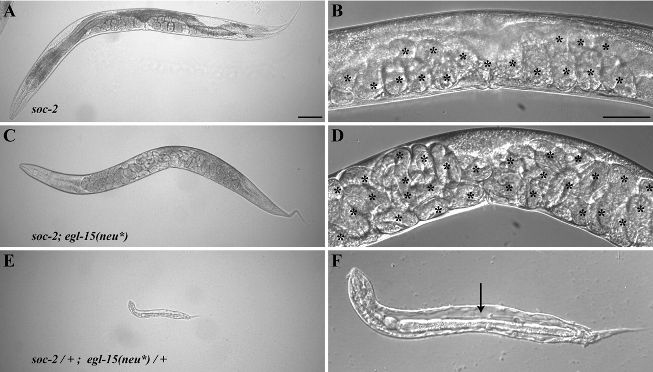

Phenotypic effects of hyperactivated EGL-15.
Isaac E. Sasson, and Michael J. Stern Development 2004;131:5381-5392
© 2004.
Notes:
Phenotypic effects of hyperactivated EGL-15. (A,B) ccIs4251 [Pmyo-3::GFP]; soc-2(n1774) animals are egg-laying proficient, and animals display a normal number of embryos in the uterus. (C,D) soc-2(n1774); ayIs15 [egl-15(neu*); Pmyo-3::GFP] animals display a severe Egl phenotype, with an increased number of eggs retained in the uterus. (E,F) soc-2 + / + mIs11; ayIs15/+. EGL-15 remains hyperactivated in these integrated lines as indicated by the dominant Clr phenotype revealed when the recessive soc-2 suppressing mutation is heterozygous. ccIs4251/+; soc-2 + / + mIs11 animals do not display a Clr phenotype (data not shown). mIs11 [Pmyo-2::GFP] was used to identify heterozygous cross progeny. All animals were photographed 30 hours after late L4. Scale bar: 100 μm in A,C,E; 50 μm in B,D,E. *, eggs. Arrow indicates clear fluid in the pseudocoelomic space.

Slide 15
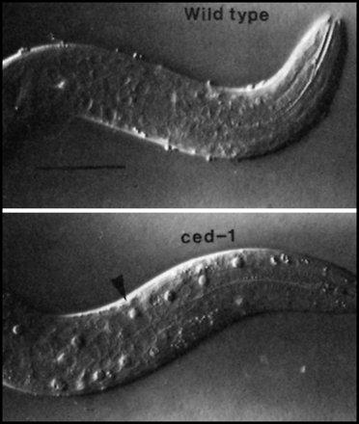
Molecular Biology
of the Cell, 1999
Cover image

Slide 16
ced-3, ced-4, and ced-9
egl-1

Slide 17
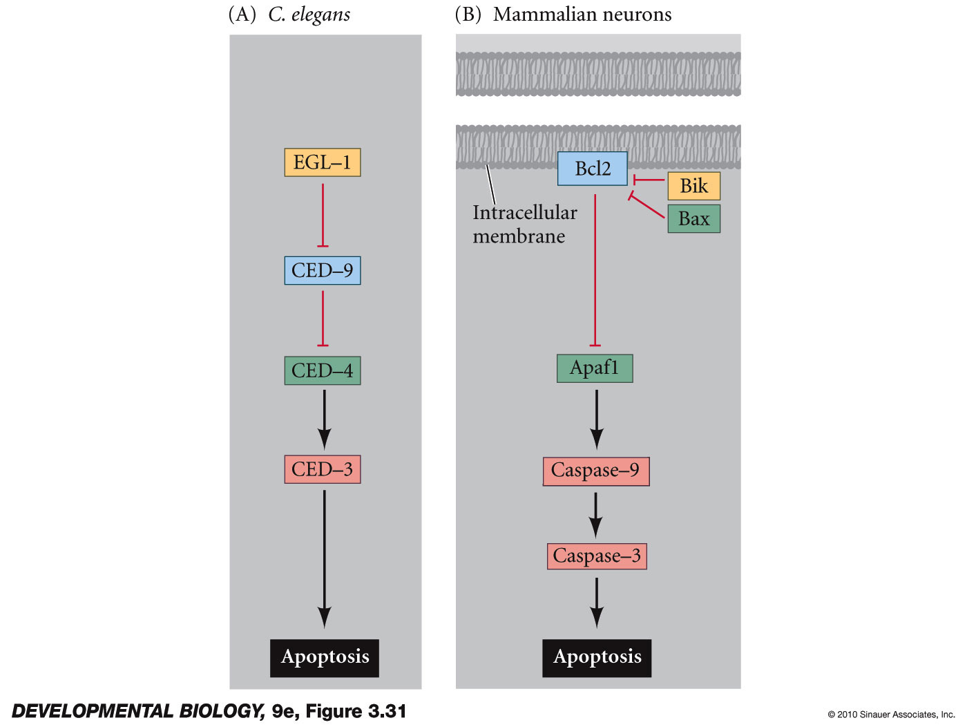
Figure 3.31 Apoptosis pathways in nematodes and mammals
Notes:
DevBio9e-Fig-03-31-0.jpg

Slide 18
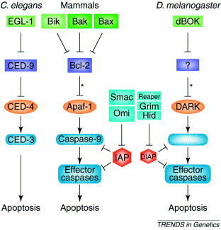

Fig. 1
Trends in Genetics 2002 18, 142-149DOI: (10.1016/S0168-9525(01)02618-X)
Notes:
Evolutionary conservation of apoptotic pathways. The mammalian proteins that participate in cell death activation and execution, and homologous proteins in Caenorhabditis elegans and Drosophila. Asterisks indicate an indirect interaction: in mammals, and proabably in flies, anti-apoptotic Bcl-2 proteins principally prevent against release of cytochrome c (cyt c), thereby preventing cyt c/apaf-1/ dark-mediated activation of caspases.

Slide 20
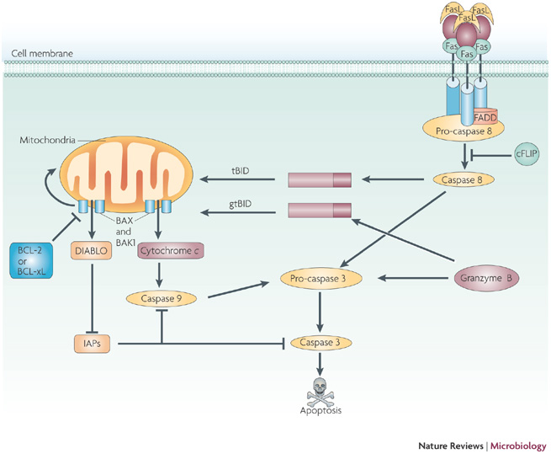
Nat Rev Microbiol. 2009 February ; 7(2): 144–155. doi:10.1038/nrmicro2071
Notes:
Caspase-dependent apoptosis.Activation of caspase 3 and caspase-dependent apoptosis are caused by the initiator caspases, caspase 8 and caspase 9, as part of the extrinsic and intrinsic apoptotic signalling pathways, or by granzyme B. In the extrinsic pathway, death ligands, including Fas Ligand (FasL), bind and activate their cognate receptors (Fas). Activated receptors, an adaptor molecule, such as Fas-associated death domain protein (FADD), and pro-caspase 8 then form a death-inducing signalling complex (DISC) in which caspase 8 is activated. Caspase 8 can activate caspase 3 and can cleave the BH3-only protein BCL-2 interacting domain death agonist (BID), forming truncated BID (tBID), which can activate the intrinsic apoptotic pathway. In the intrinsic apoptotic pathway, pro-apoptotic B-cell lymphoma 2 (BCL-2) family members BCL-2 associated x protein (BAX) and BCL-2 antagonist killer 1 (BAK1) form pores in the mitochondrial membrane. Pro-apoptotic mitochondrial factors, including DIABLO (direct inhibitor of apoptosis protein-binding protein with low pI; also known as SMAC) and cytochrome c, are released and contribute to apoptosis by activating caspase 9 or inhibiting cellular inhibitor of apoptosis proteins (IAPs). Granzyme B can directly cleave and activate pro-caspase 3. Granzyme B can also cleave BID, resulting in granzyme tBID, which can activate the intrinsic apoptotic pathway. cFLIP (cellular FLIP/caspase 8 inhibitor protein) can block the activation of caspase 8. Bcl-xL, BCL-extra large.

Slide 21
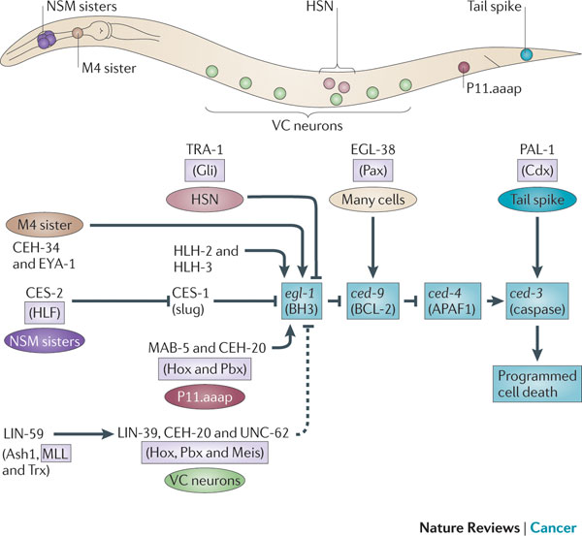
Malia B. Potts & Scott Cameron
Nature Reviews Cancer 11, 50-58 (January 2011)

Slide 22
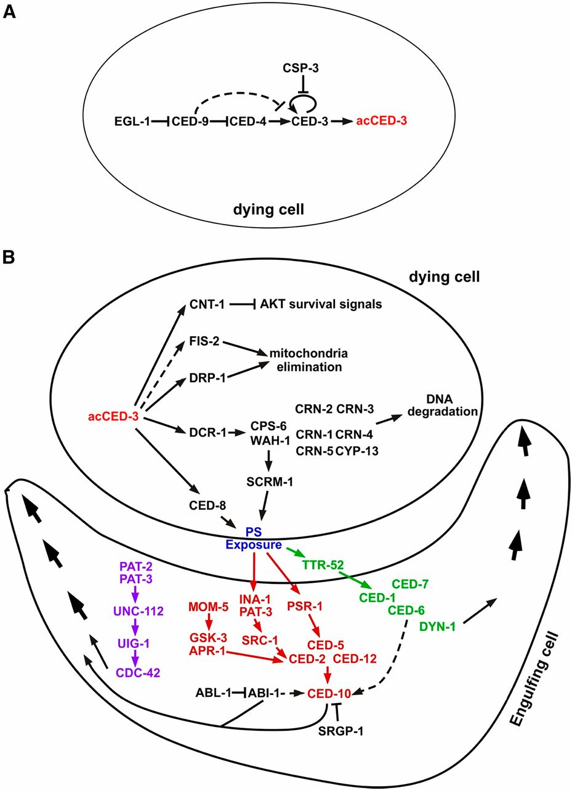

Genes involved in the activation and the execution phases of programmed cell death in C. elegans.
Barbara Conradt et al. Genetics 2016;203:1533-1562
Copyright © 2016 by the Genetics Society of America
Notes:
Genes involved in the activation and the execution phases of programmed cell death in C. elegans. Genes involved in two critical phases of programmed cell death, (A) activation and (B) execution, are shown. In the execution phase, four cell death execution events (fragmentation and degradation of chromosomal DNA, mitochondrial elimination, engulfment of apoptotic cell corpses, and inactivation of survival signals) are directly activated by the proteolytic cleavage of the CED-3 caspase. Three partially-redundant pathways, colored in pink, red, and green, respectively, mediate recognition and removal of apoptotic cell corpses. The activation of CED-10 and CDC-42 small GTPases leads to cytoskeletal reorganization required for pseudopod extension around an apoptotic cell. Arrows indicate confirmed activation and dashed arrows indicate proposed activation.

