Slide 1
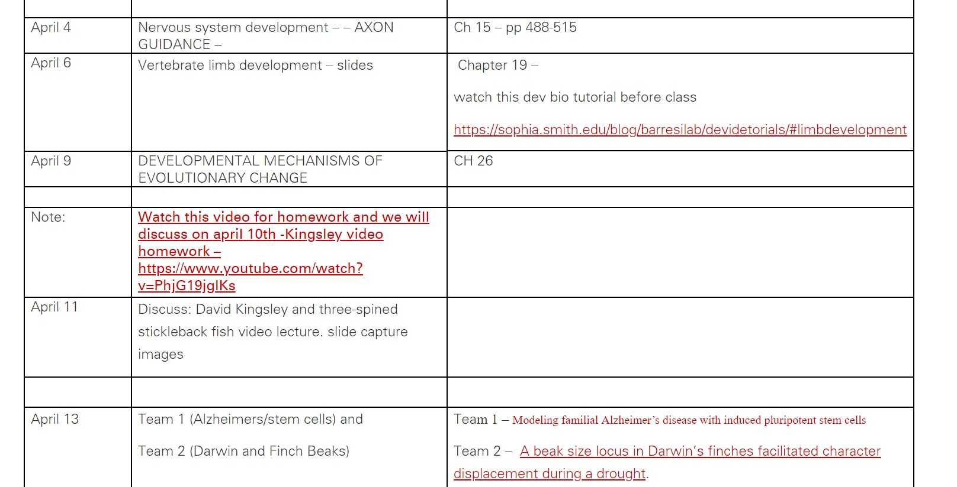
Limb development video – discussion on April 6
https://sophia.smith.edu/blog/barresilab/devidetorials/#limbdevelopment

Slide 2
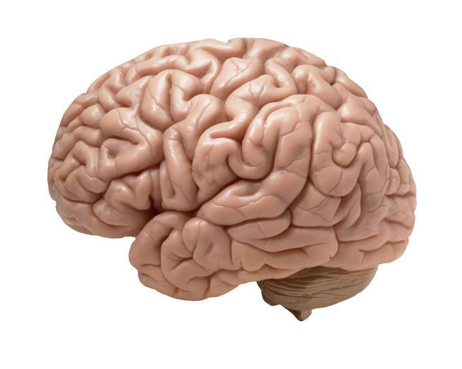
Development of the Mammalian Central Nervous System

Slide 3
Development of the Mammalian Central Nervous System
For the real amazement, if you wish to be amazed, is this process. You start out as a single cell derived from the coupling of a sperm and an egg; this divides in two, then four, then eight, and so on, and at a certain stage there emerges a single cell which has as all its progeny the human brain. The mere existence of such a cell should be one of the great astonishments of the earth. People ought to be walking around all day, all through their waking hours calling to each other in endless wonderment, talking of nothing else except that cell.
LEWIS THOMAS (1979)

Slide 4
Cells of the nervous system
Neurons
  between 1 billion and 1 trillion in human brain
  elaborate network of communication
Glia (or neuroglia)
  anywhere from 3x to 100x as many glia as neurons
  support and modulate neuronal function
  also play critical roles in development and after injury/disease
Ventricular ependymal cells
  Neural tube lining
  Secrete cerebrospinal fluid

Slide 5
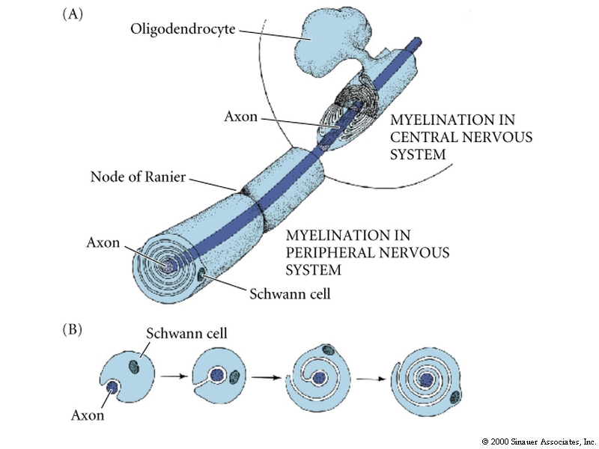
Glia cells
3 general types of glia:
  Schwann cells (PNS)
  oligodendrocytes (CNS)
  astrocytes (CNS)
    Astrocytes guide the
    migration of neurons
    during development
    others make myelin

Slide 6
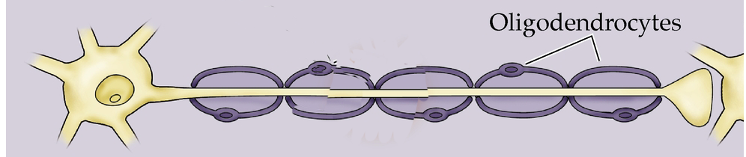
Neurons
basic design:
  cell body (soma)
  dendrites
  axon
  terminals (form synapses)
BUT many different types of neurons
once born, neurons do not divide again (post-mitotic)
axon
cell body or soma
terminals
Dendrites extend from soma

Slide 7
Cell type – neuron versus glial cell
Type of neuron – morphology
Connections – axon pathway guidance
Interactions with targets to refine connections

Slide 8
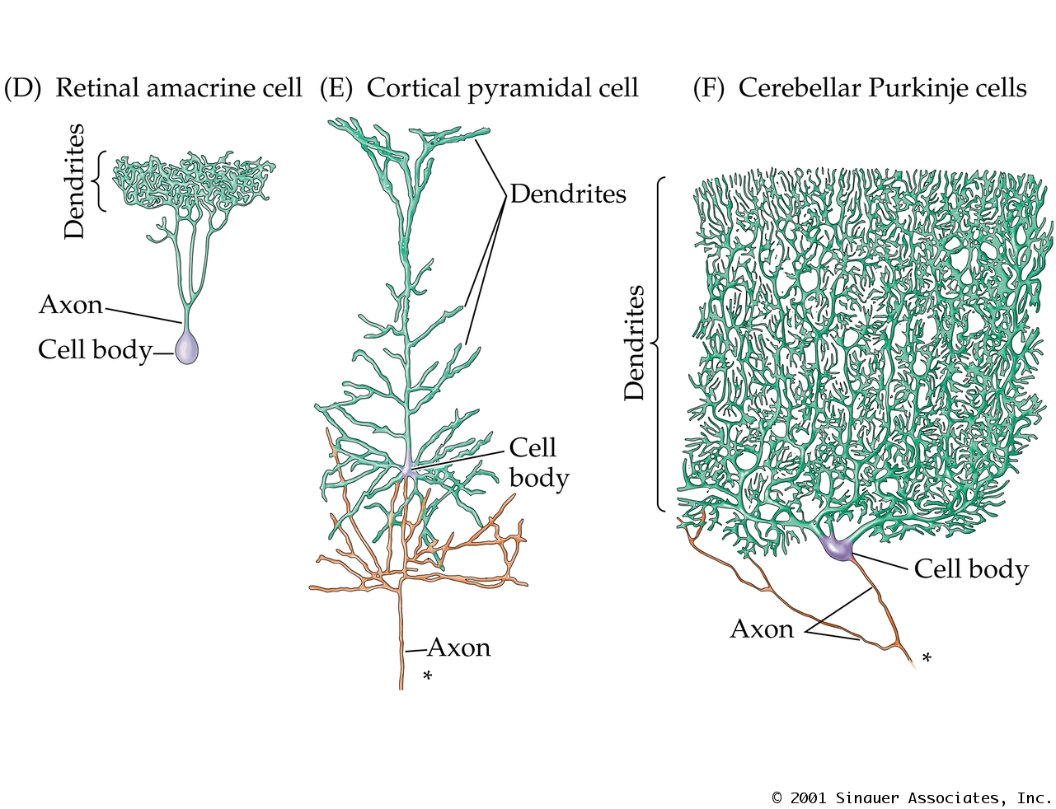
Examples of different types of neurons
retinal
amacrine cell
cortical
pyramidal cell
cerebellar
Purkinje cell

Slide 9
Dorsal Ventral Patterning

Slide 10
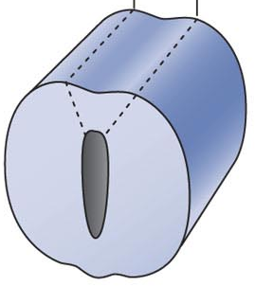
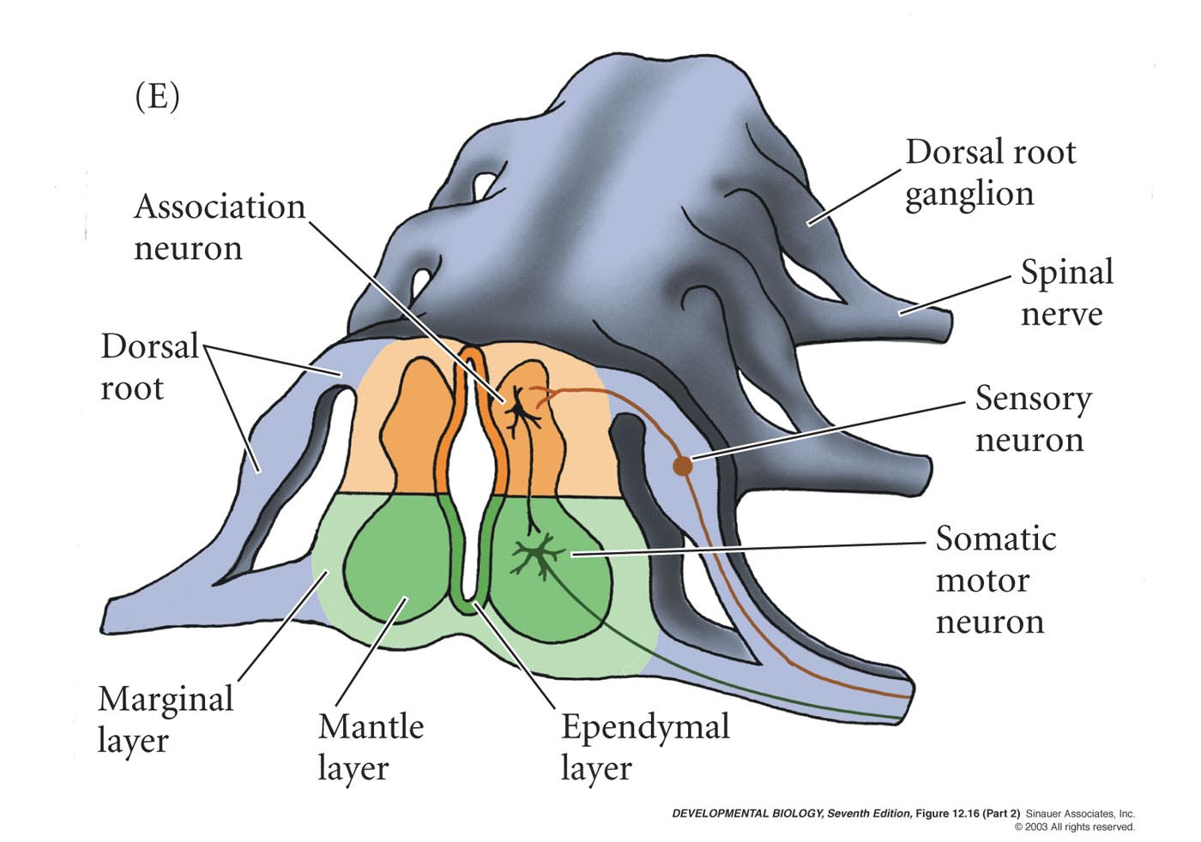
Spinal cord structure
Interneuron
Ventricular layer
Notes:
Figures\Chapter12\DevBio7e12162.jpg

Slide 11
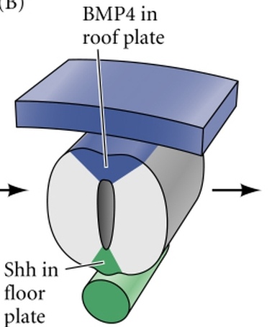
DV axis
Neural tube polarized along DV axis
Spinal cord
  Dorsal region - spinal neurons receive input from sensory neurons
  Ventral region - motor neurons
  Middle - interneurons relay information between them

Slide 12
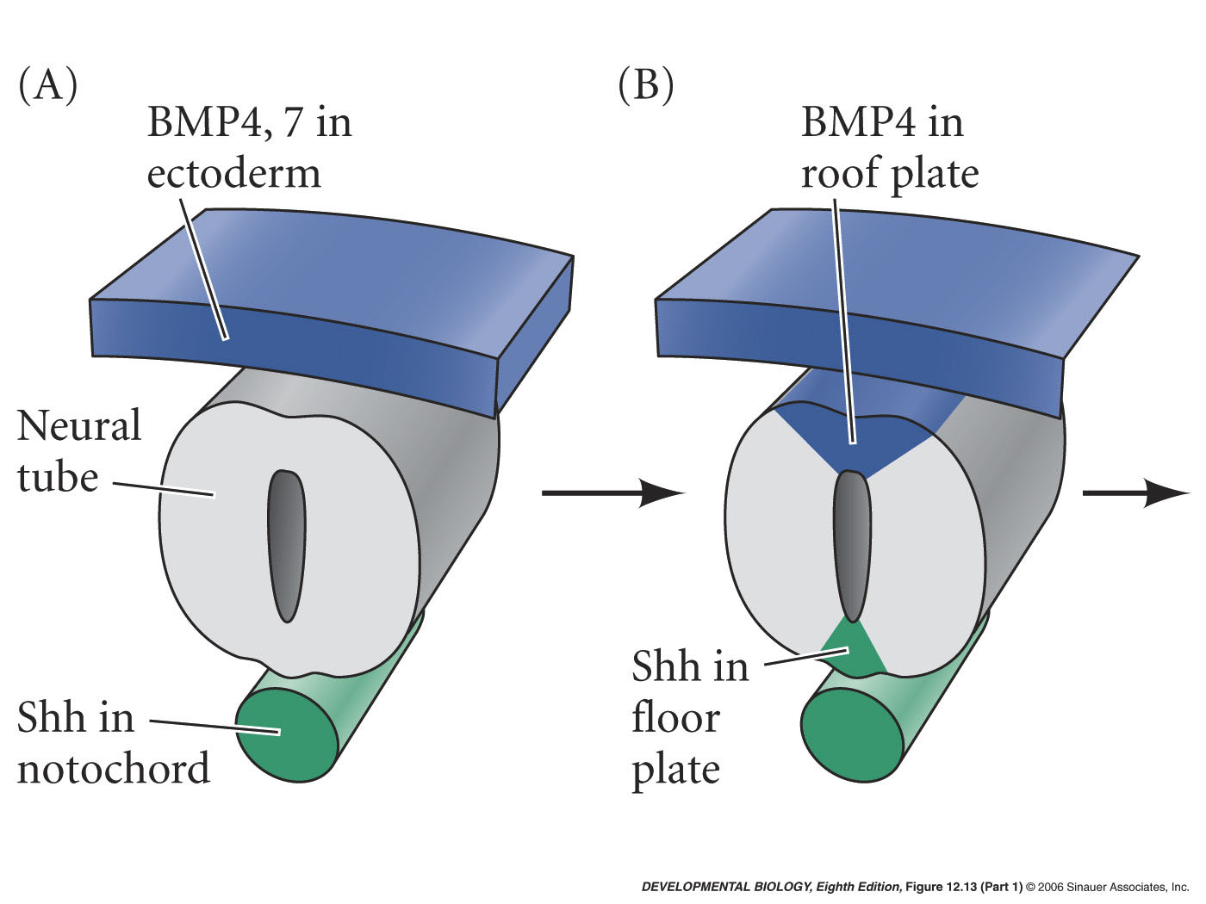
D/V signaling in spinal cord
TGF-beta family in ectoderm induces TGF -beta family in roof plate
Sonic hedgehog in notochord induces Sonic hedgehog in floor plate

Slide 13
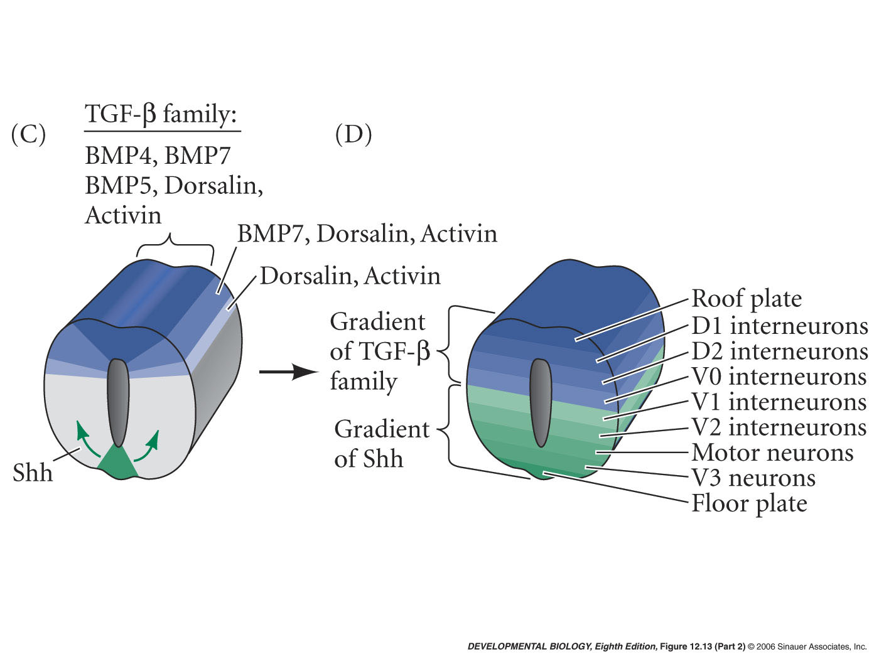
Gradients of Shh and TGF-beta family ligands
Different neuronal fates

Slide 14
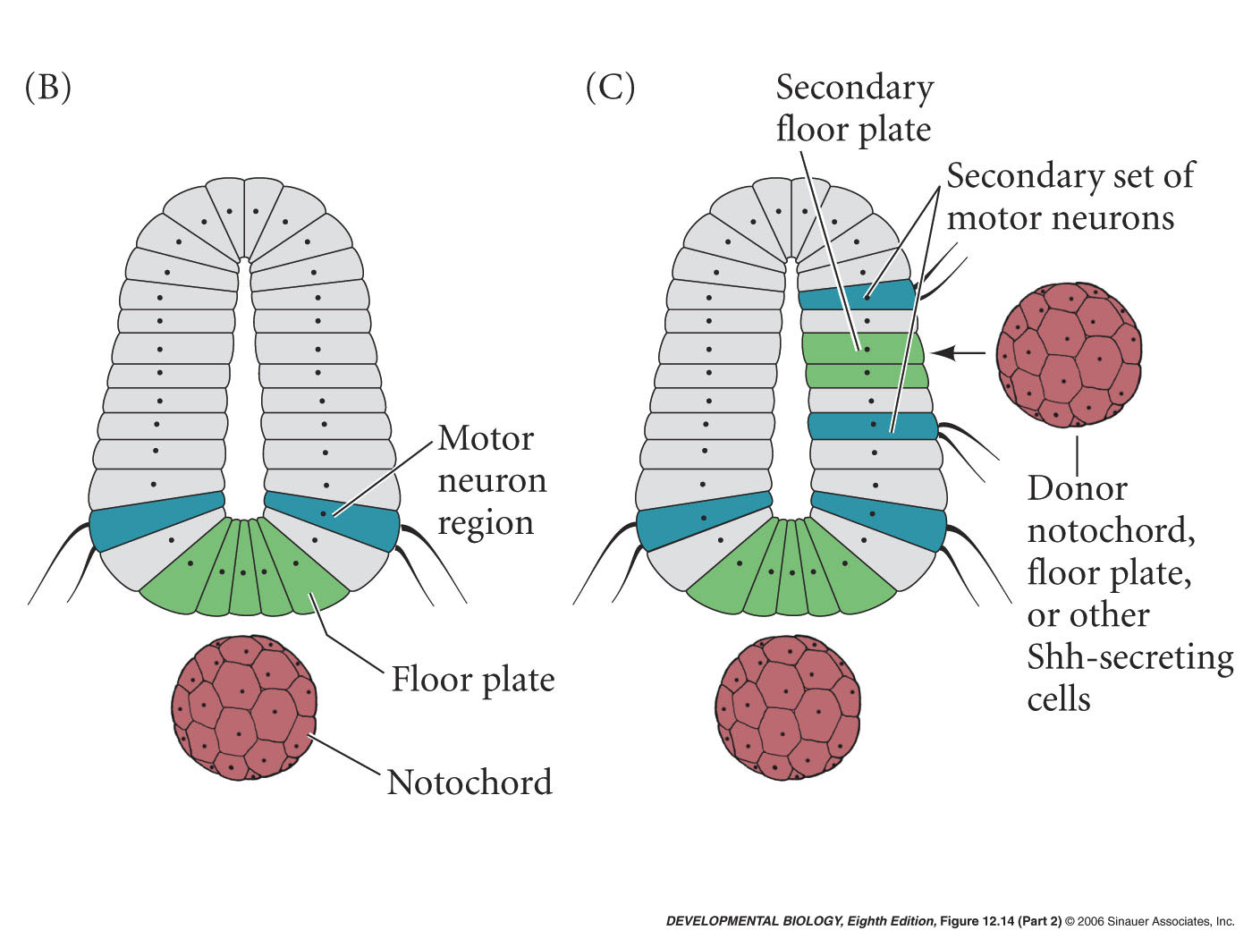
Ventral patterning of the neural tube

Slide 15
Axonal pathfinding

Slide 16
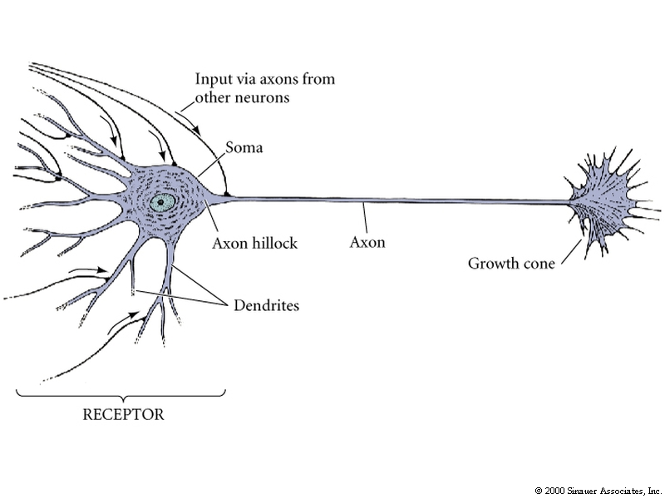
Axonal outgrowth involves a specialized structure called the growth cone

Slide 17
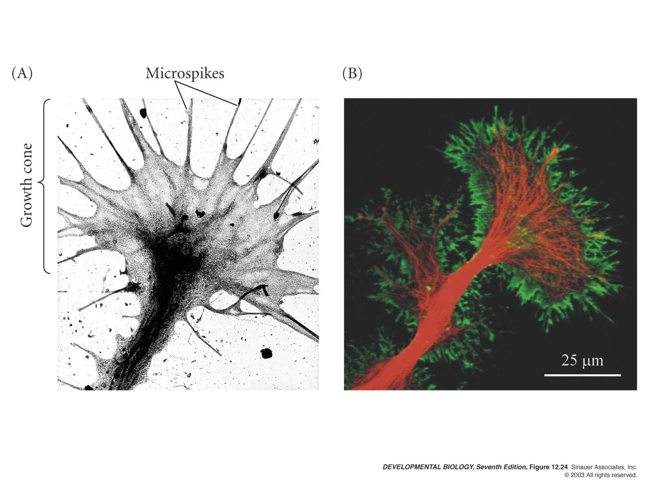
Axon Growth Cones
Green= actin
Red= tubulin
Pulling and sensing
Fig 15.24
Notes:
Figures\Chapter12\DevBio7e12240.jpg

Slide 18
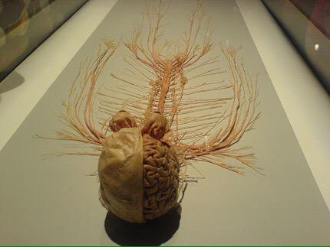
Axonal Guidance
3 steps:
Pathway selection – axons travel along route to particular region
Target selection – axons reach correct area and recognize and bind to cells and form stable connections
Address selection – initial patterns refined and each axon binds to small subset of targets

Slide 19
Cell adhesion and contact guidance
Migrational cues come from
extracellular matrix or
adjacent cell surfaces (glia and neurons)
signals can be attractive or repulsive depending on cell type and developmental stage

Slide 20
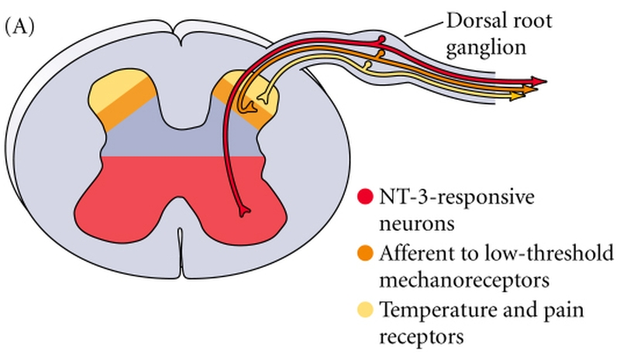
Selective Growth Cone Repulsion
Dorsal root ganglia - Several types of neurons whose axons enter dorsal spinal cord
Semaphorin/collapsin patterns sensory projections
by selectively repelling certain axons so they terminate dorsally
NT-3 responsive
subset travel
ventrally
Not inhibited by
semaphorin III
Semaphorin
expression

Slide 21
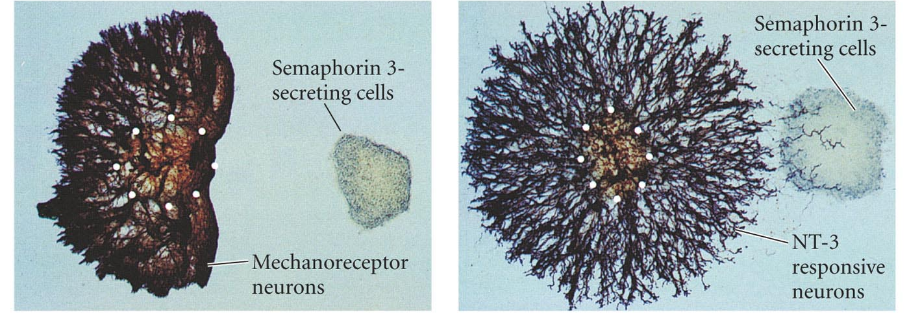
Selective Growth Cone Repulsion
Semaphorin III
protein collapses growth cones of axons originating in dorsal root ganglia
Response to semaphorin depends on type of nerve cell
Fig 15.31

Slide 22
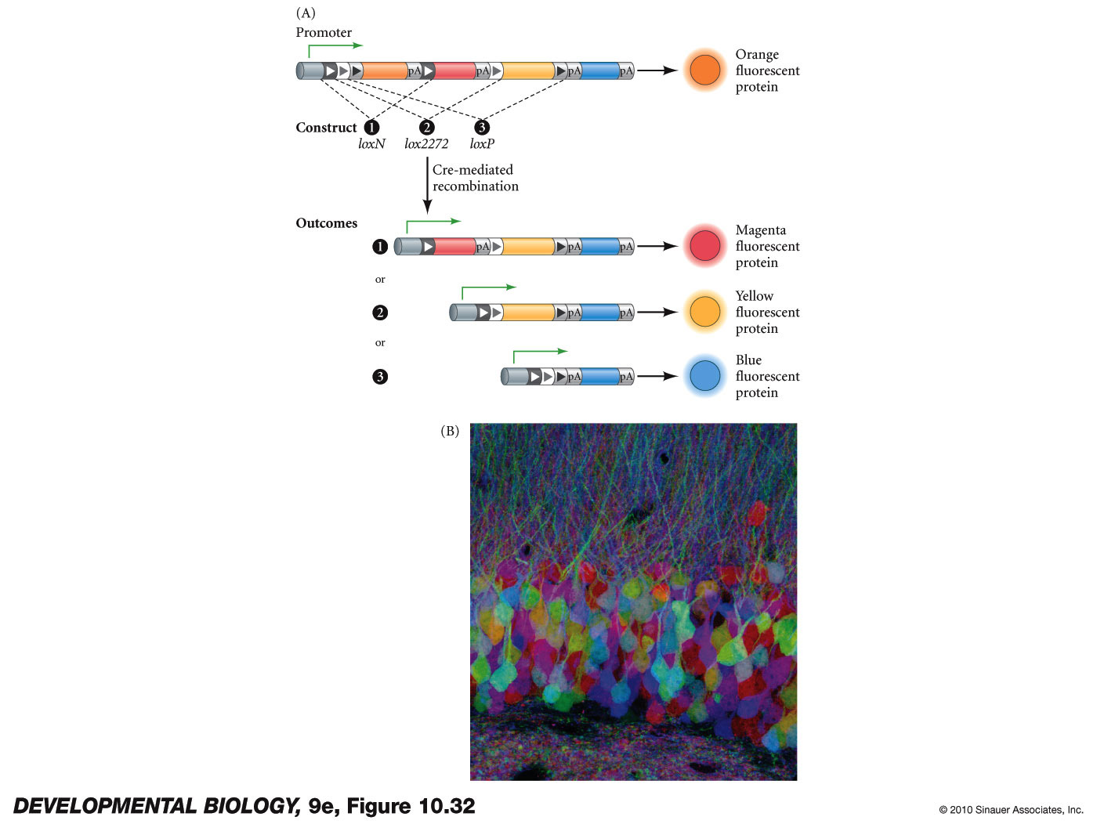
How can we follow all these axons?
Brainbow technology

Slide 23
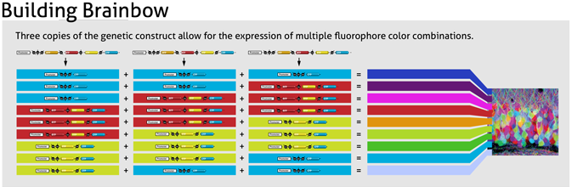
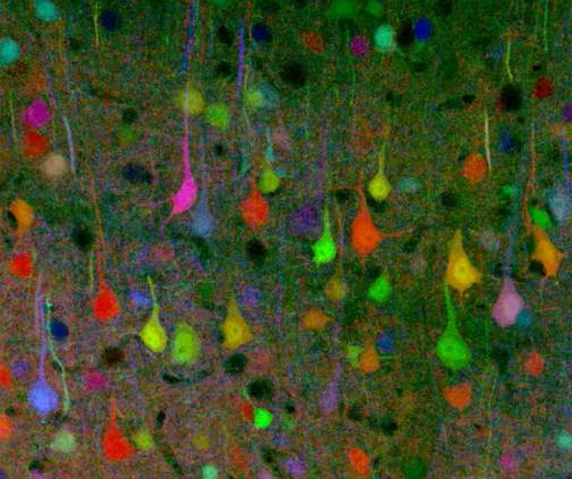

Slide 24
Target selection and Address Selection (Refinement)
Neurotrophins (secreted factors that guide and support growth or suppress apoptosis)
Activity dependant mechanisms

Slide 25
Differential survival after innervation: Neurotrophic factors
Neuronal cell death
Many parts of vertebrate CNS and PNS over half of the neurons die

Slide 26
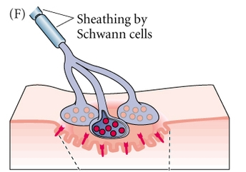
Differential survival after innervation: Neurotrophic factors
Target tissue has
limiting supply of a
neurotrophin
Neurotrophins regulate survival of different subsets of neurons
Removal of neurons’ target tissues
cause death of neurons
that would have innervated them
Good correlation between
amount of NGF secreted and
survival of neurons that innervate tissue

Slide 27
Neurotrophic factors and adult onset disease
Glial cell line-derived neurotrophic factor (GDNF)-
Enhances survival of midbrain dopaminergic neurons. Destruction of these may cause Parkinson disease
Brain-derived Neurotropic Factor (BDNF) - patients with Huntington’s disease have lower levels

Slide 28
Activity dependant development
radioactive labeled proline labels columns of cortex that responds to one eye
normal
one eye deprived of stimulus
experience/stimuli can modify neural connections

