Slide 1
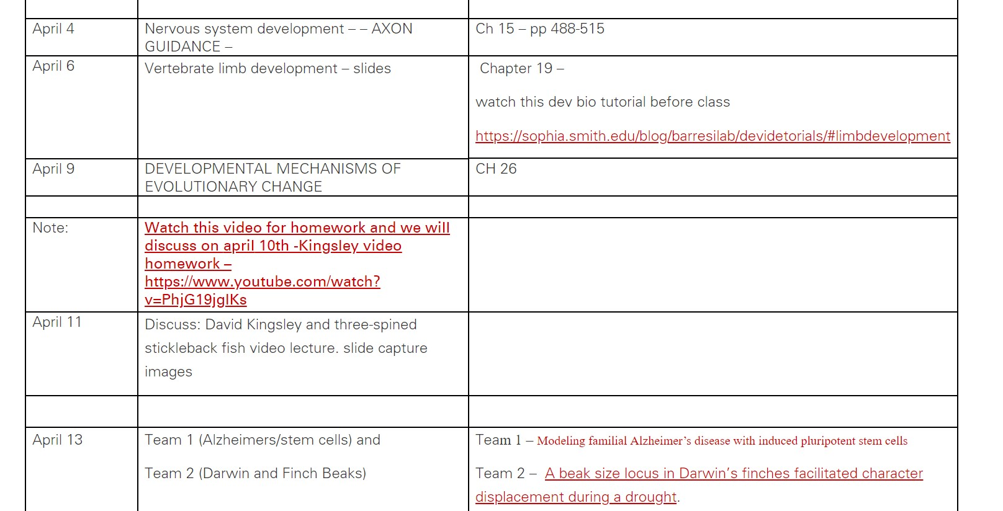
Watch Kingsley video for discussion April 11th
Everyone is responsible for explanation of figures/images from the video slide presentation. I am not assigning figures. All of you will be responsible and called upon at random.

Slide 2
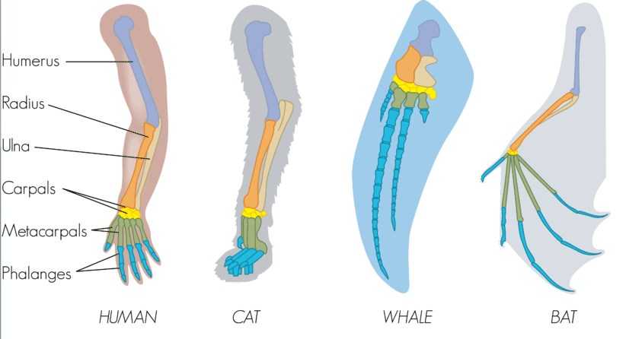
Tetrapod Limb development
Stylopod
Zeugopod
Autopod
What can be more curious than that the hand of a man formed for grasping, that of a mole for digging, the leg of a horse, the paddle of the porpoise, and the wing of the bat should all be constructed on the same pattern and should include similar bones, and in the same relative positions?
Charles Darwin 1859

Slide 3
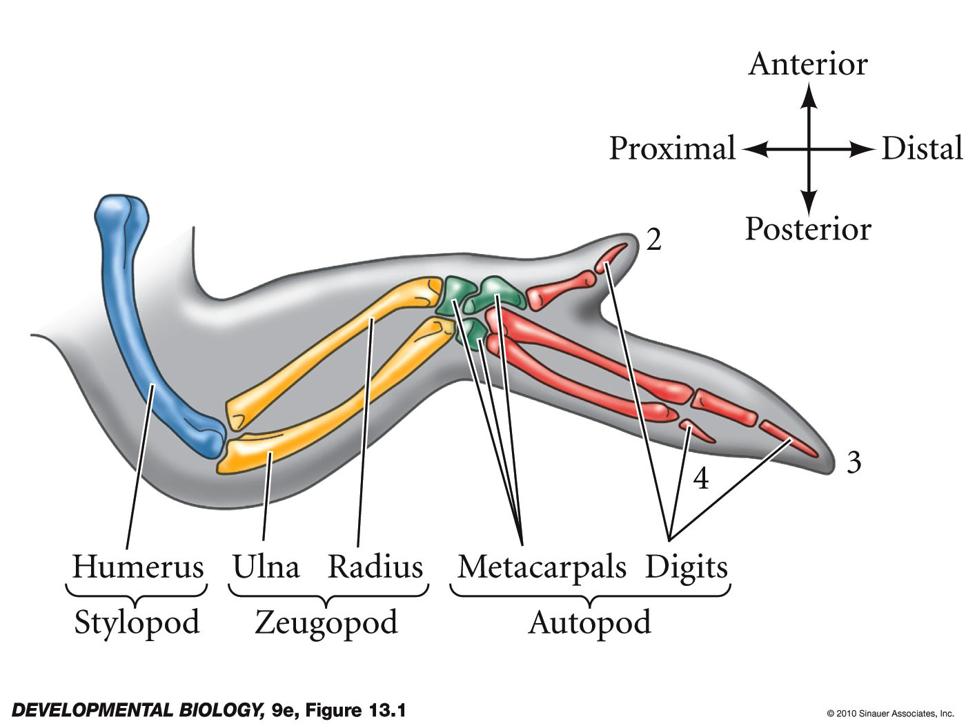
Tetrapod Limb development
Proximal/distal – FGF family;
A/P (thumb pinkie) – shh;
dorsal/ventral – Wnt7a

Slide 4
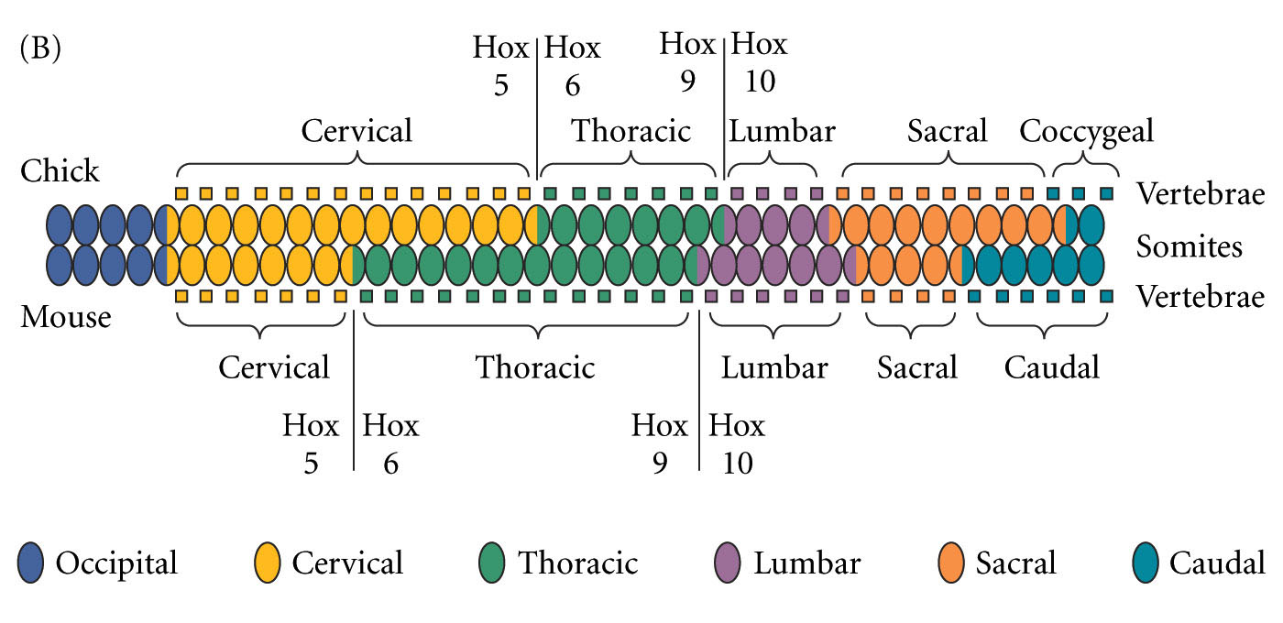
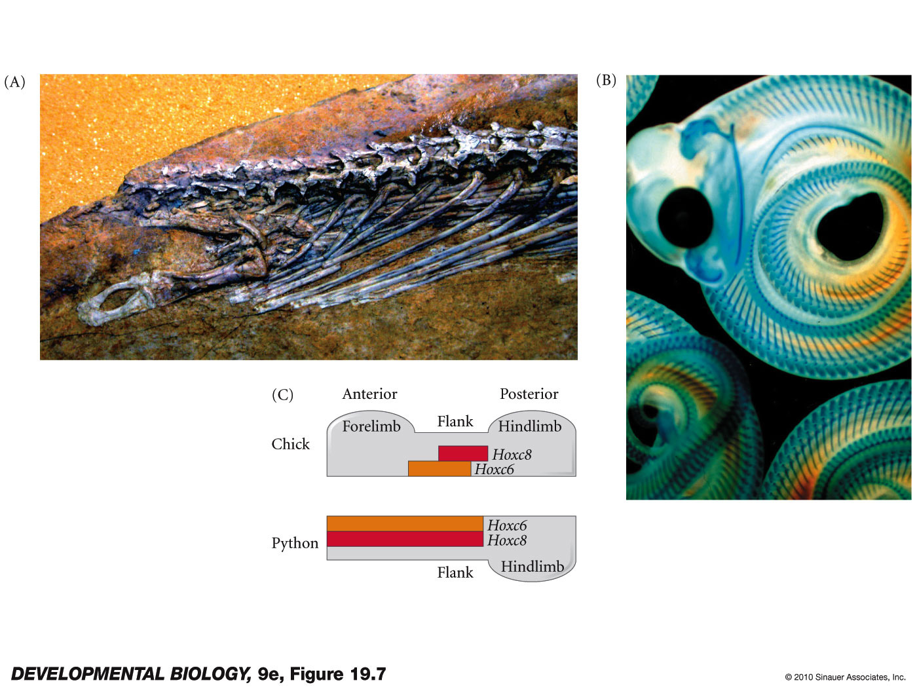
early limb bud formation
Chicken wing
Hox genes define limb fields
Example fore limb formed just anterior to Hox6 expression domain
Fgf10 is activated in limb fields/ limb buds
Mouse front leg

Slide 5
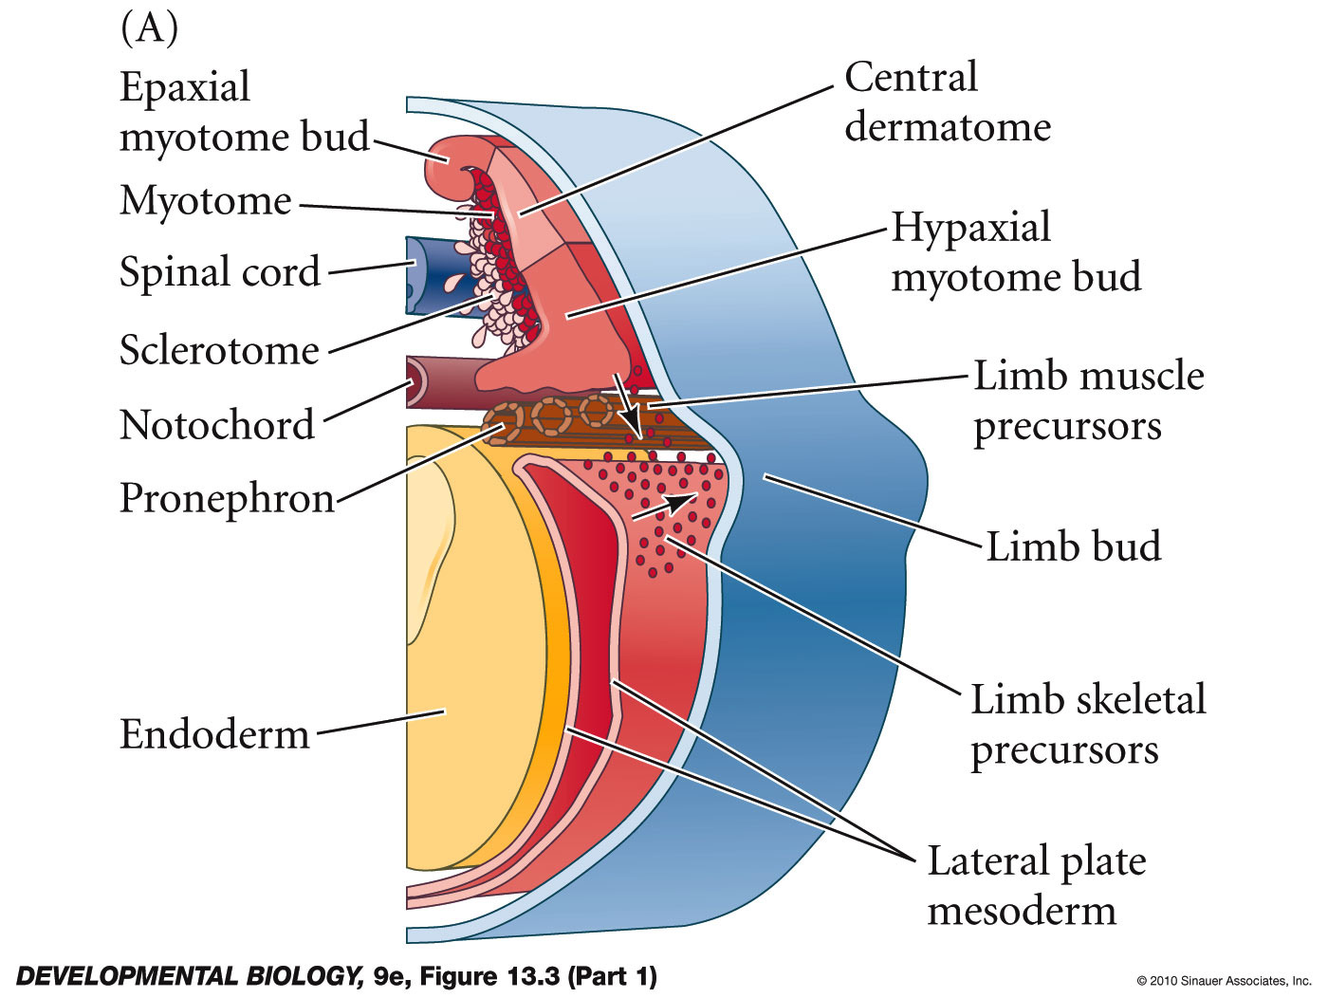
early limb bud formation
Hox genes define limb fields
Fgf10 is activated in limb fields
Skeletal and muscle precursors from the mesoderm migrate into the forming limb bud

Slide 6
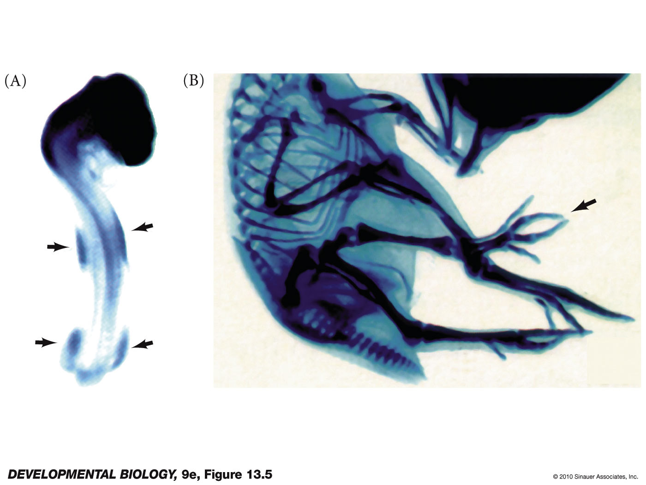
FGF10 in mesodermal mesenchyme
Bead of FGF10 induces ectopic limb
Figure 19.10 -
fgf10 expression in lateral plate mesoderm
ectopic limb formed by placement of fgf10 beads or cells

Slide 7
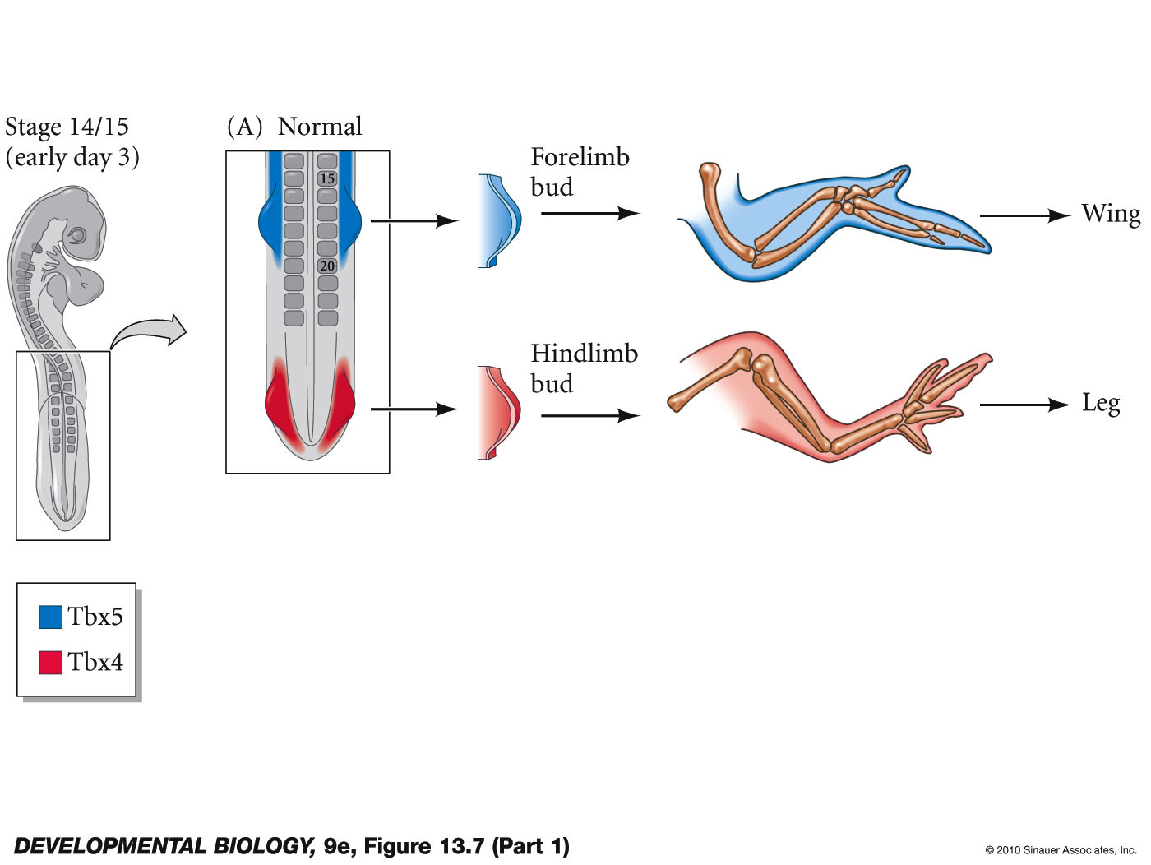
Tbx5 and Tbx4 (Pitx1) help distinguish fore and hind limb identity
also Pitx1 in hind limbs
Figure 19.10

Slide 8
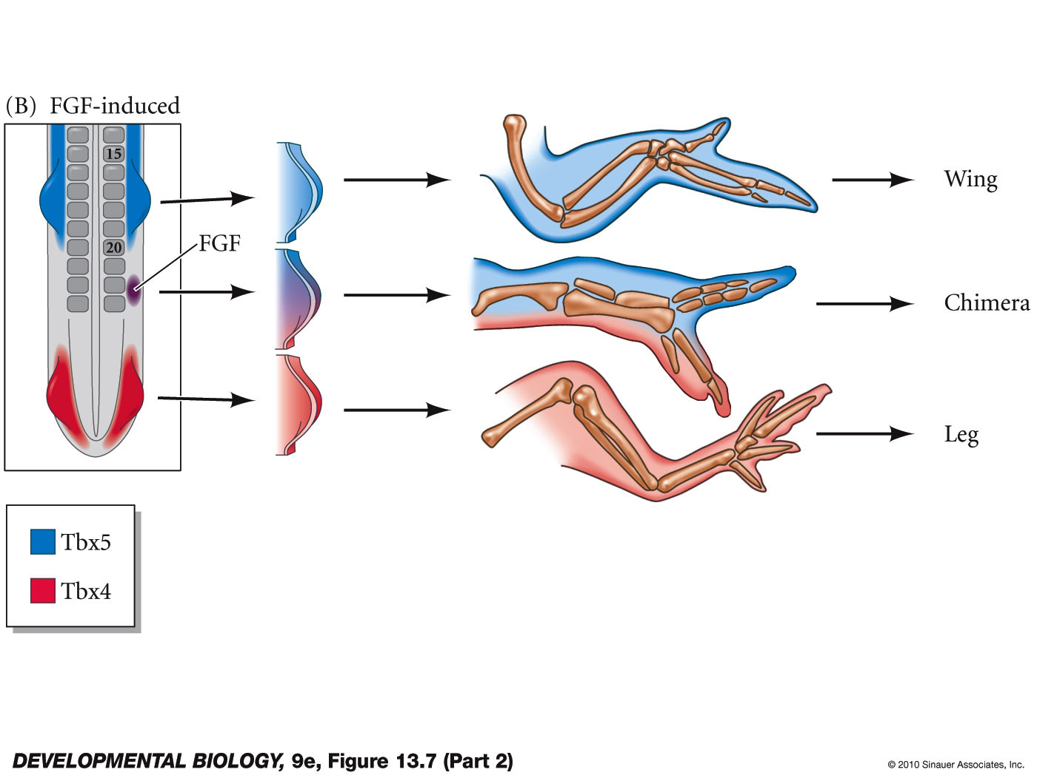
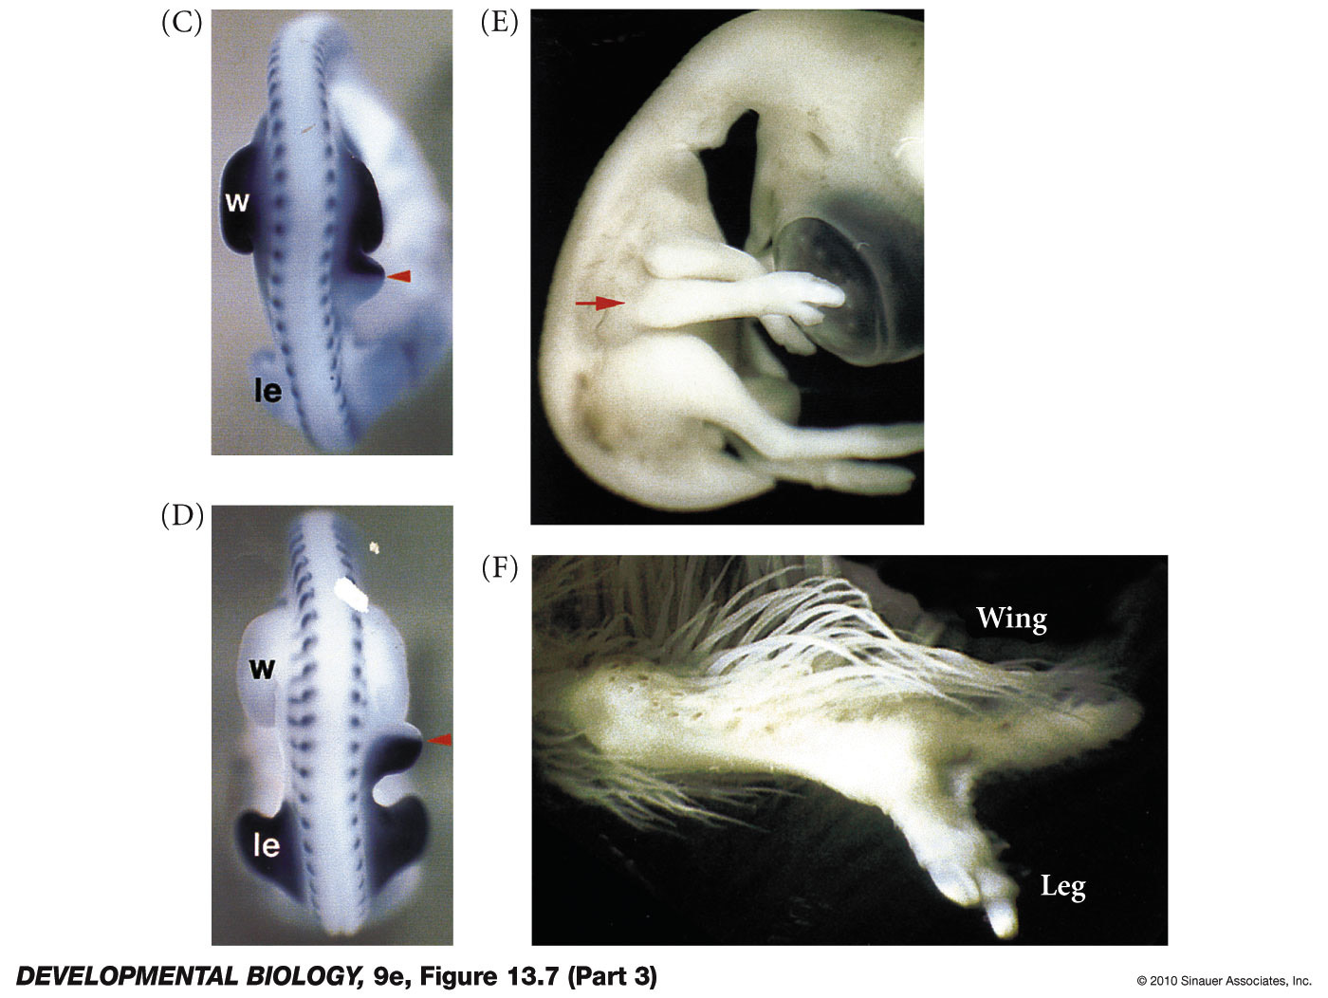
Tbx5 and Tbx4 (Pitx1) help distinguish fore and hind limb identity
also Pitx1 in hind limbs
TBX5 expression
Figure 19.10
TBX4 expression

Slide 9
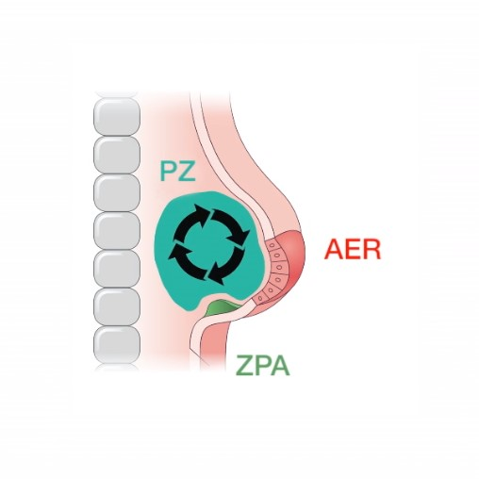
Limb bud developmental zones
AER – apical ectodermal ridge
ZPA – zone of polarizing activity
PZ – Progress zone

Slide 10
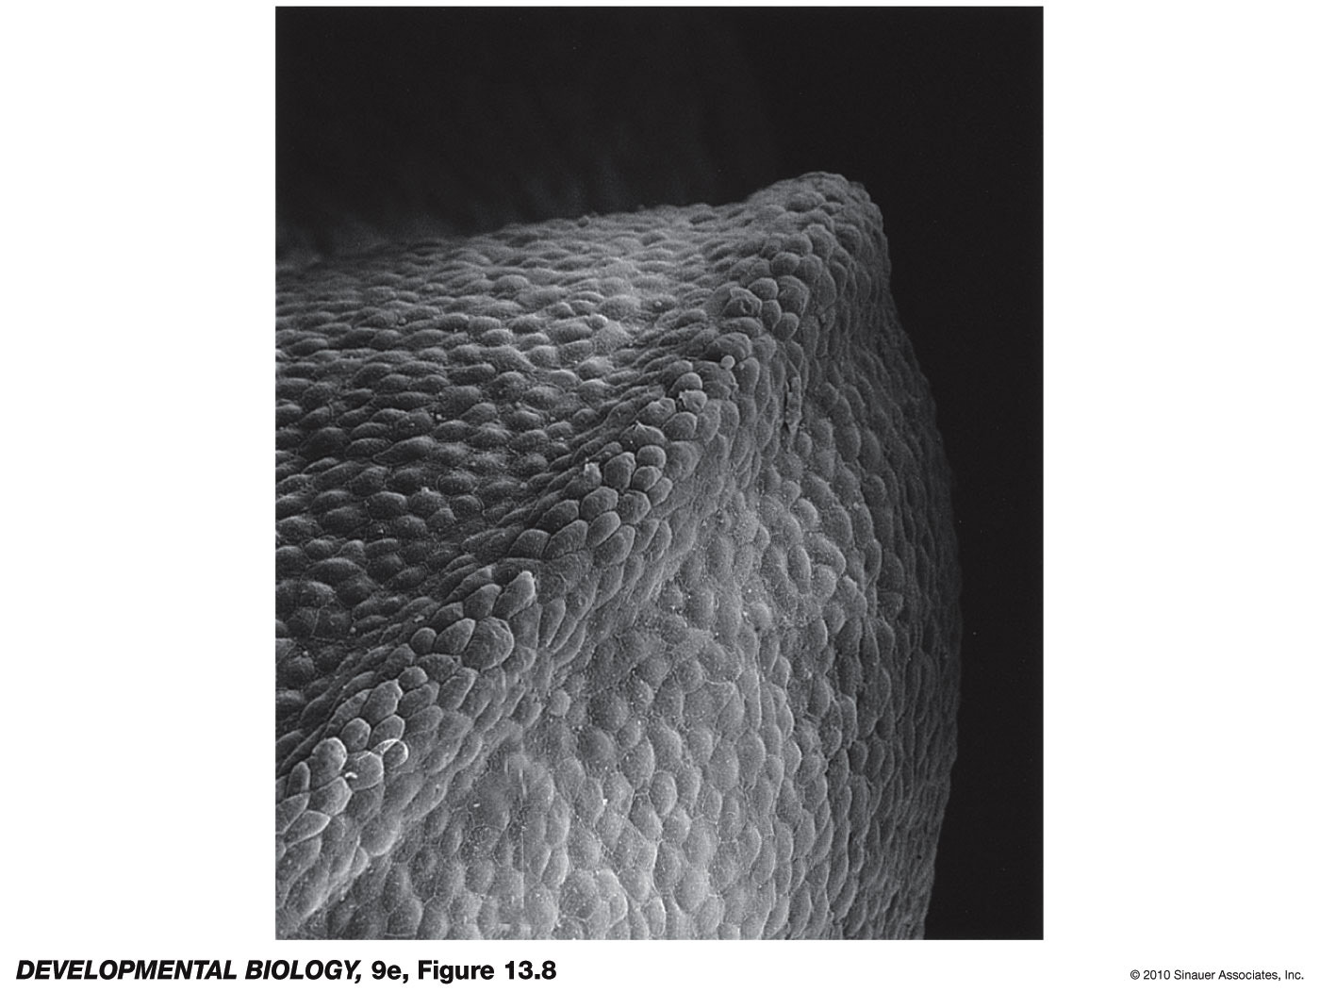
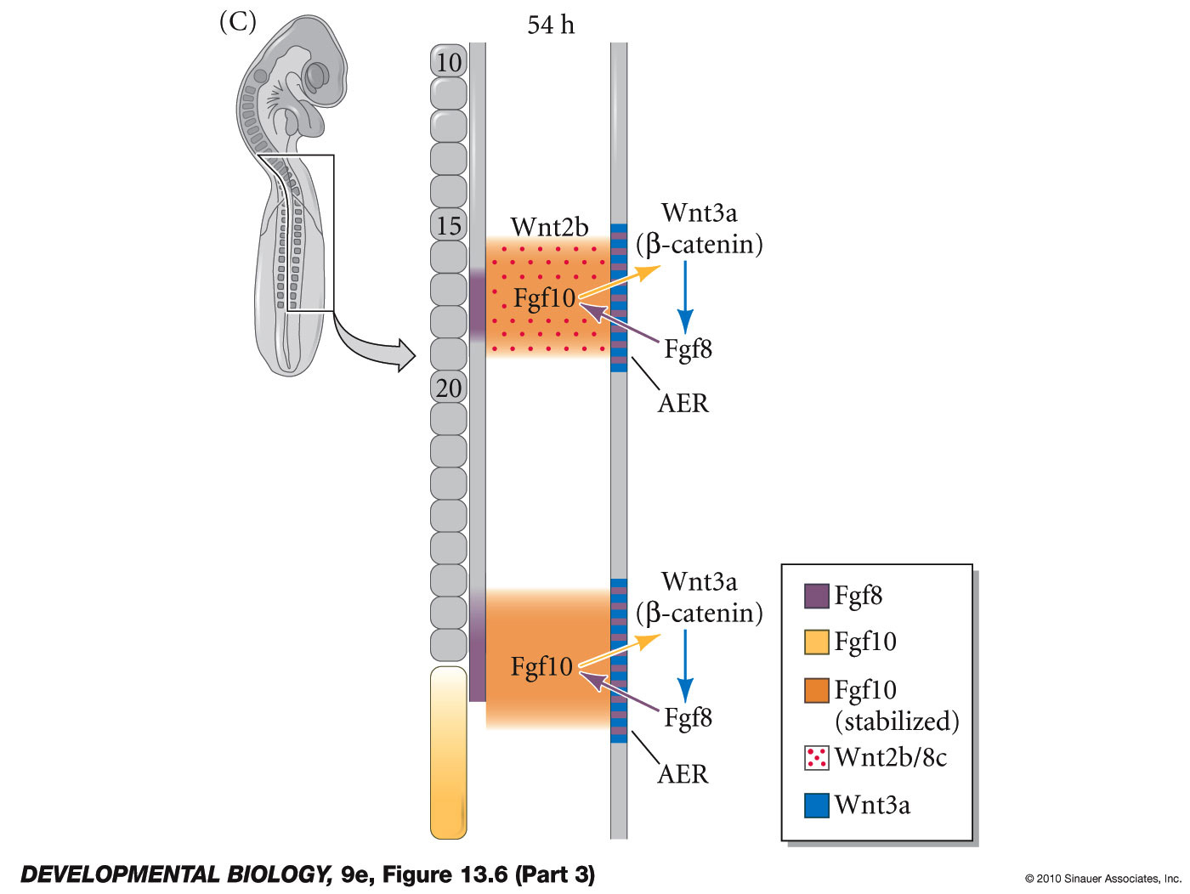
Apical Ectodermal Ridge (AER)
Fgf10 from mesenchyme (lateral plate mesoderm) induces AER that secretes fgf8
Fgf8 secretion maintains mesenchyme in plastic and dividing state
reinforcing paracrine loop
Mesenchymal/epidermal interaction

Slide 11
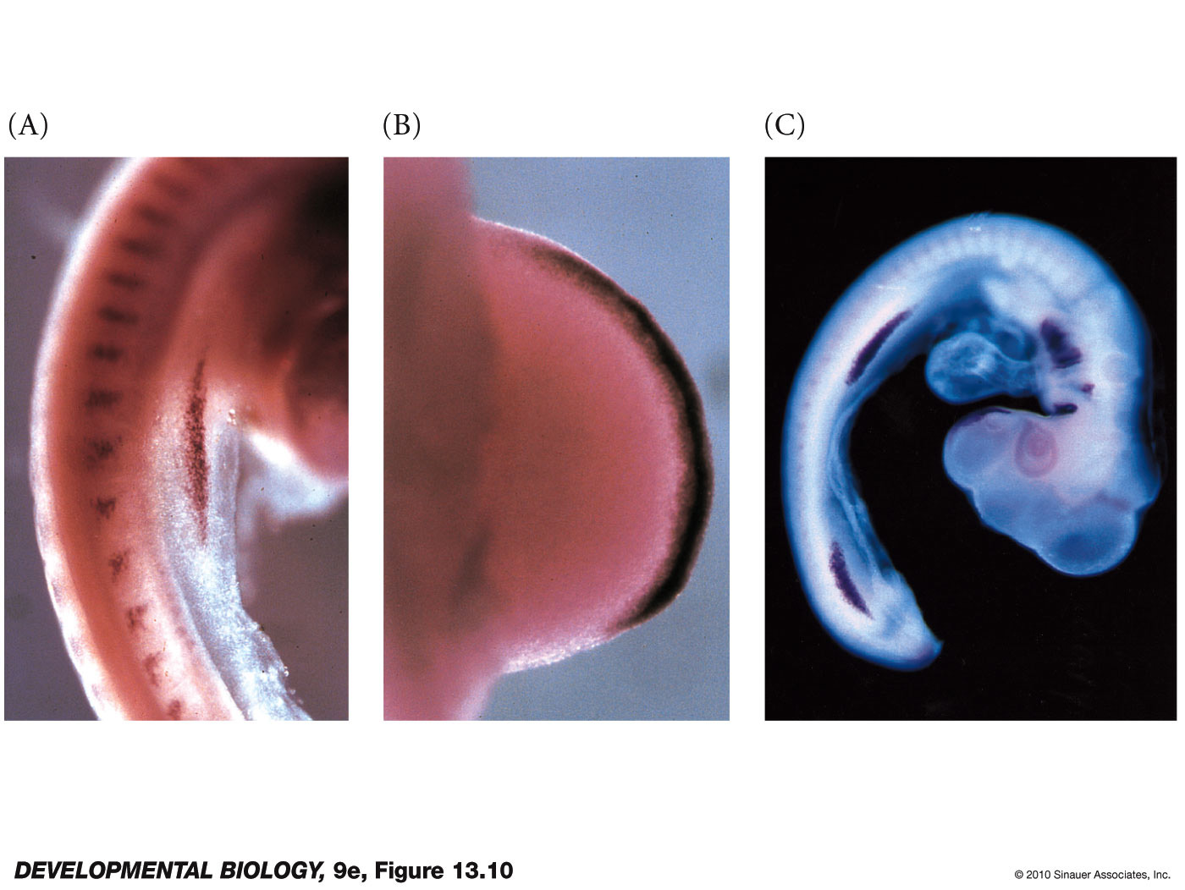
Fgf8 expression in AER

Slide 12
AER functions
Maintain mesenchyme – plastic and proliferating - allows proximal to distal growth
2) Maintain Shh for anterior to posterior axis (i.e. thumb to pinkie)
3) Coordinate anterior posterior and dorsal ventral axes

Slide 13
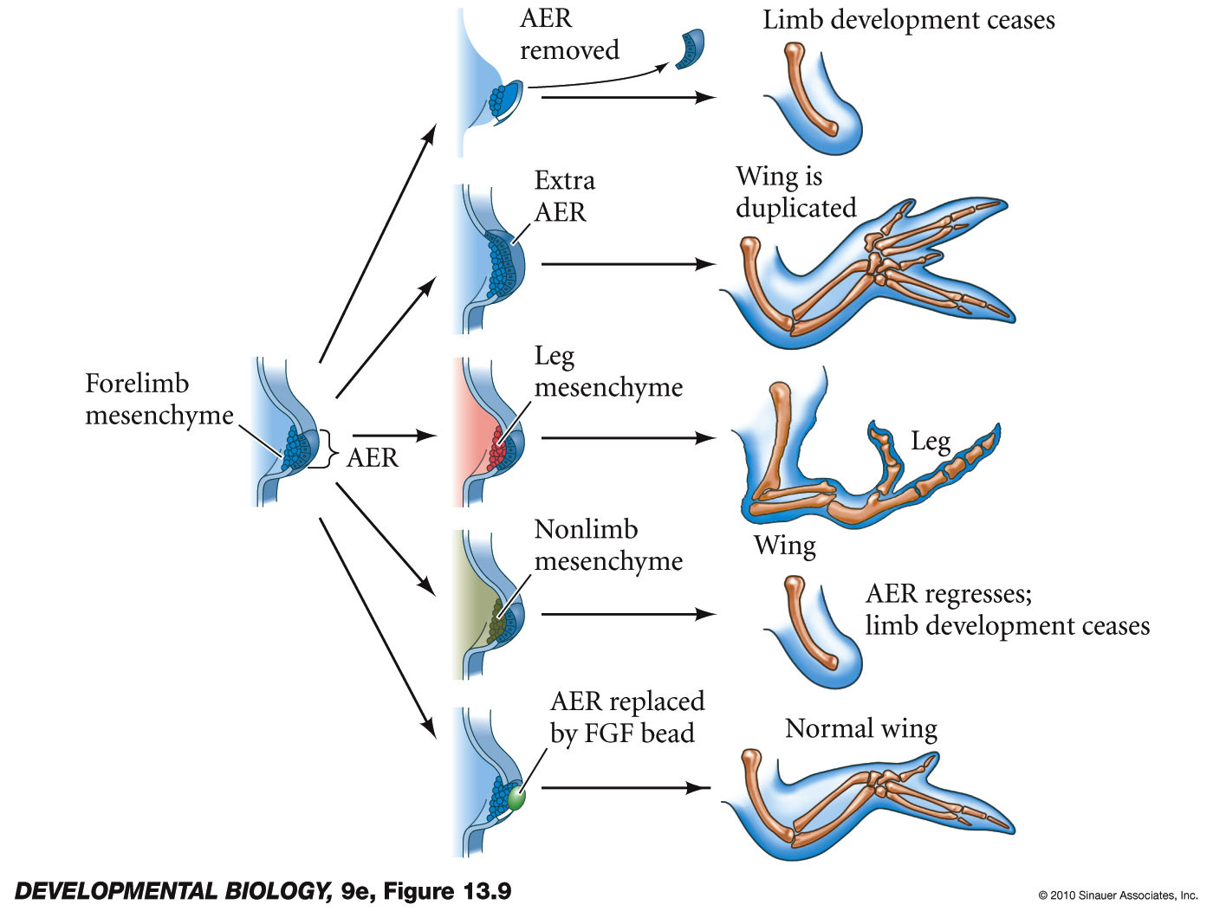
Fig 13.9 -

Slide 14
Fig 13.9 -

Slide 15
Fig 13.9 -

Slide 16
Fig 13.9 -

Slide 17
Fig 13.9 -

Slide 18
Fig 13.9 -

Slide 19
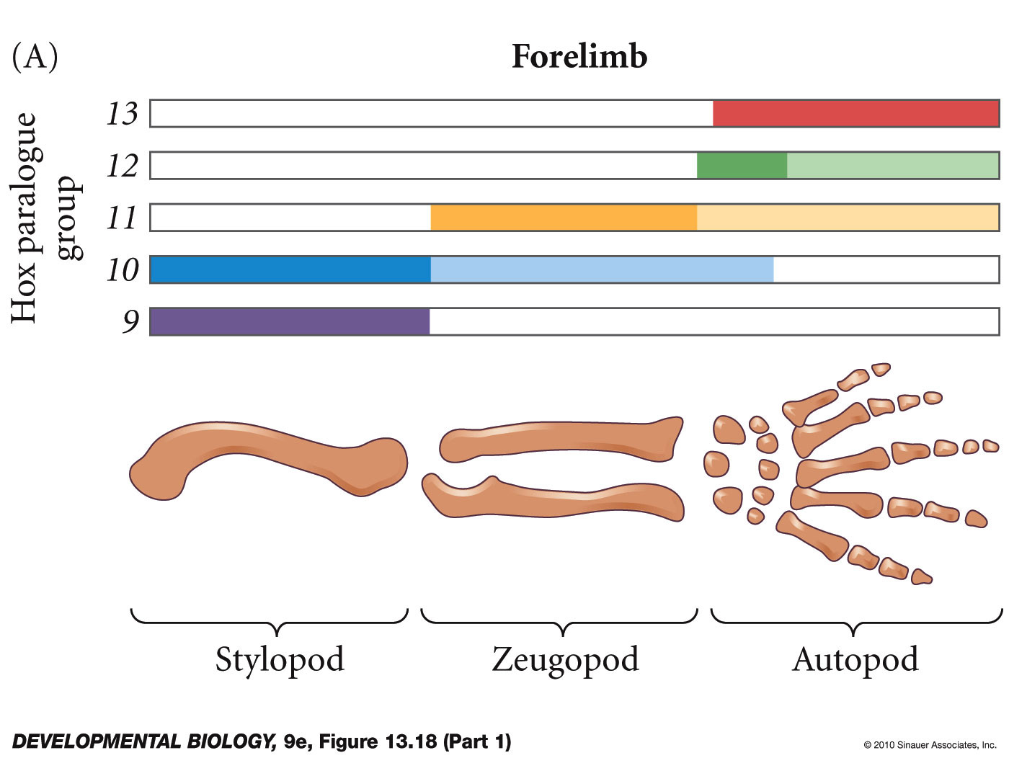
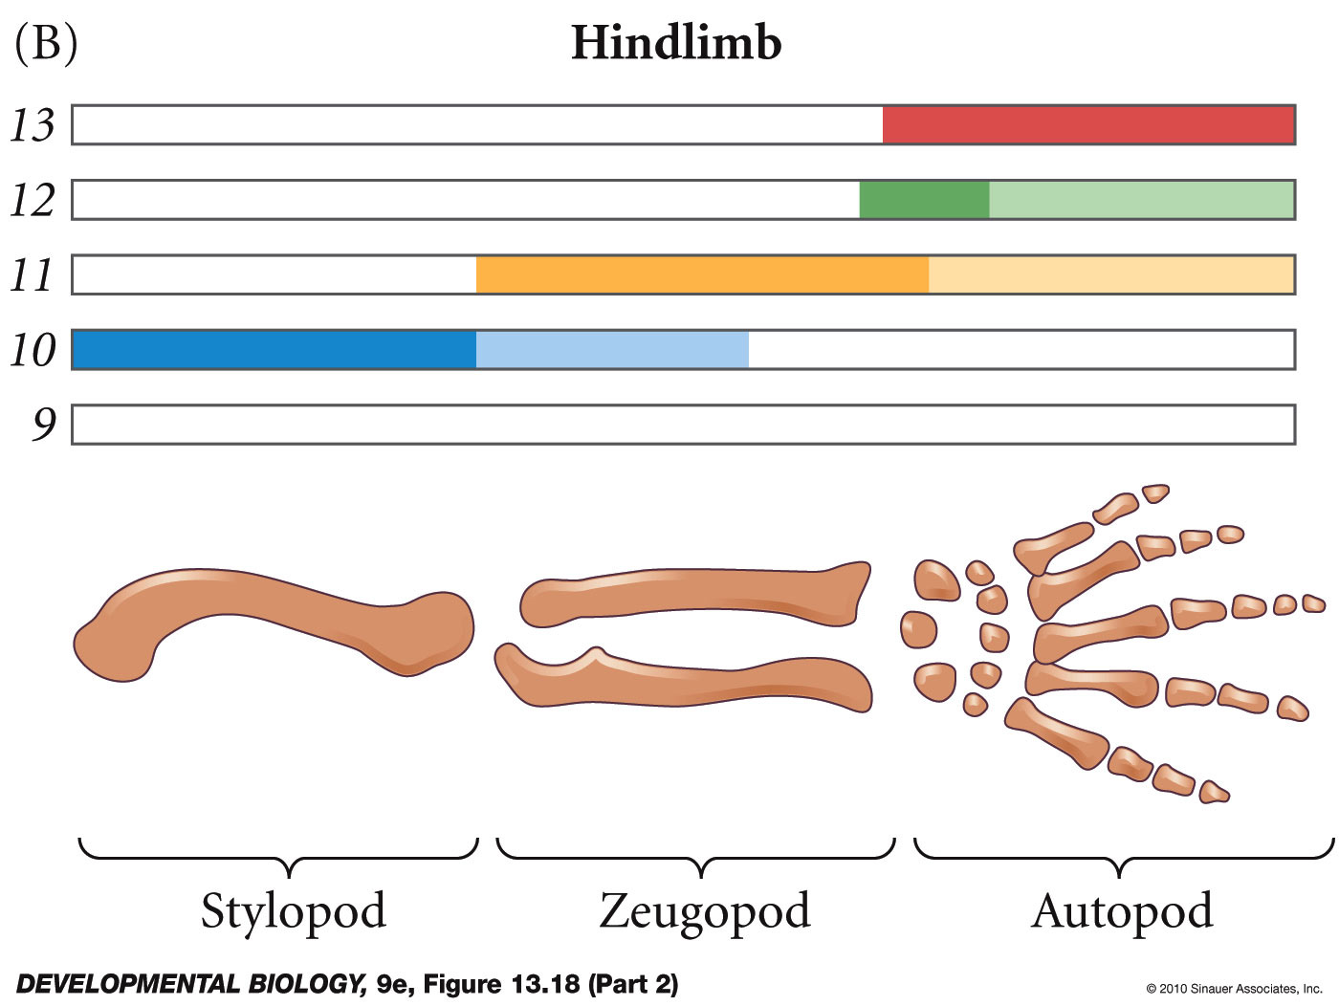
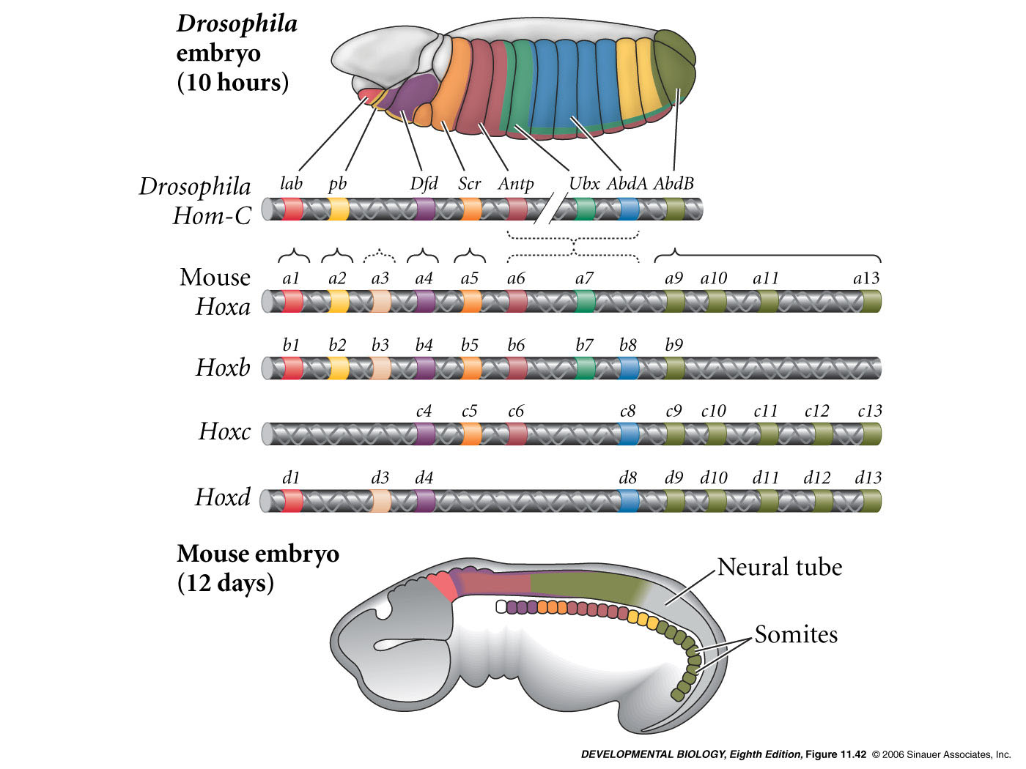
hox genes help specify identity of structures along proximal distal limb

Slide 20
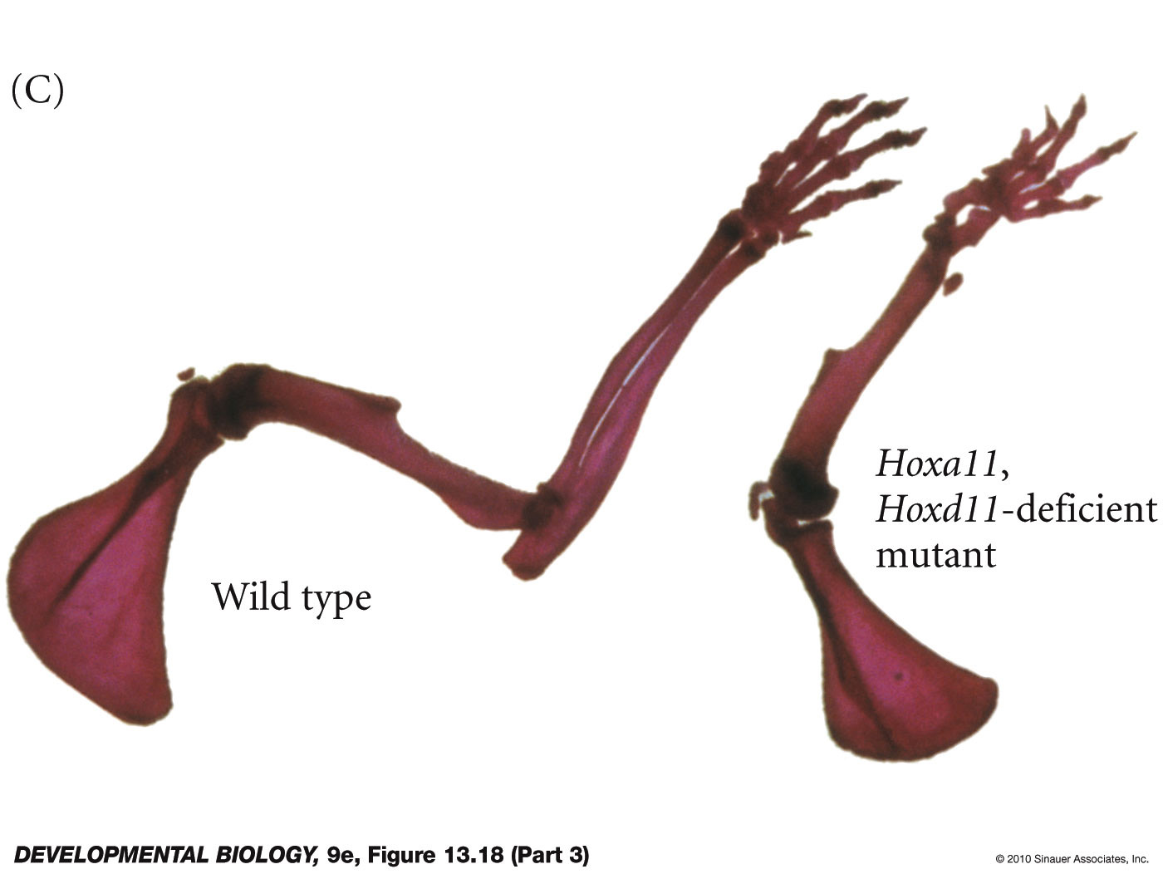
Hoxa11 Hoxd11 double mutants in mouse

Slide 21
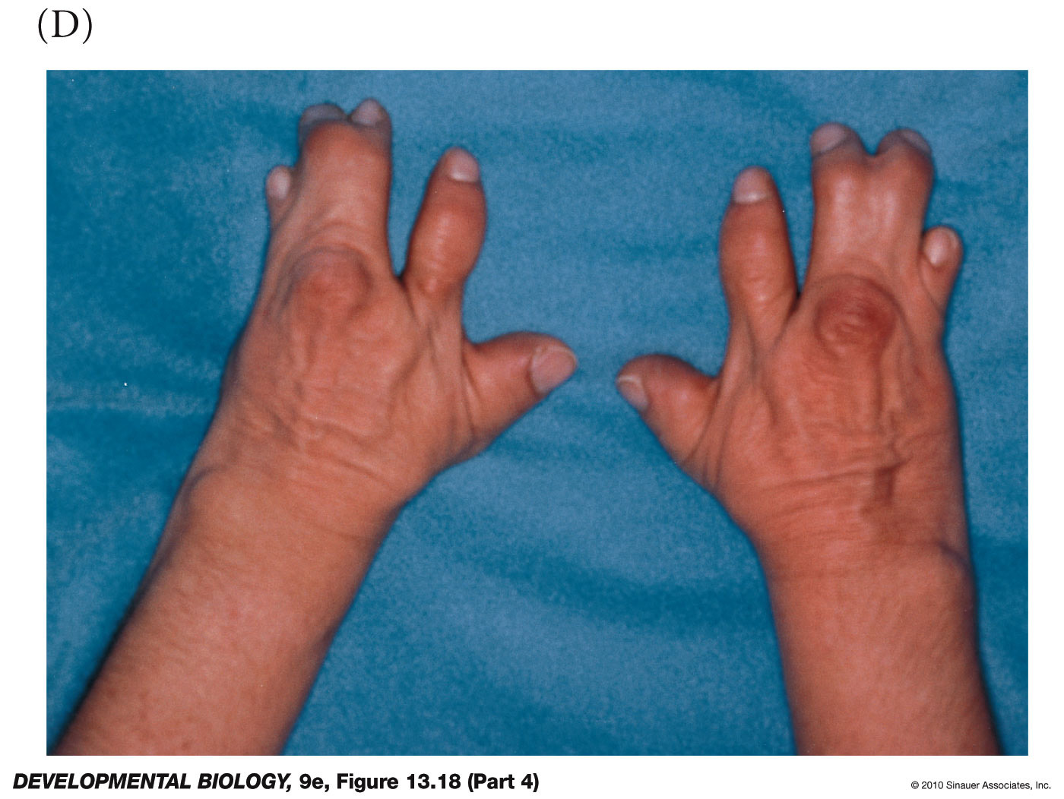
mutations in HoxD13 in human

Slide 22
Anterior to posterior limb polarity
Thumb to pinkie axis

Slide 23
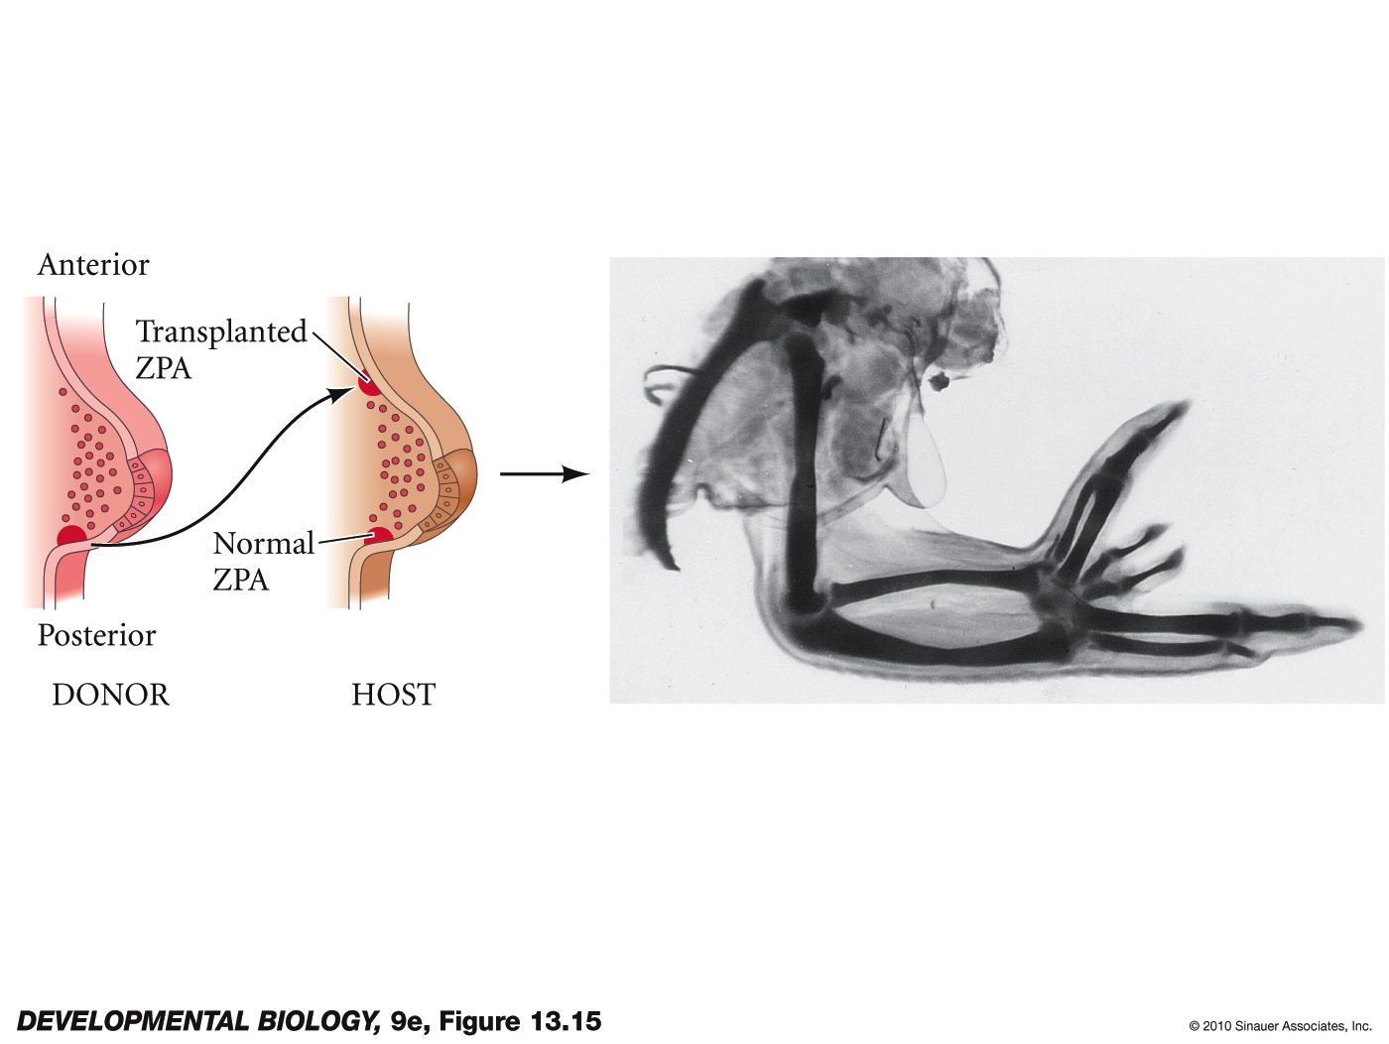
ZPA - zone of polarizing activity
transplant of ZPA induces extra digits with mirror image fates

Slide 24
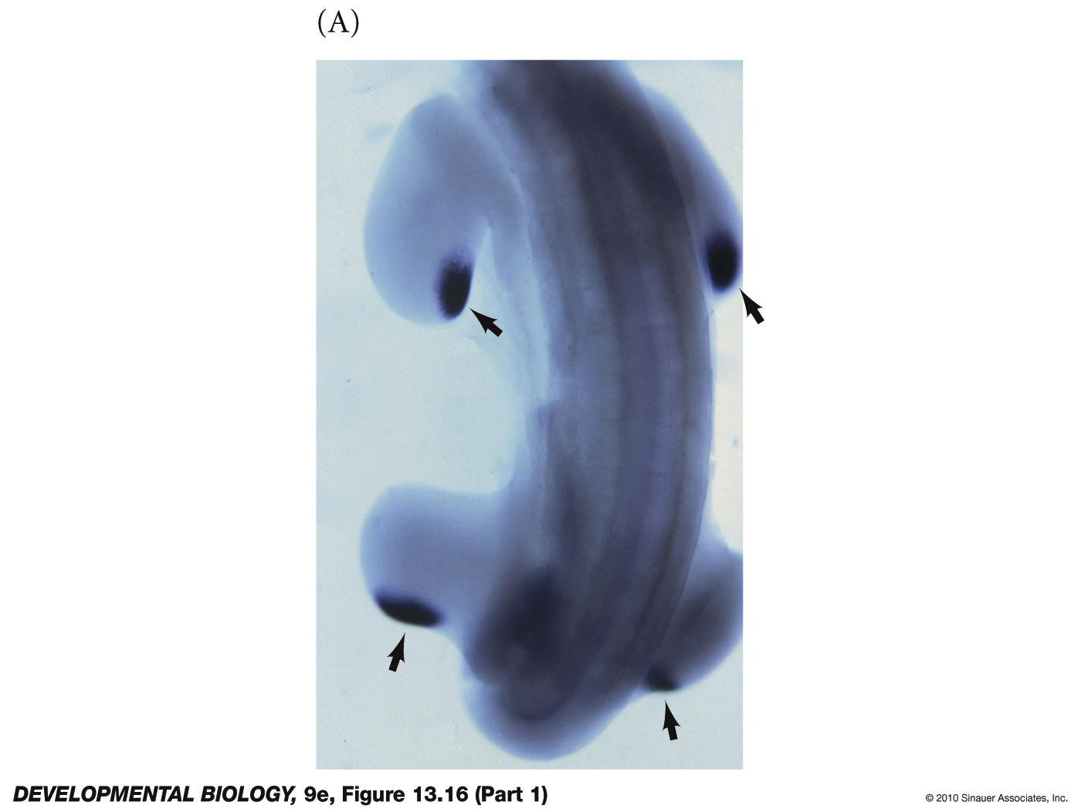
sonic hedgehog is active component of ZPA
Fig 19.20
chick limb buds express shh in posterior mesoderm

Slide 25
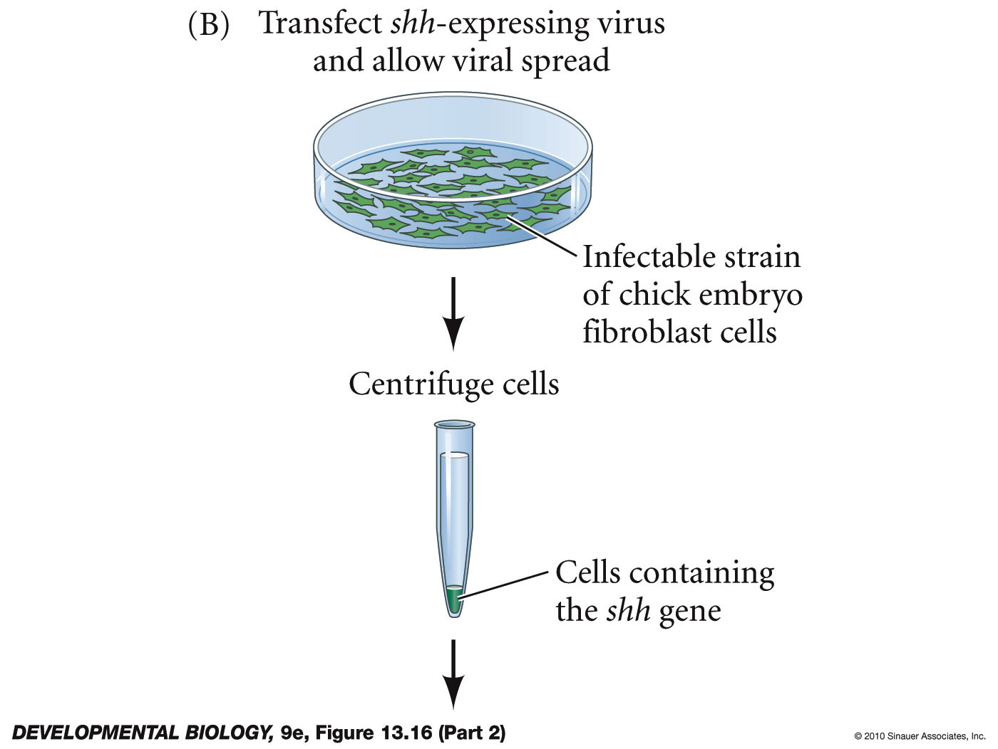
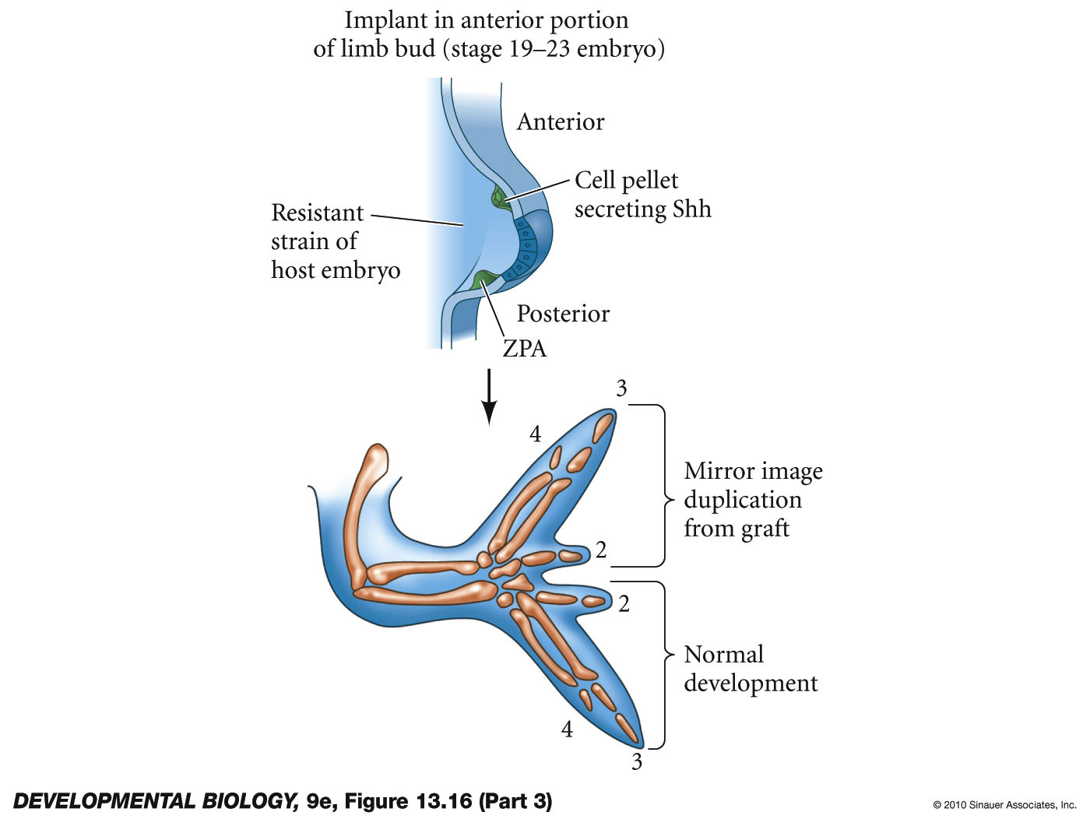
sonic hedgehog is active component of ZPA

Slide 26
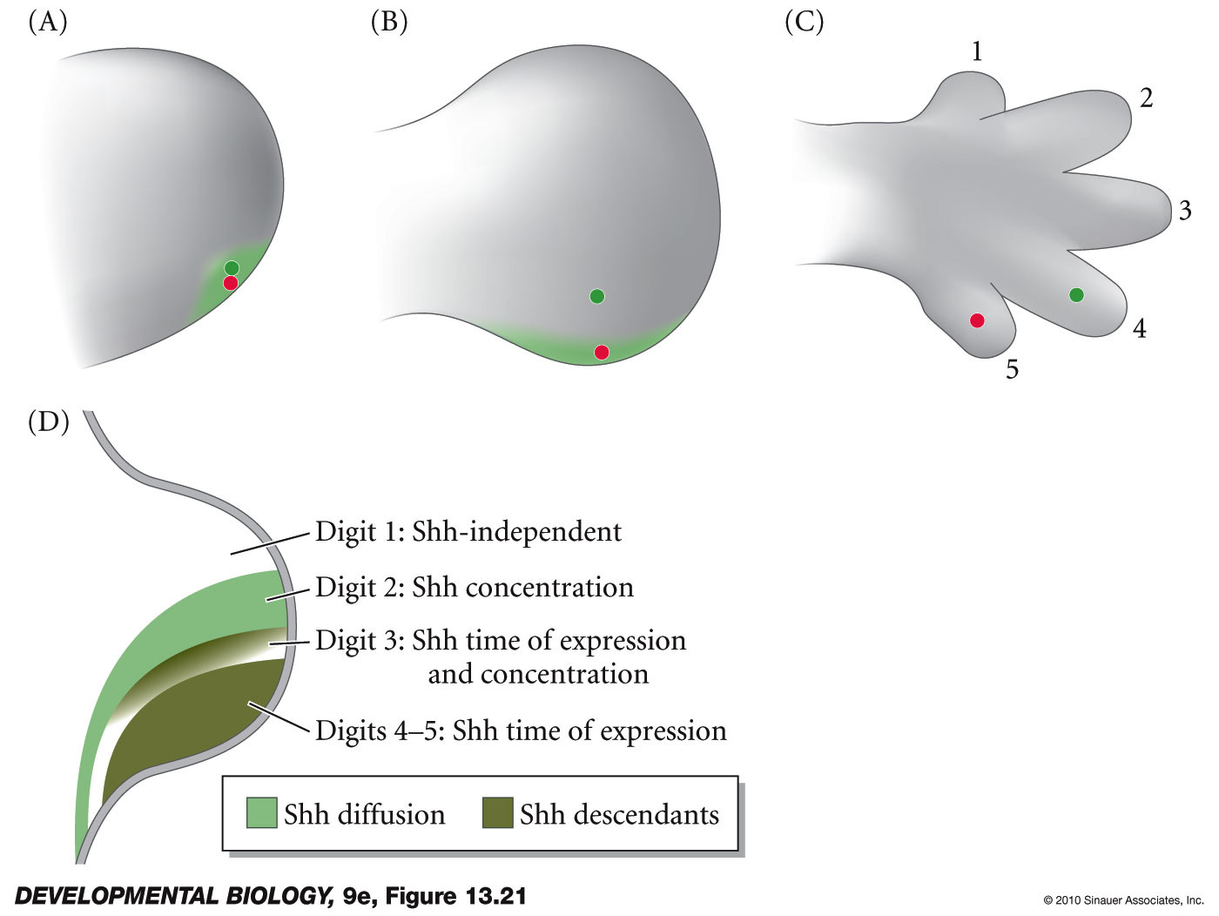
concentration and time of shh exposure determines digit fate
Fig 19.22
shh induces BMP pathway in interdigital webbing
Webbing is actually important in specifying identity of digit anterior to it before webbing undergoes apoptosis

Slide 27
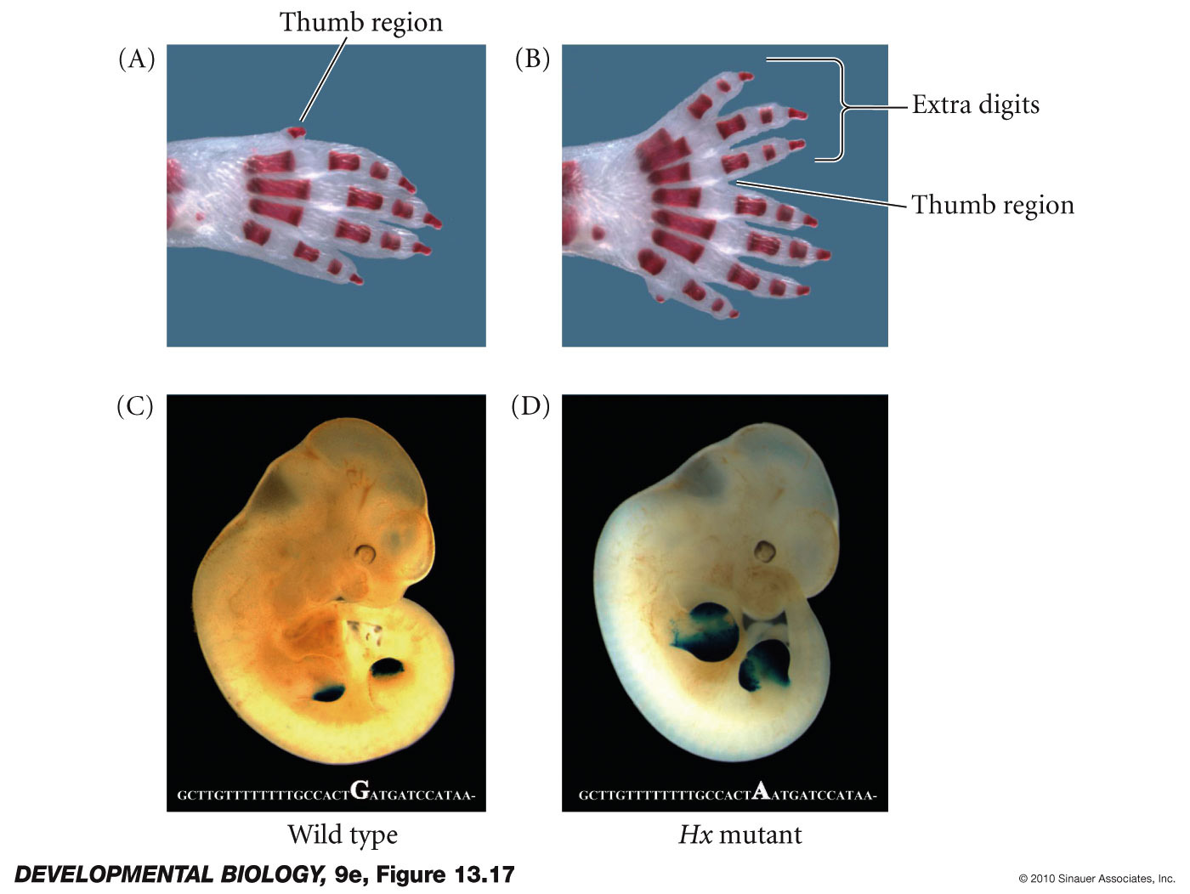
sonic hedgehog enhancer mutation
Fig 19.21
hemimelic extra-toes (Hx) mutant of mice
limb specific shh enhancer element mutation
generates an extra ectopic ZPA

Slide 28
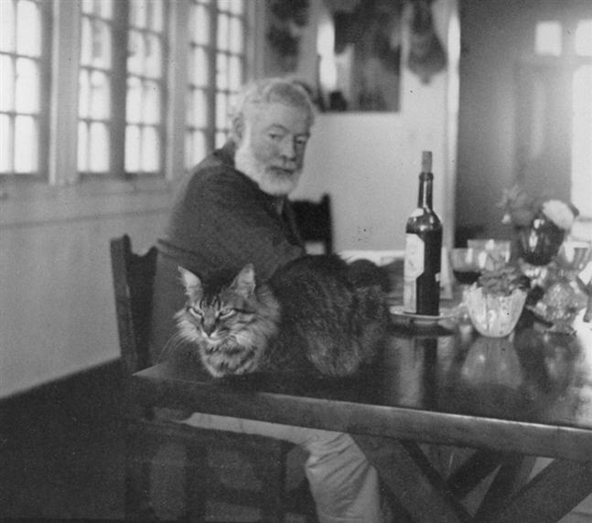
Ernest Hemingway
polydactyl cats
Good luck charms for Sea Captains
Sequence the conserved enhancer upstream of the shh gene. Find G to A change in this ZRS enhancer same as in mouse.

Slide 29
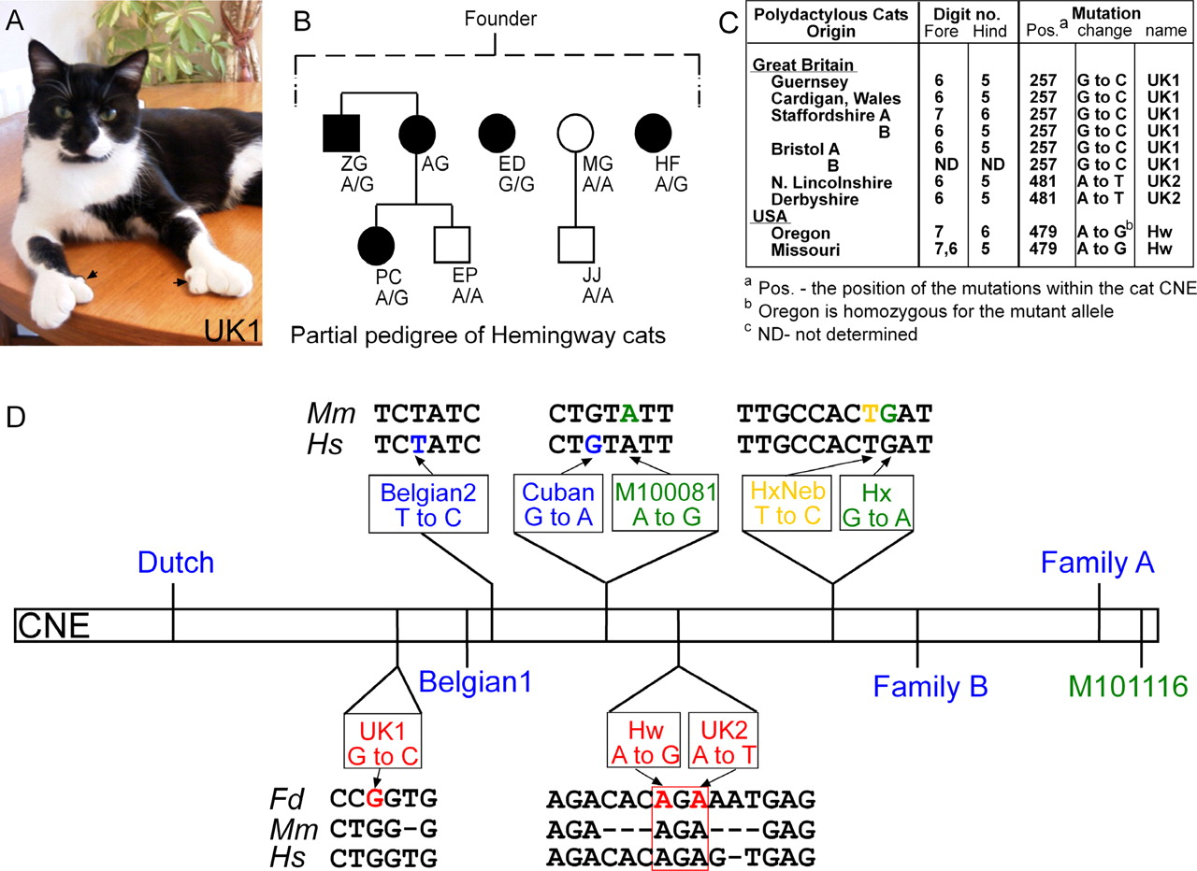
Genetic analysis of polydactylous cats and a summary of the mutations.
Laura A. Lettice et al. Hum. Mol. Genet. 2008;17:978-985
© 2007 The Author(s)‏
Notes:
Genetic analysis of polydactylous cats and a summary of the mutations. (A) Picture of a polydactylous cat (carrying the UK1 mutation) showing the extra digits on the fore paws (arrows). (B) A partial pedigree of the Hemingway cats that were sampled. All affected cats are presumably derived from a single founder. The affected cats are depicted with solid squares (males) and circles (females). The initials for each individual cat are shown and the genotype of each cat is shown below the initials. The wild-type allele has an A at position 481 of the cat sequence and the mutant allele a G. (C) List of the polydactylous cats from Great Britain and the USA showing the origin of each, the limb phenotype and mutation that was determined. (D) Summary of the 12 mutations that reside in the ∼800 bp conserved non-coding element (CNE, represented by rectangle). The relative position of the cat mutations are shown below. The position of the mutation is designated by red nucleotide and the surrounding sequence and corresponding sequence in mouse and human are shown (Fd, Felis domesticus; Mm, Mus musculus; and Hs, Homo sapiens). The conserved nucleotide triplet is designated by the red box. Other mutations used in the analysis are shown above the CNE. The name and the position of the mutations are shown (mutations identified in Hs are indicated in blue while Mm mutations are in green). The relative position of the human Cuban mutation and the mouse M100081 are shown and are one nucleotide apart. The 11 bp Hx subdomain is shown and the position of the Hx and HxNeb mutations are indicated.

Slide 30
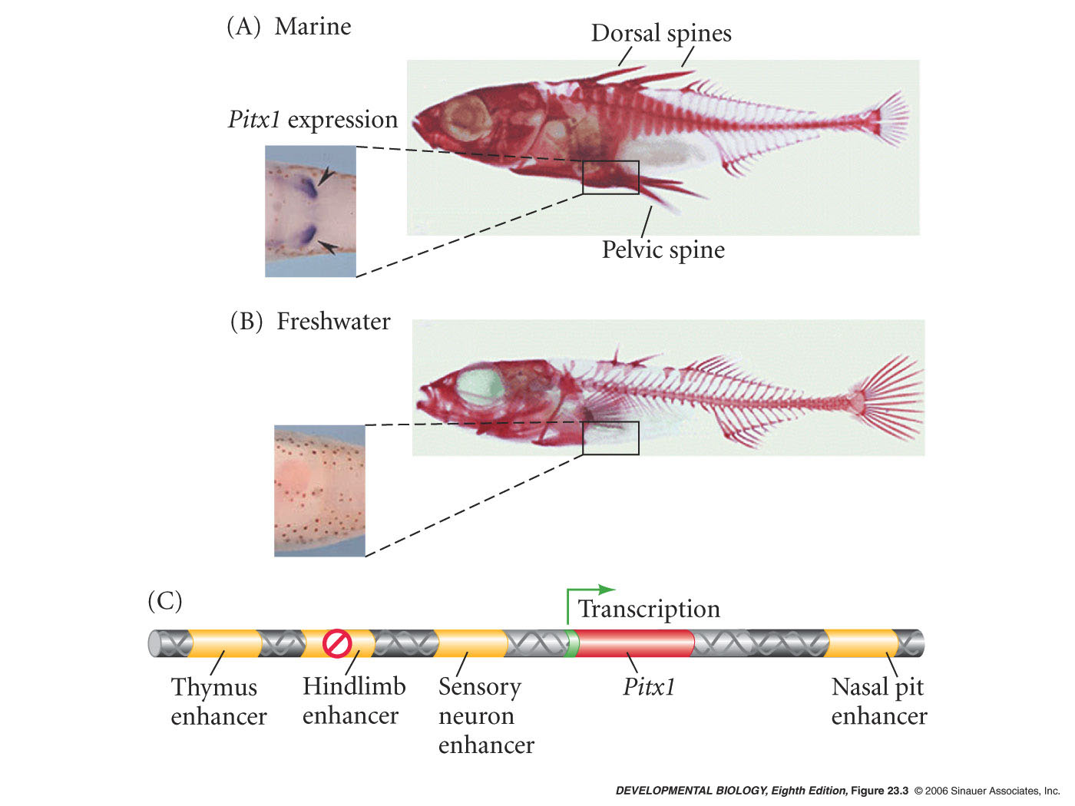
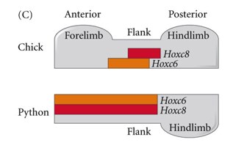
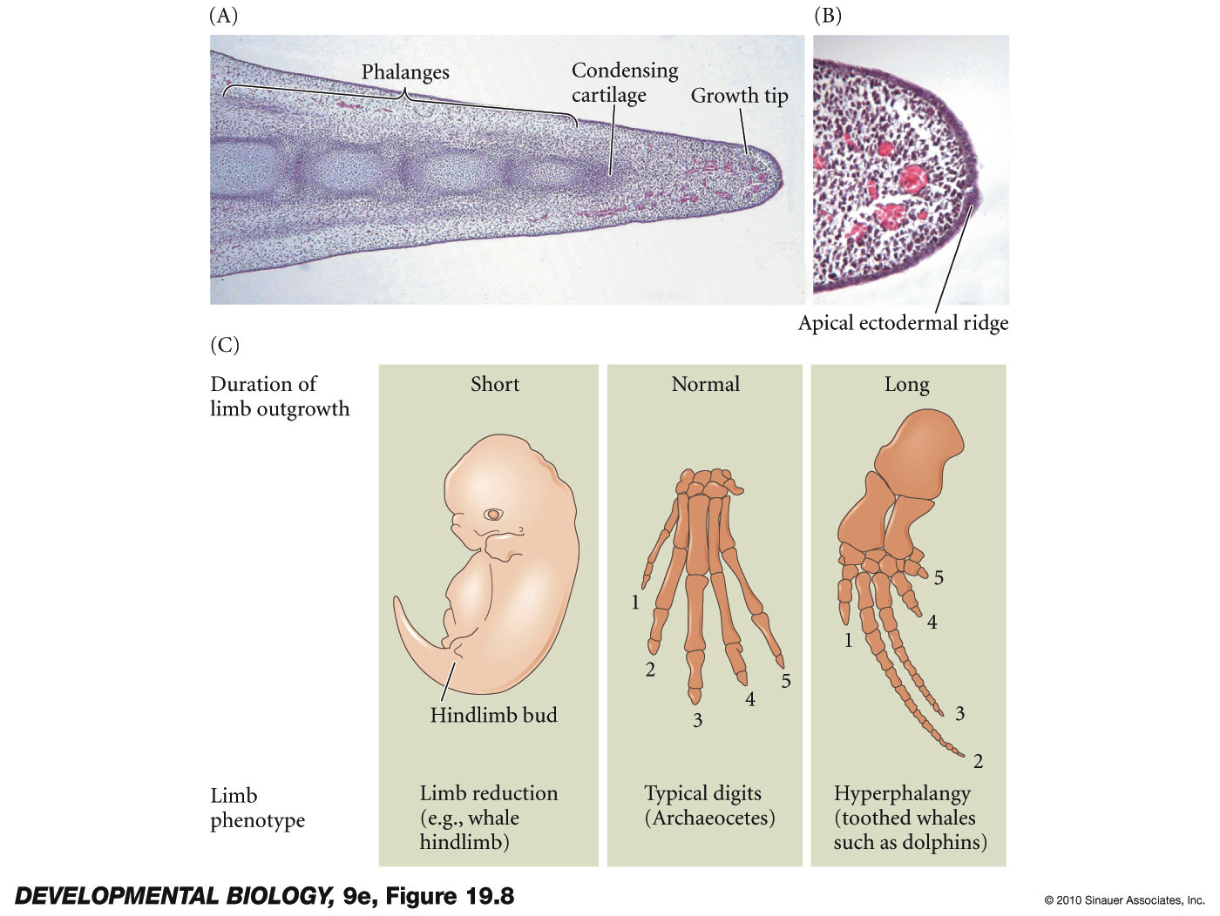
Different ways to alter limb development over evolutionary time
Stickle back fish hindlimb reduction – pelvic spine reduction – PitX TF expression is reduced specifically in early hindlimb limb bud.
Snakes – forelimb reduction – alteration of Hox6 and Hox8 gene expression prevents formation of limb bud in forelimb area. Expansion of thoracic vertebrae and ribs.
Whales – hindlimb reduction disruption of AER activity – molecular function unknown.
Dolphin forelimb (flipper) - heterochronic expression of FGF8 in phalanges.

Slide 31
ZRS – ZPA regulatory sequence is a enhancer element conserved across mammalian species
Making reporter constructs in mouse
• A mouse containing the mouse ZRS region with the different human mutations (Cuban, Belgian2)
• A mouse containing the human ZRS region with the different human mutations
• A mouse containing the mouse ZRS region with the different mouse mutations (M100081, Hx)
• A mouse containing the cat ZRS region with two of the different cat mutations (Hw and UK2)
• A mouse containing the mouse ZRS region with the two different cat mutations was created
Lettice, L. A., Hill, A. E., Devenney, P. S., & Hill, R. E. (2008). Point mutations in a distant sonic hedgehog cis-regulator generate a variable regulatory output responsible for preaxial polydactyly. Human Molecular Genetics, 17(7), 978-985. doi:10.1093/hmg/ddm370

Slide 32
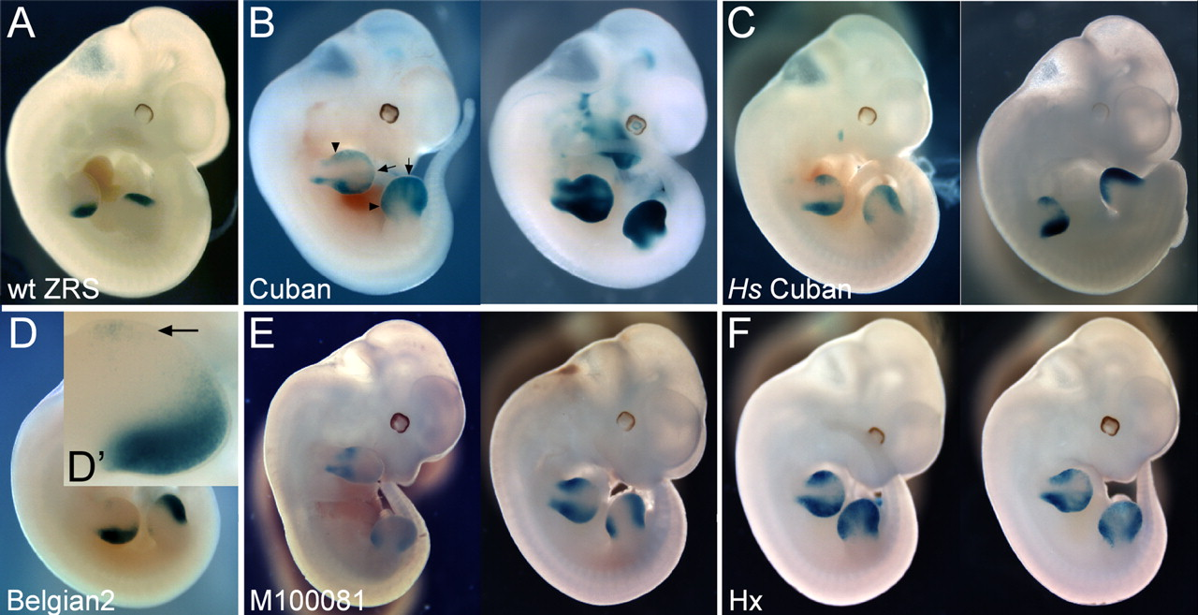
Transgenic analysis of the human and mouse mutations showing the variable expression output.
Laura A. Lettice et al. Hum. Mol. Genet. 2008;17:978-985
© 2007 The Author(s)‏
Notes:
Transgenic analysis of the human and mouse mutations showing the variable expression output. All embryos are at approximate stage E11.5. (A) The typical pattern of LacZ in transgenic embryos carrying the mouse wild-type (wt) ZRS. The stain resides at the posterior margins of both the fore and hind limbs. (B) Transgenic embryos carrying the human Cuban mutation on the mouse ZRS. Two embryos are shown to indicate that the pattern is consistent in embryos even when the overall level of expression differs. One embryo is designated to show the position of the ectopic expression along the anterior margin indicated by an arrowhead and the extension of the posterior to the distal margin by an arrow. The Cuban mutation on the human ZRS (Hs) is shown in (C). The expression does not extend as far into the interior of the limb as seen in (B). The Belgian2 mutation in (D) reveals a low level of anterior expression. The arrow in the D’ inset points to the cells expressing LacZ. (E) Expression of the mouse M100081 mutation one nucleotide removed from the Cuban mutation. Note that the expression pattern is similar to Cuban showing the extension to the distal edge. (F) Expression pattern of the Hx mutation with appreciable ectopic expression but the distal expression is not apparent.

Slide 33
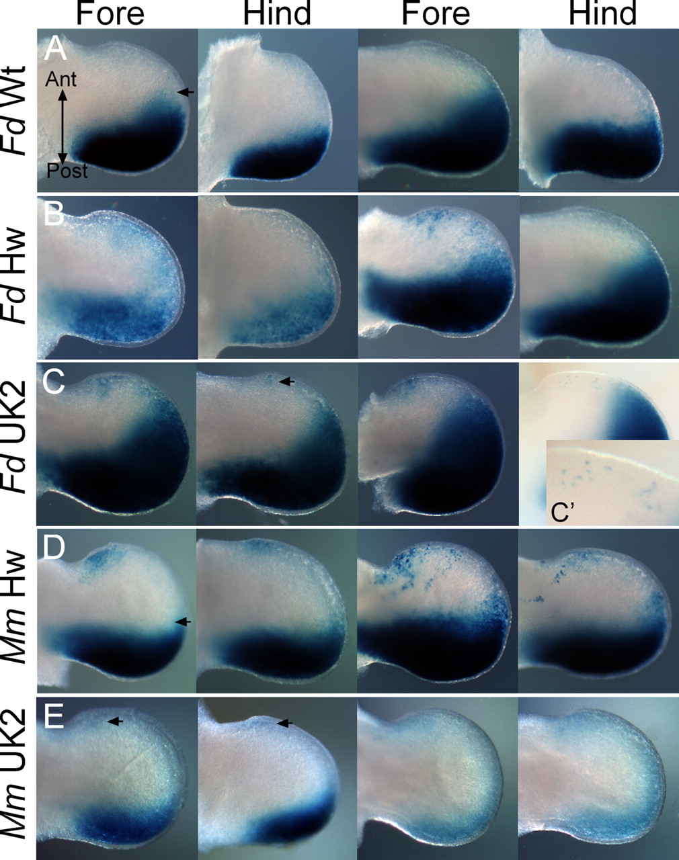
Limb bud expression in transgenic embryos expressing the cat mutations.
Laura A. Lettice et al. Hum. Mol. Genet. 2008;17:978-985
© 2007 The Author(s)‏
Notes:
Limb bud expression in transgenic embryos expressing the cat mutations. The fore and hind limb buds from two embryos for each transgenic construct are shown. (A) LacZ expression from the cat wild-type ZRS. In all limb buds shown, the view is from the dorsal side and the anterior and posterior axes are indicated. Posterior expression occasionally extended along the distal margin (indicated by arrow). (B and C) Expression of the Hemingway (Hw) and the UK2 cat mutations, respectively, which reside in a conserved nucleotide triple separated by one basepair. (B) Ectopic expression at the anterior margin is detected only in the fore limbs. Expression is lower in the anterior than the posterior and often appears in patches of cells. In (C) ectopic, anterior expression is also detected in the hindlimbs. The inset C' shows labelled cells scattered along the anterior margin at a higher magnification. (D and E) Expression of the Hw and the UK2 mutations, respectively, contained in the mouse ZRS. Expression in (D) occurs in the ectopic domain in both the hind and the fore limbs. UK2 mutation (E) shows low anterior expression in both fore and hind limbs.

