Slide 1
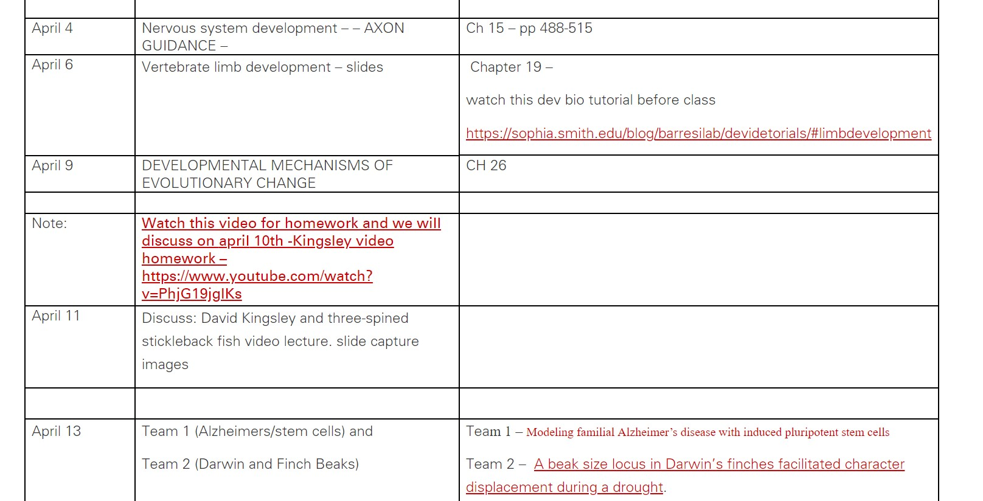
Watch Kingsley video for discussion April 11th
Everyone is responsible for explanation of figures/images from the video slide presentation. I am not assigning figures. All of you will be responsible and called upon at random.

Slide 2
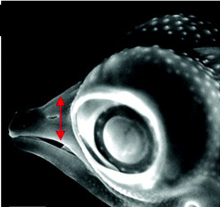
Developmental Mechanisms of Evolutionary Change

Slide 3
Developmental Mechanisms of Evolutionary Change
Evolutionary Developmental Biology - EvoDevo
Goal: explain the diversity of life on Earth

Slide 4
Types of Evolutionary change
Macroevolutionary Change - changes between different species
Microevolutionary Change - changes within a given species

Slide 5
Speciation
Hypothesis: Speciation can be caused by heritable changes in development
Compatible with population biology explanations - changes in gene frequencies between generations

Slide 6
How can developmental programs be altered and yet still produce viable organisms?

Slide 7
Preconditions for Macroevolutionary Change
Duplication and Divergence
Modules - dissociable parts

Slide 8
Modules
Units of development that can be dissociated
Molecular
gene enhancers

Slide 9
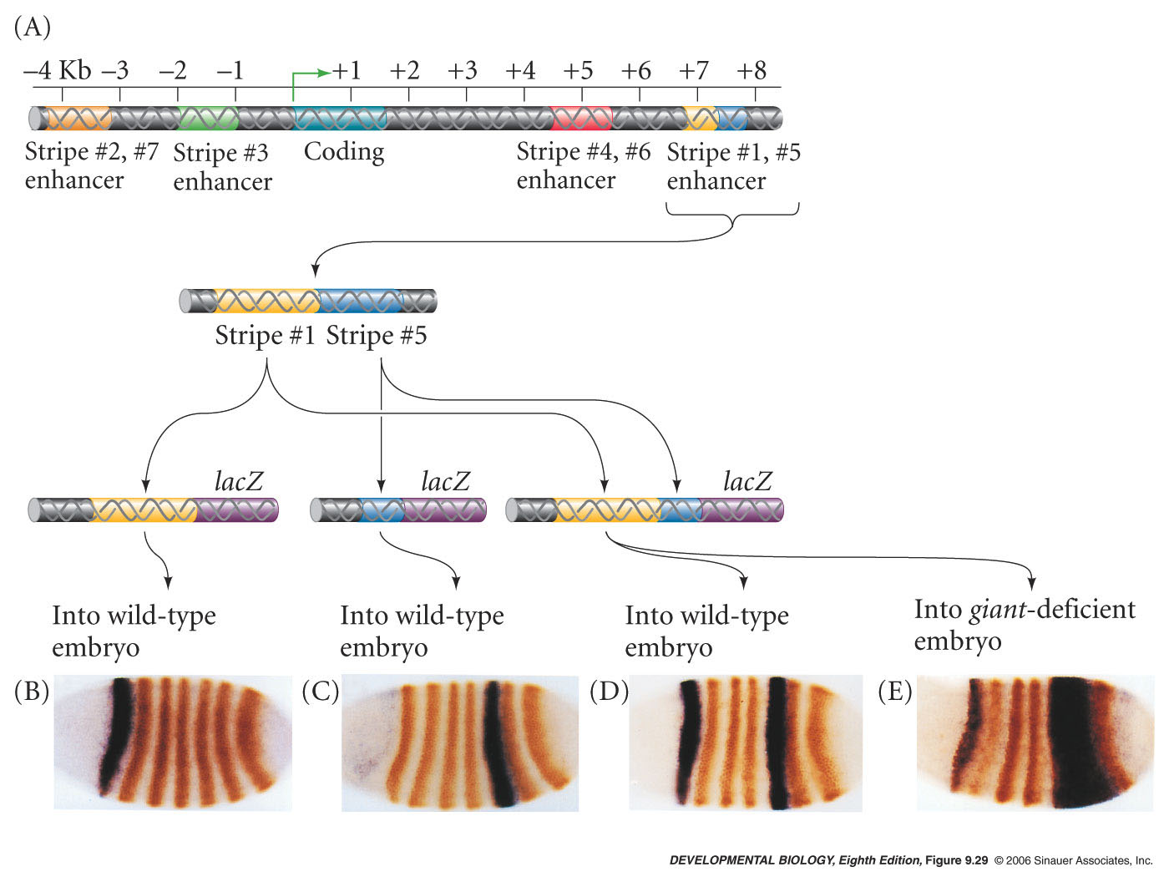
Gene Enhancers are Modular
Function independently
Can be mutated independently
Drosophila pair rule stripes

Slide 10
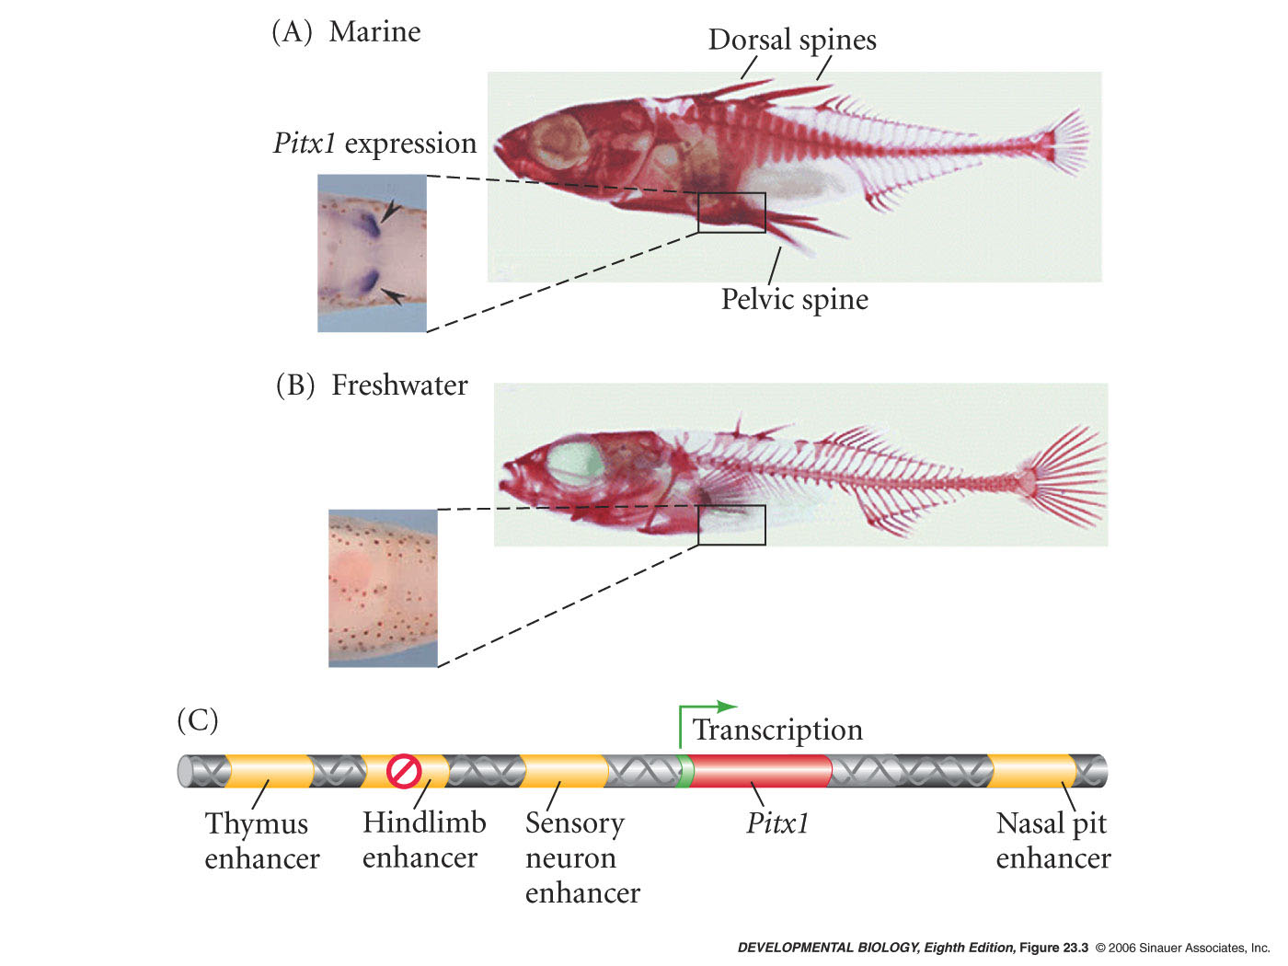
Three spine stickleback fish
Figure 26.1
Quantitative trait Loci (QTL) analysis – link genotype to phenotype – multigenic – major effect

Slide 11
Three spine stickleback fish
Fresh water species thought to have evolved from the Marine species about 12, 000 years ago
spine vs. no spine
can still cross the two species
look for genes associated with absence of spine
Marine species
Fresh water species
David Kingsley

Slide 12
Three spine stickleback fish
Region of Chromosome 7
Pitx1 - candidate transcription factor gene (from mouse work)
Amino acid sequences of marine Pitx1 and freshwater Pitx1 were identical
Expression patterns were different
Mutation in an enhancer element in freshwater species
David Kingsley

Slide 13
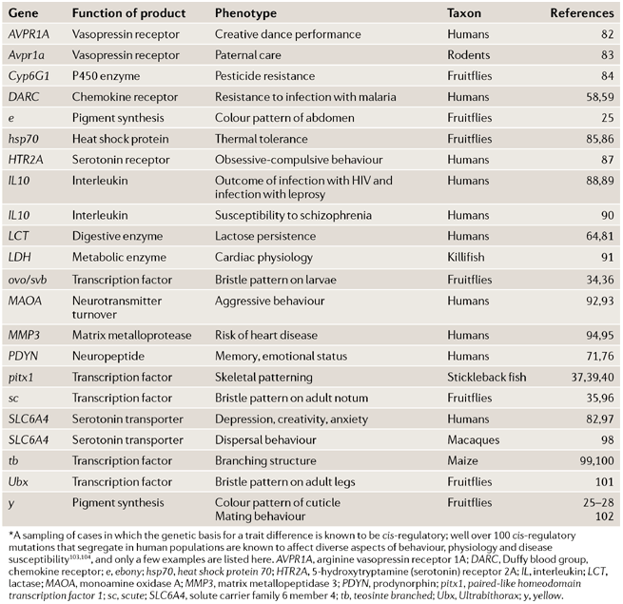
Cis-regulatory mutations associated with a trait difference
Lactose persistence
Wray Nature Reviews Genetics 8, 206–216 (March 2007) | doi:10.1038/nrg2063

Slide 14
Evolution Still in Humans?
Cis-regulatory mutations in human populations
LCT gene encodes lactase - ability to digest lactose from milk
likely evolved in association with pastoralism (7,500 years ago)
mutations in cis-regulatory region increase expression of LCT in adult
independently evolved four times
Wray Nature Reviews Genetics 8, 206–216 (March 2007) | doi:10.1038/nrg2063

Slide 15
Evolution still in humans?
NY Times – Science Section
Scientists Cite Fastest Case of Human Evolution
JULY 1, 2010
Comparing the genomes of Tibetans and Han Chinese, the majority ethnic group in China, the biologists found that at least 30 genes had undergone evolutionary change in the Tibetans as they adapted to life on the high plateau.
3,000 years (but could be more like 7-10K)
Hypoxia-inducible factor 2-alpha, or HIF2a. - Tibetans with the favored version have fewer red blood cells and hence less hemoglobin in their blood.
The finding explains why Tibetans do not get mountain sickness but raises the question of how they compensate for the lack of oxygen if not by making extra red blood cells
http://nyti.ms/1HsLHYu

Slide 16
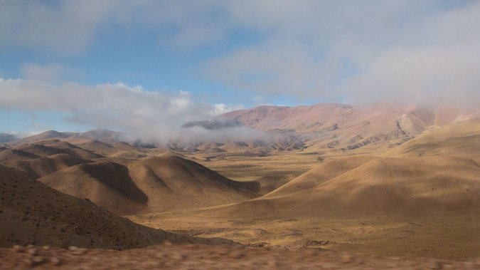
Evolution still in humans?
Science Times - NY Times
An Unlikely Driver of Evolution: Arsenic
MARCH 12, 2015
http://nyti.ms/19eHixM
Atacama Desert straddles the Andes Mountains, reaching into parts of Chile, Peru, Bolivia and Argentina.
The people who carried the protective mutation were able to detoxify the arsenic faster, perhaps by making extra copies of the AS3MT enzyme. AS3MT is a liver enzyme that helps detoxify.

Slide 17
Mechanisms of Macroevolutionary Change
Changes in gene expression
Heterotopy - change in the location
Heterochrony - change in the timing
Heterometry - change in the amount
Heterotypy - change in the kind
DEVO

Slide 18
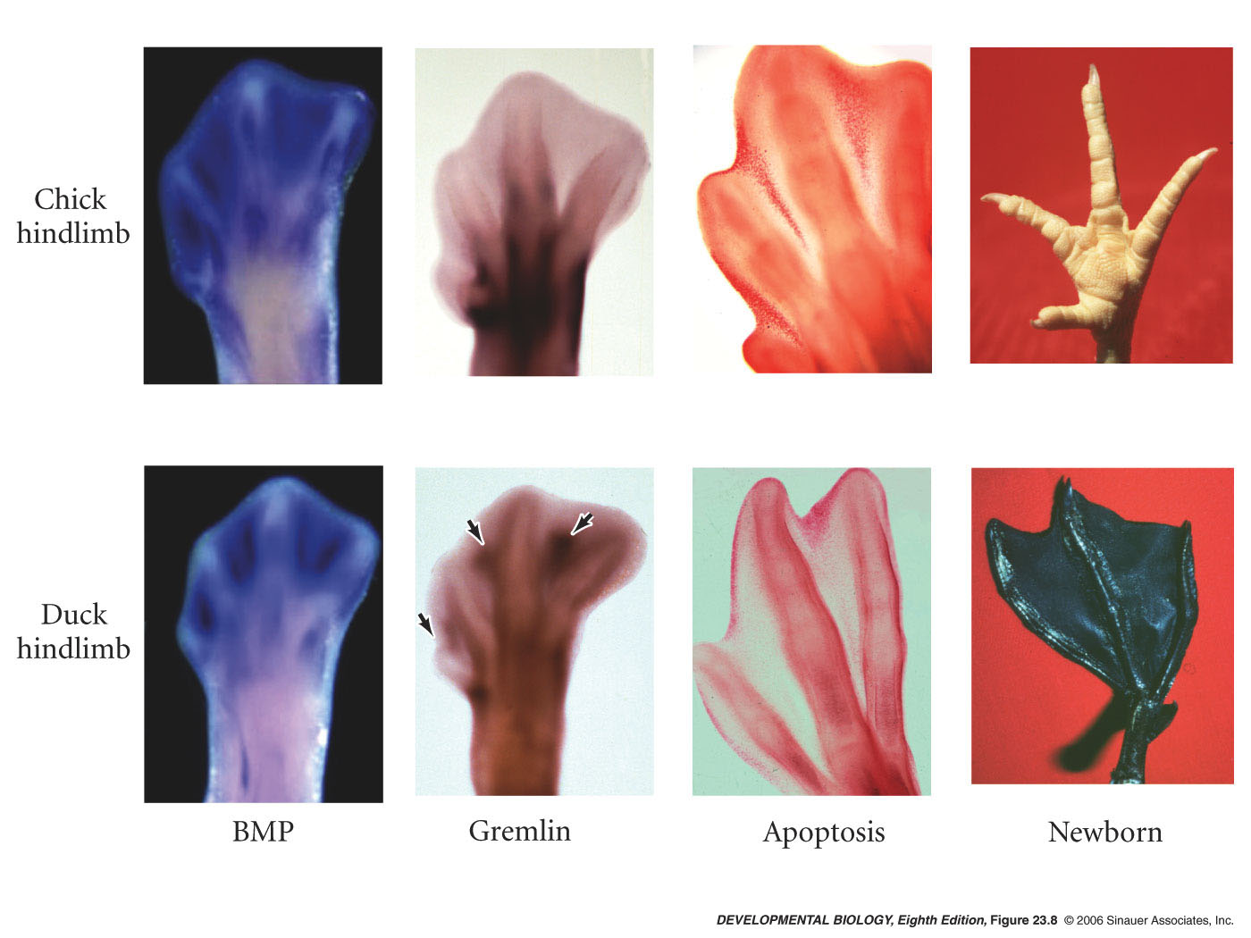
Heterotopy
Change in the location of gene expression
Gremlin gene - inhibitor of BMP
BMP initiates apoptosis
location of gremlin gene expression alters structure of foot
Gilbert p650 Ch19 – edition 11.

Slide 19
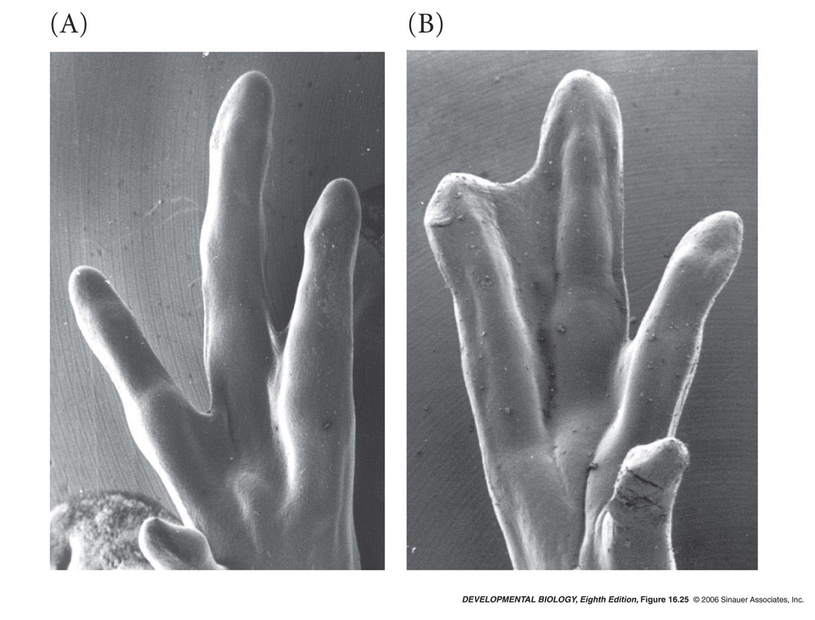
Chick foot development
Experimental manipulation on developing chicken foot
soak beads in Germlin protein
place beads between toes of developing chicken
webbing is maintained
negative control beads
gremlin-soaked beads

Slide 20
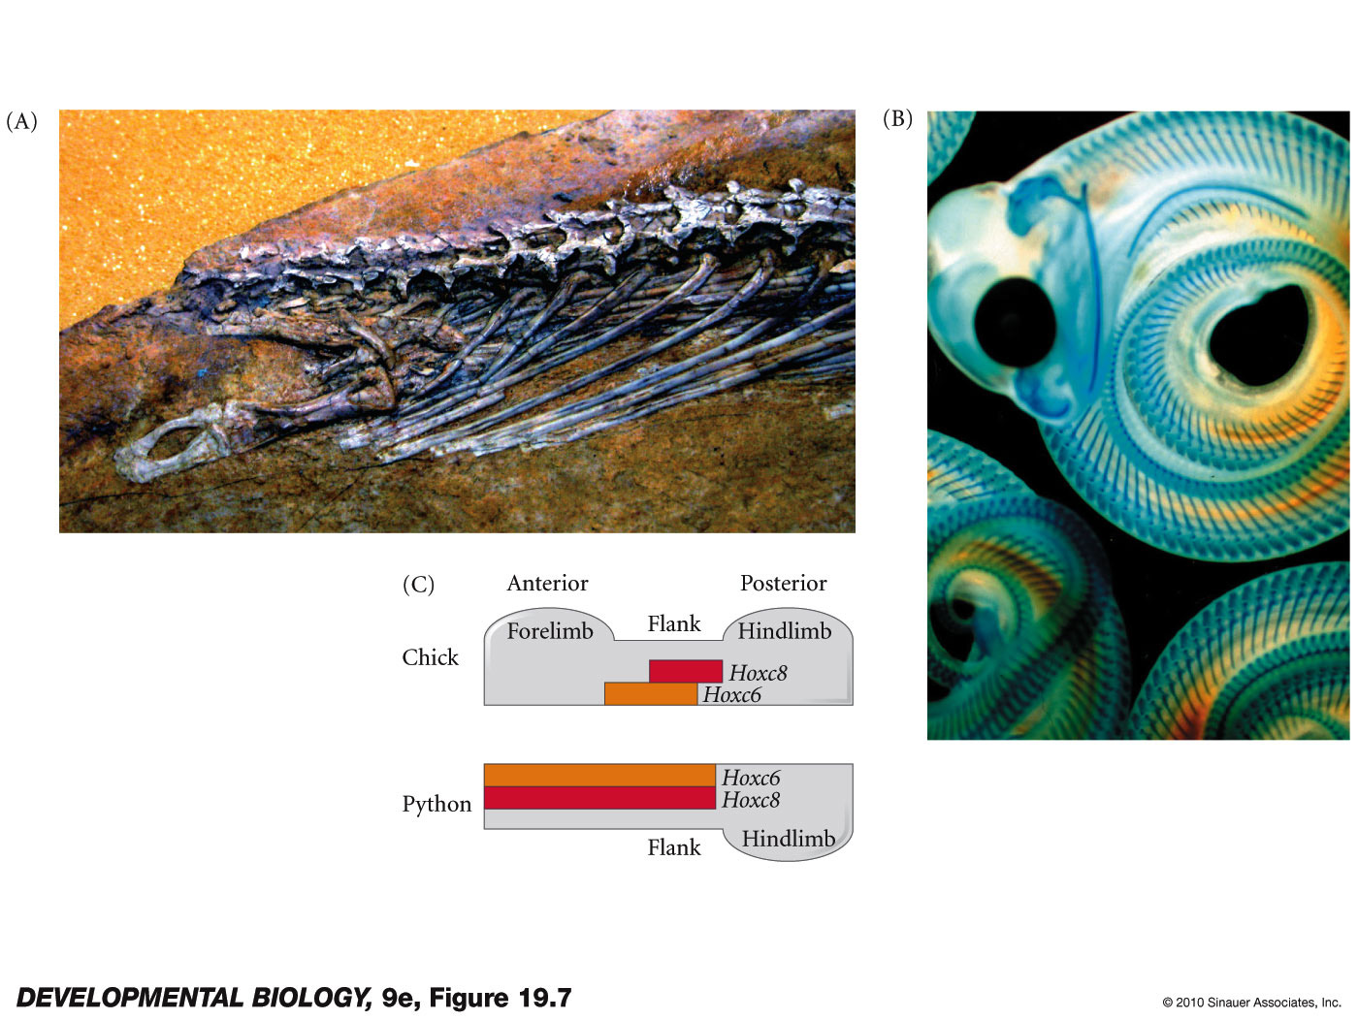
Heterotopy - snake limb loss
Forelimb is placed anterior to a HOXC6 only region
In snakes Hox6 and Hox8 always overlap and specify thoracic segments (ribs)
Hind limb reduction is a different mechanism – Loss of AER (apical ectodermal ridge) the growing tip of the limb bud

Slide 21
Mechanisms of Macroevolutionary Change
Changes in gene expression
Heterotopy - change in the location
Heterochrony - change in the timing
Heterometry - change in the amount
Heterotypy - change in the kind
DEVO

Slide 22
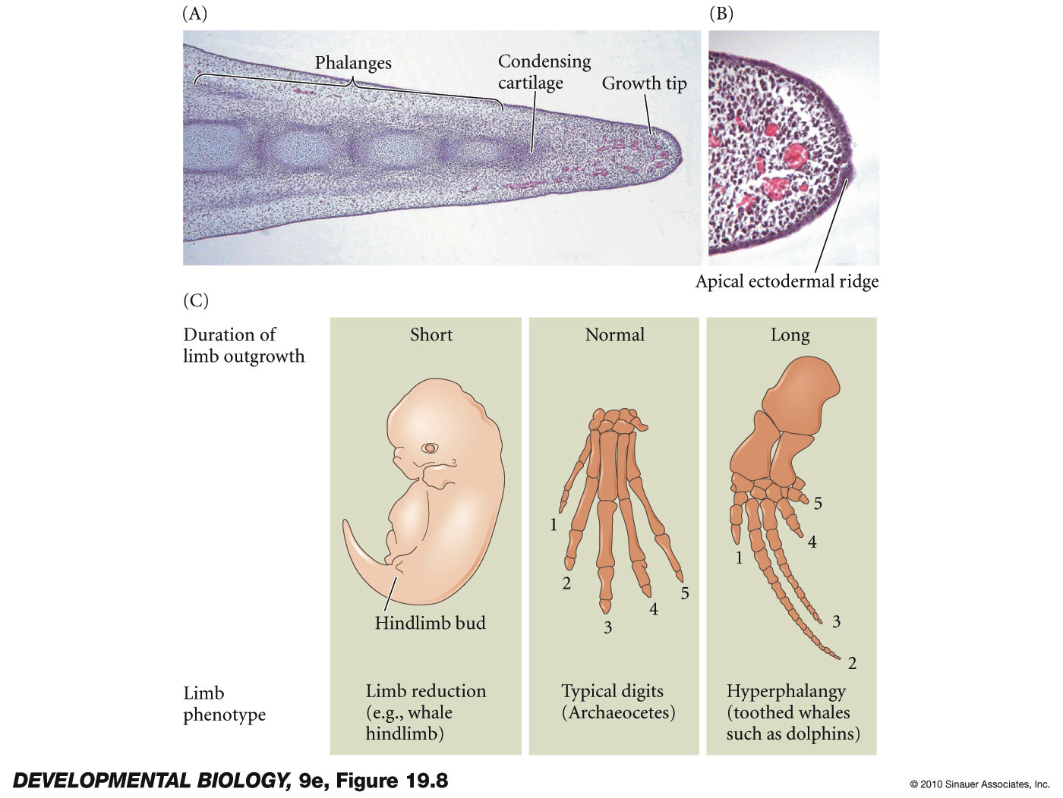
Heterochrony
change in the timing of gene expression
Duration of Apical ectodermal ridge (AER) and its secretion of FGF8
Maintains growth of the underlying mesenchyme
If AER activity is cut short – loss of limb – Hindlimb reduction in whale
If AER activity is extended - hyperphalangy (extra long digits) fins of dolphins and whales in fore limbs

Slide 23
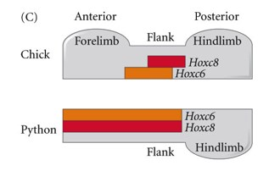
Different ways to alter limb development over evolutionary time
Stickle back fish hindlimb reduction – pelvic spine reduction – PitX TF expression is reduced specifically in early hindlimb limb bud.
Snakes – forelimb reduction – alteration of Hox6 and Hox8 gene expression prevents formation of limb bud in forelimb area. Expansion of thoracic vertebrae and ribs.
Whales – hindlimb reduction disruption of AER activity – molecular function unknown.
Dolphin forelimb (flipper) - heterochronic expression of FGF8 in phalanges.

Slide 24
Mechanisms of Macroevolutionary Change
Changes in gene expression
Heterotopy - change in the location
Heterochrony - change in the timing
Heterometry - change in the amount
Heterotypy - change in the kind
DEVO

Slide 25
Heterometry
change in amount of gene product or structure
Darwin’s Finches

Slide 26
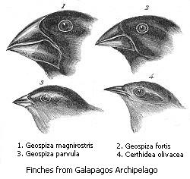
Heterometry
change in amount of expression
Darwin’s Finches
adaptive radiation -
rapid speciation of a single species to fill different ecological niches

Slide 27
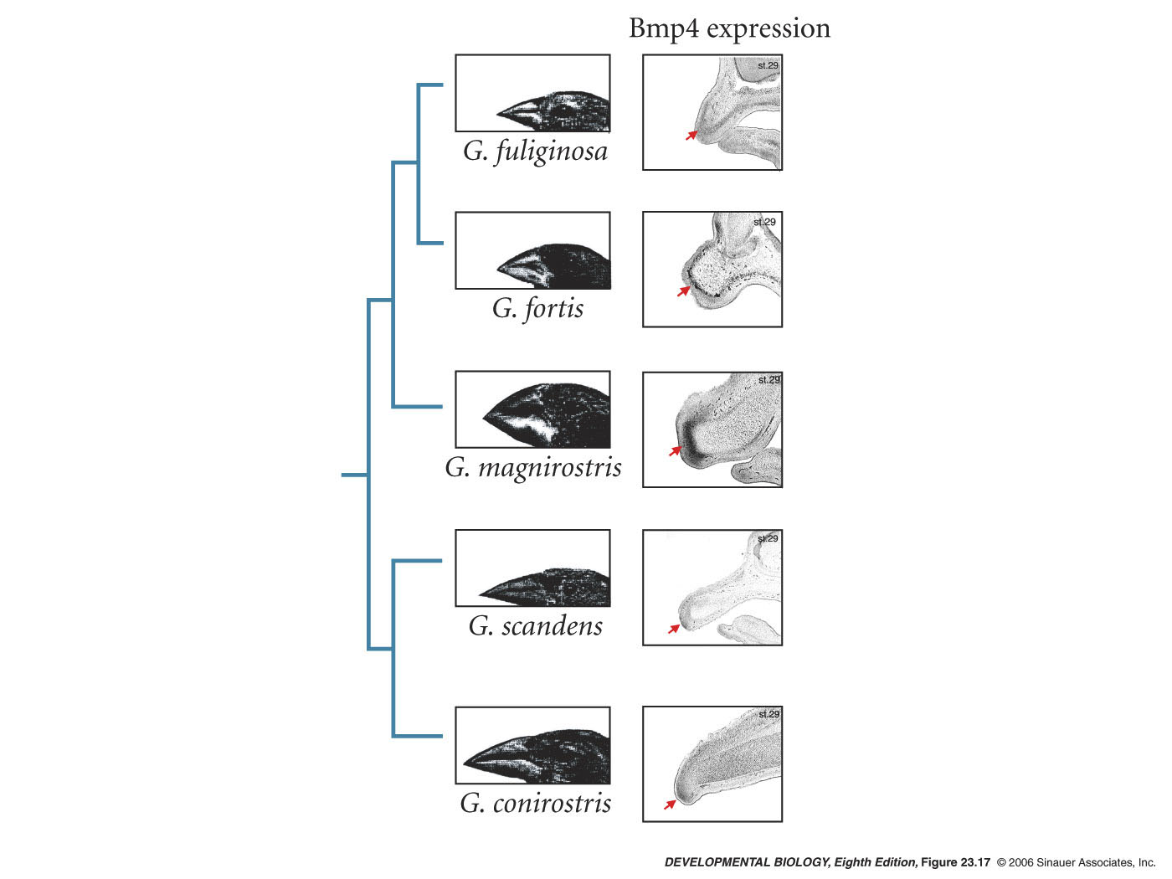
Heterometry
ground feeders - (seeds)
cactus feeders - (bugs and flowers)
Figure 26.8-

Slide 28
Heterometry
ground feeders - (seeds)
higher levels of noggin, a BMP inhibitor
cactus feeders - (bugs and flowers)

Slide 29
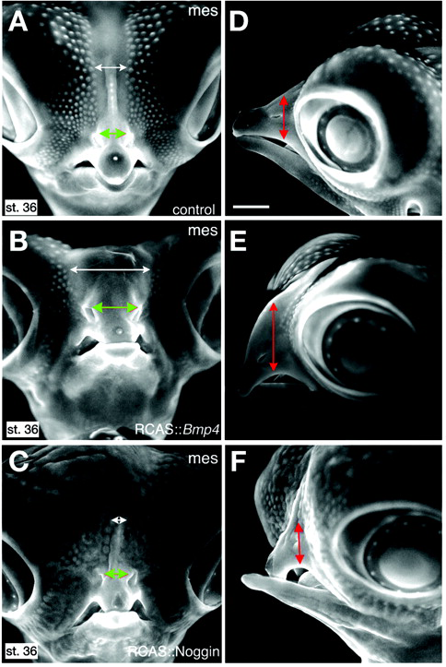
Test in chicken Abzhanov et al. 2004, Science 305: 1462–1465
negative control
expression of BMP4
expression of Noggin

Slide 30
Mechanisms of Macroevolutionary Change
Changes in gene expression
Heterotopy - change in the location
Heterochrony - change in the timing
Heterometry - change in the amount
Heterotypy - change in the kind
regulatory mutations in enhancers
mutations in coding sequence

Slide 31
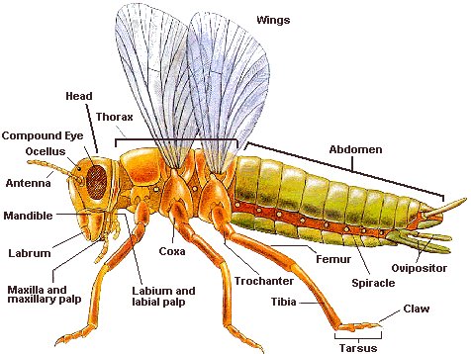
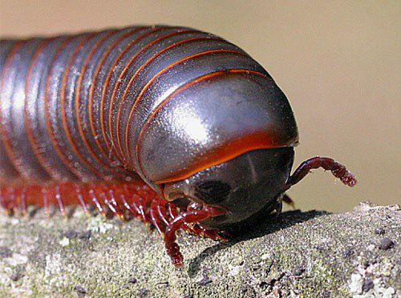
Heterotypy
change in the kind of protein produced
Why do insects have only six legs while other arthropods can have many more?

Slide 32
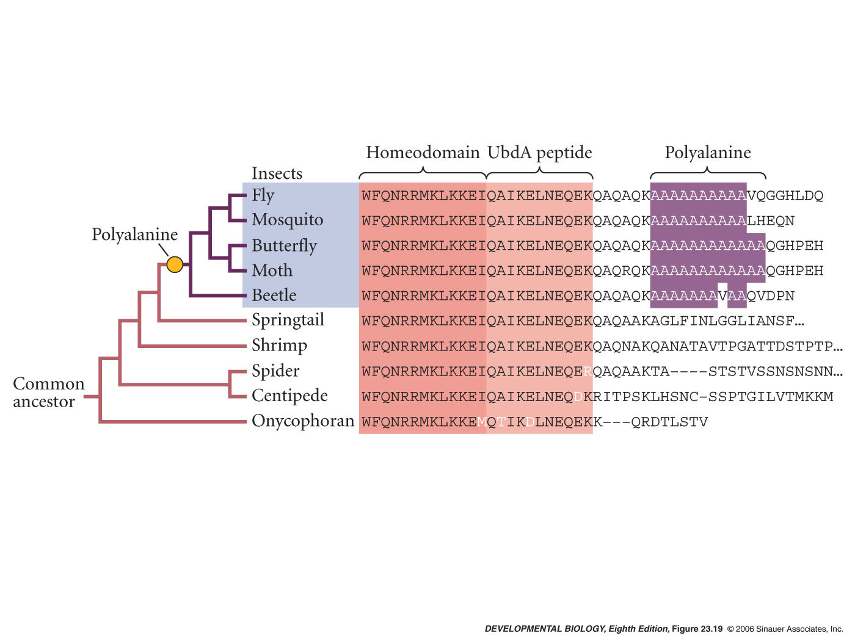
Heterotypy
Fig 26.11

Slide 33
Heterotypy
poly-alanine mutation in insect ancestor -
replication slippage
polyalanine tract allows Ubx to repress distal-less transcription
inhibits abdominal legs
How to test this idea?

Slide 34
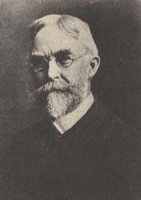
Replication slippage and human disease
Huntington’s chorea
Huntingtin gene
CAG triplet codon - poly-glutamine tracts
Normal individuals 7-36 repeats
Upregulates brain derived neurotrophic factor
Diseased individuals more (up to 250)
results in neural cell death
George Huntington

Slide 35
EvoDevo Summary
Preconditions-
Modules and Molecular Parsimony
dissociable
duplication and divergence
Mechanisms -
heterochrony
heterotopy
heterometry
heterotypy

Slide 36
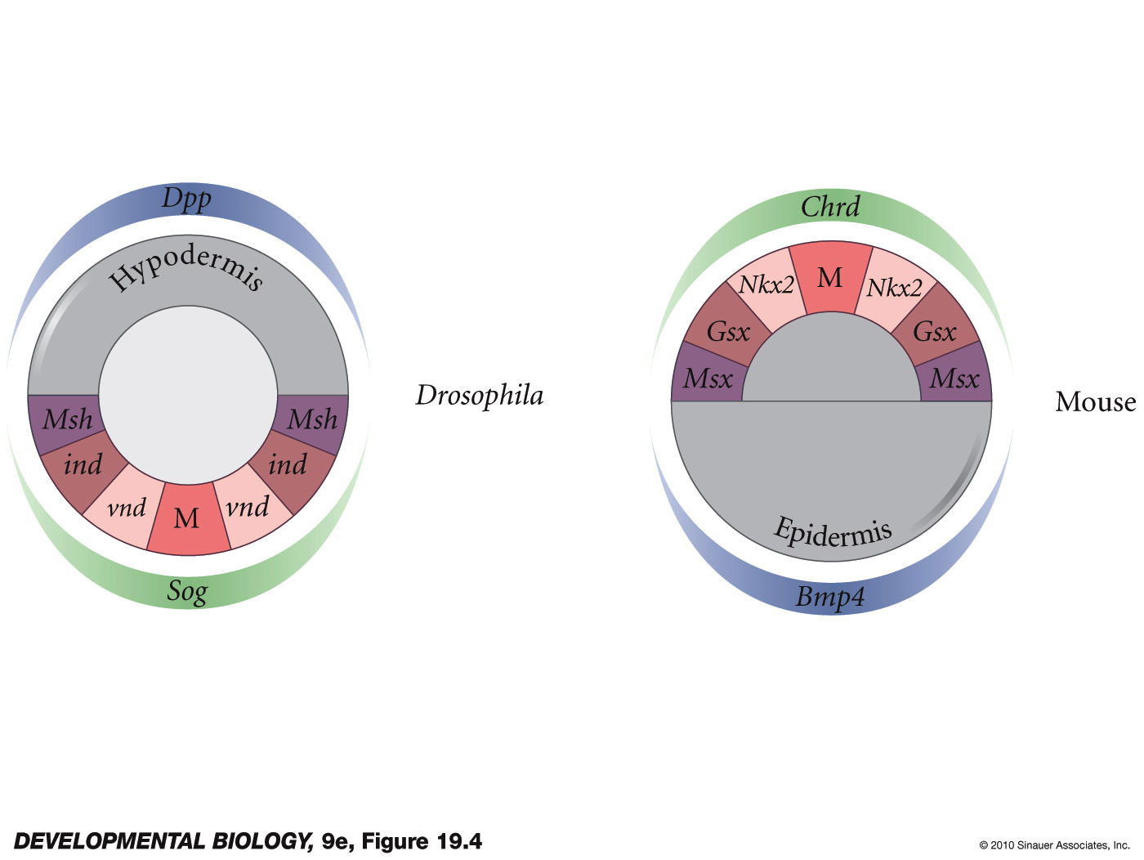
Deep Homology
Homologous pathways
Homologous parts
Same function
protostome
deuterostome
Dpp/BMP4 – TGF beta ligands
Chordin/Sog –
Genes that respond to the different concentrations all share sequence similarity

Slide 37
Heterotypy
change in the kind of protein produced
Why do insects have only six legs while other arthropods can have many more?
insects
Ubx gene does inhibit distal-less gene
other arthropods
Ubx gene does not inhibit distal-less gene
gain-of-function mutation found in the insect Ubx genes

