Slide 1
DNA methylation signatures link prenatal famine exposure to growth and metabolism

Slide 2
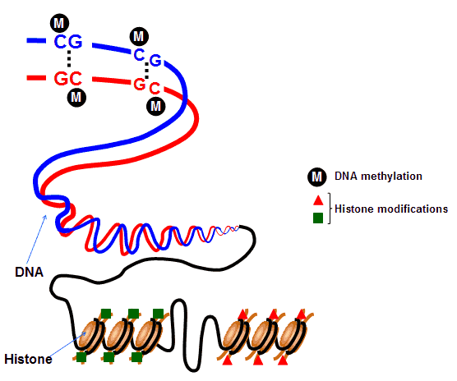
Epigenetic regulation of gene expression can change due to exposure to certain environments
How those environmental exposures affect and relate to human disease has not yet been determined
http://epigeneticsunraveled.wixsite.com/epigenetics/dna-methylation

Slide 3
Dutch Hunger Winter
November 1944- to May 1945
Higher BMI
suboptimal glucose handling
Elevated total and LDL cholesterol
Higher risk of schizophrenia later in life
https://www.verzetsmuseum.org/museum/en/tweede-wereldoorlog/kingdomofthenetherlands/thenetherlands/thenetherlands,june_1944_-_may_1945/the_hunger_winter

Slide 4
Reduced Representation Bisulfite Sequencing
1.2M individual CpG nucleotides
24 individuals prenatally exposed to famine
24 unexposed same-sex siblings as controls
Early gestation- “window of increased sensitivity and extensive epigenetic reprogramming”
Identify prenatal malnutrition-associated differentially methylated regions (P-DMRs)

Slide 5
Reduced Representation Bisulfate Sequencing
In DNA, cytosine can be methylated when next to guanine (CpG site)
RRBS purifies DNA, then replaces unmethylated cytosines at CpG sites with Uracil
Methylated cytosine is not affected
You then PCR amplify and sequence the DNA
DNA from famine exposed individuals was compared to DNA from same sex siblings who were not exposed to famine during prenatal development

Slide 6
Recruitment of People
Pre 1943
Between February 1945 and March 1946
Post 1947
Unexposed same-sex sibling control
Consent Forms
12 male and 12 female sibling pairs selected
Notes:
38 pairs identified as useful, only used 12 randomly selected

Slide 7
Phenotyping
No birth weight records
Telephone interview
Physical tests
BMI
Cholesterol

Slide 8
Actual Genetics Yayyyyy
DNA extracted from whole blood via salting out
Bisulfite conversion rate
98.9%
Mean methylation
42.55
42.64
CpG dinucleotides mapped
R package GlobalTest66
Notes:
Cytosines outside of CpG dinucleotides used to assess bisulfite conversion rate

Slide 9
Enrichment test and Cell culture
Contrast 181 P-DMRs with non-significant regions
HEL293 cells cultured in Dulbecco’s modified Eagle’s medium
Transfected with methylated or unmethylated vector with Renilla.

Slide 10
Results
Fig 1
Shows general methylation across all entrez genes in database for human peripheral blood mononuclear cells.
What is most likely to be methylated in genes?
Notes:
So as you can see, normally, promoter regions usually more likely to be methylated compared to the 5’ untranslated region.

Slide 11
28 genomic annotations were selected from literature for study
Selected general regions for study as well as regions especially relevant to development.
Both high CpG and low CpG regions were selected.
Genomic annotations were used because looking at all individual CpG sites would have been impossible and resulted in less significant data.

Slide 12
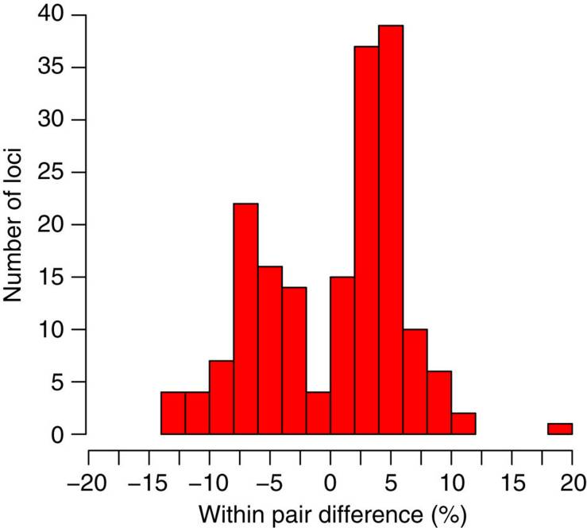
Results
Fig 2
Shows the % difference in relative methylation for famine exposed individuals.
Positive value represents methylation increased for exposed individuals for specified number of genes.
Notes:
For instance, the right most bar shows that 1 region/ loci experienced a 20% increase in methylation in famine exposed individuals.

Slide 13
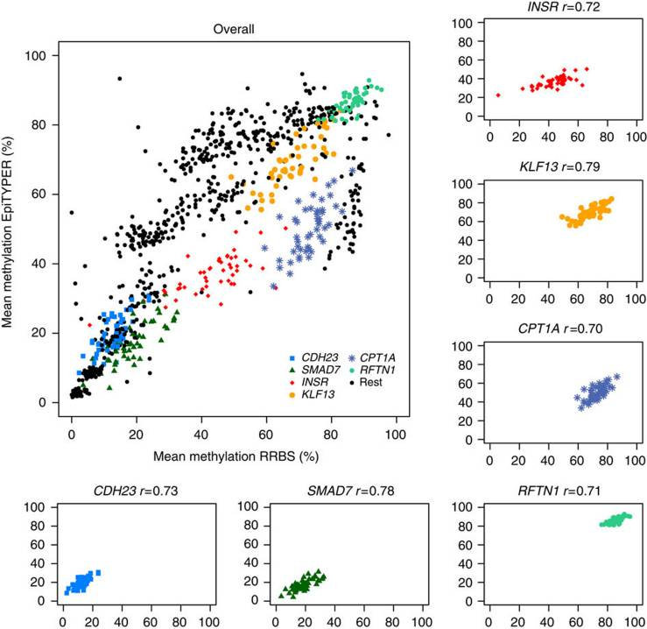
Results
Fig 3
Researchers attempted to validate P-DMR data with epiTYPER spectroscopy software.
Results were similar although epiTYPER could not target full RRBS region
Colored regions refer to specific loci that had good correlation. SMAD7, CDH23, INSR, RFTN1, CPT1A and KLF13
Loci from specified genes are separated by color.
Notes:
Epityper uses DNA spectroscopy to confirm regions of methylated DNA from samples that were previously treated with bisulfate.
Also, they used all 60 people for the epityper so study now incorporated 120 people instead of 48.

Slide 14
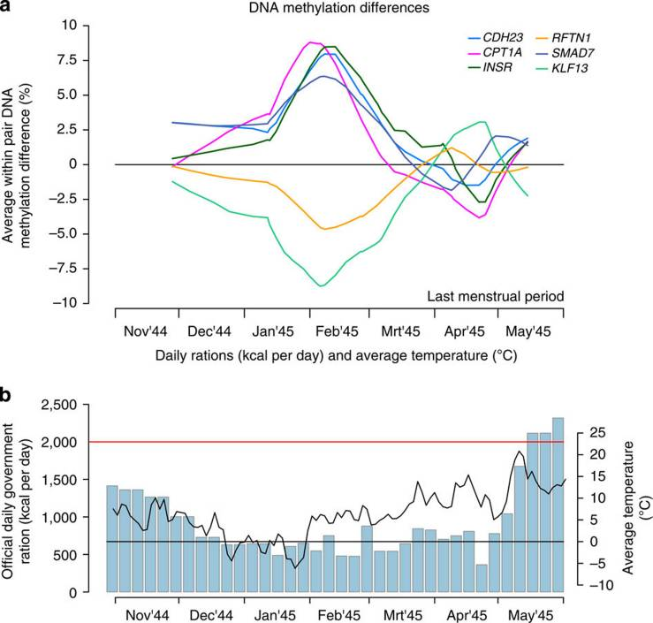
Results
Fig 4
Critical window for exposure
Last menstrual period was used to show relative start of pregnancy
Shows effect of timing during the famine period on methylation of genes.
Pre-April Pregnancies had large changes in methylation.
Notes:
You can see that specific genes were more or less methylated based on timing of the famine. A menstrual cycle in the direct middle of the famine resulted in maximum/ minimum methylation for specific genes. Rising temperatures and food supply after the end of the famine resulted in return to normal levels of methylation.

Slide 15
CDH23 and RFTN1: eye development
SMAD7: Forebrain formation and pancreatic beta cell signaling
INSR: growth and insulin signaling
KLF13: sustaining early pregnancy and cholesterol metabolism
CPTIA: fatty acid oxidation
Observed changes in methylation due to famine may have effected these pathways.

Slide 16
Individuals exposed early in gestation had higher birth rates compared to those that gestated before and after the famine
Exposed individuals commonly had these characteristics
Higher BMI
suboptimal glucose handling
Elevated total and LDL cholesterol
Higher risk of schizophrenia later in life

Slide 17
Results
Fig 6
Notes:
A is a diagram showing correlation between birth weight and average methylation of ISMR gene in famine exposed individuals. Increased methylation suggests increased birth weight. B is the correlation between LDL cholesterol and CPT1A P-DMR methylation. It too shows positive correlation between LDL cholesterol and methylation of DNA of exposed individuals.

Slide 18
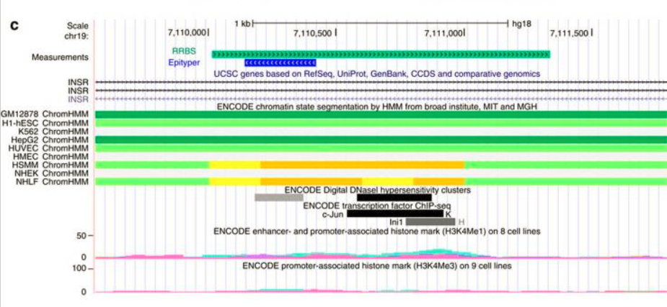
Figure 6
Notes:
Shows annotation of INSR gene, examined in study. P-DMR overlaps an enhancer in two cell lines (shown in yellow).

Slide 19
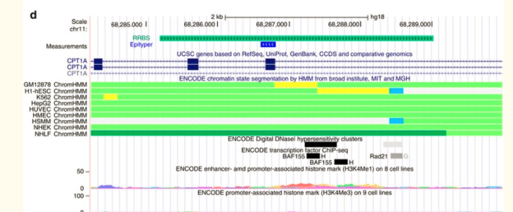
Figure 6
Notes:
Annotation of CPT1A P-DMR examined in study. It overlaps an enhancer in the two lines demarcated with yellow bands. So in other words, yellow bands represent increased methylation in these specified regions of the gene. BAF155 transcription factor also binds in this region.

Slide 20
Significance of INSR and CPT1A methylation
Individuals prenatally exposed to famine had increases in INSR and CPT1A methylation at defined enhancer regions.
INSR and CPT1A genes are responsible for growth and fatty acid oxidation respectively.
Increased methylation of INSR regions seemed to correlate with increased birth weight. Increased methylation of CPT1A regions seemed to correlate with increased LPL cholesterol later in life.
Link between ISNR and birth rate is well established
Link between CPT1A and LDL cholesterol levels was less clear

Slide 21
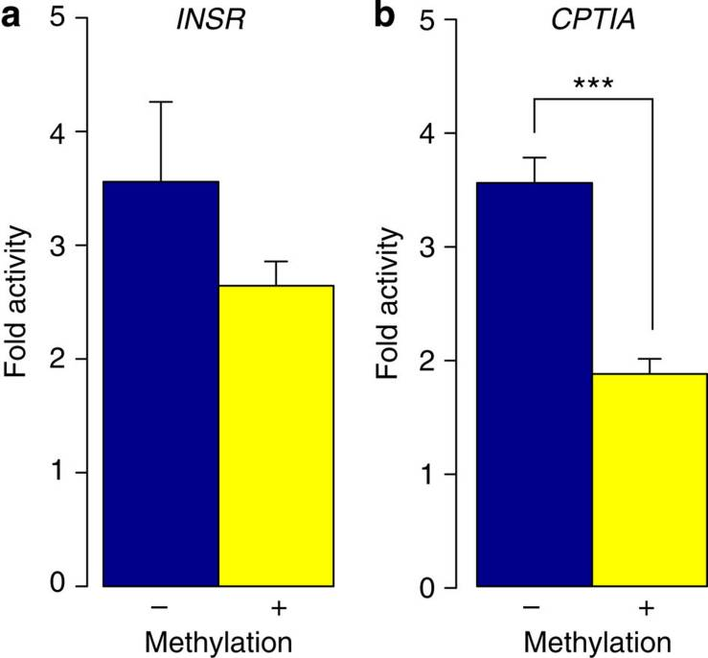
Results
Fig 7
Put INSR and CPT1A into CpG-free luciferase vector and tried to express it in vitro.
Compared unmethylated and methylated expression of the enhancer.
Significant difference was seen in CPT1A but not in INSR.

Slide 22
Discussion
Chose 28 genomic annotations to study for P-DMRs
Within these annotations, identified 181 P-DMRs in line with exposure period.
Majority of P-DMRs occurred in gene bodies.
P-DMRs in genes SMAD7, CDH23, INSR, RFTN1, CPT1A and KLF13 underwent technical and biological validation.
Critical period (figure 4) was observed
Looked specifically at connection between INSR and CPT1A with birth weight and LPL cholesterol specifically. Both were related and both P-DMRs within the regions were enhancers. Both were downregulated, apparently as a response to famine conditions during prenatal development.
Study was unique because it linked DNA methylation and prenatal malnourishment in humans. Previously this was only done in animal studies.

