Slide 1
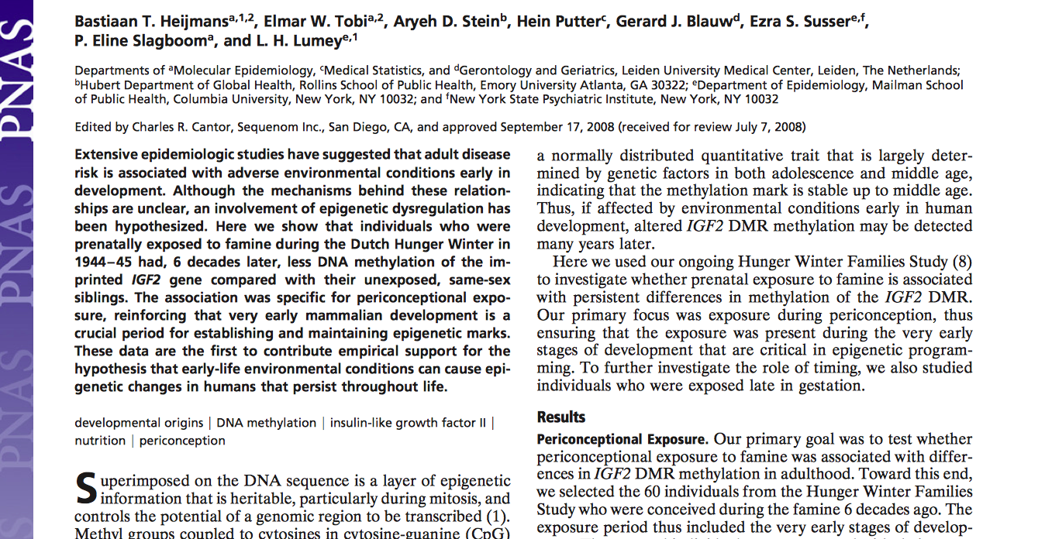
Persistent epigenetic differences associated with prenatal exposure to famine in humans
Presented by Alease Daniel, Rachel Nicholson, and Alison Jester

Slide 2
Introduction and Background
We have seen in animal studies that adult disease risk has been associated with negative environmental conditions early in embryonic development.
Change epigenetic markers and affect phenotype throughout life.
Epigenetic markers: CpG and histone modifications
Rare chance to study this phenomenon in humans
Dutch Hunger Winter

Slide 3
Background
Dutch Hunger Winter
What was it?
Why is it appropriate for this particular study?
Clearly defined
Known rations
Records intact
Notes:
The Dutch Hunger Winter was the term applied to a food embargo upon the western part of the Netherlands by the Germans near the end of WWII. It occurred during the winter of 1944-1945.
This is an appropriate famine to do this particular study on because we have a lot of data from this time. We know that the famine took place during one particular winter, we know what the people in this famine were eating due to the official food rations being documented, and we have intact registries and healthcare records from the time so we can keep track of the individuals involved throughout their lives.

Slide 4
Introduction
Insulin-like growth factor II (IGF2)
Best characterized epigenetic loci
Growth and development
Differentially methylated region (DMR)
Notes:
-The peptide being looked at in this study is IGF2. It is heavily involved in human growth and development, and is maternally imprinted.
-When the differentially methylated region of IGF2 is hypomethylated, bi-allelic expression of IGF2 (expressed on both alleles) occurs. This methylation mark stays stable throughout the middle age of the individual.
-This means that by looking for altered methylation many years later, we can determine if the individual was exposed to particular environmental conditions in early embryonic development.

Slide 5
Main Question
Is prenatal exposure to famine associated with differences in methylation of IGF2 DMR?

Slide 6
Methods
60 individuals were selected from the Hunger Winter Families Study
These individuals were born at the midwifery training schools in Amsterdam, Rotterdam and the Leiden University hospital.
The average daily rations were 667 kcal
Controls:
Same sex siblings
Unrelated individuals
Blood samples were collected from the participants
Notes:
Individuals that were born at the midwifery training schools in Amsterdam and Rotterdam and the Leiden University hospital were recruited. These hospitals were located in famine-exposed cities. The controls were same sex siblings that were born before or conceived after the famine period (these may or may not have been born at one of the above institutions) and unrelated individuals (these were born at one of the above institutions.) The exposure period included the very early stages of development. The exposed individuals were compared with their samesex sibling to achieve partial genetic matching.
Blood sampling was completed for exposed individuals, the same-sex siblings, and the unrelated controls.

Slide 7
Methods
Methylation of the IGF2 DMR was measured using genomic DNA.
Genomic DNA was bisulfite-treated using the EZ 96-DNA methylation kit.
The IGF2 DMR region was then amplified using sequence specific primers.
DNA methylation of CpG sites were measured using a mass spectrometry–based method.
Notes:
The salting out method was used to extract the DNA.
The kit allowed them to analyze many samples at once.
The IGF2 DMR region was amplified using PCR and sequence specific primers.

Slide 8
Results: Figure 1
Notes:
1A: Individuals conceived during famine and thier unexposed siblings. Difference in IGF2 DMR methylation within sibships according to the estimated conception date of the famine-exposed individual. IGF2 DMR methylation was lowest in the famine-exposed individual among 72% (43/60) of sibships.
1B: Individuals exposed late in gestation and their unexposed siblings. no difference in IGF2 DMR methylation between the exposed individuals and their unexposed siblings

Slide 9
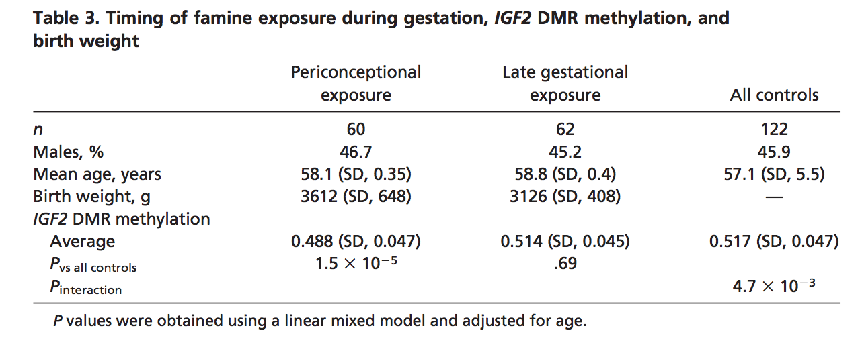
Results
Notes:
To formally test whether the association with lower IGF2 DMR methylation depended on the timing of exposure, they analyzed the periconceptional and late exposure groups together with all 122 controls in a single model. They saw that periconceptional exposure was associated with lower methylation, whereas late exposure was not. There was statistically significant evidence for an interaction between timing and exposure.

Slide 10
Results
All CpG sites but one were significantly less methylated among periconceptionally exposed individuals compared with their siblings.
Periconceptional exposure was associated with a 5.2% lower methylation.
IGF2 DMR methylation was not associated with birth weight.
Notes:
The process was done twice to confirm technical accuracy and a similar value of 5.6% lower IGF2 DMR methylation was observed.
The mean birth weight of the 60 individuals who were exposed periconceptionally was not lower than that of the reference births.

Slide 11
Discussion--Main Conclusions
Early gestational famine exposure = associated with lower IGF2 methylation
Epigenetic markers are influenced by environmental conditions in early development
May contribute to adult disease risk
Notes:
Early gestational famine exposure…
6 decades later they found that those exposed to the famine conditions during the periconceptional period revealed lower levels of IGF2 methylation. This indicates their epigenetic markers were likely influenced by the lack of proper nutrition incurred by their mothers
Epigenetic markers….
Environmental conditions do seem to play a role in development, and may even reveal an increased risk for adult disease

Slide 12
Study Limitations
Other stressors: cold, emotional stress
Association, not causation
Due to early organismal development or early tissue development?
No consideration of epigenetic changes during later development/aging
Notes:
Other stressors…
This study did not take into account other environmental factors that the mothers may have been experiencing during their periconceptional time period. If their country was experiencing a famine, I’m sure there were many other stressor involved that may have contributed to the compromised prenatal development, such as cold or emotional stress.
Association…
This study is based on associations, not causations. While the data is strong, it does not prove anything.
Due to early…
They mentioned in their study that there may be a timing dependence of the association of lower IGF2 methylation and early gestational famine.
Different tissues develop at different rates during development, and thus the researchers aren’t clear as to whether these epigenetic markers were influenced by famine during the early development of the entire organism, or if it’s influenced by the early development of the tissues of that organism. Is the crucial epigenetic period during the early development of the organism, or during the early development of certain tissues?
No consideration…
This study analyzed the epigenetic markers of these individuals 6 decades after the famine. This study does not consider the effects of later development and aging on these epigenetic markers. It could be that other factors throughout the organism’s life alters their epigenetic markers.

Slide 13
Supporting Studies
Female rats experience famine before pregnancy
Mouse zygotes cultured to determine vulnerability of epigenetic markers
Birth weight is not an accurate way to measure the effects of famine
Notes:
Female rats….
The researchers mention that their study is comparable to another study done on female rats.
Female rats were exposed to famine before pregnancy. It was found that low levels of methylation were found in these rats, which is comparable to the low methylation levels found in the humans of this study. The genes used in the rat study were different from the IGF2 gene in this study, but the results were comparable.
Mouse zygotes…
Another study analyzed the vulnerability of epigenetic markers during development and also found that the early stages of development is a cruicial period for epigenetic markers.
Birth weight…
Many studies use birth weight as a means to determine compromised prenatal development, but this study shows that this may not be an accurate way to measure this.
Those they found to be exposed to the famine during early gestation were recorded to have normal birth weights, yet were revealed to have lower IGF2 methylation than their “normal” siblings
Those that were exposed to the famine late in gestation were recorded to have low birth weights, yet were revealed to have normal IGF2 methylation

Slide 14
Future Studies
Determine whether epigenetic markers are vulnerable during early development of the organism, or of the tissue?
Monitor the effect of maternal lifestyle and its effects on embryonic growth
Nutrition: under- or overnutrition
Assisted reproductive technologies
Assess phenotypic consequences associated with early gestational famine
Schizophrenia
Coronary heart disease
Notes:
Determine whether….
Another study should be conducted to determine if the crucial period of development is in fact during early development, or if it’s during early development of specific tissues
Monitor the effect…
Another study should be conducted to determine if other environmental stressors such as cold or emotional stress have influence over the epigenetic vulnerability
Assess phenotypic…
Another study should be conducted to determine if these lower epigenetic markers have influence over the risk of adult diseases such as schizophrenia and coronary heart disease

Slide 15
“Understanding how epigenetic control depends on early exposure may shed light on the link between development and health over the lifespan and ultimately suggest new ways to prevent human disease.”
Notes:
This study will help provide information on how to prevent human disease by linking development and health over the lifespan.

Slide 16
Sources

