Slide 1
Presenting: Correction of a pathogenic gene mutation in human embryos by Hong et al. (2017)
Beth Bryan, Emily Davis, and Michael Schnatter

Slide 2
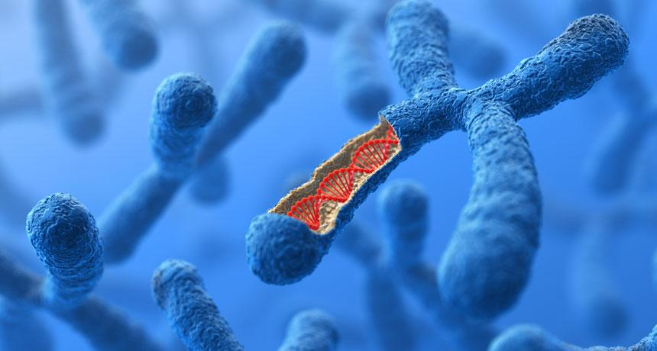
Background and Introduction
More than 10,000 monogenic inherited disorders identified that affect millions of people
Here, focusing on mutation MYBPC3
MYBPC3: causes hypertrophic cardiomyopathy (HCM)
Condition in which a portion of the heart muscle becomes thickened without an obvious cause
Estimated prevalence of 1 in 500 adults
Image address: https://www.sciencenews.org/sites/default/files/2017/10/main/articles/101917_TI_noncoding-DNA_main_FREE.jpg

Slide 3
MYBPC3
Autosomal dominant
Encodes a thick filament-associated cardiac myosin-binding
Works with actin in contraction and relaxation of muscle cells
Mutation accounts for about 40% of all genetic defects causing HCM
Current treatment:
Mostly based on treating symptoms
Lack of focus on solving genetic causes

Slide 4
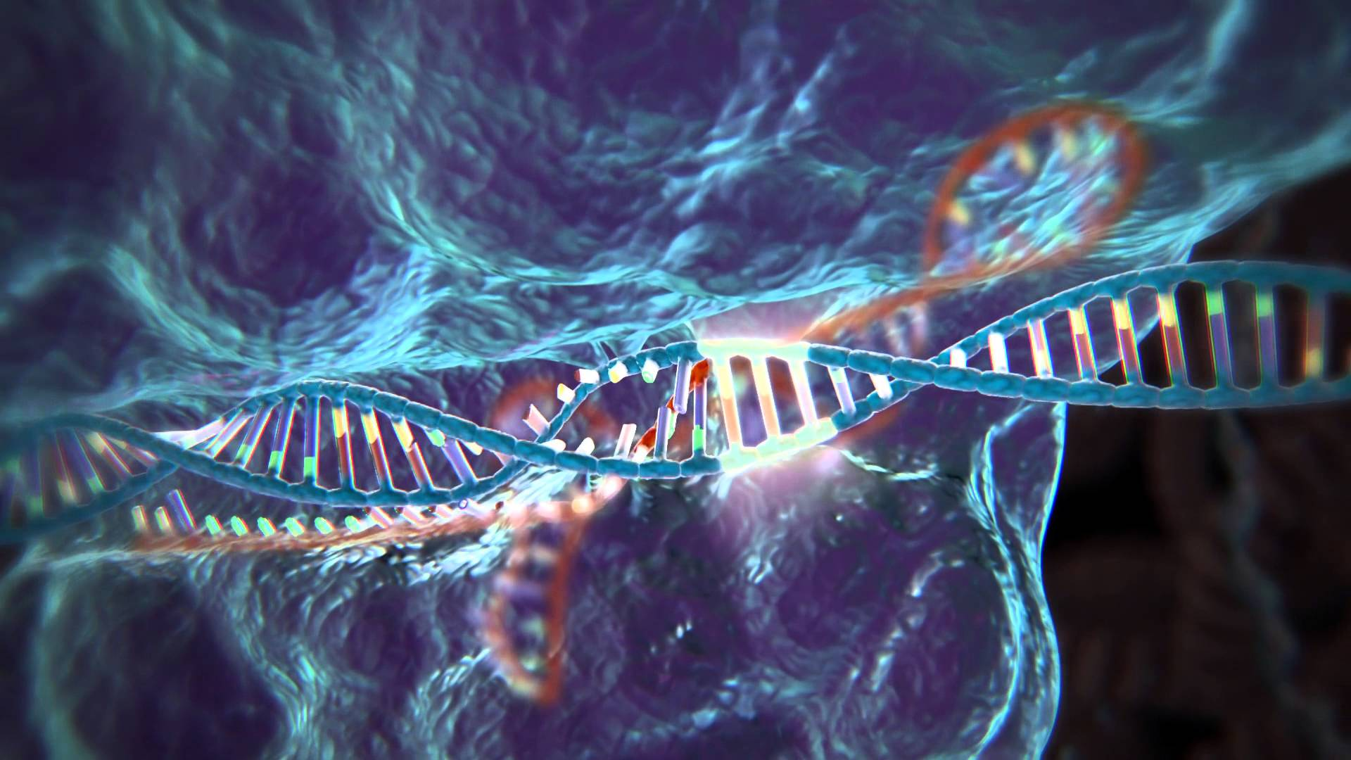
CRISPR/Cas9
Is an effective tool for targeting specific sequences
Using specific gRNA to lead to target sequence
The Cas9 enzyme cuts the sequence from the DNA
NHEJ commonly used, but can lead to error-prone mutations
Alternative process is homology-directed repair (HDR)
HDR uses the homologous chromosome as a template for DNA repair
Image address: https://i.ytimg.com/vi/2pp17E4E-O8/maxresdefault.jpg

Slide 5
Purpose of the paper:
To show heterozygous gene mutations can be corrected in human gametes or early embryos

Slide 6
Things to Know:
Skin fibroblast cultures used to make iPS cells
Used donated germ cells
Construct of control embryos:
WT egg crossed with WT sperm
Case embryo construct:
WT egg crossed with heterozygous sperm
Targeted sequence was 4 bp deletion (GAGT)
Single-stranded oligodeoxynucleotide (ssODN) used as templates for HDR
2 single-guide RNAs (sgRNA)- Cas9 constructs were made
Target specific deletion
Main concerns for future clinical studies
Mosaisms
Off-target effects

Slide 7
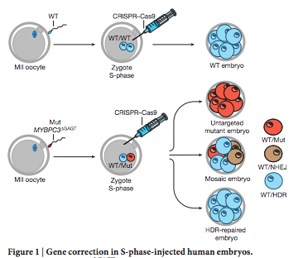
Figure 1: Observed expression of WT × WT and WT × heterozygous mutant

Slide 8
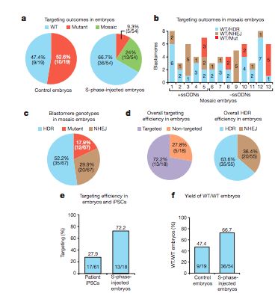
Figure 2: Gene targeting and HDR efficiency in S-phase-injected human embryos.

Slide 9
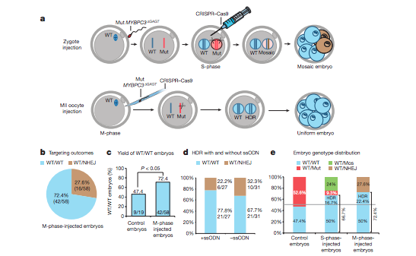
Figure 3: Gene correction in M-phase injected human embryos.

Slide 10
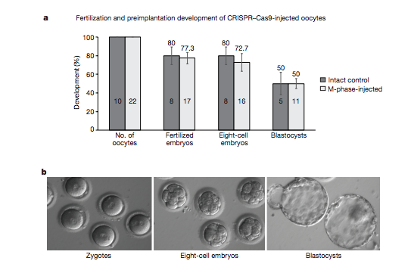
Figure 4: Preimplantation development of CRISPR-Cas9-injected embryos.

Slide 11
Future implications of Gene Editing
While this study showed double-stranded breaks in zygotes were preferentially repaired by HDR, NHEJ-induced indels pose serious problems for gene editing.
Various approaches might address this.
Some studies have reported NHEJ-inhibiting, HDR-promoting pathways.
Primate studies showed CRISPR-Cas9 injection can result in mosaicism.
Mosaicism was not seen in MII-phase injections.
This implies the cell cycle is important to gene editing efficiency.
Cas9 introduced by plasmid transfection can be overexpressed, resulting in the alteration of off-target DNA.
This study used purified Cas9 protein instead of plasmid.
This may enhance specificity and thereby diminish off-site targeting.
CRISPR-Cas9 targeting in this study showed high specificity.
HDR-based gene editing is not an option for embryos with homozygous mutant phenotypes, because HDR requires a homologous template strand.

Slide 12
Reference
Hong Ma, Nuria Marti-Gutierrez, Sang-Wook Park, Jun Wu, Yeonmi Lee, Keiichiro Suzuki, . . . Shoukhrat Mitalipov. (2017). Correction of a pathogenic gene mutation in human embryos. Nature, 548(7668), 413. 10.1038/nature23305 Retrieved from https://www.nature.com/articles/nature23305

Slide 13
Questions?

