Slide 1
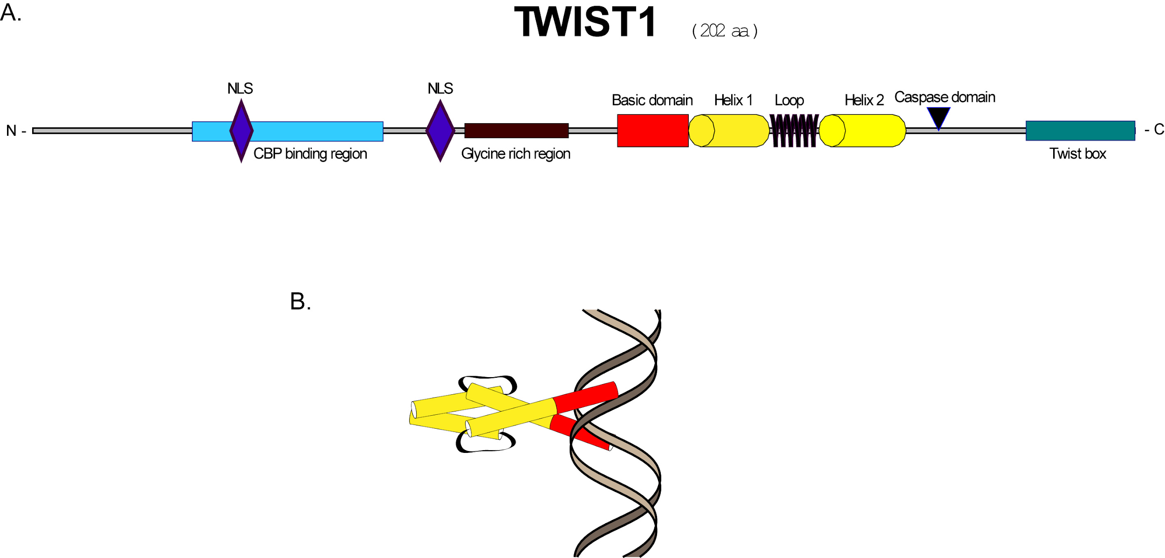
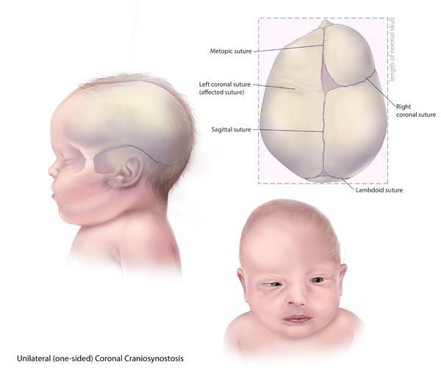
Mutations in TCF12, encoding a basic
helix-loop-helix partner of TWIST1, are frequent cause of coronal craniosynostosis
Allison Renwick, Maggie Cummings, Gavin Speers, Greg Lara

Slide 2
Intro/Background
The scientists focused on Craniosynostosis, which is the premature fusion of the cranial sutures in infants
For their exome sequencing data, they chose to sequence individuals with bilateral coronal craniosynostosis because of its monogenic properties.
They chose to first sequence the exomes of human patients to find mutated genes that may have contributed to the craniosynostosis and then mutate the suspected target genes in mice to find which mutations cause the disorder.
They found that in 21% of the cases there was a mutation in TWIST1, which codes for a basic helix loop helix transcription factor that plays a role in neurogenesis, myogenesis, heart development, and hematopoiesis.
They also thought that TCF12, which produces a transcription factor that heterodimerizes with the class to bHLH transcription actor may also play a role in the disorder

Slide 3
Methods: Sample Procedure
The sample children involved in the experiment were first obtained through written consent of the parents.
Craniosynostosis diagnosis is confirmed in the samples via computerized tomographic scanning and evidence associated with the disease from clinical exams.
The Venous blood was obtained for RNA and DNA extraction and was collected in PAXgene blood RNA tubes.
Fibroblast cultures were gained from skin biopsies obtained from the scalp incision at the time of surgical intervention.

Slide 4
Sample Procedure
The samples were then tested for mutation hotspots in FGFR2, FGFR3, and TWIST1.
Significant chromosome aneuploidy was investigated as well using array comparative genomic hybridization.
This excluded any already identified mutations known to cause craniosynostosis.

Slide 5
Sample Procedure
Seven samples were then selected from unrelated individuals that had bilateral coronal synostosis for exomic sequencing.
This was comprised of five patients that were clinically non-syndromic and had negative family history.
One of the patients included did not have coronal synostosis; however, they did have two children with the diagnosis.
The last patient was the only person in the family affected with craniosynostosis, but they had several generations of short thumbs being in several other members of the family.

Slide 6
Methods: Exome Sequencing
Agilent SureSelect Human All Exon Kit(v.2; 44 Mb) was used to capture exonic DNA from a library prepared from 3 μg of each proband’s genomic DNA from whole blood.
An Illumina GAIIx platform with 51 bp paired-end reads was used to sequence the enriched DNA.
Between 3.98 Gb and 4.56 Gb of sequence was generated for each sample.
The Novoalign was used to map the hg19 genome and remove artefacts using custom perl scripts.
This resulted in the average coverage of exons between fold 33- and 44-.
Variants from this were called using SAMtools and annotated with ANNOVAR and PolyPhen-2.
All variants that were annotated in dbSNP132 were removed.
The gene lists were manually examined for overlaps of two or more variants.
Sequence Data was visualized using GBrowse2.

Slide 7
Methods: TCF12 Analysis
TCF12 mutations were first identified in the exome sequence.
To further confirm this analysis, PCR amplification products, MLPA and cDNA products were directly sequenced.
Amplification products were sequenced with the BigDye Terminator v3.1 cycle sequencer system.
MLPA was analyzed using synthetic oligonucleotide probes designed specifically for TCF12.
These fragments underwent electrophoresis and its peaks were visualized using Gene Mapper v3.7 from Applied Biosystems.
cDNA was synthesized with the Fermentas RevertAid microsatellites to confirm sample relationships.

Slide 8
Methods: Immune Function tests
Peripheral blood mononuclear cells were obtained from whole blood through density gradient centrifugation in cell separation tubes.
These PBMCs were then washed three times wtih sterile PBS and rested overnight in a media supplement.
Monocytes, NK cells and naive, effector and memory T and B cell subsets were singled out by flow cytometry of PBMCs stained with anti-human antibodies.
The IgM, IgA, and IgG antibody titres were specifically measured with ELISA.

Slide 9
Missense mutation analysis Methods
OriGene was first used to obtain a full length TCF12 cDNA clone and synthesize the TWIST1 clone.
The control was a pCaSpeR-Tinman::lacZ(pTinE1/E2/E3) construct used as a bHLH protein-responsive reporter and placZ.
The three Tinman boxes were two 5’-CATGTG-3’ and one 5’-CATATG-3’ respectively.
cDNA mutations in the TCF12 were then fully sequence verified with primers.
HT1080 human cell line was cultured via high-glucose Dulbecco’s modified Eagle’s medium.
All cells were transfected with 1 microg of reporter plasmid, as well as 1 microg of TWIST1 and TCF12 constructs
Cells were then harvested and beta-galactosidase assays were performed.
Missense mutations were then modelled onto murine E47/NeuroD1.

Slide 10
Methods: Mouse Mutants
To test their hypothesis that the total quantity of TCF12/TWIST1 heterodimers is a critical factor in the coronal suture development, the scientists looked at mouse heterozygous null mutants (EIIa-Cre;Tcf12flox/+ and Twist1+/−), and mouse compound heterozygotes (EIIa-Cre;Tcf12flox/+;Twist1+/−).
They found that the EIIa-Cre;Tcf12flox/+ null mutants had normal coronal suture development, and the Twist1+/− exhibited variable coronal synostosis.
The compound heterozygotes (EIIa-Cre;Tcf12flox/+;Twist1+/−) exhibited the expected Mendelian ratio of 25% showing signs of severe coronal synostosis.
This provides more causational evidence to support their hypothesis on the importance of heterodimers in the normal coronal suture development.

Slide 11
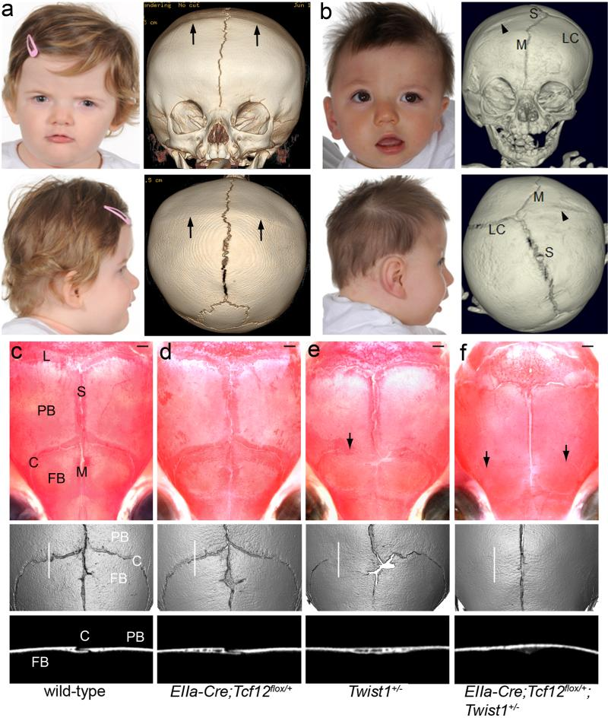
Figure 1

Slide 12
Figure 1 A and B

Slide 13
Figure 1 C-F

Slide 14
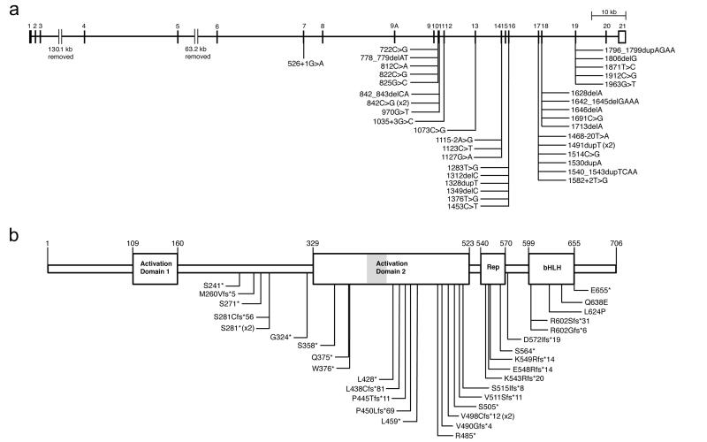
Figure 2

Slide 15
Figure 2 A

Slide 16
Figure 2 B

Slide 17
Results
Using Exome sequencing 38 heterozygous TCF12 mutations were identified in 347 samples from unrelated individuals with craniosynostosis.
The mutations occur predominantly in individuals with coronal synostosis and accounted for 32% and 10% of subjects with bilateral and unilateral pathology.
The mutations identified in TCF12 comprise 14 nonsense, 15 frameshift, 7 splicing and 2 missense changes, strongly suggesting a loss-of-function mechanism.

Slide 18
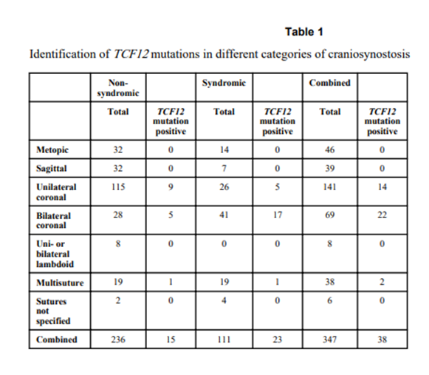
Results

Slide 19
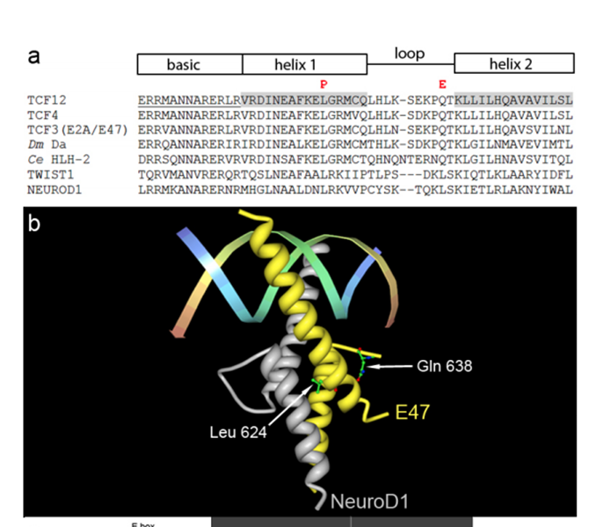
Structure of TCF12

Slide 20
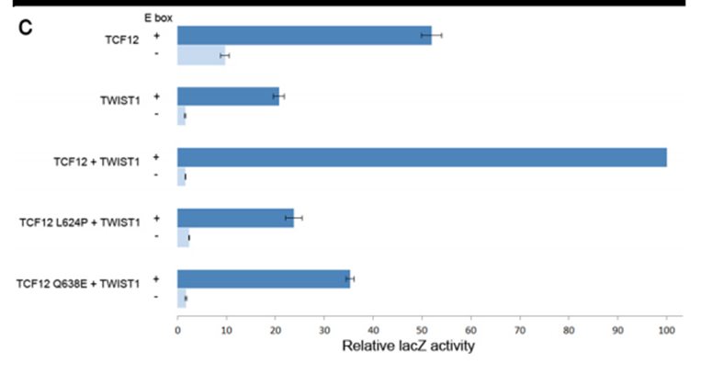
Twist1 and TCF12 Transactivation Assay Results: They act synergistically

Slide 21
Conclusion
TCF12 and TWIST1 act synergistically in the transactivation assay
Mice doubly heterozygous for loss-of-function mutations in Tcf12 and Twist1 have severe coronal synostosis.
DOSAGE of TCF12-TWIST1 heterodimers is critical for normal coronal suture development.
Mutations in TCF12 which encodes a bHLH frequently causes coronal cranioynostosis.

Slide 22
Possible Limitations of the Data
Sample size- only 387 samples from unrelated individuals used in exome sequencing
The diversity of the disease phenotypes among patients

Slide 23
Implications of the Data
The Authors state that. “ The TCF12-TWIST1 heterodimer is likely to regulate specifications of the boundary between the neural crest and cephalic mesoderm and/ or inhibits osteogenic differentiation via actions on RUNX2 ( Runt-related transcription factor 2- a key transcription factor associated with osteoblast differentiation) and bone morphogenetic protein or fibroblast growth factor signaling”.

Slide 24
Future Work: Include TCF12 testing in nonsyndromic coronal craniosynostosis
Findings highlight the importance of the balance between TCF12 and TWIST1 in TCF12/TWIST1 heterodimer formation and coronal suture development.
These results strongly support the inclusion of TCF12 testing when pathogenic variants are not identified in FGFR1-3 and TWIST1, in individuals with nonsyndromic coronal craniosynostosis or clinically suspected Saethre-Chotzen syndrome.
This is supported by other studies that assert that TCF12 testing should be performed in individuals with unilateral or bilateral coronal synostosis, and in patients with Saethre-Chotzen syndrome who are negative for TWIST1.
Reference: Lee et Al. A craniosynostosis massively parallel sequencing panel study in 309 Australian and New Zealand patients: findings and recommendations. Genetics In Medicine. December 2017. DOI: 10.1038/gim.2017.214

Slide 25
Questions?

