Slide 1
Light-focusing human micro-lenses generated from pluripotent stem cells model lens development and drug-induced cataract in vitro
John Hipp, Kerri Keys, Vivian Truong

Slide 2
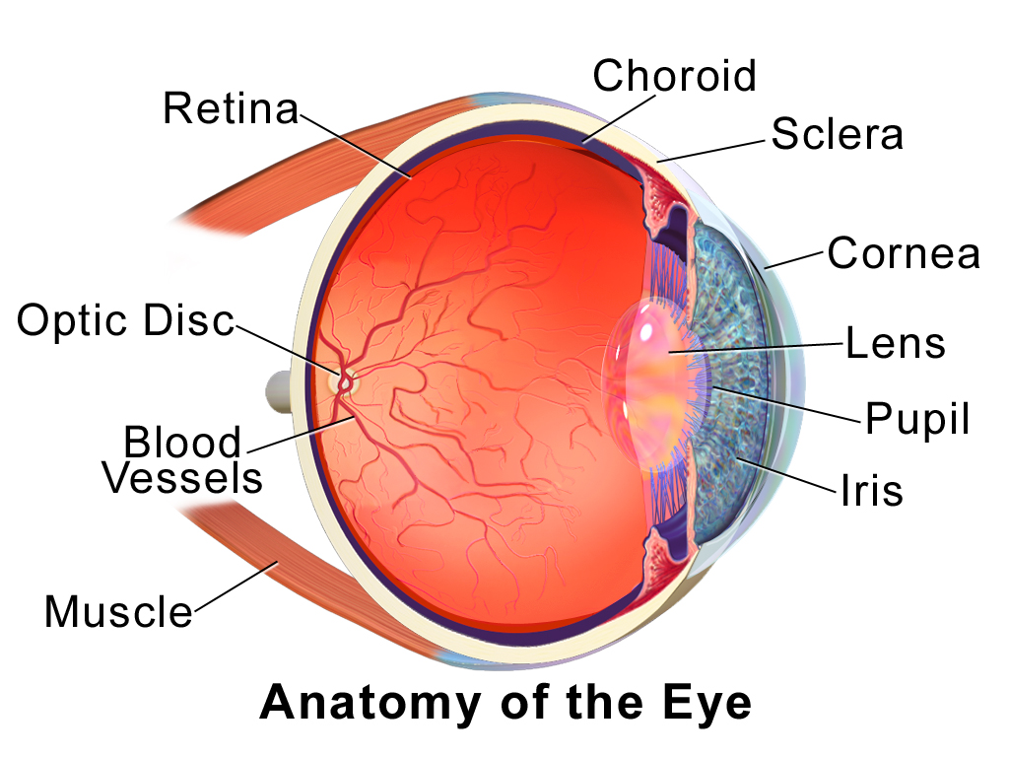
Overview
During embryogenesis, the ocular lens develops opposite of the optic cup
Basic lens architecture is formed by the anterior lens maintaining a monolayer of lens epithelial cells (LECs), and the posterior cells differentiating into lens fibre cells within the lumen of the lens vesicle.
Key characteristics of the lens are transparency and the ability of the lens to focus light to a point
https://commons.wikimedia.org/wiki/File:Blausen_0388_EyeAnatomy_01.png
Notes:
During embryogenesis, the ocular lens will develop opposite of the optic cup.

Slide 3
Introduction
Previously, light-focusing rat micro-lenses were grown in vitro but continued culture would generate human-like cataracts
Wanted to improve suitability and mass-producibility of in vitro lens regeneration for cataract studies.
Previous studies used differentiated human pluripotent stem cells (hPSC) but results were poor due to spontaneous nature of lens production
Lenses have an anterior lens epithelial cell (LEC) monolayer expressing crystallins for transparency and the ability to focus light at a point

Slide 4
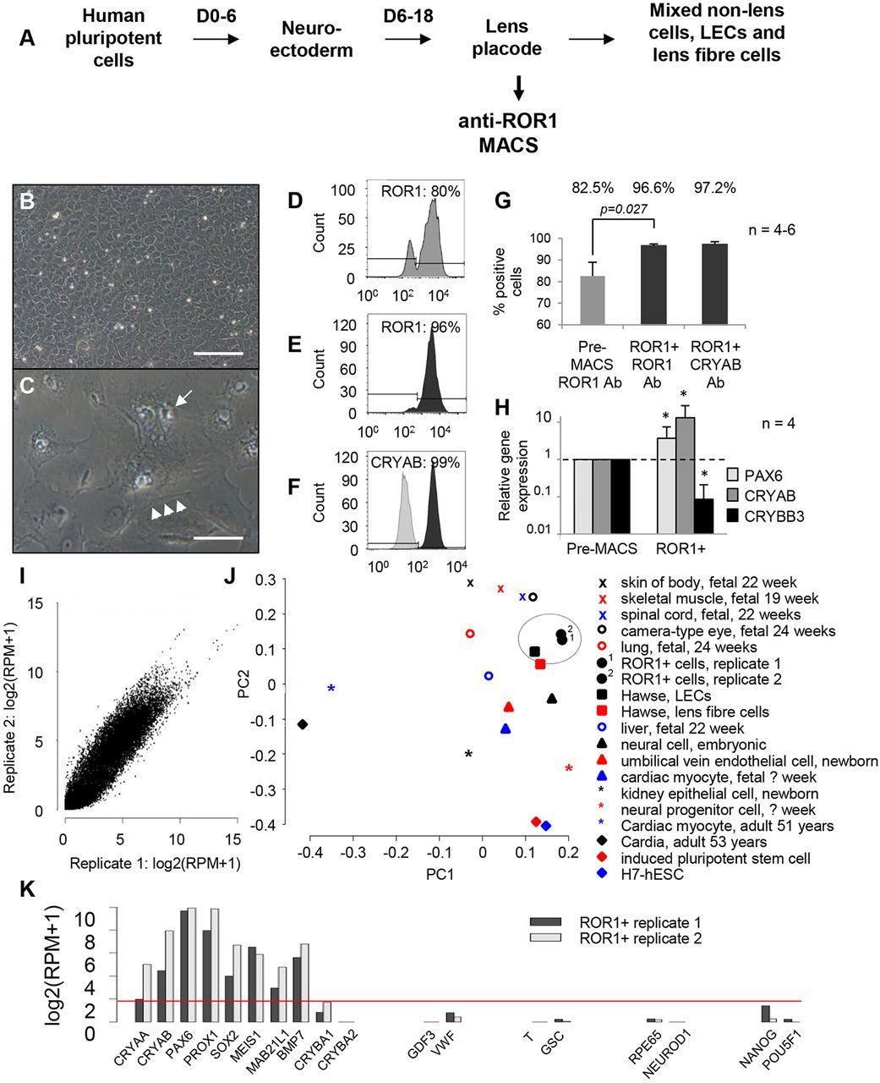
Figure 1: Identification and characterisation of ROR1 as a LEC marker.
ROR1+ Cells exhibit homogeneous LEC morphology under high density growth
Gene expression patterns similar to adult LECs
No teratoma formation seen when ROR1+ LECs transplanted into rats

Slide 5
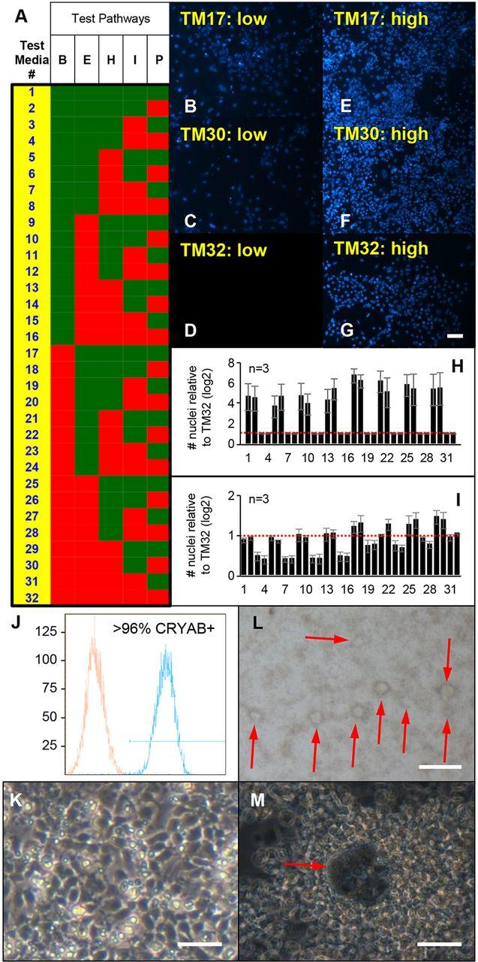
Figure 2: Combinatorial growth factor screening identified media for ROR1+ cell expansion and differentiation.
Trying to avoid large vacuolated phenotype
Five pathways tested with 8 different growth factors
TM17 showed most colonies
Notes:
FGF signalling is crucial for lens development
FGF2 was included in the basal medium stimulates lens growth
After ∼2 weeks of high density culture in TM17, or after exposure to media containing FGF2 and BMP4/7, random lentoid production and lens fibre cell crystallin expression was seen

Slide 6
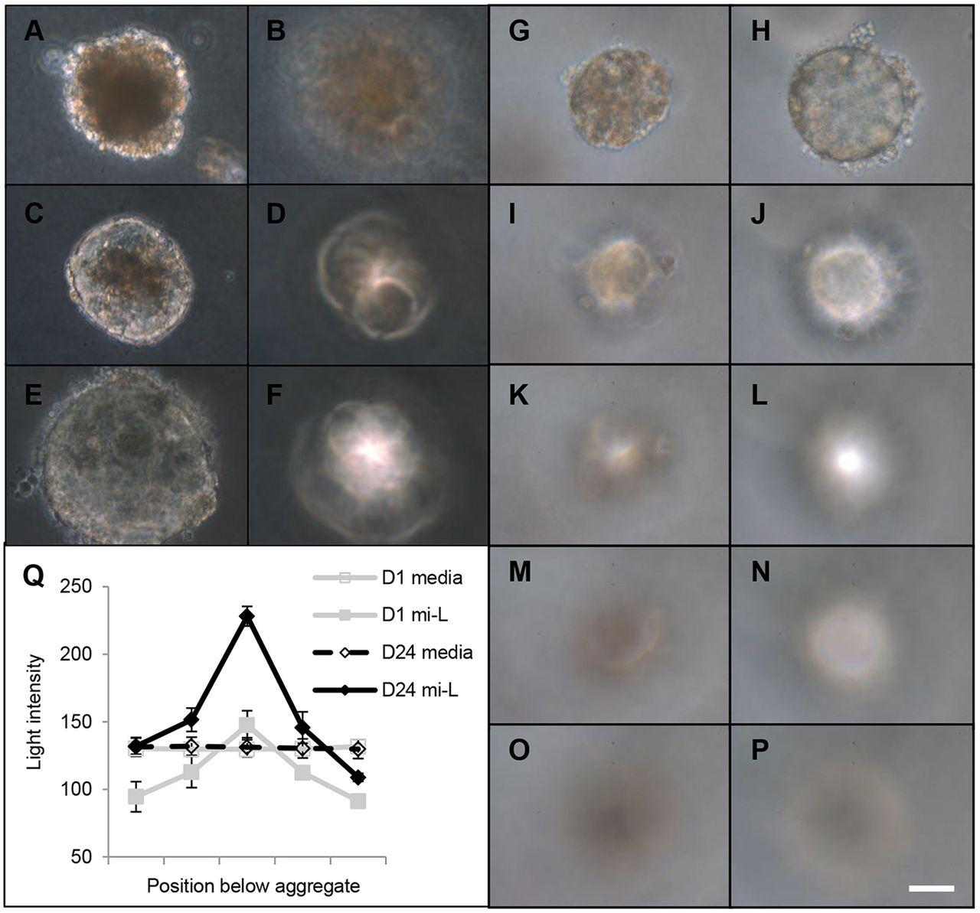
Figure 3: ROR1+ cell aggregation leads to transplant and light-focusing micro-lenses.
ROR1+ cells observed to have no light focusing and transmittance capabilities when first cultured.
Over time, the cells are able to focus and transmit light
Notes:
Column 1: transmittance (day 3,7,14)
Column 2: light focus capabilities (day 3,7,14)
Column 3: day 3 (transparency/focusing abilityx4)
Column 4: day 27 (transparency/focusing abilityx4)
5 microlens; single aggregate

Slide 7
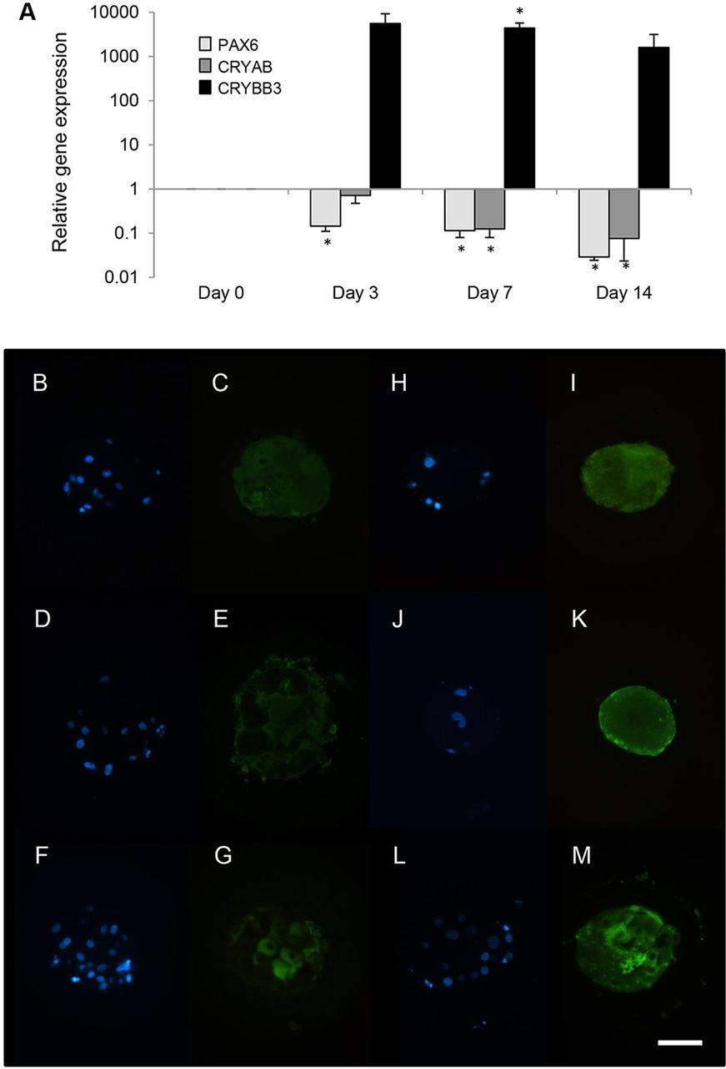
Figure 4:Aggregation of ROR1+ cells induces lens fibre cell crystallin expression.
PCR amplification showing relative mRNA expression and Immunofluorescent analysis showing the presence of crystallin protein through development
Notes:
Blue: blue stained nuclei Green: crystallin protein
Columns 1/2: day 14
Columns 3/4: day 24

Slide 8
Figure 5: Evidence of progressive lens fibre cell differentiation in ROR1+ cell aggregates.
LEC-like cells and signs of organelle degradation after 14 days
Ball-and-socket membrane interdigitations and degraded nuclei after 42 days

Slide 9
Figure 6: The CFTR potentiator Vx-770 inhibits light focusing in ROR1 micro-lenses
Vx-770 treatment during culturing affected the development of both lens transparency and light-focusing ability
After lens transparency and light-focusing ability has developed, treatment for 7 days with Vx-770 did not affect transparency but did affect light-focusing ability

Slide 10
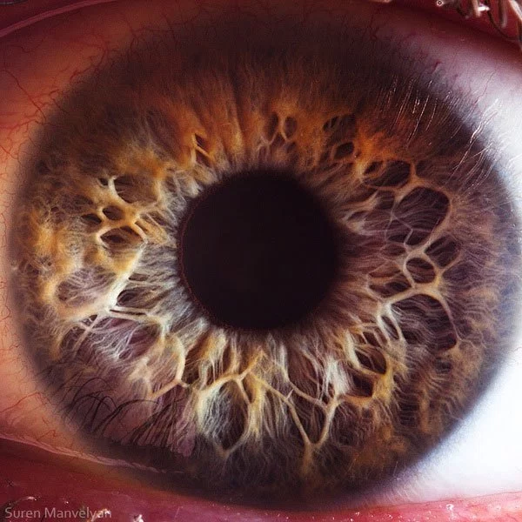
Discussion
ROR1+ cells closely resemble human LECs
ROR1+ cells for investigation of posterior capsule opacification
Functional human organoids from non-mammalian developmental templates
Lens fibre cell differentiation in micro-lenses mimics events seen in vivo
Towards a systems biology blueprint for development of lens function
Investigating human cataracts using ROR1+ cells and micro-lenses
http://twistedsifter.com/2012/08/extreme-close-ups-of-the-human-eye/

Slide 11
Summary
Used human pluripotent stem cells to create light focusing microlenses by using a modified three stage differentiation protocol
Imaged development of cells over a 6 week period showed that over time the cells are able to transmit and focus light
Combination of ROR1+ screening and selection and the modified growth factor protocol for culturing led to successful human lens formation
High dosages of 2000 ng/mL of Vx-700 drug reduced light focusing capabilities
Overall, were able to efficiently mass-produce light-focusing, human micro-lenses whose transparency and light-focusing abilities can be modified and quantified for use in many different studies

