Slide 1
Leadership and Departmental Vision:
Past, Present, and Future
Bob Franks
Department of Plant and Microbial Biology
Notes:
Goals for this talk –
Let you know a little more about myself what my relevant life experiences have been and how they have shaped my philosophy of how to best collablrate and cooperate.
Then present my view of the current department and to highlight some of the challenges and opportunities that we will have to plan for and respond to as a department in the future.

Slide 2
Leadership and Departmental Vision:
Past, Present, and Future
“Baseball is a simple game. If you have good players and if you keep them in the right frame of mind then the manager is a success.” – Sparky Anderson
Bob Franks
Department of Plant and Microbial Biology
Notes:
Sparky Anderson was the very successful manager of the Cincinnati Reds in the mid 70’s.
I hope that running this department may be somewhat like managing a baseball team. I see my role as department head as a facilitator. My role is to provide the environment that will allow you to continue to succeed. Your successes then become in part my successes.

Slide 3
Leadership and Departmental Vision:
Past, Present, and Future
How I got here
My research, teaching and service work at NCSU
Snapshot of the Department
Where do we go from here and how can we get there?
Bob Franks
Department of Plant and Microbial Biology

Slide 4
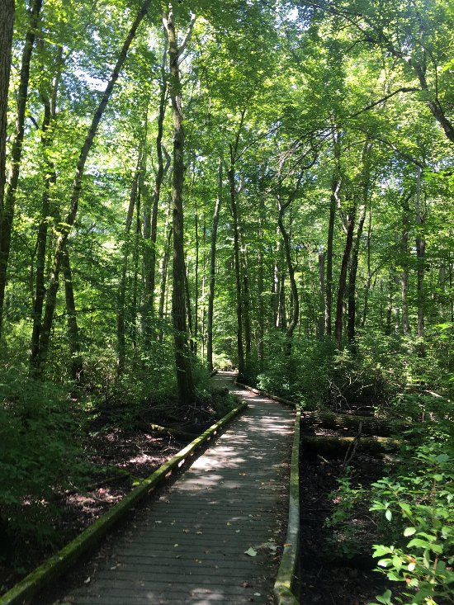
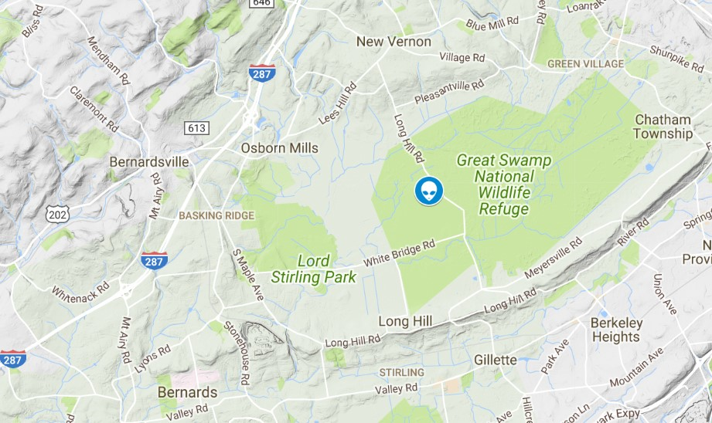
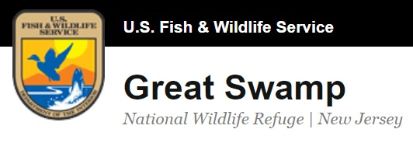
A Broad Interest in Biology Begins: Basking Ridge, NJ.
Notes:
I grew up in Basking Ridge NJ. About 30 miles from NYC. This area still had a lot of green spaces and growing up I spent a lot of time in the woods around our house turning over rocks to look for salamanders, catching snakes, and playing in streams. Growing up I had wanted to be a park ranger or a veterinarian.
My parents helped me find my first summer job with the youth conservation corps working at the Great Swamp National Wildlife refuge. Working in the great swamp was perfect summer job for me. Lots of time outside in a diverse natural environment. I was very interested in birds at that time and of course the swamp had a diversity of bird species.
We spent a lot of time repairing these boardwalks. Many of which ran over several feet of swamp water so we were often waist deep in the swamp water working on these repairs.
Just as an aside the great swamp was in a way Basking Ridge’s claim to fame as in 1938 an alien space pod landed in the Great Swamp during Orsen Welles War of the Worlds radio broadcast. That kind of put us on the map. We never did find evidence of the pod that summer, but it was a pretty big swamp.

Slide 5
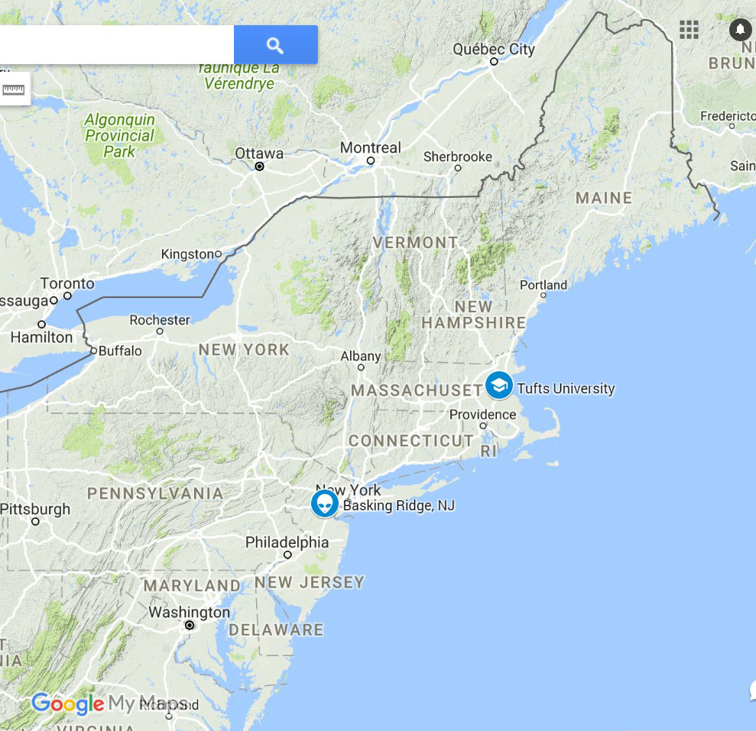
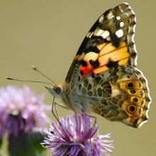
Studying Animal Behavior and Neurobiology: Tufts University
Vanessa cardui (Linnaeus 1758)
Painted Lady
Notes:
I worked with Nancy Milburn at Tufts in the department during on a summer research project. We studies aspects of feeding behavior in the brush footed butterfly Vanessa cardui.
Chemosensory hairs on their tarsal segments (feet). They detect salts and sugars when they stand on these substances and this elicits the extension of the proboscis and feeding. We studied mostly behavioral responses although we did also do a bit of electrophysiology recording the neuronal activity of the chemosensory neurons.
Brush footed butterflies – females strike the leaves of host plants to determine if it is the correct plant to lay the eggs.
Had a strong interest in neurobiology and animal behavior and upon graduation was accepted to the Interdepartmental Program in Neuroscience at UCLA.

Slide 6
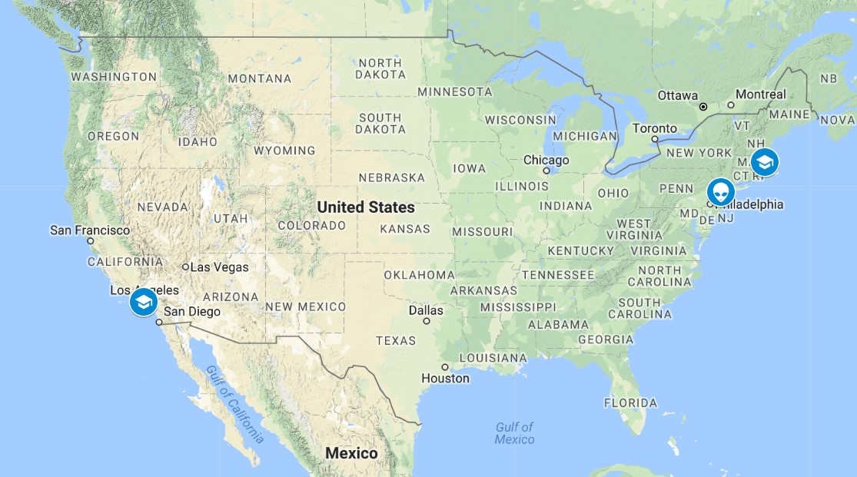
Notes:
UCLA – Interdepartmental Program in Neuroscience.
Interdepartmental program – very diverse and did rotations - one rotation in animal behavior with vervet monkies on social behavior and neurohormonal regulation of behavior
But also developed a growing interest in molecular biology and molecular mechanisms

Slide 7
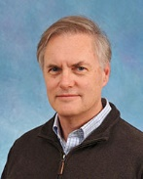
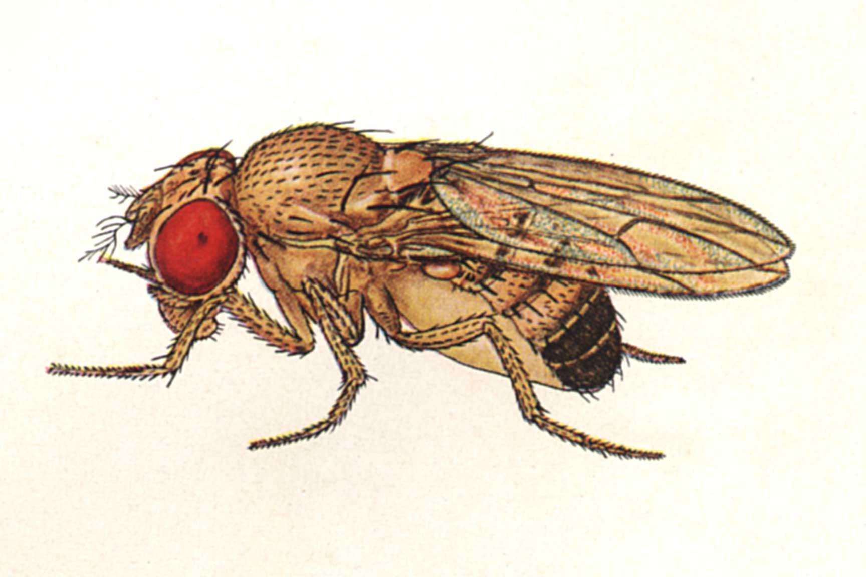
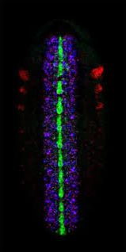
Developmental Biology and Molecular Genetics
Steve Crews
Drosophila melanogaster
Notes:
Steve had just cloned a gene called Single-minded that appeared to encode a transcription factor and we worked to determine where it was expressed and the sets of genes that it regulated during development and cell fate specification in the embryonic CNS. – Fortunate to work with John Nambu a postdoc in the lab and have our work published in the Journal Cell
After finishing my PhD. I started looking into postdoctoral positions in industry, but I also looked into alternative options.
I looked into the possibility of trying to work with venture capitalists, industry postdocs, academic postdocs and science and technology policy.
Made a somewhat unusual career move
Wanted to live in another country
Wanted to explore the possibility of a career in science and technology transfer or international development
join a volunteer program called volunteers in Asia. VIA provided an opportunity for me to live and work in INDONESIA for over two years.

Slide 8
Indonesia
“Life is like riding a bicycle. To keep your balance, you must keep moving.” – Albert Einstein
Notes:
Made a somewhat unusual career choice and decided not to accept a postdoctoral position at a the biotech company AMGEN but instead to join a volunteer program called volunteers in Asia. VIA provided an opportunity for me to live and work in INDONESIA for over two years.
Live in another country
Explore the role of science in international development
While in Indonesia I worked with two different groups:
I worked mainly with an INDONESIAN conservation biology NGO.
I worked with the Indonesian Institute of Sciences in a research lab working with the Research group of Ibu Inez Selamat who was working on Indonesian rice varieties.

Slide 9
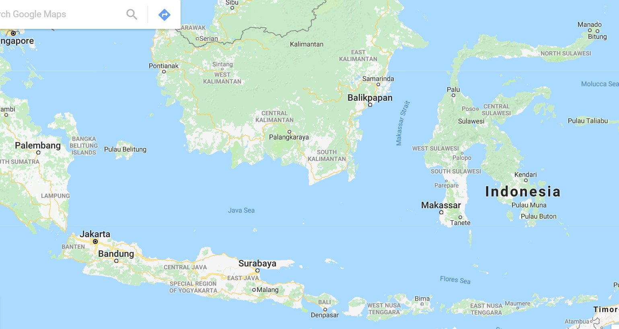
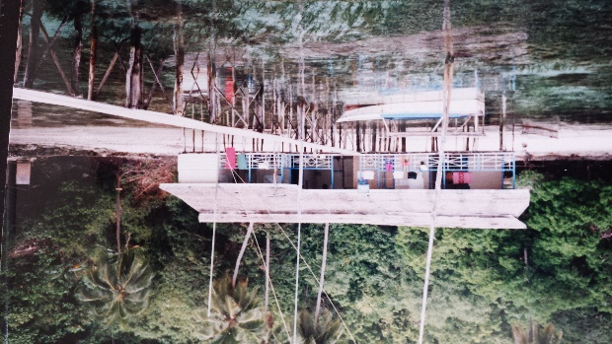
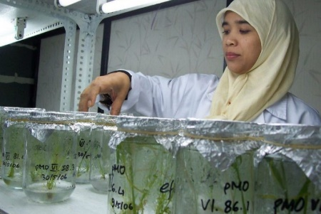
Conservation Biology and International Agricultural Biotechnology
Indonesian Foundation for the Advancement of Biological Sciences
Indonesian Institute of Sciences Center for Biotechnology
Notes:
Fun part was I worked with Indonesians in Indonesian organizations. And I lived with an Indonesian family. Really experience the culture.
I have been fortunate to have a diversity of scientific experiences and life experiences this has profoundly influenced my personality and my view of life. I mention this all because I do believe that these personality traits and this diversity of interests is something that will help me to succeed as the Head of the department.
I value a diversity of experiences and willing to explore non-conventional options.
Have first hand knowledge of other cultures – makes me a more open-minded person and a better head.
Indonesian Institute of sciences Center for Biotechnology – Worked with Inez Slamet-Loedin – molecular subcloning efforts to support her rice transformation experiments.
With The foundation for Biological Sciences - Indonesian Conservation Biology NGO - English research person - Writing grants, managing the editing and production of an Indonesian scientific journal called tropical biodiversity. Also worked at the research station in central Sulawesi. We worked to petition the government to designate this area as a national park

Slide 10
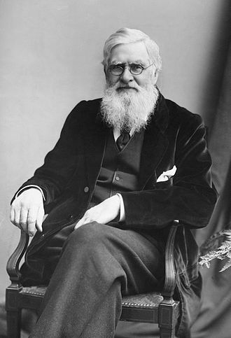
Conservation Biology and International Agricultural Biotechnology
Indonesian Foundation for the Advancement of Biological Sciences
Alfred Russel Wallace
Notes:
This is in Wallacea. Named after Alfred Russel Wallace.
Experience a bit of life as a field biologists. -
Theme here developing that I have worked in a variety of biological problems
Second aspect is that I have worked in a variety of situations and cultures.
I have been fortunate to have a diversity of scientific experiences and life experiences this has profoundly influenced my personality and my view of life. I mention this all because I do believe that these personality traits and this diversity of interests is something that will help me to succeed as the Head of the department.
I value a diversity of experiences and willing to explore non-conventional options.
Have first hand knowledge of other cultures – makes me a more open-minded person and a better head.
Another decision to make – Pursue a career in international development or international tech transfer or get back in the lab and do molecular genetics. Missed aspects of the lab work and the sense of discovery. I went to work for zhongchi Liu.

Slide 11
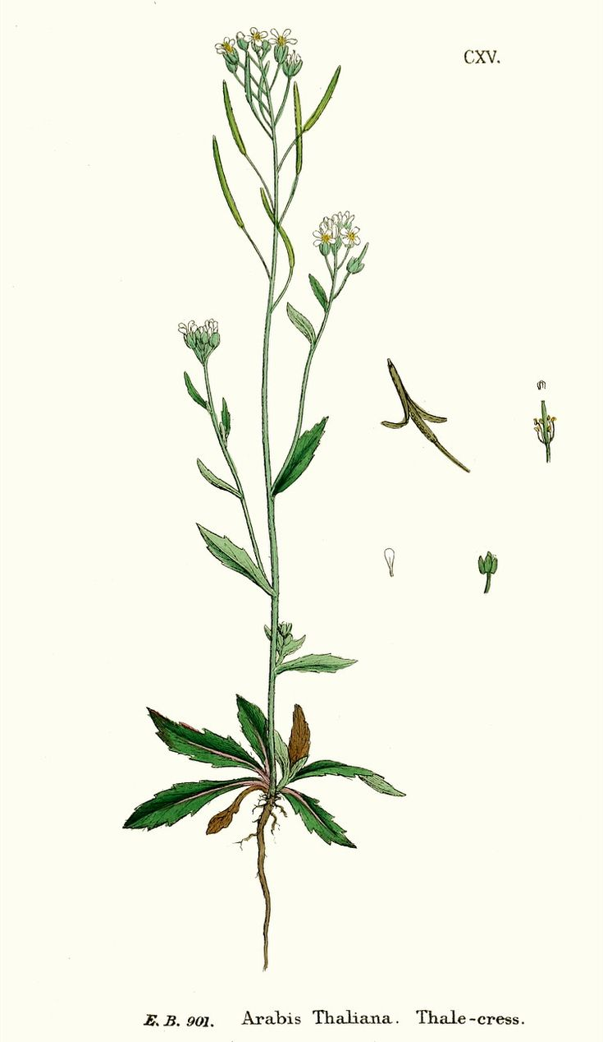
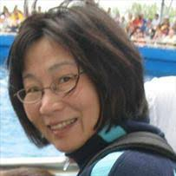
GOING GREEN: Plant Molecular Genetics and Development
University of Maryland College Park,
NIH NRSA Postdoctoral Fellowship
Zhongchi Liu
https://www.pinterest.com/pin/403916660313399867
Notes:
Moved over to plants – part of this was because of my experiences at the Indonesian institute of sciences and seeing their efforts to use plants to understand important biological processes and also to impact peoples lives via agricultural applications. This was also in a way a natural progression as Arabidopsis is like the drosophila of the plant world.

Slide 12
GOING GREEN: Plant Molecular Genetics and Development
University of Maryland College Park,
NIH NRSA Postdoctoral Fellowship
SEUSS
Zhongchi Liu
https://www.pinterest.com/pin/403916660313399867
Notes:
Moved over to plants – part of this was because of my experiences at the Indonesian institute of sciences and seeing their efforts to use plants to understand important biological processes and also to impact peoples lives via agricultural applications. This was also in a way a natural progression as Arabidopsis is like the drosophila of the plant world.

Slide 13
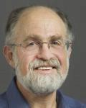
GOING GREEN: Plant Molecular Genetics and Development
University of Maryland College Park,
NIH NRSA Postdoctoral Fellowship
University of California, Berkeley, CA
SEUSS
Bob Fisher
Zhongchi Liu
https://www.pinterest.com/pin/403916660313399867
Notes:
Bob and Zhonghi set me up for success allowed me to develop the project in their labs and take it to start my own.
Bob said “You need two things when you write a grant – the Steak and the sizzle”.

Slide 14
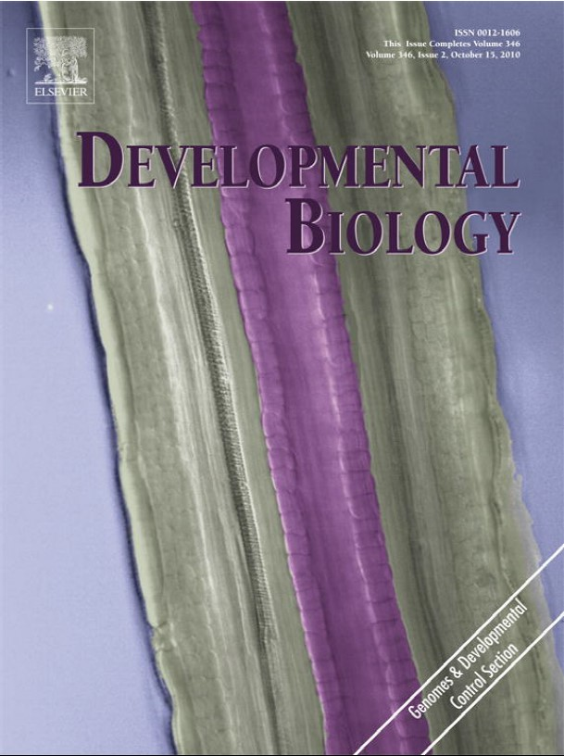
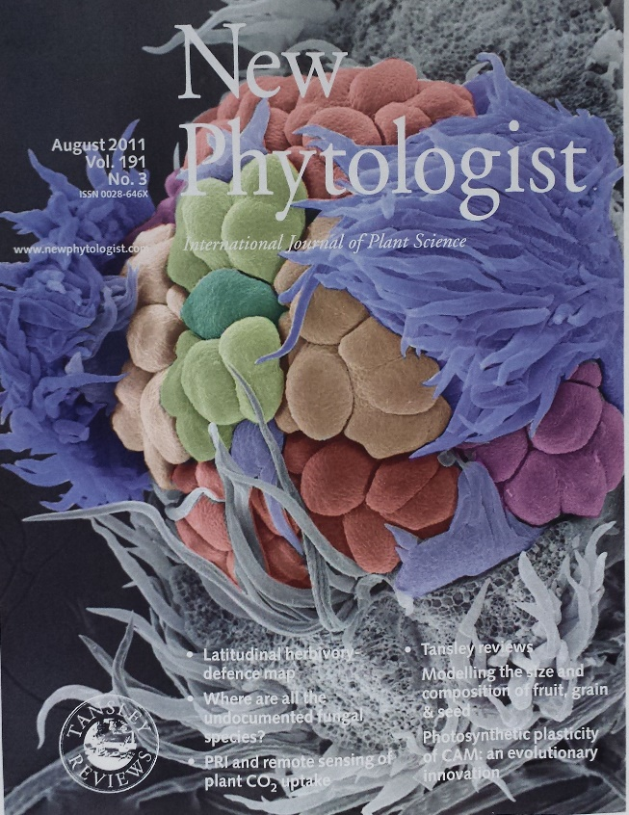
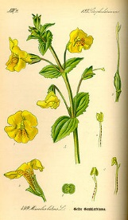
A Record of Successful Extramural Funding
and Interdisciplinary Research
Transcriptional Regulatory Networks and the Development of the Arabidopsis Gynoecium
with Steffen Heber
Computer Sciences
The Evolution of Inflorescence Developmental Diversity in Cornus (Dogwood) Species
with Jenny Xiang
and Deyu Xie
Hybrid Seed Inviability and
the Evolution of Endosperm Development in Mimulus
with Elen Oneal and John Willis
at Duke University

Slide 15
Transcriptional regulatory networks regulating ovule development in the Arabidopsis gynoecium
Development of the seed and seed pod/fruit
Eleven peer-review journal articles
Since 2004 over $1.5 million in external funding from NSF
Three graduate students, five postdoctoral researchers and numerous undergraduates trained
Visiting scholars from Italy, Spain, Portugal and Japan

Slide 16
The Evolution of Inflorescence Developmental Diversity in Cornus (Dogwood) Species
Developmental mechanisms that underlie the evolution of floral and inflorescence morphologies
Seven peer-review journal articles
$520,000 in external funding from NSF
Collaborative project with Jenny Xiang and Deyu Xie

Slide 17
Hybrid Seed Inviability and the Evolution of Endosperm Development in Mimulus
Molecular genetic and evolutionary mechanisms acting during the development of the seed that support reproductive isolation between species
Over the past two years; one peer-review journal article
$320,000 in external funding from NSF (to NCSU)
Two postdoctoral researchers and three undergraduates
Collaborative interdisciplinary project with Willis Lab at Duke University
Notes:
Successful initiation and management of Interdisciplinary collaborative externally-funded research programs. Familiar with the process of obtaining funding from competitive government funding sources and the needs of faculty who run research programs in this fashion and I will thus be able to effectively represent the interests of these faculty at the college level in a college where perhaps a minority of the departments have such a significant portion of the faculty supported by these means.

Slide 18
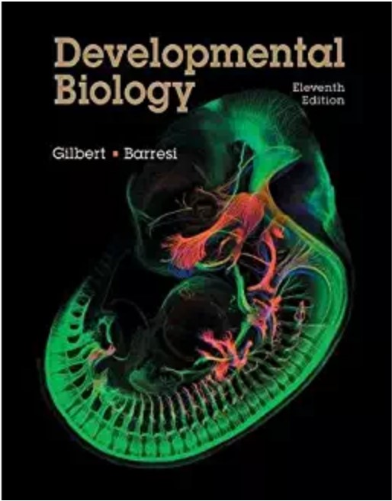
Teaching Critical Thinking and Evidenced-based Analyses
GN434 - Genes and Development
Upper-division undergraduate level
Offered in Genetics (COS)
Student Feedback - In response to “How has this course impacted your view of science?”
“Made reading primary literature more accessible and improved my critical thinking and assessment skills
“Improved my view of science as it was a very interesting class that provoked my scientific curiosity”
“Science is about thinking, not memorization. I think the course did a good job showing me how to think about different topics.”
Notes:
One of my responsibilities will be to manage or oversee the academic programs of the department. Having over 15 years of first hand classroom experience.
No Facts – its evidence
Bias, error and perspectives
Critical Thinking

Slide 19
A diversity of service responsibilities at the
departmental, college and national levels
Service and Outreach
College-level RTP committee
NSF and NIH review panels
Departmental Plant Biology Graduate Student Affairs and Admissions Committees
CFEP Quantitative and Computational Developmental Biology Cluster Hire
K-12 Outreach – GO NCSU science demonstrations
Administrative and Leadership Training
Faculty Mediation and Conflict Resolution Training - organized by The Provost, the Office of General Counsel and the Faculty Senate
2018 Fall Agricultural Leadership Learning Institute for Faculty - organized by Rhonda Sutton, the Director of College Leadership Programs

Slide 20
35 Faculty (Teaching, Research and Extension) Diversity of overlapping disciplines (Cell and Molecular Biology, Microbiology, Ecology and Evolution, Systems Biology and Ethnobotany)
87 graduate students - 3 Graduate Programs (Plant Biology, Microbiology and Masters in Microbial Biotechnology)
30 Postdoctoral researchers/Technicians
8 Administrative Staff members
2 Undergraduate Programs (Plant Biology and Microbiology)
2 Service/Extension Facilities (Phytotron and the Herbarium)
2016/2017 - 6,355 Teaching Credit hours; overhead generated $1,057,521 (2nd in CALS)
Respect for a diversity of disciplines
Culture of collaboration and support
Interdisciplinary research is valued
Notes:
Overlapping disciplines - department merged three departments about 5 years ago. Relatively smooth process
About 50% molecular and cellular Plant Research Pis – 25% ecology and evolution and 25% microbiology
Several bridge people

Slide 21
Where do we go from here and how do we get there?
Notes:
I expect to use the first three to six months to continue to gather information from the Deans and directors and from the members of the department before starting any bold initiatives.
Retreat – in 6 or 8 months
facilatator needs to know where the collective wants to go – shared vision – vision need to include by in and input from the Dean.
Servant leadership – Robert Greenleaf –
Use a lens to examine the merit of any initiatives - How do we invest and grow the skills of our people at all levels. - Look for opportunities of mutual benefit.

Slide 22
Major challenges and opportunities
Shape the focus of the Plant Sciences Initiative
Promote the department externally and at the College level
Strengthen graduate and undergraduate programs
Hire and retain excellent and diverse faculty and staff
Strengthen “bridges” between different portions of our department
Support interdisciplinary research and education activities
Aging facilities/Gardner Hall

Slide 23
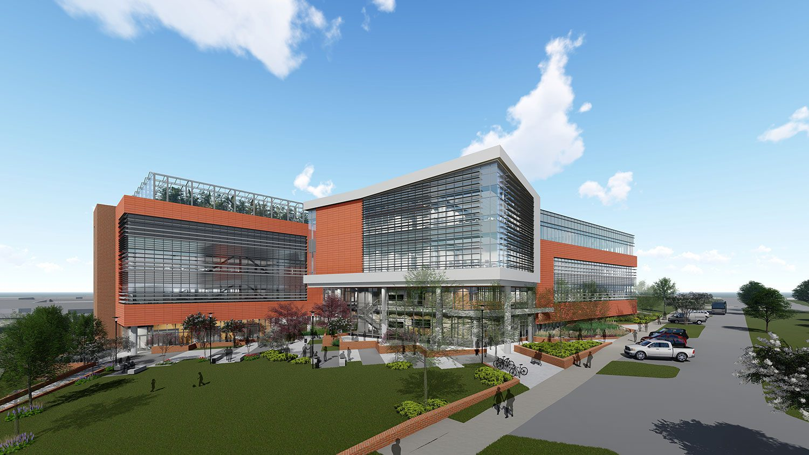
Shape the focus of the Plant Sciences Initiative
Why?
Potential access to interdisciplinary research projects and funding sources
Additional new research space and facilities
Resources will be pushed into the PSI and thus could be diverted from the Department
Ensure a role for Life Sciences in the PSI
How do we do this?
Departmental committee (Amy Grunden, Anna Stepanova, Carole Saravitz)
Continued communication with Steve Briggs, Steve Lommel and Harry Daniels
Notes:
utilize the young people – undergraduates!!!
this may require that I go out and give talks about the department and its activities to local biotech interests – alexander and gardening groups (gardeners of wake county, North carolina conservation network, Carolina wetlands association)
to reinforce the message that we are a vital and vibrant portion of this college and that we have an critical role in the future of this college and that they need to continue to invest in our department. One investment would be additional RA positions

Slide 24
Promote the Department Externally and at the College level
Who are the stakeholders?
Alumni, Biotechnology Companies, NC Citizen Groups
How do we do this?
Social media
Additional face-to-face interactions
Continued dialogue with the Dean and the Directors
Alumni list and communications/Alumni scientific conference
Citizen science
Other creative ideas?
Notes:
utilize the young people – undergraduates!!!
this may require that I go out and give talks about the department and its activities to local biotech interests – alexander and gardening groups (gardeners of wake county, North carolina conservation network, Carolina wetlands association)
to reinforce the message that we are a vital and vibrant portion of this college and that we have an critical role in the future of this college and that they need to continue to invest in our department. One investment would be additional RA positions

Slide 25
Strengthen our Graduate Programs
Challenges
Stipends are not competitive with peer institutions
Further develop profession skills of our graduates
Provide interdisciplinary training environments
Big data and quantitative analyses
How do we do this?
Continue to ask for RA support from the Dean’s office
Explore opportunities for competitive training grants
Continue to find opportunities to work with Biotechnology companies
Enhance and support additional cross-department and cross-college collaborative research efforts
Notes:
utilize the young people – undergraduates!!!
this may require that I go out and give talks about the department and its activities to local biotech interests – alexander and gardening groups (gardeners of wake county, North carolina conservation network, Carolina wetlands association)
to reinforce the message that we are a vital and vibrant portion of this college and that we have an critical role in the future of this college and that they need to continue to invest in our department. One investment would be additional RA positions

Slide 26
Hire and Retain Excellent and Diverse Faculty and Staff
Is the model for hiring faculty within the college changing?
Replacement positions/disciplinary hires are less popular
Provost cluster hire positions are finishing up
Last 7 of the 40 College-level Provost-funded positions will be filled this upcoming hiring cycle
Going forward will the College move toward a system of faculty-driven proposals?
Opportunities to cooperate with other Life Sciences departments
Grow Microbiology and Ecology/Evolution portions of the department
Notes:
Common interests with other life sciences departments with respect to hiring.
This is not a one person job

Slide 27
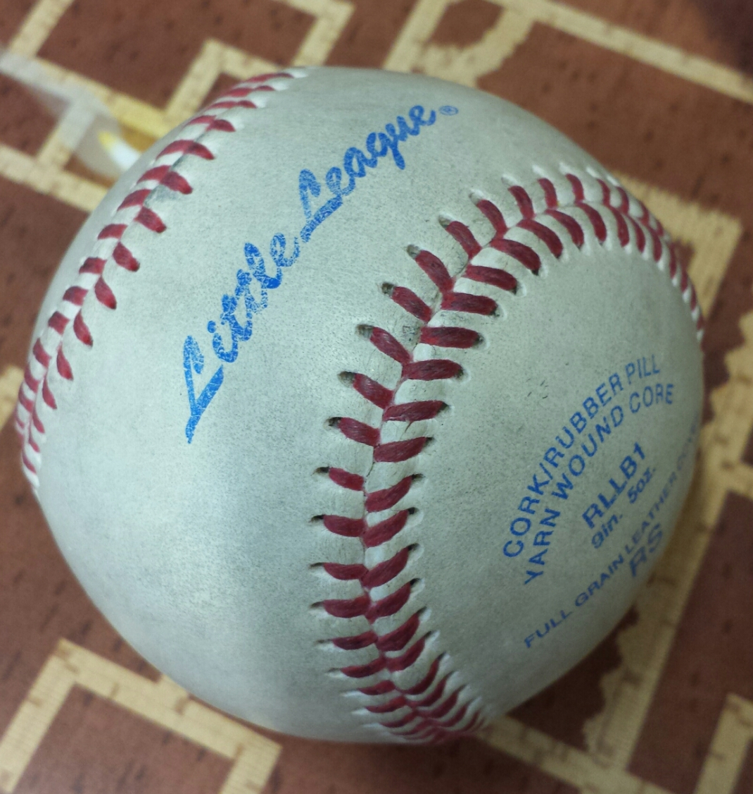
“Baseball is about talent, hard work, and strategy. But at the deepest level, it’s about love, integrity, and respect.”
– Pat Gillick
Notes:
General Manager of the Blue Jays and the Phillies – won three world series
Doing good science and helping other people.

Slide 28
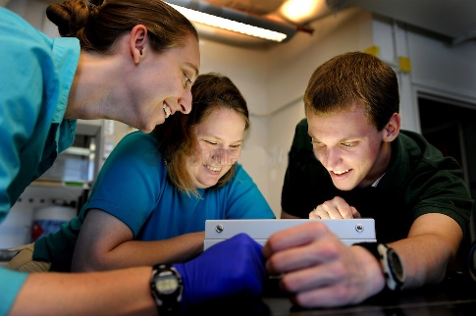
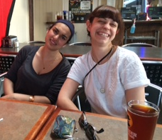
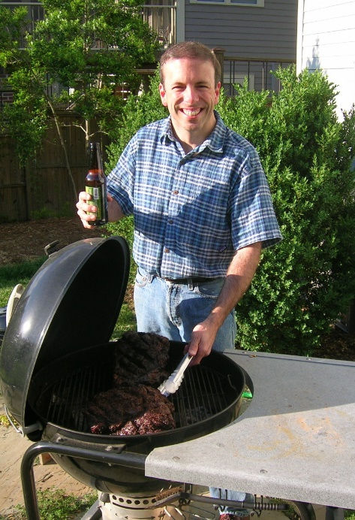
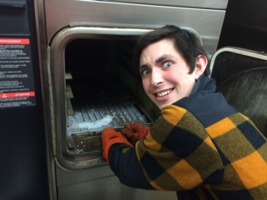
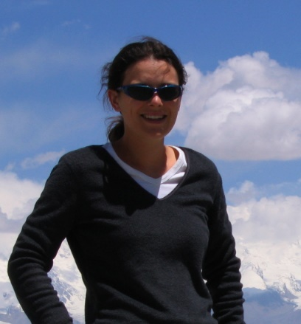
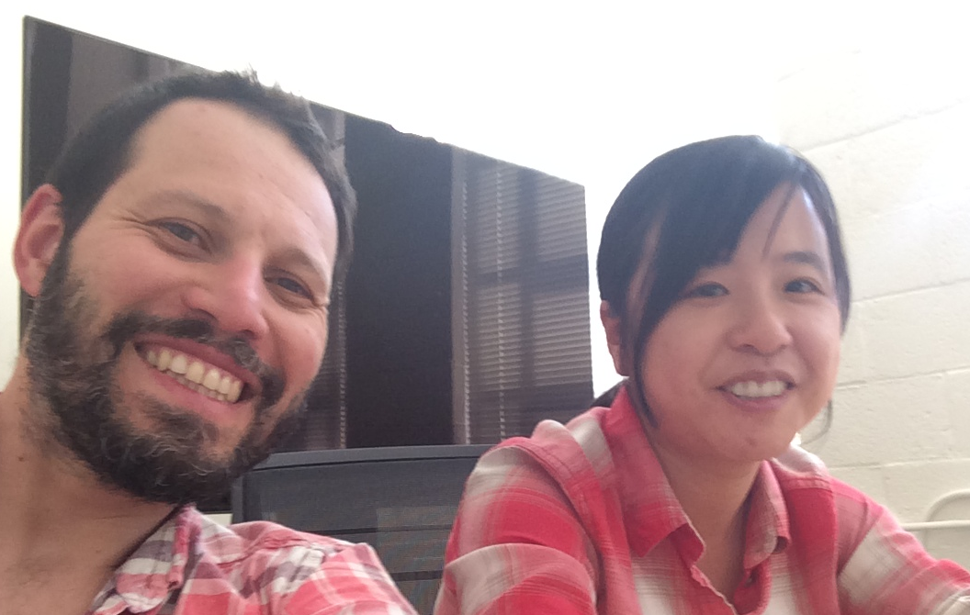
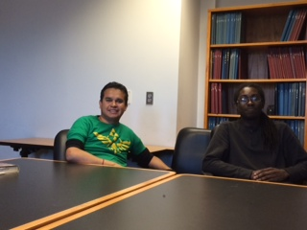
THANK YOU
Margo Daub
Franks’ Lab Members – Past and Present
Scientific Mentors and Collaborators
Dept. of PMB
Friends and Colleagues

Slide 29
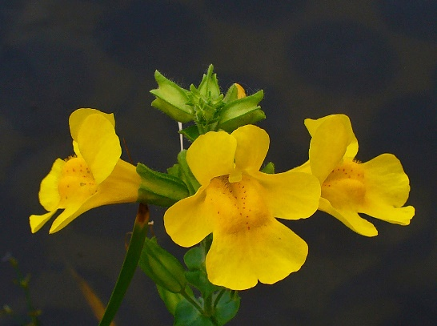

Slide 32
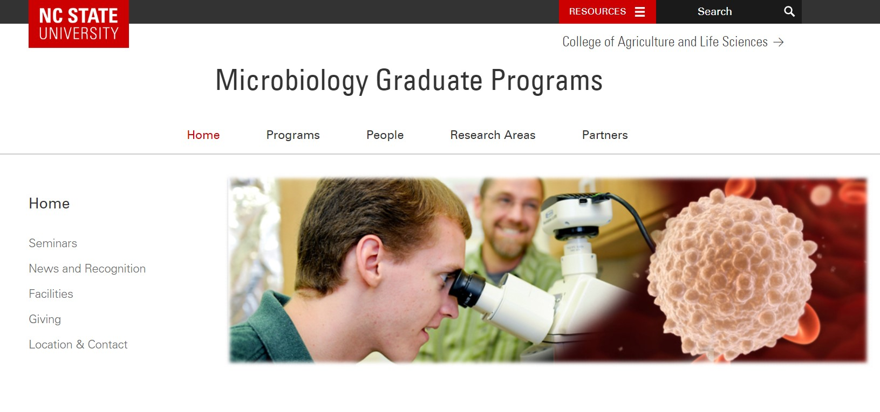

Slide 34
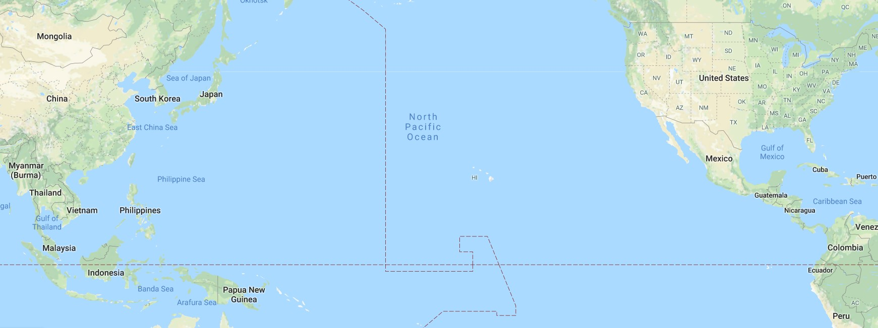
To the University of Maryland

